Slide 1


Diffraction Imaging of Sedimentary Basins: An example from the Porcupine Basin
Brydon Lowney, Lewis Whiting, Ivan Lokmer & Gareth O’Brien

Slide 2

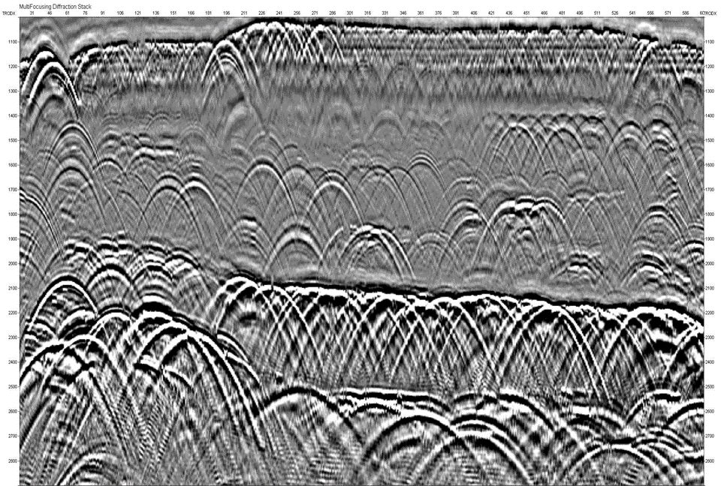
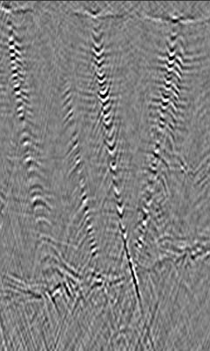
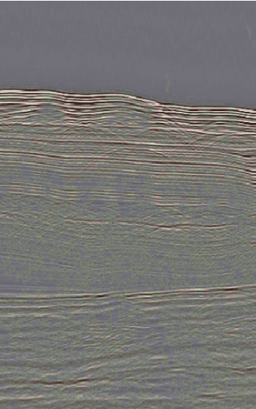
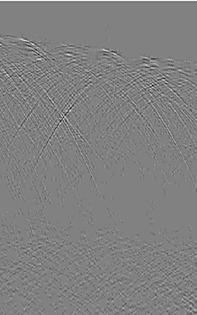

Contents
1
2
3
4
Introduction
What are diffractions | Why diffraction imaging
Method
Direct GAN Separation | Interpreting diffraction images
Results
Porcupine Basin | 3D examples | 2D interpreted slices
Conclusions and Future Work

Slide 3
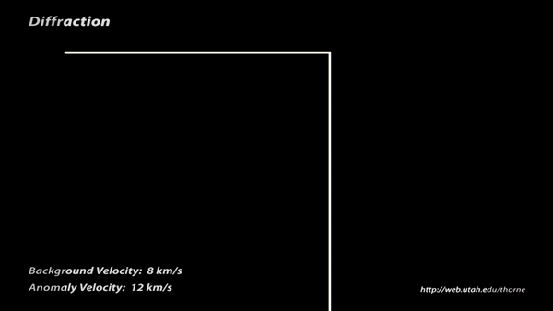
What are diffractions?
Introduction | Method | Results | Conclusions and Future Work
Diffractions originally referred to the bending of a wave into the geometrical shadow of an obstacle.
Diffractions later incorporated any non-geometrical scattering caused by objects or discontinuities (structurally and stratigraphically important).
(Thorne, 2015)

Slide 4
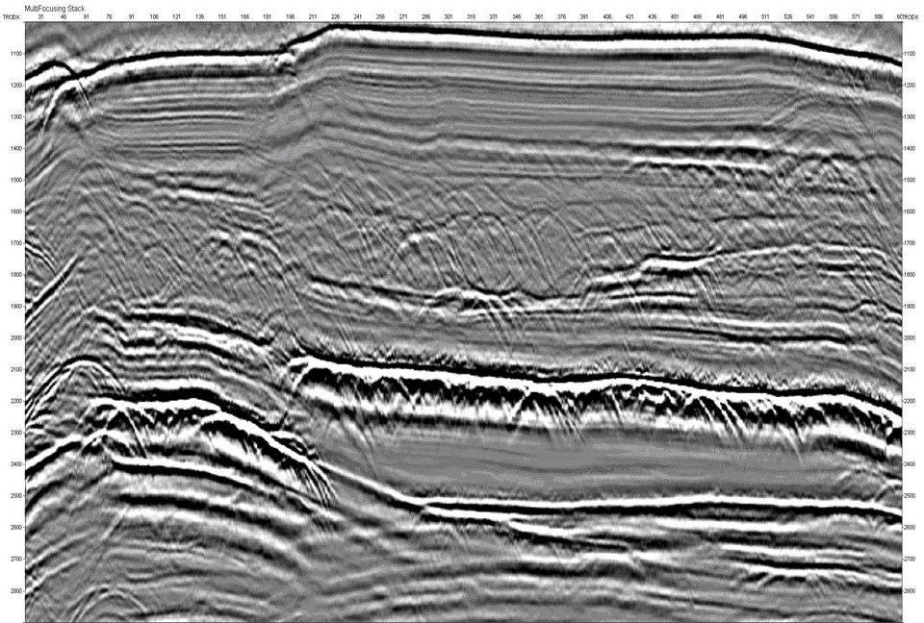
What are diffractions?
Introduction | Method | Results | Conclusions and Future Work
Reflection Image (Geomage, 2017)

Slide 5
What are diffractions?
Introduction | Method | Results | Conclusions and Future Work
Diffraction Image (Geomage, 2017)

Slide 6
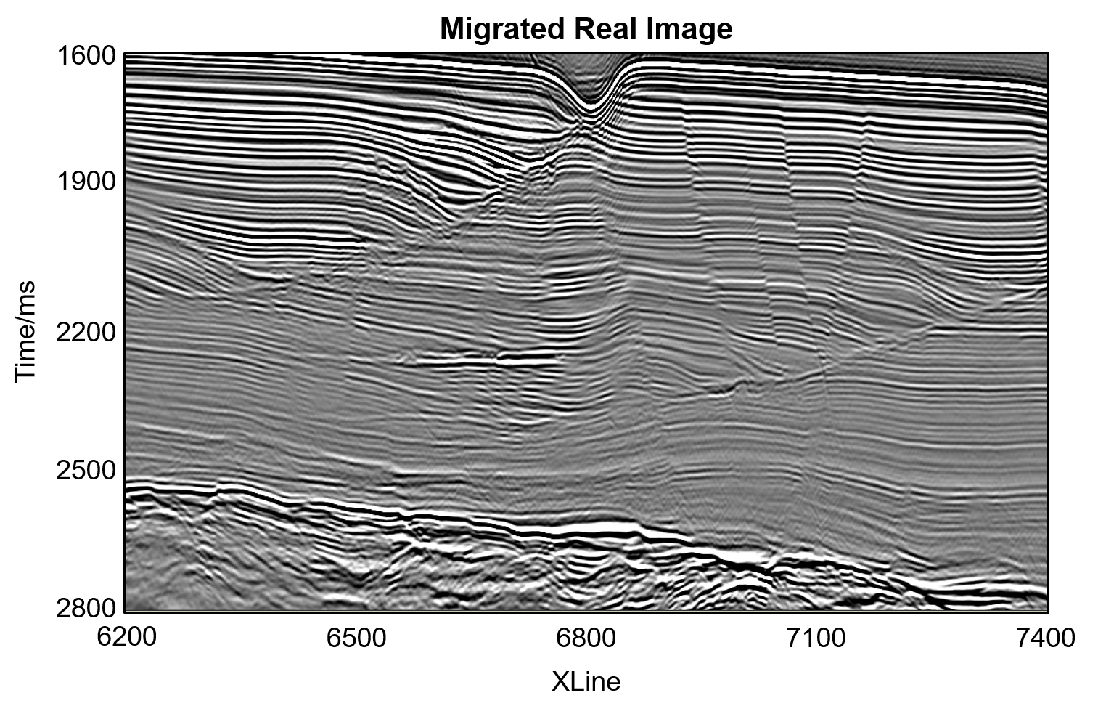
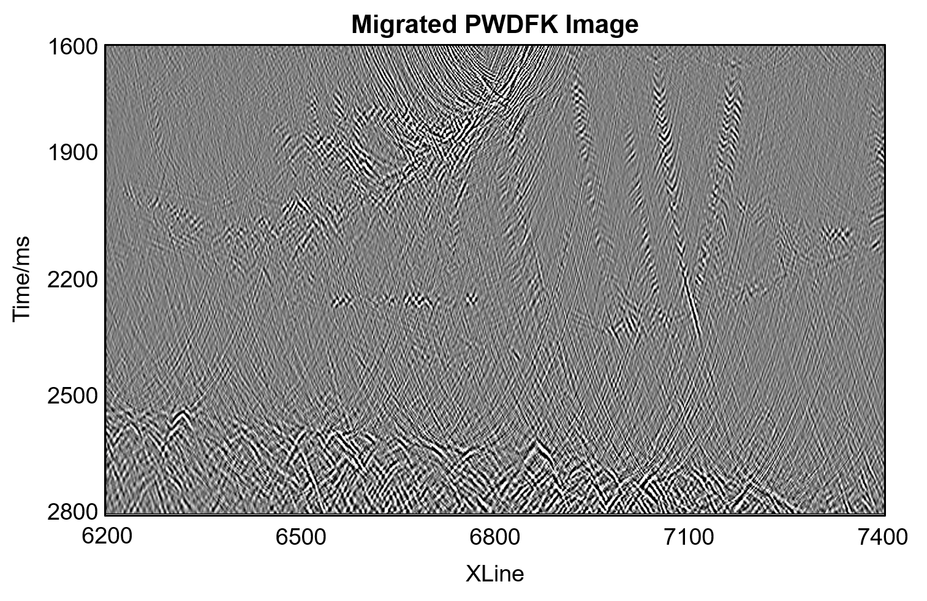
Why diffraction imaging?
Introduction | Method | Results | Conclusions and Future Work
As diffractions form from objects and discontinuities, by imaging the diffractions the objects which formed them can be directly imaged.
These are geologically significant both structurally and stratigraphically (i.e., faults, pinchouts, vugs, fractures etc.).
(Lowney et al., 2020a)

Slide 7
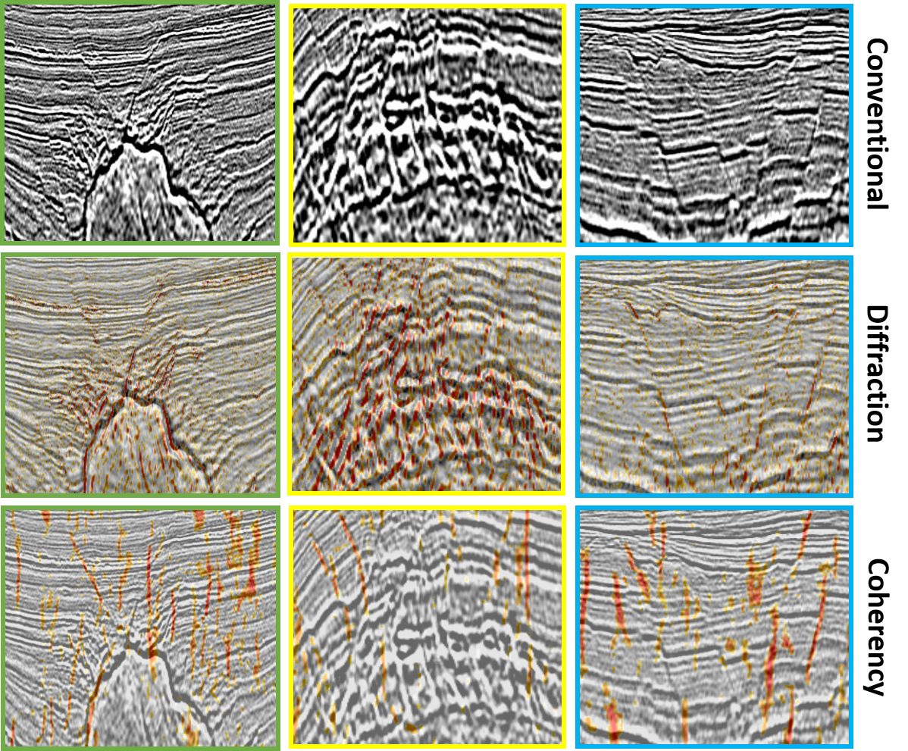

Why diffraction imaging?
Introduction | Method | Results | Conclusions and Future Work
Diffractions can also be used to complement existing structural analysis tools such as coherency.
(Lowney et al., 2020b)
Conventional Image
Coherency Image

Slide 8
Why diffraction imaging?
Introduction | Method | Results | Conclusions and Future Work
Diffractions can also be used to complement existing structural analysis tools such as coherency.
(Lowney et al., 2020b)
Conventional Image
Diffraction Image

Slide 9
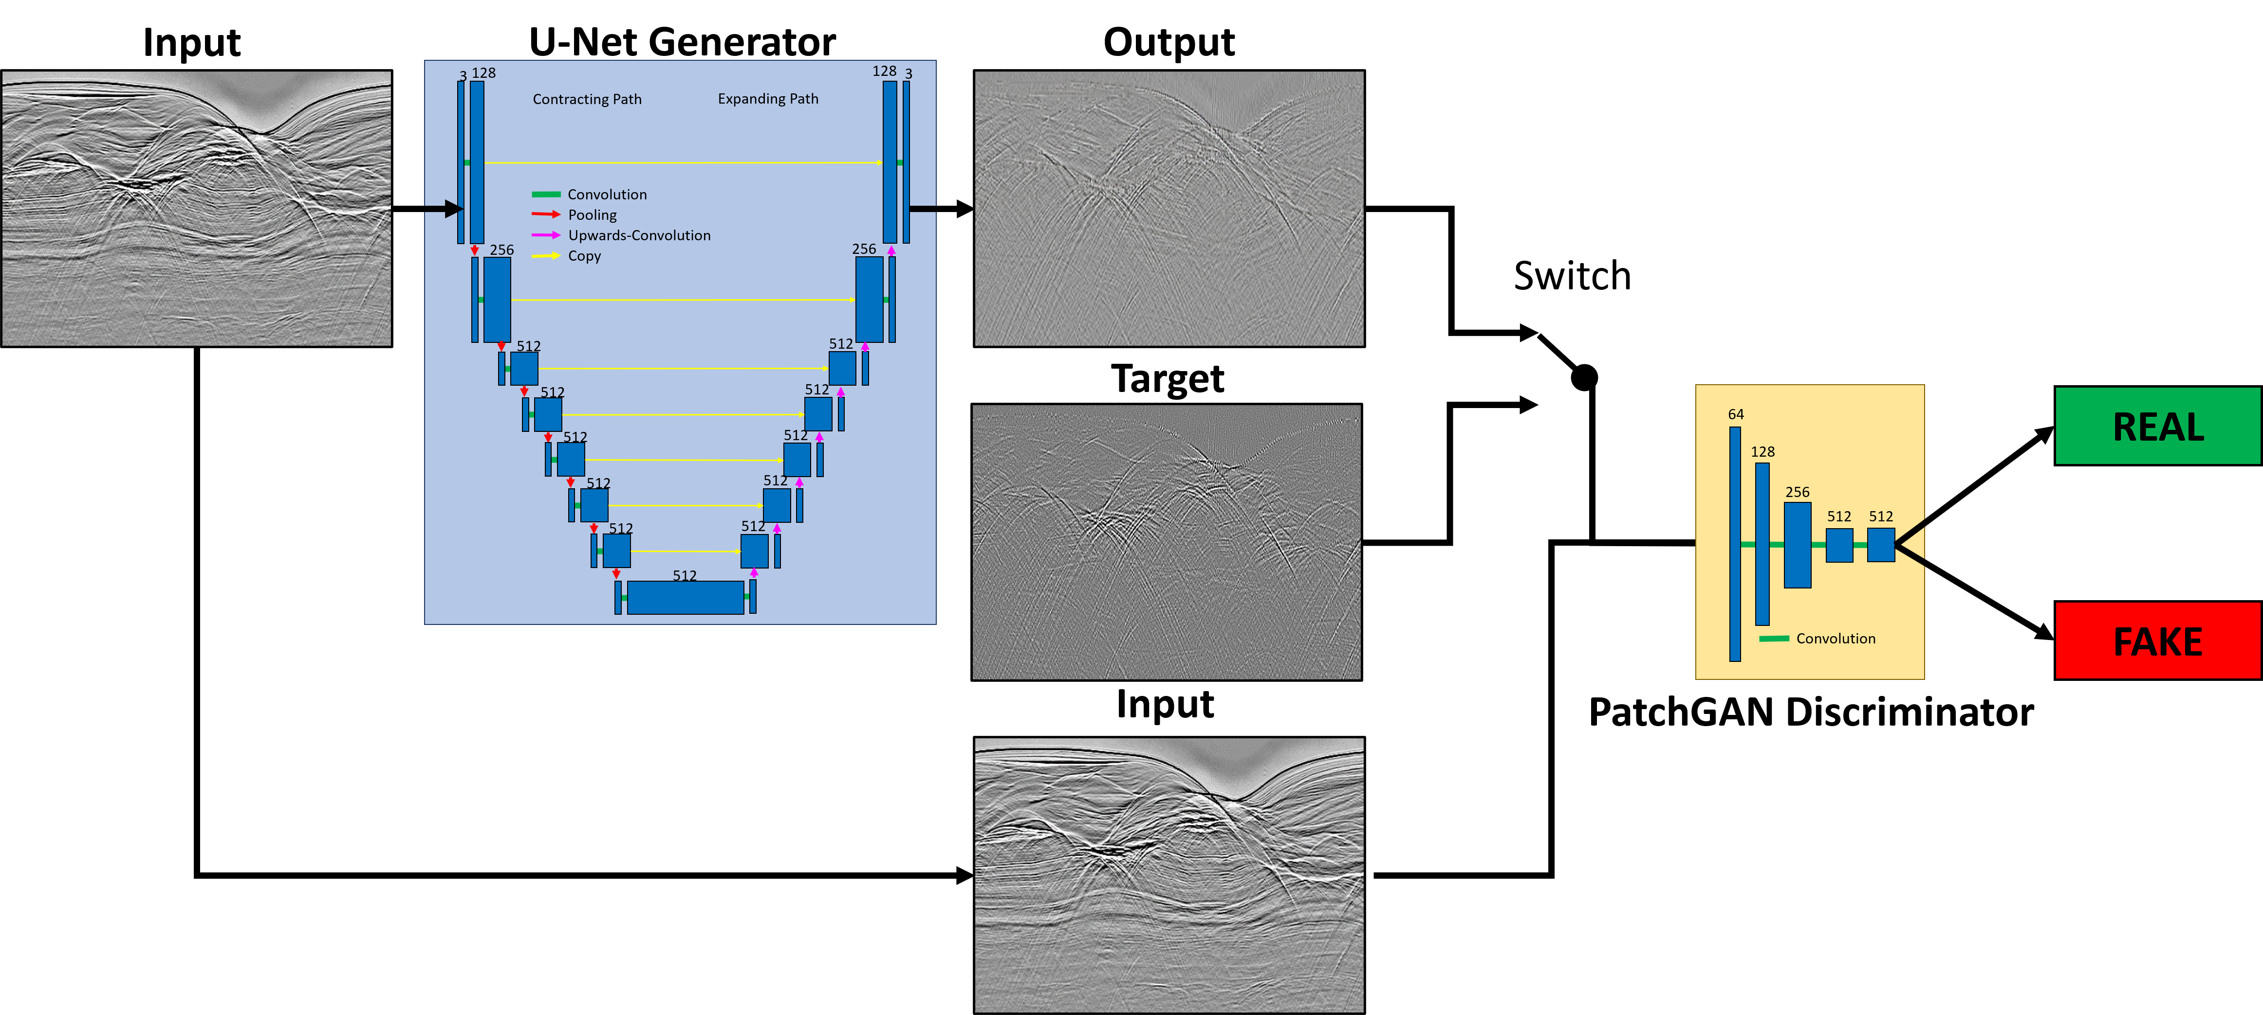
Direct GAN Separation
Introduction | Method | Results | Conclusions and Future Work
(Lowney et al., 2021)
A Generative Adversarial Network (GAN) is trained using screened, conventionally created diffraction images, to automatically separate diffractions from reflections.

Slide 10
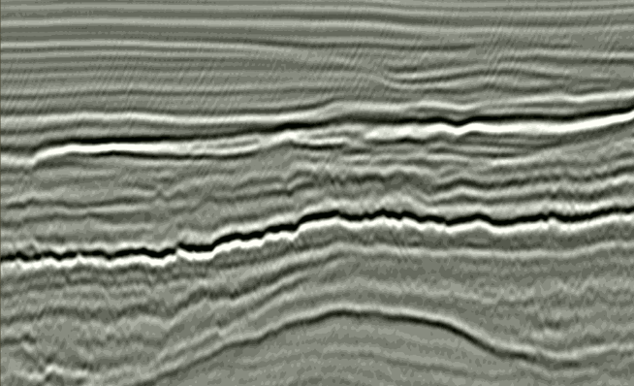
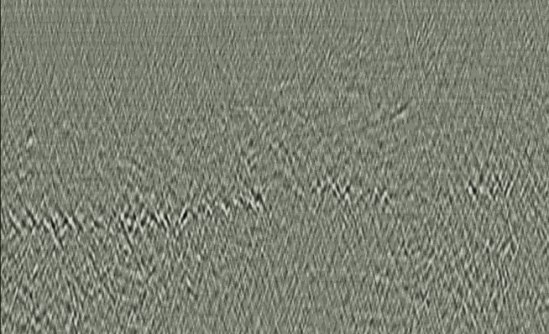
Interpretation
Introduction | Method | Results | Conclusions and Future Work
Conventional Image at Inline 4100
(Lowney et al., 2021)
GAN Image at Inline 4100
2100
2100
2200
2200
2300
2300
Time (ms)
Time (ms)
2400
2400
2500
2500
2600
2600
2500
2800
3100
2500
2650
2800
2950
3100
2650
2950
Xline
Xline
Interpretation was completed using a combination of diffraction and reflection images.
Diffractions are picked as bright amplitude points in the diffraction image.

Slide 11
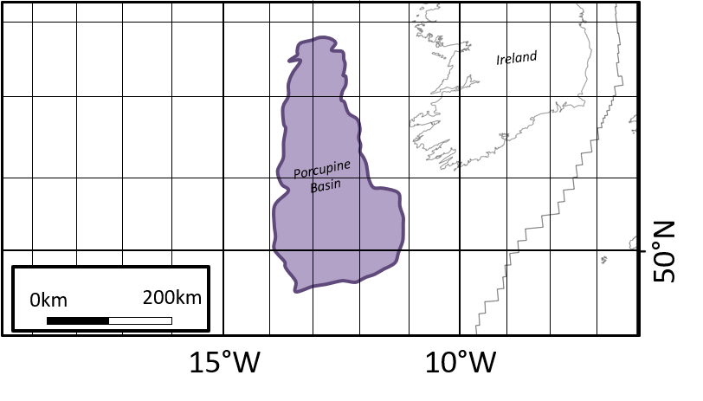
Porcupine Basin
Introduction | Method | Results | Conclusions and Future Work
Porcupine Basin is a sedimentary basin located 200km to the South-West of Ireland.

Slide 12
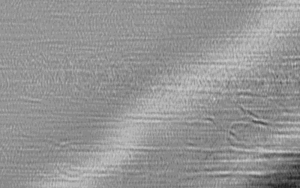
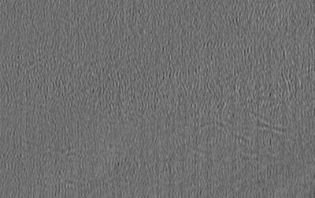
3D Images
Introduction | Method | Results | Conclusions and Future Work
Diffractions images are incredibly useful in 3D, highlighting faults and fractures as well as other points of interest.

Slide 13
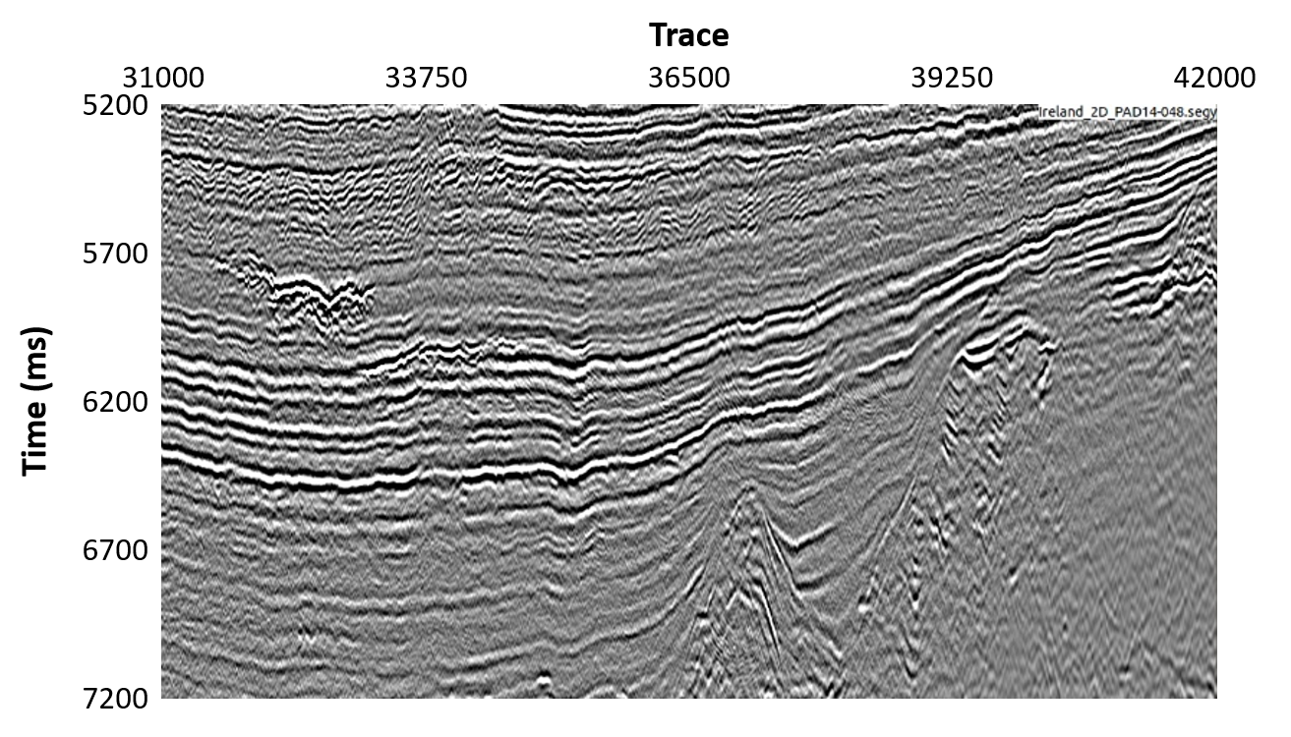
2D Interpreted Slices
Introduction | Method | Results | Conclusions and Future Work
The data was interpreted using a reflection image only and then using both reflections and diffractions to identify additional information.

Slide 14
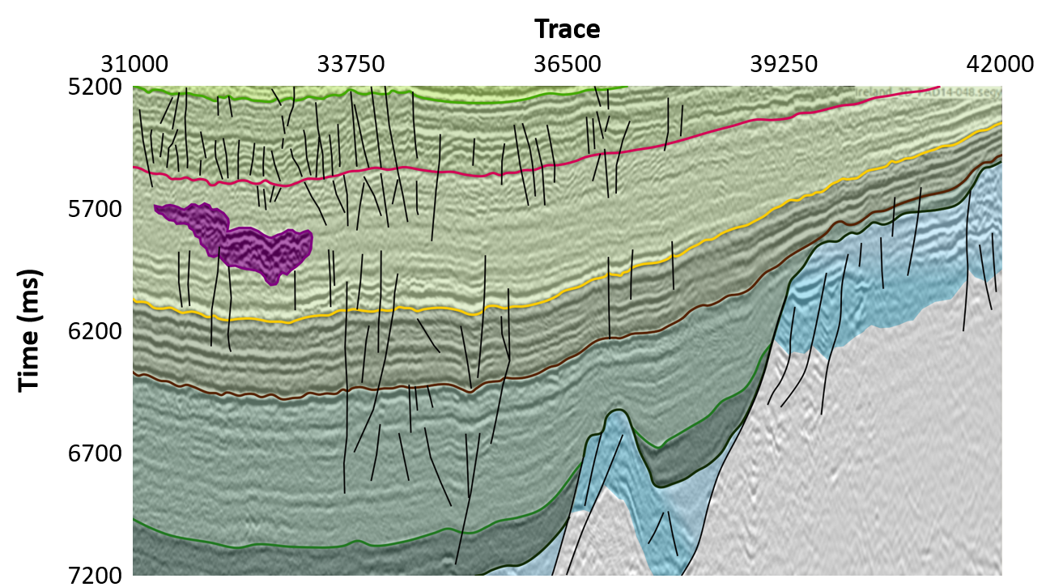
2D Interpreted Slices
Introduction | Method | Results | Conclusions and Future Work
The data was interpreted using a reflection image only and then using both reflections and diffractions to identify additional information.

Slide 15
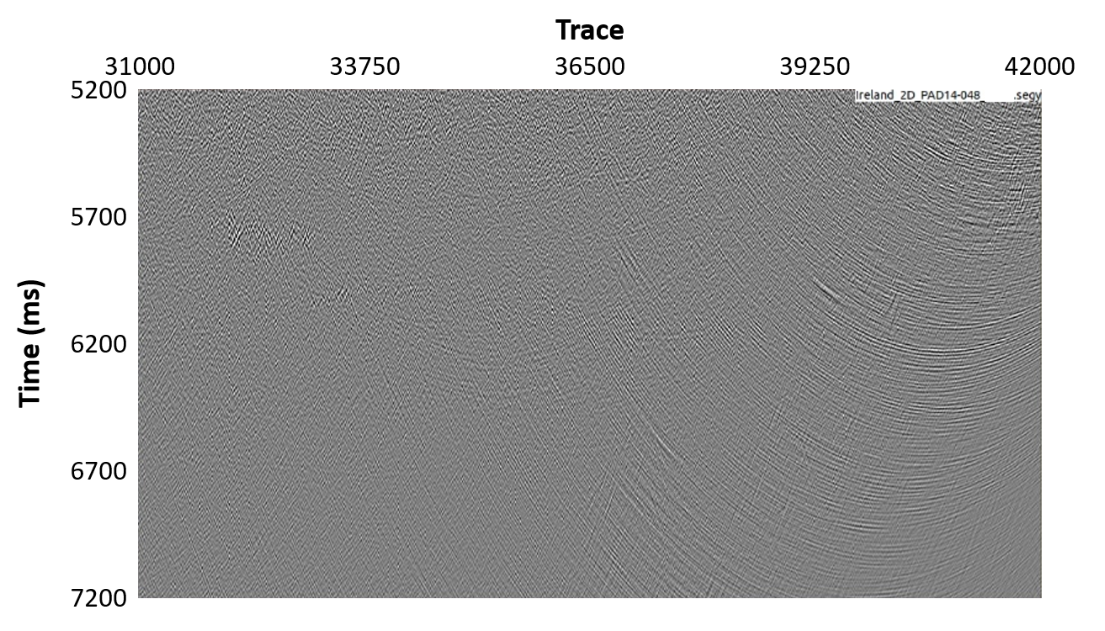
2D Interpreted Slices
Introduction | Method | Results | Conclusions and Future Work
The data was interpreted using a reflection image only and then using both reflections and diffractions to identify additional information.

Slide 16
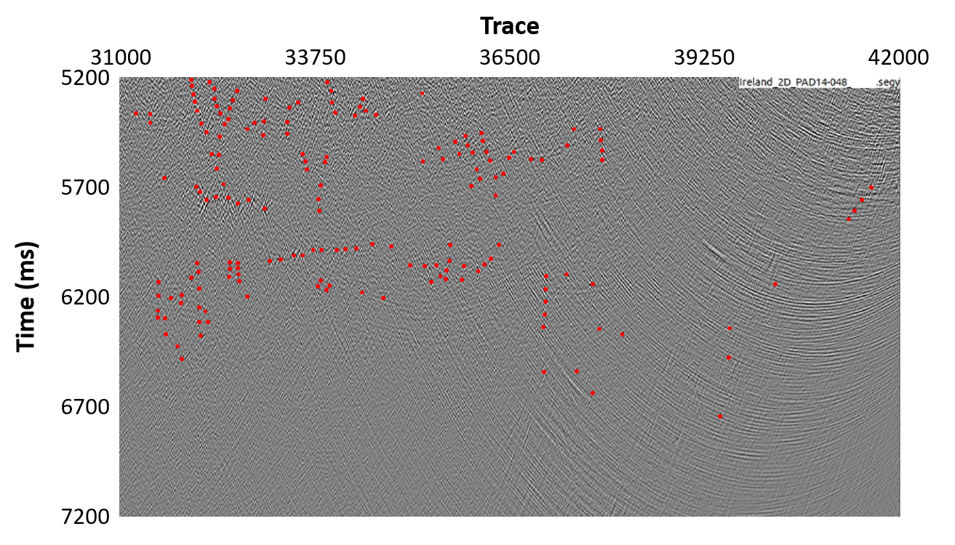
2D Interpreted Slices
Introduction | Method | Results | Conclusions and Future Work
The data was interpreted using a reflection image only and then using both reflections and diffractions to identify additional information.

Slide 17
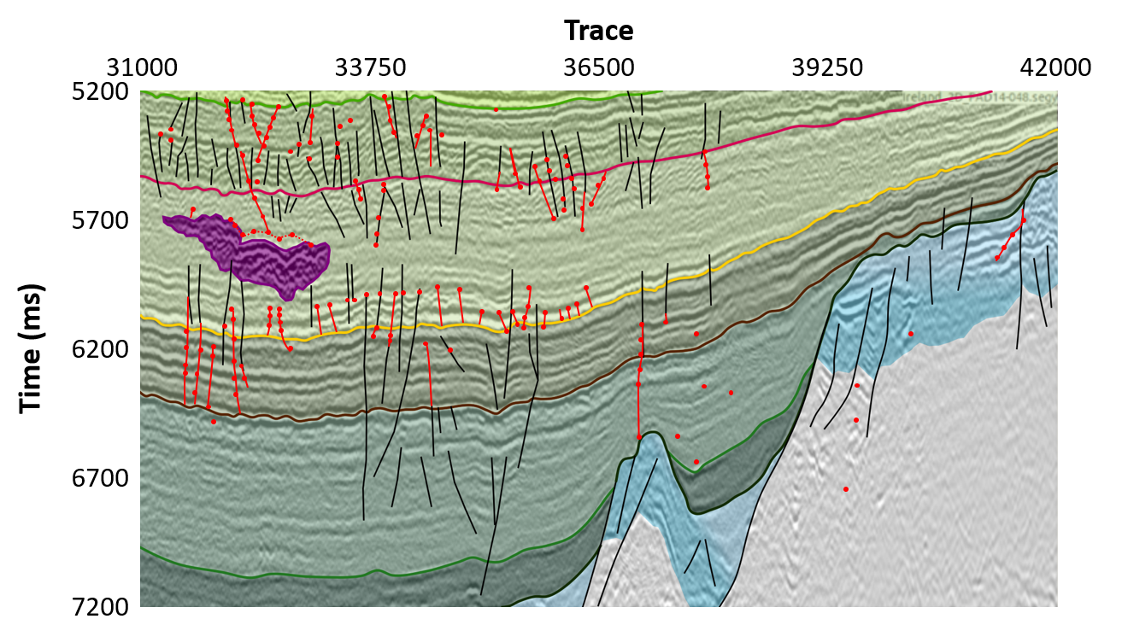
2D Interpreted Slices
Introduction | Method | Results | Conclusions and Future Work
The data was interpreted using a reflection image only and then using both reflections and diffractions to identify additional information.

Slide 18
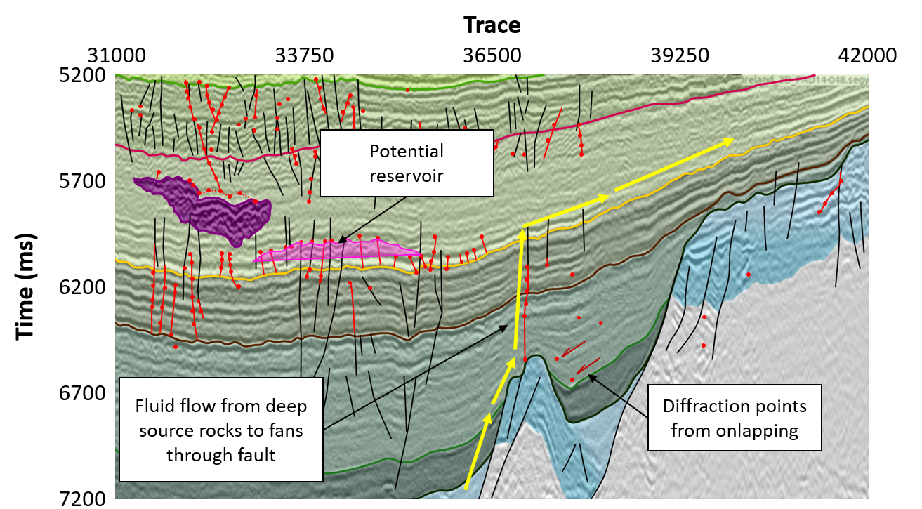
2D Interpreted Slices
Introduction | Method | Results | Conclusions and Future Work
The data was interpreted using a reflection image only and then using both reflections and diffractions to identify additional information.

Slide 19
Conclusions and Future Work
Introduction | Method | Results | Conclusions and Future Work
Diffraction imaging is a powerful tool in a geophysicist’s arsenal, allowing structures to be imaged directly
Diffractions can be directly separated on pre-migration data using deep learning methods in order to remove the need for additional parameters such as dip.
By combining reflection and diffraction images, additional information can be ascertained about the subsurface.
Fracture networks in the Porcupine Basin can be detailed using diffraction imaging, identifying potential reservoirs and migration information.

Slide 20
References
Claerbout, J.F. [1992]. Earth soundings analysis: Processing versus inversion. Blackwell Scientific Publications, London.
Fomel, S. [2002]. Applications of plane-wave destruction filters. Geophysics, Volume 67, pp. 1946-1960.
Klokov, A. & Fomel, S. [2012]. Separation and imaging of seismic diffractions using migrated dip-angle gathers. Geophysics, 77, 131–143.
Landa, E. & Keydar, S. [1998]. Seismic monitoring of diffraction images for detection of local heterogeneities. Geophysics, 63, 1093–1100.
Lowney, B., Hoeber, H., Kaszycka, E. & Hou, S. [2020b]. Combined pre- and post-migration diffraction separation. Amsterdam, European Association of Geoscientists and Engineers.
Lowney, B., Lokmer, I., O’Brien, G.S., Amy, L., Bean, C.J. & Igoe, M. [2020a]. Enhancing interpretability with diffraction imaging using plane-wave destruction aided by frequency-wavenumber f-k filtering. Interpretation, Volume 8, pp. 1-52.
Lowney, B., Lokmer, I., O’Brien, G.S. & Bean, C.J. [2021]. Pre-migration diffraction separation using Generative Adversarial Networks. Geophysical Prospecting, Volume 69, pp. TBC.
Moser, T.J. & Howard, C.B. [2008]. Diffraction imaging in depth. Geophysical Prospecting, 56, 627–641.
Image references:
http://home.chpc.utah.edu/~thorne/animations.html
http://www.geomage.com/software/multifocusing-processing-2d-3d/diffraction-imaging/

Slide 21





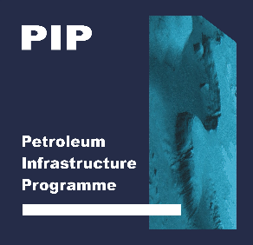
Acknowledgements / Thank You / Questions?
This presentation has emanated from research supported in part by a research grant from Science Foundation Ireland (SFI) under Grant Number 13/RC/2092 and is co-funded under the European Regional Development Fund and by PIPCO RSG and its member companies.

