Slide 1

vEGU 2021, Gather Online
NH9.6 - 'Costs of Natural Hazards and vulnerability modelling of the built environment'
Friday, 30 April 2021
Consequence assessment of linear infrastructure exposed to hazardous weather-related events
U. Eidsvig and L. Piciullo
NGI (Norwegian Geotechnical Institute), Norway.

Slide 2
Barriers reducing the probability of
loss of infrastructure service, caused either
by the natural event directly or
through damage to infrastructure assets
Barriers reducing the consequences of the loss of the infrastructure service, e.g. back-up solutions to provide electricity, alternative modes of transportation
Natural event
Adverse event:
Loss of infrastructure service
Consequence
Natural event
Consequence
Factors affecting the probability of loss of infrastructure service
Factors affecting the severity of the consequences
Notes:
This bow-tie diagram illustrates the scope of the work. The top event as shown in the middel of the figure …
In the left of the diagram causes of the top event are shown. In this work the considered triggers are natural events encompassing extreme weater events or related hazards.
The probability of the top event also encompass the physical vulnerabilty of the infrastructure related to e.g. robustness; condition and degree of protection
On the right side of the top event, the consequences of the top event are shown; here indirect consequences of the loss of mobility.

Slide 3


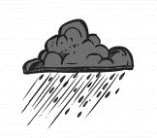
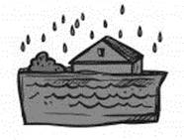
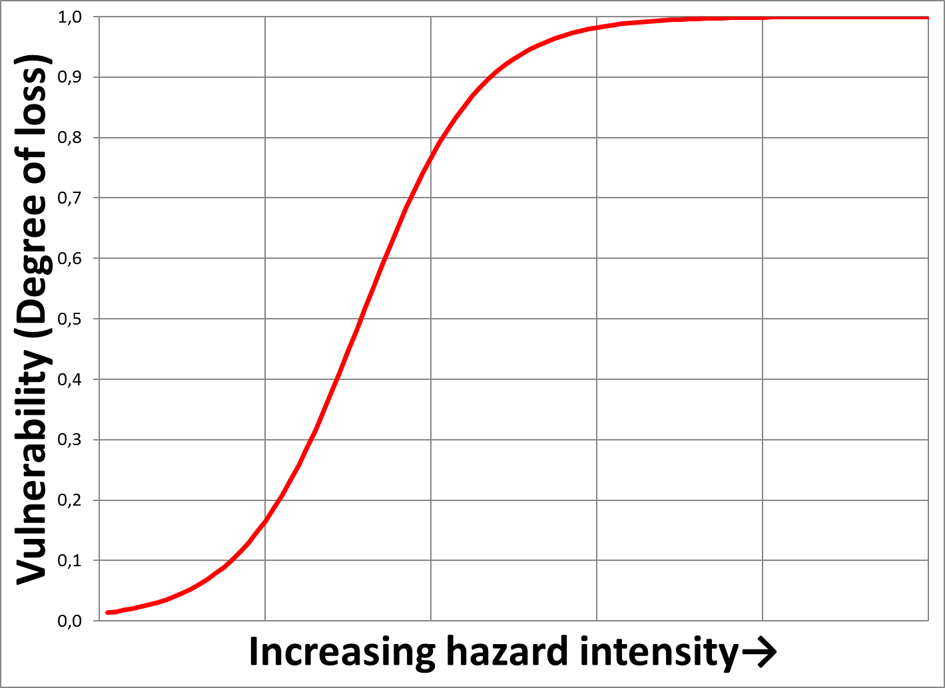
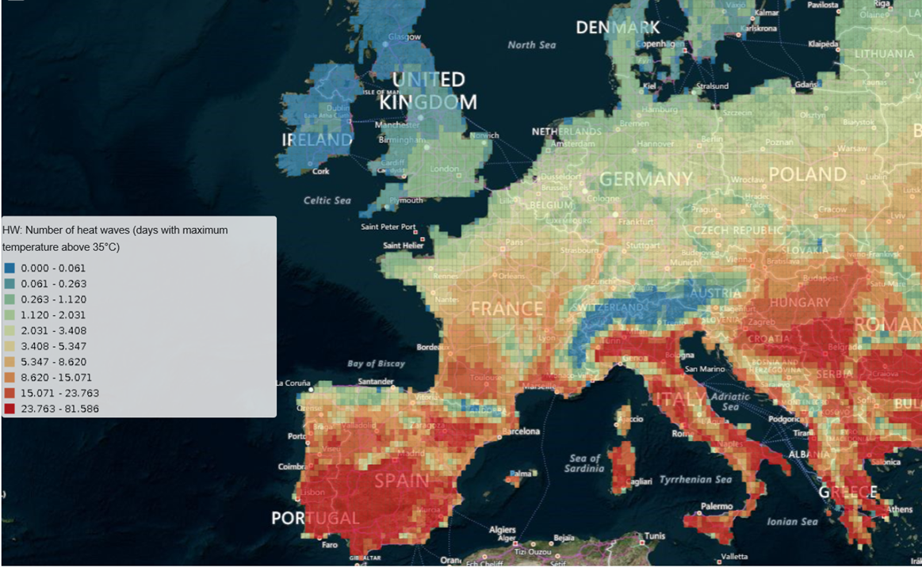
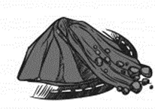
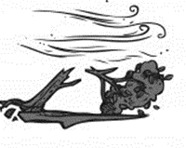
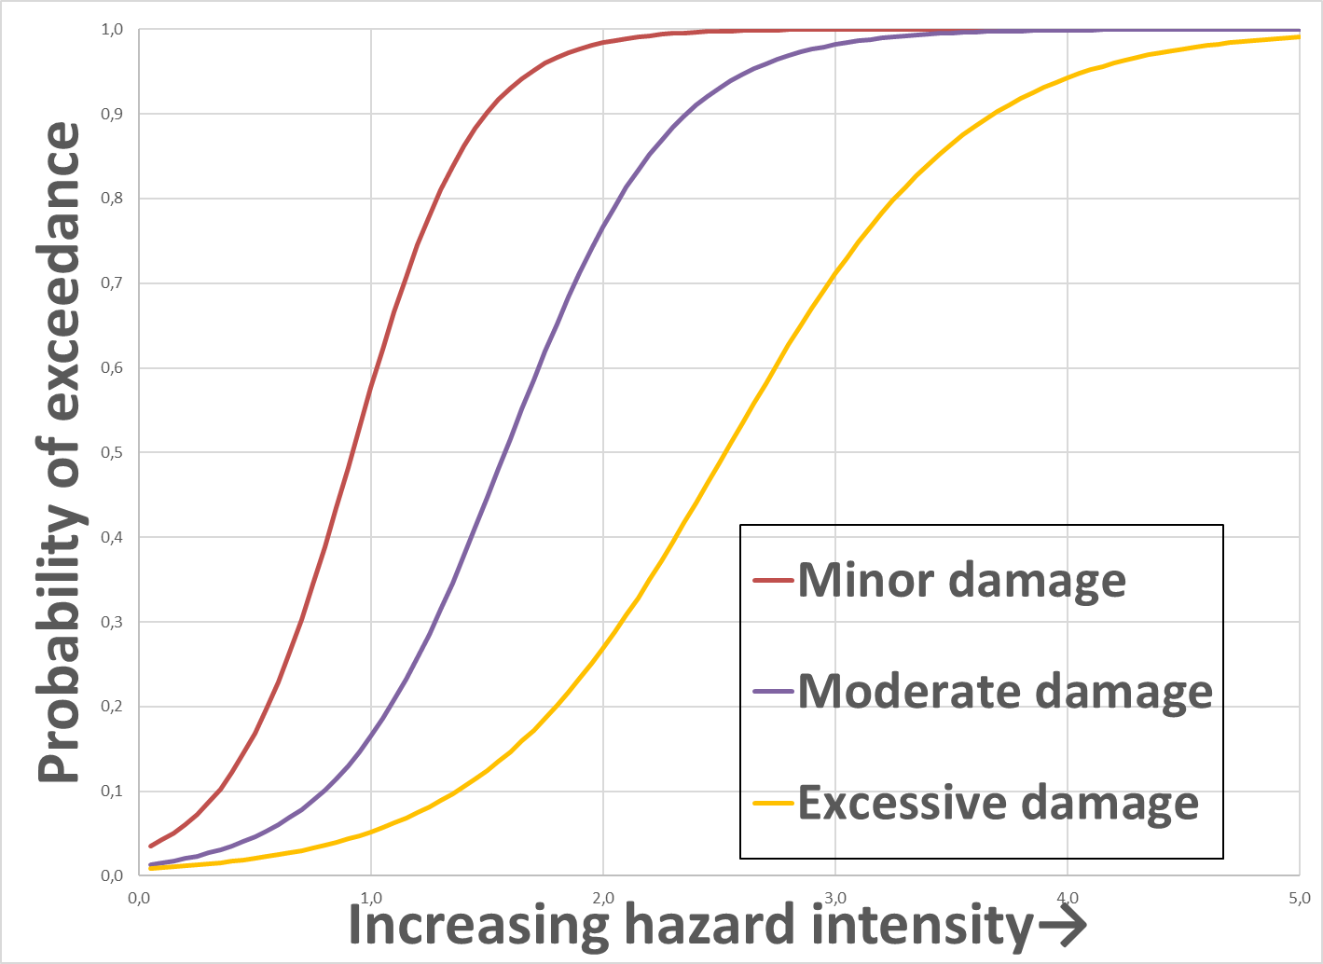
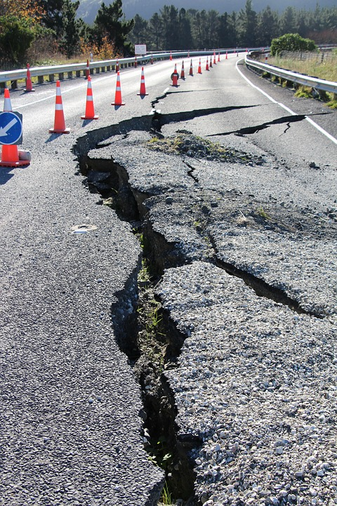
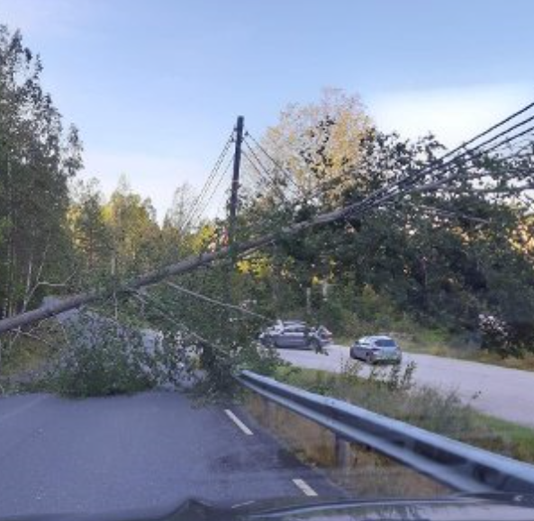
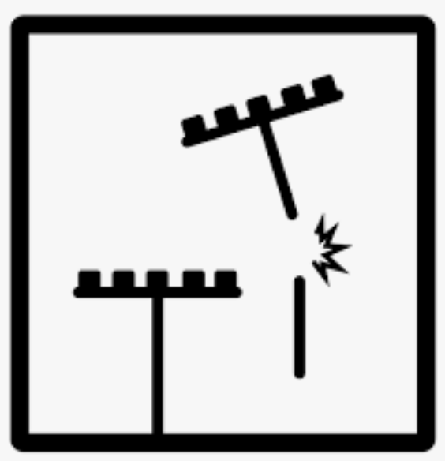
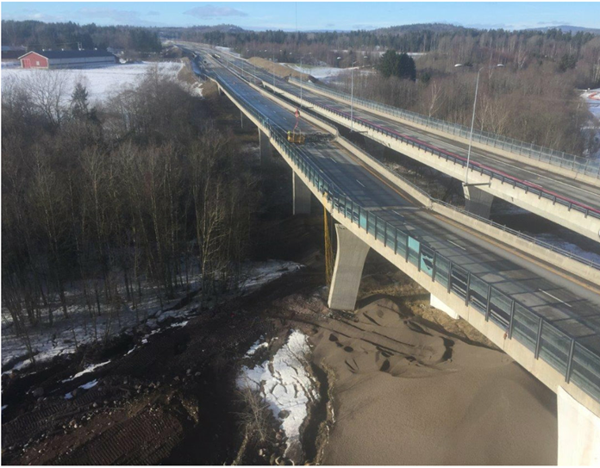
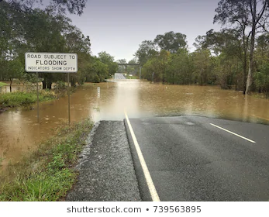

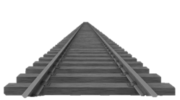







EGU21-2253
Triggers
Frequency of occurrence
Tools (asset level):
Tools (network level):
Approaches based on:
- Simulations (agent-based)
- Economic theory
- Graph and network theory
WORK UP-TO-DATE
Damage
functions
Fragility
functions
Risk identification
Hazard
Exposure
Vulnerability
(structural, functional)
Impacts
Failure modes
Intensity
Infrastructure assets
Vulnerability
Consequences of loss of infrastructure service

Slide 4

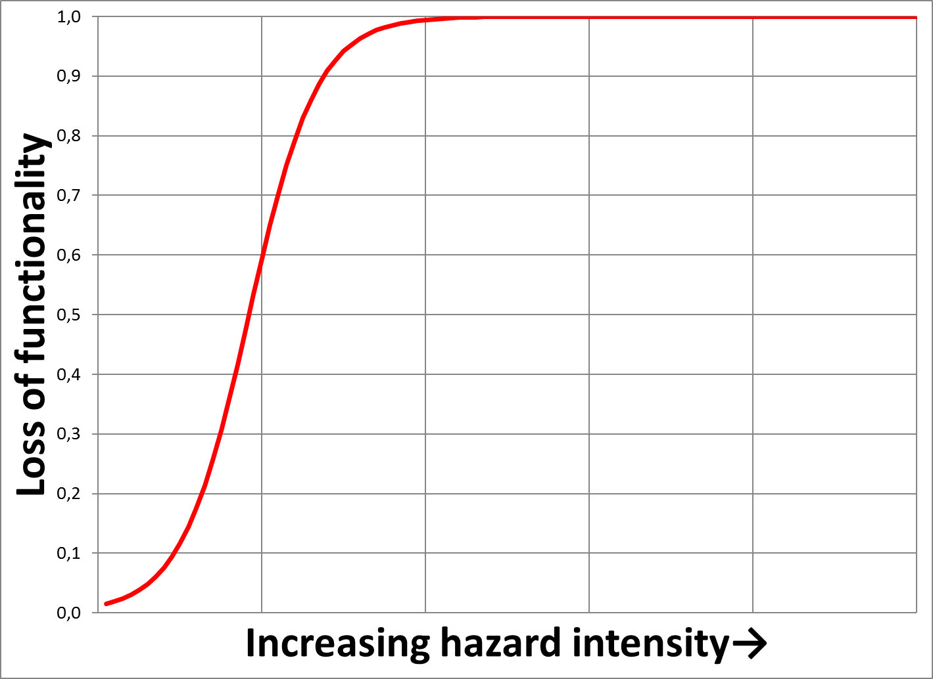
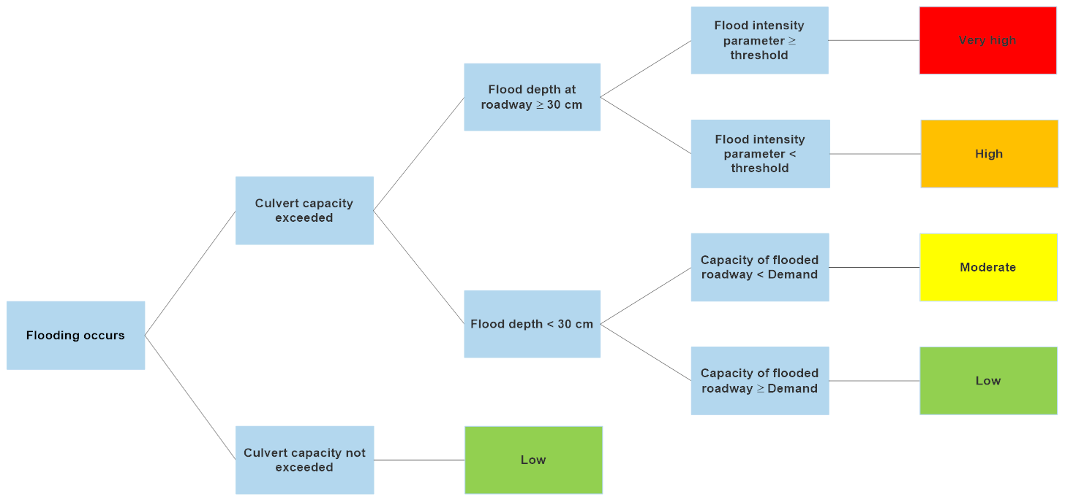
Structural asset vulnerability function - deterministic
Interruption of transportation service
Natural events leading to service interruption with damage to assets
Malfunctioning of asset due to damage
Criticality of asset for transportation service
Natural events leading directly to service interruption without material damage to assets
Functional vulnerability function
Asset fragility function -probabilistic
Assessment of relation between asset damage and service disruption
Notes:
This slide shows different scenarios leading to interruption of the transportation service – as well as tools for assessment.

