Slide 1
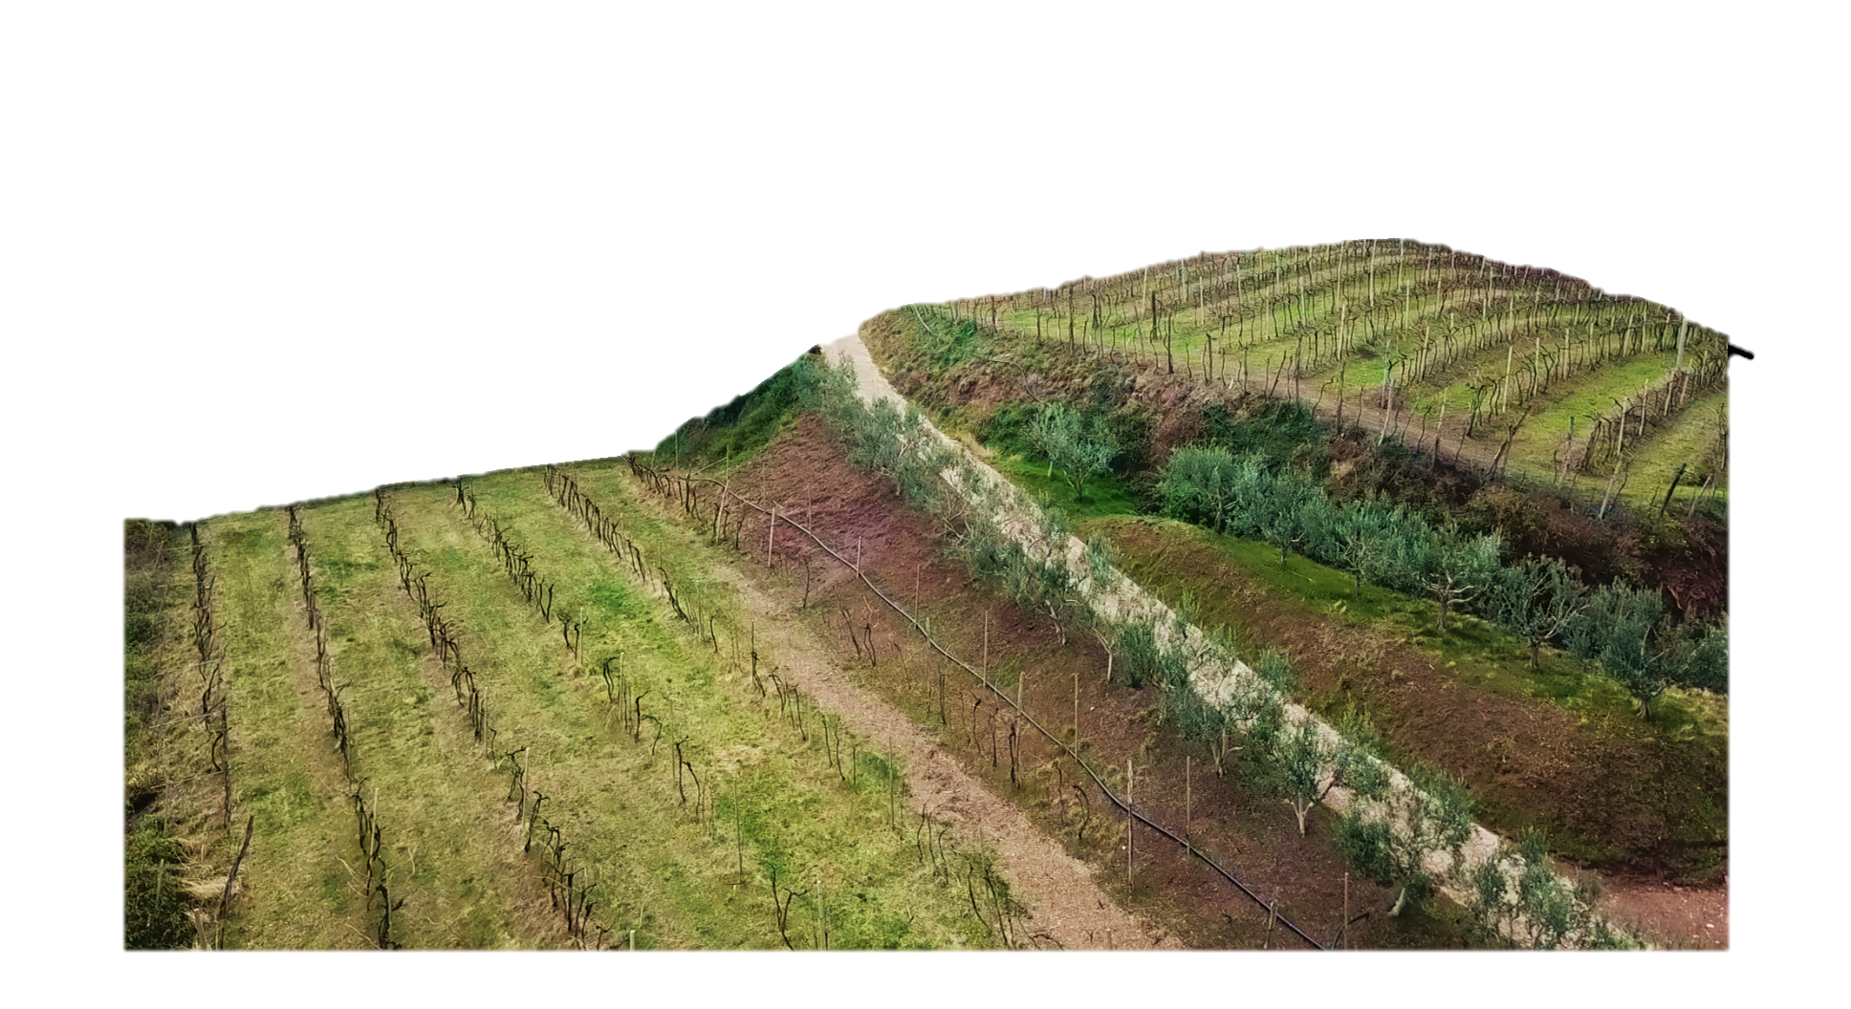
A grand comparison of soil & water conservation in 50 vineyards under 5 different terracing systems
💡 jump to introduction
Anton Pijl, Eugenio Straffelini, Wendi Wang, and Paolo Tarolli Department of Land, Environment, Agriculture and Forestry, University of Padova Agripolis, Viale dell’Università 16, 35020 Legnaro (PD), Italy (anton.pijl@unipd.it)
💡 jump to vineyard types
💡 jump to methods
💡 jump to results
💡 jump to conclusions
doi.org/10.5194/egusphere-egu21-2272

Slide 2
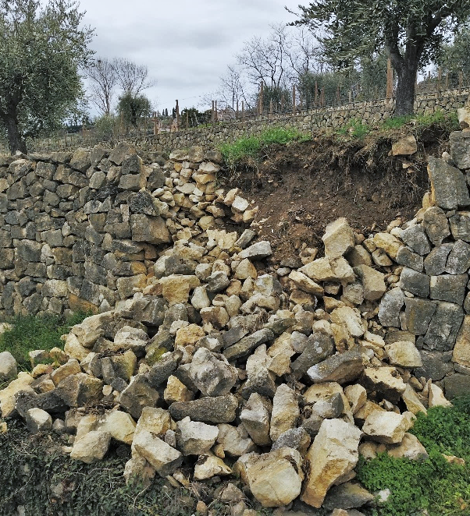
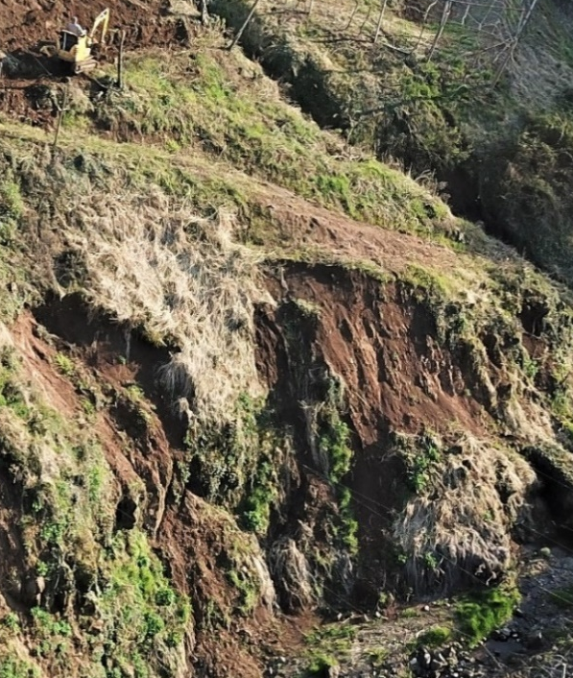
Background of study
Land degradation is a common challenge in steep cultivated systems, such as vineyard landscapes
Several approaches to soil and water conservation exist for mitigating soil loss and runoff at hillslopes, such as different types of terracing
A previous nearby study* revealed how different terracing and non-terracing practices are associated with different manifestations of land degradation, such as soil erosion, terrace failure and landslides
In order to develop sustainable future management plans for steep-slope vineyard landscapes, a systematic comparison of practices is essential to derive robust conclusions
A large-scale analysis of 50 vineyards with 5 different hillslope configurations is presented here, based on a big data approach of physical erosion modelling at high spatial resolution for quantifying the processes of erosion, deposition, sediment flux and runoff for all vineyards study sites
💡 about the zone
💡 go to methods
💡 go to results

Slide 3
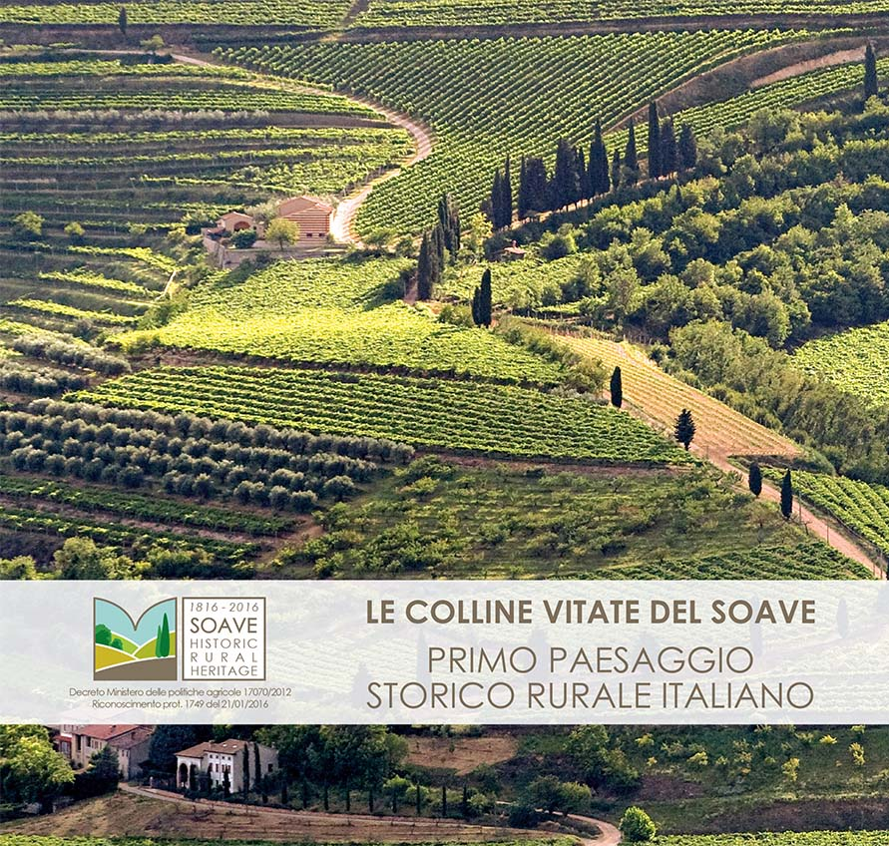
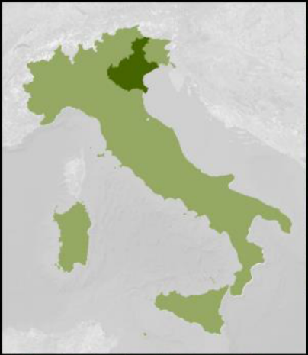
Geographical location: Soave wine production zone
In this study, 50 vineyards in the wine production zone of Soave, Veneto region (IT) were analysed
Recognised as a FAO Globally Important Agricultural Heritage System (GIAHS*), the vineyard landscape of Soave represents important historical and cultural values, as well as valuable agro-ecological functions
Traditionally, several types of hillslope cultivation systems have evolved in this zone, further shaped by modern mechanisation of vineyards. The 5 practices identified and analysed in this study are:
Slope-wise cultivation without terraces
Contour cultivation without terraces
Contour terracing
Broad-base terracing
Diagonal (oblique) terracing
A recent nearby study revealed that different terracing and non-terracing practices have strong impacts on hydro-erosive risk – and this study tests the robustness of these findings by a systematic large-scale comparison of 5 practices in 50 sites
💡 about vineyard types
💡 go to methods
doi.org/10.5194/egusphere-egu21-2272

Slide 4
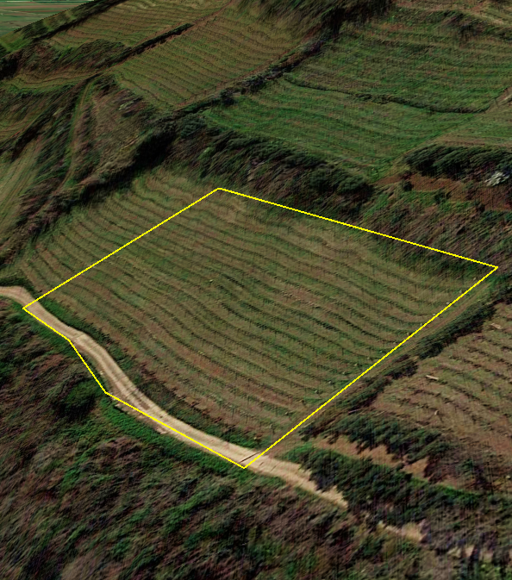
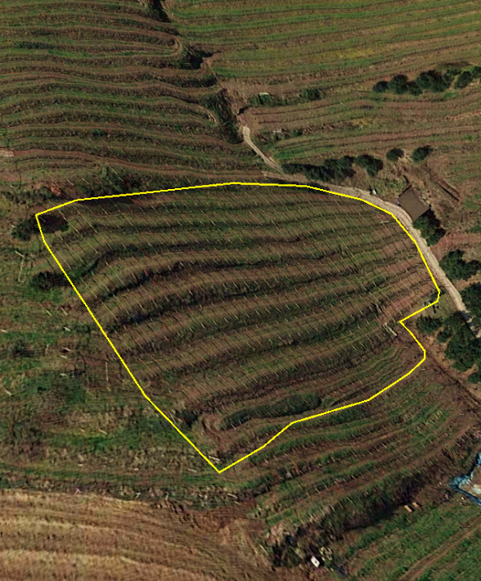
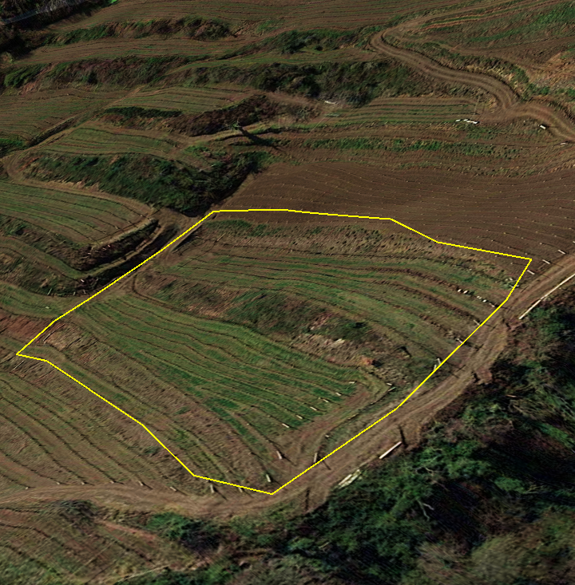
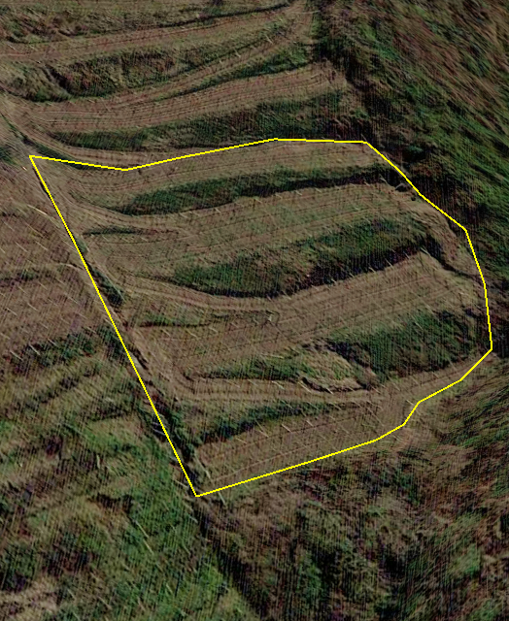
The 5 types of steep cultivation practices
💡about geospatial data
Site selection: 10 study areas were selected for each type below, based on homogeneity in:
soil texture = clay
soil permeability = moderate
slope length = 50 - 60 m
slope steepness = 30 - 35 %
surface area = 0.3 - 0.5 ha
hillslope drainage = concave (inwards)
Slope-wise Cultivation (SC)
IT: « rittochino »
no terraces used
widespread modern practice
favourable for mechanised construction and cultivation
Contour Cultivation (CC)
IT: « girapoggio »
no terraces used
widespread modern practice
favourable for mechanised construction and cultivation
Contour Terracing (CT)
IT: « ciglionamento »
earth bank terraces perpendicular to the slope
narrow platforms, high field occupancy by terraces
Broad-base Terracing (BT)
IT: « terrazzamento al base larga »
earth bank terraces perpendicular to the slope
broad platforms, low field occupancy by terraces
Diagonal Terracing (DT)
IT: « ripiani raccordati »
earth bank terraces, diagonally connected by a continuous road
intermediate width of platforms
rare local terracing practice
💡 about the zone
💡 go to methods
💡 go to results

Slide 5
Data analysis workflow
hydrologic data
rainfall, infiltration
land cover data digitised orthophoto
Final evaluation of 5 cultivation practices
based on quantification of:
- overall sediment flux
- uphill erosion
- downhill deposition & runoff
- comparison natural scenario
SIMWE* physical model
water erosion simulations *doi.org/10.1029/97WR03347
simulated sediment flux
Tukey’s HSD test
statistical difference between 5 practices
topographic data 1-m LiDAR DTM
💡about geospatial data
soil properties texture, permeability
simulated erosion, deposition & runoff
💡 go to results
«natural scenario»
all sites smoothed & forested
zonation analysis
uphill vs. downhill processes
💡 A «natural scenario» was reconstructed for each site. Input data was based on hypothetical forest land cover and terraces were smoothed out from the topography. This allowed for a direct impact estimation of cultivation at each site.
💡 Each vineyard was separated into 2 zones: the vineyard slope (upper 80%) & the runout zone (lower 20%). Spatial processes were analysed separately, e.g. uphill erosion and downhill deposition or runoff.

Slide 6
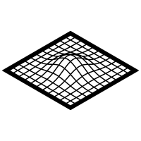
Geo-spatial data
hydrologic data
rainfall, infiltration
Rainfall data at 5-min scale was provided by the regional environmental protection agency (ARPAV). A simulation rainstorm of 182 mm/h was used here, based on the maximum recorded intensity during a local devastating event on 29/08/2020. Infiltration capacity was based on field-measurements using a double-ring infiltrometer for each of the 3 land cover types below.
land cover data digitised orthophoto
Three types of land cover were digitised from Google Satellite imagery for each vineyards: vine rows, lightly trafficked grass interrows (1 tractor pass / operation), and highly trafficked bare access roads (>1 pass / operation). Infiltration and surface roughness were assigned to each.
topographic data 1-m LiDAR DTM
3D topographic LiDAR data was provided by the Italian Ministero dell’Ambiente e della Tutela del Territorio e del Mare (MATTM) based on 2008 aerial surveys using ALTM Gemini and ALTM 3100EA scanners. Point clouds with 30 cm vertical accuracy were processed into 1-m Digital Terrain Models (DTMs) in this work as input for physical erosion simulations.
soil properties texture, permeability
Soil properties were based on a distributed soil map provided by the regional environmental protection agency (ARPAV). Firstly, homogeneous soil type (clay) and permeability classes were used in preselecting the 50 vineyards to ensure homogeneity of study sites. Secondly, model soil parameters (e.g. roughness, detachment & transport capacity) were determined from reference values in literature, in correspondence to the local soil type and land cover described above.
💡 about methods
💡 to all results

Slide 7
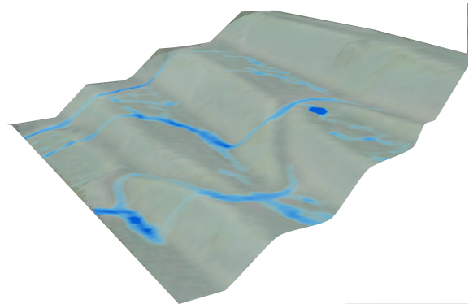
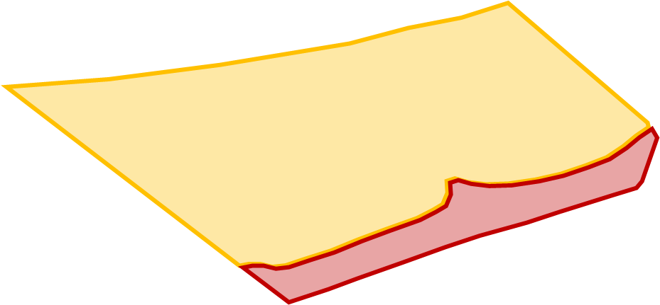
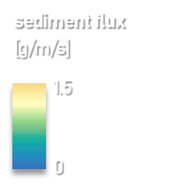
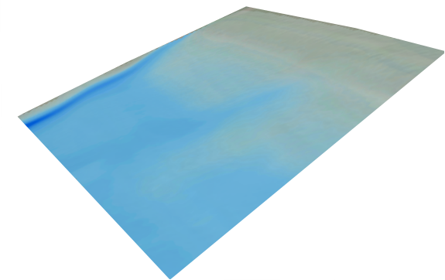
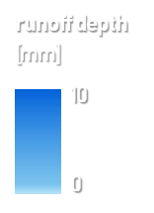
Results
Click on the panels below to explore the results of this study.
sediment flux in all vineyards across the vineyards
uphill vs. downhill processes zonation of erosion, deposition & runoff
comparison «Natural Scenario» hillslope processes in a non-cultivated scenario
💡 about vineyard types
💡 about methods
💡 to the end

Slide 8
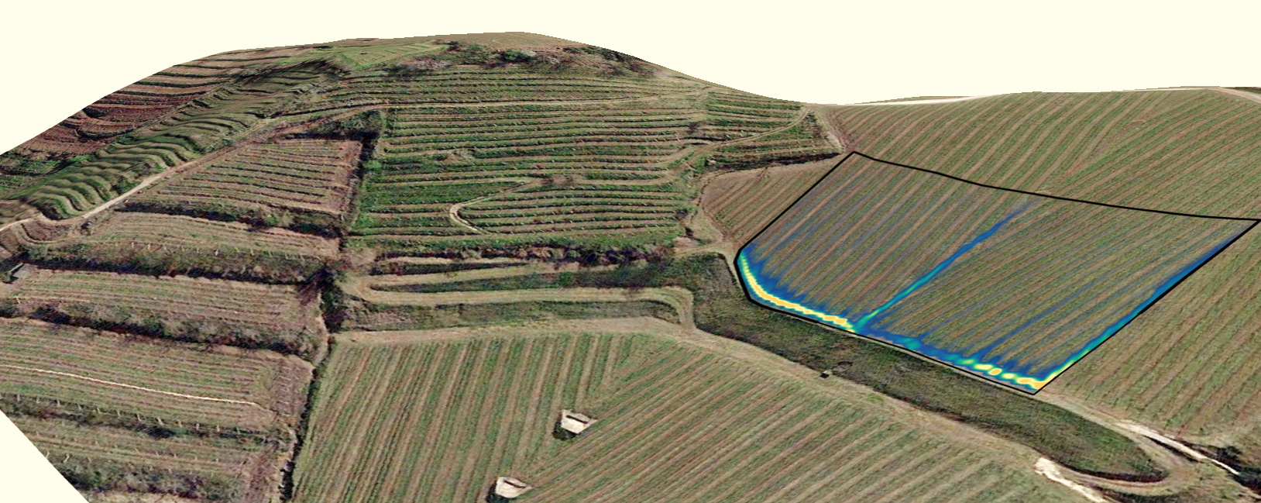
Sediment flux in all vineyards
Sediment flux was calculated for all 50 vineyards using SIMWE physical model
example of simulated sediment flux in study area SC1
Of the 5 vineyard types, «Contour Terracing» (CT) showed the lowest median sediment flux, with a median of 0.58 g/m/s on average for the 10 CT vineyards
The highest sediment flux was related to «Diagonal Terracing» (DT), with a median of 1.17 g/m/s for the 10 DT vineyards
sediment flux [g/m/s]
While «Slope-wise Cultivation» (SC) shows the second-lowest median sediment flux, it also shows among the highest values due to localised concentrated movement of soil particles (as visible on the left).
Tukey’s HSD test revealed that all 5 sample groups show significantly different sediment flux values with a 99% confidence level
1.5
0
💡 about vineyard types
💡 about methods
💡 to all results
💡 to the end

Slide 9
Zonation of erosion, deposition & runoff
Erosion, deposition & runoff simulated by SIMWE were quantified seperately for uphill (the hillslope) and downhill (the run-out area)
Uphill erosion shows a similar distribution as sediment flux (previous slide), with lowest medians for «Contour Terracing» (CT) and the highest for «Diagonal Terracing» (DT)
However, downhill deposition and runoff reveal how the 3 terraced practices (CT, BT, DT) are more effective in retaining soil and water on the slope than the 2 non-terraced practices (SC, CC), indicated by lower medians
Tukey’s HSD test furthermore showed that «Contour Terracing» (CT) showed significant statistical similarities with all other practices
« uphill segment » : upper 80% of vineyard
« downhill segment » : lower 20% of vineyard
> key example of zonation
> boxplot erosion uphill
> boxplots deposition and water downhill
> statistics on differences
💡 about vineyard types
💡 about methods
💡 to all results
💡 to the end

Slide 10
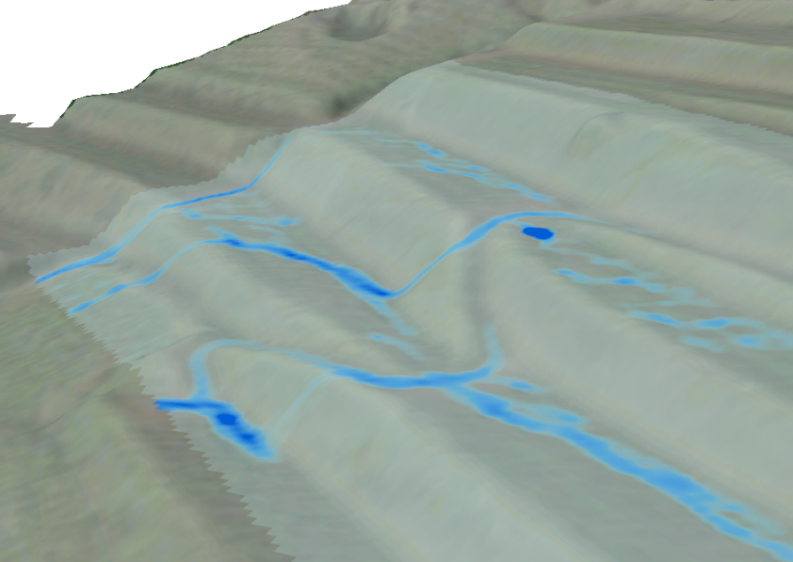
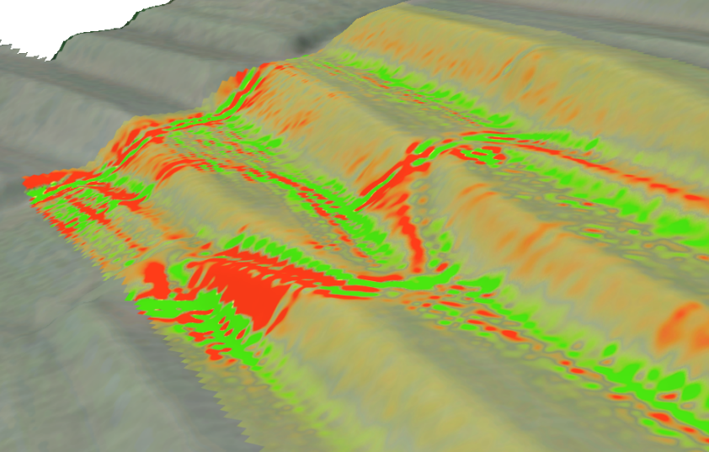
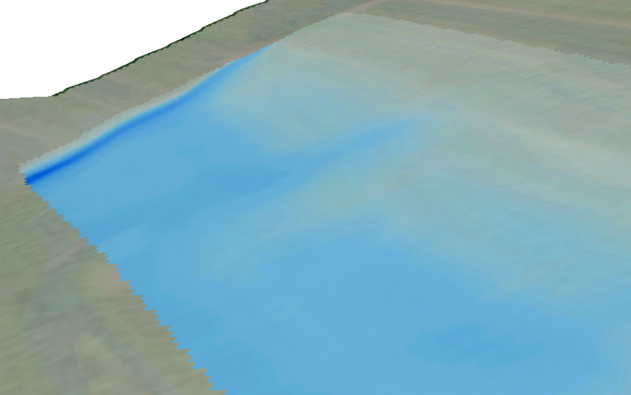
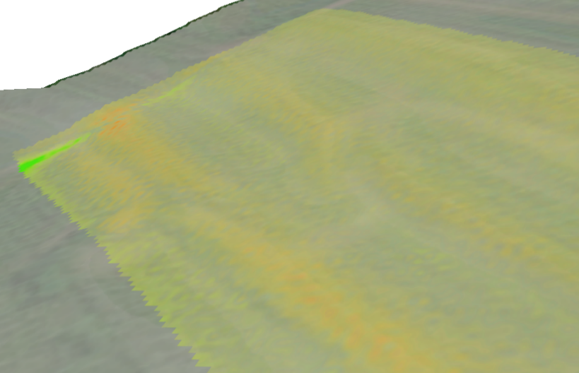
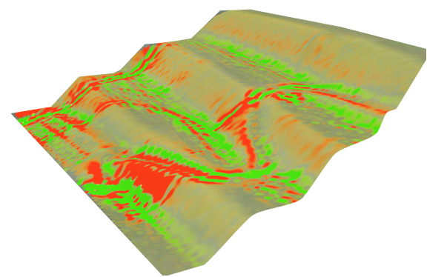
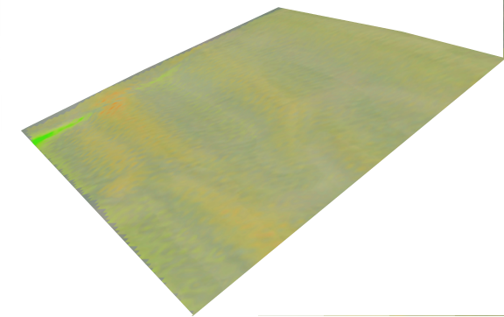
Comparison with «Natural Scenario»
ACTUAL SCENARIO NATURAL SCENARIO (terraced vineyard) (smooth forest hillslope)
A hypothetical «natural scenario» was reconstructed for all 50 study sites by:
removing terrace geomorphology by smoothing (kernel size 41 m)
replacing Vineyard land use with Forest land use (affecting infiltration, roughness)
Uphill erosion and downhill deposition and runoff were re-computed for the «natural» study sites, and summarised per original practice in the table below
runoff depth [mm]
10
0
Each of the 5 vineyard practices has a positive impact on runoff reduction compared to the «natural» scenario (i.e. lower downhill runoff depth)
However, erosion and deposition are much higher for each vineyard practice, despite runoff reduction. «Diagonal Terracing» (DT) showed the highest negative impact on soil loss, and «Contour Terracing» (CT) the lowest
erosion & deposition [g/m²/s]
 | Median downhill |  |  | Median uphill erosion |  |  | Median downhill deposition
 | runoff depth (mm) |  |  | (g/m²/s) |  |  | (g/m²/s)
 | natural | actual | % change | natural | actual | % change | natural | actual | % change
SC | 3.05 | 1.22 | -60% | 0.08 | 0.13 | 55% | 0.1 | 0.43 | 331%
CC | 4.07 | 1.31 | -68% | 0.08 | 0.15 | 89% | 0.11 | 0.6 | 455%
CT | 2.49 | 0.6 | -76% | 0.09 | 0.12 | 33% | 0.08 | 0.22 | 183%
BT | 2.36 | 1.09 | -54% | 0.07 | 0.17 | 149% | 0.08 | 0.51 | 566%
DT | 2.13 | 0.86 | -60% | 0.08 | 0.24 | 187% | 0.05 | 0.28 | 485%
1 0 -1
example «natural scenario» for study site CT6
💡 about vineyard types
💡 about methods
💡 to all results
💡 to the end

Slide 11
Conclusions & Recommendations
This study provides a novel massive evaluation of soil and water conservation in 5 different hillslope configurations commonly found in steep-slope viticulture in northern Italy (as illustrated below)
A big-data approach of physical erosion modelling based on high-resolution topography was used for offering a robust and systematic analysis of erosion, deposition, sediment flux and runoff
Simulations revealed how Contour Terracing (CT) resulted in the lowest amounts of sediment flux throughout the vineyard, opposed by Diagonal Terracing (DT), reflecting statistically significant differences
Zonal analysis showed that upslope erosion was similarly lowest for the CT practice and highest for the DT practice
However, downslope deposition and runoff depth was lower in all terraced practices (CT, BT, DT) as compared to non-terraced practices (SC, CC)
Our findings indicate that terracing practices are generally favourable for retaining soil and water on the hillslopes
However, oblique terracing (DT) can cause high sediment flux and erosion due to connected flow paths
An optimal vineyard configuration aims at minimising flow concentration and velocity along the hillslope
Slope-wise Cultivation (SC)
Contour Cultivation (CC)
Contour Terracing (CT)
Broad-base Terracing (BT)
Diagonal Terracing (DT)
💡 about methods
💡 to all results

