Slide 1








Assessing the biogeographical and socio-ecological representativeness of the ILTER site network
Accepted for publication in Ecological Indicators
Christoph Wohner*^{1, 2} https://orcid.org/0000-0002-0655-3699
Thomas Ohnemus³ https://orcid.org/0000-0002-1391-7673
Steffen Zacharias³ https://orcid.org/0000-0002-7825-0072
Hannes Mollenhauer³ https://orcid.org/0000-0002-4746-9143
Erle C. Ellis⁴ https://orcid.org/0000-0002-2006-3362
Hermann Klug² https://orcid.org/0000-0002-0545-9721
Hideaki Shibata⁵ https://orcid.org/0000-0002-8968-3594
Michael Mirtl^{1, 3} https://orcid.org/0000-0001-8942-1917
*Corresponding author: christoph.wohner@umweltbundesamt.at
¹ Environment Agency Austria, Department for Ecosystem Research and Monitoring, Spittelauer Lände 5, A-1090 Vienna, Austria
² Paris-Lodron University of Salzburg, Schillerstraße 30, 5020 Salzburg, Austria
³ Helmholtz Centre for Environmental Research - UFZ, Department Monitoring and Exploration Technologies, Permoserstr. 15, D-04318 Leipzig, Germany
⁴ Department of Geography & Environmental Systems, University of Maryland, Baltimore County, Baltimore, MD 21250, USA
⁵ Field Science Center for Northern Biosphere, Hokkaido University; Kita-9, Nishi-9, Kita-ku, Sapporo, Hokkaido 060-0809, Japan and International Long-Term Ecological Research Network

Slide 2
Introduction
Aim of the study
Assessing the representativeness and coverage of the ILTER in-situ site network with respect to multiple biogeographical and socio-ecological gradients
Is the coverage of world regions suitable for global comparative studies and meta-analyses or is this constrained by biases common to terrestrial ecological study sites (Martin et al., 2012)?
Based on the results recommendations for the extension of the network are formulated

Slide 3
Introduction
Motivation of the study
A large number of sites alone does not ensure good representativeness of global ecosystems since
  there may be over-representation or under-representation of certain world regions
  or biases in certain
    Biomes
    Climatic zones
    Landforms ….
In order to effectively manage such a network and potentially mitigate biases you need to identify these gaps and biases first

Slide 4
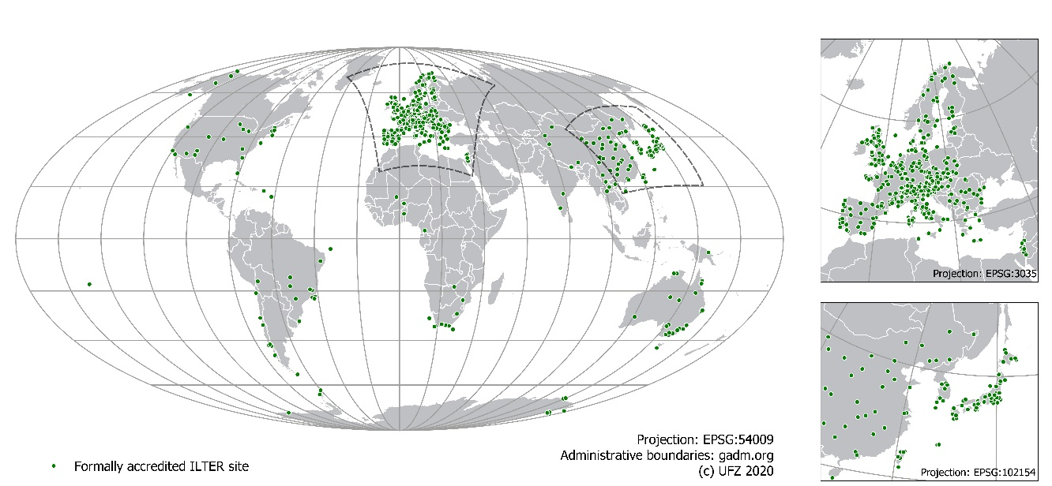
Introduction
What is ILTER?
International Long-Term Ecological Research Network (ILTER) is a global network of networks founded in 1993
“bottom-up” governance structure consisting of (national) member networks, e.g. US LTER, LTER-D (Germany), JaLTER (Japan), …
focuses on long-term, site-based research
consisting of 743 research sites globally (as of October 2020)

Slide 5
Introduction
Overview of the study
Geographic information of all ILTER sites was taken from DEIMS-SDR (Wohner et al., 2019)
Six global classifications were chosen and used to assess biogeographic and eco-sociological representativeness on a global scale
Statistical concepts defined by Schmill et al. (2014) were taken, extended and applied to the input data
Results include a detailed assessment of over- and underrepresented regions of the world as well as recommendations for extending the network to improve coverage and representativeness

Slide 6
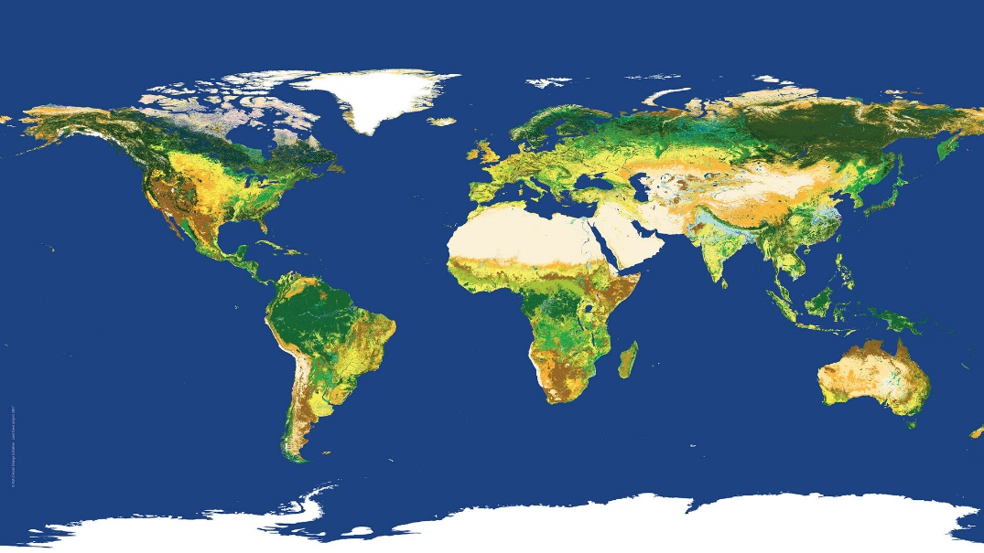
Methodology
Used datasets and code
ILTER sites
  Point-based and polygon-based site locations taken from deims.org
  Used version archived online (Ohnemus and Wohner, 2020)
Classifications
  Anthromes (Ellis et al., 2020)
  Biomes (Dinerstein et al., 2017)
  Bioclimatic zones (Metzger et al., 2013)
  Economic density (Kummu et al., 2020 & CIESIN, 2018)
    ED = GDP/Capita * Population Density
  Land cover (ESA, 2015)
  Landforms (Karagulle et al., 2017)
  Were harmonised to ensure comparability
    Reclassifying miniscule classes
    Reprojecting the spatial resolution
    Clipping the spatial extent, e.g. Antarctica, …
R Code for analysis
  Available online (Ohnemus 2020)
ESA Land cover map 2015

Slide 7
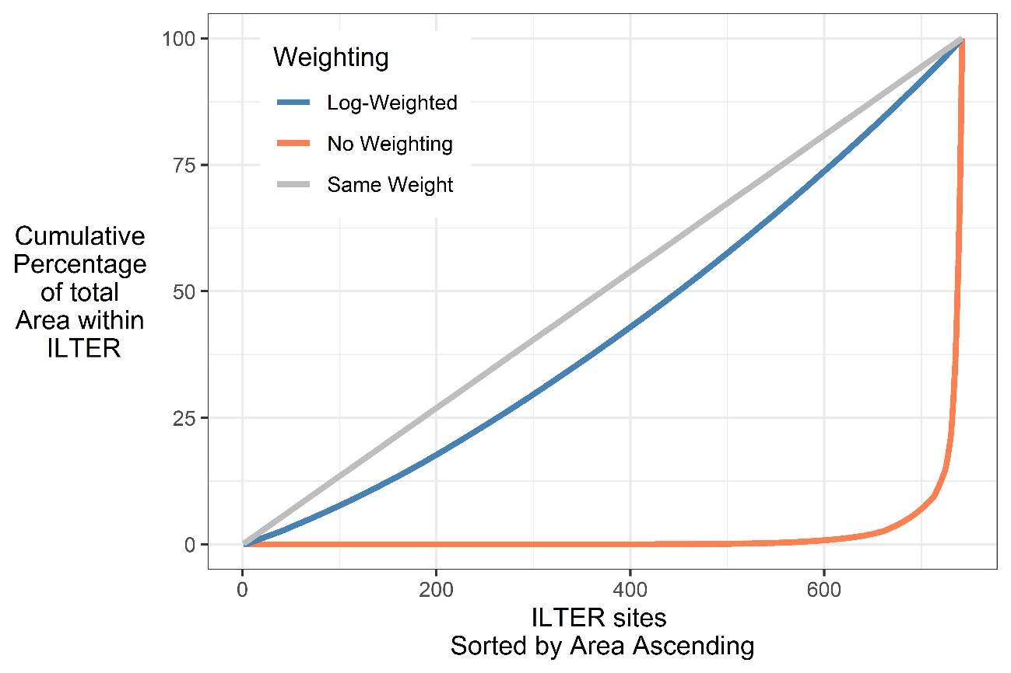
Methodology
ILTER sites dataset
Site data taken from DEIMS-SDR (Wohner et al., 2019)
500 sites provide exact boundaries
242 sites provide a point coordinate and a size value
1 site provided only a point
  A marine buoy located outside of the geographic scope of the analysis
  Was excluded from analysis
Problem of extreme outliers
  11 sites are registered with an extent of
  over 100 000 km²
  150 of 742 ILTER sites would accounted for 99% of the total spatial coverage
  Log-weighting was applied to the size values to mitigate this effect
The result is a multi-polygon dataset with adjusted size values

Slide 8
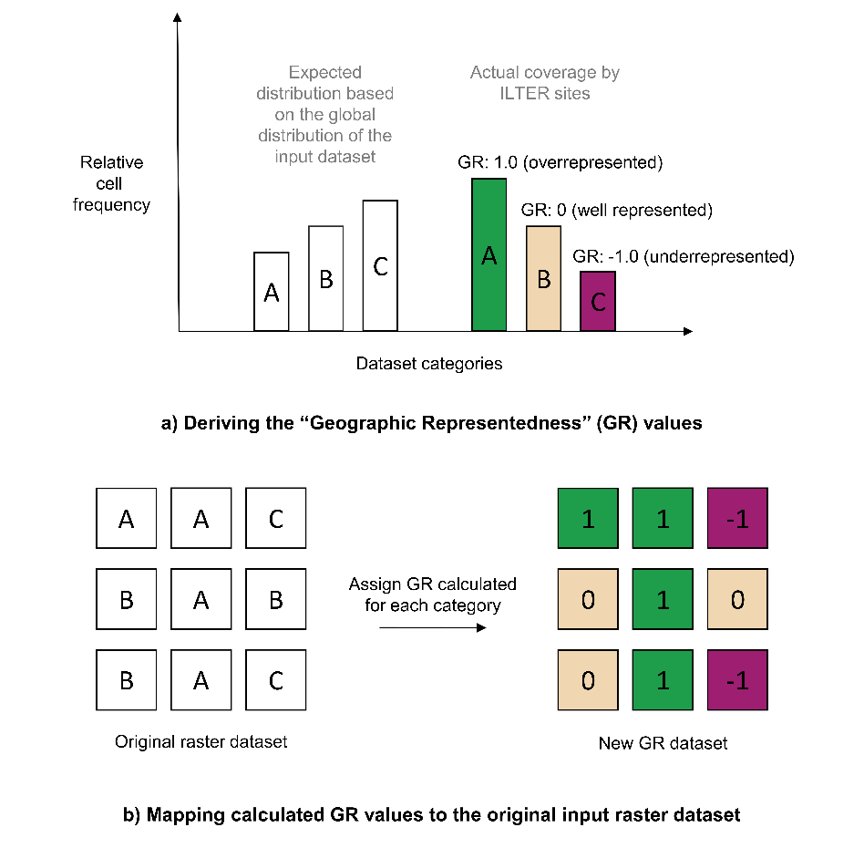
Methodology
Calculating the indices
Calculating chi²-tests (a)
  Taking a classification (expected distribution) and comparing it to the actual distribution (covered by the ILTER sites)
  Getting a p value for each category within a classification
Reclassifying the p values to represent a geographic “representedness” (GR) value (Schmill et al., 2014) (Tab. 1)
GR values are mapped to the original input rasters to create “GR datasets” (b)
Tab. 1
Condition | Geographic Representedness (GR)
 | value calculation | meaning | value range
If obs = exp | 0.00 | Well represented | 0.00
if obs < exp | -1.00 + p value | Underrepresented | -1.00 to <0.00
if obs > exp | +1.00 - p value | Overrepresented | >0.00 to +1.00

Slide 9
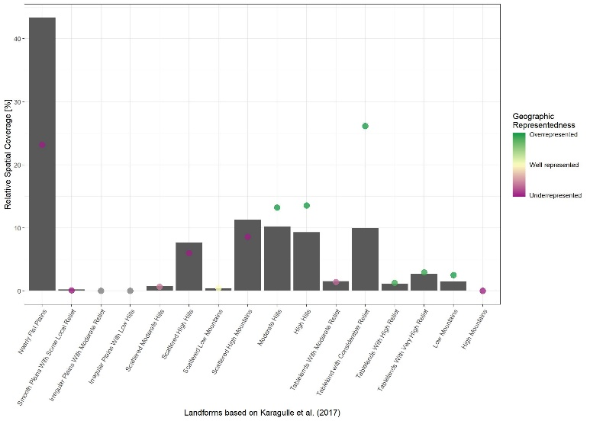
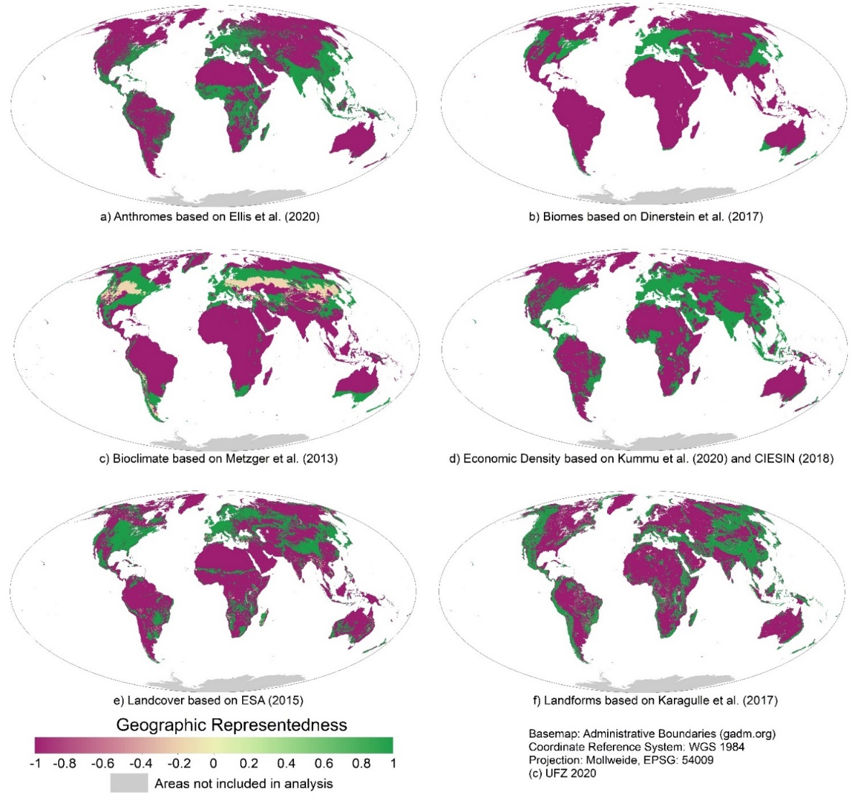
Results
Fig. “Geographic Representedness” (GR) per classification following Schmill et al. (2014)

Slide 10
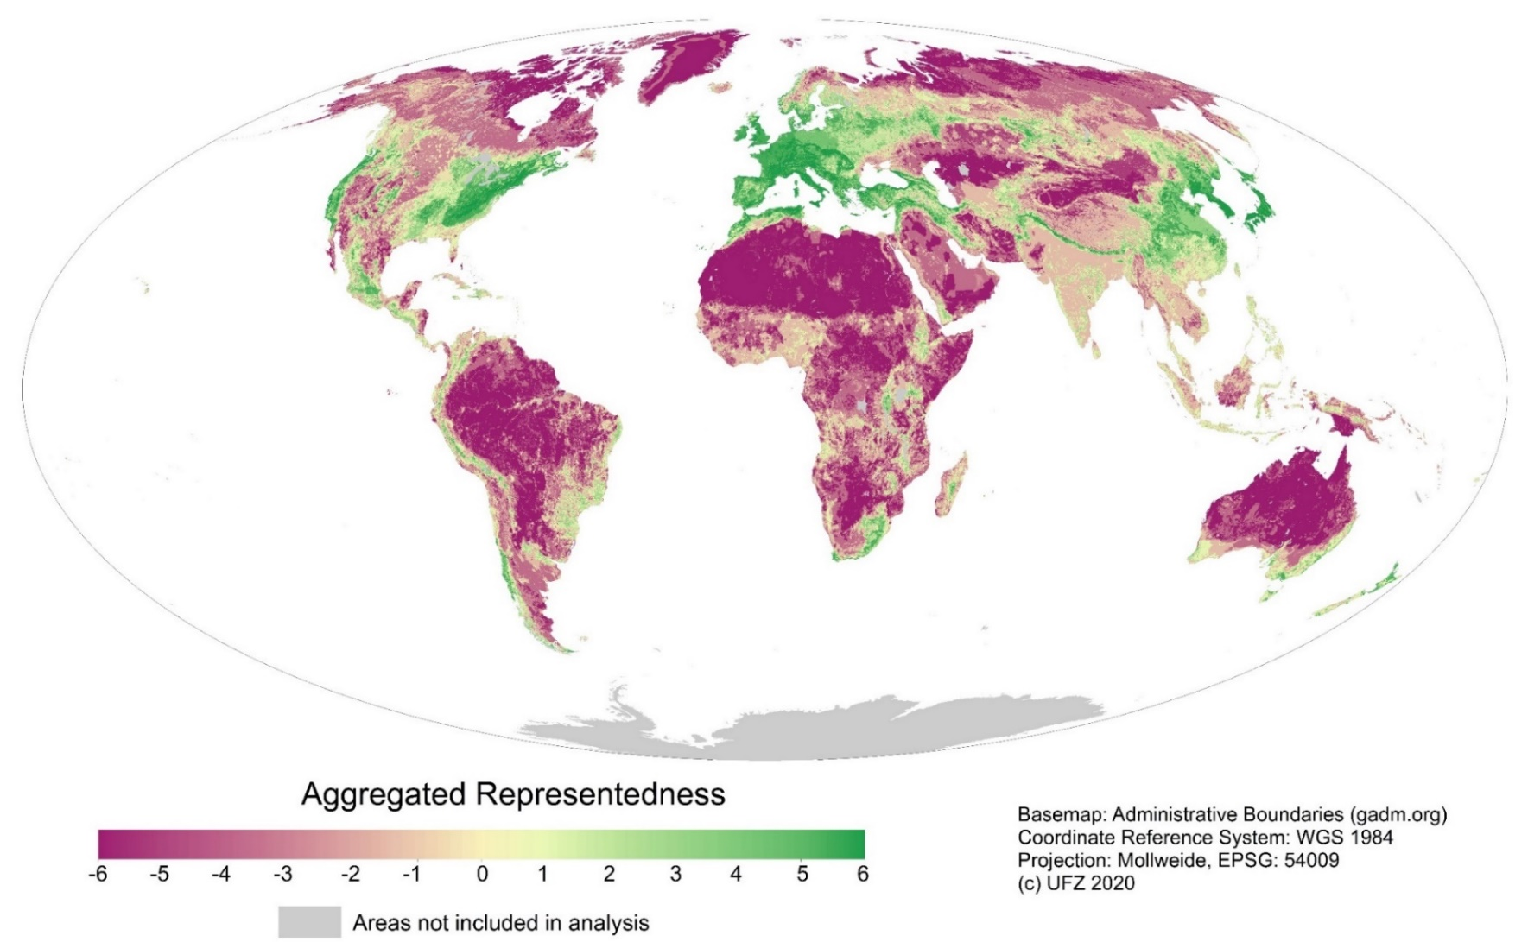
Results
Fig. “Aggregated Representedness” (AR) following Schmill et al. (2014)

Slide 11
Methodology
Reclassifying AR values
Problem:
  AR values around 0 can be (and in our case always are) the result of overrepresentation and underrepresentation in different datasets cancelling out each other
  The AR dataset doesn’t take the exact locations of existing ILTER sites into consideration – a raster cell can be underrepresented even though an LTER site is located within it
Solution: Deriving so-called priority regions
  Creating a global, hexagonal grid with 5° spacing
  Calculating and mean value per cell
  Cross-checking if ILTER sites are located within a cell
  Assigning a “priority for additional sites” value based on these parameters
Mean Aggregated Representedness (AR) | Priority for additional sites
-6.00 to -4.00 | very high
-3.99 to -2.00 | high
-1.99 to -0.01 | medium
0.00 to 3.00 or if one ILTER site is located in the cell | low
3.01 to 6.00 or if more than one ILTER site is located in the cell | very low
Tab. 3 Reclassification of “Aggregated Representedness” (AR) values

Slide 12
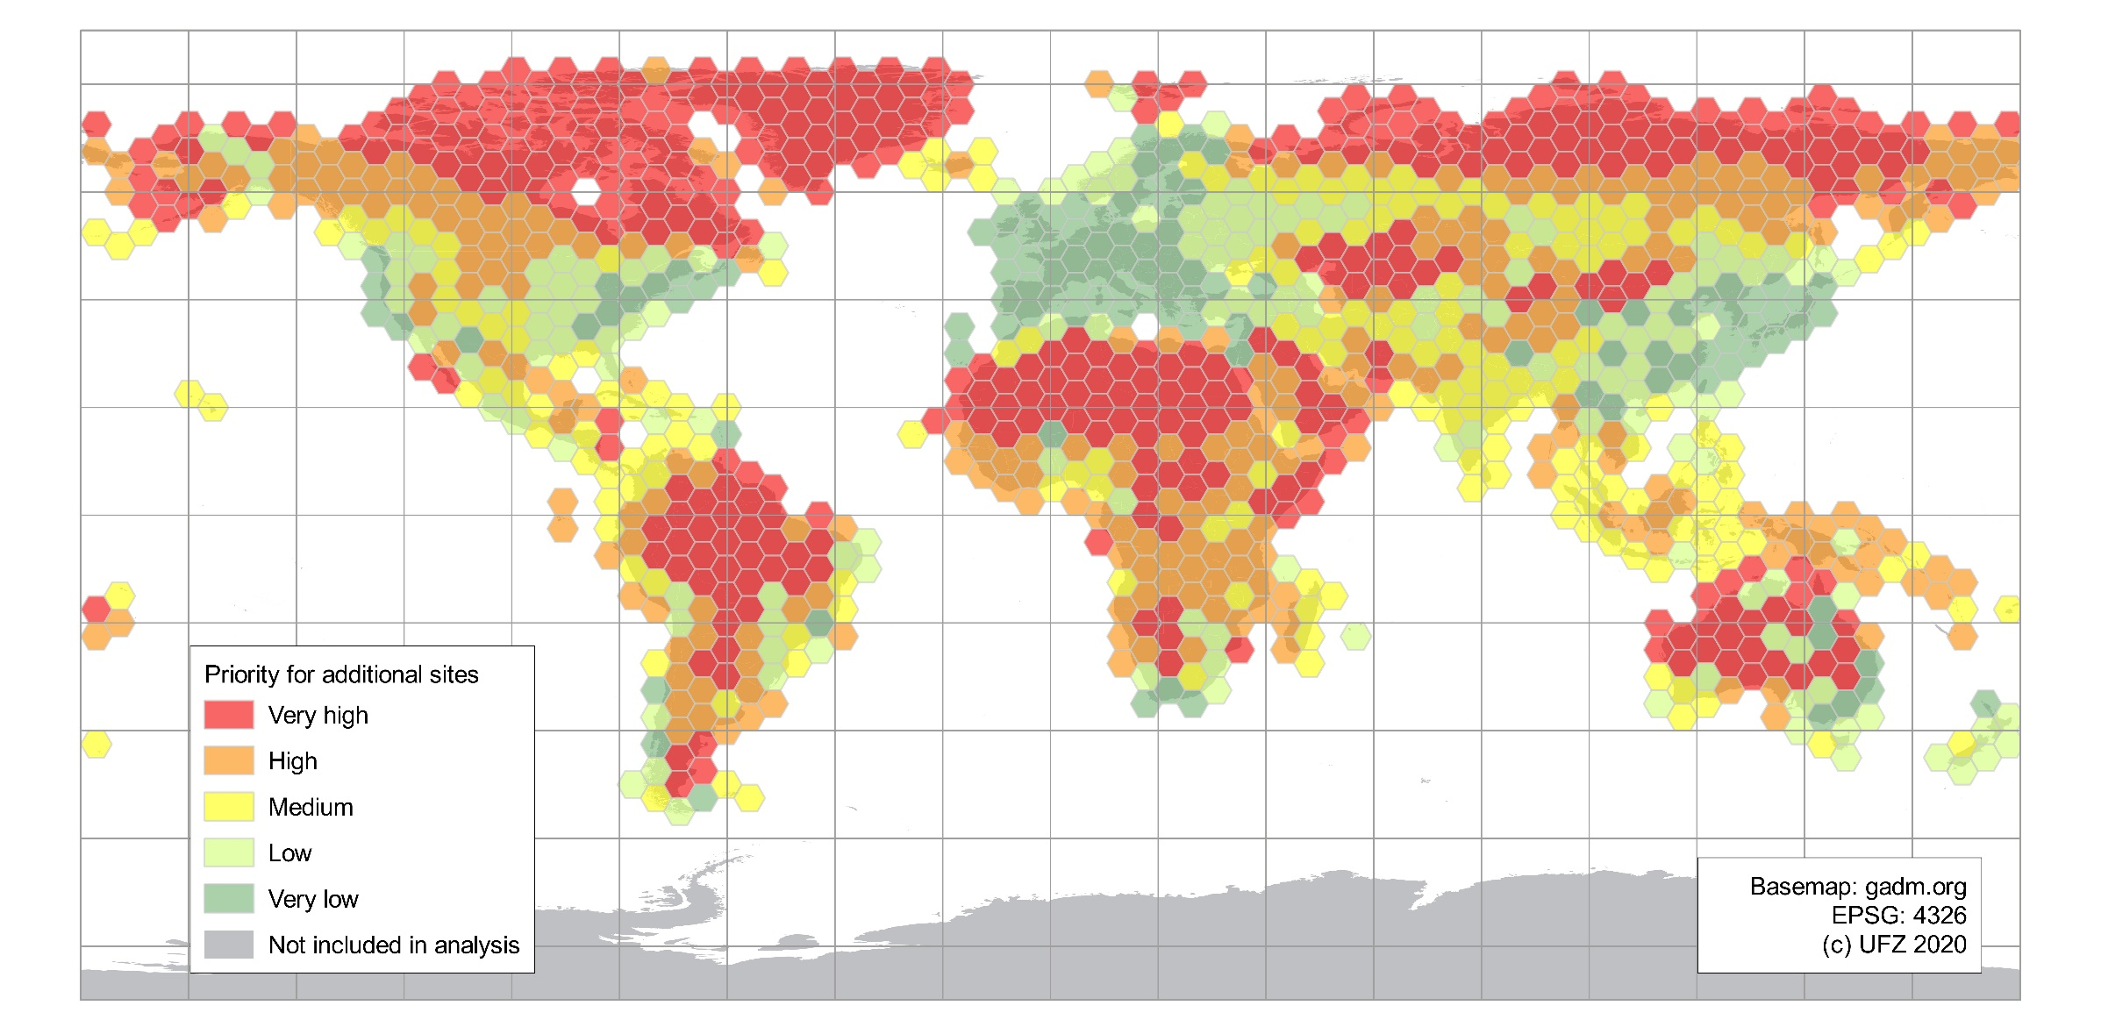
Results
Fig. Priority regions for the proposed expansion of the ILTER site network

Slide 13
Conclusions for the ILTER network – key factors of representativeness
Bias towards more anthropogenically developed areas
  Under-sampling of all wild and less anthropogenically influenced semi-natural and rangeland areas
  Economic Density indicates a bias towards wealthy regions
Strong biases in bioclimates
  “cold and mesic” being clearly overrepresented
  Underrepresentation of “hot”, “extremely hot” and “extremely cold and mesic” bioclimate zones
Strong underrepresentation of landform “nearly flat plains”
No coverage of landcover classes “needleleaf (sic) deciduous trees”, “evergreen shrubland” and “lichens and mosses”

Slide 14
Conclusions for the ILTER network – recommendations of future extensions
ILTER should establish additional networks
  in the Arctic region
    e.g. Iceland, Canada or Russia
  Central Asia
    e.g. Kazakhstan, Uzbekistan or Turkmenistan
  most parts of Africa
    e.g. Egypt, Mauritania, Namibia or Botswana
  inner continental parts of South America
    e.g. Peru or Bolivia
Or build on existing networks in underrepresented regions
  LTER France for West Africa
  LTER Brazil for inner continental parts of South America

Slide 15
Conclusions for future work
Analysis workflow is automated and can be rerun periodically
  Reduce future workload
  Suitable for monitoring the development of the ILTER site network
  However, quality of site geodata could be improved
Workflow can be applied to other (non-ILTER) networks as well
  On the continental, national or region scale
  But used classifications need to be adapted for this
Overall it is a suitable workflow for evaluating coverage and representativeness of in-situ site networks

Slide 16
Acknowledgements
Financed and coordinated by the International Long-Term Ecological Research network (ILTER, 2020)
Supported by the global observation and research site registry DEIMS-SDR
  Developed by eLTER and
  Funded by projects of the European Commission
    H2020 eLTER grant agreement number 654359
    H2020 eLTER PLUS grant agreement number 871128
This study is based upon work supported by the National Science Foundation under grant number CNS 1125210 awarded to Erle C. Ellis in 2011
We would like to thank all member networks of ILTER for their data input of site information
This study also contributes to the Global Land Programme (GLP, 2020)

Slide 17
Selected References
CIESIN, 2018. Center For International Earth Science Information Network. Gridded Population of the World, Version 4 (GPWv4): Population Density, Revision 11.
Dinerstein, E., Olson, D., Joshi, A., Vynne, C., Burgess, N.D., Wikramanayake, E., Hahn, N., Palminteri, S., Hedao, P., Noss, R., Hansen, M., Locke, H., Ellis, E.C., Jones, B., Barber, C.V., Hayes, R., Kormos, C., Martin, V., Crist, E., Sechrest, W., Price, L., Baillie, J.E.M., Weeden, D., Suckling, K., Davis, C., Sizer, N., Moore, R., Thau, D., Birch, T., Potapov, P., Turubanova, S., Tyukavina, A., Souza, N. de, Pintea, L., Brito, J.C., Llewellyn, O.A., Miller, A.G., Patzelt, A., Ghazanfar, S.A., Timberlake, J., Klöser, H., Shennan-Farpón, Y., Kindt, R., Lillesø, J.-P.B., van Breugel, P., Graudal, L., Voge, M., Al-Shammari, K.F., Saleem, M., 2017. An Ecoregion-Based Approach to Protecting Half the Terrestrial Realm. Bioscience 67 (6), 534–545.
Ellis, E.C., Ramankutty, N., 2008. Putting people in the map: anthropogenic biomes of the world. Frontiers in Ecology and the Environment 6 (8), 439–447.
ESA, 2017. Land Cover CCI Product User Guide Version 2. Tech. Rep.
GLP, 2020. https://glp.earth. Accessed 2 October 2020.
ILTER, 2020. www.ilter.network. Accessed 2 October 2020.
Karagulle, D., Frye, C., Sayre, R., Breyer, S., Aniello, P., Vaughan, R., Wright, D., 2017. Modeling global Hammond landform regions from 250-m elevation data. Trans. in GIS 21 (5), 1040–1060.
Kummu, M., Taka, M., Guillaume, J.H.A., 2018. Gridded global datasets for Gross Domestic Product and Human Development Index over 1990-2015. Scientific data 5, 180004.
Martin, L.J., Blossey, B., Ellis, E., 2012. Mapping where ecologists work: biases in the global distribution of terrestrial ecological observations. Frontiers in Ecology and the Environment 10 (4), 195–201.
Metzger, M.J., Bunce, R.G.H., Jongman, R.H.G., Sayre, R., Trabucco, A., Zomer, R., 2013. A high-resolution bioclimate map of the world: a unifying framework for global biodiversity research and monitoring. Global Ecology and Biogeography 22 (5), 630–638.
Ohnemus, T., 2021. ILTER analysis R scripts. Repository: Zenodo. https://doi.org/10.5281/zenodo.4479128
Ohnemus, T., Wohner, C., 2020. ILTER analysis datasets. Repository: Zenodo. https://doi.org/10.5281/zenodo.4081099.
Schmill, M.D., Gordon, L.M., Magliocca, N.R., Ellis, E.C., Oates, T., 2014. GLOBE: Analytics for Assessing Global Representativeness, in: 2014 Fifth International Conference on Computing for Geospatial Research and Application. IEEE, pp. 25–32.
Wohner, C., Peterseil, J., Poursanidis, D., Kliment, T., Wilson, M., Mirtl, M., Chrysoulakis, N., 2019. DEIMS-SDR ‐ A web portal to document research sites and their associated data. Ecological Informatics 51, 15–24.

