Slide 1
Water use for future heating systems in the Netherlands
Chelsea Kaandorp
Nick van de Giesen
Edo Abraham
Local water withdrawal
Local water consumption
4.4 ·10⁶ m³
1.3·10⁶ m3
Water Footprint of fuels
10⁹ m³
Power to heat
0.5%
20.7%
2015
2050

Slide 2
Link to accepted manuscript: https://iopscience.iop.org/article/10.1088/1748-9326/abede7

Slide 3
Virtual Water Flows
embedded in fuels
Operational Water Use
water withdrawal & consumption
Virtual Water Flows
embedded in electricity
Global scale
Fuel Supply
National scale
Heat generation
Electricity generation
Urban scale
Heat generation
Power-to-Heat
Electricity generation
Multi-scale water and energy use model

Slide 4
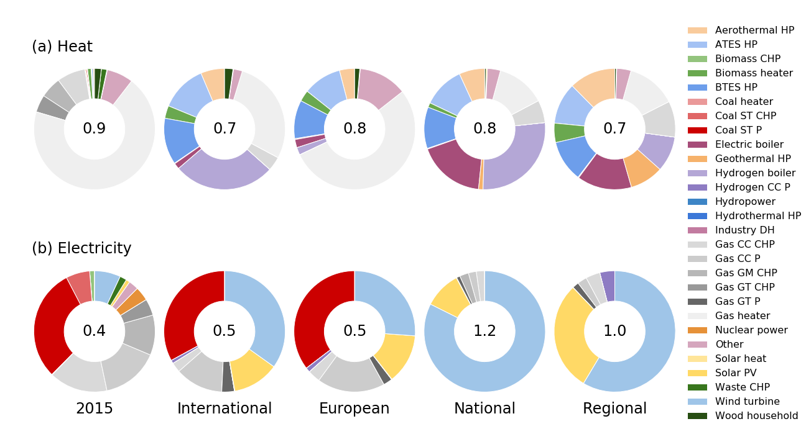
Energy scenarios for the Netherlands

Slide 5
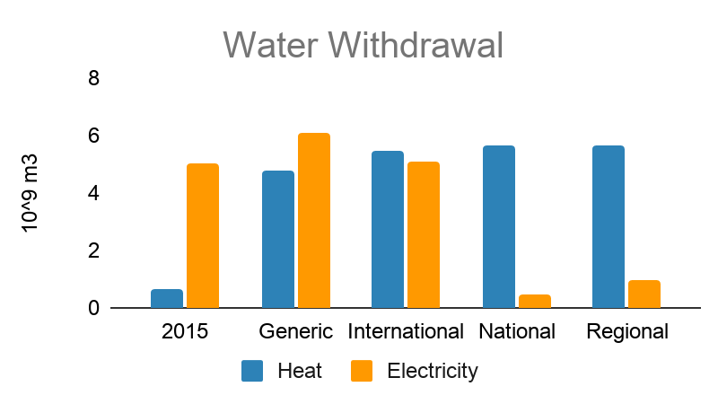

Slide 6
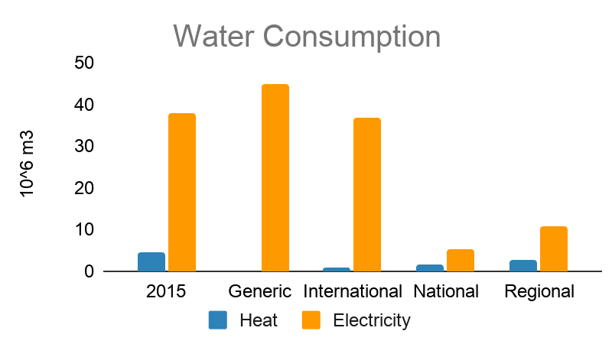

Slide 7
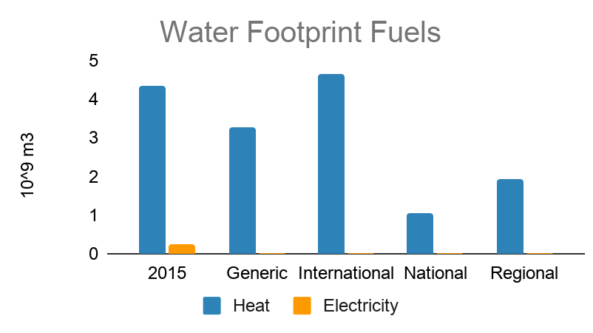

Slide 8
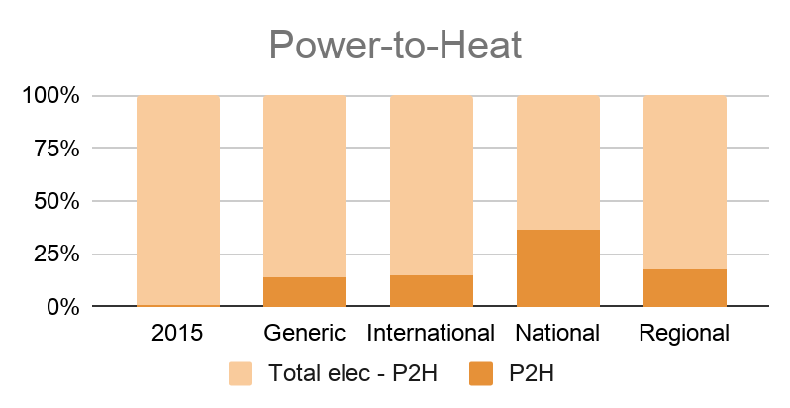

Slide 9
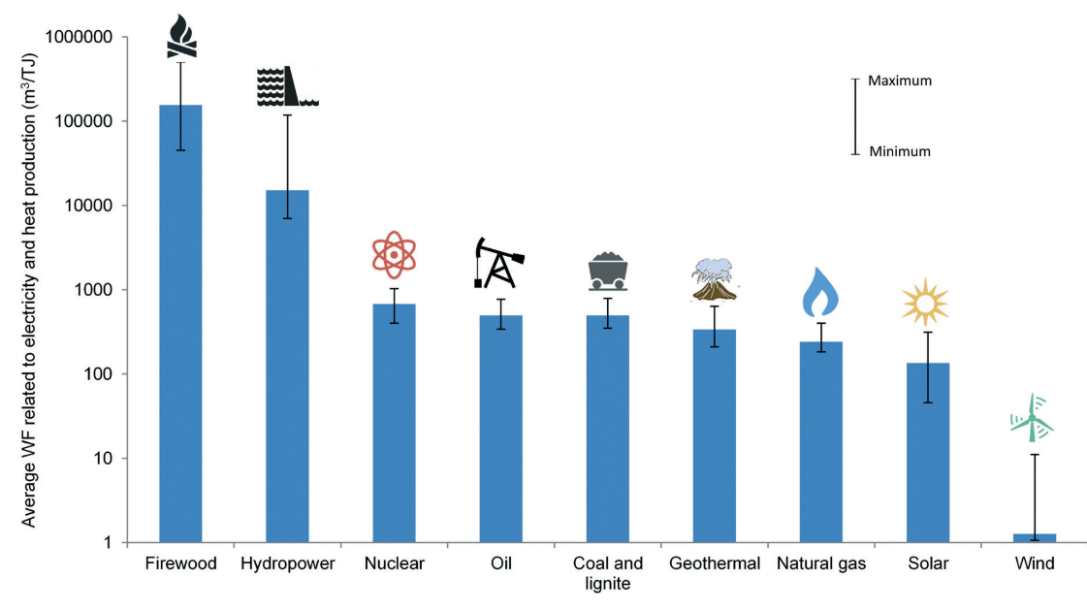
Maximum
Minimum
Mekonnen, Mesfin M, W. Gerbens-Leenes, and Arjen Y Hoekstra. 2015. “The Consumptive Water Footprint of Electricity and Heat: A Global Assessment.” Environmental Science: Water Research & Technology.

Slide 10
Carbon emission reduction potential of reliable heating systems

Slide 11
The carbon emission reduction potential of reliable heating system depends on...
Insulation levels
Heating system used
Greenhouse gas emissions for electricity production

