Slide 1










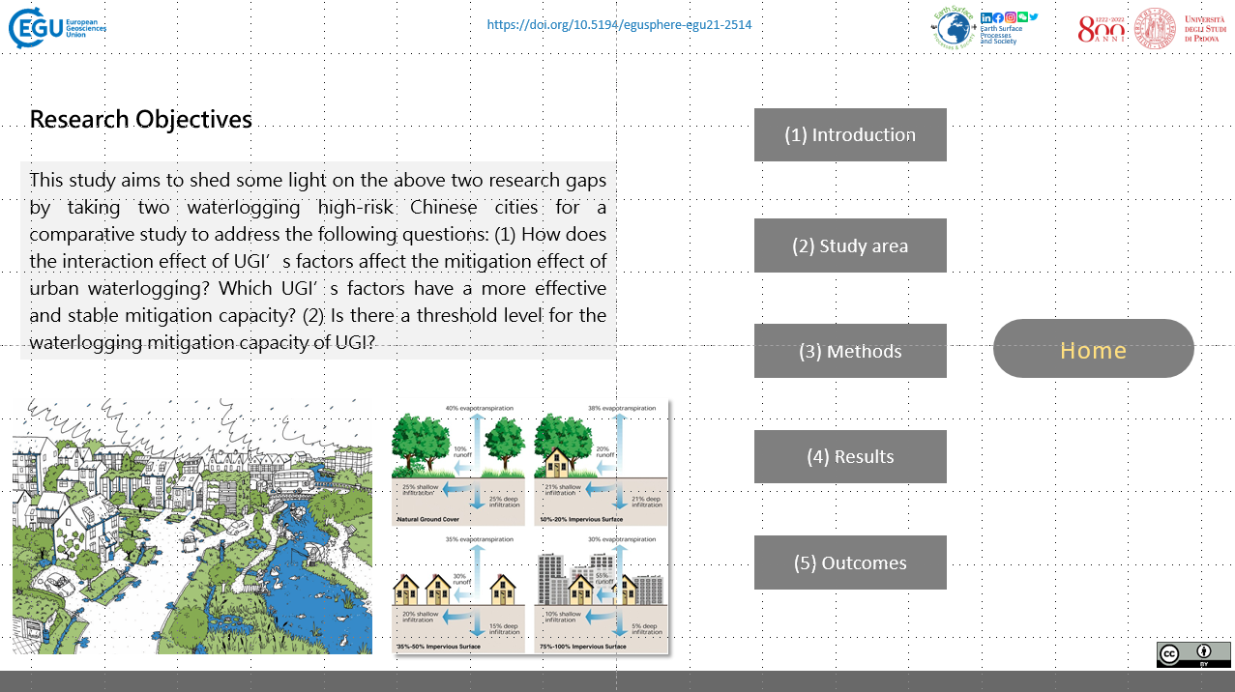
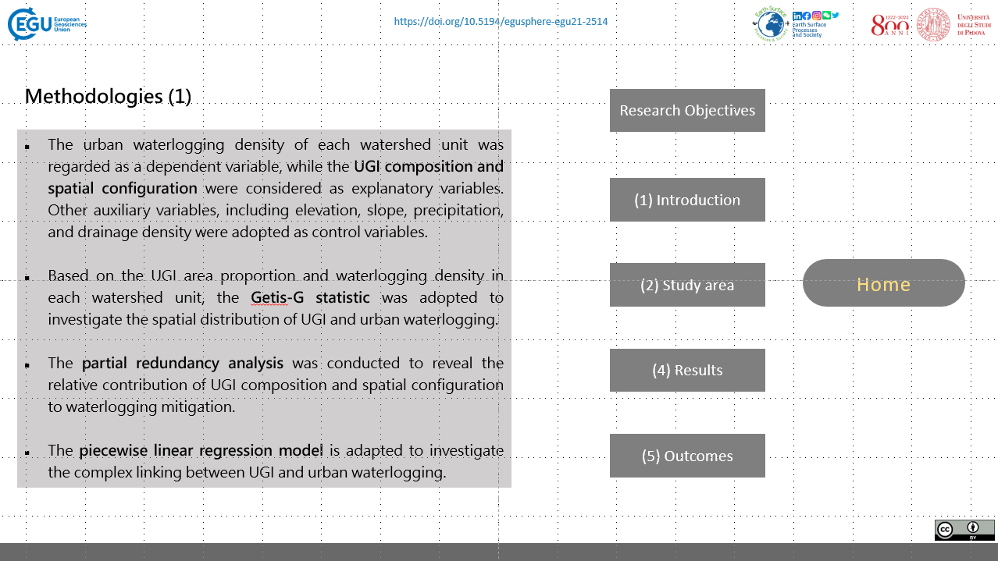
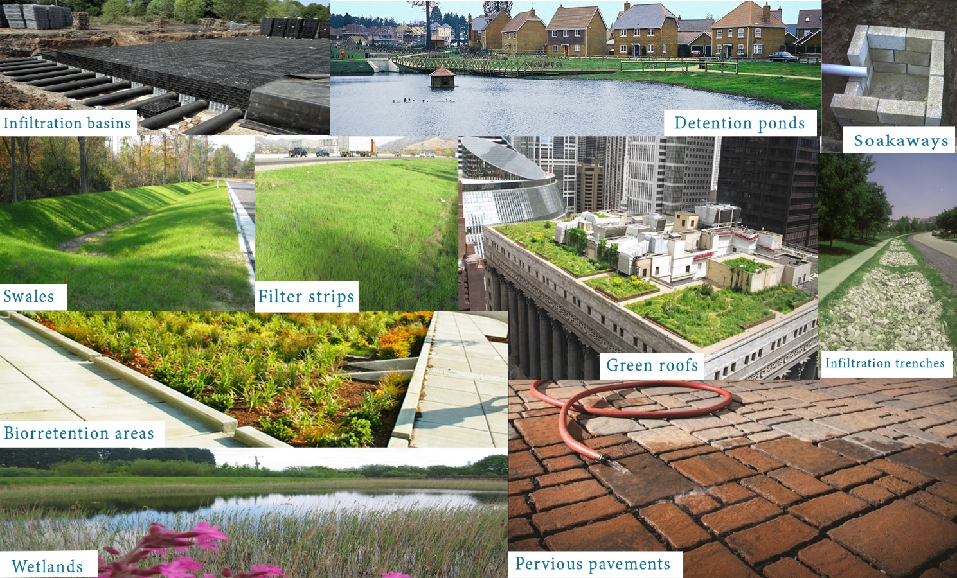
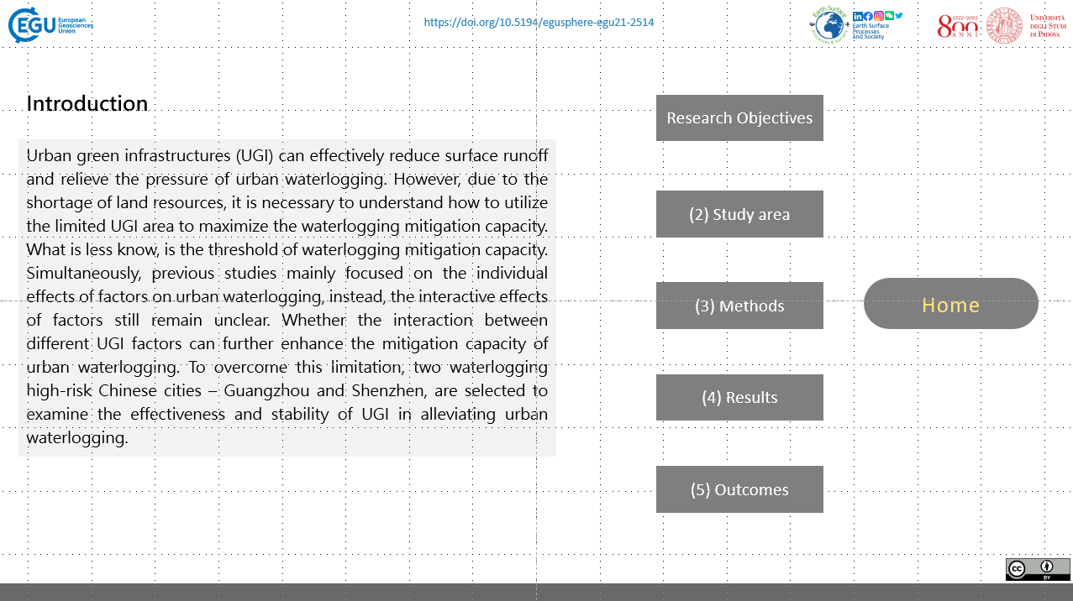
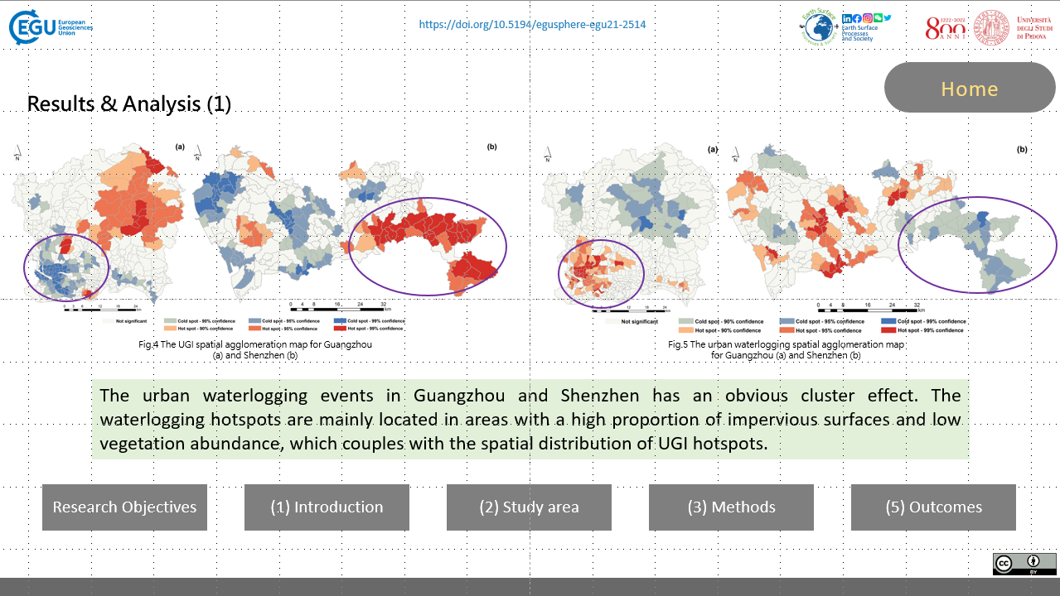
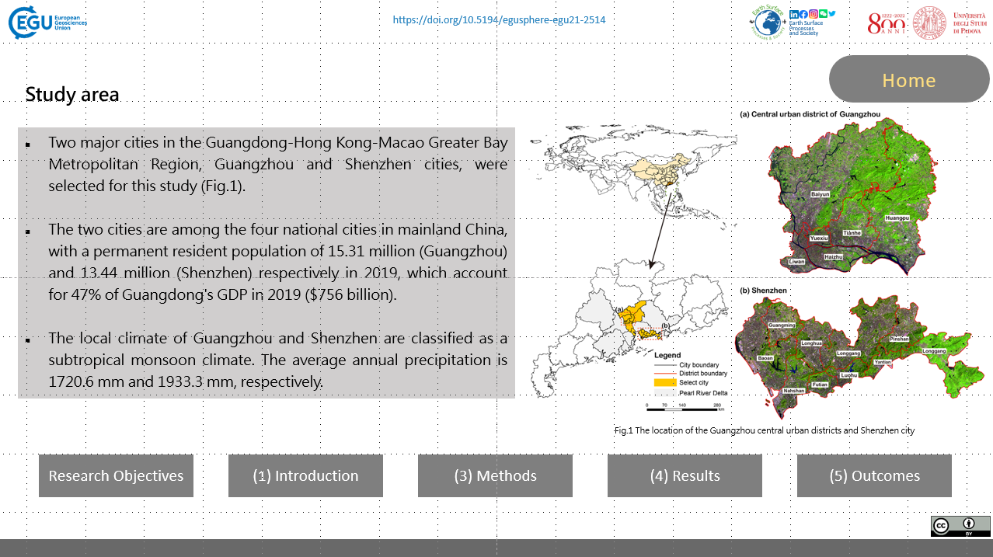
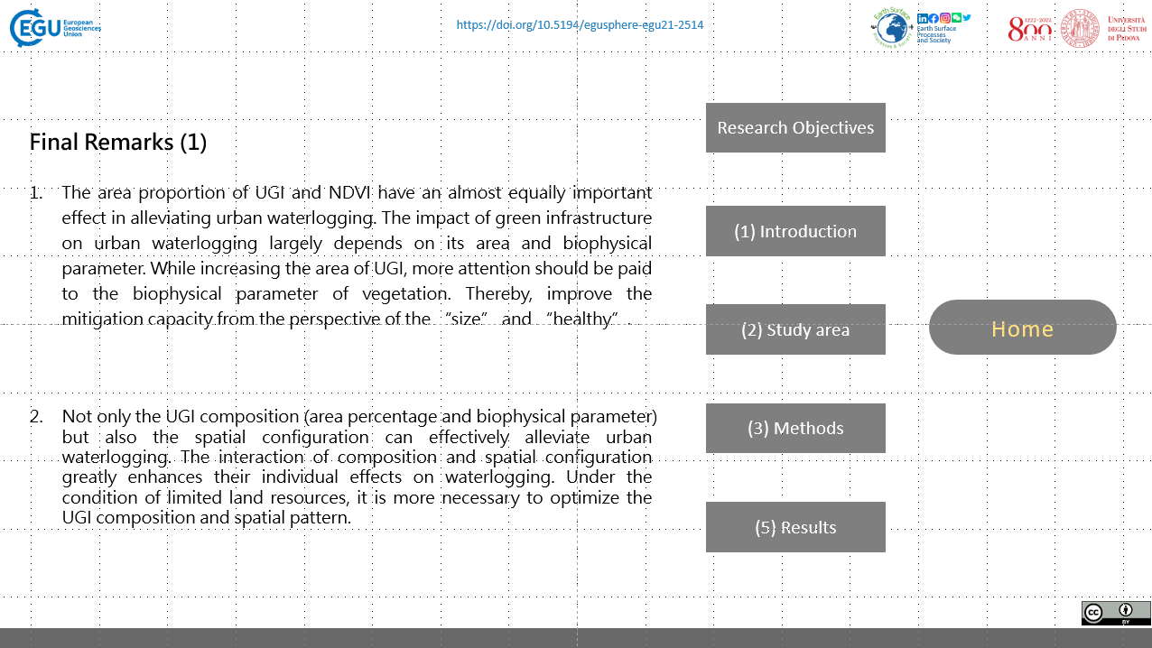
@EarthSurfS
The mitigation effect of urban green infrastructure (UGI) on urban waterlogging
Qifei Zhang¹, Zhifeng Wu², Paolo Tarolli¹
¹ University of Padova, Dept. of Land, Environment, Agriculture and Forestry, University of Padova, Agripolis, 35020 Legnaro (PD), Italy
² Guangzhou University, School of Geographical Sciences, Guangzhou University, 510006 Guangzhou (Guangdong), China
EGU21-2514
https://doi.org/10.5194/egusphere-egu21-2514
Research Objectives
(3) Methods
(1) Introduction
(4) Results
(2) Study area
(5) Outcomes

Slide 2






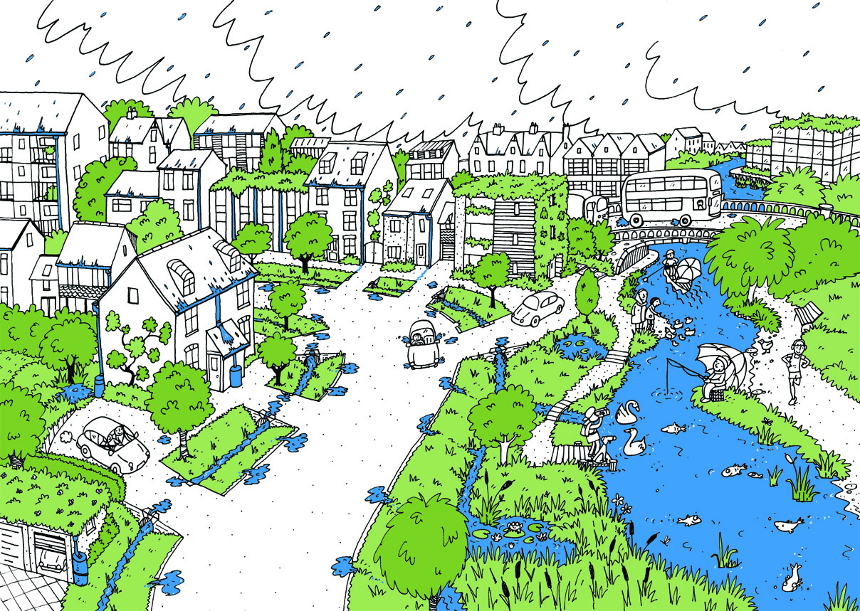
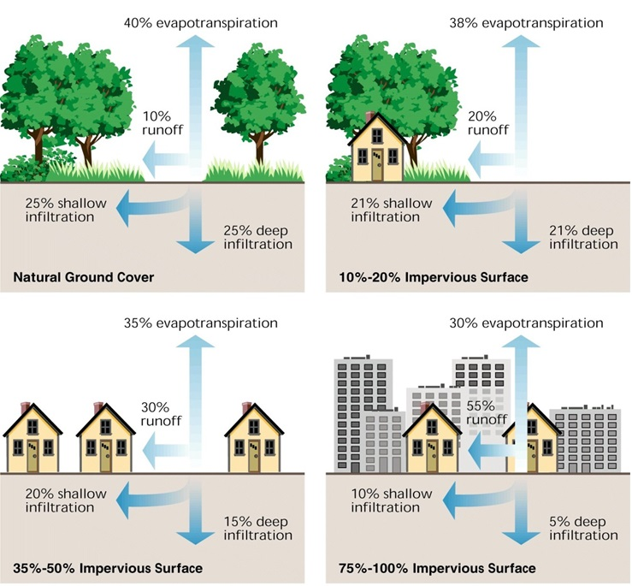
https://doi.org/10.5194/egusphere-egu21-2514
Earth Surface Processes
and Society
Research Objectives
(1) Introduction
This study aims to shed some light on the above two research gaps by taking two waterlogging high-risk Chinese cities for a comparative study to address the following questions: (1) How does the interaction effect of UGI’s factors affect the mitigation effect of urban waterlogging? Which UGI’s factors have a more effective and stable mitigation capacity? (2) Is there a threshold level for the waterlogging mitigation capacity of UGI?
(2) Study area
(3) Methods
Home
(4) Results
(5) Outcomes

Slide 3
https://doi.org/10.5194/egusphere-egu21-2514
Earth Surface Processes
and Society
Introduction
Research Objectives
Urban green infrastructures (UGI) can effectively reduce surface runoff and relieve the pressure of urban waterlogging (Dong et al., 2018; Pour et al., 2020). However, due to the shortage of land resources, it is necessary to understand how to utilize the limited UGI area to maximize the waterlogging mitigation capacity. What is less know, is the threshold of waterlogging mitigation capacity. Simultaneously, previous studies mainly focused on the individual effects of factors on urban waterlogging, instead, the interactive effects of factors still remain unclear. Whether the interaction between different UGI factors can further enhance the mitigation capacity of urban waterlogging. To overcome this limitation, two waterlogging high-risk Chinese cities – Guangzhou and Shenzhen, are selected to examine the effectiveness and stability of UGI in alleviating urban waterlogging.
(2) Study area
(3) Methods
Home
(4) Results
(5) Outcomes
Dong, W., Lian, Y., & Zhang, Y. (2018). Sustainable Development of Water Resources and Hydraulic Engineering in China Proceedings for the 2016 International Conference on Water Resource and Hydraulic Engineering.
Pour, S. H., Abd Wahab, A. K., Shahid, S., & Dewan, A. (2020). Low impact development techniques to mitigate the impacts of climate-change-induced urban floods: Current trends, issues and challenges. Sustainable Cities and Society, 102373.

Slide 4
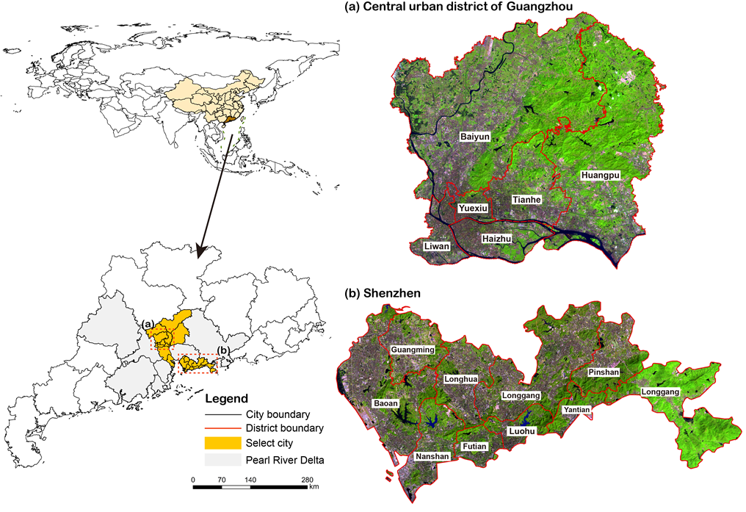
https://doi.org/10.5194/egusphere-egu21-2514
Earth Surface Processes
and Society
Home
Study area
Two major cities in the Guangdong-Hong Kong-Macao Greater Bay Metropolitan Region, Guangzhou and Shenzhen cities, were selected for this study (Fig.1).
The two cities are among the four national cities in mainland China, with a permanent resident population of 15.31 million (Guangzhou) and 13.44 million (Shenzhen) respectively in 2019, which account for 47% of Guangdong's GDP in 2019 ($756 billion).
The local climate of Guangzhou and Shenzhen are classified as a subtropical monsoon climate. The average annual precipitation is 1720.6 mm and 1933.3 mm, respectively.
Fig.1 The location of the Guangzhou central urban districts and Shenzhen city
Research Objectives
(1) Introduction
(3) Methods
(4) Results
(5) Outcomes

Slide 5

https://doi.org/10.5194/egusphere-egu21-2514
Earth Surface Processes
and Society
Methodologies (1)
Research Objectives
The urban waterlogging density of each watershed unit was regarded as a dependent variable, while the UGI composition and spatial configuration were considered as explanatory variables. Other auxiliary variables, including elevation, slope, precipitation, and drainage density were adopted as control variables.
Based on the UGI area proportion and waterlogging density in each watershed unit, the Getis-G statistic was adopted to investigate the spatial distribution of UGI and urban waterlogging.
The partial redundancy analysis was conducted to reveal the relative contribution of UGI composition and spatial configuration to waterlogging mitigation.
The piecewise linear regression model is adapted to investigate the complex linking between UGI and urban waterlogging.
(1) Introduction
(2) Study area
Home
(4) Results
(5) Outcomes

Slide 6
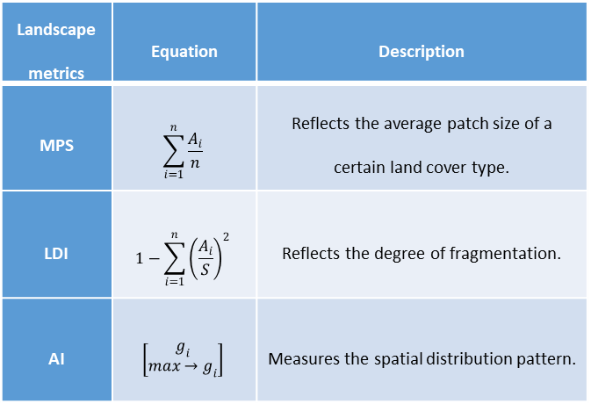
https://doi.org/10.5194/egusphere-egu21-2514
Earth Surface Processes
and Society
Home
Methodologies (2)
Table 1 List of landscape pattern metrics
Landscape metrics | Equation | Description
MPS | $$\sum_{i=1}^{n}{\frac{A_{i}}{n}}$$ | Reflects the average patch size of a certain land cover type.
LDI | $$1−\sum_{i=1}^{n}{{\left(\frac{A_{i}}{S}\right)}^{2}}$$ | Reflects the degree of fragmentation.
AI | $$\left[\begin{matrix}g_{i} \\ max→g_{i}\end{matrix}\right]$$ | Measures the spatial distribution pattern.
Research Objectives
(1) Introduction
(2) Study area
Fig.2 The land cover maps and UGI maps for Guangzhou and Shenzhen
(4) Results
(5) Outcomes
Fig.4 The spatial distribution of urban waterlogging events and watershed units for Guangzhou and Shenzhen
Fig.3 The NDVI for Guangzhou and Shenzhen

Slide 7
https://doi.org/10.5194/egusphere-egu21-2514
Earth Surface Processes
and Society
Home
Results & Analysis (1)
Fig.5 The UGI spatial agglomeration map for Guangzhou (a) and Shenzhen (b)
Fig.6 The urban waterlogging spatial agglomeration map for Guangzhou (a) and Shenzhen (b)
The urban waterlogging events in Guangzhou and Shenzhen has an obvious cluster effect. The waterlogging hotspots are mainly located in areas with a high proportion of impervious surfaces and low vegetation abundance, which couples with the spatial distribution of UGI hotspots.
Research Objectives
(1) Introduction
(2) Study area
(3) Methods
(5) Outcomes

Slide 8
https://doi.org/10.5194/egusphere-egu21-2514
Earth Surface Processes
and Society
Home
Results & Analysis (2)
First, the UGI composition (area proportion and NDVI) in both cities show the strongest impact on waterlogging, which both have an explanatory power of over 30%. The result indicates that the proportion of UGI and NDVI has an almost equally important effect in alleviating urban waterlogging.
However, the individual effect of UGI spatial configuration on waterlogging is relatively small. The PD values for MPS in Guangzhou and Shenzhen are 0.142 and 0.171 respectively, while the other spatial conformation indices (LDI and AI) are even smaller. It hints that urban waterlogging is mainly affected by UGI area proportion and NDVI, rather than the spatial configuration.
Fig.7 The relative contribution of UGI factors in different cities
Research Objectives
(1) Introduction
(2) Study area
(3) Methods
(5) Outcomes

Slide 9
https://doi.org/10.5194/egusphere-egu21-2514
Earth Surface Processes
and Society
Home
Results & Analysis (3)
The results indicate that the interaction of UGI factors greatly enhances their individual effects on waterlogging. In these 10 pairs of interactions, all the factors have strong binary enhancement, and some even show a non-linear enhancement. Both in Guangzhou and Shenzhen, the largest interaction is UGI area proportion interacting with NDVI, followed by NDVI interacting with MPS. This illustrates the importance of the interaction between the UGI area and its biophysical parameter (reflect vegetation healthy and density).
These results underscore the importance of the combination of UGI composition (area proportion and NDVI) and spatial configuration. On the basis of a certain percentage of UGI, the interaction of UGI composition and configuration can further enhance its impact on urban waterlogging, which has important implications for the metropolis with a shortage of urban land resources.
Table 2 The interactive detector results of UGI factors in different cities
Guangzhou city |  |  | Shenzhen city
Factor | Interactive PD | Enhancement | Factor | Interactive PD | Enhancement
PD (UGI∩NDVI) | 0.525 | Binary | PD (UGI∩NDVI) | 0.557 | Binary
PD (UGI∩MPS) | 0.446 | Binary | PD (UGI∩MPS) | 0.483 | Binary
PD (UGI∩LDI) | 0.424 | Binary | PD (UGI∩LDI) | 0.442 | Binary
PD (UGI∩AI) | 0.405 | Binary | PD (UGI∩AI) | 0.439 | Binary
PD (NDVI∩MPS) | 0.474 | Nonlinear | PD (NDVI∩MPS) | 0.505 | Nonlinear
PD (NDVI∩LDI) | 0.362 | Binary | PD (NDVI∩LDI) | 0.407 | Binary
PD (NDVI∩AI) | 0.311 | Binary | PD (NDVI∩AI) | 0.374 | Binary
PD (MPS∩LDI) | 0.252 | Binary | PD (MPS∩LDI) | 0.308 | Nonlinear
PD (MPS∩AI) | 0.267 | Nonlinear | PD (MPS∩AI) | 0.289 | Nonlinear
PD (LDI∩AI) | 0.238 | Nonlinear | PD (LDI∩AI) | 0.231 | Nonlinear
Research Objectives
(1) Introduction
(2) Study area
(3) Methods
(5) Outcomes

Slide 10
https://doi.org/10.5194/egusphere-egu21-2514
Earth Surface Processes
and Society
Home
Results & Analysis (4)
The effect of UGI on urban waterlogging is nonlinear and contains a threshold. In Guangzhou, the NDVI present a strong negative linear relationship only when the NDVI value is greater than 0.06 (Fig.8a). When the NDVI value is less than 0.06, there is no longer a linear relationship between NDVI and urban waterlogging.
This result suggests that sparse vegetation is difficult to play an active role in alleviating urban waterlogging.
Fig.8 The relationship between UGI variables and waterlogging for Guangzhou (a~f) and Shenzhen (g~l).
The blue line indicates the nonlinear fitting curve, the red line indicates the piecewise linear fitting curve in the intervals (orange).
Research Objectives
(1) Introduction
(2) Study area
(3) Methods
(5) Outcomes

Slide 11
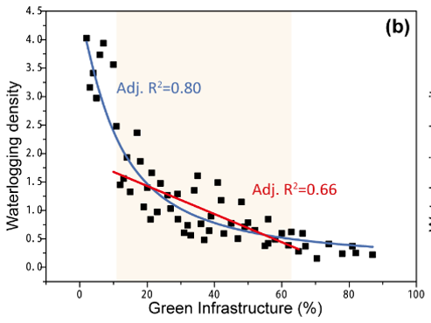
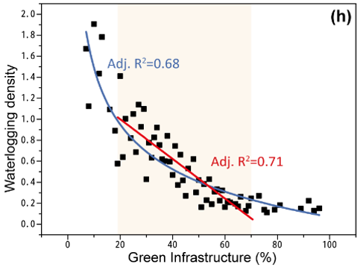
https://doi.org/10.5194/egusphere-egu21-2514
Earth Surface Processes
and Society
Home
Results & Analysis (5)
As for UGI area proportion (Fig.8b), with the increase of UGI proportion, the decreasing trend of urban waterlogging is gradually gentle. Therefore, it can be inferred that the proportion of UGI needs to be maintained at a certain proportion (exceed lower threshold) in order to effectively exert its waterlogging mitigation effect.
lower threshold
upper threshold
lower threshold
upper threshold
UGI proportion
UGI proportion
Research Objectives
(1) Introduction
(2) Study area
(3) Methods
(5) Outcomes

Slide 12
https://doi.org/10.5194/egusphere-egu21-2514
Earth Surface Processes
and Society
Home
Results & Analysis (6)
lower threshold
upper threshold
lower threshold
upper threshold
If the proportion of UGI is lower than the lower threshold, it is difficult to effectively alleviate urban waterlogging magnitude; whereas when it exceeds the upper threshold, the mitigation effect is no longer enhanced with the increase of the UGI proportion.
UGI proportion
UGI proportion
Research Objectives
(1) Introduction
(2) Study area
(3) Methods
(5) Outcomes

Slide 13
https://doi.org/10.5194/egusphere-egu21-2514
Earth Surface Processes
and Society
Research Objectives
Final Remarks (1)
The area proportion of UGI and NDVI have an almost equally important effect in alleviating urban waterlogging. The impact of green infrastructure on urban waterlogging largely depends on its area and biophysical parameter. While increasing the area of UGI, more attention should be paid to the biophysical parameter of vegetation. Thereby, improve the mitigation capacity from the perspective of the “size” and “healthy”.
(1) Introduction
(2) Study area
Home
Not only the UGI composition (area percentage and biophysical parameter) but also the spatial configuration can effectively alleviate urban waterlogging. The interaction of composition and spatial configuration greatly enhances their individual effects on waterlogging. Under the condition of limited land resources, it is more necessary to optimize the UGI composition and spatial pattern.
(3) Methods
(5) Results

Slide 14
https://doi.org/10.5194/egusphere-egu21-2514
Earth Surface Processes
and Society
Research Objectives
Final Remarks (2)
The waterlogging mitigation effect presents a threshold phenomenon. An oversized UGI is not conducive to its mitigation capacity. Therefore, it is necessary to control the UGI area within a certain range to play a corresponding role in mitigating urban waterlogging. Since the threshold values of some UGI indicators (area proportion, MPS) are different among cities, which indicates that the thresholds are disturbed by regional characteristics. Therefore, the UGI-based waterlogging prevention strategies should be adapted to local conditions.
(1) Introduction
(2) Study area
Home
(3) Methods
(5) Results

