Slide 1

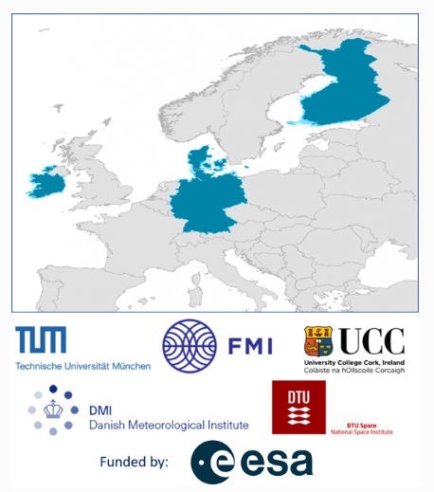









Absolute Baltic Sea Level Trends in the Satellite Altimetry Era: A Revisit
Julius Oelsmann¹, Marcello Passaro¹, Felix L. Müller¹, Laura Rautiainen³, Denise Dettmering¹, Michael G. Hart-Davis¹, Adili Abulaitijiang⁷, Ole B. Andersen⁷, Jacob L. Høyer² , Kristine S. Madsen²,,
Ida M. Ringgaard², Jani Särkkä³, Rory Scarrott⁴, Christian Schwatke¹, Florian Seitz¹, Laura Tuomi³, Marco Restano⁵, Jérôme Benveniste⁶
¹ Deutsches Geodätisches Forschungsinstitut, Technische Universität München (DGFI-TUM), Germany
² Danish Meteorological Institute (DMI), Denmark
³ Finnish Meteorological Institute (FMI), Finland
⁴ Department of Geography, MaREI Centre, Environmental Research Institute,University College Cork
⁵ SERCO/ESRIN, Largo Galileo Galilei, I-00044 Frascati, Italy
⁶ European Space Agency-ESRIN, Largo Galileo Galilei, I-00044 Frascati, Italy
⁷ Danish technical University
Session - CL2.12
Climate change and other drivers of environmental change: Developments, interlinkages and impacts in regional seas and coastal regions.
Contact – julius.oelsmann@tum.de

Slide 2
Table of content
Project overview: Motivation and key development steps
Analysis of Baltic absolute sea level variability and trends in the satellite altimetry era
Additional project output and developments
  A new regional mean sea surface
  An experimental high temporal resolution grid
The way forward

Slide 3
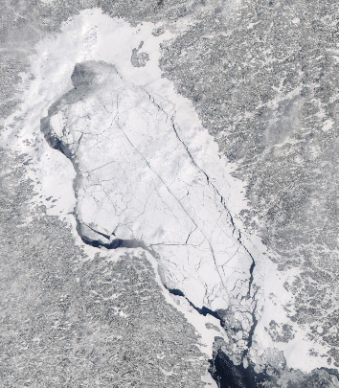
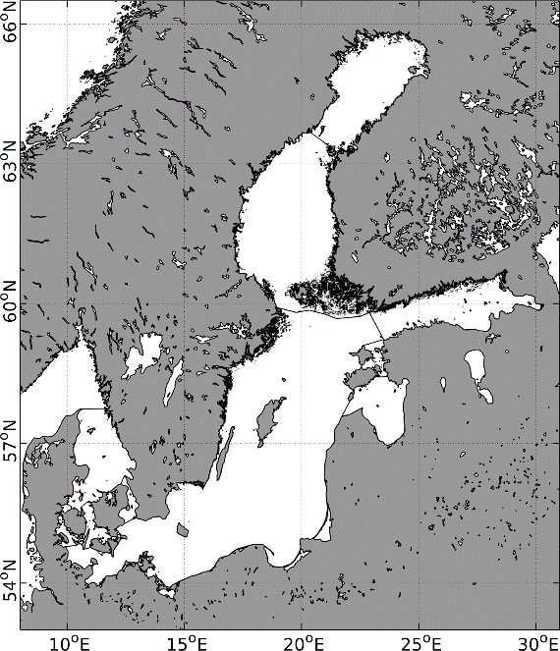
Why the Baltic Sea
Previous sea-level products do not include information from the sea-ice covered surface and from the coastal zone
Ideal test environment for developing advanced sea-level products
Complex coastlines
Seasonal sea-ice formation
High abundance of in-situ observations and long data records
Improvements in retracking solutions (closer to the coast), geophysical corrections etc.
Aim:
Generation of novel long-term multi-mission along-track and gridded sea level products (monthly SL, mean sea surface, sea level trends )
© Modis (NASA Worldview)
© Sentinel-2 (Copernicus)

Slide 4
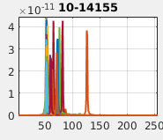
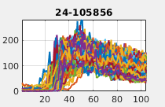
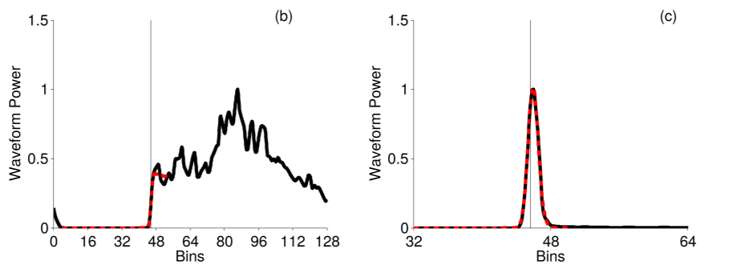
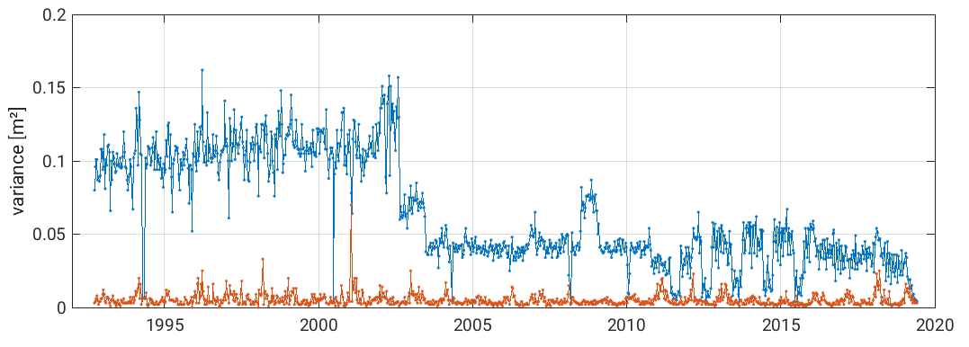
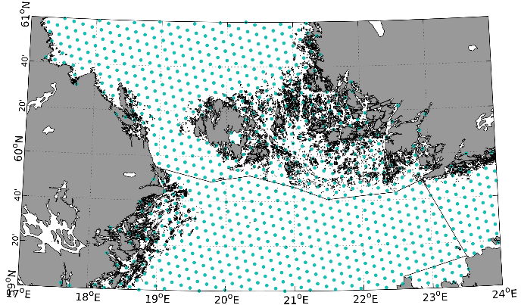
Baltic+ SEAL – Algorithm Development Challenges
UNSUPERVISED WAVEFORM CLASSIFICATION
WAVEFORM RETRACKING
before MMXO
after MMXO
MULTIMISSION CROSSCALIBRATION
GRIDDING
Unstructured grid

Slide 5
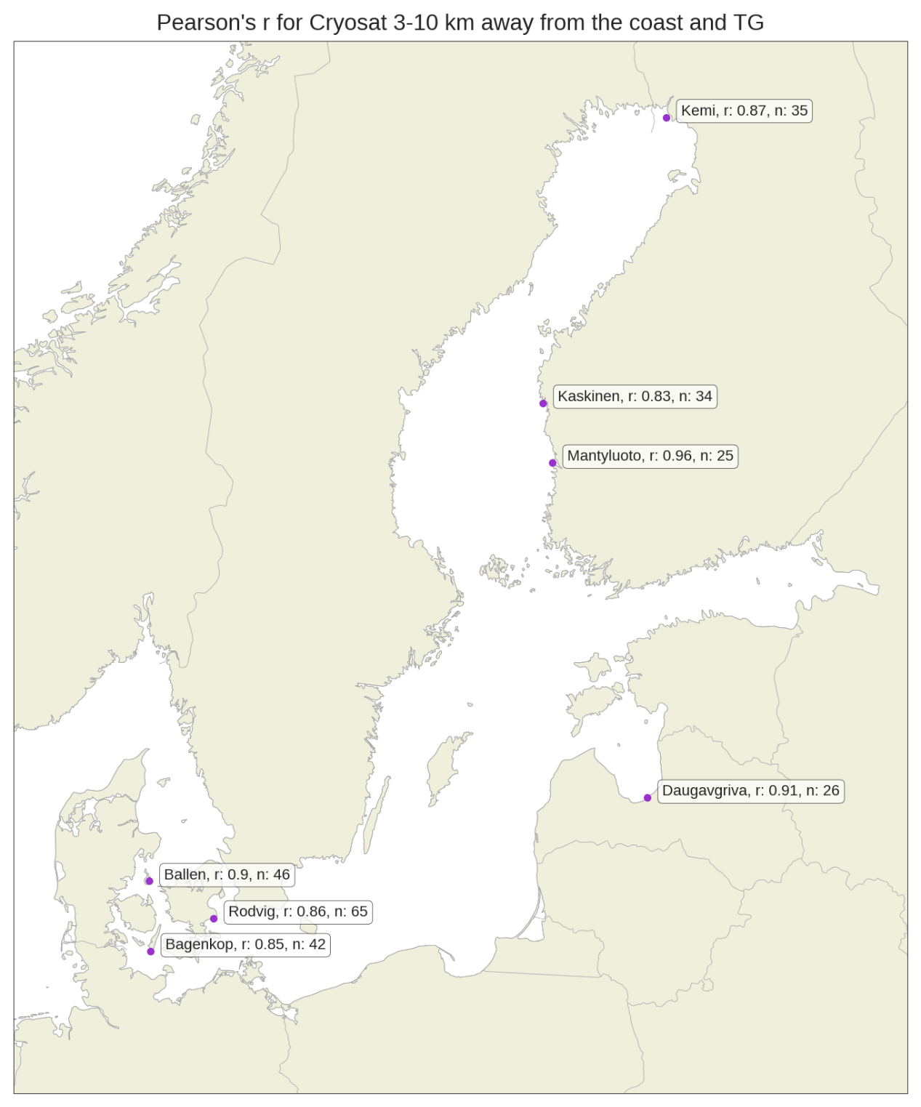
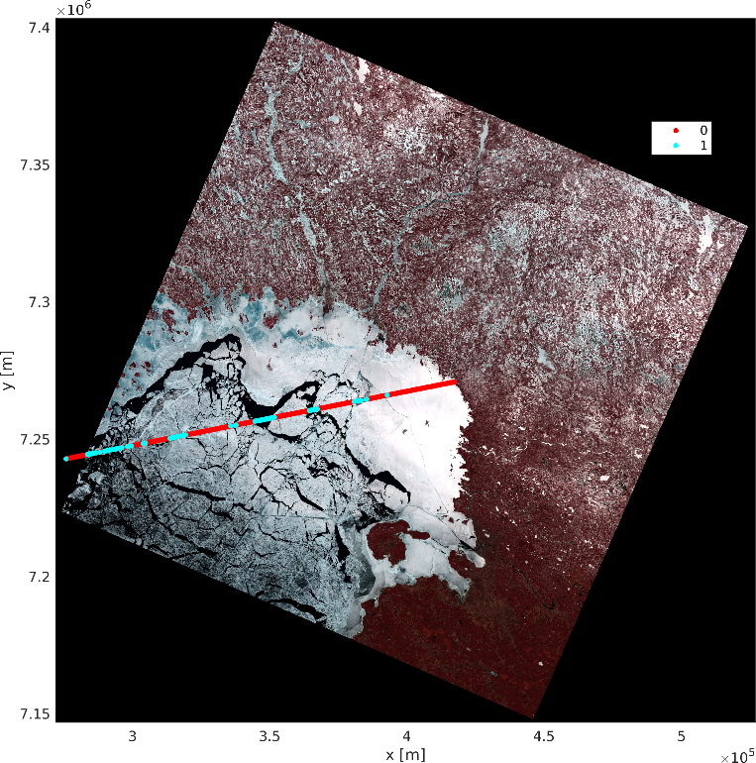
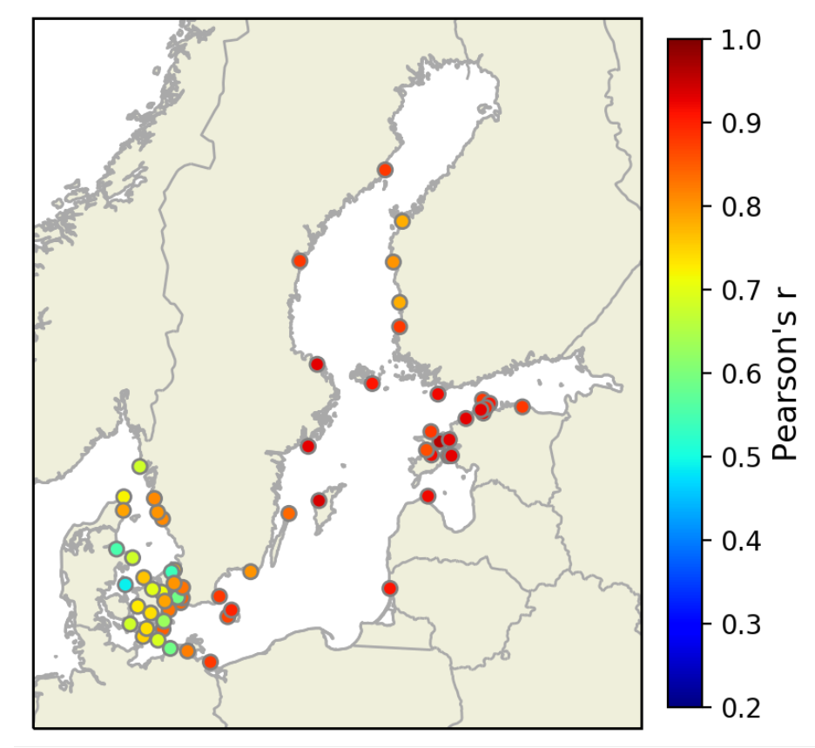
Baltic+ SEAL – Validation Steps
More info: Müller F.L et al.: Monitoring the Arctic Seas: How Satellite Altimetry Can Be Used to Detect Open Water in Sea-Ice Regions. Remote Sensing, 9(6), 551, 10.3390/rs9060551, 2017c
Validation of classification with SAR and Optical images
Validation of sea level products through tide gauges

Slide 6
Table of content
Project overview: Motivation and key development steps
Analysis of Baltic absolute sea level variability and trends in the satellite altimetry era
Additional project output and developments
  A new regional mean sea surface
  An experimental high temporal resolution grid
The way forward

Slide 7
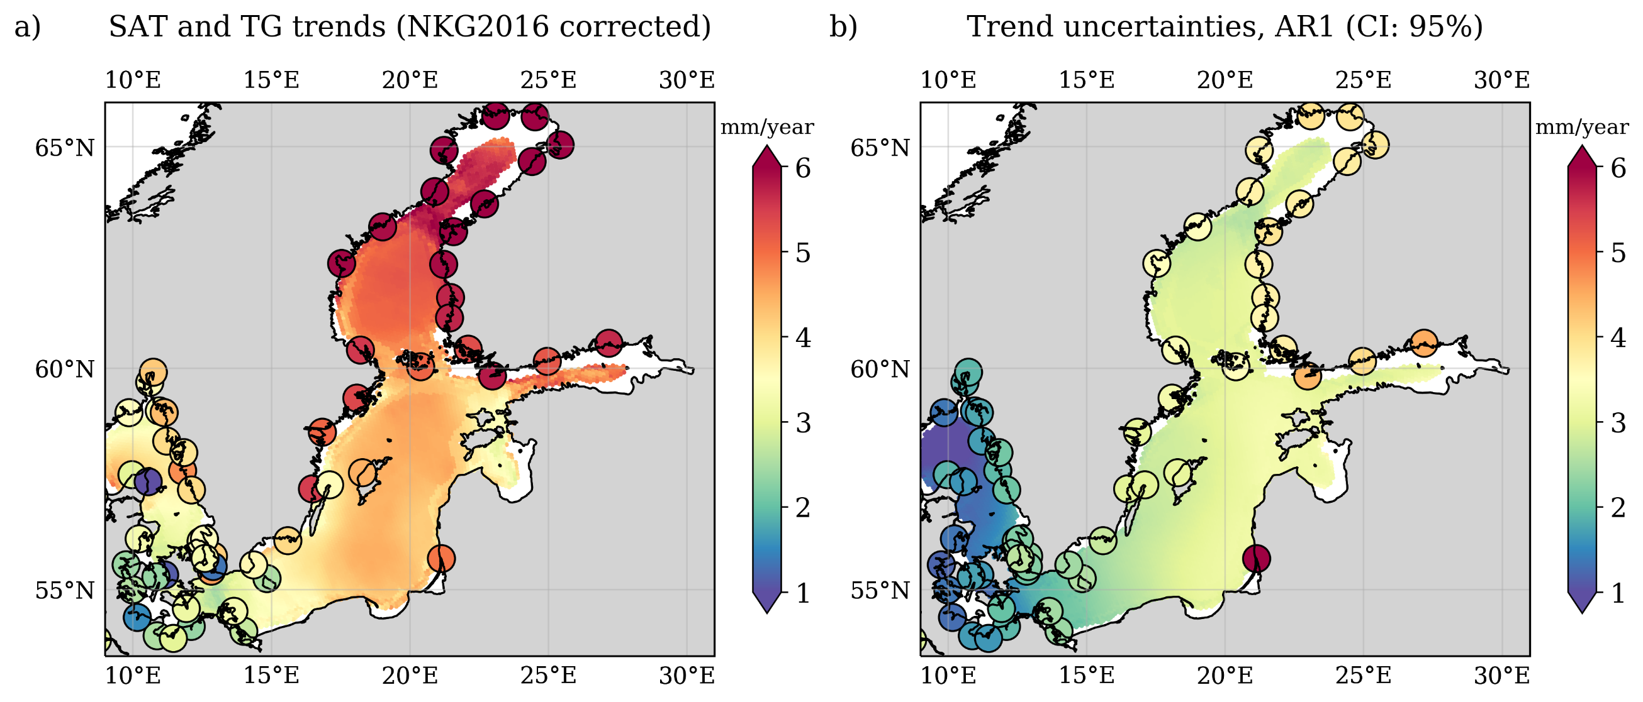
Absolute Baltic Sea Level Trends in the Satellite Altimetry Era:
A Revisit
Mean Trend: 4.27 ± 3.58 mm/year (during 1995-2019)

Slide 8
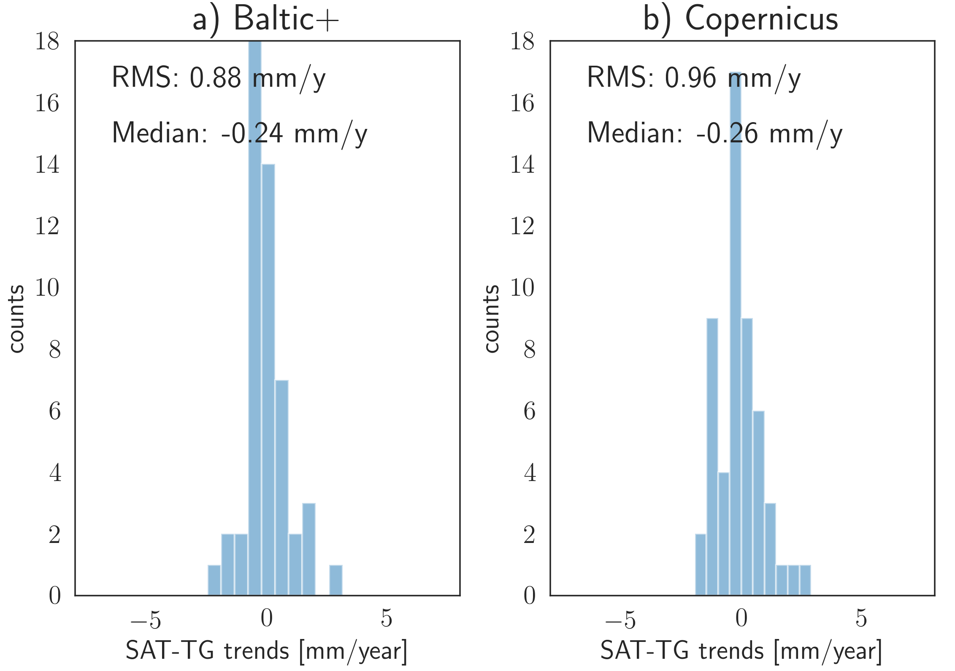
Absolute Baltic Sea Level Trends in the Satellite Altimetry Era:
A Revisit
Higher agreement of SL trends with TGs for Baltic SEAL compared to alternative products
Better trend estimation substantiates the increased coastal performance as well as the reliability of data in sea-ice affected regions
53 Tide gauges (Holgate et al., 2013; PSMSL, 2020) used to compare absolute sea level trends are corrected for DAC (Carrère and Lyard, 2003) and vertical land motions (NKG2016LU, Vestøl et al., 2019); Gridded products CMEMS, http://marine.copernicus.eu,

Slide 9
Absolute Baltic Sea Level Trends in the Satellite Altimetry Era:
A Revisit
What causes the spatial variations in absolute sea level trends in the altimetry era (in particular the pronounced SW-NE trend gradient)?
What are the underlying dynamics and driver of the spatio-temporal monthly and interannual SL variations?
Investigations on the influence of atmospheric forcing on Baltic SL
Mean Trend: 4.27 ± 3.58 mm/year (during 1995-2019)

Slide 10
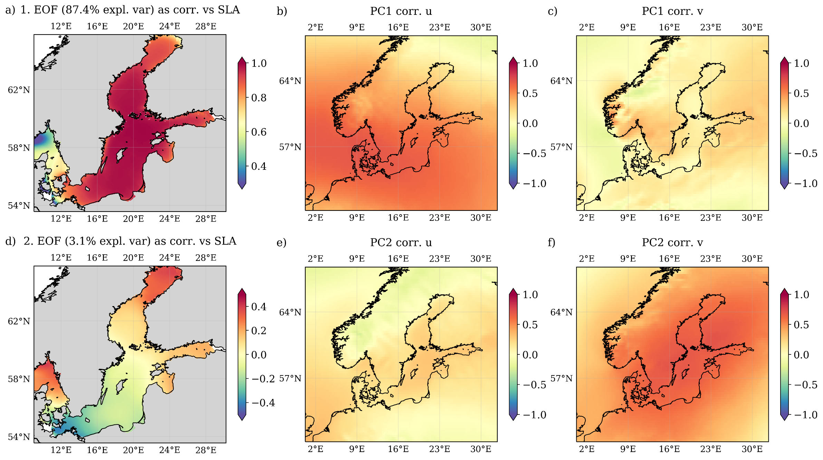
The Major Modes of Baltic Sea Level Variability
Identification of major modes of SL variability by Empirical orthogonal functions (EOFs) of deseasoned and detrended monthly Baltic SLAs
1. and 2. EOF explain together more than 90% of the observed variance
1. PC is homogeneously correlated with SLAs over the full domain
2. PC is associated with anticorrelated SLAs in the SW and NE of the domain

Slide 11
The Major Modes of Baltic Sea Level Variability
Point-wise correlations of principal components with surface winds
Zonal surface wind variations (u) are most strongly correlated to the first mode
Meridional winds (v) drive the second mode
Atmospheric data are from ERA5

Slide 12
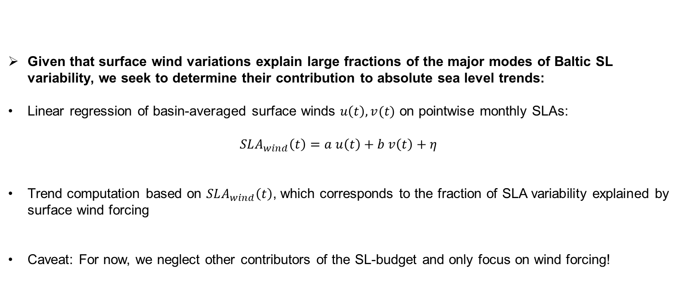
The impact of surface winds on sea level trends
Given that surface wind variations explain large fractions of the major modes of Baltic SL variability, we seek to determine their contribution to absolute sea level trends:
Linear regression of basin-averaged surface winds $u\left(t\right),v(t)$ on pointwise monthly SLAs:
$SLA_{wind}\left(t\right)=a u\left(t\right)+b v\left(t\right)+η$
Trend computation based on $SLA_{wind}\left(t\right)$, which corresponds to the fraction of SLA variability explained by surface wind forcing
Caveat: For now, we neglect other contributors of the SL-budget and only focus on wind forcing!

Slide 13
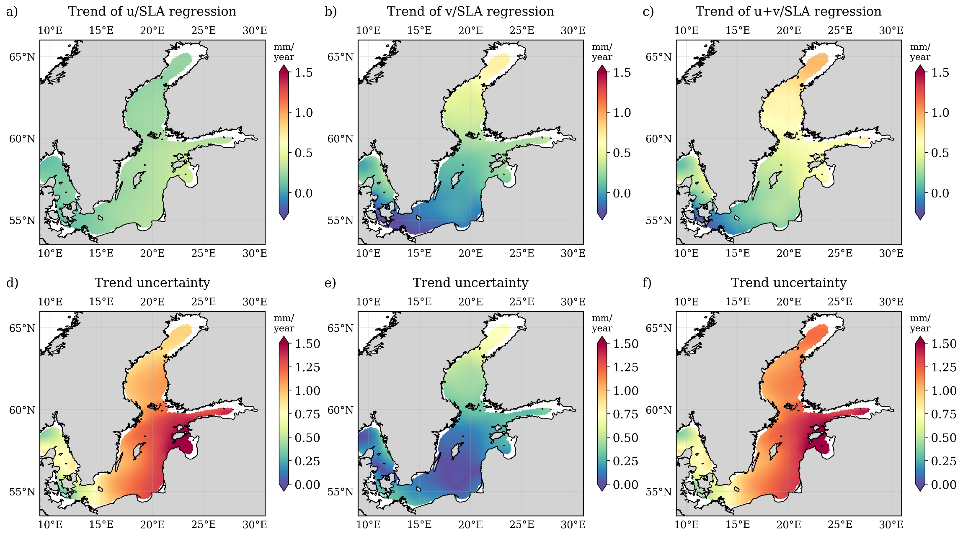
The impact of surface winds on sea level trends
Trends (+ uncertainties) of regressions of u- and v-wind anomalies on SLAs
Strengthening southerly winds during (1995-2019) explain a fraction (~1 mm/year) of the observed (SW-NE) trend gradient over the domain
How do the surface winds impact on SL?
Trend explained by:
Zonal wind component
Meridional wind component
Combined surface winds

Slide 14
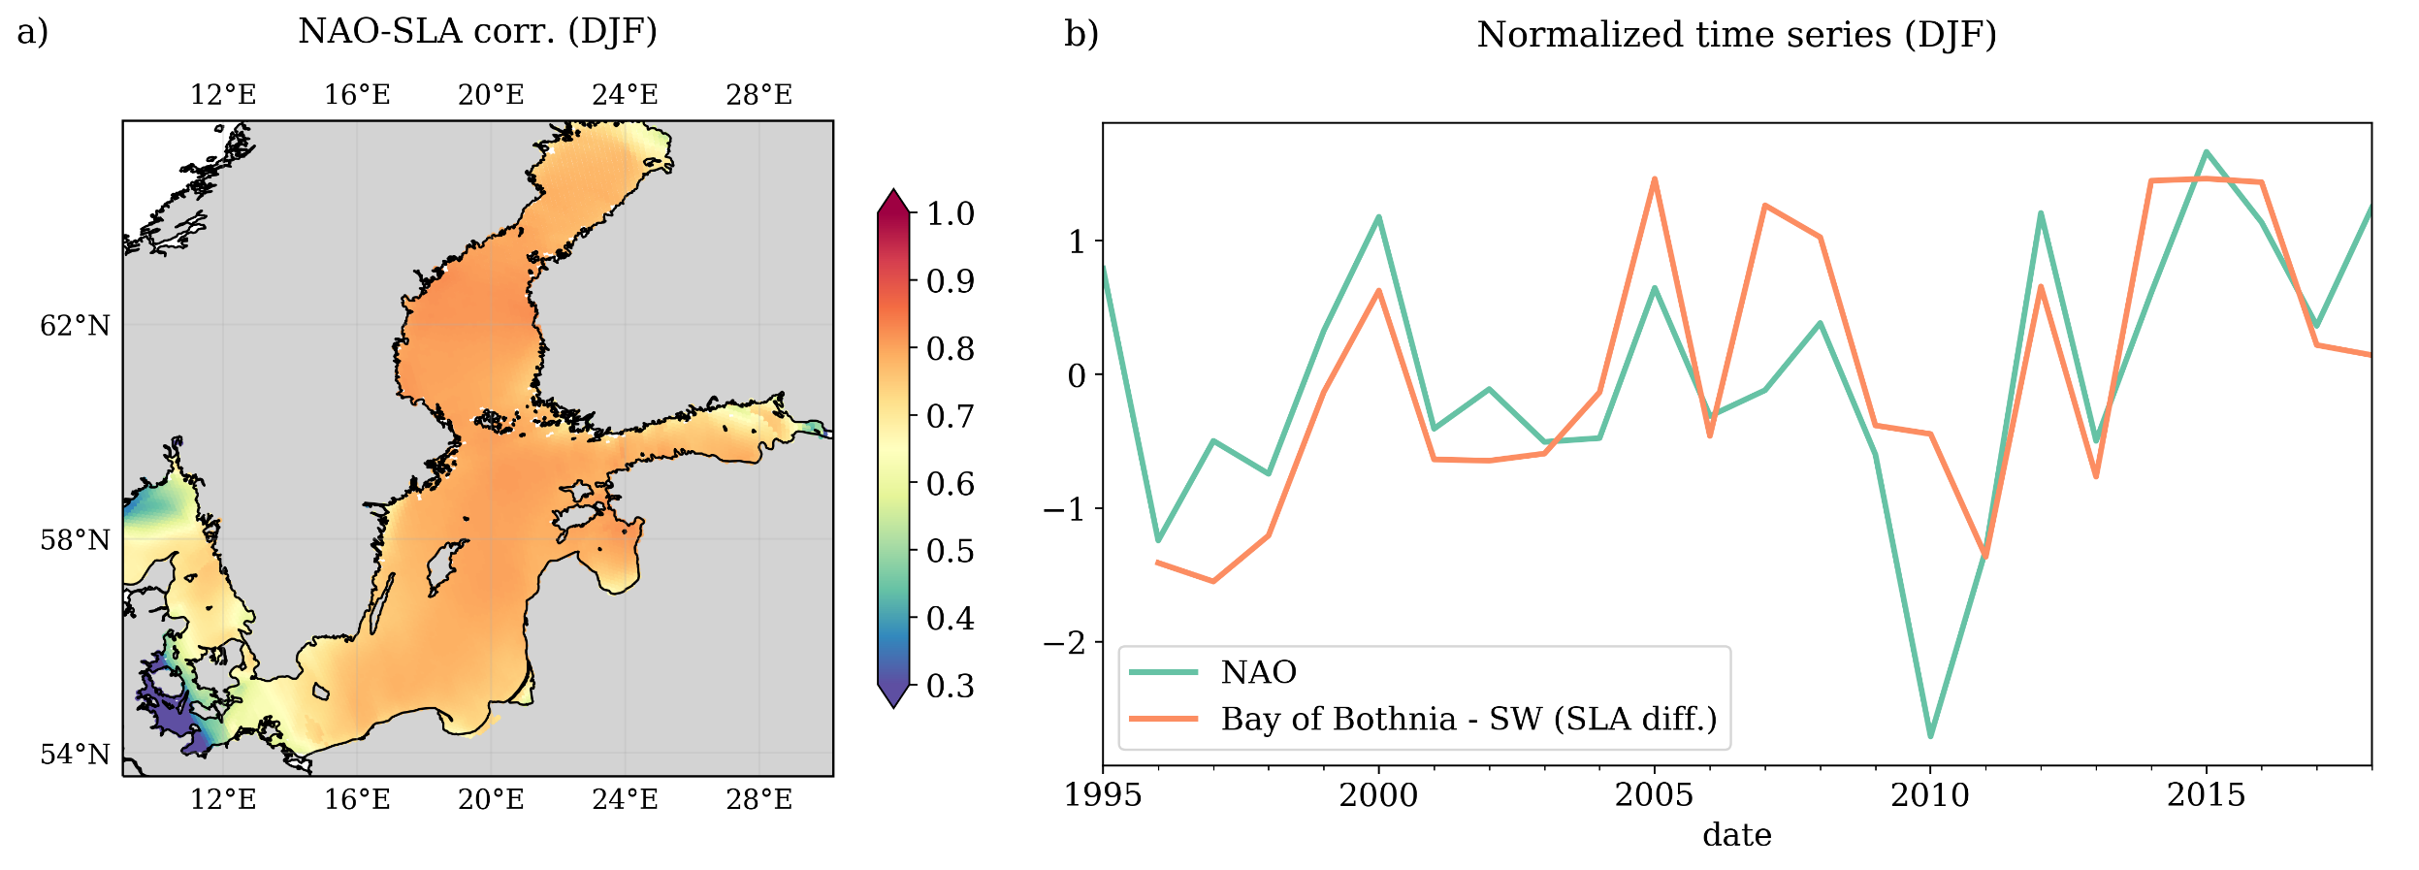
The role of the NAO in shaping Baltic SL-variability (winter season)
Bay of Bothnia
S-W
(see also e.g. Jevrejeva et al. 2005; Hünicke and Zorita 2006;
Karabil et al. 2018; Gräwe et al. 2019)
Correlation of NAO with differences of SLAs averaged over the Bay of Bothnia and the SW is 0.7

Slide 15
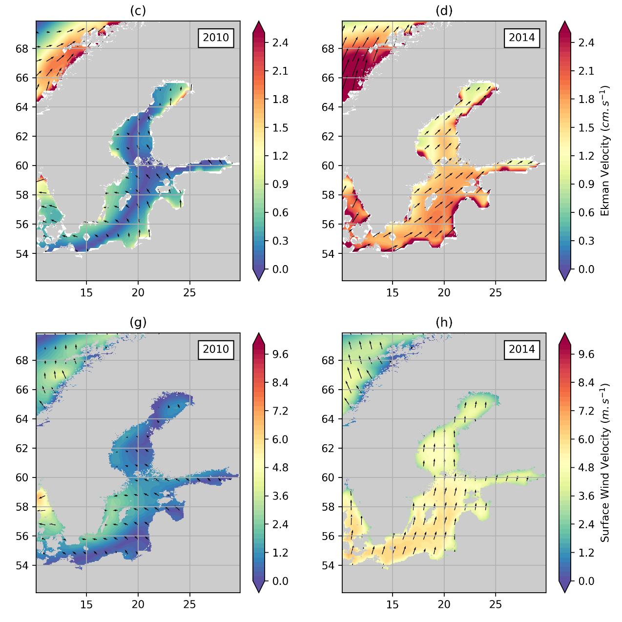

NAO+: Southerly winds + stronger ekman transport towards the N-E
NAO-
NAO+
Reduced southerly winds + reduced ekman transport towards the N-E
Absolute Ekman transport (15m)
Absolute Surface winds
NAO-
NAO+
NAO related surface wind variations shape the anticorrelated SL variations (in the NE and SW domain) via their influence on Ekman transport
Ekman transport data from GlobCurrrent

Slide 16
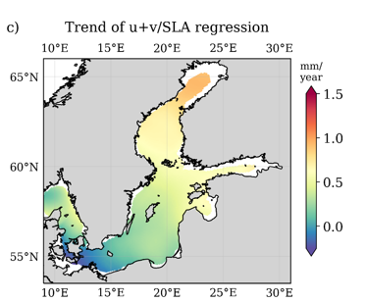
Trends and variability analysis - Conclusion
The regionalized Baltic+ SL- dataset provides more reliable estimates of absolute SL trends in the Baltic Sea than comparable products
A strong SL-trend gradient from S-W to N-E was found
Monthly Baltic SL-variability is dominated by 2-major modes of variability, which are characterized by
  1. spatially homogeneous SL variations and
  2. by inversely correlated SL-variations in the S-W and N-E domain
Southerly surface wind anomalies cause anomalous Ekman transport to the N-E, which can explain a trend gradient of ~1mm/year over the domain
Next to a strong basin-wide influence, positive NAO phases are associated with increased southerly winds and water accumulation in the Bay of Bothnia
Study accepted at Frontiers in Marine Science

Slide 17
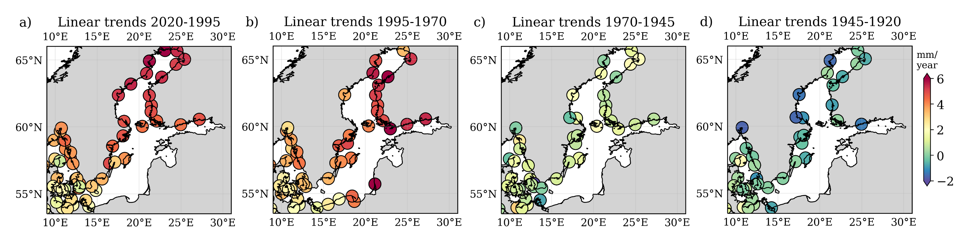
Trends and variability analysis - Outlook
How has sea level changed over the last century in the Baltic Sea?
time
The observed SW-NE trend gradient is most pronounced during 1970-present, but is not present in the period before (1920 - 1945)
Motivation to further study other factors of past and present Baltic Sea level change!

Slide 18
Table of content
Project overview: Motivation and key development steps
Analysis of Baltic absolute sea level variability and trends in the satellite altimetry era
Additional project output and developments
  A new regional mean sea surface
  An experimental high temporal resolution grid
The way forward

Slide 19
A Mean Sea Surface for the Baltic Sea
Major improvements observed near the coast
New regional Mean Sea Surface available, including quality flag (Baltic SEAL MSS)
Baltic SEAL MSS
Baltic SEAL MSS – DTU15MSS

Slide 20
A Mean Sea Surface for the Baltic Sea
Visual analysis by observing the MEAN DYNAMIC TOPOGRAPHY (mean sea surface – geoid) -> ”the smoother, the better”
MDT = Baltic SEAL MSS – EGM08
MDT = DTU15MSS – EGM08

Slide 21
A Mean Sea Surface for the Baltic Sea
NOTE: Mean Dynamic Topography is getting more homogenous towards the coast.
MDT = Baltic SEAL MSS – EGM08
MDT = DTU15MSS – EGM08

Slide 22
Table of content
Project overview: Motivation and key development steps
Analysis of Baltic absolute sea level variability and trends in the satellite altimetry era
Additional project output and developments
  A new regional mean sea surface
  An experimental high temporal resolution grid
The way forward

Slide 23
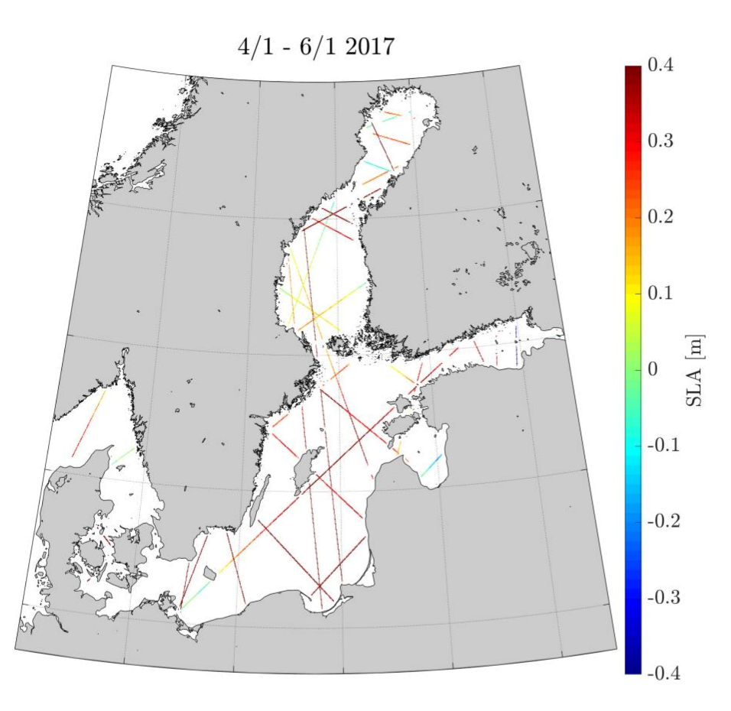
3-days experimental gridded product
Identification and analysis of storm surge events
Provision of the initial state of the sea level before the surge event, to more accurately predict the surge through models
Joint analysis of model, altimetry and TG data

Slide 24
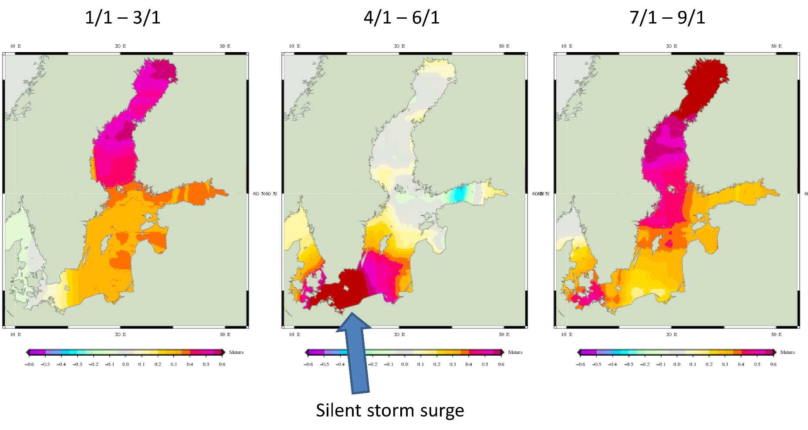
3-days experimental gridded product
Before …
…During…
…After
-0.6 m
+0.6 m
-0.6 m
+0.6 m
January 2017

Slide 25
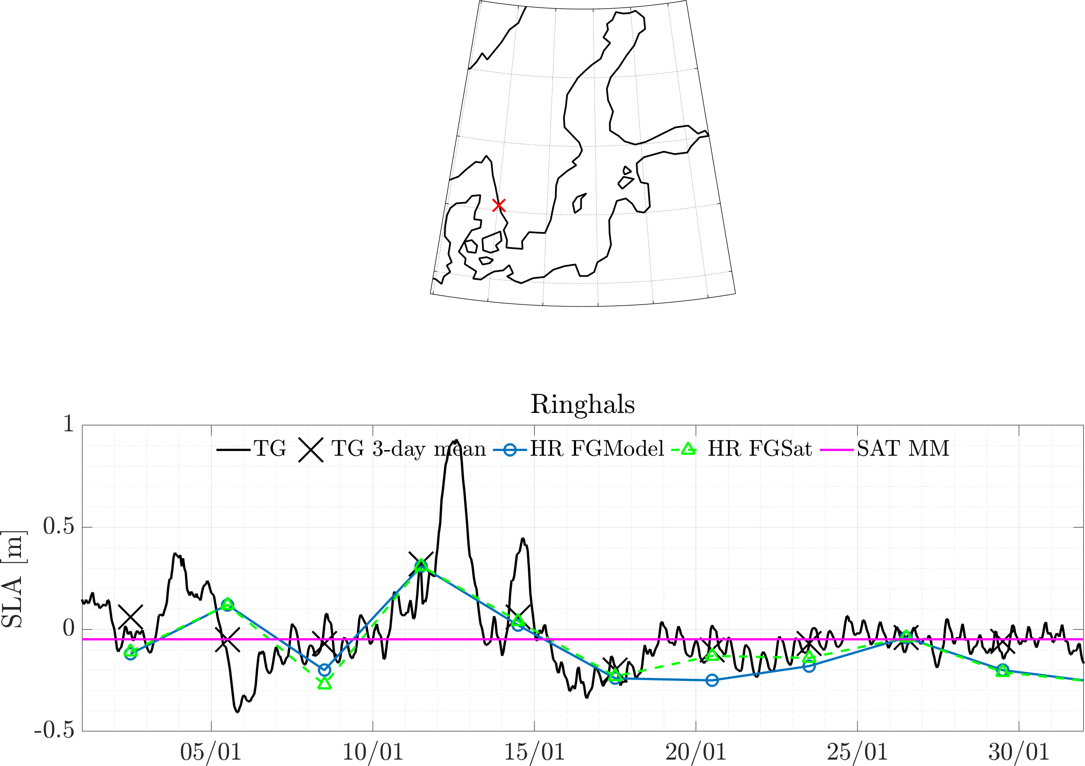
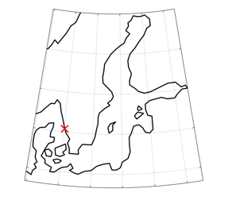
3-days experimental gridded product
Example time series of TGs, model (FGModel), altimetry (3 day and monthly mean) during storm surge
A higher temporal resolution is required to improve the potential of preconditioning storm surges

Slide 26
Table of content
Project overview: Motivation and key development steps
Analysis of Baltic absolute sea level variability and trends in the satellite altimetry era
Additional project output and developments
  A new regional mean sea surface
  An experimental high temporal resolution grid
The way forward

Slide 27
Where do we go from here? The „Baltic Sea Lab“…
Synergies: multi-variable observation of Atlantic Inflow and recirculation within the Baltic Sea (using salinity and temperature dataset)
Synergies: increase the performances of Vertical Land Motion estimation by Tide Gauge-Altimetry, perfect validation set up thanks to extensive GNSS network and the geodetic SAR technique
Wave Height climate, variability, trends and extremes: latest wave height data based on advanced altimetry processing show significant progresses in the coastal zone, and abatement of the measurement noise and wave spectral variability. The Baltic Sea shall „host“ both exploitation work and research on further improvements!
Advanced coastal altimetry grids: Baltic+ SEAL first attempt to produce them. Further studies shall investigate: irregular capsize, covariance based on external dataset, integration/validation for SWOT
Export best practice to other regions with complex coastlines and/or partial sea-ice coverage

Slide 28

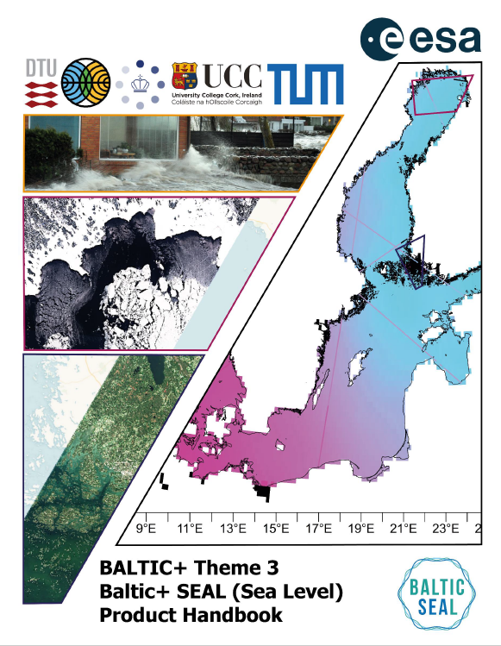
Thank you for reading/listening!
For further information, go to http://www.balticseal.eu, or contact info@balticseal.eu
Product download and documentation is available via the Baltic SEAL website. This includes the requirements analysis, validation reports, algorithm theoretical basis documents, and impact assessment reports. The scientific roadmap is also made available, charting a course forward for the various scientific advances made by the Baltic SEAL team.
The Product Handbook describing the dataset is:
Passaro, M., Müller, F., Dettmering, D., Abulaitjiang, A., Rautiainen, L., Scarrott, R.G., Chalençon, E., Sweeney, M., (2021).Baltic SEAL: Product Handbook, Version 1.1.Reportdelivered under the BalticSEALproject (ESA contract no. 000126590/19/I/BG). DOI: http://doi.org/10.5270/esa.BalticSEAL.PH1.1
For further information, go to http://www.balticseal.eu, or contact info@balticseal.eu
An article has been accepted by Frontiers in Marine Science:
Passaro M., Müller F.L., Oelsmann J., Rautiainen L., Dettmering D., Hart-Davis M.G., Abulaitijiang A., Andersen O.B., Høyer J.L., Madsen K.S., Ringgaard I.M., Särkkä J., Scarrott R., Schwatke S., Seitz F., Tuomi L., Restano M., Benveniste J.: Absolute Baltic Sea Level Trends in the Satellite Altimetry Era: A Revisit, Frontiers in Marine Science, under review.

