Slide 1
SEA ICE DATA ASSIMILATION WITH CICE AND PDAF
Nicholas Williams¹, Nicholas Byrne¹, Daniel Feltham¹, Peter Jan Van Leeuwen¹², Ross Bannister¹, David Schroeder¹, Andy Shepherd³
1: University of Reading
2: Colorado State University
3: University of Leeds

Slide 2
OUTLINE
Part 1: Goals, Motivation and model setup
Project Goals and Motivation
CICE-PDAF Coupling
How does the Kalman filter work?
Part 2: Generating Ensemble Spread
Part 3: Experiments with CICE-PDAF
Setup and post-processing of PDAF analysis
How does CPOM-CICE behave when sea ice concentration and thickness are assimilated?
Summary and Next Steps

Slide 3
Part 1: Goals, Motivation
and Model Setup

Slide 4
PrOJECT GOAL
Produce a sea ice reanalysis for the satellite era and analyse it to understand proximate causes of changes in the Arctic sea ice cover.
Use coupled Los Alamos Sea Ice Model (CICE) and Parallelized Data Assimilation Framework (PDAF) to set up sea ice data assimilation system.
Develop an observational operator so that we can compare observations and model background.

Slide 5
MOTIVATION
Observations of sea ice are limited to concentration, motion and recent efforts in thickness.
Models can be used to gain a better understanding of the driving forces behind sea ice changes, but they are not perfect.
We can use a reanalysis to combine both to get a fuller picture of the Arctic sea ice state over the satellite era.
Current reanalyses like PIOMAS are not assimilating ice thicknesses – could be missing key information from these observations.

Slide 6
CICE-PDAF COUPLING
CPOM-CICE has been coupled to the Parallelized Data Assimilation Framework (PDAF), a software environment which enables models to use ensemble based data assimilation. We are using the Local Ensemble Transform Kalman Filter (LETKF).
Kalman filter works as a weighted mean between model and observations, with weights from ensemble spread and observation errors.
State variables related to observations through observation operator (model version of observation) and the state is then updated through the covariances.

Slide 7
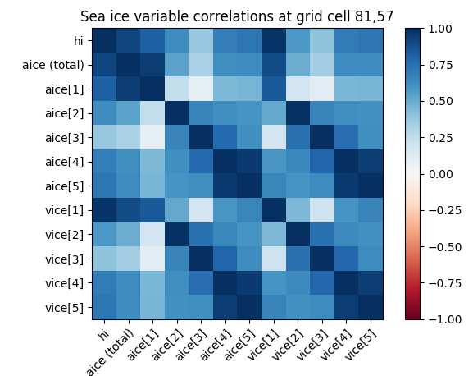
Ensemble Kalman filter
Rather than just updating the observed variables, we want to extract as much information as possible from the observations.
The Kalman filter does this by using the covariances between the state variables and the model’s observation, which are used to update every state variable.
Fig: Correlation matrix of hi (mean grid box ice thickness), total sea ice concentration (aice (total)), sea ice concentration in categories 1-5)
and vice[n] (sea ice volume in Thickness categories 1-5) at a grid cell on the sea ice edge.

Slide 8
Part 2: Generating Ensemble
Spread in CICE-PDAF

Slide 9
ENSEMBLES with CICE
Ensemble spread is extremely important for the data assimilation to work, as it represents the “error” in the model state.
If ensemble spread is too low, the observations will be ignored, as confidence in the model itself is too high.
CICE is a forced dissipative model – therefore we need a way to produce variability in the model.

Slide 10
GENERATING AN ENSEMBLE
There are two main ways we could generate variability within the model in order to produce an ensemble:
Vary the atmospheric/oceanic forcing.
Precipitation, air temperature, wind speed, longwave and shortwave radiation.
Vary poorly-known model parameters.
Ice strength, form drag coefficients, sea ice albedo

Slide 11
RECIPE for perturbing the atmospheric forcings
To introduce variability in the model we choose to perturb the atmospheric forcing.
We perform a Multivariate EOF analysis to decompose the forcing fields into a set of orthogonal functions.
$Z\left(x,y,t\right)= \sum_{k=1}^{N}{PC\left(t\right) EOF(x,y)}$
This covariance analysis can reveal the spatial patterns in the variability
Eigenvalues of the covariance matrix tell you the fraction of variance explained by each EOF.

Slide 12
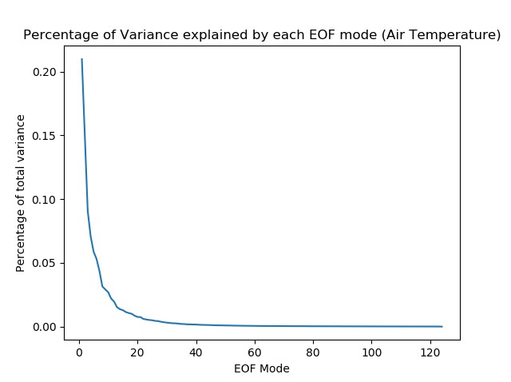

Slide 13
RECIPE for perturbing the atmospheric forcings
We can then choose a number of EOFs that represent the vast majority of the variance in the forcing fields.
Perturb fields with:
$\sum_{i=1}^{j}{N_{i} σ_{i} {EOF}_{i}}$
With j chosen number of EOFs to represent the variability.
N are random numbers chosen from a normal distribution with mean = 0, variance = 1.

Slide 14
Part 3: Experiments with
Assimilation in CICE-PDAF

Slide 15
EXPERIMENT SETUP
Using the perturbation method discussed in section 2, 30 sets of forcing fields are generated, and each ensemble member uses a different set.
Linear correlation effects of the Kalman filter can cause unphysical or inconsistent values in the sea ice variables, so some restrictions are required in post processing.
I have looked at the effects assimilating daily sea ice concentration and monthly mean sea ice thickness have on CPOM-CICE estimates of the sea ice state.

Slide 16
ASSIMILATING PSEUDO OBSERVATIONS OF SEA-ICE CONCENTRATION AND THICKNESS
We try to assimilate pseudo pan-arctic observations of daily concentration and monthly mean sea ice thickness with pseudo-observations coming from a previous standalone run of CICE in 1980, with a model using perturbed 2012 NCEP forcing.
We ran four different versions of CICE-PDAF 1) control, with no assimilation 2) assimilation of daily ice concentration 3) assimilation of concentration and monthly mean thickness 4) assimilation of concentration and monthly mean sea ice thickness with a forgetting factor of 0.97.
Note: 0.1 error in ice concentration and 0.4m error in ice
thickness observations. Line shows ensemble mean and shade
shows ensemble spread.

Slide 17
ASSIMILATING PSEUDO OBSERVATIONS OF SEA-ICE CONCENTRATION AND THICKNESS
Assimilating thickness and concentration while using a forgetting factor of 0.97 to help produce spread in the model leads to better estimates of volume and very good estimates of extent.
In this experiment monthly mean ice thickness is assimilated at the end of every month, including Summer, where Cryosat-2 data is not available.
Here the assimilation of ice thickness seems to perform worse in Early Summer.
Note: 0.1 error in ice concentration and 0.4m error in ice
thickness observations
Note: 0.1 error in ice concentration and 0.4m error in ice
thickness observations. Line shows ensemble mean and shade
shows ensemble spread.

Slide 18
ASSIMILATING PSEUDO OBSERVATIONS OF SEA-ICE CONCENTRATION AND THICKNESS
In this second experiment we try to assimilate pseudo-observations of concentration and thickness from one of our control runs (again we use perturbed 2012 NCEP forcing).
This time we ran three different versions of CICE-PDAF 1) control, with no assimilation 2) assimilation of daily ice concentration 3) assimilation of concentration and monthly mean ice thickness.
Good initial improvement in ice volume when also assimilating sea ice thicknesses.
Note: 0.1 error in ice concentration and 0.4m error in ice
thickness observations
Note: 0.1 error in ice concentration and 0.4m error in ice
thickness observations. Line shows ensemble mean and shade
shows ensemble spread.

Slide 19
ASSIMILATING PSEUDO OBSERVATIONS OF SEA-ICE CONCENTRATION AND THICKNESS
Looking at a grid cell level we can see that the first assimilation of ice thickness at the end of January has a big effect on the ability of the model to correctly estimate the ice thickness in the first half of the year.
On the other hand in the run where only concentration is assimilated it tends to follow the non-assimilation ‘control’ run during the first half of the year.
It may be important to assimilate ice thickness in order to get a good understanding of the ice at grid-cell level.
Note: 0.1 error in ice concentration and 0.4m error in ice
thickness observations.

Slide 20
SUMMARY
Fully coupled sea ice data assimilation model: CICE-PDAF (using CPOM version of CICE).
We have tested assimilation of pseudo-observations of sea ice concentration and thickness with our method of generating ensemble spread by perturbing the atmospheric forcings.
Assimilating both sea ice concentration and thickness seems to be most important for understanding the full state of the Arctic sea ice.

Slide 21
NEXT STEPS
Do further testing of coupled CICE-PDAF assimilation system with larger ensemble size (n=100)
Assimilate Cryosat-2 monthly mean thickness alongside concentration in shorter runs. Also possibility of Envisat-Cryosat-2 continuous time series (Tilling et al. 2019).
Assimilate Cryosat-2 sea ice thickness distributions and freeboards alongside concentration for longer periods (Schroeder et al. 2019).
Produce a sea ice reanalysis over the satellite era to understand proximate causes of changes in the Arctic sea ice cover.

