Slide 1
Impact of circulation on tropical cloud feedbacks in cloud resolving models
Anna Mackie and Michael P. Byrne
University of St Andrews
arm33@st-andrews.ac.uk

Slide 2
Cloud feedbacks and circulation
Tropical cloud feedbacks are a source of uncertainty in climate sensitivity and future projections
Need to develop understanding of fundamental processes relating changes in circulation and cloud feedbacks, and how they differ with model resolution

Slide 3
Cloud feedbacks and circulation
Tropical cloud feedbacks are a source of uncertainty in climate sensitivity and future projections
Need to develop understanding of fundamental processes relating changes in circulation and cloud feedbacks, and how they differ with model resolution
low OLR
high OLR

Slide 4
Cloud feedbacks and circulation
Tropical cloud feedbacks are a source of uncertainty in climate sensitivity and future projections
Need to develop understanding of fundamental processes relating changes in circulation and cloud feedbacks, and how they differ with model resolution
low OLR
high OLR

Slide 5
Isolating the role of circulation changes
Decompose cloud feedback into dynamic/thermodynamic components (Bony et al., 2004)
Dynamic effects – component due to circulation changes, for example:
Changes in area fraction of cloud
Strengthening/weakening of circulation
Thermodynamic effect – component due to changes in the thermodynamic properties of clouds, for example:
Changes to cloud optical depth
Previous work has shown the role of the circulation changes, the dynamic effect, is small in GCMs (Byrne and Schneider, 2018)
GCMs are not resolving km-scale clouds or circulation

Slide 6
Isolating the role of circulation changes
Here, we focus on the dynamic effect in cloud resolving models (CRMs) in radiative-convective equilibrium
How important is the dynamic effect in CRMs?
Which processes can be linked to the spread in dynamic effect between models?
RCEMIP (Wing et al., 2018; 2020)
Hierarchy of models, fixed experiments, radiative-convective equilibrium
Non-rotating, fixed uniform SSTs at 295, 300 and 305K
Use 10 CRMs:
3km horizontal resolution, 1 hour timestep
'large domain' ( 6000km x 400km)

Slide 7
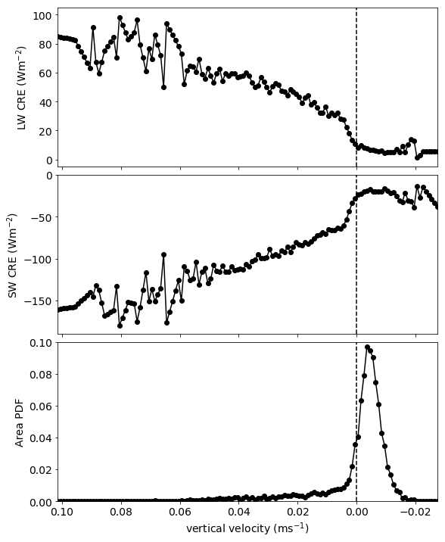
Cloud radiative effect as a function of vertical velocity
Obtain R(w), the cloud radiative effect (SW and LW) as a function of the vertical velocity
Sort vertical velocity into 0.001ms⁻¹ 'bins'
Take the mean cloud radiative effect of grid cells in those bins
Number of grid points in each bin -> probability density function
LW CRE
ascending
SW CRE
Area PDF
0.050-0.051ms⁻¹
spatial and time averages (24 hours, 96km² )
vertical velocity (ms⁻¹)

Slide 8
Dynamic-thermodynamic decomposition
Decompose the cloud feedback (change in cloud radiative effect with temperature, dR [Wm⁻²K⁻¹]) into changes where:
R(w) does not change, but circulation changes (dA(w))
Circulation does not change (A(w)), but dR(w) does
Both dR(w) and dA(w) change
e.g. R(w) at 295K
dA(w) = A(w) at 300K – A(w) at 295K
1. dynamic effect
2. thermodynamic effect
3. nonlinear effect

Slide 9
Dynamic-thermodynamic decomposition
Non-negligible contribution to total cloud feedback – contrast to GCMs
Large spread in magnitude of dynamic effect
Highly correlated with spread in total feedbacks (r² = 0.68)
300K - 295K
305K - 300K
LW cloud feedback (Wm⁻²)
What controls the spread in dynamic effect between models?

Slide 10
Circulation metrics
Want to understand what controls the spread in dynamic effect
Look at spread in dynamic effect in relation to bulk circulation metrics
Ascent fraction
Circulation strength
Organisation index

Slide 11
Circulation metrics
Want to understand what controls the spread in dynamic effect
Look at spread in dynamic effect in relation to bulk circulation metrics
Ascent fraction
Circulation strength
Organisation index
α_{up}= fraction of points ascending, at 500 hPa
Area PDF
vertical velocity (ms⁻¹)

Slide 12
Dynamic component with α_{up} at 500hPa
Fractional changes
What controls the spread in α_{up} at 500hPa?

Slide 13
Physical constraints on ascent area (α_{up})
Follow the framework laid out by Jenney et al. (2020)
Link α_{up} to diabatic heating rates in ascending and descending regimes
Weak temperature gradient approximation
Energy balance:
Jenney, A. M., Randall, D. A., & Branson, M. (2020). Understanding the response of tropical ascent to warming using an energy balance framework. Journal of Advances in Modeling Earth Systems, 12. https://doi.org/10.1029/2020MS002056

Slide 14
Physical constraints on ascent area (α_{up})
Follow the framework laid out by Jenney et al. (2020)
Link α_{up} to diabatic heating rates in ascending and descending regimes
Weak temperature gradient approximation
Energy balance:
Jenney, A. M., Randall, D. A., & Branson, M. (2020). Understanding the response of tropical ascent to warming using an energy balance framework. Journal of Advances in Modeling Earth Systems, 12. https://doi.org/10.1029/2020MS002056

Slide 15
Physical constraints on ascent area (α_{up})
Follow the framework laid out by Jenney et al. (2020)
Link α_{up} to diabatic heating rates in ascending and descending regimes
Weak temperature gradient approximation
Energy balance:
Mass balance:
Jenney, A. M., Randall, D. A., & Branson, M. (2020). Understanding the response of tropical ascent to warming using an energy balance framework. Journal of Advances in Modeling Earth Systems, 12. https://doi.org/10.1029/2020MS002056

Slide 16
Physical constraints on ascent area (α_{up})
Follow the framework laid out by Jenney et al. (2020)
Link α_{up} to diabatic heating rates in ascending and descending regimes
Weak temperature gradient approximation
Energy balance:
Mass balance:
Jenney, A. M., Randall, D. A., & Branson, M. (2020). Understanding the response of tropical ascent to warming using an energy balance framework. Journal of Advances in Modeling Earth Systems, 12. https://doi.org/10.1029/2020MS002056

Slide 17
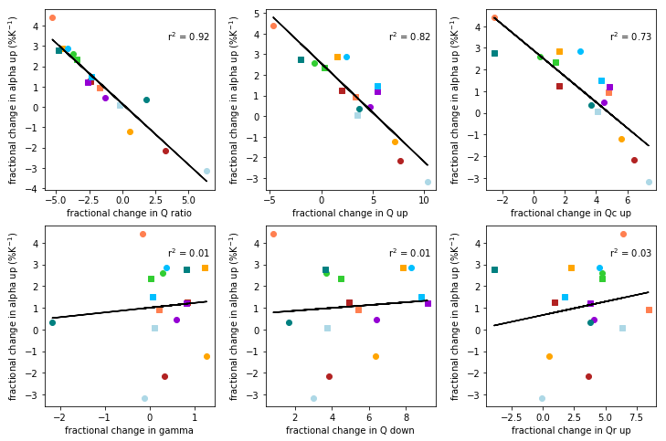
Interpreting dynamic effect through controls on α_{up}
Frac. change in α_{up} (%K⁻¹)
Frac. change in Q_{up}/Q_{dn} (%K⁻¹)
frac change in α_{up} (%K⁻¹)
Frac. change in gamma (%K⁻¹)

Slide 18
Interpreting dynamic effect through controls on α_{up}
Frac. change in α_{up} (%K⁻¹)
Frac. change in α_{up} (%K⁻¹)
Frac. change in Q_{up}/Q_{dn} (%K⁻¹)
Frac. change in Q_{up} (%K⁻¹)
frac change in α_{up} (%K⁻¹)
Frac. change in α_{up} (%K⁻¹)
Frac. change in gamma (%K⁻¹)
Frac. change in Q_{dn} (%K⁻¹)

Slide 19
Interpreting dynamic effect through controls on α_{up}
Frac. change in α_{up} (%K⁻¹)
Frac. change in α_{up} (%K⁻¹)
Frac. change in α_{up} (%K⁻¹)
Frac. change in Q_{up}/Q_{dn} (%K⁻¹)
Frac. change in Q_{up} (%K⁻¹)
Frac. change in Q_{up}^{c} (%K⁻¹)
frac change in α_{up} (%K⁻¹)
Frac. change in α_{up} (%K⁻¹)
Frac. change in α_{up} (%K⁻¹)
Frac. change in gamma (%K⁻¹)
Frac. change in Q_{dn} (%K⁻¹)
Frac. change in Q_{up}^{r} (%K⁻¹)

Slide 20
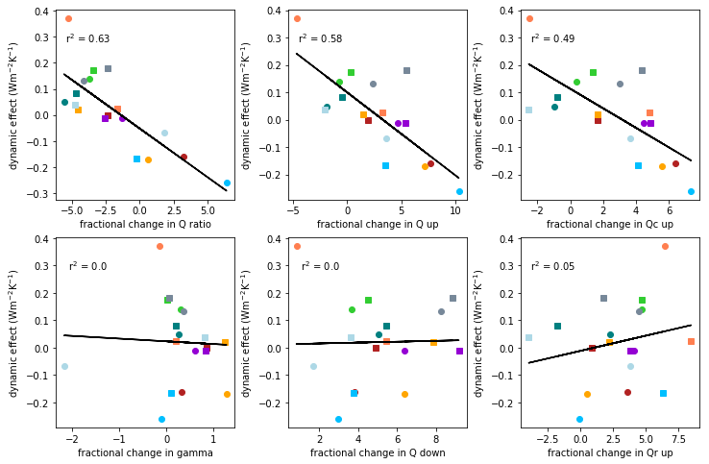
Interpreting dynamic effect through controls on α_{up}
Dynamic effect (Wm⁻²K⁻¹)
Dynamic effect (Wm⁻²K⁻¹)
Dynamic effect (Wm⁻²K⁻¹)
Find a high correlation between fractional changes in non-radiative diabatic heating in ascent regions and the LW dynamic effect
Frac. change in Q_{up}/Q_{dn} (%K⁻¹)
Frac. change in Q_{up} (%K⁻¹)
Frac. change in Q_{up}^{c} (%K⁻¹)
Dynamic effect (Wm⁻²K⁻¹)
Dynamic effect (Wm⁻²K⁻¹)
Dynamic effect (Wm⁻²K⁻¹)
Frac. change in gamma (%K⁻¹)
Frac. change in Q_{dn} (%K⁻¹)
Frac. change in Q_{up}^{r} (%K⁻¹)

Slide 21
Summary and direction of research
Using dynamic/thermodynamic decomposition to understand the role of circulation in cloud feedbacks in cloud resolving models in RCEMIP
Dynamic component not negligible
Find spread in dynamic effect explained by fractional changes in ascent fraction at 500hPa
Show that largest contribution is the non-radiative diabatic heating in ascending regions
Latent heating? Detrainment? Turbulent mixing?
RCEMIP allows us to compare across a hierarchy of models – how do GCMs in RCEMIP compare?

