Slide 1
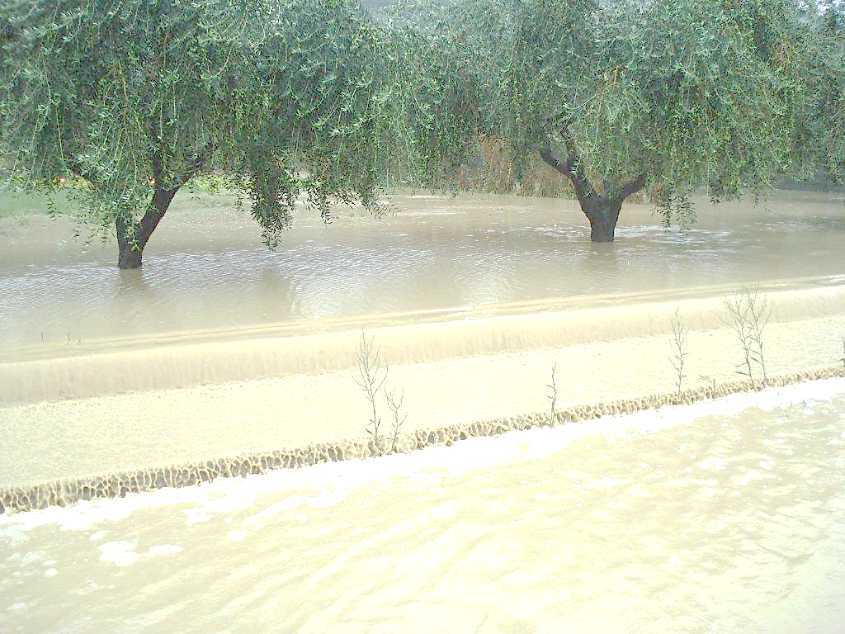




FATALITIES CAUSED BY FLOODS:
A COMPARISON BETWEEN GLOBAL DATABASES AND
COUNTRY SCALE HISTORICAL RESEARCH
Michele Mercuri, Olga Petrucci
CNR-IRPI
Italian National Research Council, Research Institute for Geo-Hydrological Protection, Cosenza (Italy)
EGU21-2688

Slide 2
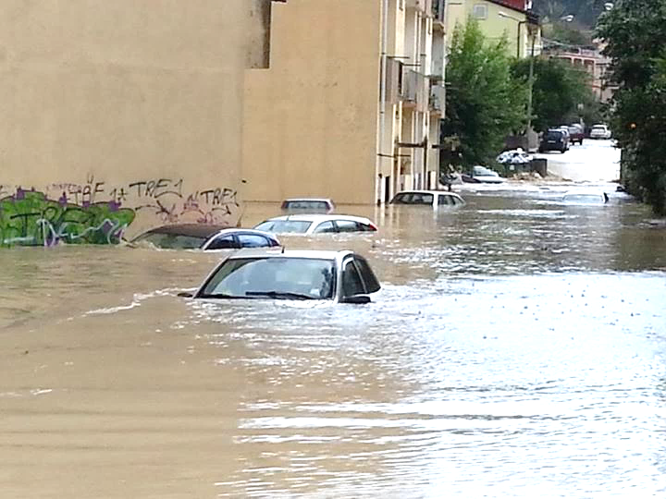
SUMMARY
THE PROBLEM: FLOOD FATALITIES
THE METHODOLOGICAL APPROACH
Euff -EUROPEAN FLOOD FATALITIES dATABASE
EM-DAT Database
DFA Database
EPF Database
HANZE-E Database
comparison of the number of flood fatalities in EUFF and other databases
CONCLUSIONS

Slide 3
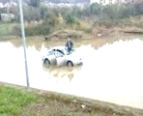
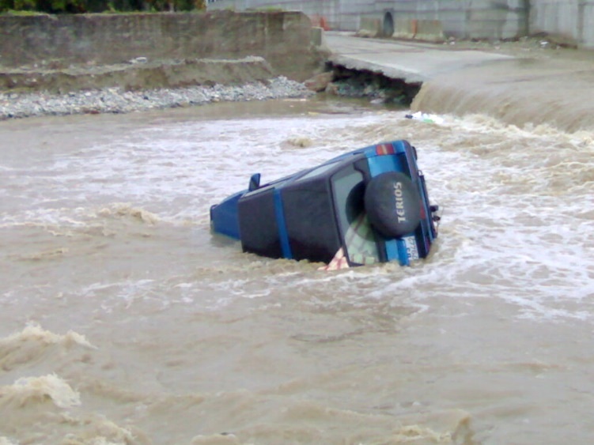
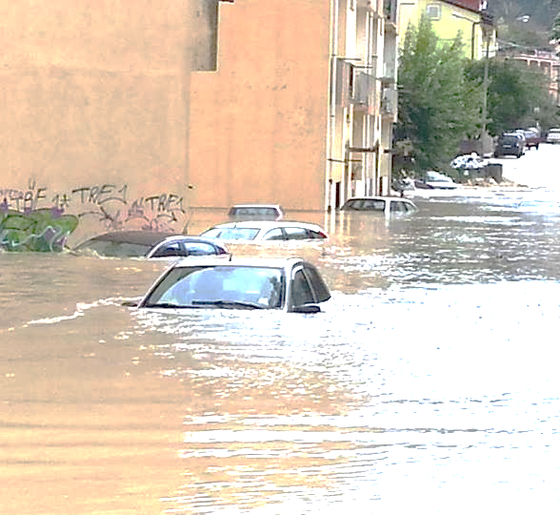
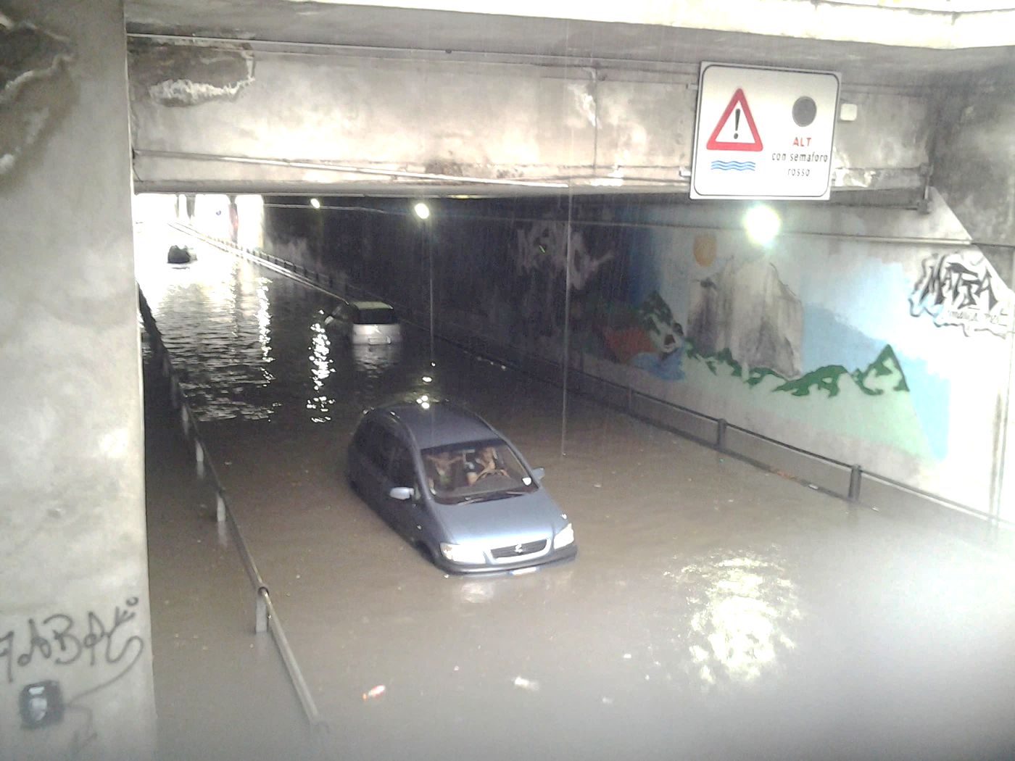
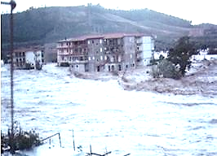
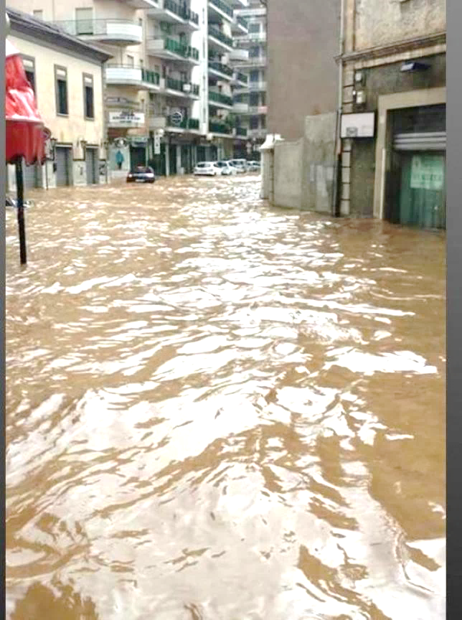
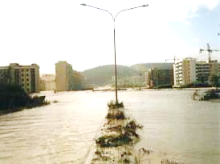
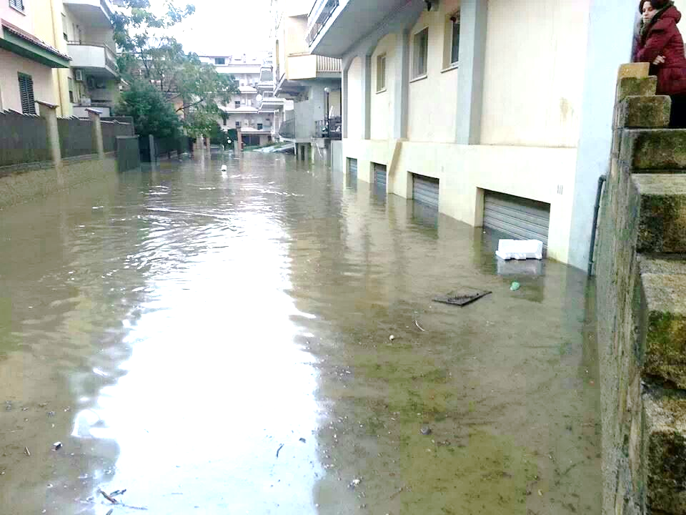





THE PROBLEM: FLOOD FATALITIES
In the XX century, floods caused ≈7 million fatalities worldwide
To reduce flood fatalities, risk management, early warning and targeted emergency communication need to be improved
Science can help to reduce Flood Fatalities (FF) in the future
Data on flood fatalities and circumstances of death allow to identify vulnerable populations and develop specific preparedness programs
In Europe, there are no other databases specifically collecting data on flood fatalities.
Flood mortality studies are based on global disasters databases, which consider only the number of fatalities per event, disregarding the characteristics of each fatal accident
HOME

Slide 4
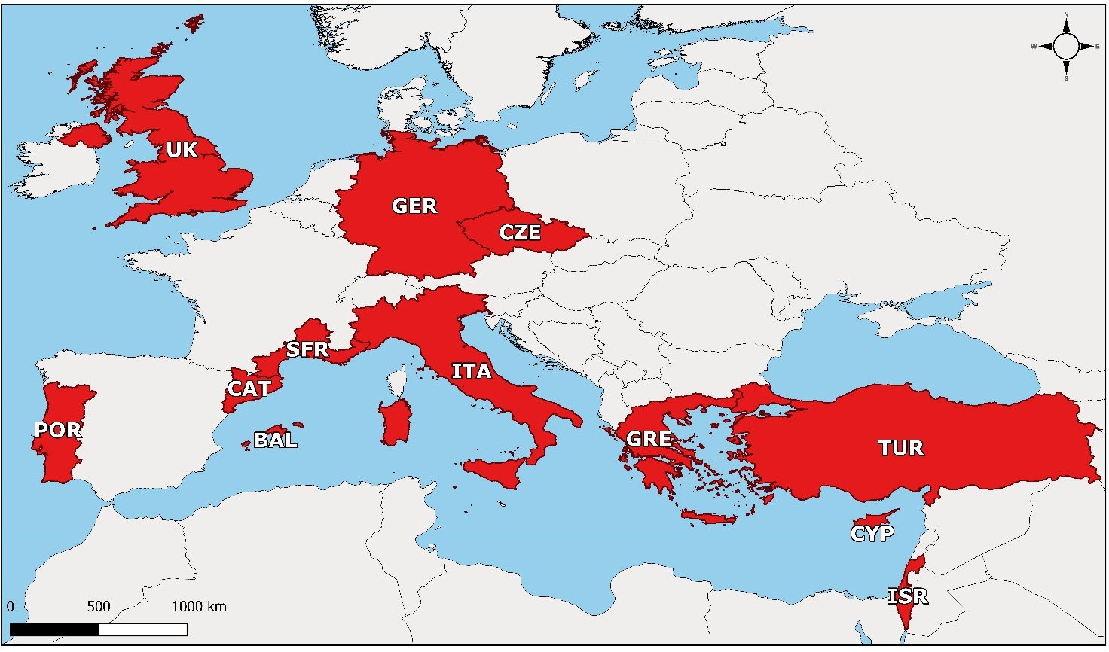


Euff (EUROPEAN FLOOD FATALITIES) database
EUFF database fills the gap in flood fatalities data in Europe and supplies crucial information to identify flood risk drivers
Study areas
BAL: Balearic Isl. | GRE: Greece
CAT: Catalonia | ISR: Israel
CYP: Cyprus | ITA: Italy
CZE: Czech Rep. | POR: Portugal
SFR: South France | TUR: Turkey
GER: Germany | UK: United Kingdom
Data on fatalities
DD/MM/YYYY | Accident place
Age | Accident dynamic
Gender | Death cause
Residency | Protective behaviour
Victim condition | Hazardous behaviour
Victim activity
Period | 1980 − 2020
Grid | NUTS 3
Data sources | Newspapers, websites etc.
Inclusion criteria | 1 or more flood fatalities
N. Flood fatalities | 2646
Send us an email if you wish to participate
EUFF is a dynamic database that can be enlarged including further study areas
Petrucci, Aceto, Bianchi, Brázdil, Diakakis, Inbar, Kahraman, Kılıç, Krahn, Kreibich, Kotroni, Madruga de Brito, Llasat, Llasat-Botija, Macdonald, Mercuri, Papagiannaki, Pereira, Řehoř, Rossello, Salvati, Vinet, Zêzere.
EUFF 2,0, 1980–2020. In preparation
olga.petrucci@irpi.cnr.it
HOME

Slide 5




THE METHODOLOGICAL APPROACH
To validate EUFF database, we compared the number of flood fatalities in EUFF study areas (1980-2020) and the number of flood fatalities included in four global databases
Number of flood fatalities in EUFF
Number of flood fatalities in EM-DAT, DFO, EPF, HANZE
HANZE-E
Historical Analysis of NH in EU
HOME

Slide 6
EM-DAT (Emergency Events Database)
Scale | Global
Period | Since 1900
Grid | Country, region, basin, latitude, longitude
Data sources | U.N. agencies, governments and the International Federation of Red Cross, nongovernmental organizations, insurance companies, research institutes and press agencies
Producer | Centre for Research on Epidemiology of Disasters
Link | https://www.emdat.be/
Focus | Natural and technological disasters
Inclusion criteria | 10 or more people killed 100 or more people affected declaration of a state of emergency and/or a call for international assistance
Data on fatalities | Number of deaths
HOME

Slide 7
DFA (Dartmouth Flood observatory Archive)
Scale | Global
Period | Since 1985
Grid | Country, provinces, towns, cities
Data sources | News and governmental sources
Producer | Dartmouth Flood Observatory
Link | www.dartmouth.edu/~floods/Archives/
Focus | Floods
Inclusion criteria | Significant damage to structures or agriculture Decades intervals since the last similar event and/or fatalities
Data on fatalities | Number of deaths
HOME

Slide 8
EPF (European Past Floods)
Scale | EU Member States
Period | 1980–2015
Grid | EU units of management
Data sources | Info reported by the EU Member States (Floods Directive 2007/60/EC), EM-DAT and DFA data
Producer | European Environment Agency
Link | www.eea.europa.eu/data-and-maps/data/european-past-floods
Focus | Floods
Inclusion criteria | Floods reported by EU Member States for the EU Floods Directive (2007/60/EC) Data provided by relevant national authorities Data from EM-DAT and DFA
Data on fatalities | Number of deaths
HOME

Slide 9
HANZE-E (Historical Analysis of Natural Hazards)
HANZE-E
Historical Analysis of natural hazards in EU
Scale | EU Member States
Period | 1870–2016
Grid | NUTS 2010 edition
Data sources | EM-DAT data, info from scientific reports and online sources
Producer | Paprotny et al., 2018
Link | doi.org/10.4121/collection:HANZE
Focus | Natural hazards (actually only floods)
Inclusion criteria | At least area flooded, or deaths, or persons affected, or monetary value of losses available. Availability of month, year, country, regions affected, type and cause of the flood
Data on fatalities | Number of deaths
HOME

Slide 10
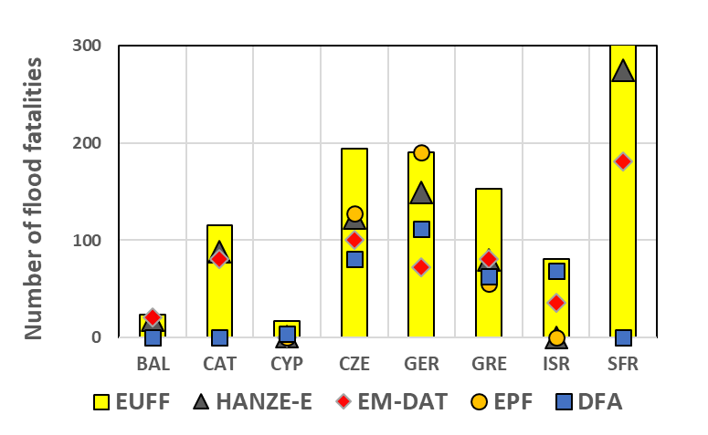
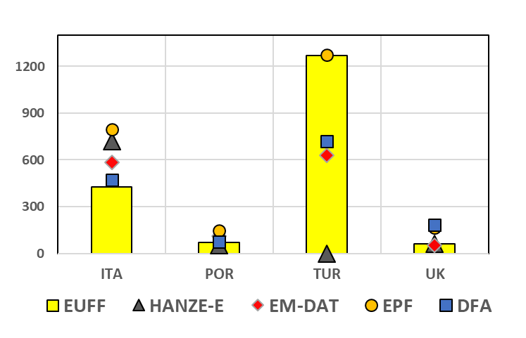
Results: comparison of the number of flood fatalities in EUFF and other databases
Flood fatalities UNDERESTIMATION
Global DB only include severe events (>10 FF). Fatalities caused by less severe events are excluded. In Europe this excludes ≈60% of flood fatalities
Flood fatalities OVERESTIMATION
Global DB often classify as flood fatalities victims caused by other phenomena (i.e. landslides, debris flows and wind), and then overestimate flood fatalities
HOME

Slide 11

CONCLUSIONS
HANZE-E
Historical Analysis of NH in EU
Focus is on FATALITIES
Only includes FLOOD fatalities
Provides the profiles of victims
Provides information on the accidents
Includes events causing one or more FF
Locate fatalities at the NUTS 3 level
Focus is on FLOODS
Merge fatalities caused by floods and other natural hazards
Do not provide the profiles of victims
Do not provide information on the accidents
Exclude events causing a few fatalities
Fatalities are not detailed geographically located
This work demonstrate how EUFF database supply realistic figures of fatalities in European countries.
EUFF data possible applications: a) assess the effects of climate change on flood mortality; b) detect differences in mortality related to demographics, economic and developments of the area; c) calibrate threshold models of rain causing deathly floods; d) validate flood risk models for the estimation of expected fatalities; e) shape public policies and civil protection activities to minimize the number of flood fatalities in the future.
We encourage researchers working in European countries to collaborate with us to increase spatial coverage of the database and promote its common use in studies on flood mortality.
olga.petrucci@irpi.cnr.it
If you whish to contribute to enlarge EUFF
HOME

