Slide 1
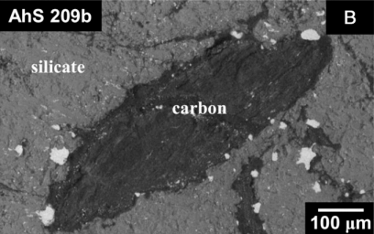
The effects of graphite and particles size on reflectance spectra of silicates
E. Bruschini¹, C. Carli¹, F. Capaccioni¹, M. Vincendon², A.-C. Buellet², M. Ferrari¹, F. Vetere³, A. Secchiari⁵, D. Perugini⁴, A. Montanini⁵
¹ Institute for Space Astrophysics and Planetology – INAF, Via del Fosso del Cavaliere, 100, 00133 Rome, Italy
² IAS, Bâtiment 121, CNRS / Université Paris-Saclay, Orsay, France
³ Institute of Mineralogy, Leibniz Universität Hannover, Callinstrasse 3, 30167 Hannover, Germany
⁴ Dept. of Chemistry, Life Sciences and Environmental Sustainability University of Parma, Parco Area delle Scienze 157/a, 43124 Parma, Italy
⁵ University of Perugia, Department of Physics and Geology Piazza Università, 06100 Perugia, Italy
Image from Nestola et al 2020, PNAS 117.41 (2020)
Image credits: https://solarsystem.nasa.gov/resources/771/colors-of-the-innermost-planet-view-1/?category=planets_mercury

Slide 2
Introduction
Graphite mixed with silicates could possibly explain the low reflectance of Mercury
Graphite is found in many meteorites like chondrites and achondrites (especially in ureilites: up to 4-5 wt%)
Lack of systematic works addressing the effect of graphite on reflectance spectra of silicates

Slide 3
Materials
GL: synthetic glass (Vetere et al. 2017); FeO (wt%) = 0
GN: Mg-rich Gabbronorite (Secchiari et al.2018); FeO < 3%
HB: hawaiitic basalt (Pasquarè et al.2008); FeO = 11%
GR: microcrystalline graphite
Mixes of end-member GL, GN, HB + GR at weight ratios:
1%, 2%, 3%, 4% and 5% → effect of graphite on reflectance
End-members at different grainsizes → effect of grainsize on reflectance

Slide 4
Methods
VNIR (350-2500 nm) reflectance spectroscopy
BC1: position (wavelength) of the maximum band depth
BD: band amplitude
BA: band area $D_{i}$ = amplitude; ∆x = 1 nm
BC2: band centroid
SL: spectral slopes [GM]: graphite mixture; [EM]: end-member
$$BA= \sum_{i=1}^{n}{D_{i}}Δx$$
$$BC2= \frac{\sum_{i=1}^{n}{{x_{i}D}_{i}}}{\sum_{i=1}^{n}{D_{i}}}$$
$$SL=\frac{R_{f}^{\left[GM\right]}−R_{i}^{\left[GM\right]}}{R_{f}^{\left[EM\right]}−R_{i}^{\left[EM\right]}}$$

Slide 5
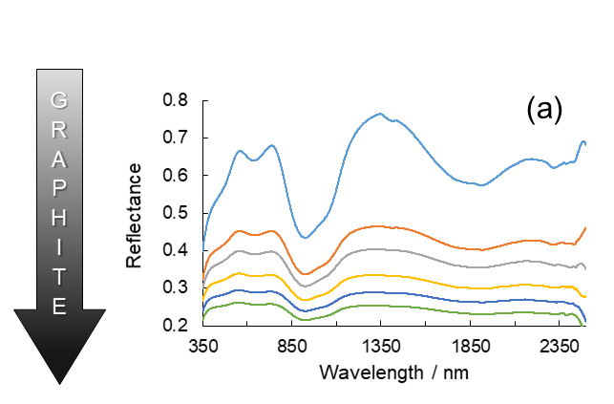
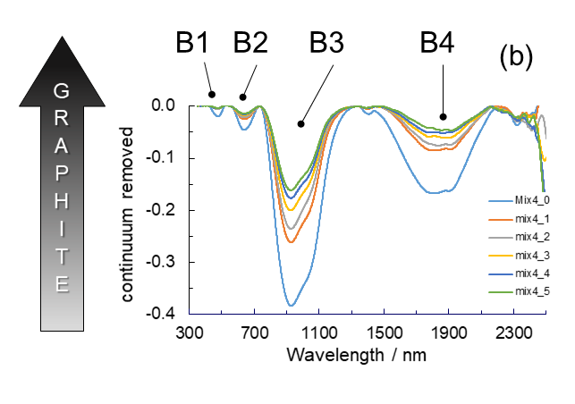
Results
GN + GR
4 main bands: B1, B2, B3, B4
Drastic reduction of spectral contrast and reflectance with graphite content

Slide 6
Results
GN + GR
Very good linear relationships between BD and BA for all bands
(B1 not showed)

Slide 7
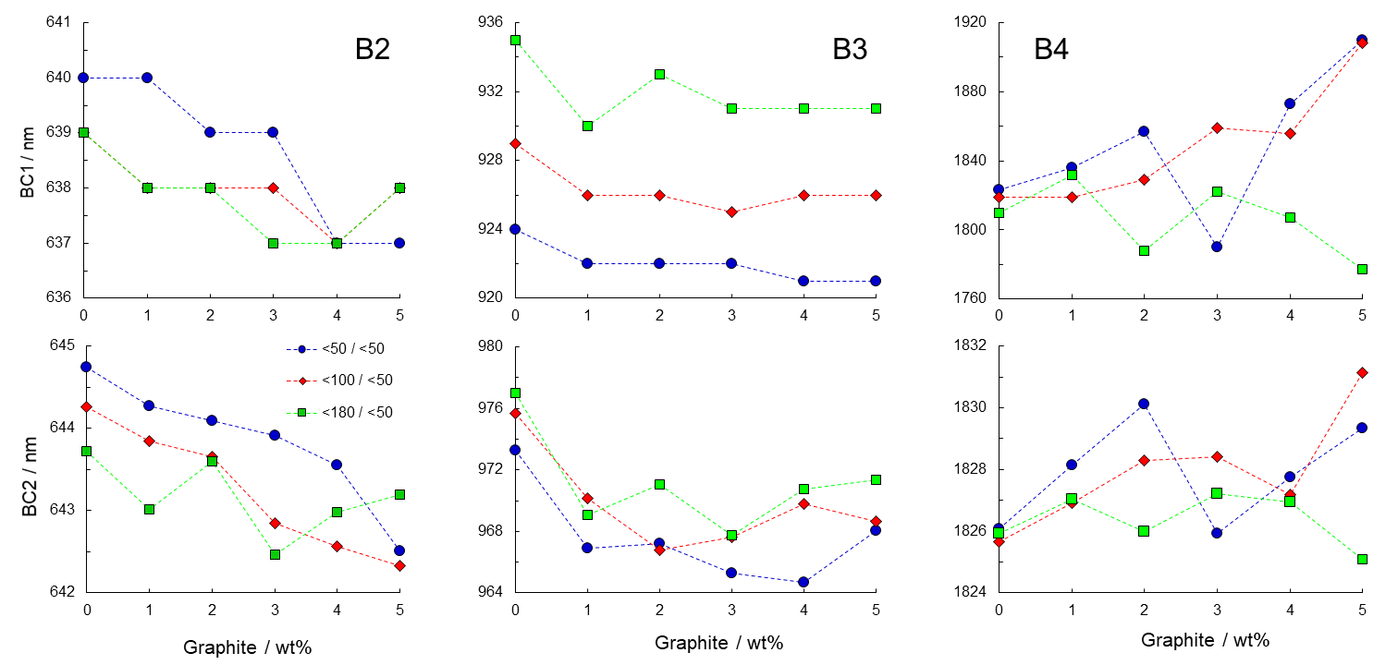
Results
GN + GR
Largest band shift in B4
General good agreement between BC1 and BC2

Slide 8
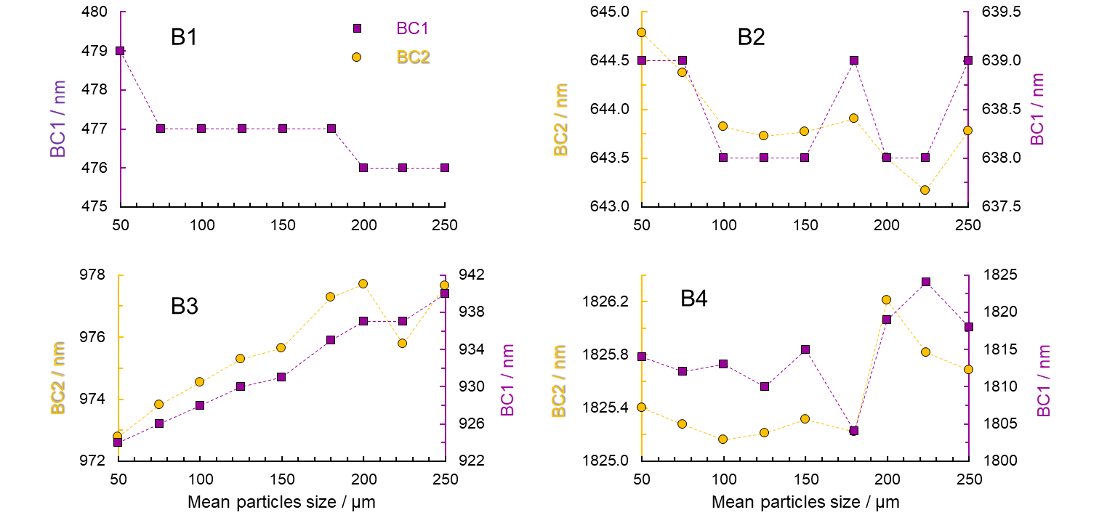
Results
GN at different grainsizes
Good agreement between BC1 and BC2
Largest variation observed in BC1 but BC2 is more sensitive to band shift

Slide 9
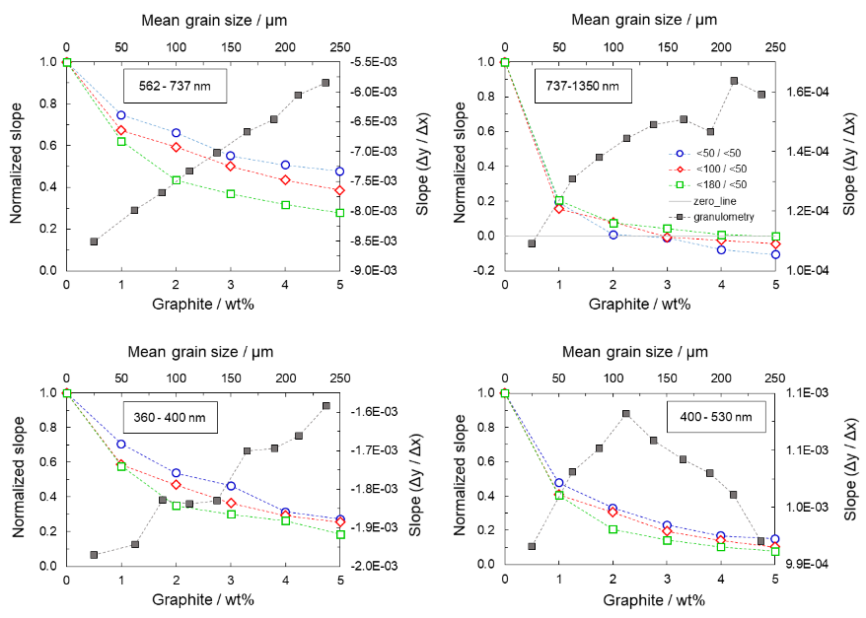
Results
GN spectral slopes
Decrease of the slopes with increasing GR
Increase of the slopes with increasing GR
Mixed behavior in the 400-530 nm spectral range
"The effects of graphite and particles size on reflectance spectra of silicates"
E. Bruschini, C. Carli, F. Capaccioni, M. Vincendon, A.-C. Buellet, M. Ferrari, F. Vetere, A. Secchiari, D. Perugini, A. Montanini

Slide 10
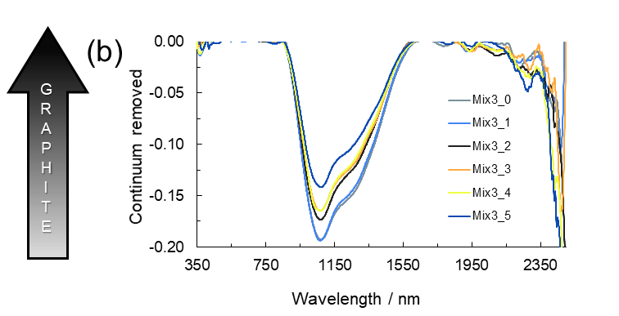
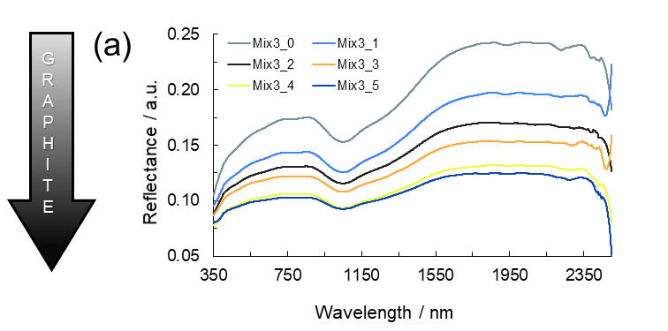
Results
HB + GR
One broad band centered @ ca 1100 nm
Drastic reduction of spectral contrast and reflectance with
graphite content

Slide 11
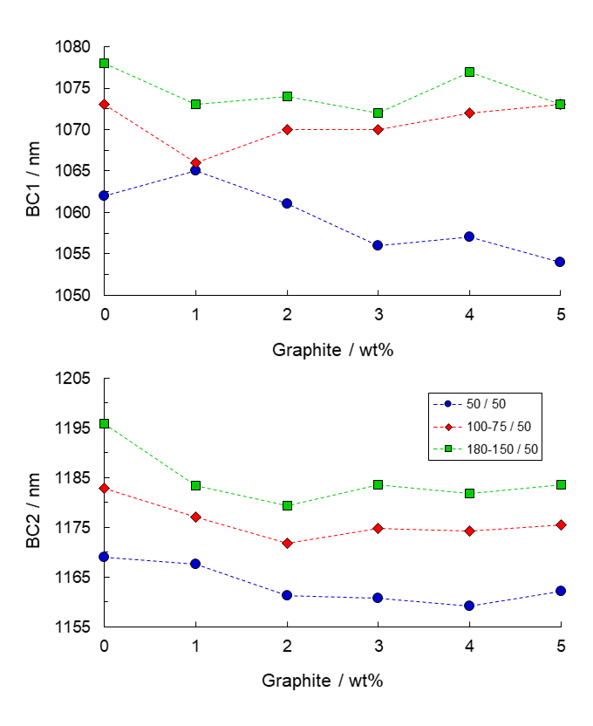
Results
HB + GR
Similar behavior of BC1 and BC2
Similar derivative of BC1 and BC2 with respect to graphite

Slide 12
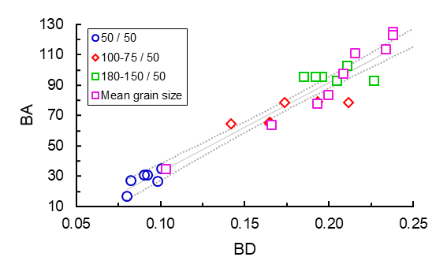
Results
HB + GR
Very good linear relationship between BD and BA

Slide 13
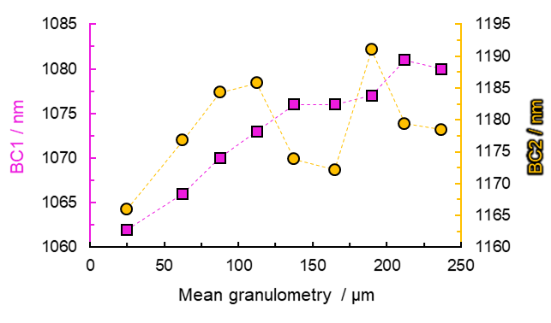
Results
HB at different grainsizes
Very good relationship between BC1 and BC2
∂BC1/∂GR ≈ ∂BC2/∂GR
BC2 more sensitive than BC1

Slide 14
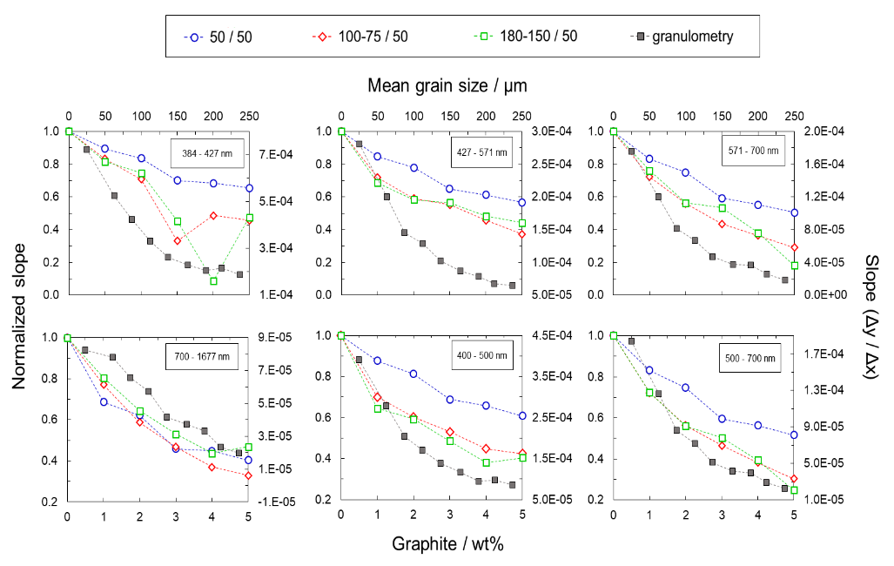
Results
HB spectral slopes
Negative ∂SL/∂GR and ∂SL/∂grain size
GR not so effective in reducing the slopes as in GN

Slide 15
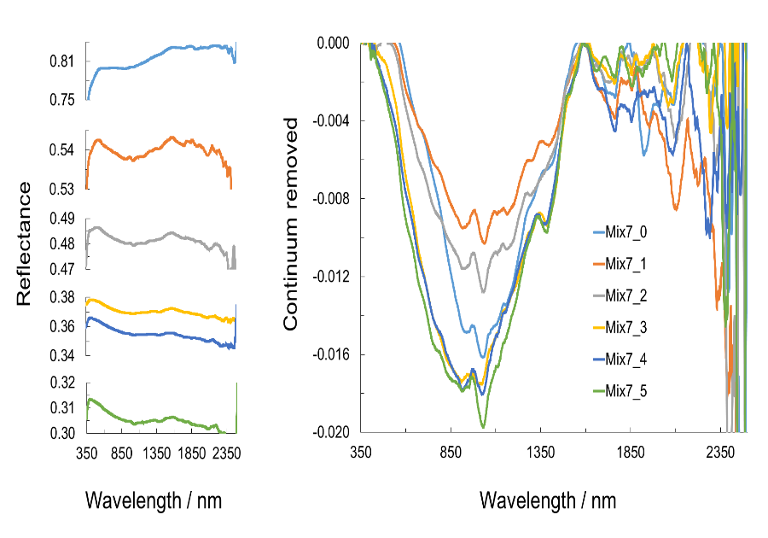
Results
GL + GR
One broad band centered @ ca 1050 nm
Many other peaks less or more visible with graphite content
Drastic reduction of spectral contrast and reflectance with graphite content

Slide 16
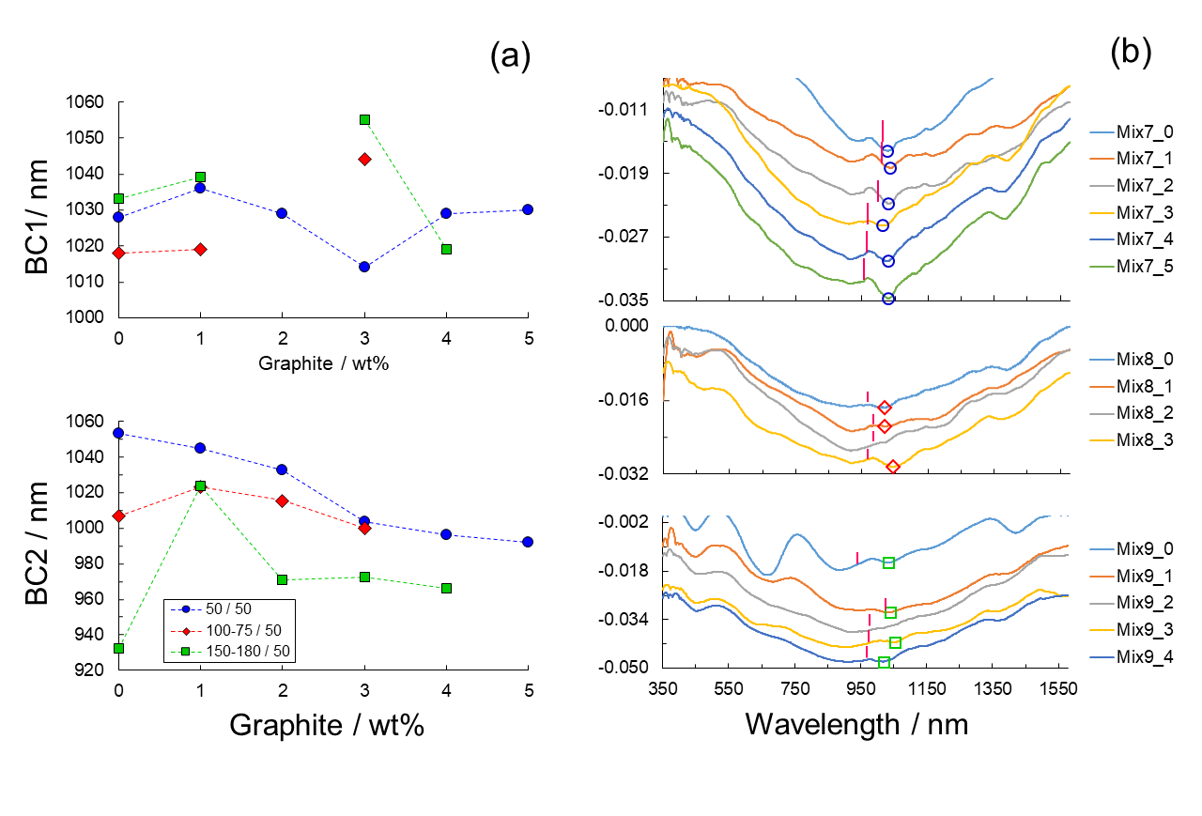
Results
GL + GR
BC2 (pink bars) much more reliable than BC1 (open symbols)
BC2 shift to lower wavelengths for small grainsize and to higher wavelengths for coarser grains

Slide 17
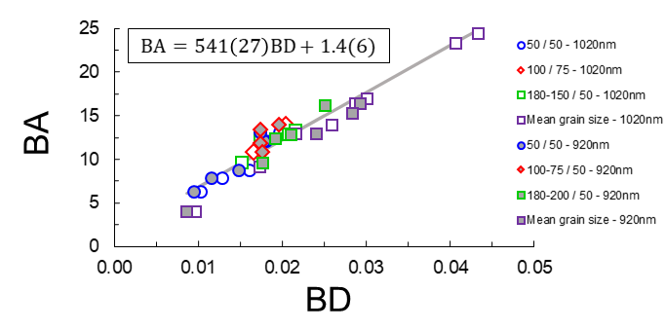
Results
GL + GR
Very good linear relationship between BD and BA

Slide 18
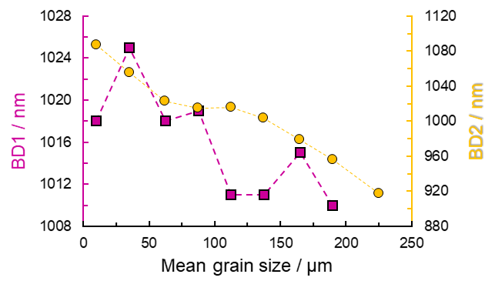
Results
GL at different grainsizes
Very good relationship between BC1 and BC2
∂BC1/∂GR << ∂BC2/∂GR
BC2 more sensitive than BC1

Slide 19
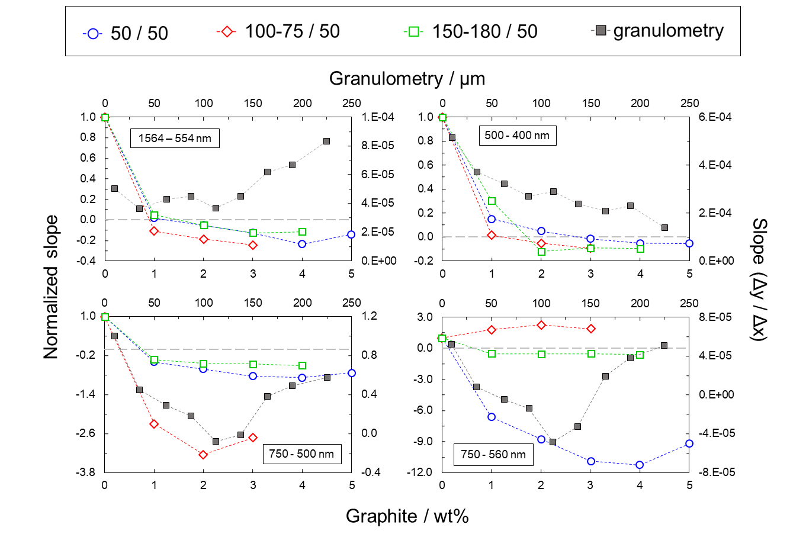
Results
GL spectral slopes
Complex behavior of ∂SL/∂GR and ∂SL/∂grain size
Huge variations of the slopes for the spectral ranges 750-500 and 750-560 nm

Slide 20
Conclusions
(preliminary)
Graphite strongly reduces reflectance and spectral contrast for all silicates end-members
Moderate influence of graphite and grain size on band shifting (with some exceptions) better resolved with BC2 than BC1
Complex behavior of SL as a function of GR and GS (grain size). ∂SL/∂GR usually negative. Huge ∂SL/∂GR observed in GL+GR
BC2 is a very useful toll for the characterization of the band properties (shift, area, etc.) especially for noisy and low-resolution spectra → application to remote sensing??
Add Your Text

