Slide 1
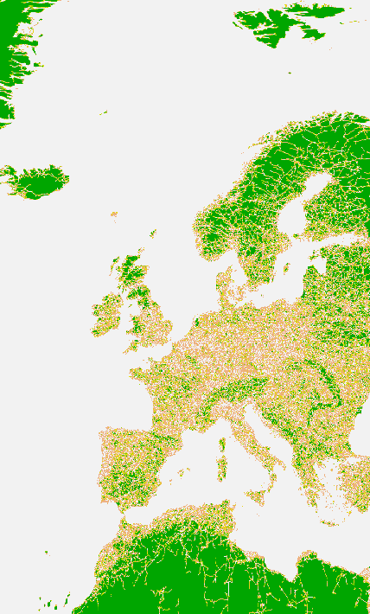
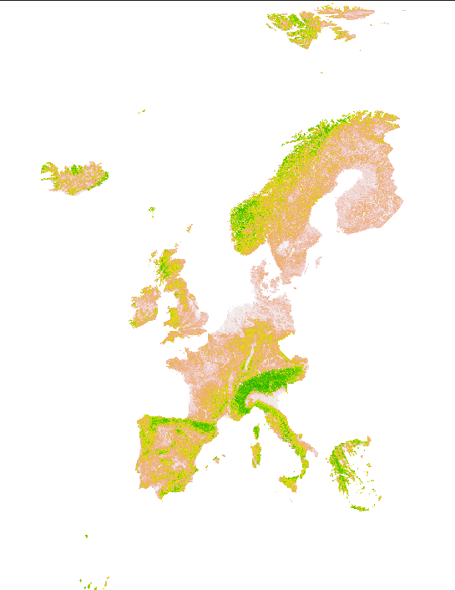
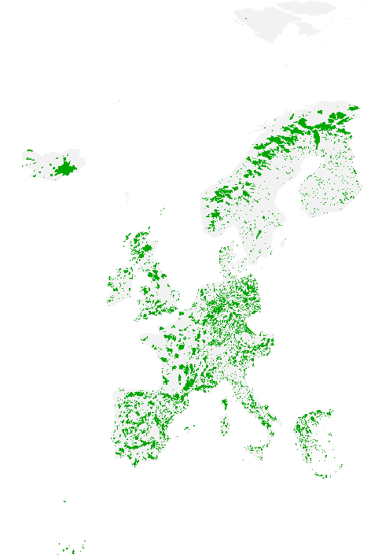
Determinants of the distribution of solar PV parks
Joyce H.C. Bosmans¹, Mirza Cengic¹, Aafke M. Schipper^{1,2}, David E.H.J. Gernaat^{2,3}, Detlef P. van Vuuren^{2,3} and Mark A.J. Huijbregts¹
Goal: to predict probability of occurrence of a PV park, using 1km maps of resource availability (irradiation), topography (e.g. slope), socio-economic factors (e.g. distance to urban areas), infrastructure (e.g. distance to roads and transmission lines), land cover type, and / or ecological functions (e.g. protected areas).
Methods: mixed linear effect model, as often used in ecological / biodiversity studies
For locations with PV parks (orange) as well as locations withóut PV parks (green),
we determine the values of each of the following predictors:
distance to roads, settlements and mid & high voltage grid
accessibility (travel time to nearest settlement)
slope and elevation
protected status
irradiation
land cover type
all scaled!
select best model (dredge, AIC)
Model: P = β_{int} + β_{road}X_{road} + β_{slope}X_{slope} + ...
β
Travel time -4.6
Irradiance 2.2
Distance to grid -1.7
Water^{LC} -1.5
Slope -1.0
Protected area -0.9
Wetland^{LC} -0.2
Elevation -0.1
Urban^{LC} -0.1
Forest^{LC} -0.1
^{LC}: fraction of gridcell covered
Distance to grid Slope Protected area
Country effect:
Country effect included by country-specific intercept
R² fixed effects: 0.765
R² fixed + random (country) effects: 0.911
14.6% of variance in probability determined by country effects (e.g. different policies)
To do!
Go global
Compare to suitability maps (probability ≠ suitability!)
Future expansion?
Probability of occurrence
1: Radboud University, 2: Netherlands Environmental Assessment Agency (PBL), 3: Utrecht University

