Slide 1


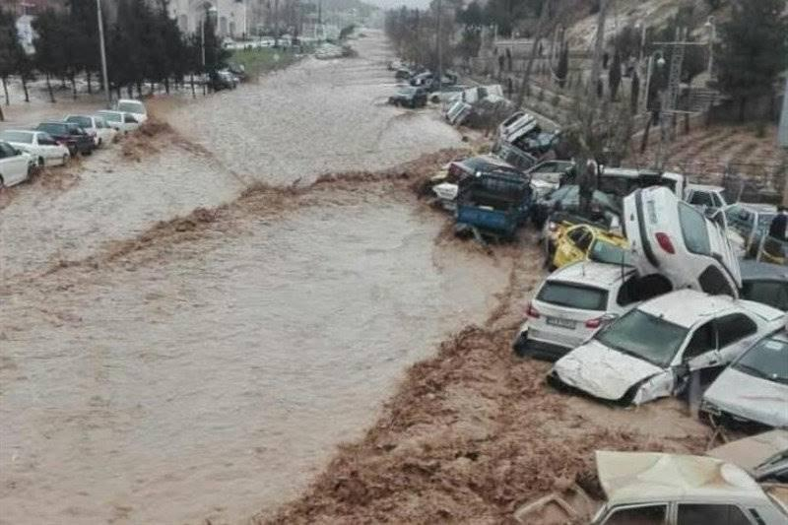
vEGU 2021
Effects of Rainfall Spatial-Temporal Variability on Flash Flood Modelling
Shahin Khosh Bin Ghomash and Daniel Bachmann
Research group Flood Risk Management
University of applied sciences Magdeburg-Stendal
28.04.2021
vEGU21-2804

Slide 2

INTRODUCTION
Understanding the dependence of discharge on the spatial-temporal structure of precipitation can be of importance in areas such as design of precipitation monitoring networks, flood protection measures, flood forecasting, etc. (Maier et al., 2020)
More variated storms are expected due to climate change
Spatially-uniform design storms neglect the impact of rain spatial variability (Cristiano et al., 2017)
Key research question:
To what extent does precipitation spatial-temporal variability affect the flood response of river basins?

Slide 3
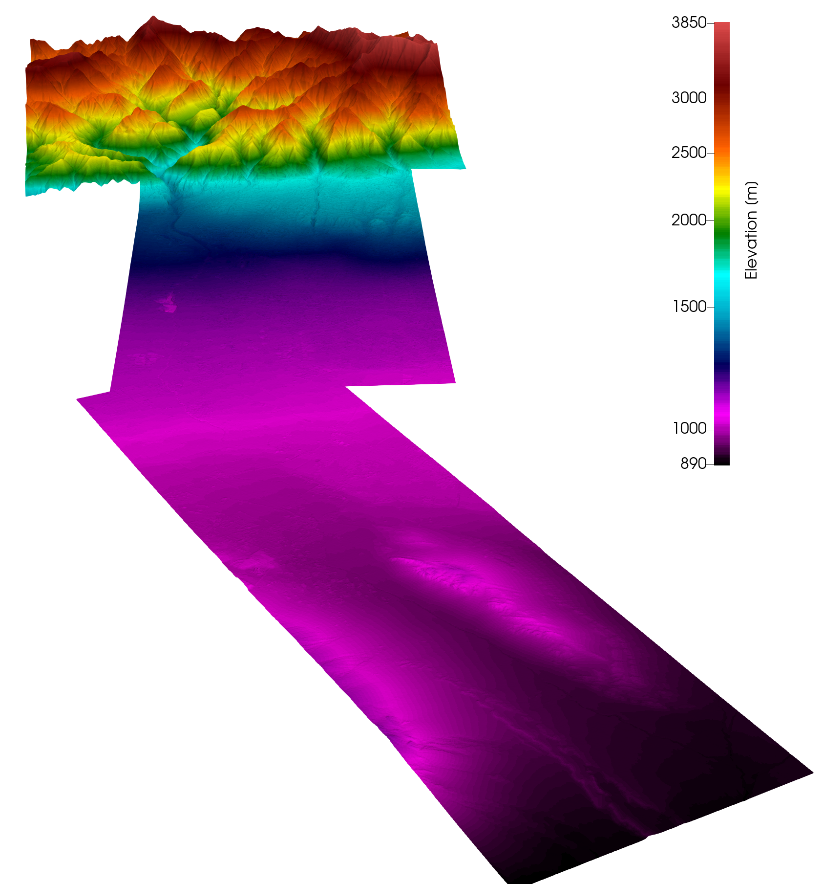
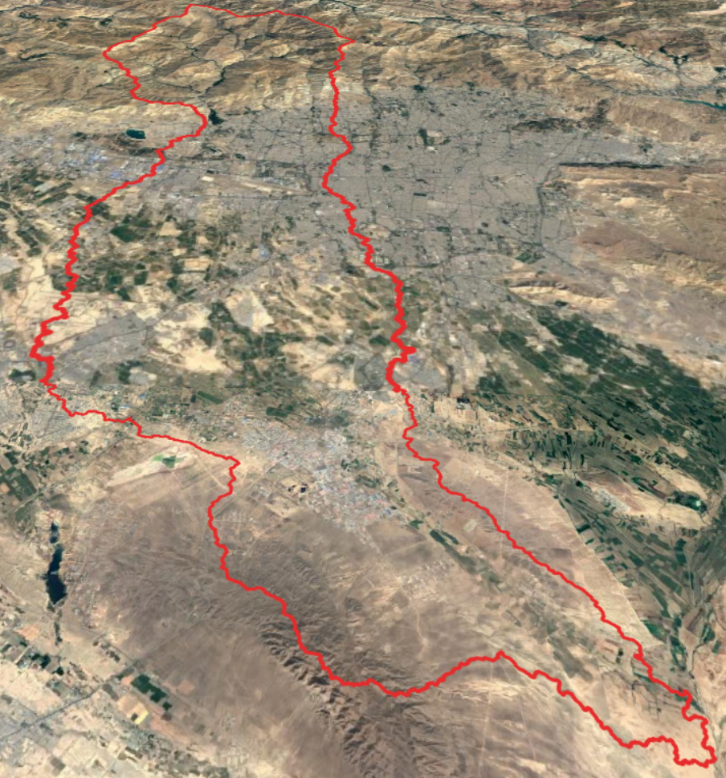
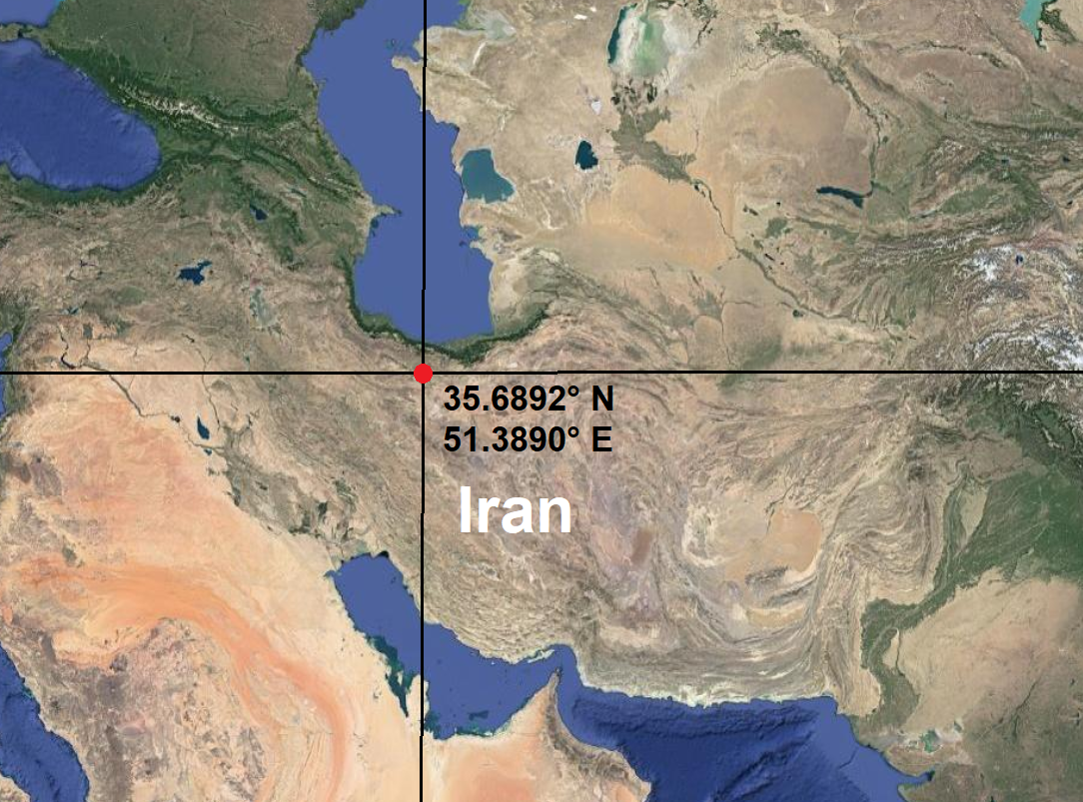
METHODOLOGIES
Study Area
The Kan catchment (Tehran, Iran)
Total area of 836 km²
Semi-arid climate, Steep topography
High potential for flash floods

Slide 4
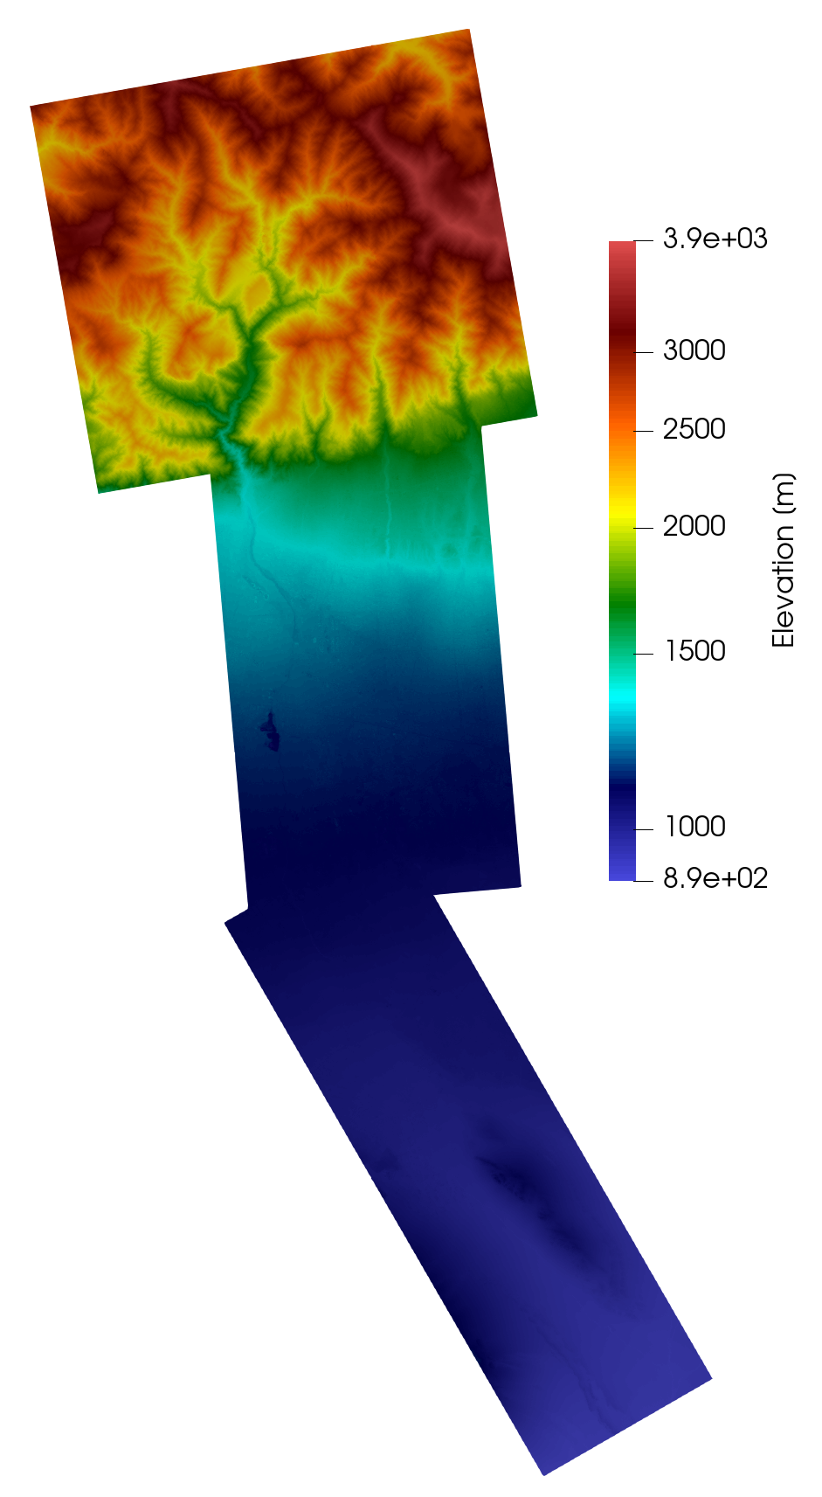
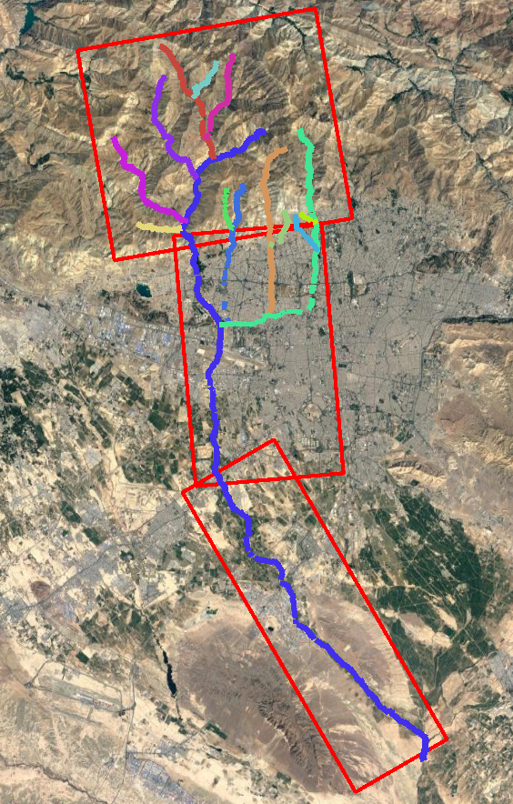
METHODOLOGIES
Model Setup
Spatially-distributed rainfall/runoff simulations using the modelling tool ProMaIDes
Flow generation based on the Diffusive Wave equation
Topography based on the TanDEM-X 12m DEM
Infiltration and roughness kept to a minimal
Rainfall
3 2d-floodplains
14 1d-rivers

Slide 5
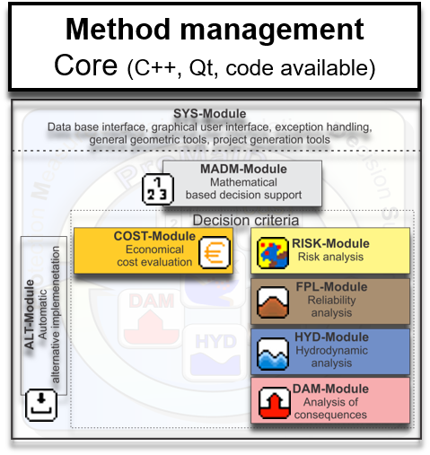
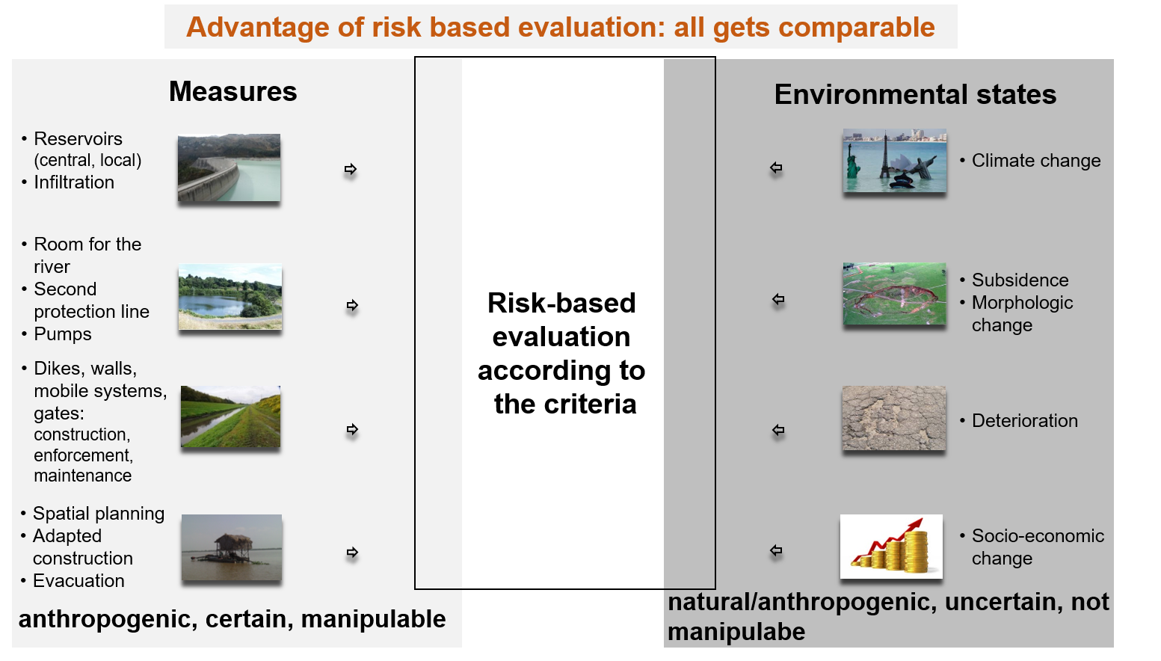
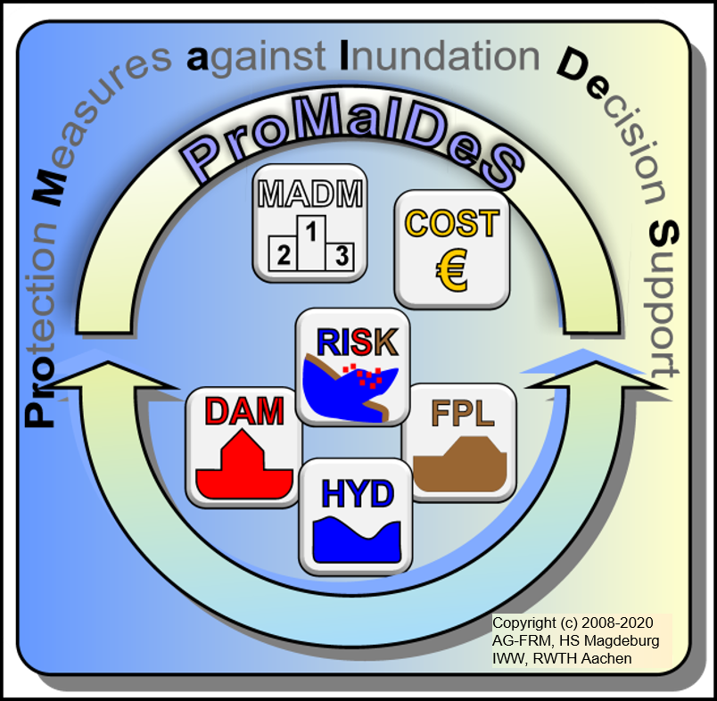
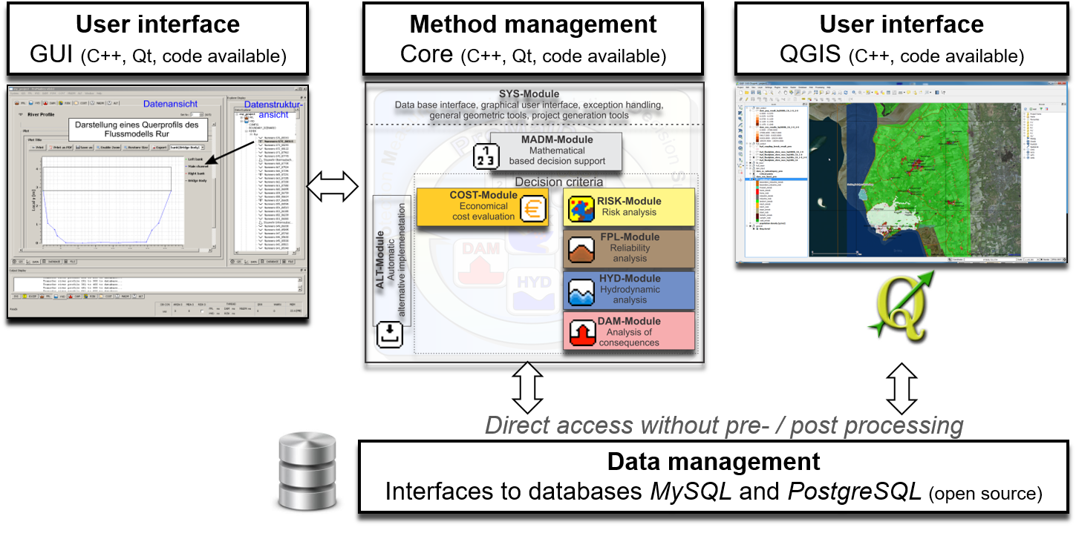
METHODOLOGIES
ProMaIDes
A modular software for the risk-based assessment of flood protection measures for river, urban and coastal flooding.
Free and opensource
Promaides.h2.de
Online manual and community of users
promaides.myjetbrains.com

Slide 6
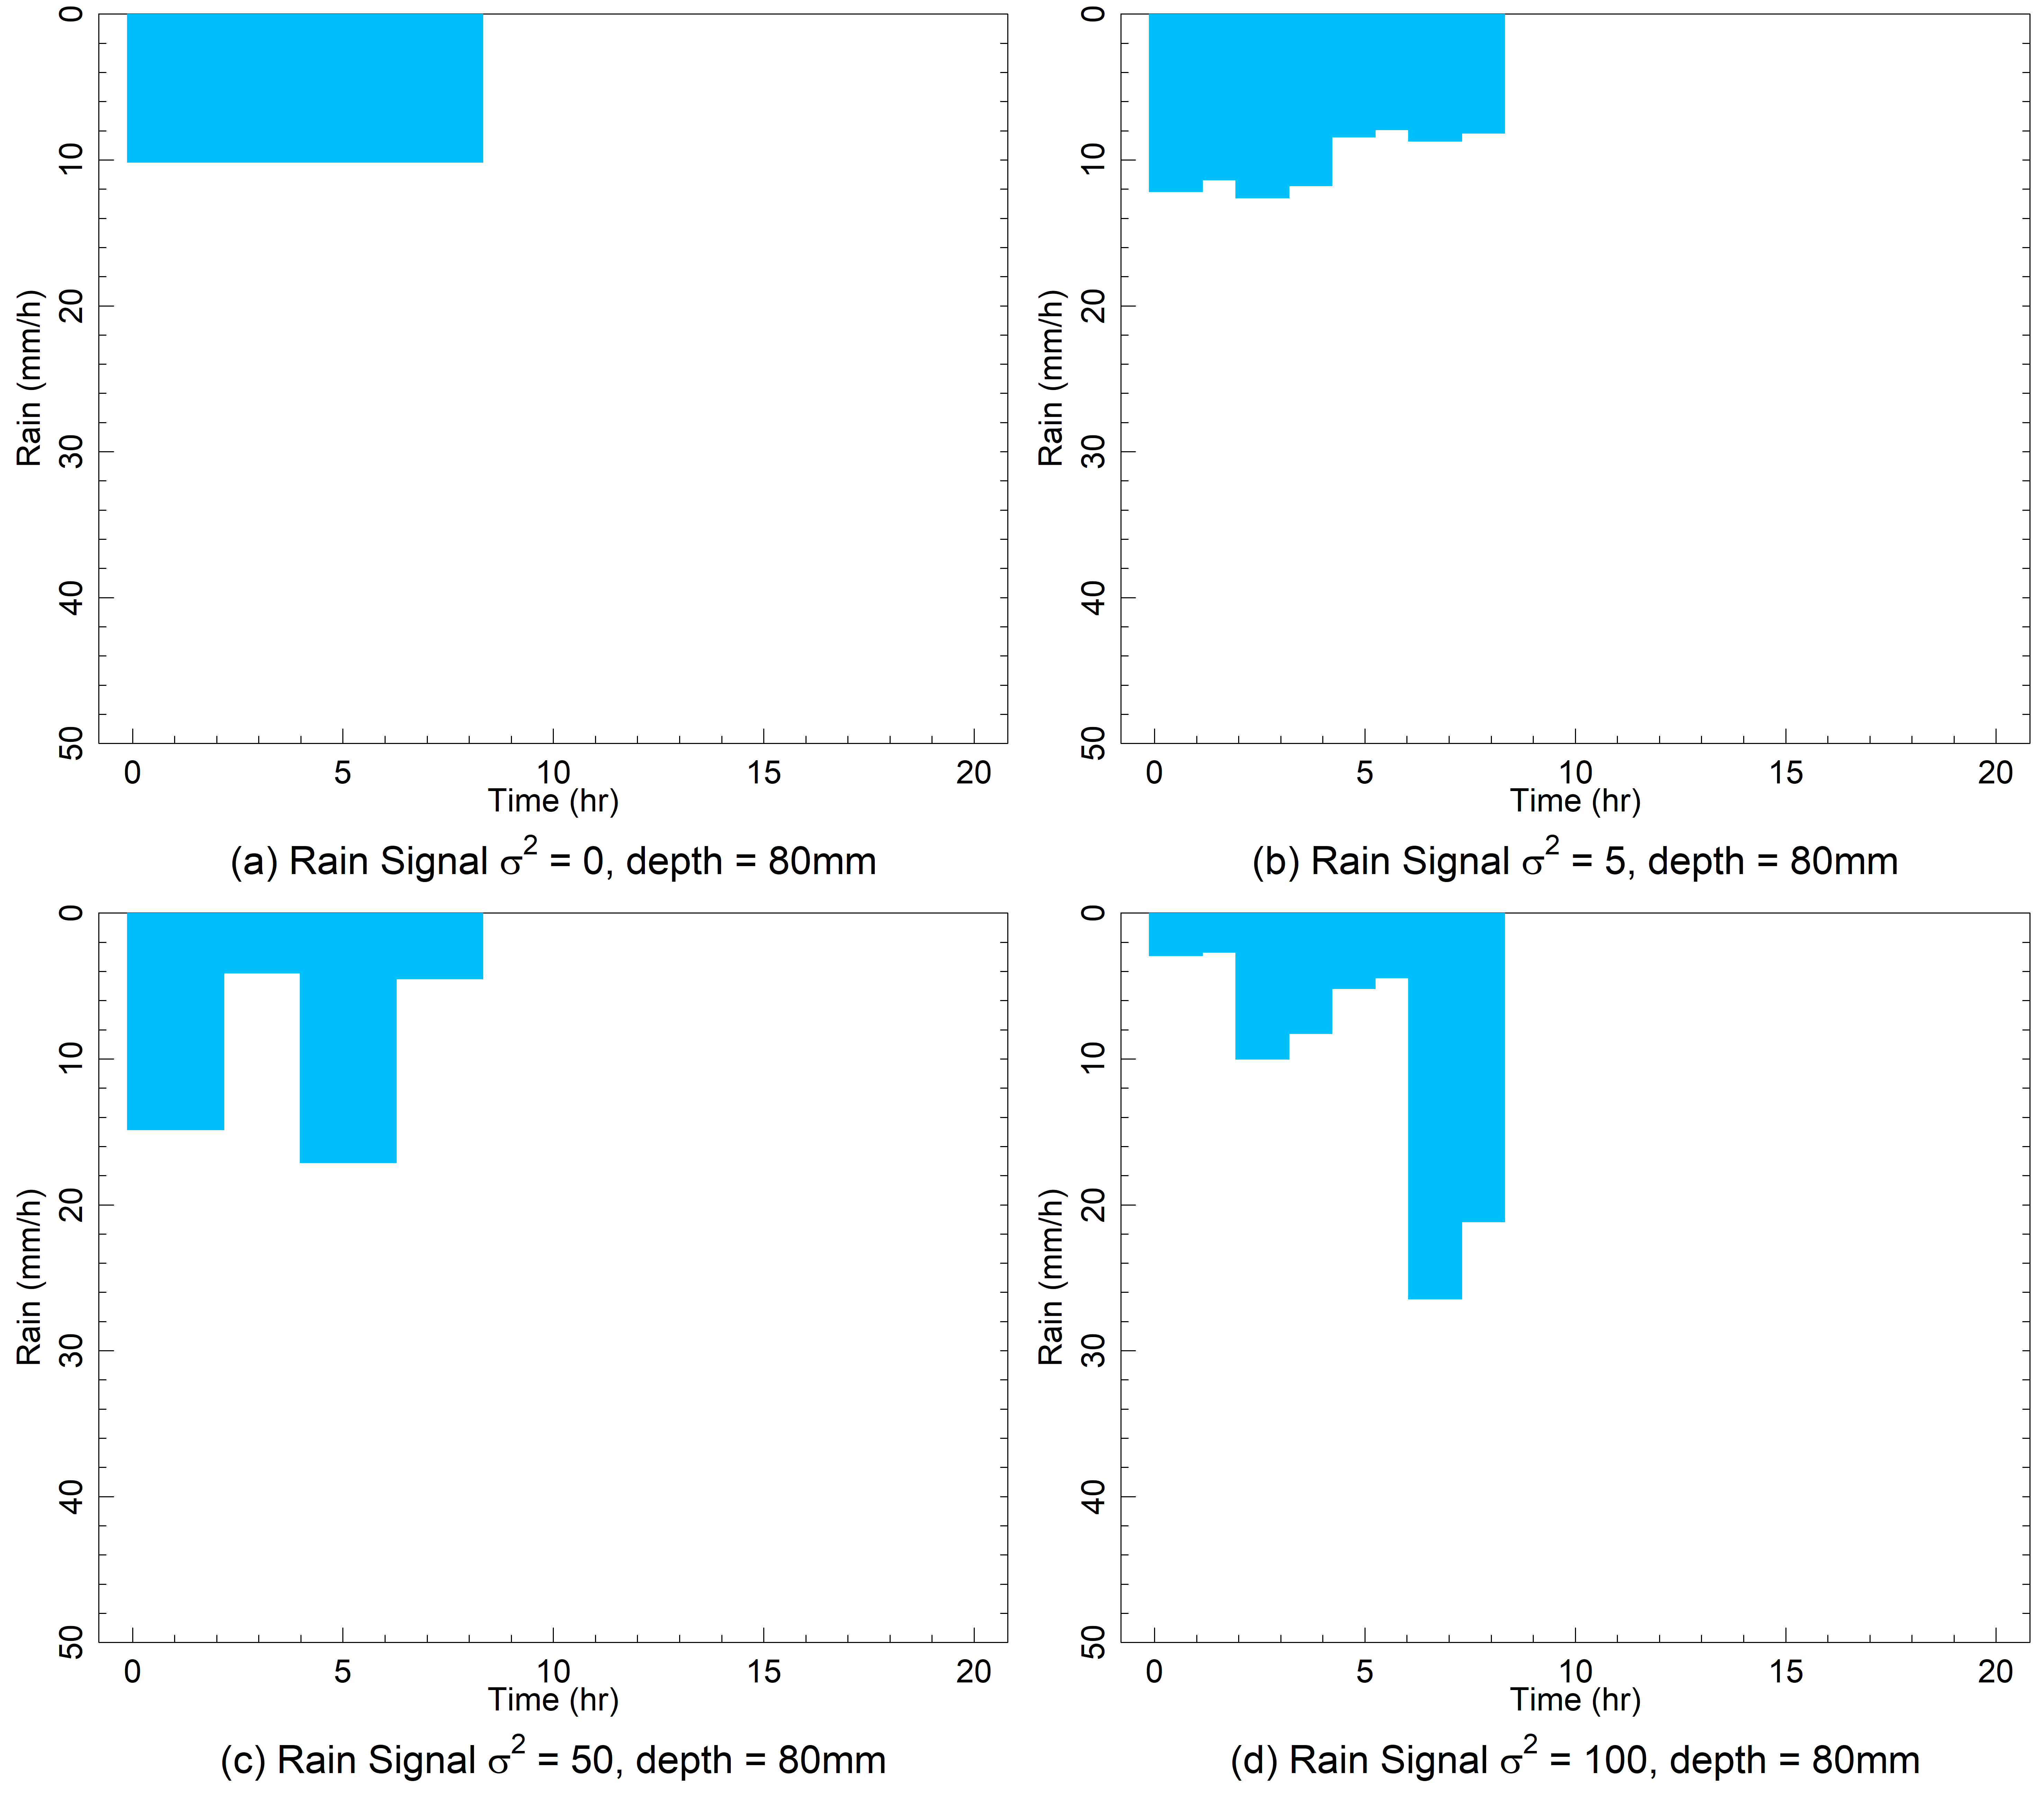
METHODOLOGIES
Rainfall temporal variability
4 synthetic rain signals
  Same volume
  Same duration
  Different variabilities
Generated randomly based on the Poisson distribution
Placed as rain gauge data moving from west to east

Slide 7
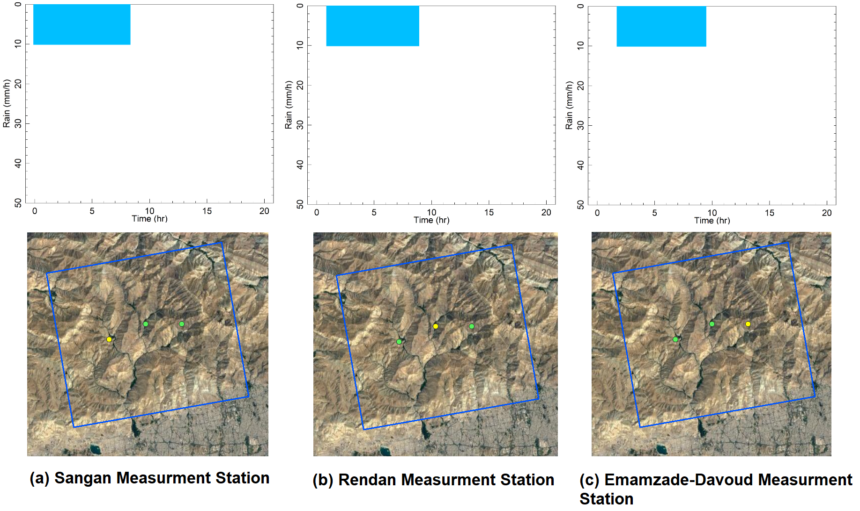
METHODOLOGIES
Rain movement
West to east with 5km/h Velocity

Slide 8
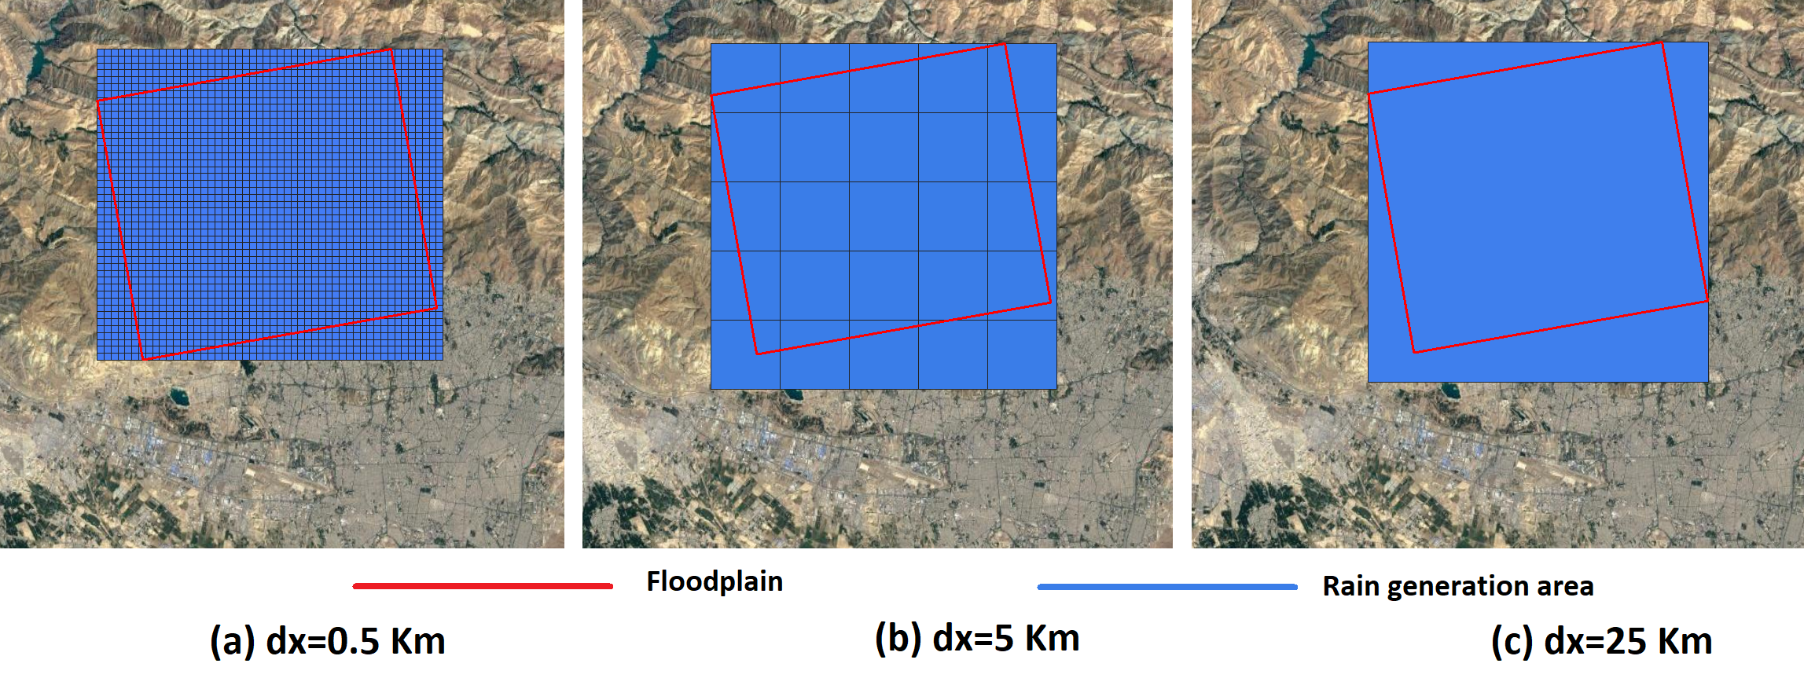
METHODOLOGIES
Rain spatial variability
Rain gauge data spatially interpolated based on IDW
5 different resolutions (dx=0.5km, dx=5km, dx=10km, dx=12.5km, dx=25km)
High spatial variation
No spatial variation

Slide 9
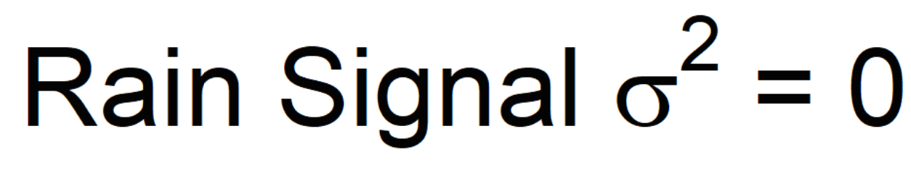

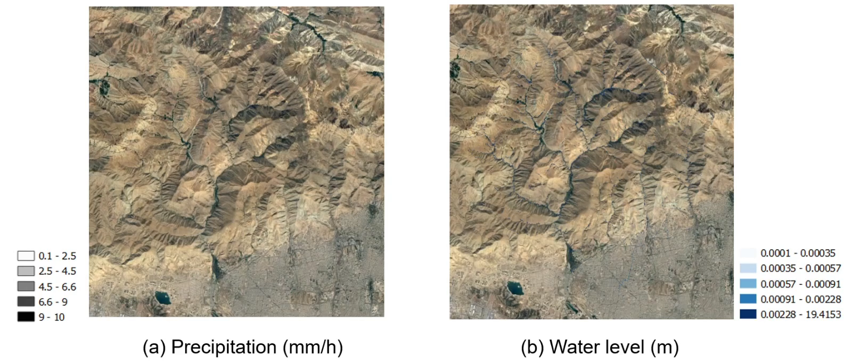
METHODOLOGIES
Rain spatial variability

Slide 10
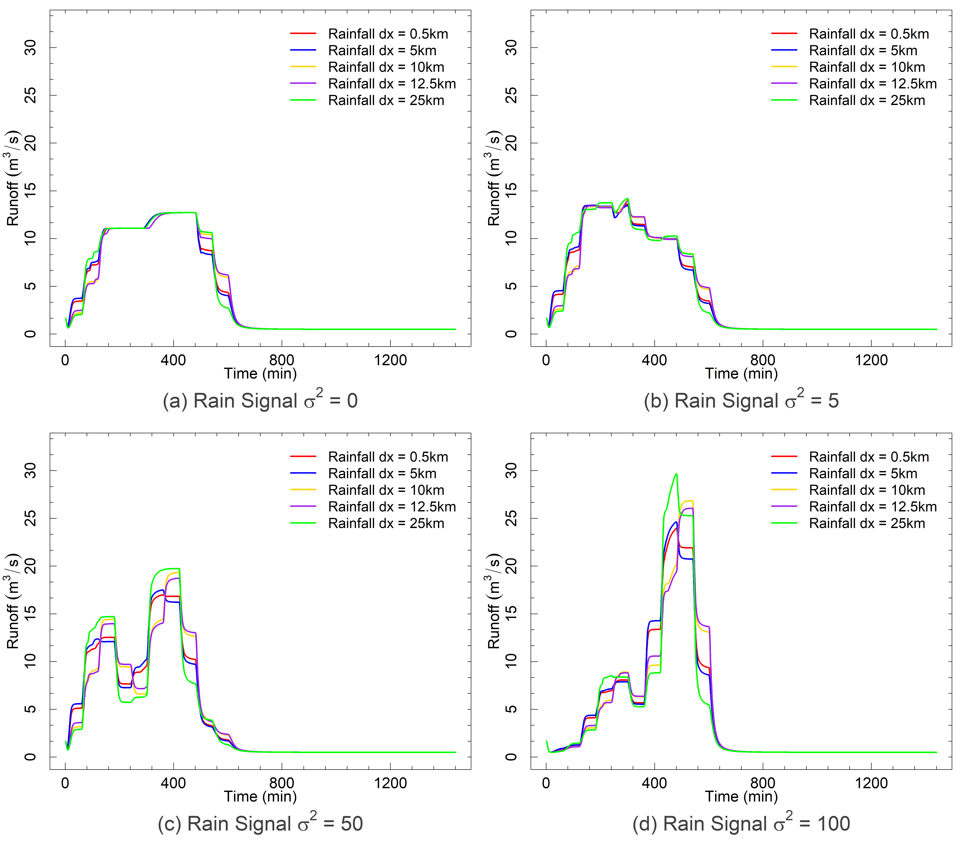
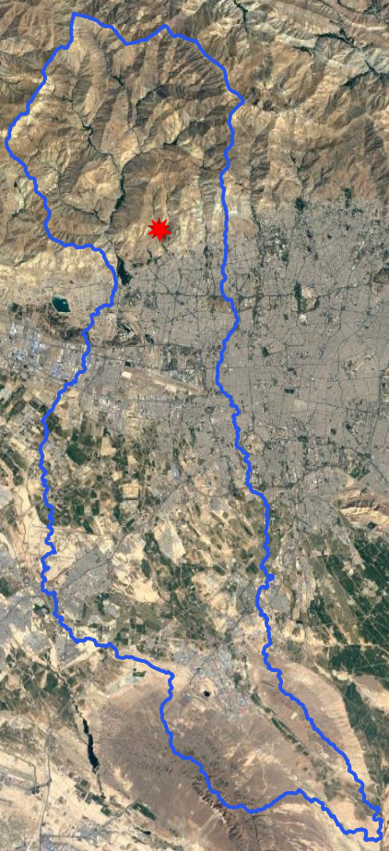
Results
More differences in higher temporal variated rain signals
Differences both in peak discharge and the onset of runoff

Slide 11
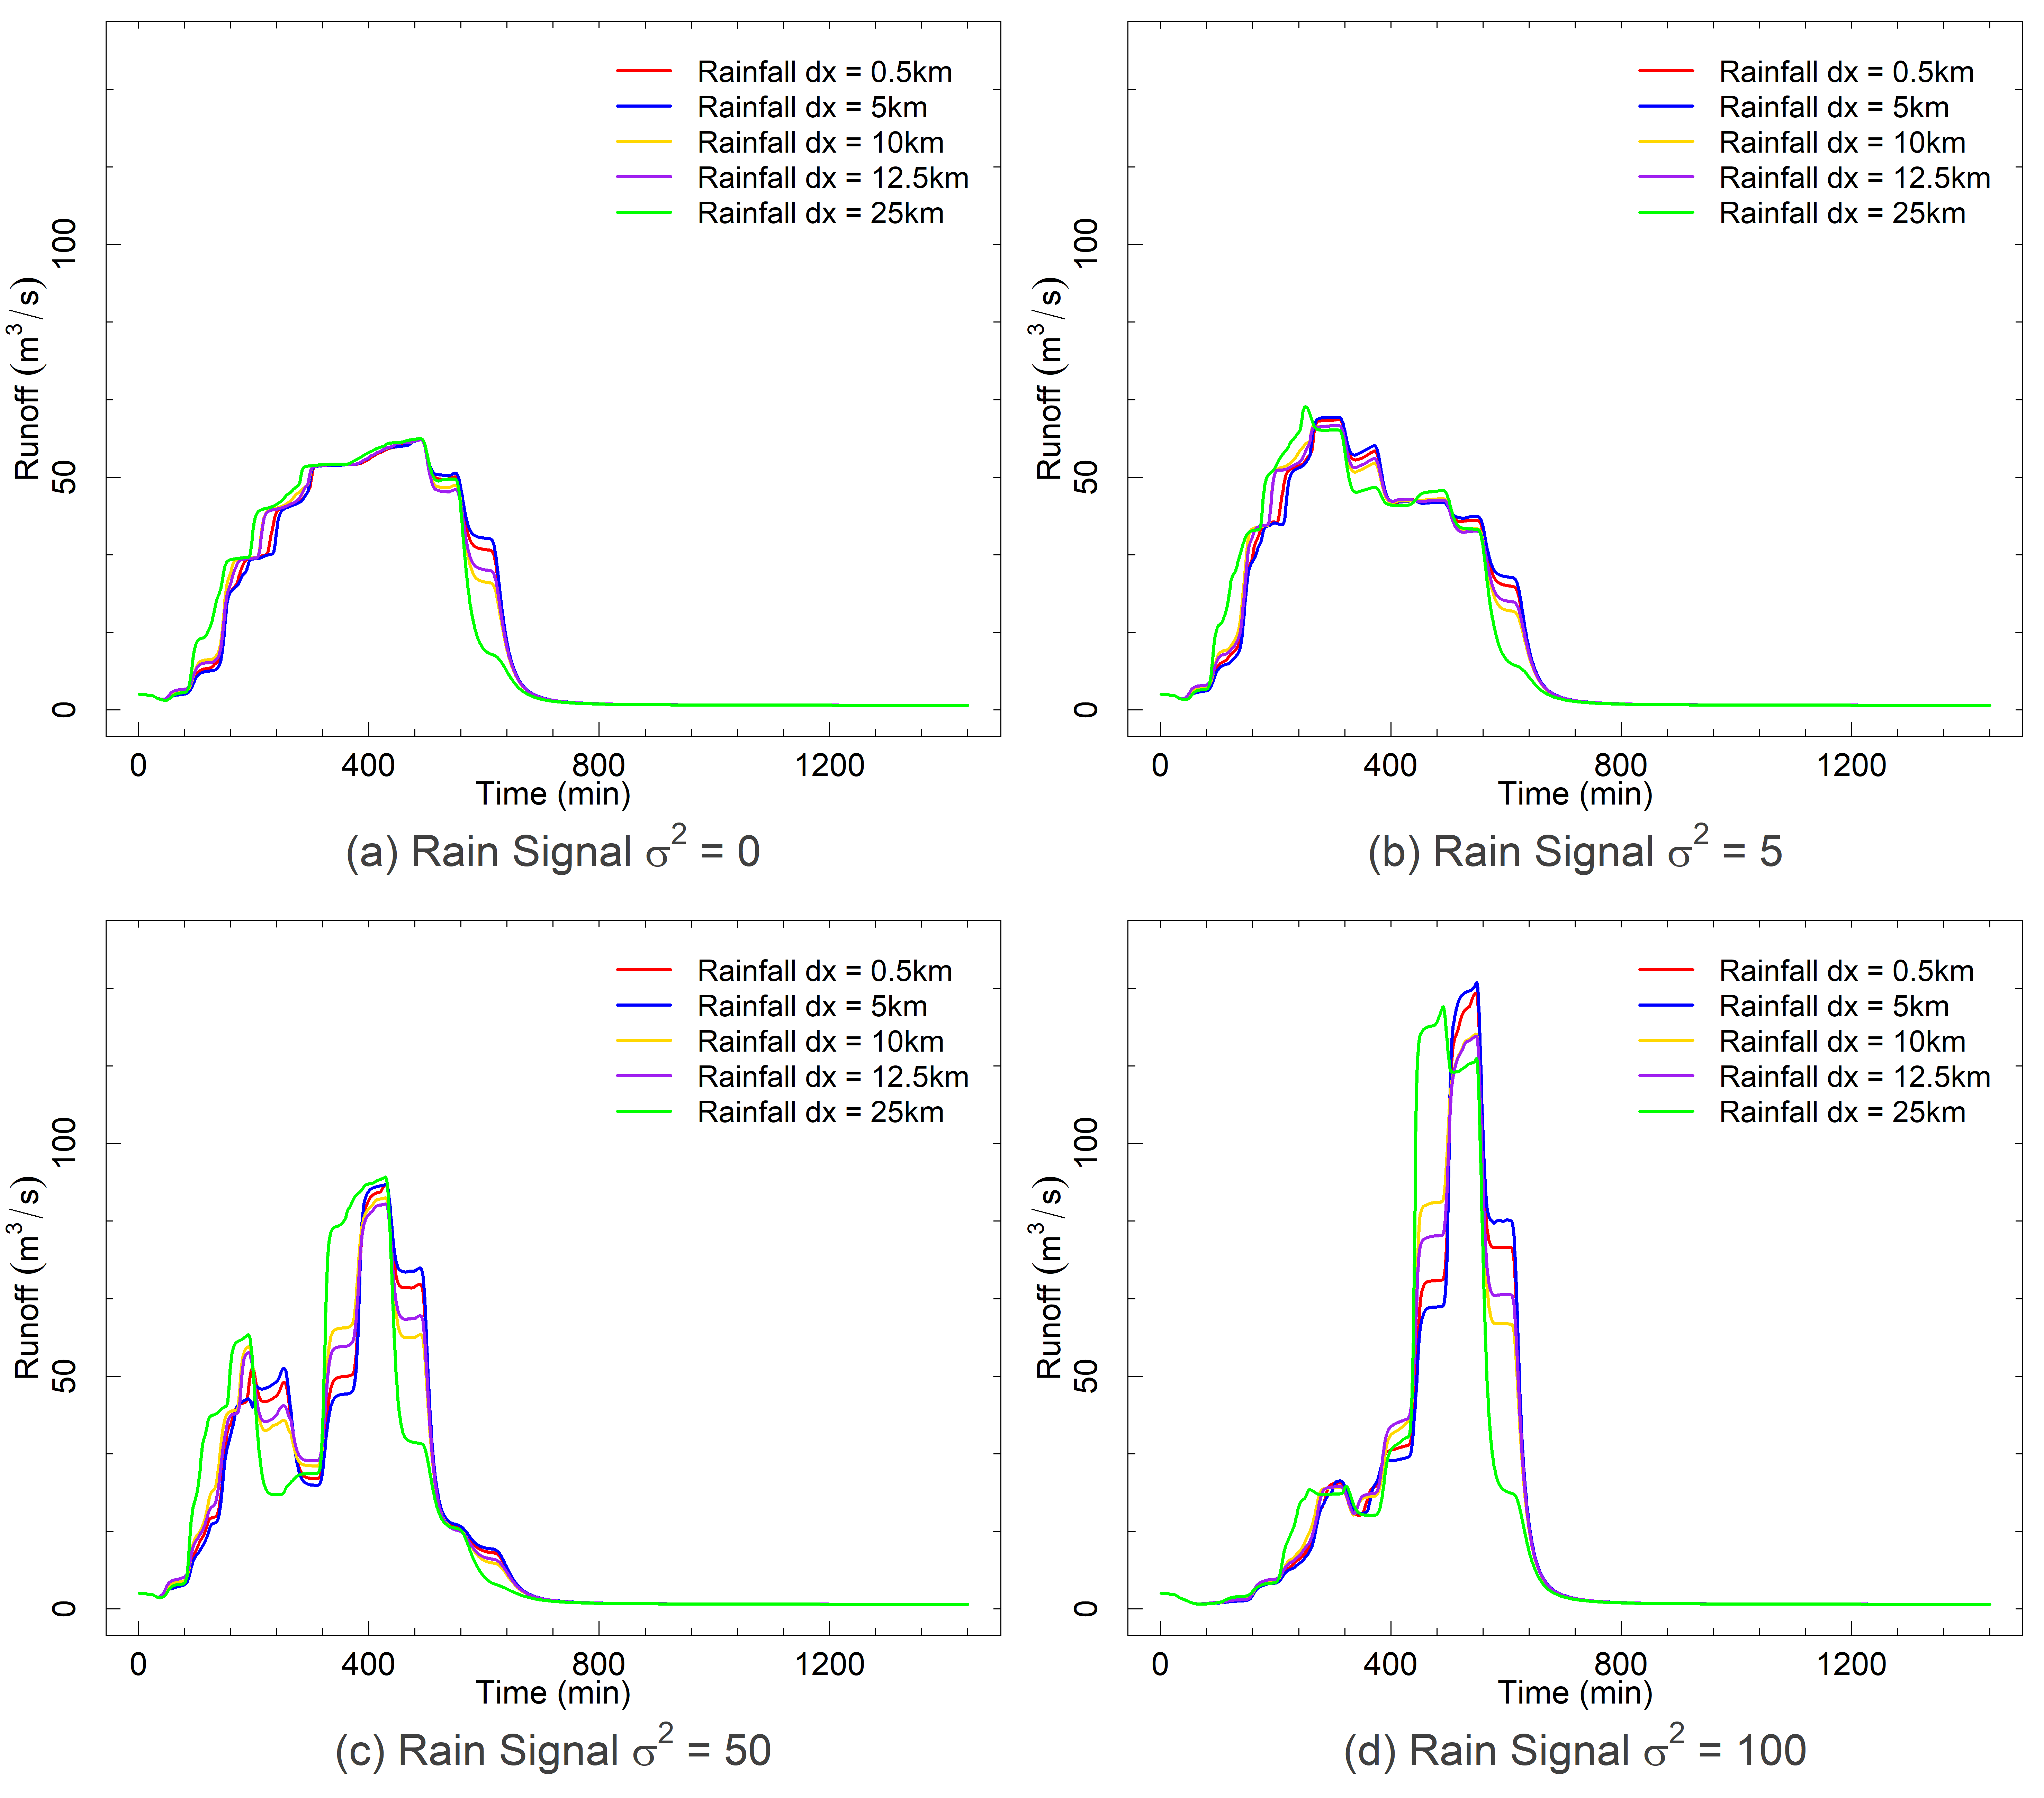
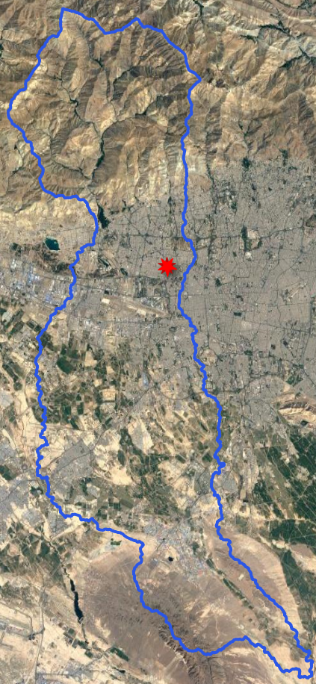
Results
Differences still seen in the middle part of the catchment but at a lower extent

Slide 12
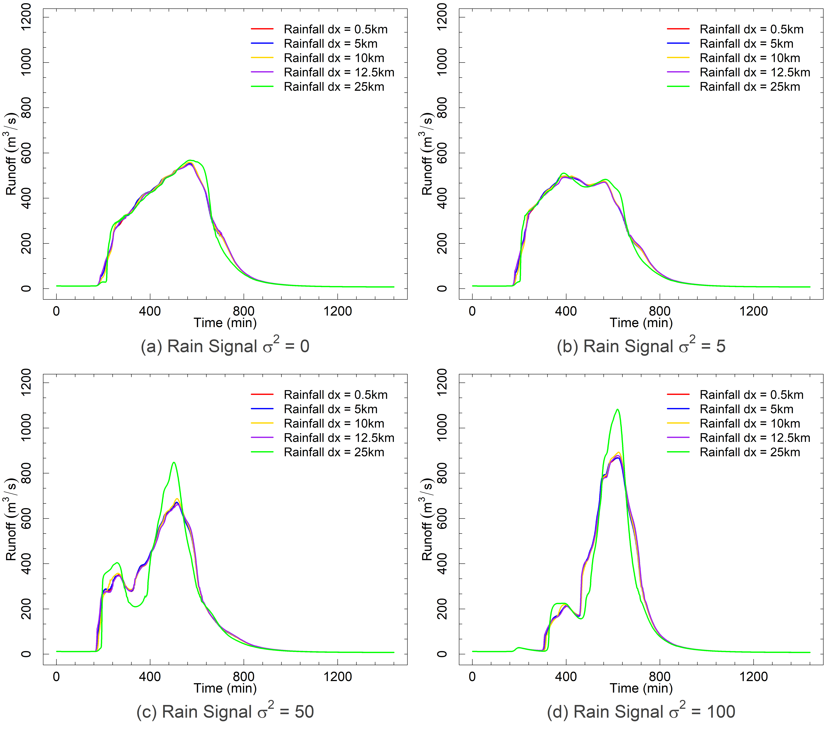
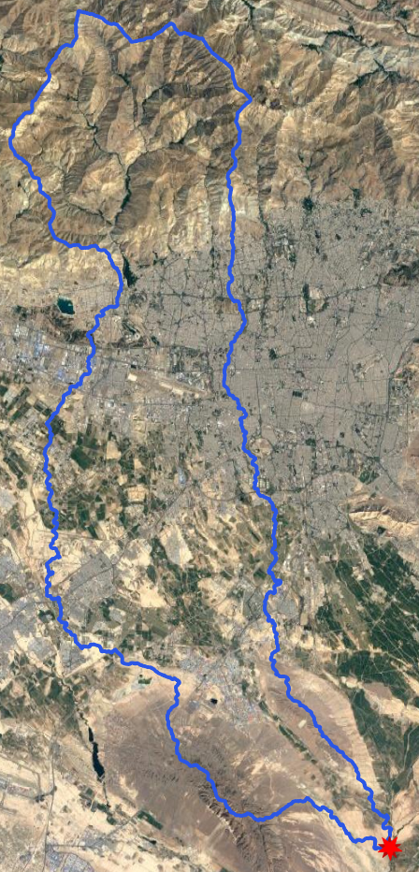
Results
Differences decrease in the lower part of the catchment
dx=25km still shows differences with high temporal variated rain signals

Slide 13
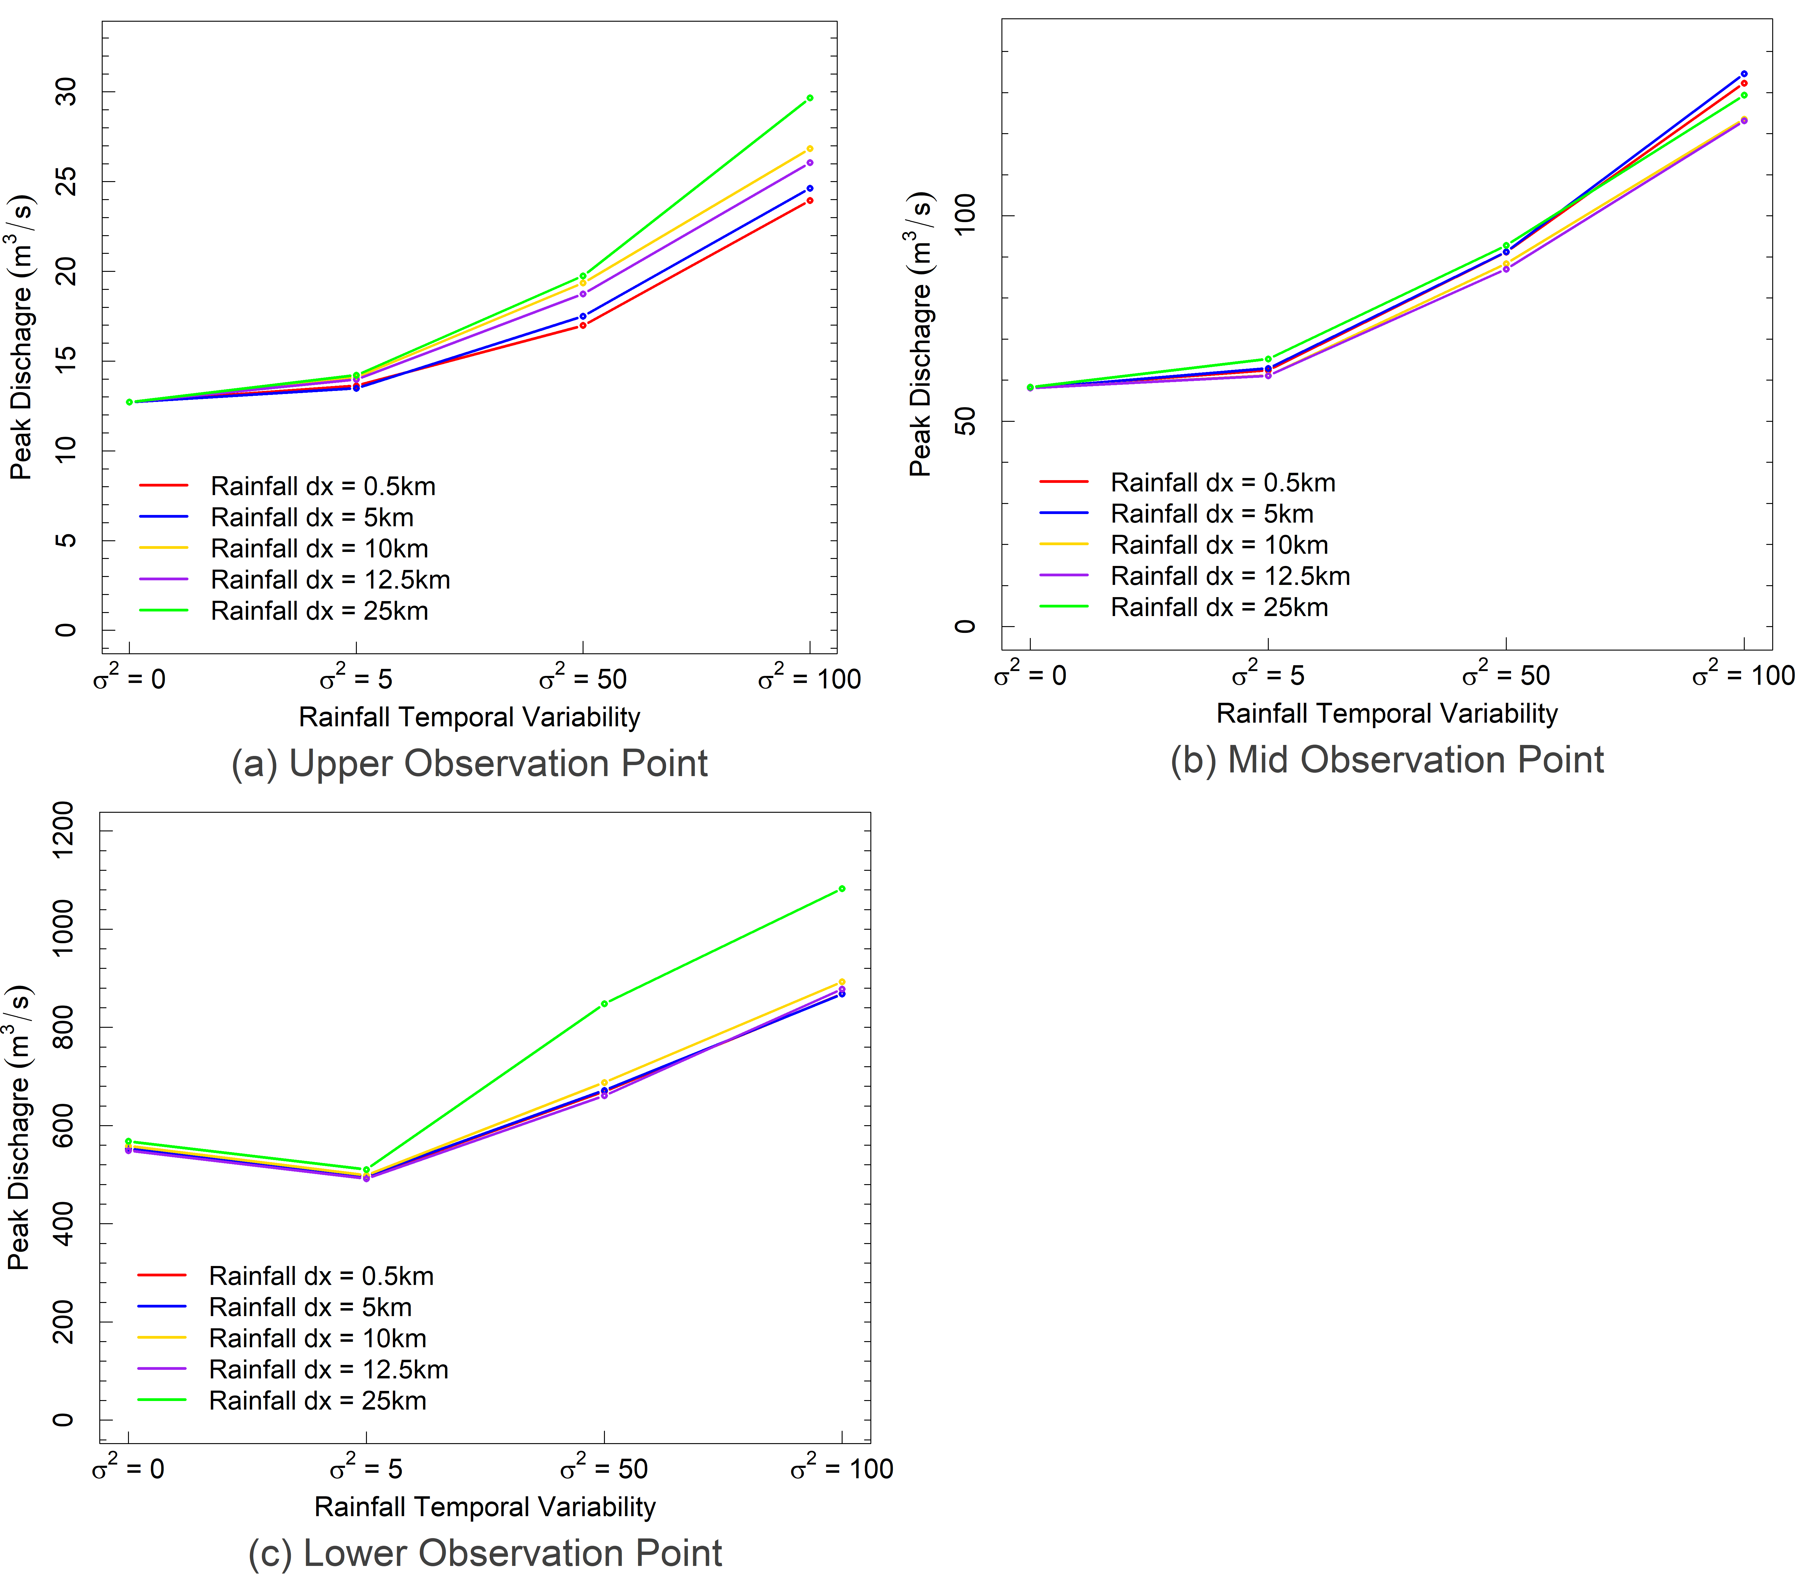
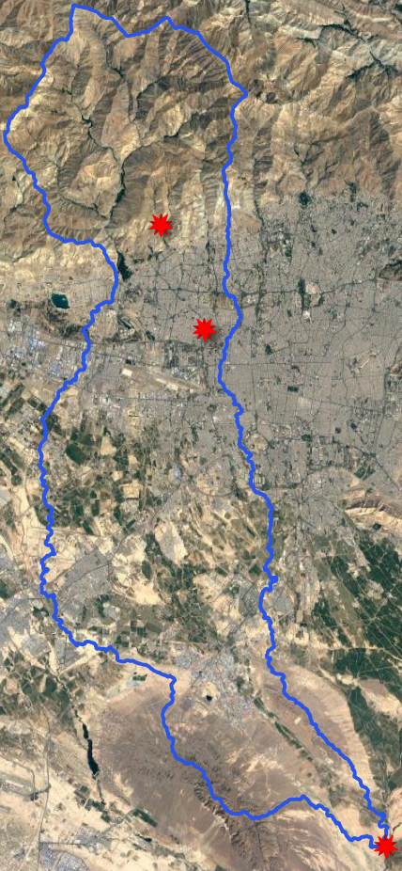
Results
Higher temporal variability results in higher variances in peak discharge.
Observation points vary in their sensitivity depending on their location in the catchment

Slide 14
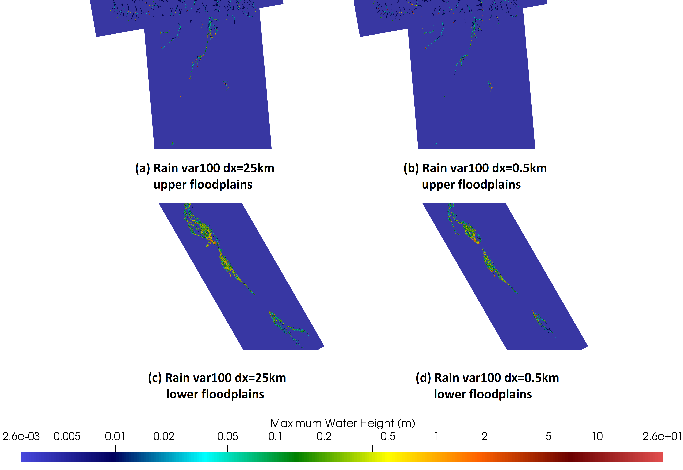
Results
Differences seen in the maximum water heights and flooded areas.
The lower floodplains show the most differences.

Slide 15
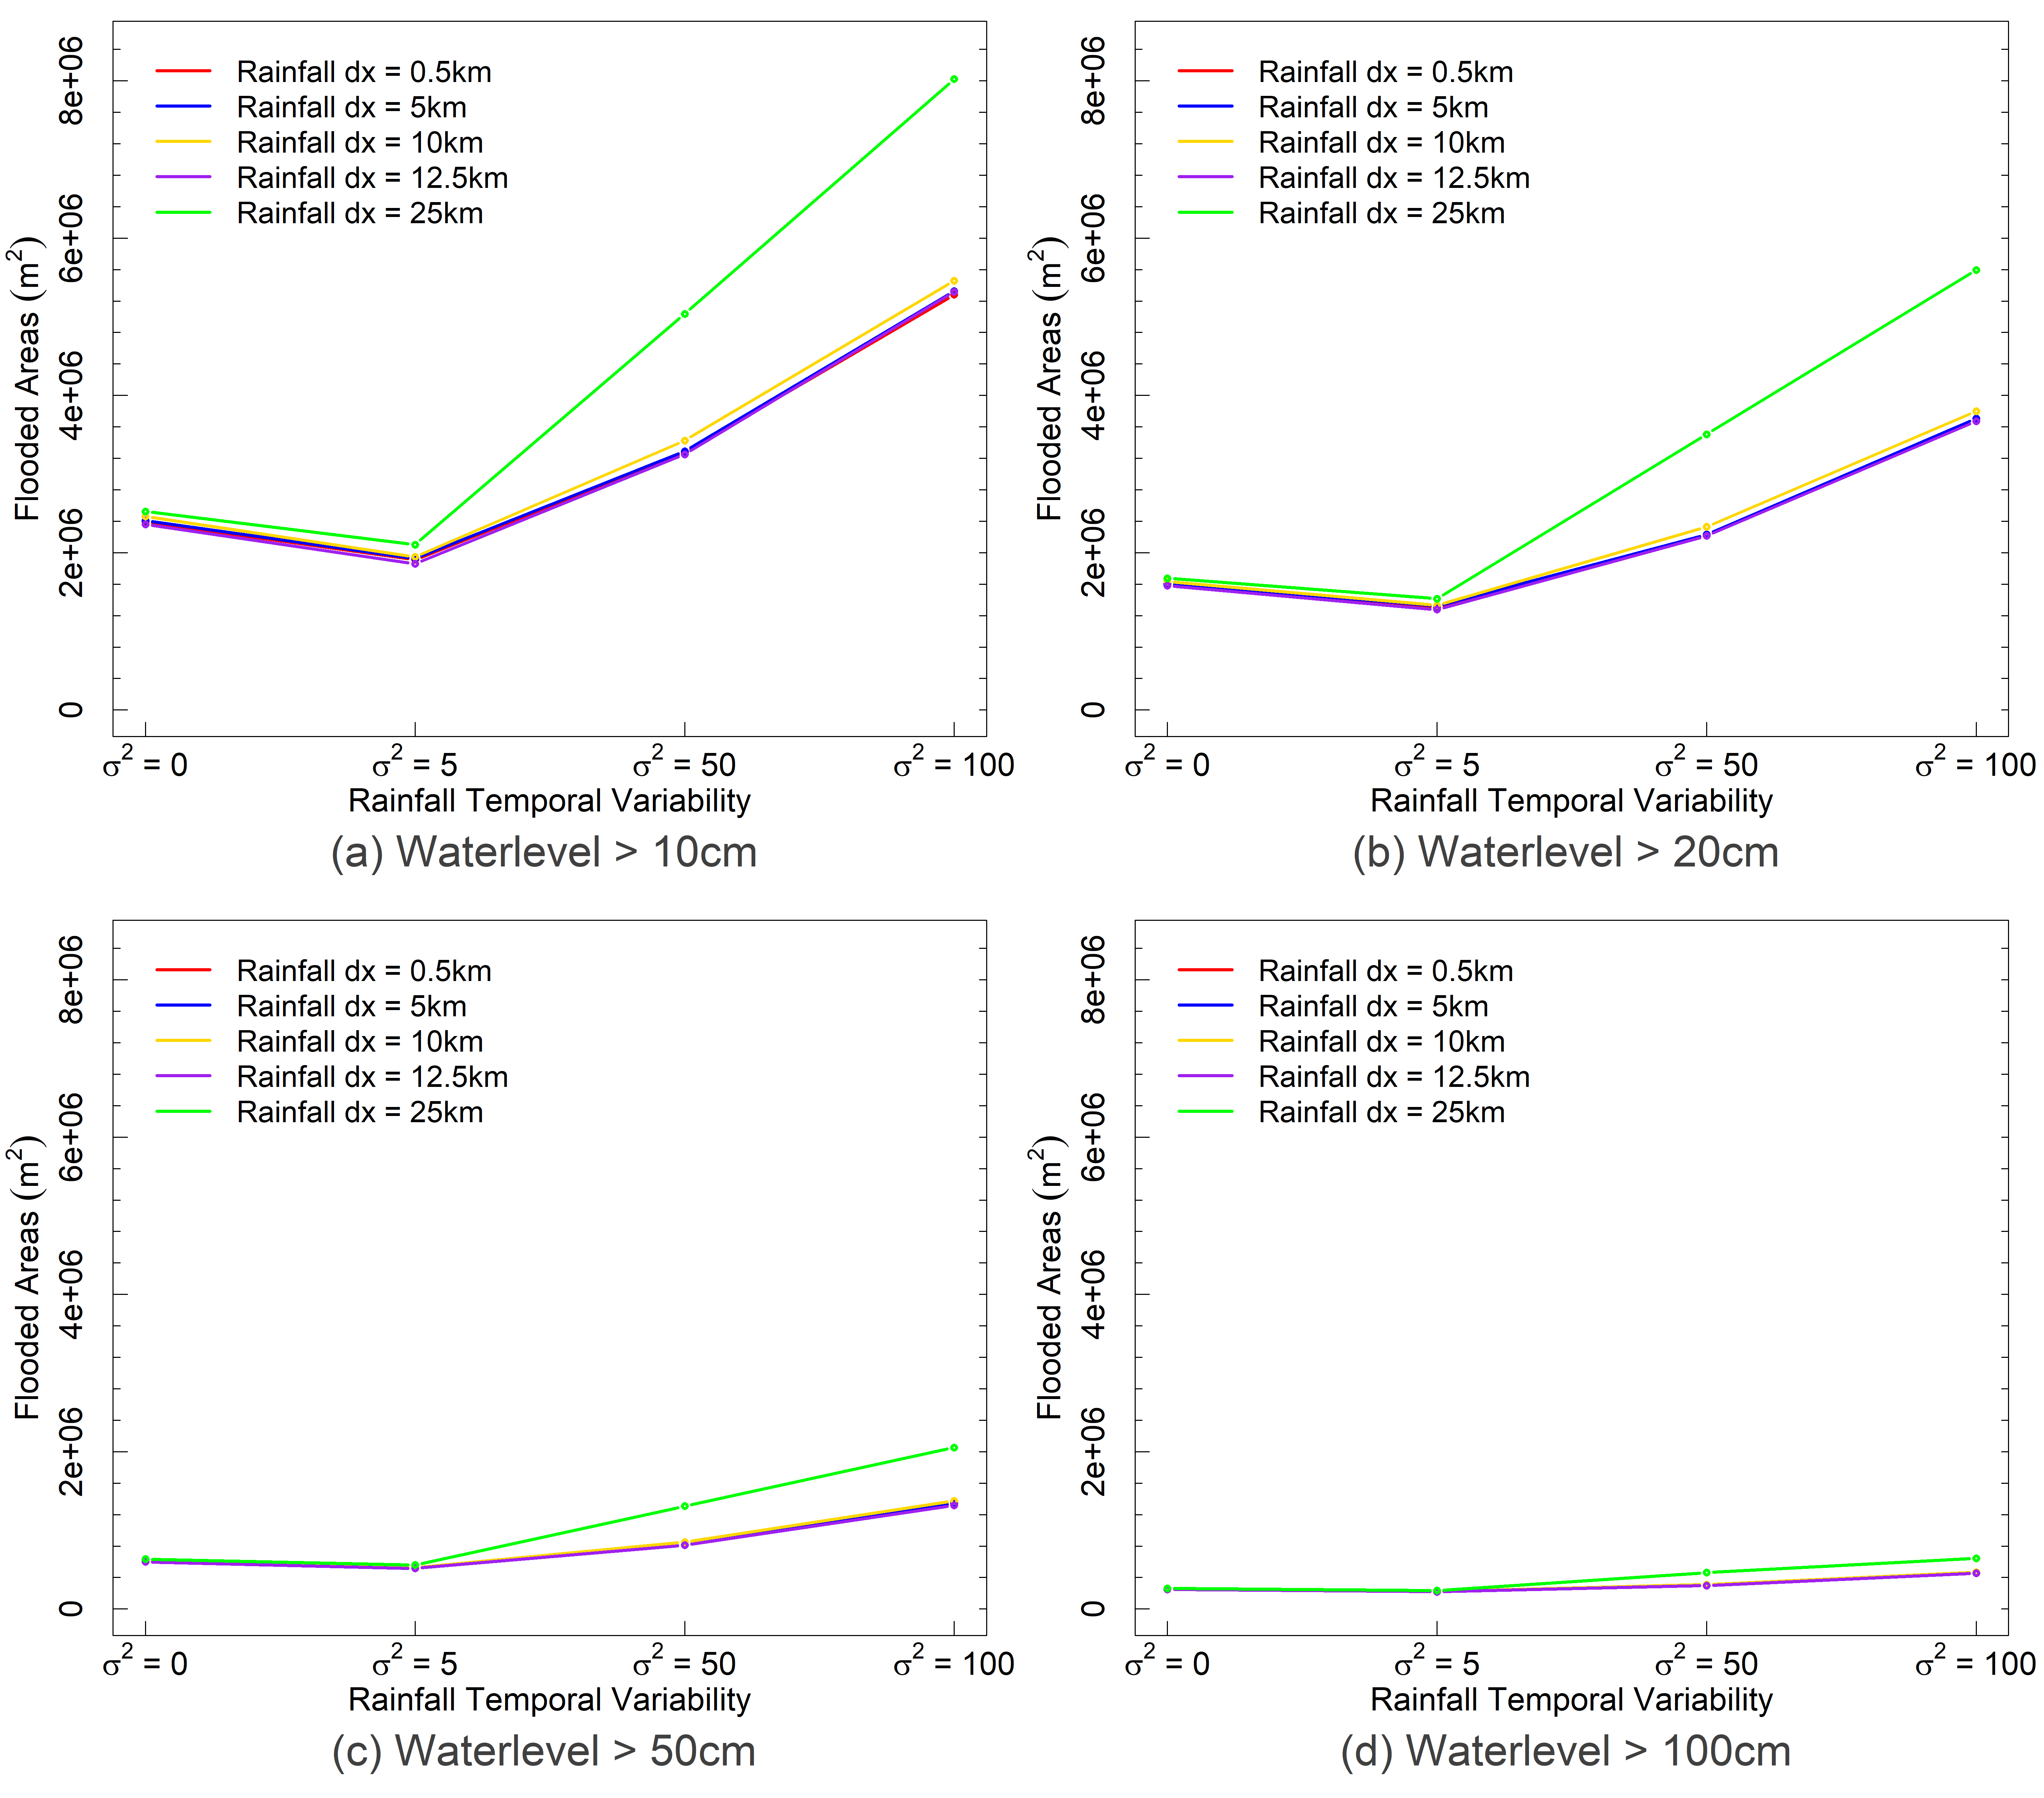
Results
The most differences seen in flood areas under high temporal variable rain signals.
Lower water levels show the most sensitivity
dx=25km shows the most variance compared to other spatial resolutions

Slide 16

Conclusions
This study highlights the importance of Precipitation spatial variability in presence of highly temporal variated rain signals in flash flood modelling.
The resulting flood maps highlight the importance of rainfall spatial-temporal variability in the estimation of flood likelihood in urban catchment areas.
It is shown that the effects of rainfall spatial-temporal variability on runoff generation can vary depending on the location in the catchment
Uniform precipitation (dx=25km) model results show the most variation compared to other spatial interpolation resolutions

Slide 17

Resources
Cristiano, E., ten Veldhuis, M.-C., and van de Giesen, N.: Spatial and temporal variability of rainfall and their effects on hydrological response in urban areas – a review, Hydrol. Earth Syst. Sci., 21, 3859–3878, https://doi.org/10.5194/hess-21-3859-2017, 2017.
Maier R, Krebs G, Pichler M, Muschalla D, Gruber G. Spatial Rainfall Variability in Urban Environments—High-Density Precipitation Measurements on a City-Scale. Water. 2020; 12(4):1157. https://doi.org/10.3390/w12041157
ProMaIDes (2021): Protection Measures against Inundation Decision support. https://promaides.h2.de (last access 12.04.2021)
Acknowledgement
This research was supported by the German Federal Ministry of Education and Research (BMBF) in the "International disaster and risk management"-call (IKARIM) as part of the “Research for Civil Security” framework program.

