Slide 1
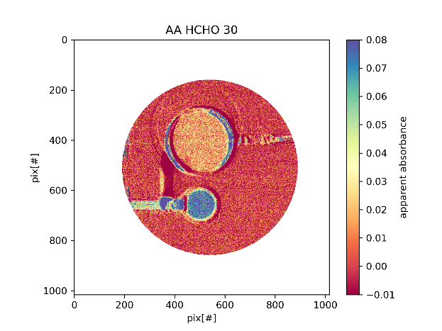
IFPICS: Combining the advantages of hyperspectral imaging and filter cameras for trace gas imaging
Alexander Nies¹, Christopher Fuchs¹, Jonas Kuhn^{1,2}, Nicole Bobrowski^{1,2} and Ulrich Platt^{1,2}
1)Heidelberg University, Institute of Environmental Physics, Heidelberg
2)Max Planck Institute for Chemistry, Mainz

Slide 2
Motivation
Scientific Goal: Building a compact and robust imaging instrument to monitor fast physical and chemical processes in the atmosphere, which combines a high spatio-temporal resolution with a high trace gas selectivity .
Common approaches:
Hyperspectral imaging (Imaging DOAS):
Band pass filter cameras:
+ measurement of several trace gases simultaneously
+ high selectivity and sensitivity
- spatial scanning reduces the spatio-temporal resolution
+ fast image acqusisition
+ high spatial resolution
- low spectral sensitivity
- strong broadband interferences e.g. by aerosols
Our Approach:
Combining high spectral selectivity and high spatio-temporal resolution by utilizing the periodic transmission features of a Fabry-Perot-Interferometer.
→ Imaging Fabry-Perot-Interferometer Correlation Spectroscopy (IFPICS)

Slide 3
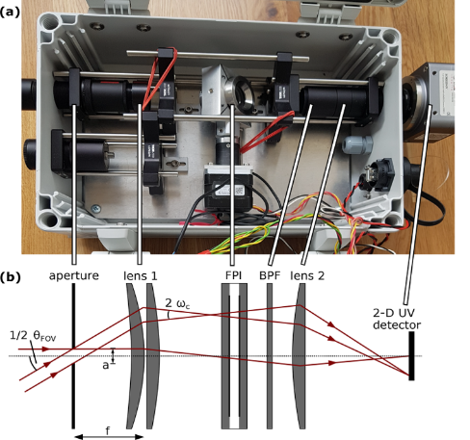
IFPICS prototype instrument
Compact and lightweight instrument optimized for field work
Dimensions: 200x300x130mm and ≈5 kg
Field of view (FOV): 17°
Parallel DOAS setup for calibration
Further information on SO₂ imaging with IFPICS:
Fuchs, C., Kuhn, J., Bobrowski, N., and Platt, U.: Technological advances to improve the quantification of volcanic emissions, EGU General Assembly 2021, online, 19–30 Apr 2021, EGU21-1308, https://doi.org/10.5194/egusphere-egu21-1308, 2021
C. Fuchs, 2019
Fuchs, C., Kuhn, J., Bobrowski, N., and Platt, U.: Quantitative imaging of volcanic SO₂ plumes using Fabry–Pérot interferometer correlation spectroscopy, Atmos. Meas. Tech., 14, 295–307, https://doi.org/10.5194/amt-14-295-2021, 2021

Slide 4
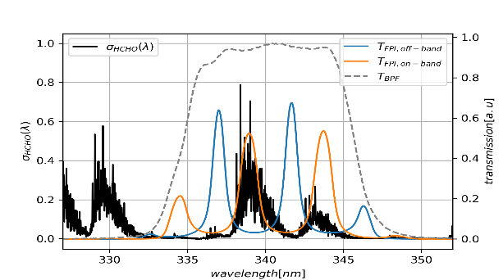
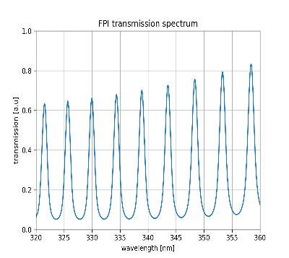
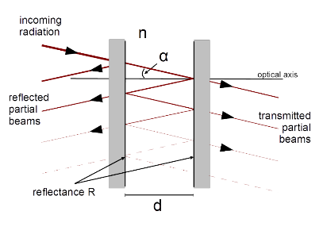
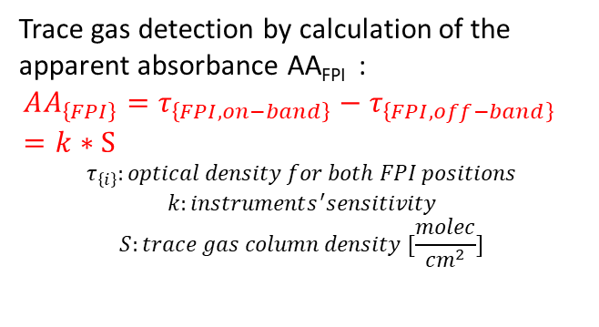
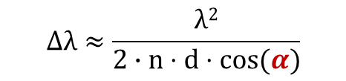
Trace gas detection with IFPICS
(J.Kuhn et al.,2019)
IFPICS measurement principle
Utilzing nearly periodic molecular absorption structures of target trace gas in the UV wavelength range
Using FPI as spectral filter + band-pass-filter (BPF) for choosing the relevant wavelength range (≈ (340± 5) nm)
Tuning of transmission spectrum T_{FPI} by incidence angle α (shift in ∆λ)
Off-band setting: T_{FPI} anti-correlates with narrowband absorption structures
On-band setting: T_{FPI} correlates with narrowband absorption structures
Fabry-Perot-Interferometer (FPI):
$$∆λ≈\frac{λ2}{2∙n⋅d⋅cos(α)}$$
Trace gas detection by calculation of the apparent absorbance AA_{FPI} :
$$AA_{\left\{FPI\right\}}=τ_{\left\{FPI,on−band\right\}}−τ_{\left\{FPI,off−band\right\}} =k∗S$$
$$τ_{\left\{i\right\}}:optical density for both FPI positions$$
$$k:instruments^{′}sensitivity$$
$$S:trace gas column density [\frac{molec}{{cm}^{2}}]$$
∆λ
C. Fuchs, 2019

Slide 5
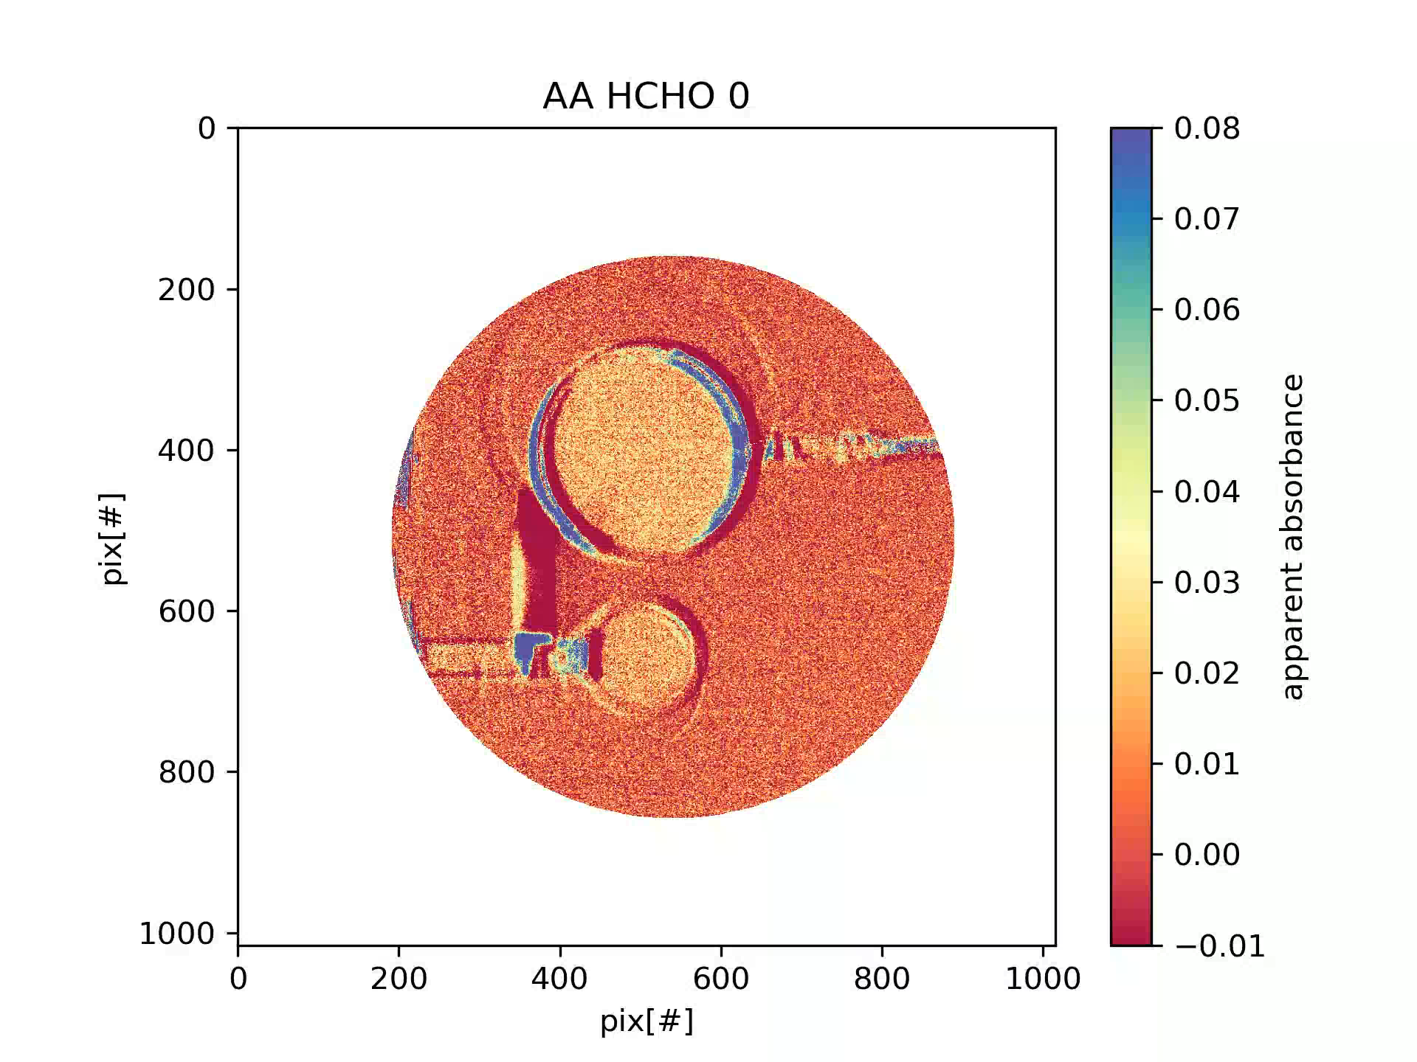
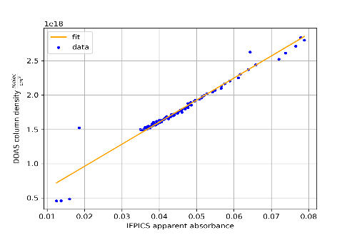
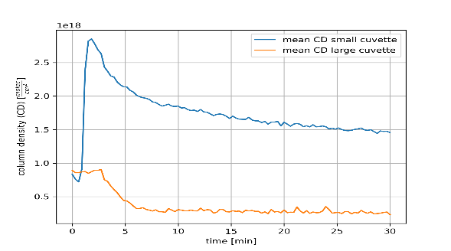


Case study: Formaldehyde (HCHO) imaging
Results:
Heating large cuvette (t=1min)
Heating small cuvette (t=3min)
Cooling of both cuvettes
Start of measurement (t=0min)
End of measurement (t=30min)
2D measurement of HCHO cuvettes with a time resolution of 4s and a spatial resolution of 400x400 pixels
Detection limit: $4.6∗{10}^{16}\frac{molec}{{cm}^{2}}$ for a spatial resolution of 90x90 pixels
Calculated BrO detection limit: $1.6∗{10}^{14}\frac{molec}{{cm}^{2}}$
Measurement of two cuvettes filled with Paraformaldehyde(PFA)
PFA evaporates to gaseous HCHO for T>130°C
Measurement timeline:
Light source: scattered sky light
Exposure time: 1 s
FPI tilt angles: $α_{\left\{on−band\right\}}=9.45°, α_{\left\{off_{band}\right\}}=6.07°$
Calibration via parallel DOAS measurement
Calibration curve:
Mean CD for both cuvettes

Slide 6
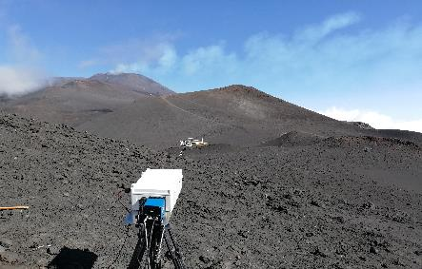
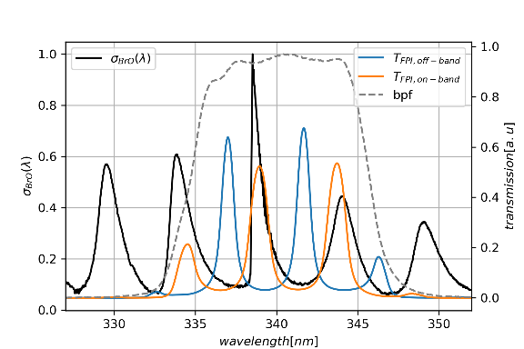
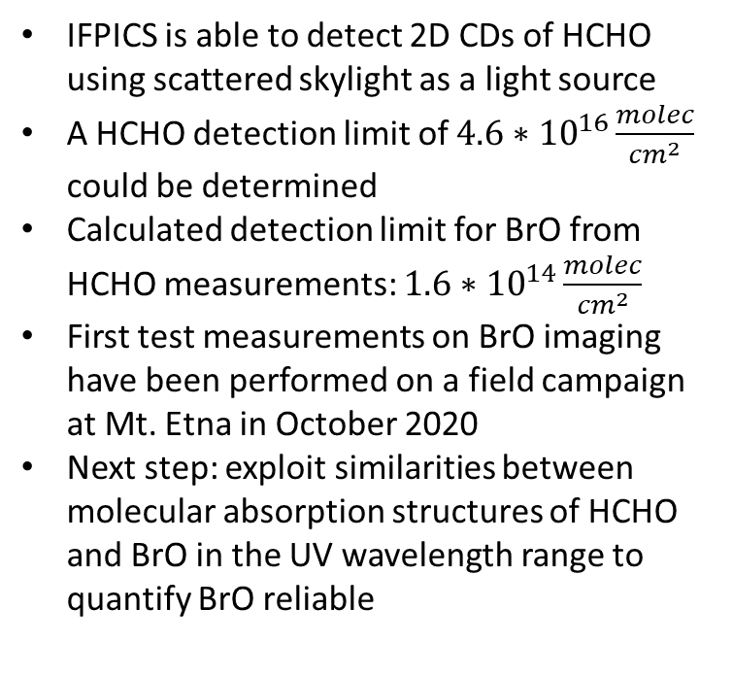
Conclusion and Outlook
IFPICS is able to detect 2D CDs of HCHO using scattered skylight as a light source
A HCHO detection limit of $4.6∗{10}^{16}\frac{molec}{{cm}^{2}}$ could be determined
Calculated detection limit for BrO from HCHO measurements: $1.6∗{10}^{14}\frac{molec}{{cm}^{2}}$
First test measurements on BrO imaging have been performed on a field campaign at Mt. Etna in October 2020
Next step: exploit similarities between molecular absorption structures of HCHO and BrO in the UV wavelength range to quantify BrO reliable

