Slide 1
On the interaction of interplanetary shocks and solar wind turbulence
Alexander Pitňa
Jana Šafránková and Zdeněk Němeček
Charles University, Faculty of Mathematics and Physics,
Department of Surface and Plasma Science, Prague, Czech Republic
EGU General Assembly 2021
27. 4. 2021
EGU21-2853
Notes:
Good afternoon. My name is Alexander Pitna and I will be presenting my latest research on the topic of interaction of interplanetary shocks and solar wind turbulence.

Slide 2
Outline
Aim
  Do enhanced turbulent fluctuations in the downstream region of IP shocks heat the plasma?
Turbulence and IP shocks
  Turbulence
  IP shocks
  Previous studies on interaction of IP shocks and turbulence
Temperature vs Specific entropy
  Evolution of specific entropy in the downstream region
Conclusion and Discussion
Notes:
The particular topic that I will investigate is whether the fluctuations in the downstream region of IP shocks lead to plasma heating which should be observed further downstream with respect to the shock front. Therefore, I will first discuss shortly the turbulent framework, then IP shocks and the previous studies on the topic. Then we will focus on the temperature and specific entropy, I will present a simple model that will help us understand the in-situ single-point measurements of the downstream region of an IP shock. And then I will present the analysis of specific entropy and then conclude the analysis by discussing a few caveats.

Slide 3
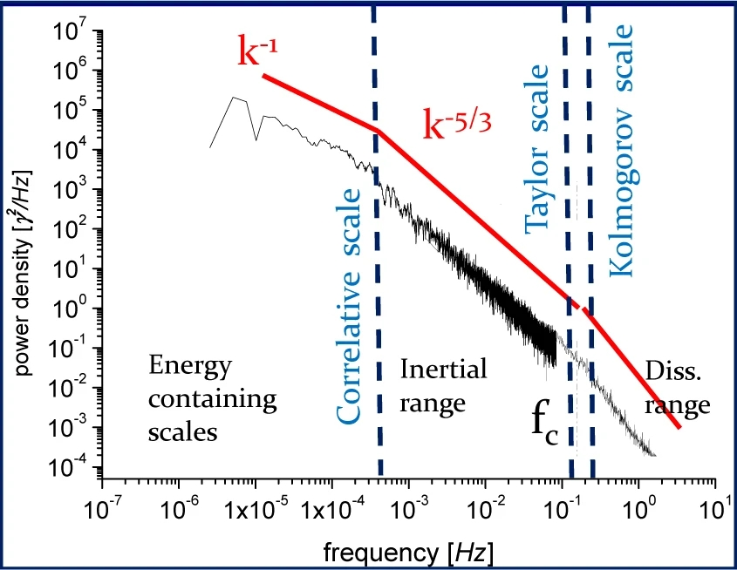

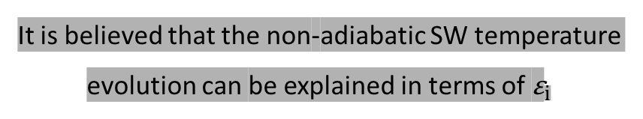
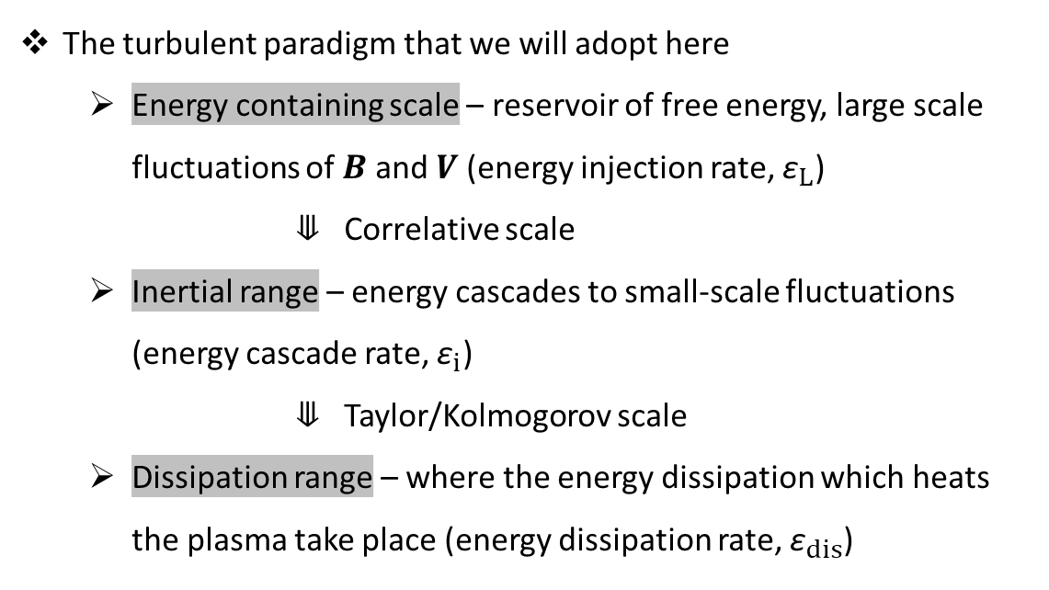






Turbulence
(Magnetohydrodynamic)
Adapted from Bruno and Carbone 2013
The turbulent paradigm that we will adopt here
  Energy containing scale – reservoir of free energy, large scale fluctuations of $B$ and $V$ (energy injection rate, ${\text{ε}}_{L}$)
  ⤋ Correlative scale
  Inertial range – energy cascades to small-scale fluctuations (energy cascade rate, ${\text{ε}}_{i}$)
  ⤋ Taylor/Kolmogorov scale
  Dissipation range – where the energy dissipation which heats the plasma take place (energy dissipation rate, ${\text{ε}}_{dis}$)
$${\text{ε}}_{L}$$
$${\text{ε}}_{i}$$
$$P_{B}≡$$
$${\text{ε}}_{dis}$$
$${\text{ε}}_{L}≅{\text{ε}}_{i}≅{\text{ε}}_{dis}$$
It is believed that the non-adiabatic SW temperature evolution can be explained in terms of ${\text{ε}}_{i}$
$${\text{ε}}_{i}={21.8}^{3}f_{sp}^{5/2}P_{B}^{3/2}V_{sw}^{−1}N_{p}^{−3/2}$$
$$\left[{\text{ε}}_{i}\right]=J∙{kg}^{−1}∙s^{−1}= {km}^{2}∙s^{−3}$$
We will follow Smith and Vasquez (2021) in the estimation of the average energy cascade rate, ${\text{ε}}_{i}$
Notes:
First, I will introduce the turbulent paradigm that we will adopt here. The figure shows a typical power spectrum of magnetic field fluctuations. The classical interpretation is that at large scales the fluctuations ( ) contain the free energy that will become part of the turbulent cascade defined be the inertial range, where the energy from large scale fluctuations is transferred to fluctuations with smaller and smaller scales and eventually the fluctuations reach the characteristic kinetic scale (thermal gyroradius or inertial length of the proton) and the energy within the fluctuations is transformed in to stochastic motions of the particles, dissipating the cascaded energy from the large scales.

Slide 4
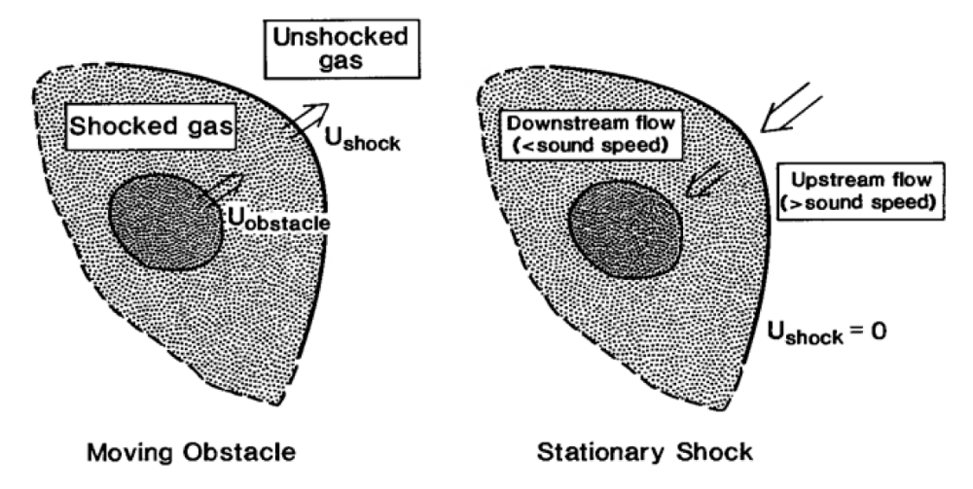
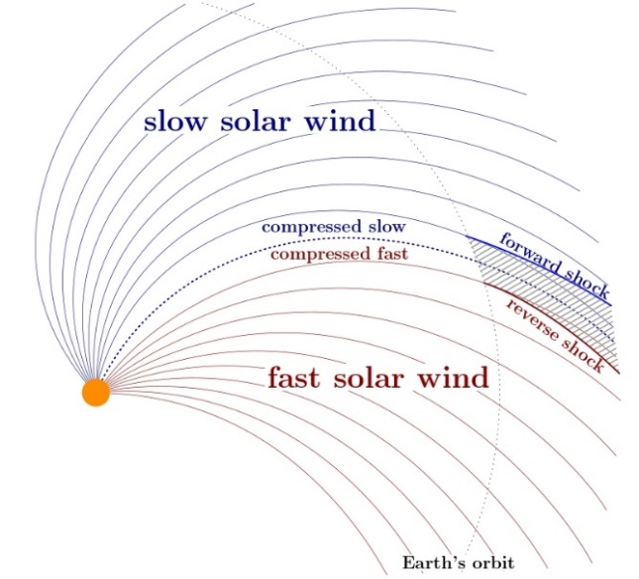
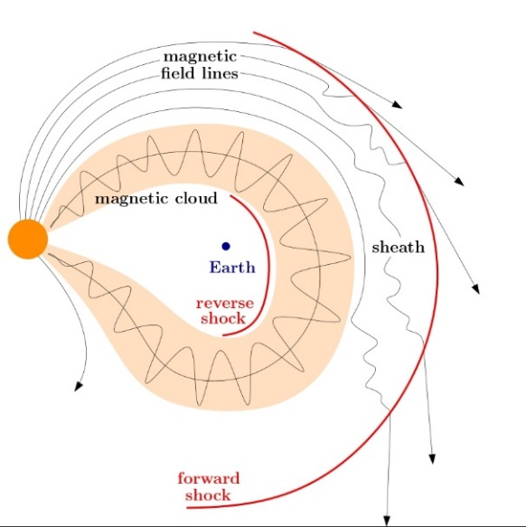
IP shocks
(fast magnetosonic forward)
Adapted from Kivelson and Russell (1995)
They naturally form around an obstacle whose relative velocity with respect to a surrounding medium exceeds the characteristic wave speed in this medium
  Key phenomenon in production of Solar Energetic Particles (SEPs)
  May enhance the solar wind–magnetosphere coupling efficiency
  They increase the levels of fluctuations (e.g., B, N) of the upstream medium
I will focus on the last point and I will introduce the latest studies on this topic that are crucial for the analysis
ICMEs and CIRs naturally produce fast forward IP shocks
CIR
ICME
→
Adapted from Pitňa et al. 2021, accepted
Notes:
Considering IP shocks, I will make just a short introduction, because everybody here knows a lot about them.

Slide 5
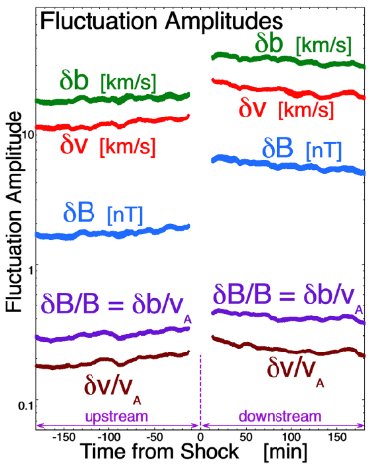
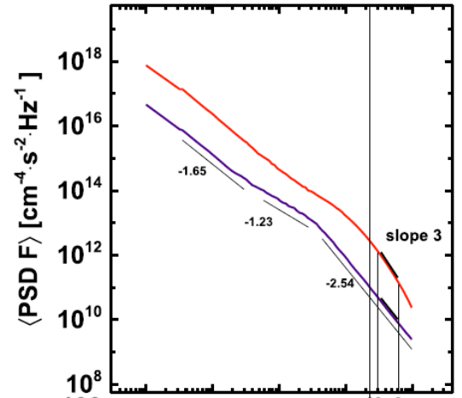




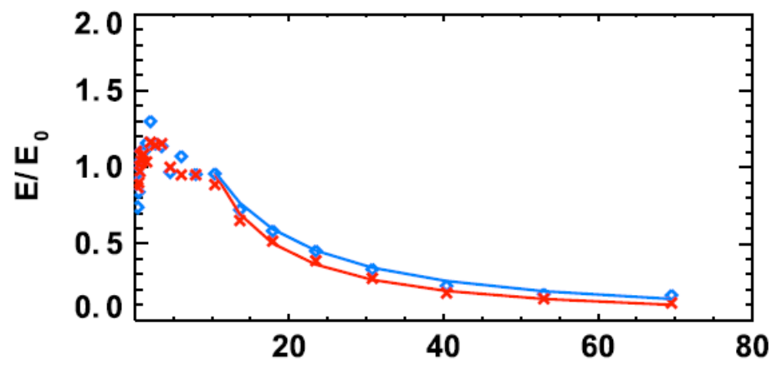




Previous studies on interaction of IP shocks and turbulence
Illustrative animation of the interaction
(IP shock frame)
Adapted from Borovsky (2019)
Adapted from Pitňa et al. (2016)
Decaying downstream turbulence
Upstream turbulence
Color codes the amplitude of perpendicular magnetic field fluctuations
$$t_{sh}$$
IP shock
What are the changes in fluctuations from upstream to downstream of IP shocks?
  Enhancement in the power is roughly tenfold
$$E_{k}∝t^{−1.2}$$
$$t_{d}=10$$
$$E_{b}∝t^{−1.2}$$
2) How does the enhanced level of fluctuations evolve?
  The energies within the fluctuations are constant for a significant time after the shock passage and then both the kinetic and magnetic energies rapidly decay
Q: Is this energy transformed into random particle motion–heat?
Adapted from Pitňa et al. (2017)

Slide 6
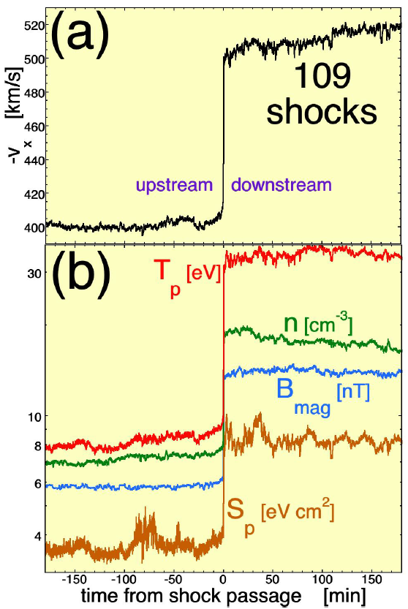
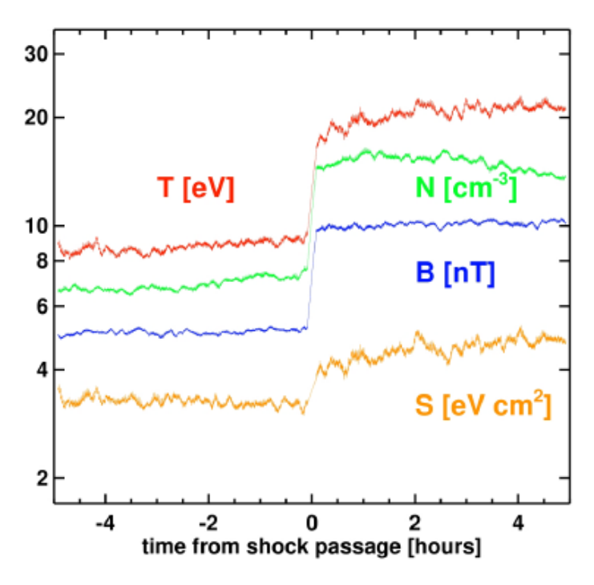
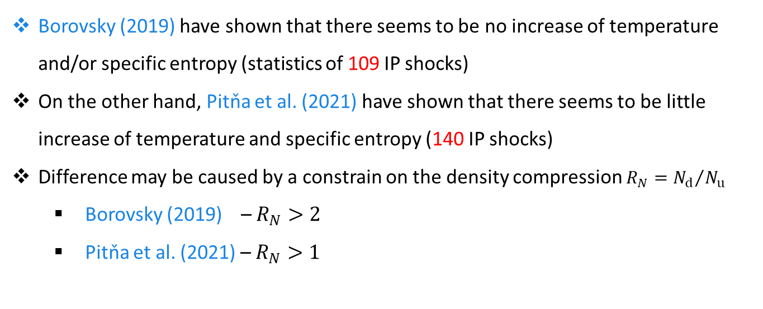
Previous studies on interaction of IP shocks and turbulence
Adapted from Borovsky (2019)
Borovsky (2019) have shown that there seems to be no increase of temperature and/or specific entropy (statistics of 109 IP shocks)
On the other hand, Pitňa et al. (2021) have shown that there seems to be little increase of temperature and specific entropy (140 IP shocks)
Difference may be caused by a constrain on the density compression $R_{N}={N_{d}}/{N_{u}}$
  Borovsky (2019) – $R_{N}>2$
  Pitňa et al. (2021) – $R_{N}>1$
Adapted from Pitňa et al. (2021), accepted
  However, the statistics are still rather small (109,140)
  Mixture of various shocks (Mach numbers, type of upstream plasma, …)
Let us analyze the problem more deeply

Slide 7




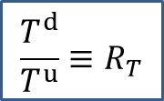


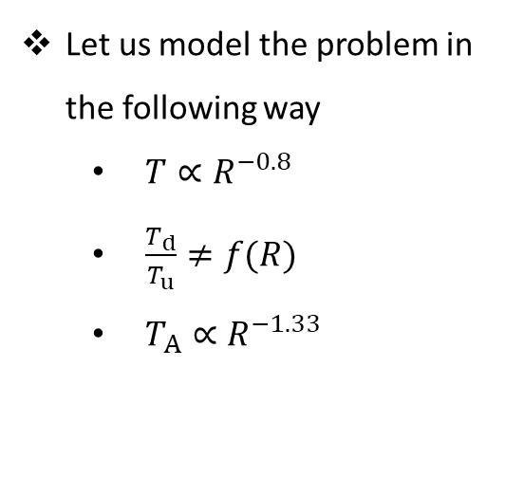

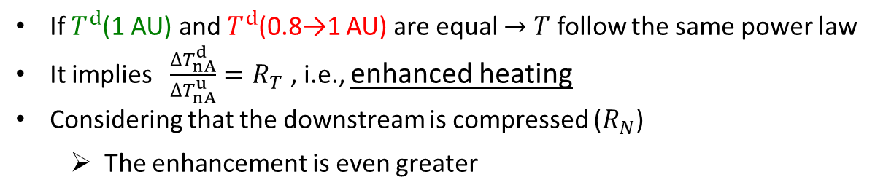
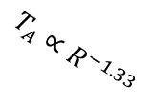

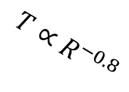
Contemplating the Temperature
Let us model the problem in the following way
  $T∝R^{−0.8}$
  $\frac{T_{d}}{T_{u}}≠f(R)$
  $T_{A}∝R^{−1.33}$
If $T^{d}$(1 AU) and $T^{d}$(0.8→1 AU) are equal $→$ $T$ follow the same power law
It implies $\frac{{∆T}_{nA}^{d}}{{∆T}_{nA}^{u}}=R_{T}$ , i.e., enhanced heating
Considering that the downstream is compressed ($R_{N}$)
  The enhancement is even greater
Log(Temperature)
$T^{d}$(0.8 AU)
$$R_{N}∙R_{T}$$
The issue with the temperature is that if there are compressions or rarefactions
  Changes of temperature
$T^{u}$(0.8 AU)
$$\frac{T^{d}}{T^{u}}≡R_{T}$$
$$T∝R^{−0.8}$$
$T^{d}$(1 AU)
$$T_{A}∝R^{−1.33}$$
$${∆T}_{nA}^{d}$$
$T^{d}$(0.8→1 AU)
$T^{u}$(1 AU)
$${∆T}_{nA}^{u}$$
Borovsky (2019) suggested to focus on the specific entropy
0.8 AU
1 AU
Log(Distance)

Slide 8







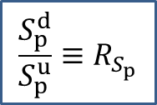

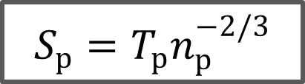


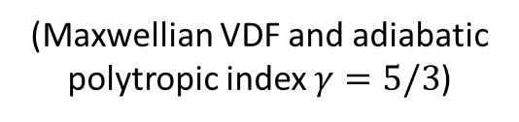
Contemplating the Specific entropy
Specific entropy
$$S_{p}=T_{p}n_{p}^{−2/3}$$
Similar reasoning can be applied
(Maxwellian VDF and adiabatic polytropic index $γ=5/3$)
Log(Specific entropy)
$S_{p}^{d}$(1 AU)
$$S_{p}∝R^{0.5}$$
$S_{p}^{d}$(0.8 AU)
$${∆S}_{p,nA}^{d}$$
$S_{p}^{d}$(0.8→1 AU)
Advantageous to temperature (Borovsky and Steinberg 2014) because it is insensitive to adiabatic fluctuations
Constant under adiabatic expansion of solar wind
$S_{p}^{u}$(0.8 AU)
$S_{p}^{u}$(1 AU)
$${∆S}_{p,nA}^{u}$$
$S_{p,A}∝$ const
$$\frac{S_{p}^{d}}{S_{p}^{u}}≡R_{S_{p}}$$
$$R_{N}∙R_{T}$$
0.8 AU
1 AU
Log(Distance)

Slide 9
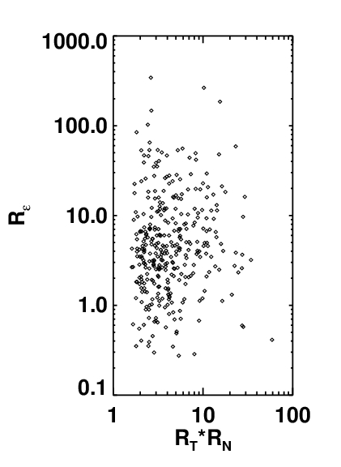
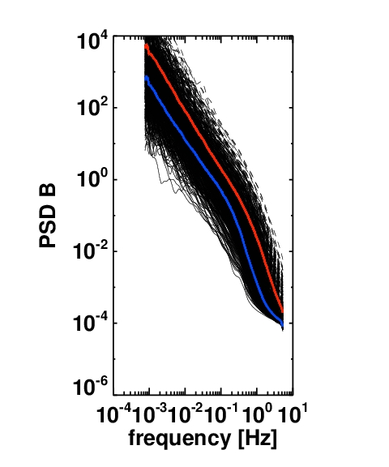
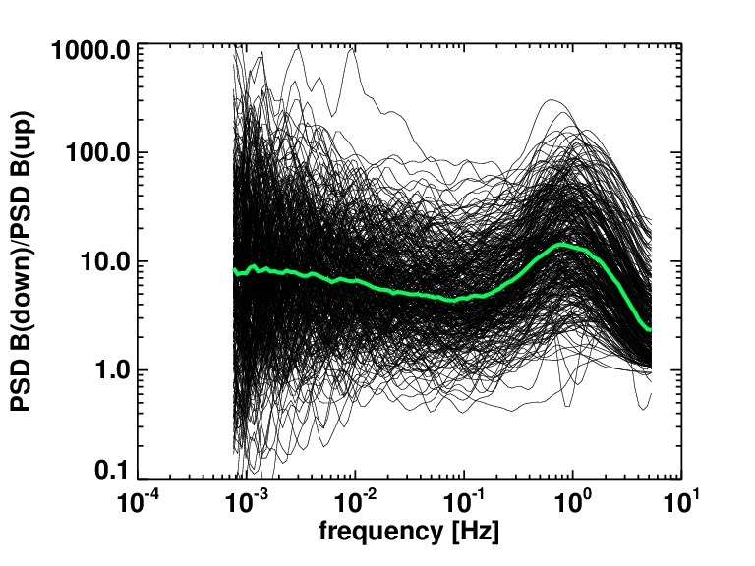
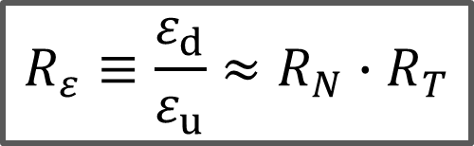
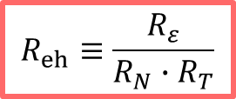
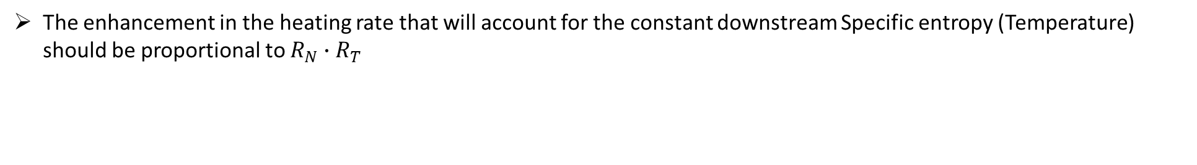
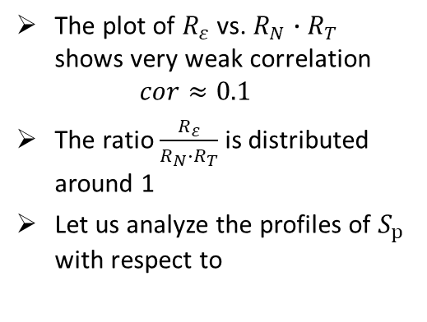
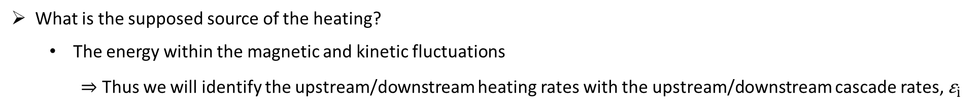

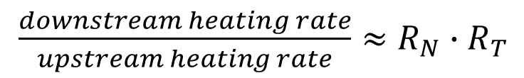
We may hypothesize
The enhancement in the heating rate that will account for the constant downstream Specific entropy (Temperature) should be proportional to $R_{N}∙R_{T}$
$\frac{downstream heating rate}{upstream heating rate}≈R_{N}∙R_{T}$
$$R_{ε}≡\frac{ε_{d}}{ε_{u}}≈R_{N}∙R_{T}$$
⇒
What is the supposed source of the heating?
  The energy within the magnetic and kinetic fluctuations
⇒ Thus we will identify the upstream/downstream heating rates with the upstream/downstream cascade rates, ${\text{ε}}_{i}$
Recall: ${\text{ε}}_{i}={21.8}^{3}f_{sp}^{5/2}P_{B}^{3/2}V_{sw}^{−1}N_{p}^{−3/2}$
We will estimate $R_{ε}$ as $R_{ε}=R_{δB}^{3/2}∙R_{N}^{−3/2}$, where $R_{δB}={\left\langle \frac{PSD B(downstream)}{PSD B(upstream)}\right\rangle }_{f ∈ \left[{10}^{−2},{10}^{−1}\right] Hz}$
The plot of $R_{ε}$ vs. $R_{N}∙R_{T}$ shows very weak correlation
$cor≈0.1$
The ratio $\frac{R_{ε}}{R_{N}∙R_{T}}$ is distributed around 1
Let us analyze the profiles of $S_{p}$ with respect to
1:1
$$R_{eh}≡\frac{R_{ε}}{R_{N}∙R_{T}}$$

Slide 10
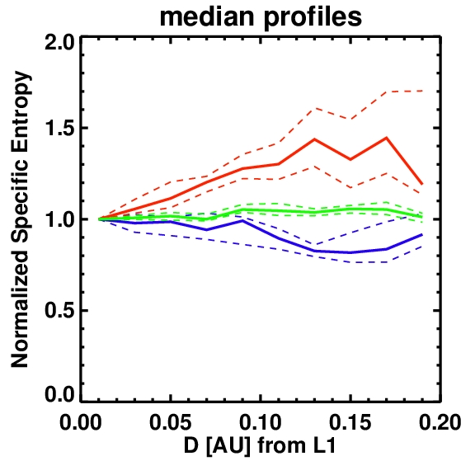
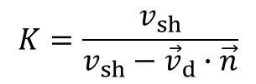

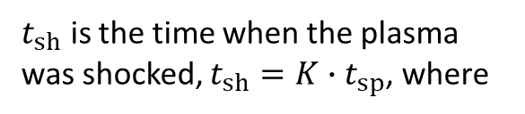

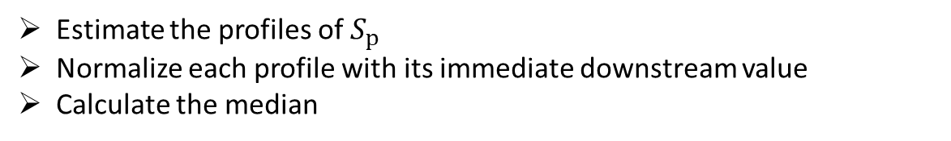
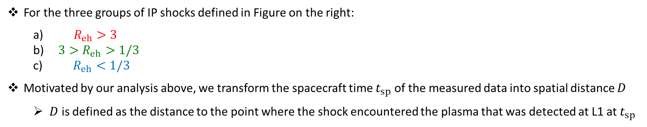

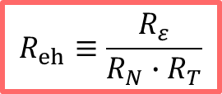


Superposed epoch analysis of the Specific entropy
$$R_{eh}≡\frac{R_{ε}}{R_{N}∙R_{T}}$$
For the three groups of IP shocks defined in Figure on the right:
  $R_{eh}>3$
  $3>R_{eh}>1/3$
  $R_{eh}<\text{1/3}$
Motivated by our analysis above, we transform the spacecraft time $t_{sp}$ of the measured data into spatial distance $D$
  $D$ is defined as the distance to the point where the shock encountered the plasma that was detected at L1 at $t_{sp}$
⇒
Estimate the profiles of $S_{p}$
Normalize each profile with its immediate downstream value
Calculate the median
We employ the methodology of Pitňa et al. (2017)
$$t_{sp}$$
$t_{sh}$ is the time when the plasma was shocked, $t_{sh}=K∙t_{sp}$, where
1:1
$$K=\frac{v_{sh}}{v_{sh}−{\vec{v}}_{d}∙\vec{n}}$$
$$t_{sh}$$
$D=$ $t_{sh}v_{d}$
$t_{sp}$→ $D$
$$D$$

Slide 11
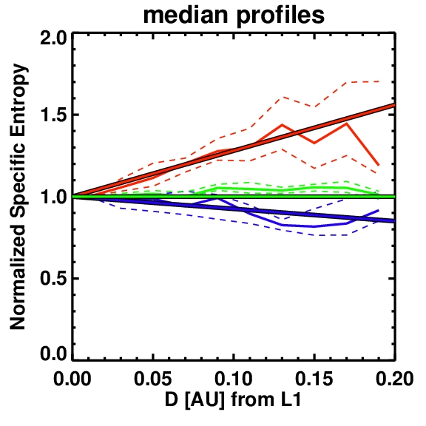
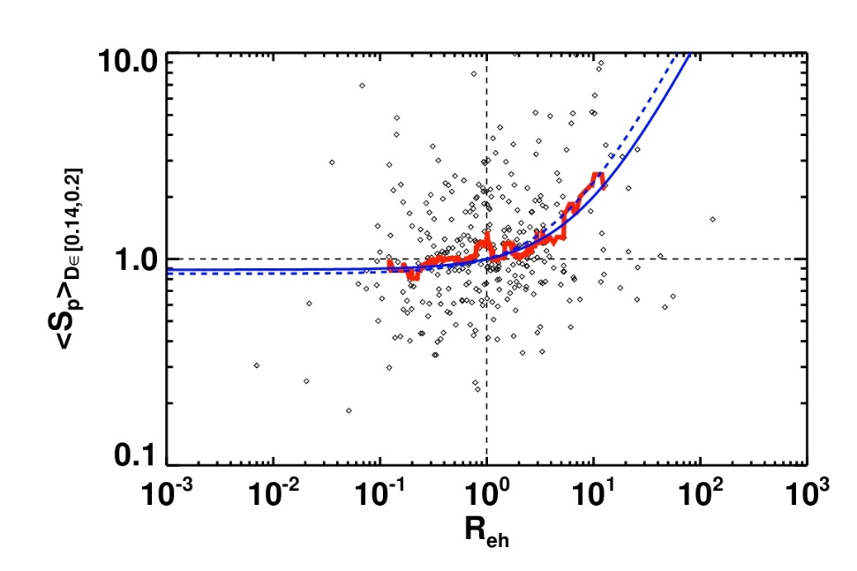
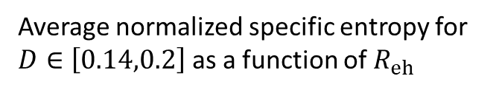
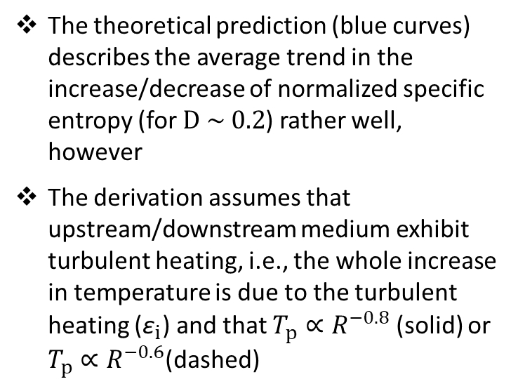
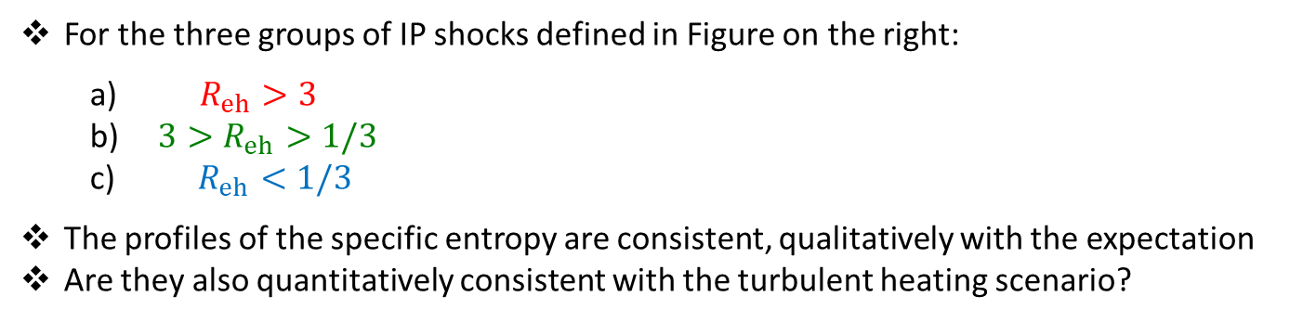
Superposed epoch analysis of the Specific entropy
$$R_{eh}≡\frac{R_{ε}}{R_{N}∙R_{T}}$$
For the three groups of IP shocks defined in Figure on the right:
  $R_{eh}>3$
  $3>R_{eh}>1/3$
  $R_{eh}<\text{1/3}$
The profiles of the specific entropy are consistent, qualitatively with the expectation
Are they also quantitatively consistent with the turbulent heating scenario?
⇒
Estimate the profiles of $S_{p}$
Normalize each profile with its immediate downstream value
Calculate the median
Yes
The theoretical prediction (blue curves) describes the average trend in the increase/decrease of normalized specific entropy (for $D \sim 0.2$) rather well, however
The derivation assumes that upstream/downstream medium exhibit turbulent heating, i.e., the whole increase in temperature is due to the turbulent heating (${\text{ε}}_{i}$) and that $T_{p}∝R^{−0.8}$ (solid) or $T_{p}∝R^{−0.6}$(dashed)
Average normalized specific entropy for $D∈\left[0.14,0.2\right]$ as a function of $R_{eh}$

Slide 12
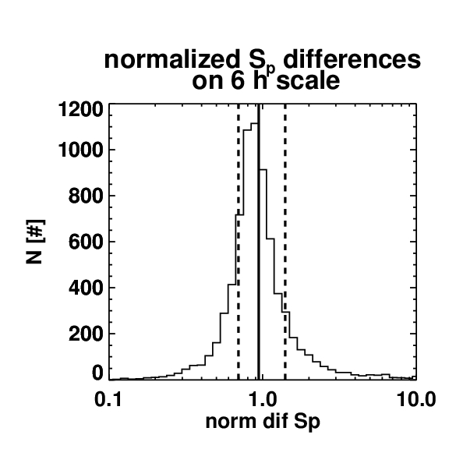
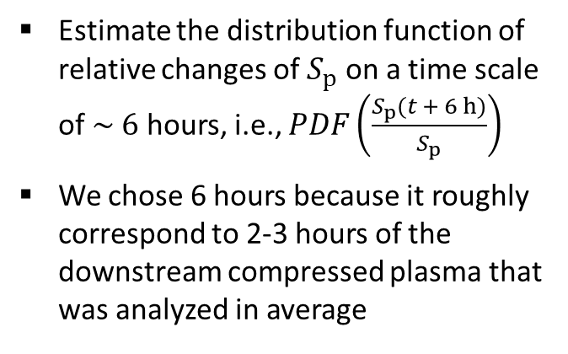
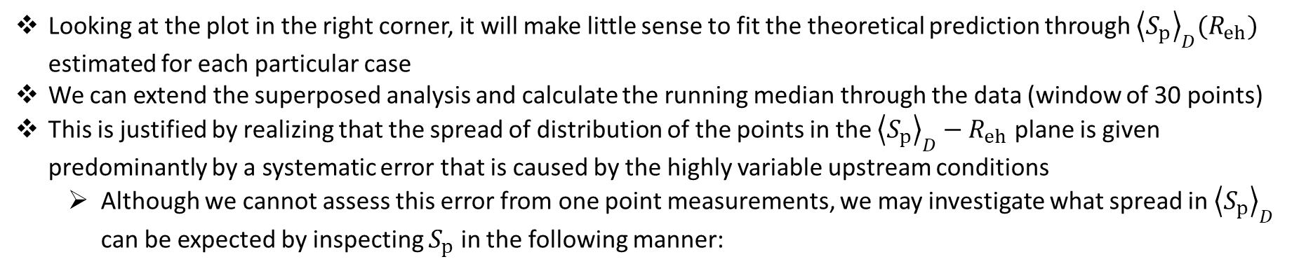


Discussing the assumptions and errors
Looking at the plot in the right corner, it will make little sense to fit the theoretical prediction through ${\left\langle S_{p}\right\rangle }_{D}(R_{eh})$ estimated for each particular case
We can extend the superposed analysis and calculate the running median through the data (window of 30 points)
This is justified by realizing that the spread of distribution of the points in the ${\left\langle S_{p}\right\rangle }_{D}−R_{eh}$ plane is given predominantly by a systematic error that is caused by the highly variable upstream conditions
  Although we cannot assess this error from one point measurements, we may investigate what spread in ${\left\langle S_{p}\right\rangle }_{D}$ can be expected by inspecting $S_{p}$ in the following manner:
Estimate the distribution function of relative changes of $S_{p}$ on a time scale of $\sim 6$ hours, i.e., $PDF\left(\frac{S_{p}(t + 6 h)}{S_{p}}\right)$
We chose 6 hours because it roughly correspond to 2-3 hours of the downstream compressed plasma that was analyzed in average
CCIF$≅3.3$
CCIF$≅2.3$
→
Roughly 70% of the spread (in terms of CCIF) is likely to be caused by the inherent changes of the upstream medium
→
CCIF – Central Confidence Interval Factor, defined as the ratio of upper to lower value of central CI range (containing 68% of data)

Slide 13
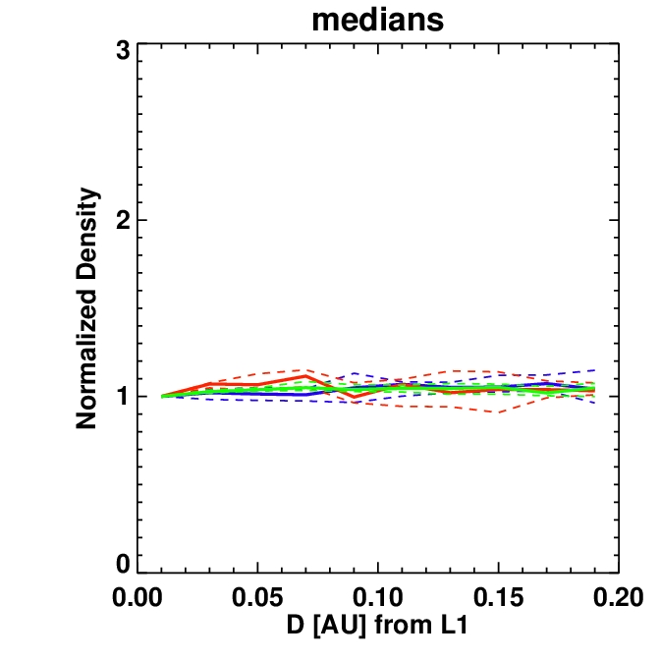
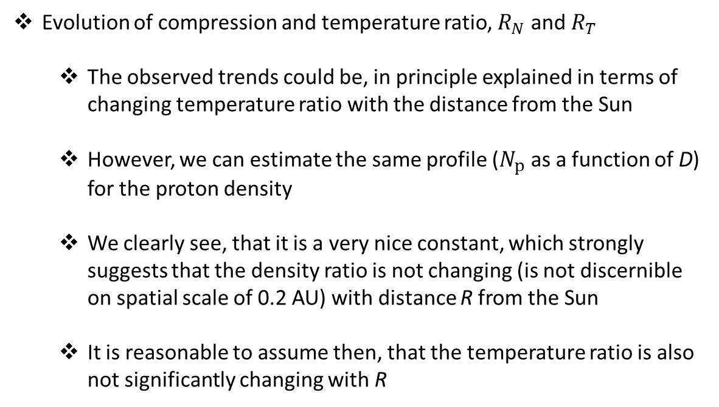
Discussing the assumptions and errors
Evolution of compression and temperature ratio, $R_{N}$ and $R_{T}$
  The observed trends could be, in principle explained in terms of changing temperature ratio with the distance from the Sun
  However, we can estimate the same profile ($N_{p}$ as a function of D) for the proton density
  We clearly see, that it is a very nice constant, which strongly suggests that the density ratio is not changing (is not discernible on spatial scale of 0.2 AU) with distance R from the Sun
  It is reasonable to assume then, that the temperature ratio is also not significantly changing with R

Slide 14
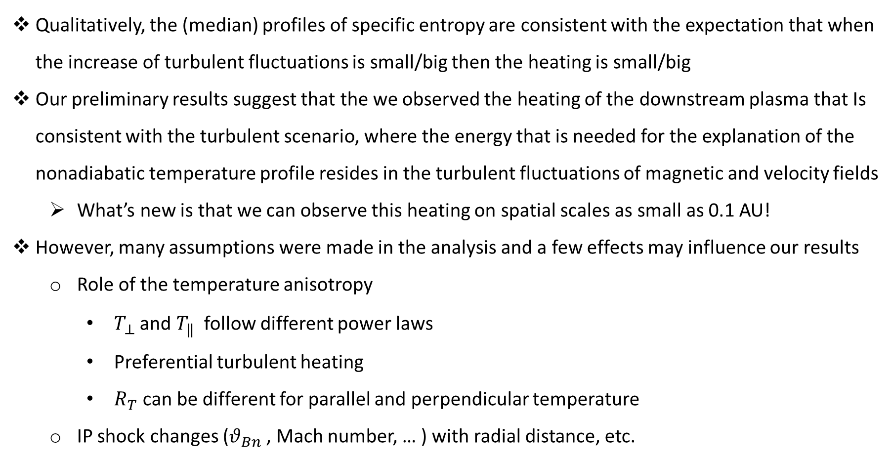
Preliminary conclusion and Discussion
Qualitatively, the (median) profiles of specific entropy are consistent with the expectation that when the increase of turbulent fluctuations is small/big then the heating is small/big
Our preliminary results suggest that the we observed the heating of the downstream plasma that Is consistent with the turbulent scenario, where the energy that is needed for the explanation of the nonadiabatic temperature profile resides in the turbulent fluctuations of magnetic and velocity fields
  What’s new is that we can observe this heating on spatial scales as small as 0.1 AU!
However, many assumptions were made in the analysis and a few effects may influence our results
  Role of the temperature anisotropy
    $T_{⊥}$ and $T_{‖}$ follow different power laws
    Preferential turbulent heating
    $R_{T}$can be different for parallel and perpendicular temperature
  IP shock changes ($θ_{Bn}$, Mach number, … ) with radial distance, etc.

Slide 15
Thank you for your attention and I am looking forward to your
Questions
Suggestions
Comments
Criticism

Slide 16
References
Borovsky, J.E., A Statistical Analysis of the Fluctuations in the Upstream and Downstream Plasmas of 109 Strong- Compression Interplanetary Shocks at 1 AU, Journal of Geophysical Research: Space Physics, Volume 125, Issue 6, article id. E27518, (2019)
Bruno, C.; Carbone, V., The Solar Wind as a Turbulence Laboratory, Living Reviews in Solar Physics, Volume 10, Issue 1, article id. 2, 208 pp. (2013)
Kivelson, M.G.; Russell, C.T., Introduction to Space Physics, Cambridge: Cambridge University Press (1995)
Pitňa, A.; Šafránková, J.; Němeček, Z.; Goncharov, O.; Němec, F.; Přech, L.; Chen, C. H. K.; Zastenker, G. N., DENSITY FLUCTUATIONS UPSTREAM AND DOWNSTREAM OF INTERPLANETARY SHOCKS, The Astrophysical Journal, Volume 819, Issue 1, article id. 41, 9 pp. (2016)
Pitňa, A.; Šafránková, J; Němeček, Z.; Franci, L., Decay of Solar Wind Turbulence behind Interplanetary Shocks, The Astrophysical Journal, Volume 844, Issue 1, article id. 51, 10 pp. (2017)
Pitňa, A.; Šafránková, J.; Němeček, Z.; Ďurovcová, T.; Kis, A., Turbulence Upstream and Downstream of Interplanetary Shocks, Front. Phys., accepted (2021), doi: 10.3389/fphy.2020.626768
Smith, C.W.; Vasquez, B.J., Driving and Dissipation of Solar-WindTurbulence: What is the Evidence? Front. Astron. Space Sci. 7:611909 (2021)

