Slide 1
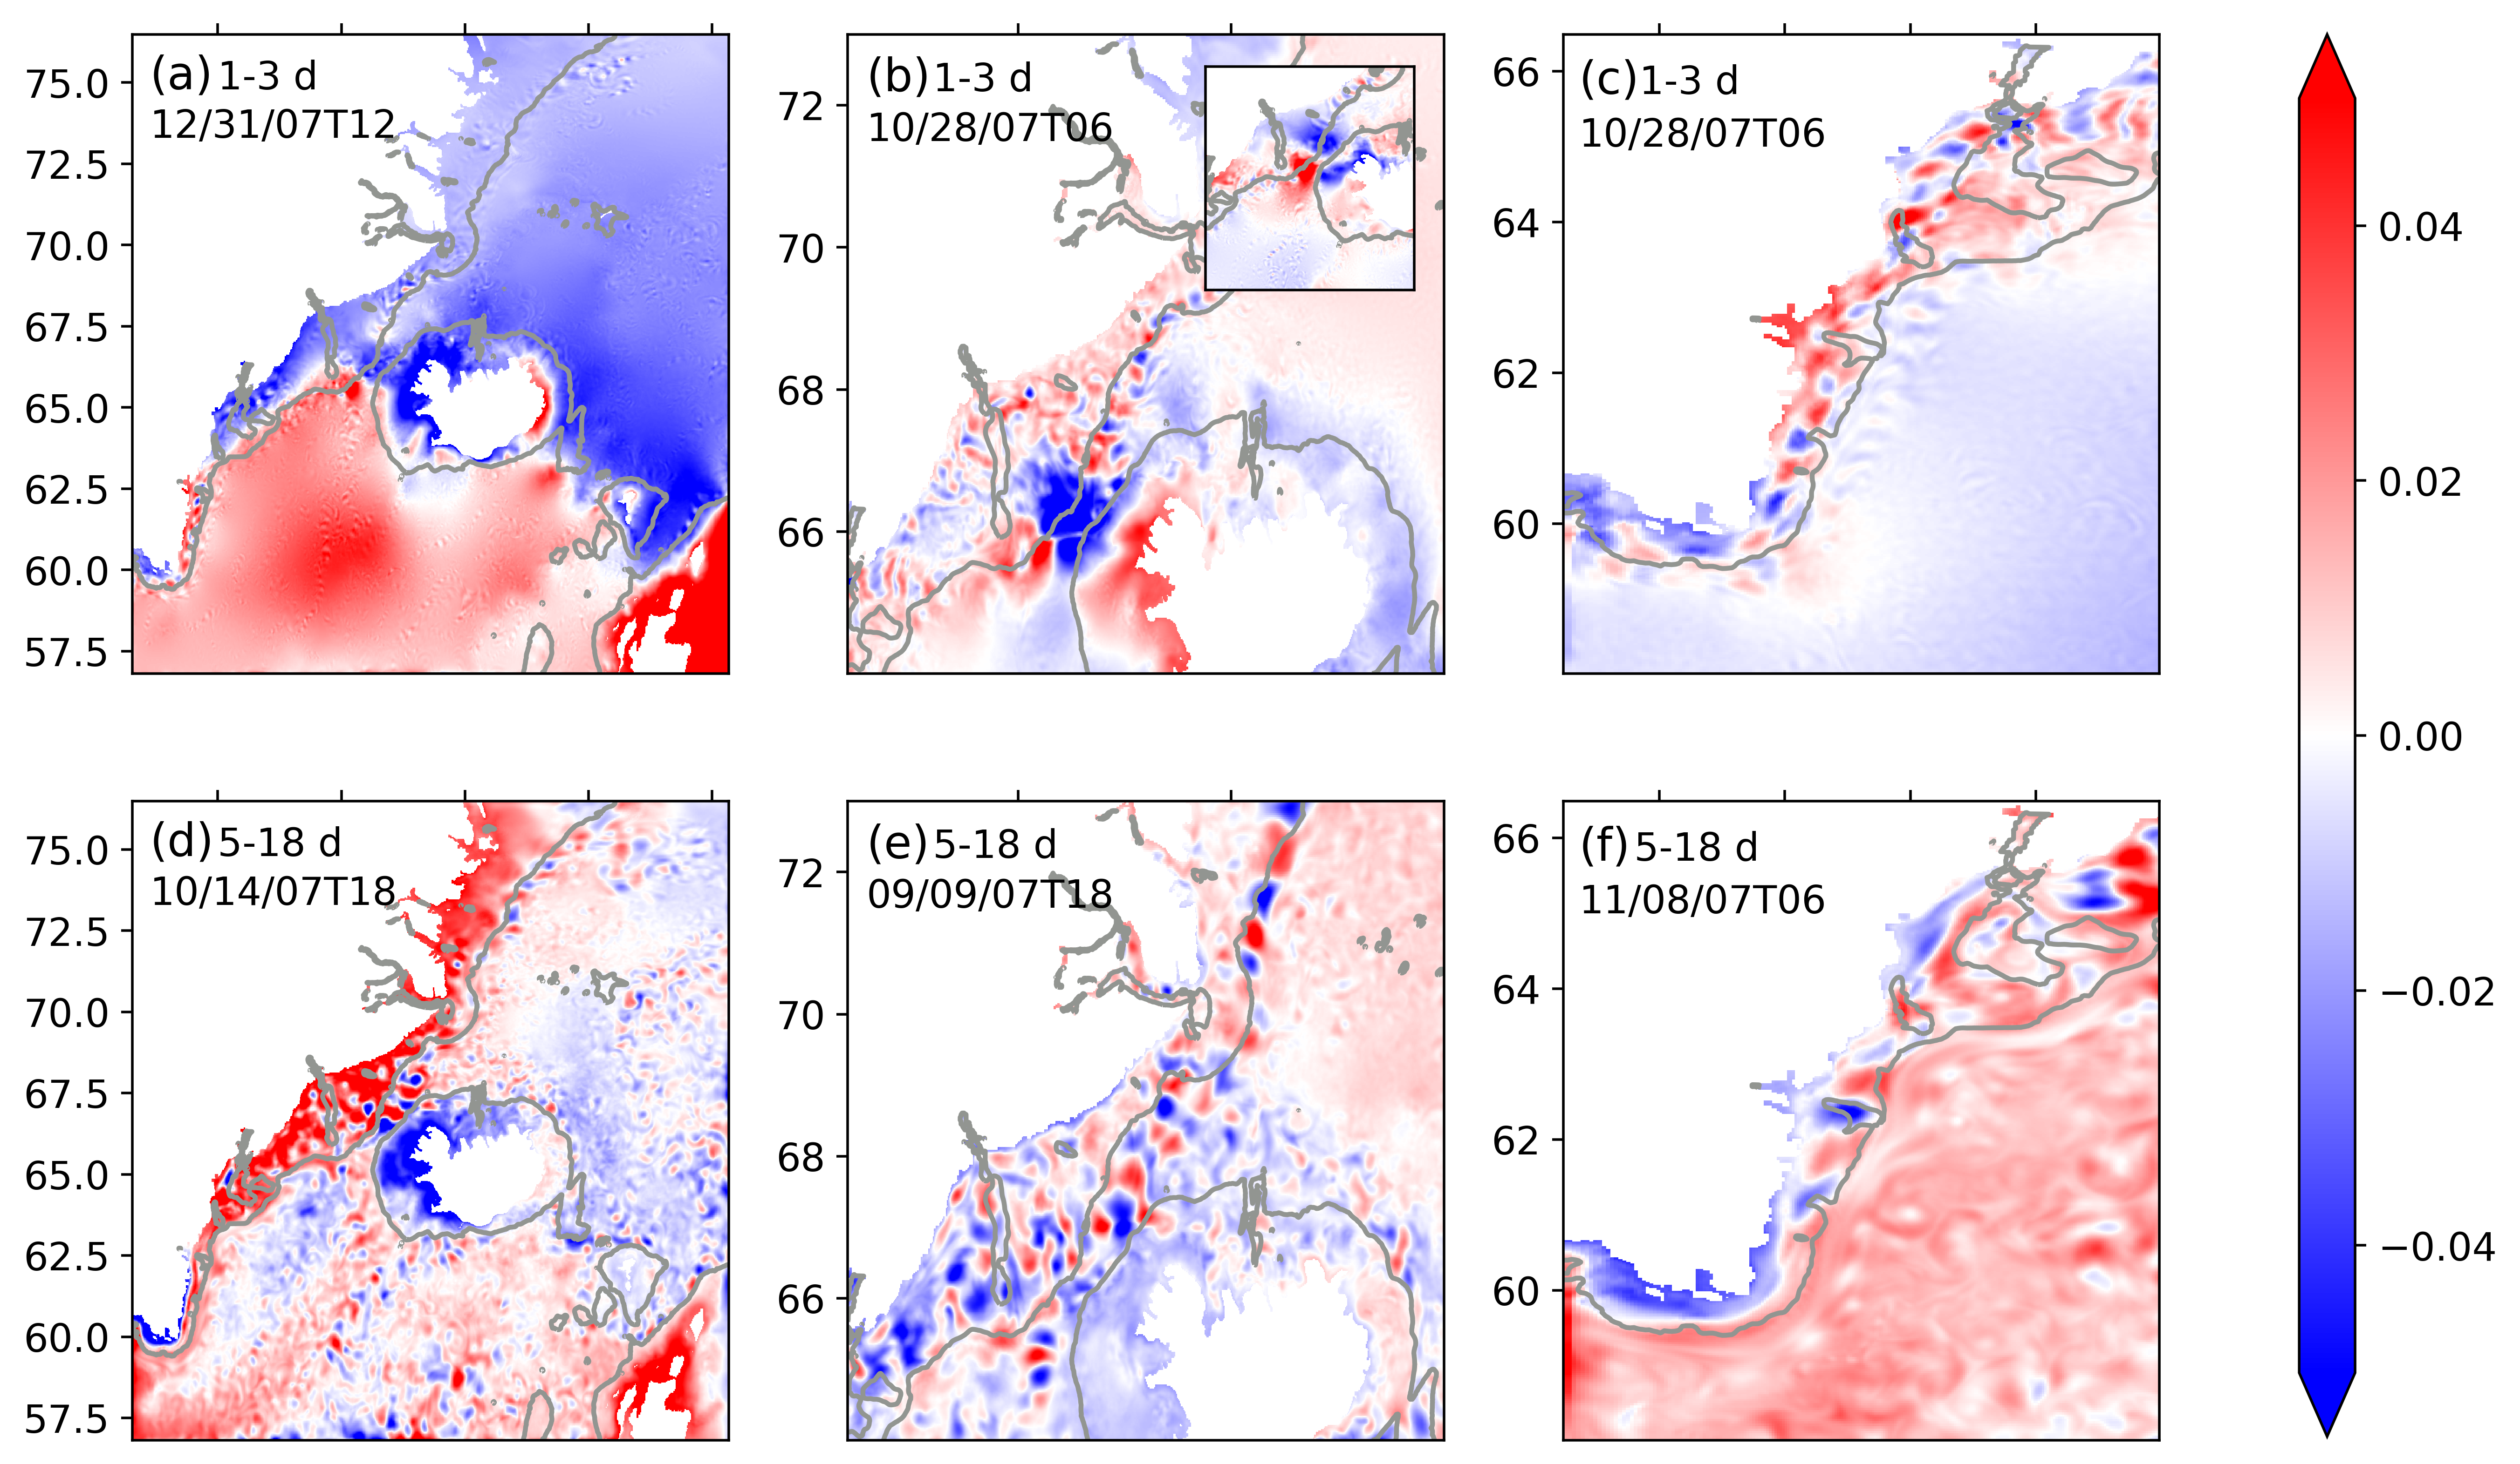


Coastal Trapped Waves along the Southeast Greenland Coast in a realistic numerical simulation
I’m new to all this.
Please give me some
background first
Just show me those waves!
I prefer theory
Tell me more about your model results
This is so cool!
How can I do this too?
Future work and Links
What role does wind play in all this?
Renske Gelderloos¹, Thomas W. N. Haine¹, and Mattia Almansi²
¹Department of Earth and Planetary Sciences, The Johns Hopkins University, Baltimore, MD, USA
²National Oceanography Centre, Southampton, UK

Slide 2
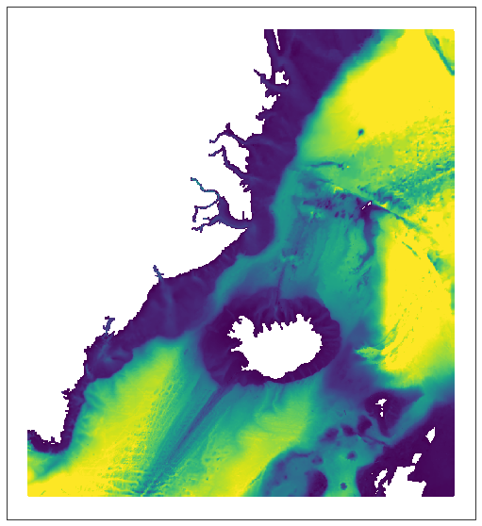
?
Research Questions
Home
Ocean currents along the Southeast Greenland Coast play an important role in North Atlantic circulation and the global climate system.
Observations show that the circulation in this region displays substantial subinertial variability, typically with periods of several days.
Click on one of the boxes to learn more!
Background
Greenland
Methods
Animations
Subinertial variability
Wind forcing
Iceland
Theory
Links

Slide 3
Home
Dense overflow transport measured at the sill in the Denmark Strait fluctuates at a subinertial frequency, as shown for example in this mooring record.
Background
Greenland
Methods
Animations
Subinertial variability
Wind forcing
Iceland
Theory
Links
Source: Haine (2010)

Slide 4
Home
Background
Greenland
Source: Jackson et al. (2014)
Methods
Flow velocity in Sermilik Fjord fluctuates on a time scale of several days (subinertial variability) as shown in this mooring time series. These flow pulses bring in warm ocean water from the shelf region into the fjord and toward the glacier, affecting the glacier melt rate.
Animations
Subinertial variability
Wind forcing
Iceland
Theory
Links

Slide 5
?
Research Questions
Home
Ocean currents along the Southeast Greenland Coast play an important role in North Atlantic circulation and the global climate system.
Observations show that the circulation in this region displays substantial subinertial variability, typically with periods of several days.
Click on one of the boxes to learn more!
Background
Question 1: Is subinertial variability along the Southeast Greenland Coast coherent along and across the continental shelf?
Question 2: Is this variability consistent with Coastal Trapped Waves?
Greenland
Methods
Animations
Subinertial variability
Wind forcing
Iceland
Theory
Links

Slide 6
Ocean model
Extracting model fields
Home
Background
Methods
Curious how we did this? Click on one of the topics to find out more!
Animations
Subinertial variability
Analysis
Wind forcing
Theory
Links

Slide 7
Home
Ocean model
Background
We used the MITgcm in an ocean-sea ice configuration to run the simulation. You can check out the entire model output for yourself.
Duration: Sep 2007 - Aug 2008
Resolution: 2-4 km, 216 layers
Atmospheric forcing: Arctic System Reanalysis v2
Open boundary forcing: HYCOM+NCODA
Greenland
Methods
Latitude
Animations
Iceland
Subinertial variability
Wind forcing
Theory
Longitude
Ocean model domain with surface current speed (filled contours) and layer-mean velocities at select stations (current arrows).
Links

Slide 8

Home
Extracting model fields
Background
Methods
We used OceanSpy to extract information from the model
Animations
Subinertial variability
Wind forcing
Theory
Click on one of the features on the map to learn more.
Links

Slide 9
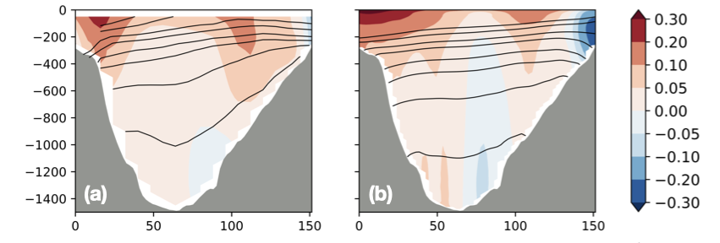
Home
We extracted the velocity information along the Kögur array and calculated the velocity orthogonal to the section.
One panel is model output, the other is based on mooring data. Which is which…?
Background
Methods
Animations
Subinertial variability
Wind forcing
Z (m)
Velocity (m/s)
Theory
Links
Distance along array (km)

Slide 10
Home
We can extract information along any curve, such as the 450-m isobath here. By plotting that as a Hovmöller diagram, we estimated the wave speed along different stretches of the coast.
Background
Methods
Animations
Subinertial variability
Wind forcing
Theory
SSH anomaly (m)
Links

Slide 11
Home
We extracted profiles from the model at particular station locations. This way we could estimate the winter and summer stratification for example, amongst other things.
Background
Methods
Animations
Subinertial variability
Wind forcing
Theory
Links

Slide 12
We used:
Analysis
Home
Background
jLab to analyze time series and calculate Fourier spectral estimates
PyCWT to calculate wavelet energy
eofs for (Multivariate) EOF analysis
Methods
Animations
Subinertial variability
The Brink algorithm to find theoretical solutions
Wind forcing
Theory
Links

Slide 13
Please see separate files for animations!
Home
Background
Methods
Animations
Subinertial variability
Wind forcing
Theory
Links

Slide 14
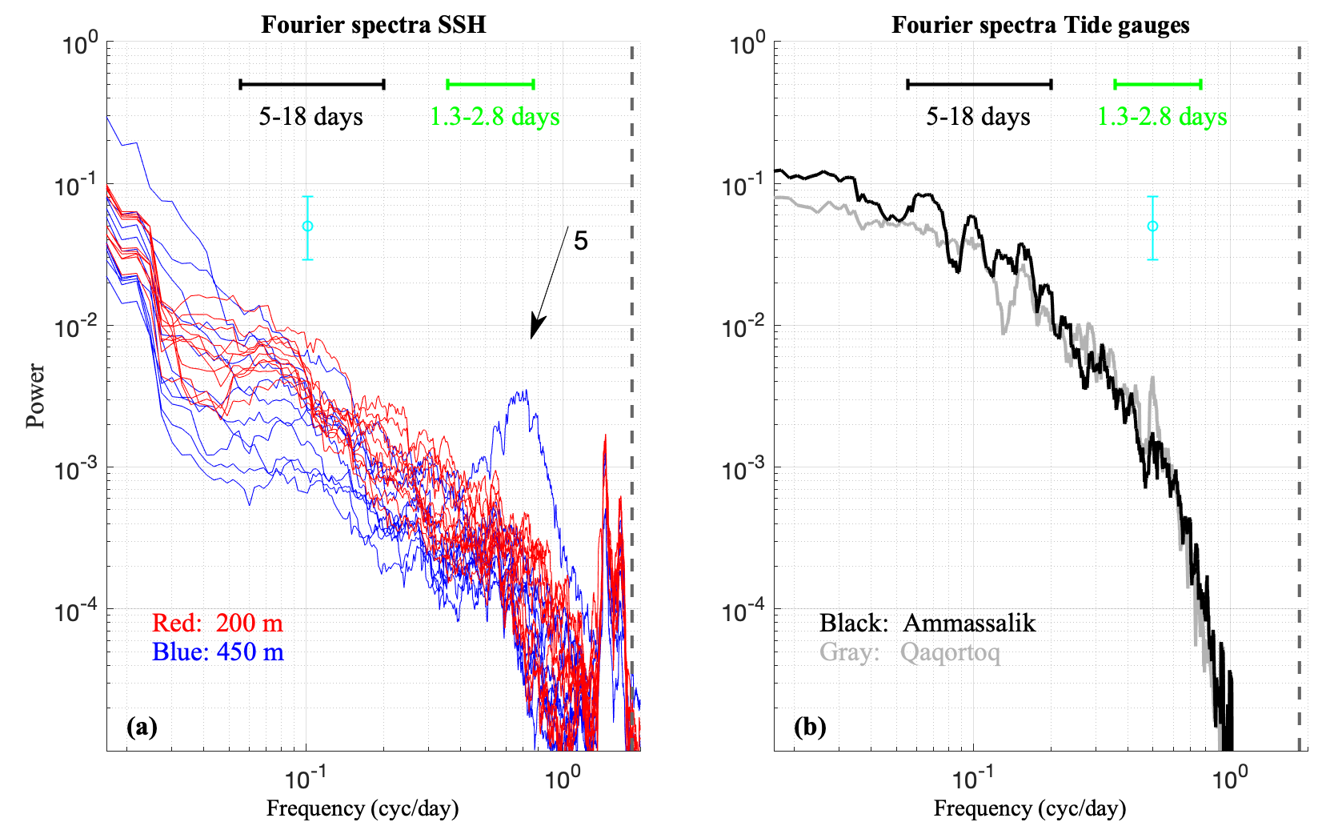
The SSH spectra at 22 station locations along the 200 and 450 m isobaths revealed peaks around 1-3 days and 5-18 days. (The large peak at blue station 5 is due to Denmark Strait Overflow eddies.)
Are the signals coherent along the shelf though? Let’s take a look.
Home
Background
Methods
Animations
Subinertial variability
Wind forcing
Theory
Links
Subinertial variability in sea surface height

Slide 15
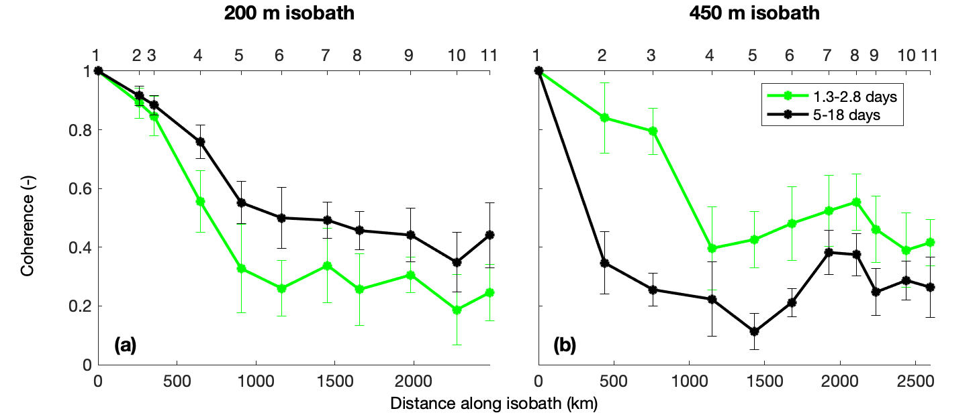
Home
Coherence of the subinertial variability
The graph below shows the coherence between the SSH variability at station 1 and every other station. The signal is coherent for 100s to 1000s of kilometers.
Background
Methods
Animations
Subinertial variability
Wind forcing
Theory
Links
Can we track signals all the way along the coast?

Slide 16
SSH along the shelf break
Station 1-11 along the 450-m isobath
Home
Background
We can indeed track the waves in sea surface height anomaly, if we band-pass filter the signal in a (a) 1–3-day a (b) 5–18-day band.
How about a full 2-D view?
Methods
Animations
Subinertial variability
Wind forcing
Theory
Links

Slide 17
Home
SSH everywhere!
Background
Methods
Animations
Subinertial variability
Wind forcing
Theory
Links
There you go: full 2D views. (a-c) 1-3 day; (d-f) 5-18 days. Let’s take a look at velocity fluctuations next.

Slide 18
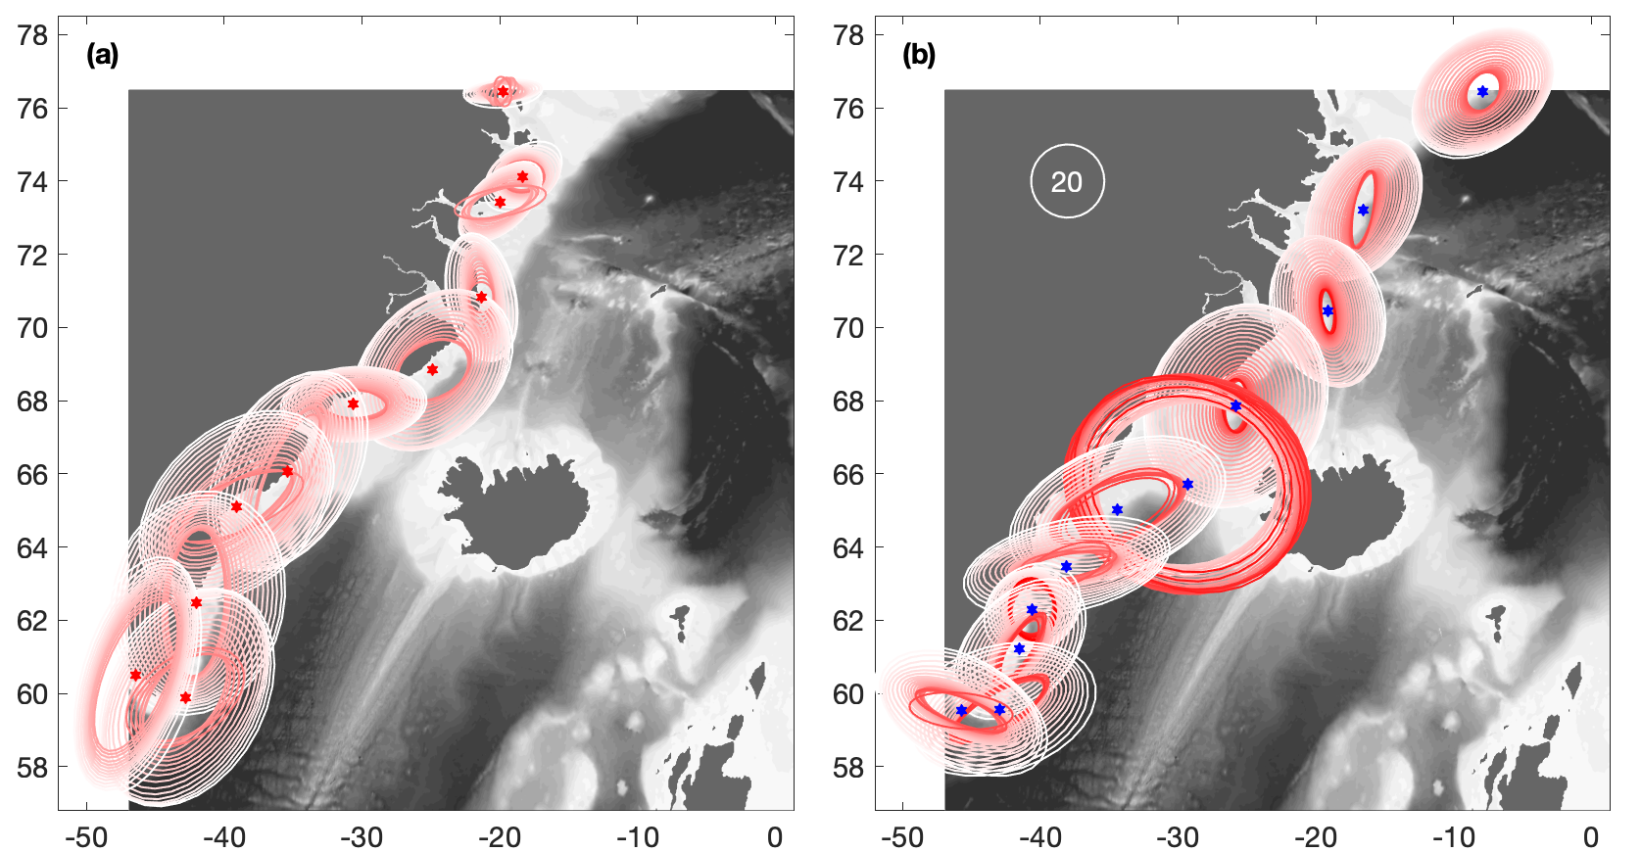
Home
Velocity fluctuations
The velocity fluctuations are consistent with boundary current variability, with more elongated ellipses closer to the bottom.
Background
Methods
Animations
Bottom-intensified Denmark Strait Overflow eddies!
Subinertial variability
Wind forcing
Variance ellipses of velocity at (a) coastal and (b) shelf break stations. Darker red is deeper in the water column.
Theory
Links

Slide 19
Home
Wind forcing
The combined EOFs (MEOF) of wind and SSH variability show that some of the 5–18-day waves are forced by wind in the Denmark Strait: peaks in the combined PC are positive and negative phases of a continental shelf wave (see figure).
Likewise, 1–3-day variability is sometimes forced by wind over Sermilik Deep (not shown).
Background
Methods
Animations
Subinertial variability
Wind forcing
Theory
Links

Slide 20
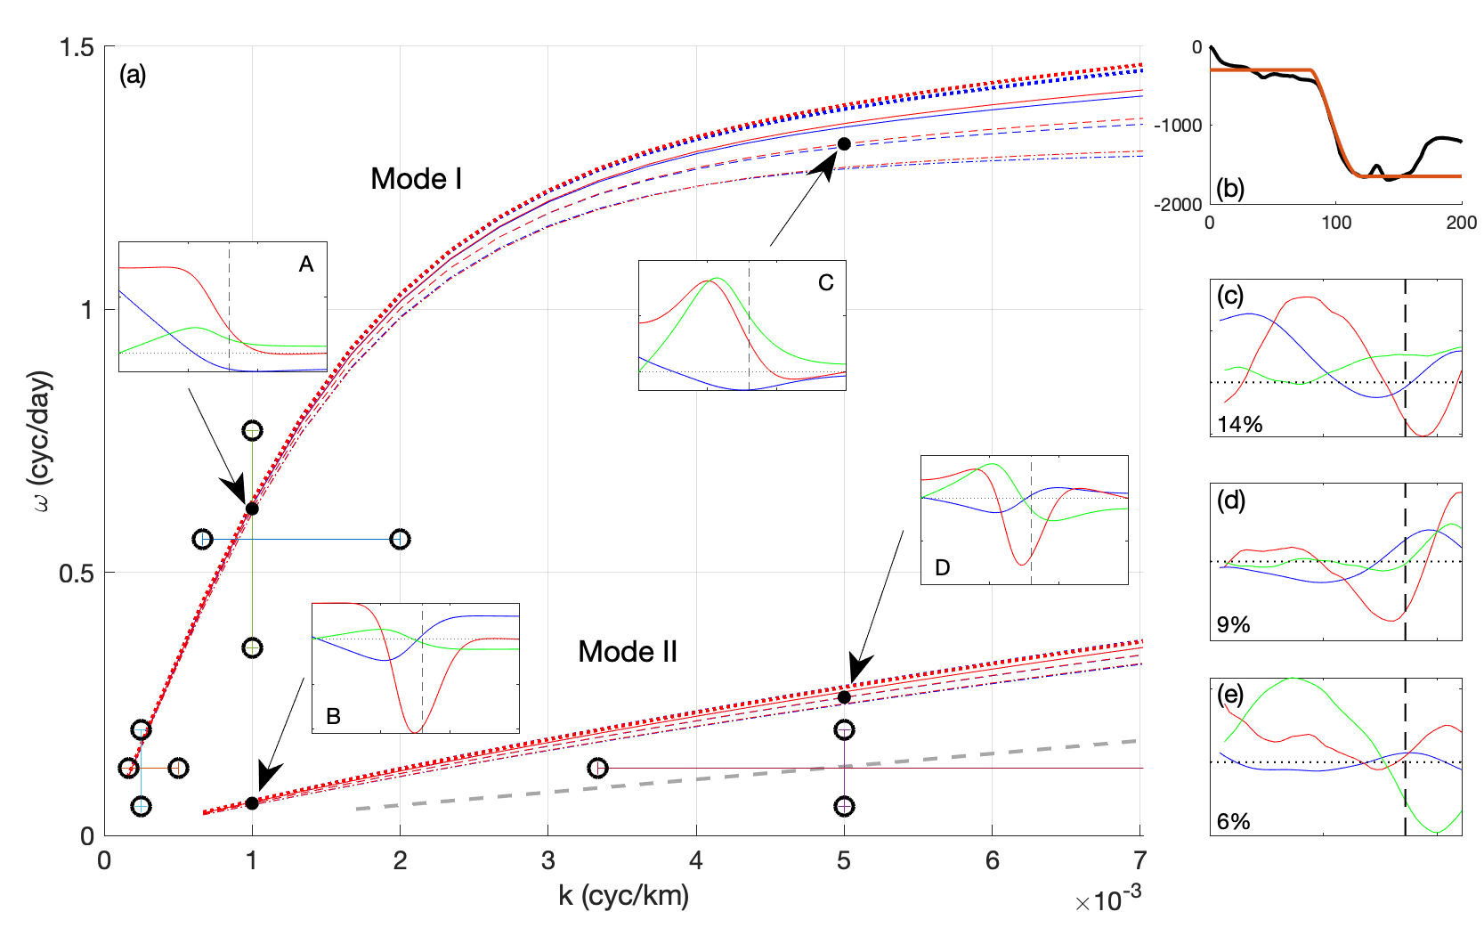
Home
Wave theory
Using an approximation of the cross-shelf bathymetry (b), we calculated k-ω pairs to find the dispersion curves (a) of possible wave solutions.
The wave properties inferred from the model fields match theoretical solutions of Mode I and II Coastal Trapped Waves. An additional Mode III would fit the model results.
Background
Methods
Animations
Subinertial variability
Wind forcing
(a) Dispersion curves for of possible wave solutions for winter (blue curves) and summer (red curves) stratification. Line styles are for mean flow strength. Dumbbells are wave solutions inferred from model results. A-D are theoretical forms for pressure (red), alongshore (blue) and cross-shore (green) velocity. (b) Model (black) and idealized bathymetry used for analysis. (c-e) Multivariate EOFs 3-5 from the model fields; compare to insets A-D.
Theory
Links

Slide 21

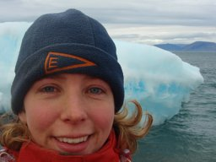

Home
Future work
Links
Read the paper and get the full story
Background
We will investigate the role of subinertial waves in fjord-shelf exchange next
We will also determine the roles of atmospheric vs oceanic variability in the forcing of these waves.
Longer term, we plan to look into the dynamics behind the phase-locking of waves around Iceland and Greenland and their role in the Denmark Strait Overflow variability. Stay tuned!
Methods
Animations
Try it out yourself!
Tom Haine
Subinertial variability
Renske Gelderloos
Wind forcing
Interested in more of our work? Click on the photos to check out our Google Scholar pages.
Theory
Links
Mattia Almansi

