Slide 1
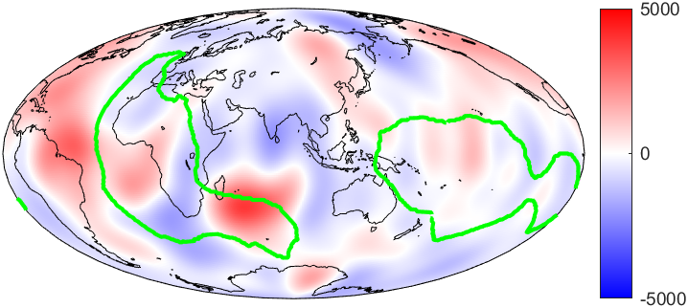
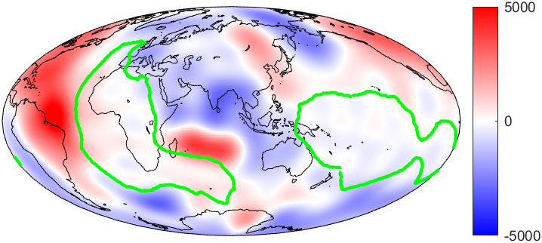
Application of spherical Slepian functions to the inversion of virtual observatory satellite magnetic data into localised regions of flow on the core-mantle boundary
This vPICO is best viewed as a ppt show. Press the green buttons to navigate through the poster and ‘Home’ to return to this page
What is the aim of the research?
Slepian separation for secular variation outside the LLSVP region at core-mantle boundary
How do you invert from magnetic data to core flow data?
What are virtual observatories?
What are spherical Slepian functions?
What is our region of interest? What are LLSVPs?
Main findings
Conclusions and Further work
References
By Hannah Rogers¹, Ciaran Beggan², and Kathy Whaler¹; with thanks to Alain Plattner³
1) School of GeoScience, University of Edinburgh, UK; 2) British Geological Survey, Edinburgh, UK; 3) University of Alabama, USA
h.f.rogers@sms.ed.ac.uk
Hannah_Rogers94
Notes:
Welcome to my poster! This is best viewed as a PPT presentation and using the green boxes to navigate through the topics

Slide 2
Application of spherical Slepian functions to the inversion of virtual observatory satellite magnetic data into localised regions of flow on the core-mantle boundary
This vPICO is best viewed as a ppt show. Press the green buttons to navigate through the poster and ‘Home’ to return to this page
References:
Le Mouël, J. Outer-core geostrophic flow and secular variation of Earth's geomagnetic field. Nature 311, 734–735 (1984). https://doi.org/10.1038/311734a0
Hagay Amit, Maria Alexandra Pais, Differences between tangential geostrophy and columnar flow, Geophysical Journal International, Volume 194, Issue 1, 1 July 2013, Pages 145–157, https://doi.org/10.1093/gji/ggt077
Kim, H.R., von Frese, R.R.B. Utility of Slepian basis functions for modeling near-surface and satellite magnetic anomalies of the Australian lithosphere. Earth Planets Space 69, 53 (2017). https://doi.org/10.1186/s40623-017-0636-0
Holme, R. (2007). Large-scale flow in the Core. In P. Olson, & G. Schubert (Eds.), Core Dynamics (Treatise on Geophysics) (Vol. 8, pp. 107-130). Amsterdam: Elsevier
Mandea, M., and Olsen, N. (2006), A new approach to directly determine the secular variation from magnetic satellite observations, Geophys. Res. Lett., 33, L15306, doi:10.1029/2006GL026616.
Garnero, E., McNamara, A. & Shim, S. Continent-sized anomalous zones with low seismic velocity at the base of Earth's mantle. Nature Geosci 9, 481–489 (2016). https://doi.org/10.1038/ngeo2733
Mound, J., Davies, C., Rost, S. et al. Regional stratification at the top of Earth's core due to core–mantle boundary heat flux variations. Nat. Geosci. 12, 575–580 (2019). https://doi.org/10.1038/s41561-019-0381-z
Ritsema, J., Deuss, A., van Heijst, H.J. and Woodhouse, J.H. (2011), S40RTS: a degree‐40 shear‐velocity model for the mantle from new Rayleigh wave dispersion, teleseismic traveltime and normal‐mode splitting function measurements. Geophysical Journal International, 184: 1223-1236. doi:10.1111/j.1365-246X.2010.04884.x
Doubrovine, P. V., B. Steinberger, and T. H. Torsvik (2016), A failure to reject: Testing the correlation between large igneous provinces and deep mantle structures with EDF statistics, Geochem. Geophys. Geosyst., 17, doi:10.1002/ 2015GC006044.
Simons F.J. (2010) Slepian Functions and Their Use in Signal Estimation and Spectral Analysis. In: Freeden W., Nashed M.Z., Sonar T. (eds) Handbook of Geomathematics. Springer, Berlin, Heidelberg. https://doi.org/10.1007/978-3-642-01546-5_30
Ciarán D. Beggan, Jarno Saarimäki, Kathryn A. Whaler, Frederik J. Simons, Spectral and spatial decomposition of lithospheric magnetic field models using spherical Slepian functions, Geophysical Journal International, Volume 193, Issue 1, April, 2013, Pages 136–148, https://doi.org/10.1093/gji/ggs122
Alain Plattner, Frederik J. Simons, Internal and external potential-field estimation from regional vector data at varying satellite altitude, Geophysical Journal International, Volume 211, Issue 1, October 2017, Pages 207–238, https://doi.org/10.1093/gji/ggx244
What is the aim of the research?
How do you invert from magnetic data to core flow data?
What are virtual observatories?
What are spherical Slepian functions?
What is our region of interest? What are LLSVPs?
Main findings
Conclusions and Further work
Title
By Hannah Rogers¹, Ciaran Beggan², and Kathy Whaler¹; with thanks to Alain Plattner³
1) School of GeoScience, University of Edinburgh, UK; 2) British Geological Survey, Edinburgh, UK; 3) University of Alabama, USA
h.f.rogers@sms.ed.ac.uk
Hannah_Rogers94

Slide 3
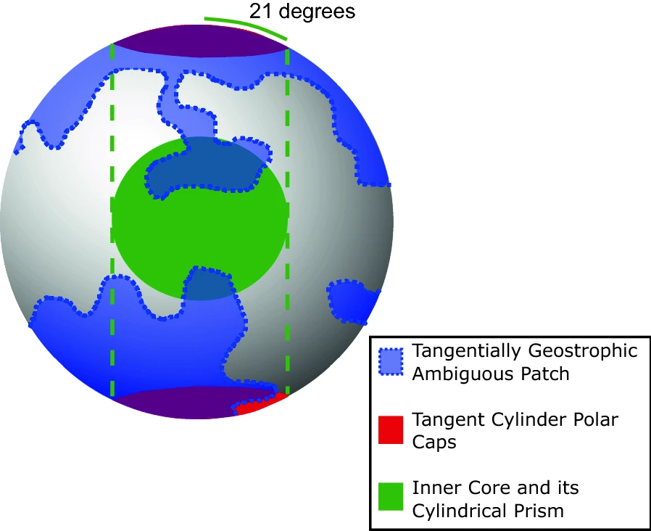
HOME
Aim of research
Magnetic data inversion
Virtual observatories
Spherical Slepian functions
Region of Interest, LLSVPs
Main findings
Conclusions and Further work
We wish to investigate how core flow on the core-mantle boundary (CMB) varies across the surface by studying different regions of interest through the application of a mathematical function. By doing this, we hope to improve forecasts of magnetic field change (or secular variation) and better understand interactions at the core-mantle boundary.
Selection of individual regions is motivated by:
assumptions are required when inverting from secular variation (SV) to flow but these define the flow over only part of the core surface, e.g. tangentially geostrophic flow (Le Mouël, 1984)
expectation of different dynamics affecting fluid motions in different regions of the core, e.g. the column above and below the inner core – the tangent cylinder (Amit & Pais, 2013)
spatially uneven data collection or the desire to use higher quality data that are only available over selected areas of the Earth (Kim & von Frese, 2017)
and investigating how features near the base of the mantle affect CMB flow, e.g. seismic velocity anomalies, like LLSVPs
AIM OF RESEARCH
Fig: Location of the tangent cylinder and tangentially geostrophic ambiguous patches on the core-mantle boundary
In this work we show how implementing altitude-cognizant spherical Slepian functions can be used to localise SV and/or CMB flows during inversions and the considerations that need to be taken into account when using this technique.

Slide 4
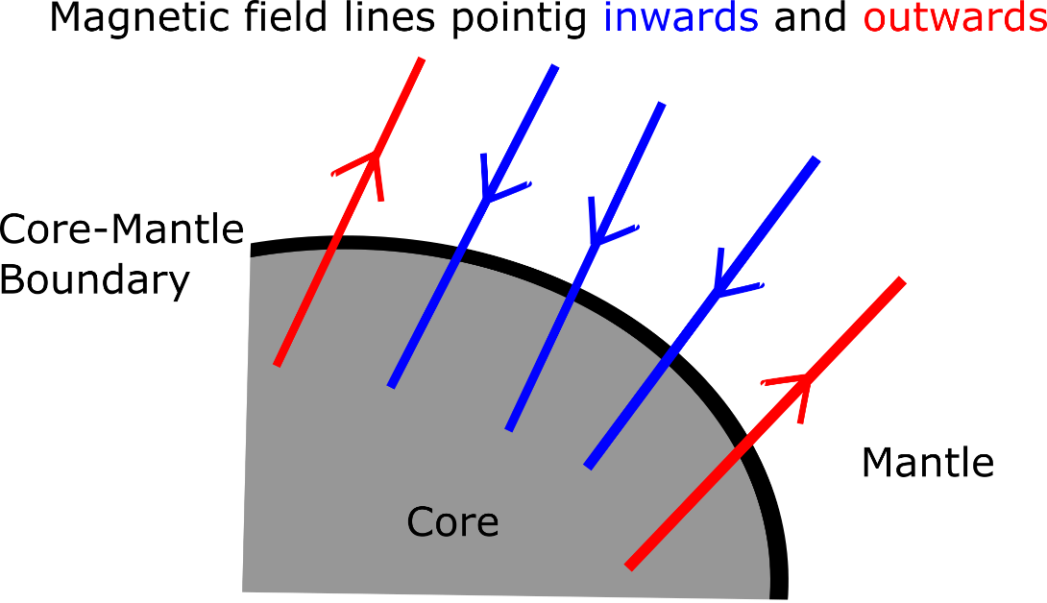
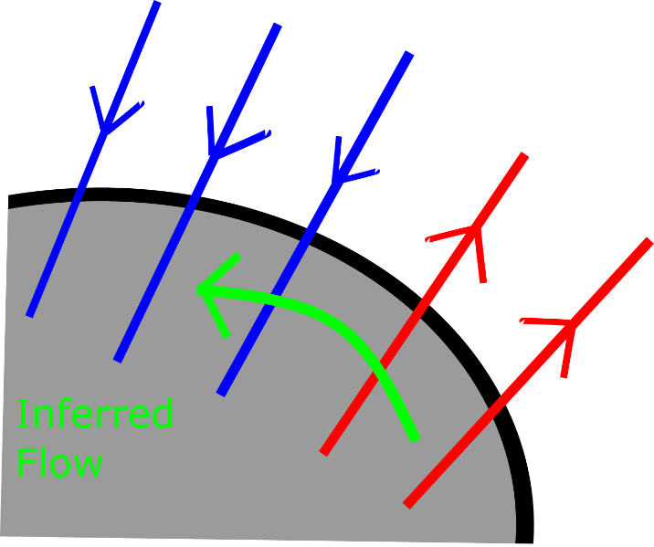
HOME
Aim of research
Magnetic data inversion
Virtual observatories
Spherical Slepian functions
Region of Interest, LLSVPs
Main findings
Conclusions and Further work
Typically a CMB flow model is derived from temporal changes in magnetic field (SV) by relating spherical harmonic representations of the main field, SV and flow (Holme, 2007). We assume the frozen-flux hypothesis which states that field lines are tied to the pockets of flow on the CMB. As the liquid iron moves along the CMB, the field lines are dragged along with it.
Spherical harmonic SV coefficients ( ) are related to related to flow coefficients by where represents linear combinations of Elsasser and Gaunt integrals and is a vector of spherical harmonic coefficients describing the flow model. is related to the observed SV data ( ) at the surface of the Earth or at satellite altitude by where has elements which are multiples of their spherical harmonics and their and derivatives.
Spatially regularised least squares minimisation gives:
where is a damping parameter and is a regularisation matrix, introduced to reduce the size of the kinetic energy for high degree coefficients.
MAGNETIC DATA INVERSION
Period of time later
Fig: Schematic showing the frozen-flux hypothesis which states that field lines are tied to the pockets of flow on the CMB
Example data inversion

Slide 5
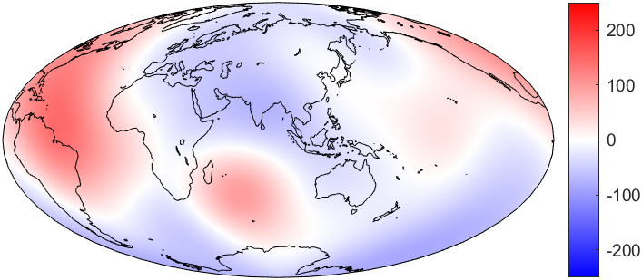
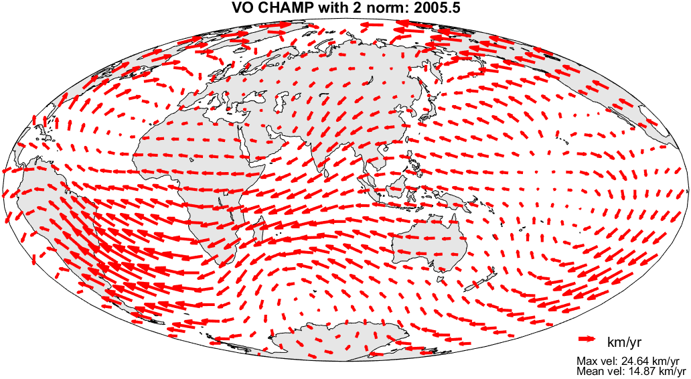
HOME
Aim of research
Magnetic data inversion
Virtual observatories
Spherical Slepian functions
Region of Interest, LLSVPs
Main findings
Conclusions and Further work
Typically a CMB flow model is derived from temporal changes in magnetic field (SV) by relating spherical harmonic representations of the main field, SV and flow (Holme, 2007). We assume the frozen-flux hypothesis which states that field lines are tied to the pockets of flow on the CMB. As the liquid iron moves along the CMB, the field lines are dragged along with it.
Spherical harmonic SV coefficients ( ) are related to flow coefficients by where represents linear combinations of Elsasser and Gaunt integrals and is a vector of spherical harmonic coefficients describing the flow model. is related to the observed SV data ( ) at the surface of the Earth or at satellite altitude by where has elements which are multiples of their spherical harmonics and their and derivatives.
Spatially regularised least squares minimisation gives:
where is a damping parameter and is a regularisation matrix, introduced to reduce the size of the kinetic energy for high degree coefficients.
Secular Variation (nT/year)
MAGNETIC DATA INVERSION
Schematic of frozen-flux
Top: Change in radial magnetic field strength (SV) at the surface of Earth, June 2005.
Bottom: The CMB flow generated from an inversion of SV in the upper image. Continents shown for reference.

Slide 6
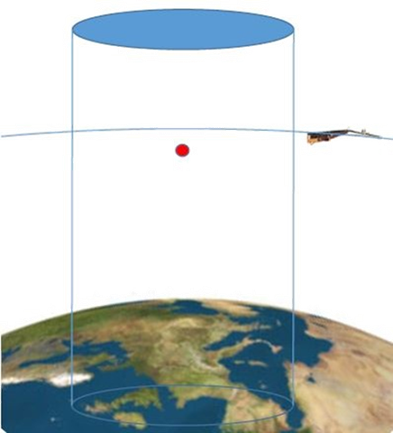
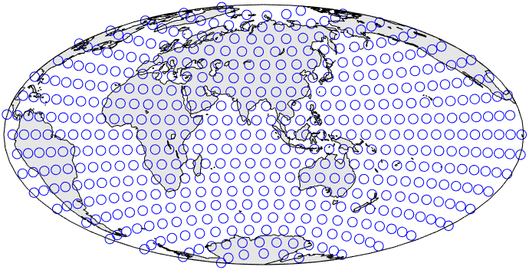
HOME
Aim of research
Magnetic data inversion
Virtual observatories
Spherical Slepian functions
Region of Interest, LLSVPs
Main findings
Conclusions and Further work
Our SV data are monthly magnetic vector satellite data from the CHAMP satellite June 2005. We treat our data using the virtual observatory (VO) concept, where all data are collected within a column and reduced to their value at a central point, indicated by the red dot within the blue column in the figure on the right (Mandea and Olsen, 2006). This allows us to treat satellite data as if they were a ground observatory at the average satellite height.
The distribution of the VO data points used in this study are shown below.
VIRTUAL OBSERVATORIES
Above: A diagram to demonstrate VOs. The blue column relates to a set footprint on the Earth’s surface and every data point collected over a month from CHAMP satellite tracks passing through the cylinder are reduced onto the red point.
Above: Distribution of VOs from CHAMP satellite mission June 2005

Slide 7
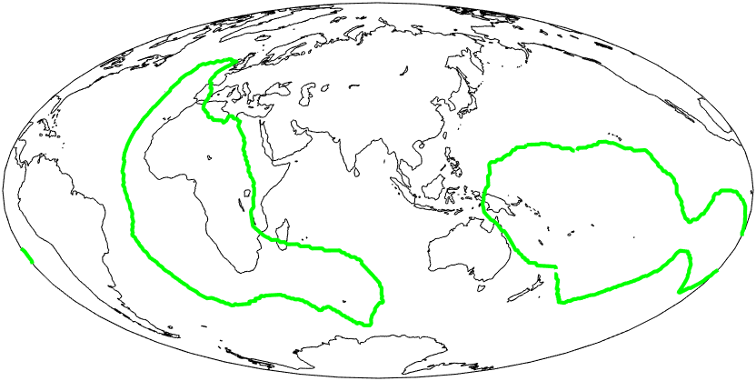
HOME
Aim of research
Magnetic data inversion
Virtual observatories
Spherical Slepian functions
Region of Interest, LLSVPs
Main findings
Conclusions and Further work
LLSVPs (Large Low Shear Velocity Provinces) are features near the base of the mantle which slow seismic waves passing through these regions (e.g. Garnero et al, 2016). The image on the right shows this heterogeneity on the CMB. There is debate about how LLSVPs formed and the impact that they have on the mantle system (Mound et al, 2019). The sharp gradients at the region edge indicate that there is compositional heterogeneity but there may also be thermal heterogeneity - both of which may influence flow in the outer core beneath it.
REGION OF INTEREST, LLSVPs
Fig: Map of shear-velocity heterogeneity at 2800 km depth for Model S40RTS
The outline used for this poster comes from Doubrovine et al. (2016), seen in the left-hand figure. It is based on the third voting contour which compares the variation in LLSVP outlines from multiple studies. Smaller patches were removed and a smoothing factor was applied to improve the performance of the Slepian decomposition.
Fig: Outline of LLSVPs (region of interest) used in this study

Slide 8
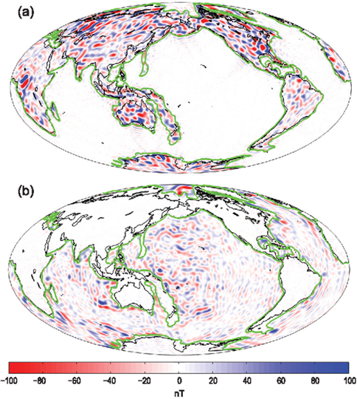
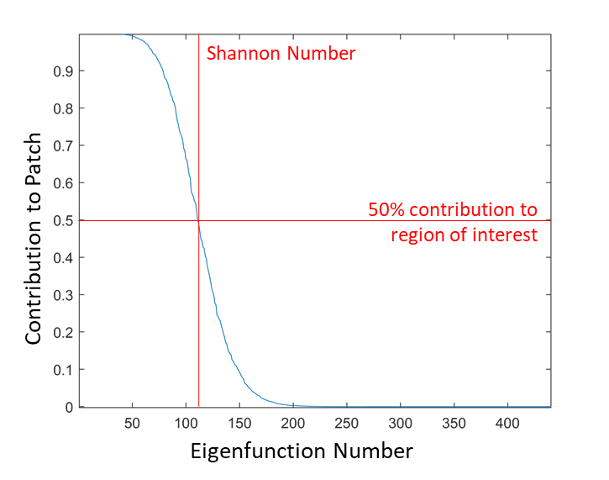
HOME
Aim of research
Magnetic data inversion
Virtual observatories
Spherical Slepian functions
Region of Interest, LLSVPs
Main findings
Conclusions and Further work
Spherical Slepian functions (or ‘Slepian functions’) are mathematical functions which can be used to decompose potential fields, as represented by spherical harmonics, into smaller regions covering part of a spherical surface. This allows a spatio-spectral trade-off between aliasing of the signal at the boundary edges while constraining it within a region of interest. Spherical Slepian functions retain many of the advantages of our usual flow description, concerning for example the boundary conditions it must satisfy, and allowing easy calculation of the power spectrum, although greater initial computational effort is required.
The Slepian basis eigenfunctions are orthogonal to the sphere and the region edge allowing us to order the functions by contribution to patch. We can set the division between ‘in’ and ‘out’ to be anywhere but a standard cut-off is the Shannon Number, which marks the function which contributes 50% of its energy to the patch (Simons, 2010).
SLEPIAN FUNCTIONS
Fig: Example of application of spherical Slepian functions to crustal magnetic data using the continental and oceanic crust as the region of interest (Beggan et al., 2013)
Fig: Division between ‘in’ and ‘out’ for degree 20 data. Everything to the left of the Shannon number will be considered ‘inside’ the region of interest

Slide 9
HOME
Aim of research
Magnetic data inversion
Virtual observatories
Spherical Slepian functions
Region of Interest, LLSVPs
Main findings
Conclusions and Further work
The Slepian functions we are using are altitude-cognizant Slepian functions (Plattner and Simons, 2017).
Choose a region of interest and identify which points are within or outside the region of interest by using VO locations
Optimization of Slepian solution over specified region considering region shape, maximum degree and downward continuation factor to produce unitary matrix G
Order terms by contribution to the patch, where 1 to the Shannon number (ShN) predominantly contribute to inside the patch
Calculate SV for the region of interest (in) using restricted VO data to calculate and
SLEPIAN FUNCTIONS
Apply Slepian separation to :
Apply Slepian separation to flows :
Plotting and investigation of features of separated flow plots
Plotting and investigation of features of separated SV plots

Slide 10
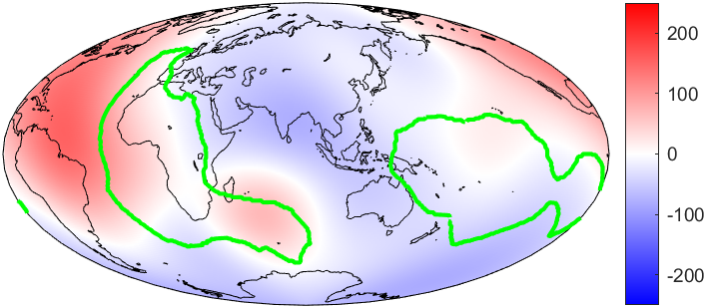
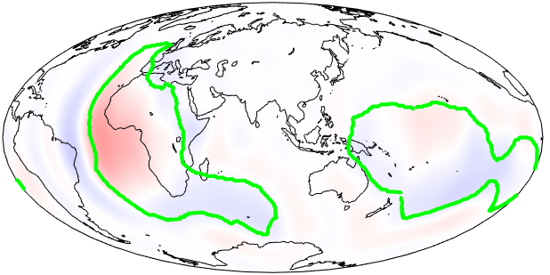
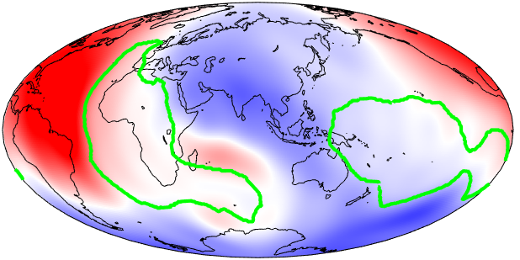
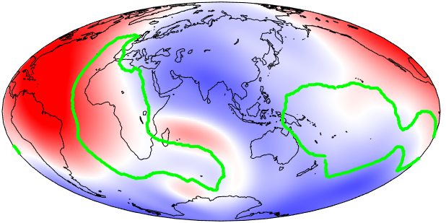
HOME
Aim of research
Magnetic data inversion
Virtual observatories
Spherical Slepian functions
Region of Interest, LLSVPs
Main findings
Conclusions and Further work
We have achieved a separation of the radial component of SV at the height of Earth’s surface.
The main features of the input are recreated in the separated results but seem to be of greater intensity compared to the input. This is indicative of a scaling issue.
The separation has not managed to capture the SV in the south eastern lobe of the African LLSVP, beneath the Indian Ocean, suggesting the region shape is a limiting factor
Input
Inside LLSVPs
MAIN FINDINGS
Outside LLSVPs
Sum of separation
Radial SV at Earth surface height (nT/year)
Next

Slide 11
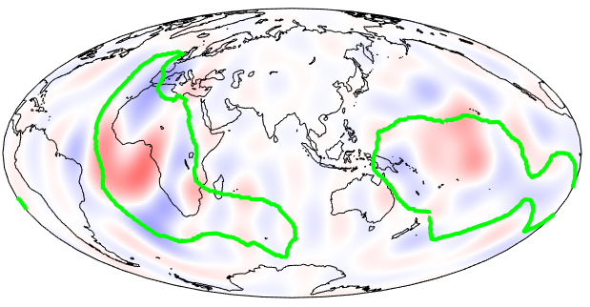
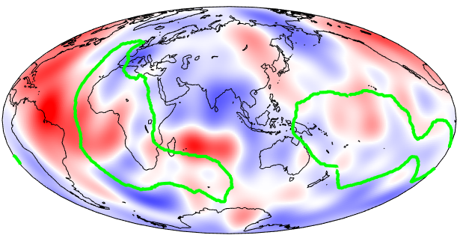
HOME
Aim of research
Magnetic data inversion
Virtual observatories
Spherical Slepian functions
Region of Interest, LLSVPs
Main findings
Conclusions and Further work
Input
Inside LLSVPs
We have achieved a separation at the radial component of SV at the CMB but with more leakage compared to the surface.
Again, the main features of the input are recreated in the separated maps but are of greater intensity compared to the input.
The separation for outside the LLSVP region appears to be better, probably due to its greater area.
MAIN FINDINGS
Outside LLSVPs
Sum of separation
Radial SV at CMB height (nT/year)
Back
Next

Slide 12
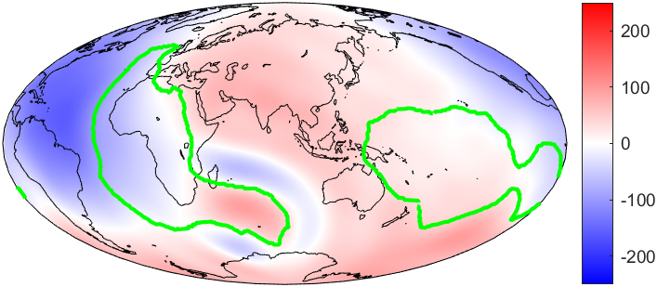
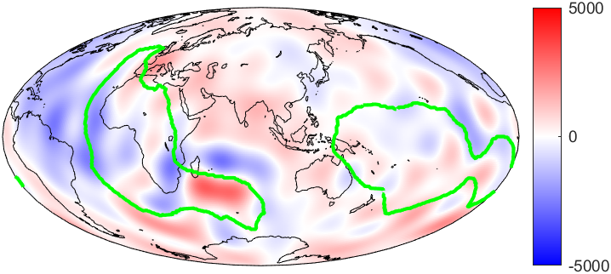
HOME
Aim of research
Magnetic data inversion
Virtual observatories
Spherical Slepian functions
Region of Interest, LLSVPs
Main findings
Conclusions and Further work
Input SV – Sum SV at Earth surface
(nT/year)
This is the difference for radial SV between the input and the sum of the separations at Earth’s surface (top) and CMB (bottom).
The difference at Earth’s surface clearly shows how radial SV in the south eastern lobe of the African LLSVP, beneath the Indian Ocean, has not been captured by the dataset. The general shape of the difference between the input and the sum of our separation is a low degree structure.
The difference at the CMB also reflects a low degree hemispherical difference but with further complexity within it. The failure to capture SV in the south eastern lobe of the African LLSVP is more pronounced compared to the surface and seems to generate ringing around the structure.
MAIN FINDINGS
Input SV – Sum SV at CMB
Back
Next

Slide 13
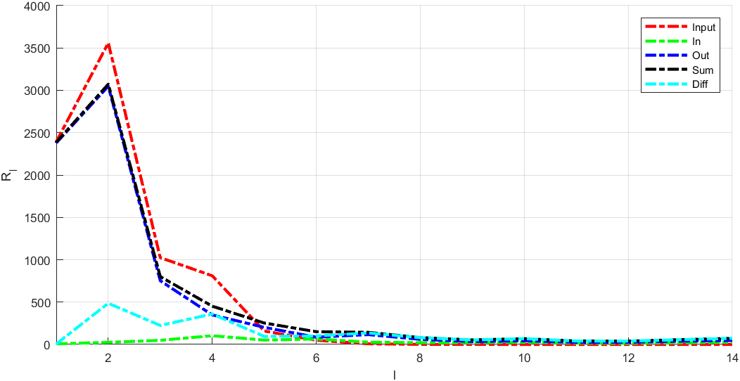
HOME
Aim of research
Magnetic data inversion
Virtual observatories
Spherical Slepian functions
Region of Interest, LLSVPs
Main findings
Conclusions and Further work
The spectra of the SV separation at the Earth’s surface show that the input data contain the highest amounts of energy at low degrees but at degree L=5 the sum of the separation has more energy than the input up to degree 14.
The complexity of the region shape will force (alias) some of that low degree energy into higher degrees which is then damped more.
The SV spectrum for inside the region is considerably lower than that of the input. This may be caused by the Pacific region having weaker SV than average, and the inside LLSVPs region has fewer VOs contributing to its estimation compared to a global model.
The sum does not recreate the input which could indicate a scaling error
MAIN FINDINGS
Spectral Energy (nT/year²)
Degree Number
Back
Next

Slide 14
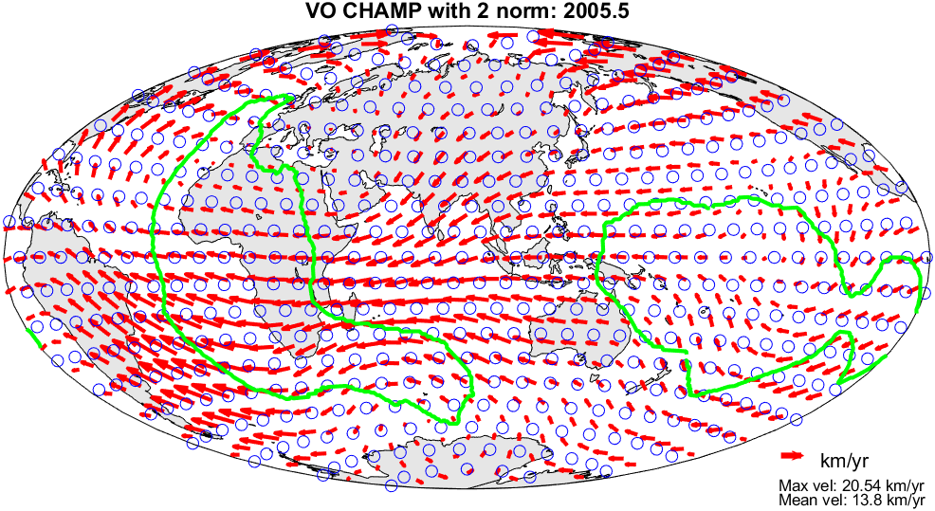
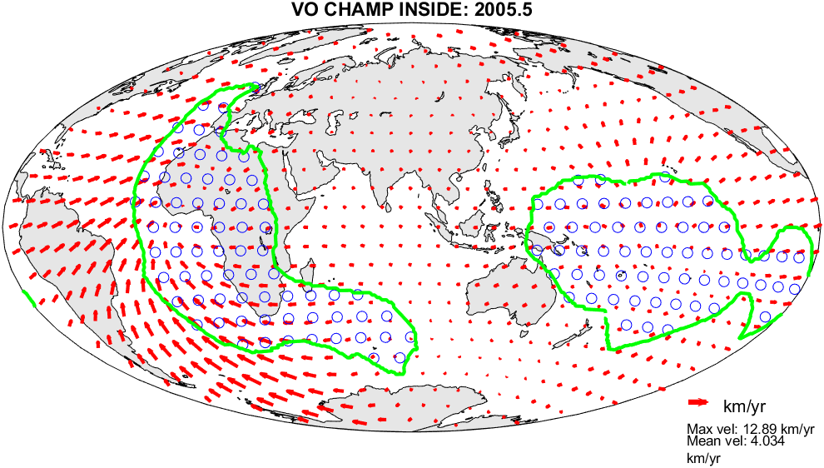
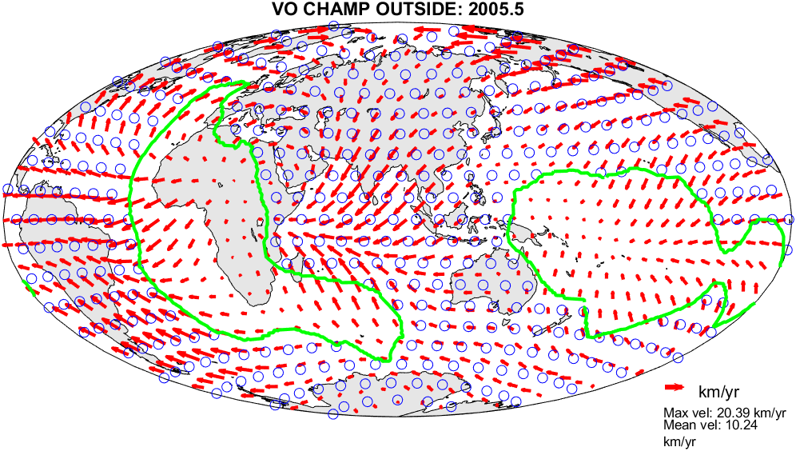
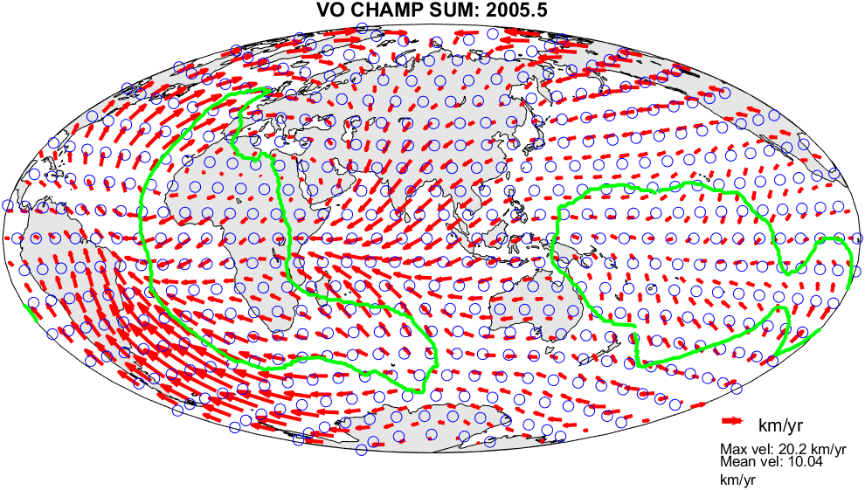
HOME
Aim of research
Magnetic data inversion
Virtual observatories
Spherical Slepian functions
Region of Interest, LLSVPs
Main findings
Conclusions and Further work
We aim to use the separated SV (as seen previously) to generate separated flows with no flow within the complementary region.
We can see that the flow is reduced substantially in the complementary region but there is still some flow remaining. This may be due to the B matrix containing a global description.
The flow recreation is poorer inside the LLSVP region and large flow speeds are generated at the region edge. This may be due to the smaller surface area it covers.
Input flow
Inside LLSVPs
Outside LLSVPs
Sum of separation
Back
Next

Slide 15
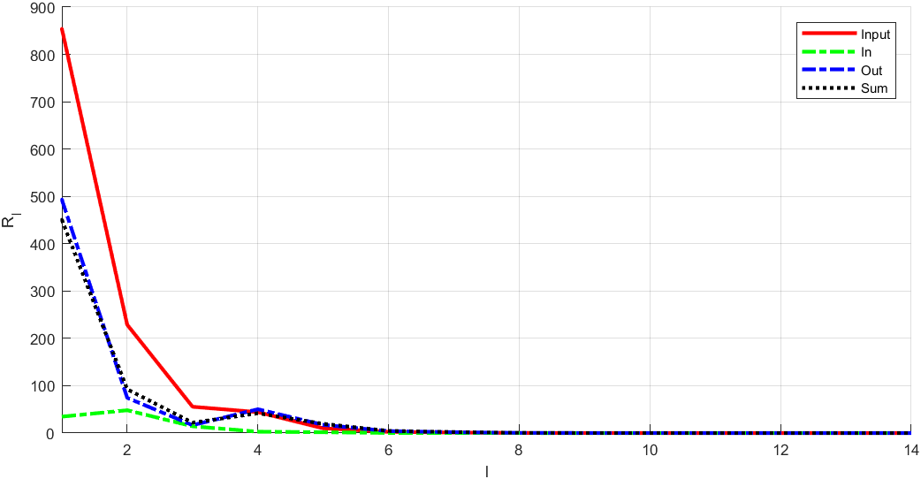
HOME
Aim of research
Magnetic data inversion
Virtual observatories
Spherical Slepian functions
Region of Interest, LLSVPs
Main findings
Conclusions and Further work
The spectra of the separated flows show a similar trend to that of the SV but with a greater disparity between the input and the separated/summed flows.
Further work needs to be done to improve our results.
MAIN FINDINGS
Spectral Energy (km/yr²)
Degree Number
Back

Slide 16
HOME
Aim of research
Magnetic data inversion
Virtual observatories
Spherical Slepian functions
Region of Interest, LLSVPs
Main findings
Conclusions and Further work
While progress has been made to adapt the use of spherical Slepian functions for CMB flows, there are still these considerations:
the separation recreates the main features of SV at the Earth’s surface and the CMB
the limited degree of core SV/flows are a major restricting factor compared to previous applications of spherical Slepian functions, e.g. crustal field has spherical harmonics to degree 133
the complexity of the region shape affects leakage so it may not be suitable for some research aims
we are currently not recreating our input when summing the inside and outside region together
CONCLUSIONS
Further work includes:
using a 20-year time series of CHAMP, Cryosat and SWARM VO SV data to see how flow under LLSVPs has changed in time
increasing the smoothing factor when defining our region edge to improve separations. However, this might mean that we do not capture the true shape of LLSVPs
investigating the cause of leakage and improve understanding of Slepian functions. This may be done by adding zeros or random numbers during the separation before plotting a truncated subset
References

