Slide 1
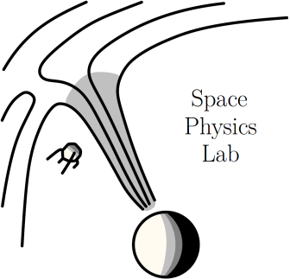
Study of alpha particle properties across rarefaction regions
Tereza Ďurovcová, Jana Šafránková, and Zdeněk Němeček
Faculty of Mathematics and Physics, Charles University
EGU General Assembly 2021

Slide 2
Outline
1
Introduction
Properties of alpha particles in the pristine solar wind
Corotating rarefaction regions
CRR structure
Events selection
Study of alpha properties in different CRR regions
Superposed epoch analysis
Case study
Impact of proton beam decay
Connection between the alpha properties and other solar wind source identifiers
Summary and conclusions

Slide 3
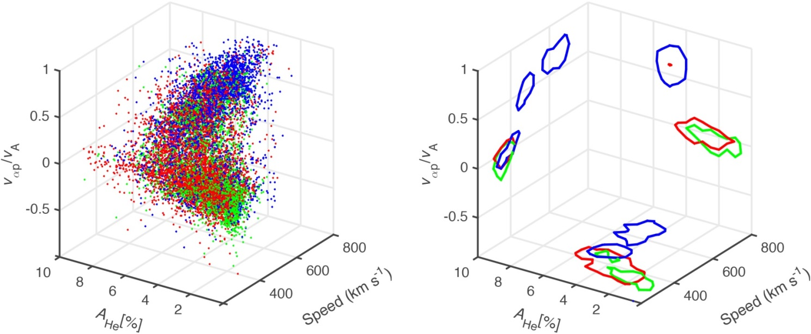
Properties of alpha particles in the pristine solar wind
2
Properties of alpha particles usually serve as one of the solar wind source identifiers:
slow solar wind ($V_{p}<400$ km/s)
Low ($≈1\%$) and highly variable relative alpha abundance $\frac{n_{α}}{n_{p}}$
Alpha-proton relative drift, $v_{αp}$ is close to 0 and protons move a bit faster than alphas
Temperatures of both ion species are balanced, $\frac{T_{α}}{T_{p}}≈1$
fast solar wind ($V_{p}>500$ km/s)
Higher relative alpha abundance $\frac{n_{α}}{n_{p}}$ ($≈4\%$)
Significant alpha-proton relative drift, alphas are faster than protons
Alphas typically have larger temperatures than protons, $\frac{T_{α}}{T_{p}}≈4$
coronal hole
active region
quiet Sun
(Fu, 2018)

Slide 4
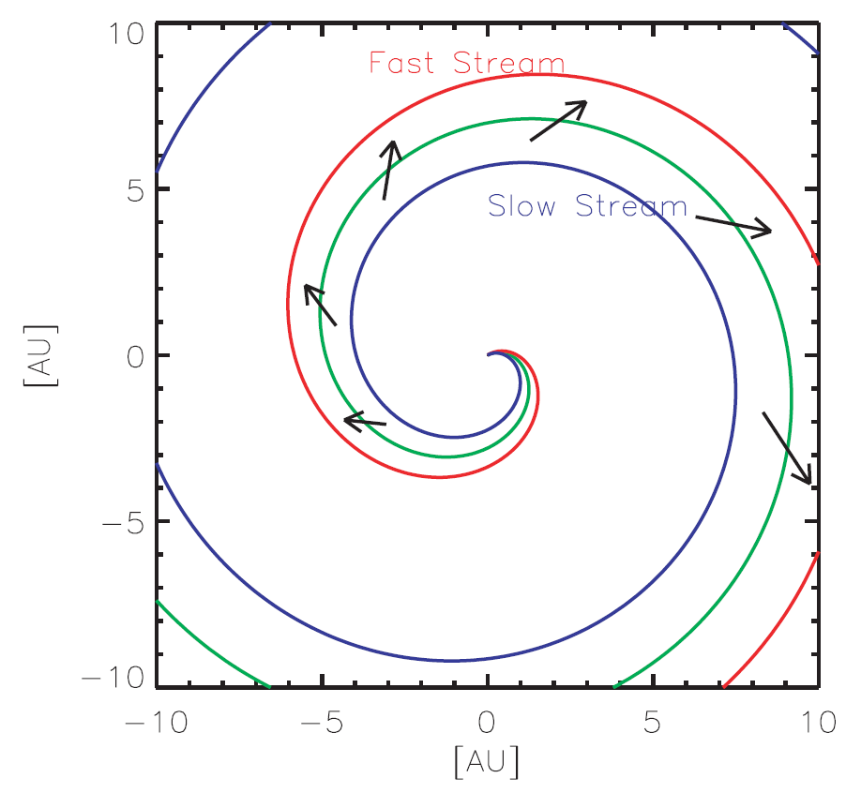
Corotating rarefaction region (CRR)
3
When the high-speed stream outruns the slow solar wind, the region of rarefacted solar wind is formed
CRRs are characterized by:
Low density and weak magnetic field
Monotonic decrease in solar wind speed
Magnetic field orientation more radial then predicted by Parker model. This is caused by footpoint motion of open magnetic field lines on the Sun and the shearing of the solar wind in CRRs (Schwadron et al., 2002)
When the solar wind within CRR is mapped back to the Sun along streamlines, assuming a constant solar wind speed, it is associated with the regions of small longitudinal extent on the Sun (called “dwells”)
Identifying stream interface in the CRR is not straightforward
Stream interface signatures (composition change, drop in the specific entropy, etc.) are temporally separated
(Murphy et al., 2002)

Slide 5
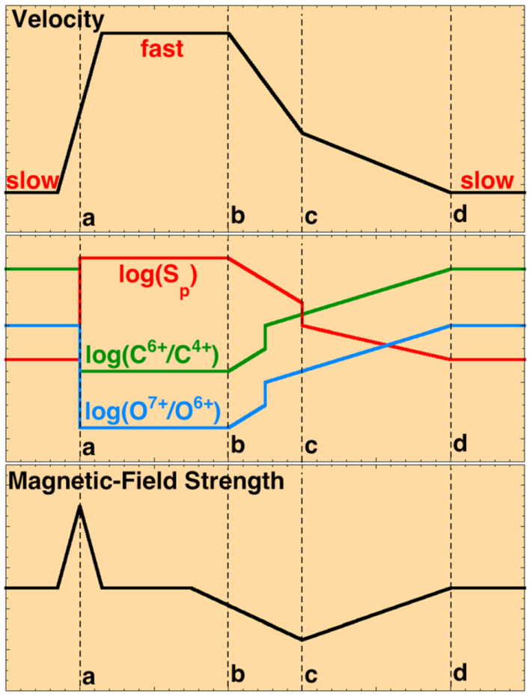
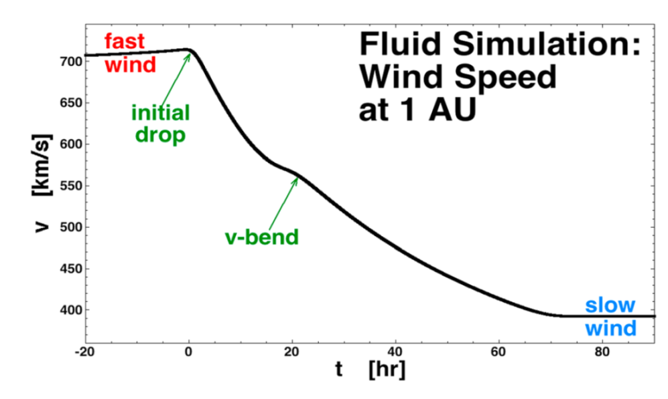
CRR structure
4
Borovsky et al. (2016) prepared a sketch shown on the left which illustrates the chronology at 1 AU of the major signatures in the fast stream and its surrounding
The initial velocity drop corresponds to the start of the fast stream rarefaction, but there is evidence indicating that the rarefaction might start sooner
The velocity bend was taken as the location of the CRR stream interface
velocity
specific entropy and the heavy ion charge state density ratios
1D numerical simulations performed by Borovsky et al. (2016) indicate that the velocity bend is the collision point of the pressure-driven expansions of the slow stream and the fast stream in CRR.
magnitude of the magnetic field
CIR stream interface
initial velocity drop
velocity bend
CRR termination
(Borovsky et al., 2016)

Slide 6
Case selection
5
In our study, we used the collection of 54 CRRs observed at 1 AU in the years 1998–2008 and collected by Borovsky et al. (2006). Selection criteria for those events were as follows:
The trailing edge must be preceded by a robust high-speed stream with a duration of a day or more
The trailing edge must have quasi-monotonic velocity profile without discontinuities or multiple velocity bend points
A trailing edge is rejected if it contains clear signatures of ejecta (such as depressed proton temperature, long duration out-of-ecliptic magnetic field vectors, or bidirectional electron strahl)
The velocity within the trailing edge should eventually reach low speeds (≈ 400 km/s or less)
For each of these cases, we added a region of quiet fast solar wind preceding the CRR and a 6-hour long interval after the CRR termination
The observation time of CRR regions varies considerably in different cases. Therefore, we divided the cases into 4 sub-intervals:
fast stream ─ initial velocity drop
initial velocity drop ─ velocity bend
velocity bend ─ CRR termination
CRR termination ─ 6 hours after CRR termination

Slide 7
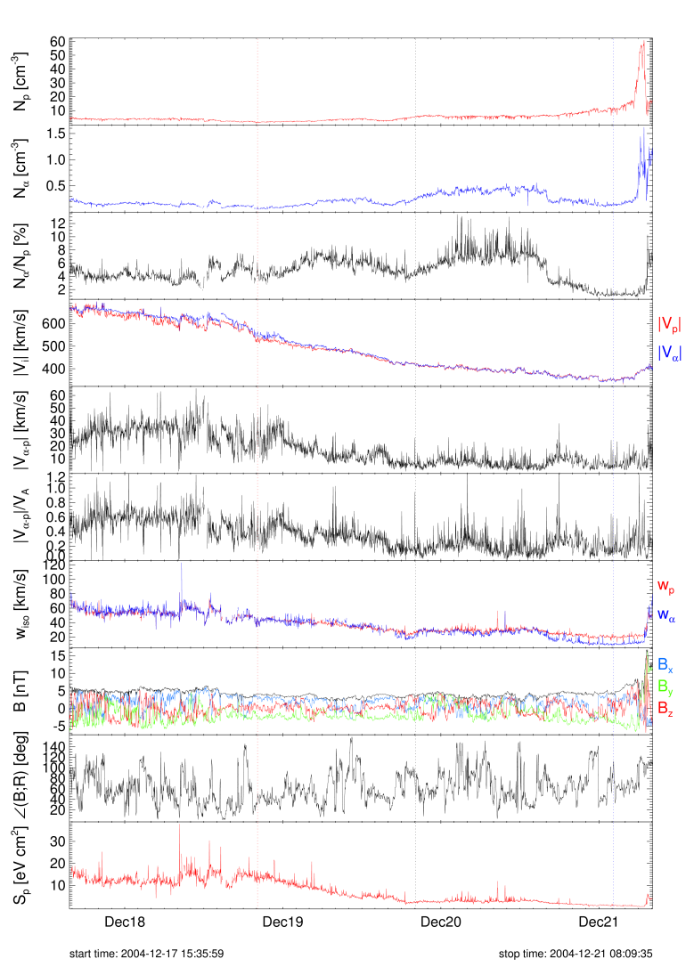
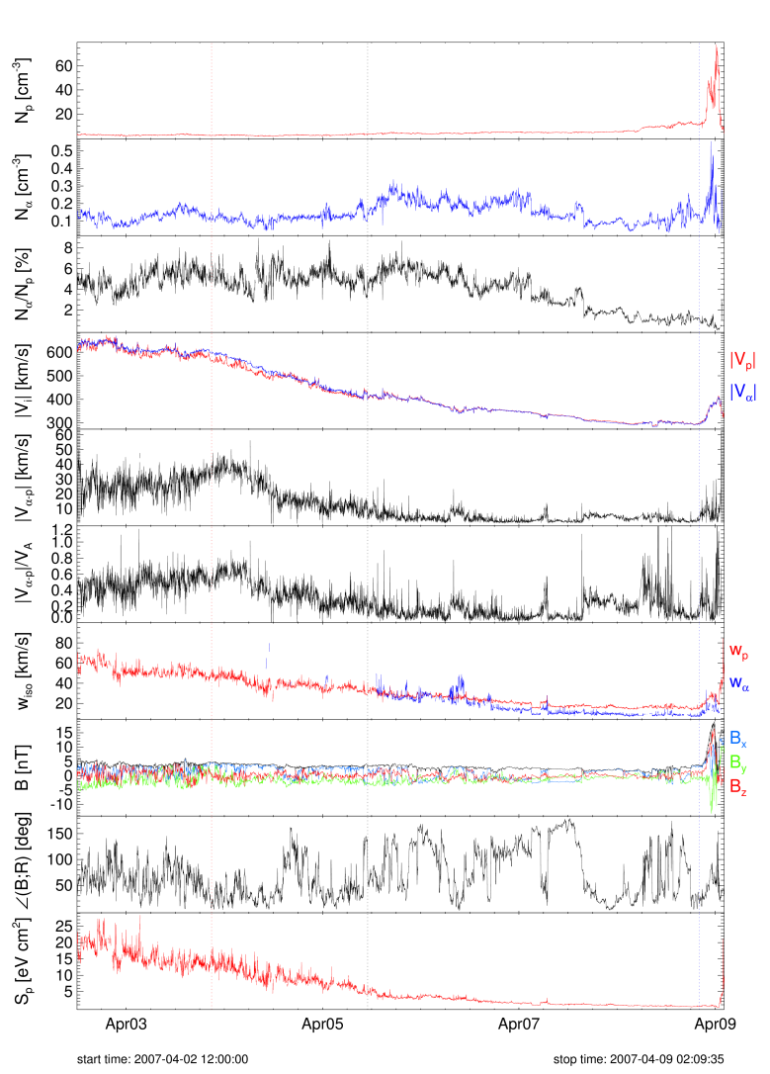
Examples of the studied CRRs
6
initial velocity drop
velocity bend
CRR termination
initial velocity drop
velocity bend
CRR termination
Here we show two examples of the studied CRRs. The four subintervals are marked with different background colors.
From top to bottom:
proton density
alpha density
relative alpha abundance
proton and alpha velocity
alpha-proton relative drift
$v_{αp}$ in units of the local Alfven speed
proton and alpha thermal speeds
magnetic field magnitude and components in the GSE coordinate system
angle between the magnetic field orientation and the radial direction
specific entropy

Slide 8
Examples of the studied CRRs
7
initial velocity drop
velocity bend
CRR termination
initial velocity drop
velocity bend
CRR termination
Alpha properties typical for the slow solar wind streams appear at different times within the CRRs. First, the alpha-proton relative drift close to zero is observed near the velocity-bend. Then, towards the CRR termination, the alpha thermal speed starts to be lower than the proton thermal speed. The large changes in the relative alpha abundance are observed throughout the CRR. Near the CRR termination, alphas finally reach the abundances similar to that usually observed in the slow streams.

Slide 9
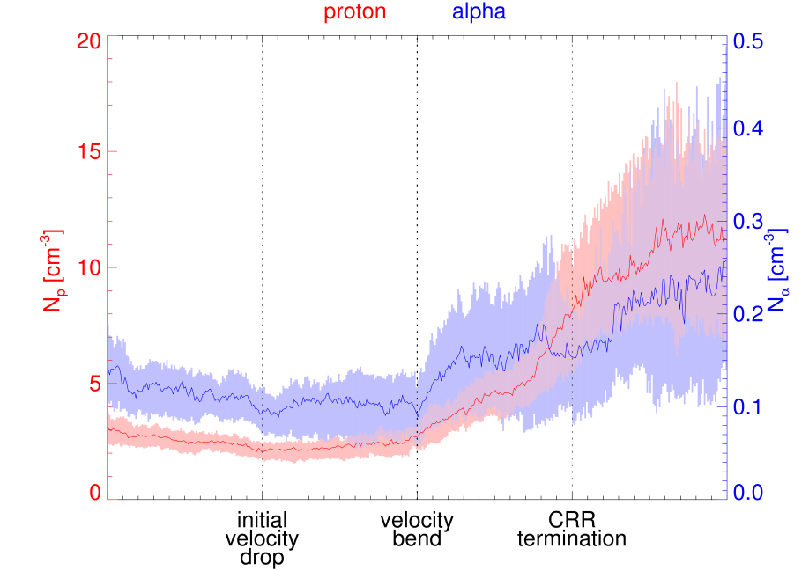
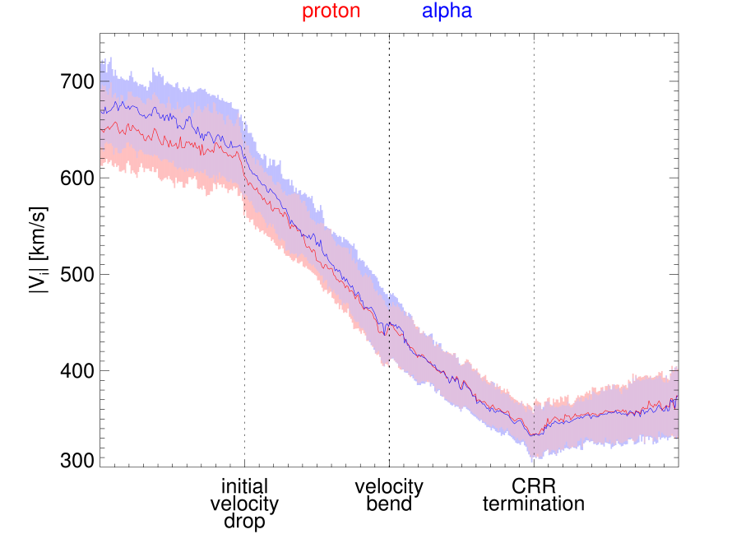
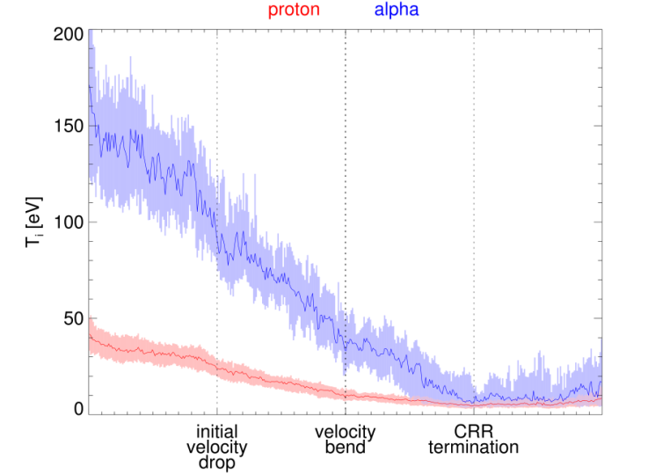
Superposed epoch analysis
8
How does the global profile of proton and alpha properties look like across CRR?
In order to answer this question, we performed a superposed epoch analysis of basic ion properties: density, bulk speed, temperature; proton properties in red and alpha properties in blue. The solid line shows the median profile and the colored background indicates region between 25th and 75th percentiles. We found that changes in different alpha properties are temporally separated:
After the initial velocity drop, the proton and alpha velocities gradually decrease. Both ionic components reach almost the same speed already near the velocity bend.
The proton and alpha temperatures decrease throughout the CRR. Near the CRR termination, the alpha temperature reaches nearly the same values as the proton temperature and stops decrease.
Profiles of the proton and alpha densities differ behind the velocity bend.

Slide 10
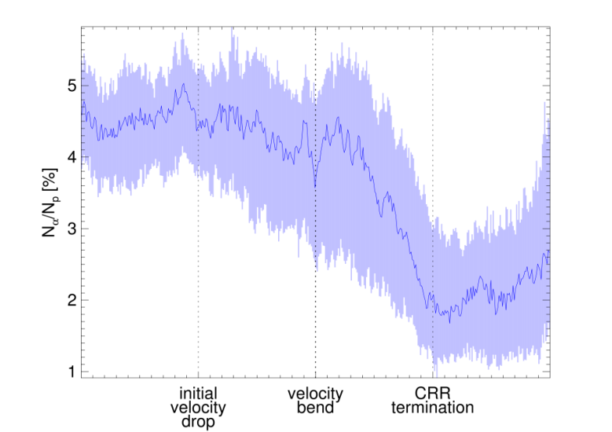
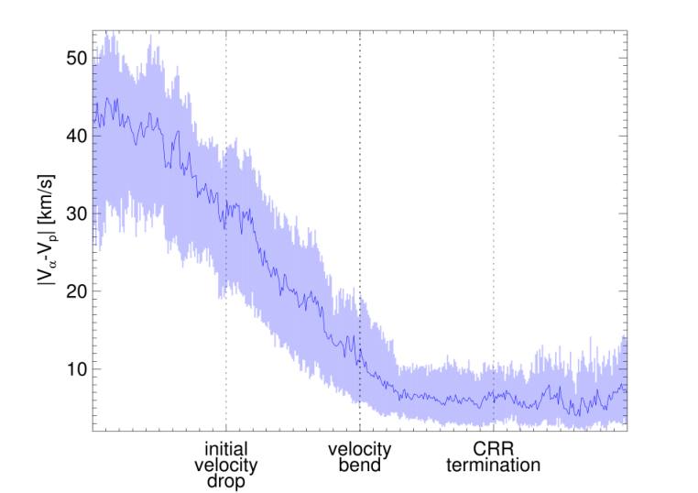
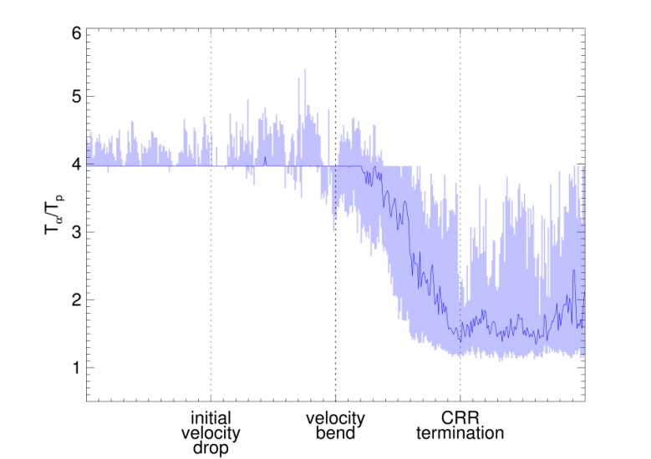
Superposed epoch analysis
9
We also performed a superposed epoch analysis of the alpha to proton relative properties.
The relative alpha abundance $\frac{N_{α}}{N_{p}}$ increases near the stream interface and then decreases sharply. These abundance changes are not associated with the alpha-proton relative drift variations, as this drift is usually close to zero after the velocity bend.
The alpha-proton relative drift decreases from the beginning of the CRR and remains close to 0 after the velocity bend.
The alpha and proton temperature ratio begins to decrease at the velocity bend. When the relative alpha abundance reaches values typical for the slow streams, both temperatures are nearly equal.

Slide 11
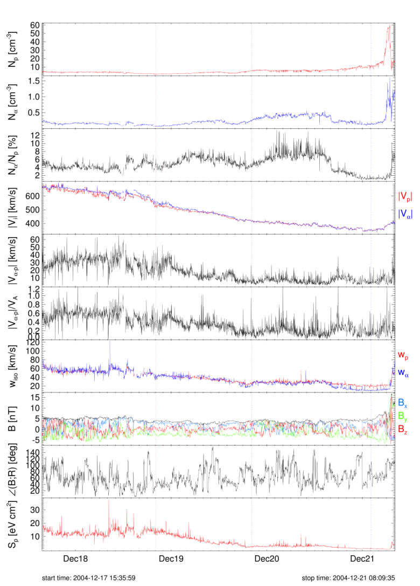
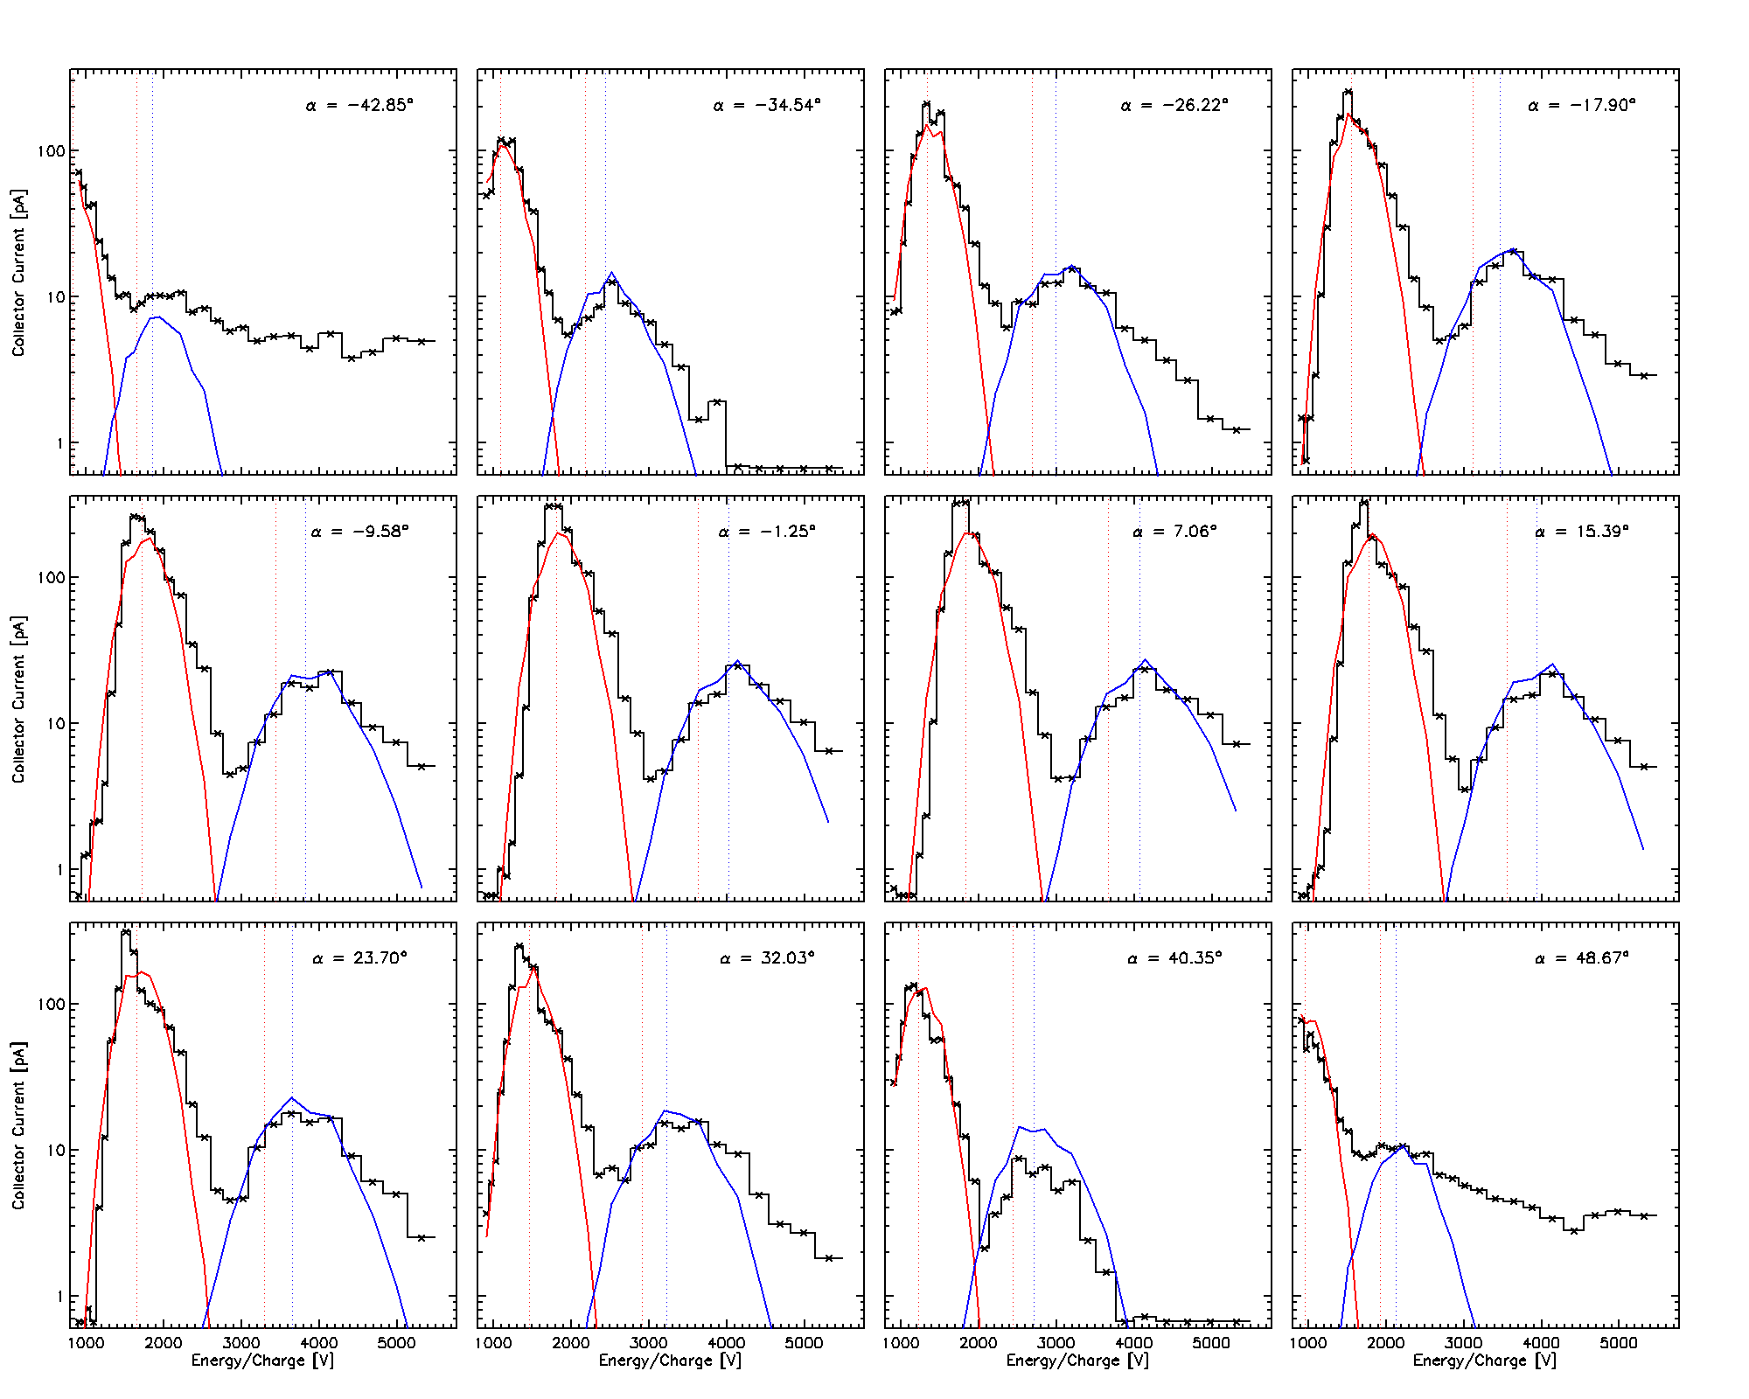
Case study
10
initial velocity drop
velocity bend
CRR termination
Ion energy spectra for different azimuthal angles:
To verify whether these variations are real, we prepared a case study and visually inspected the measured ion spectra and the fitted proton and alpha spectra for different azimuthal angles and various measurement times. The proton and alpha populations were usually clearly separated in the measured ion spectra.
Collector current [pA]
Energy/charge [V]
Assuming a bi-Mawellian VDF of incoming ions, SWE Faraday cup collector current can be expressed as a function of its collecting area $A$ and the location of the energy window $\left[V_{0},V_{0}+ΔV\right]$:
$$I=\frac{Anq_{i}}{2}\left[\frac{w_{i}}{\sqrt{π}}\left(e^{−z_{0}^{2}}−e^{−z_{1}^{2}}\right)+U_{z}\left(\operatorname{erf}\left(z_{1}\right)−erf(z_{0})\right)\right]$$
$$z_{0}= \frac{V_{0}−U_{z}}{w_{i}}$$
$$z_{1}= \frac{V_{0}+ΔV_{0}−U_{z}}{w_{i}}$$

Slide 12
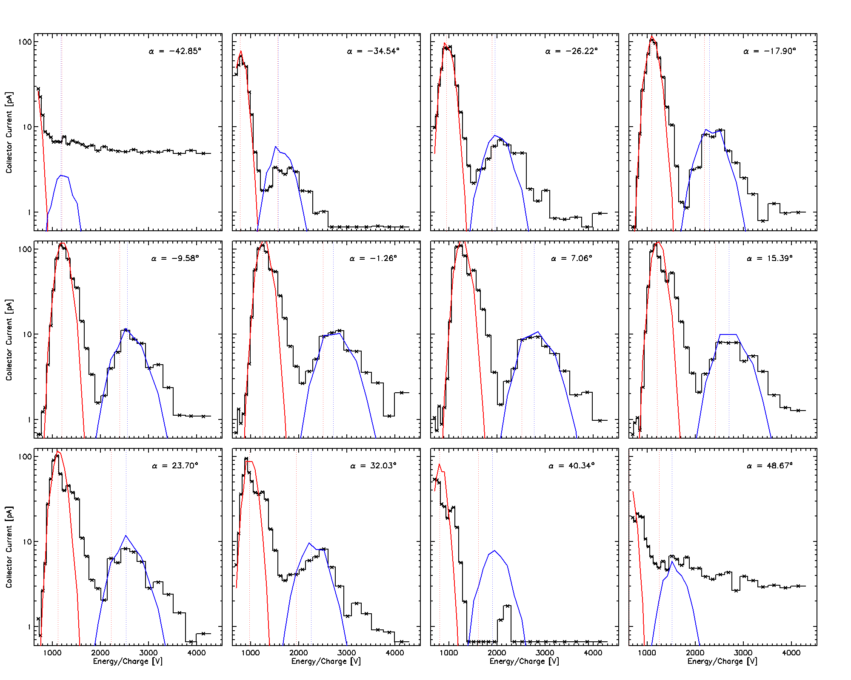
Case study
11
initial velocity drop
velocity bend
CRR termination
Ion energy spectra for different azimuthal angles:
In the fast stream, the proton beam signatures are observed at higher energy/charge ratios (marked with blue background). However, the data processing did not distinguish the proton beam population.
Collector current [pA]
Energy/charge [V]
Assuming a bi-Mawellian VDF of incoming ions, SWE Faraday cup collector current can be expressed as a function of its collecting area $A$ and the location of the energy window $\left[V_{0},V_{0}+ΔV\right]$:
$$I=\frac{Anq_{i}}{2}\left[\frac{w_{i}}{\sqrt{π}}\left(e^{−z_{0}^{2}}−e^{−z_{1}^{2}}\right)+U_{z}\left(\operatorname{erf}\left(z_{1}\right)−erf(z_{0})\right)\right]$$
$$z_{0}= \frac{V_{0}−U_{z}}{w_{i}}$$
$$z_{1}= \frac{V_{0}+ΔV_{0}−U_{z}}{w_{i}}$$

Slide 13
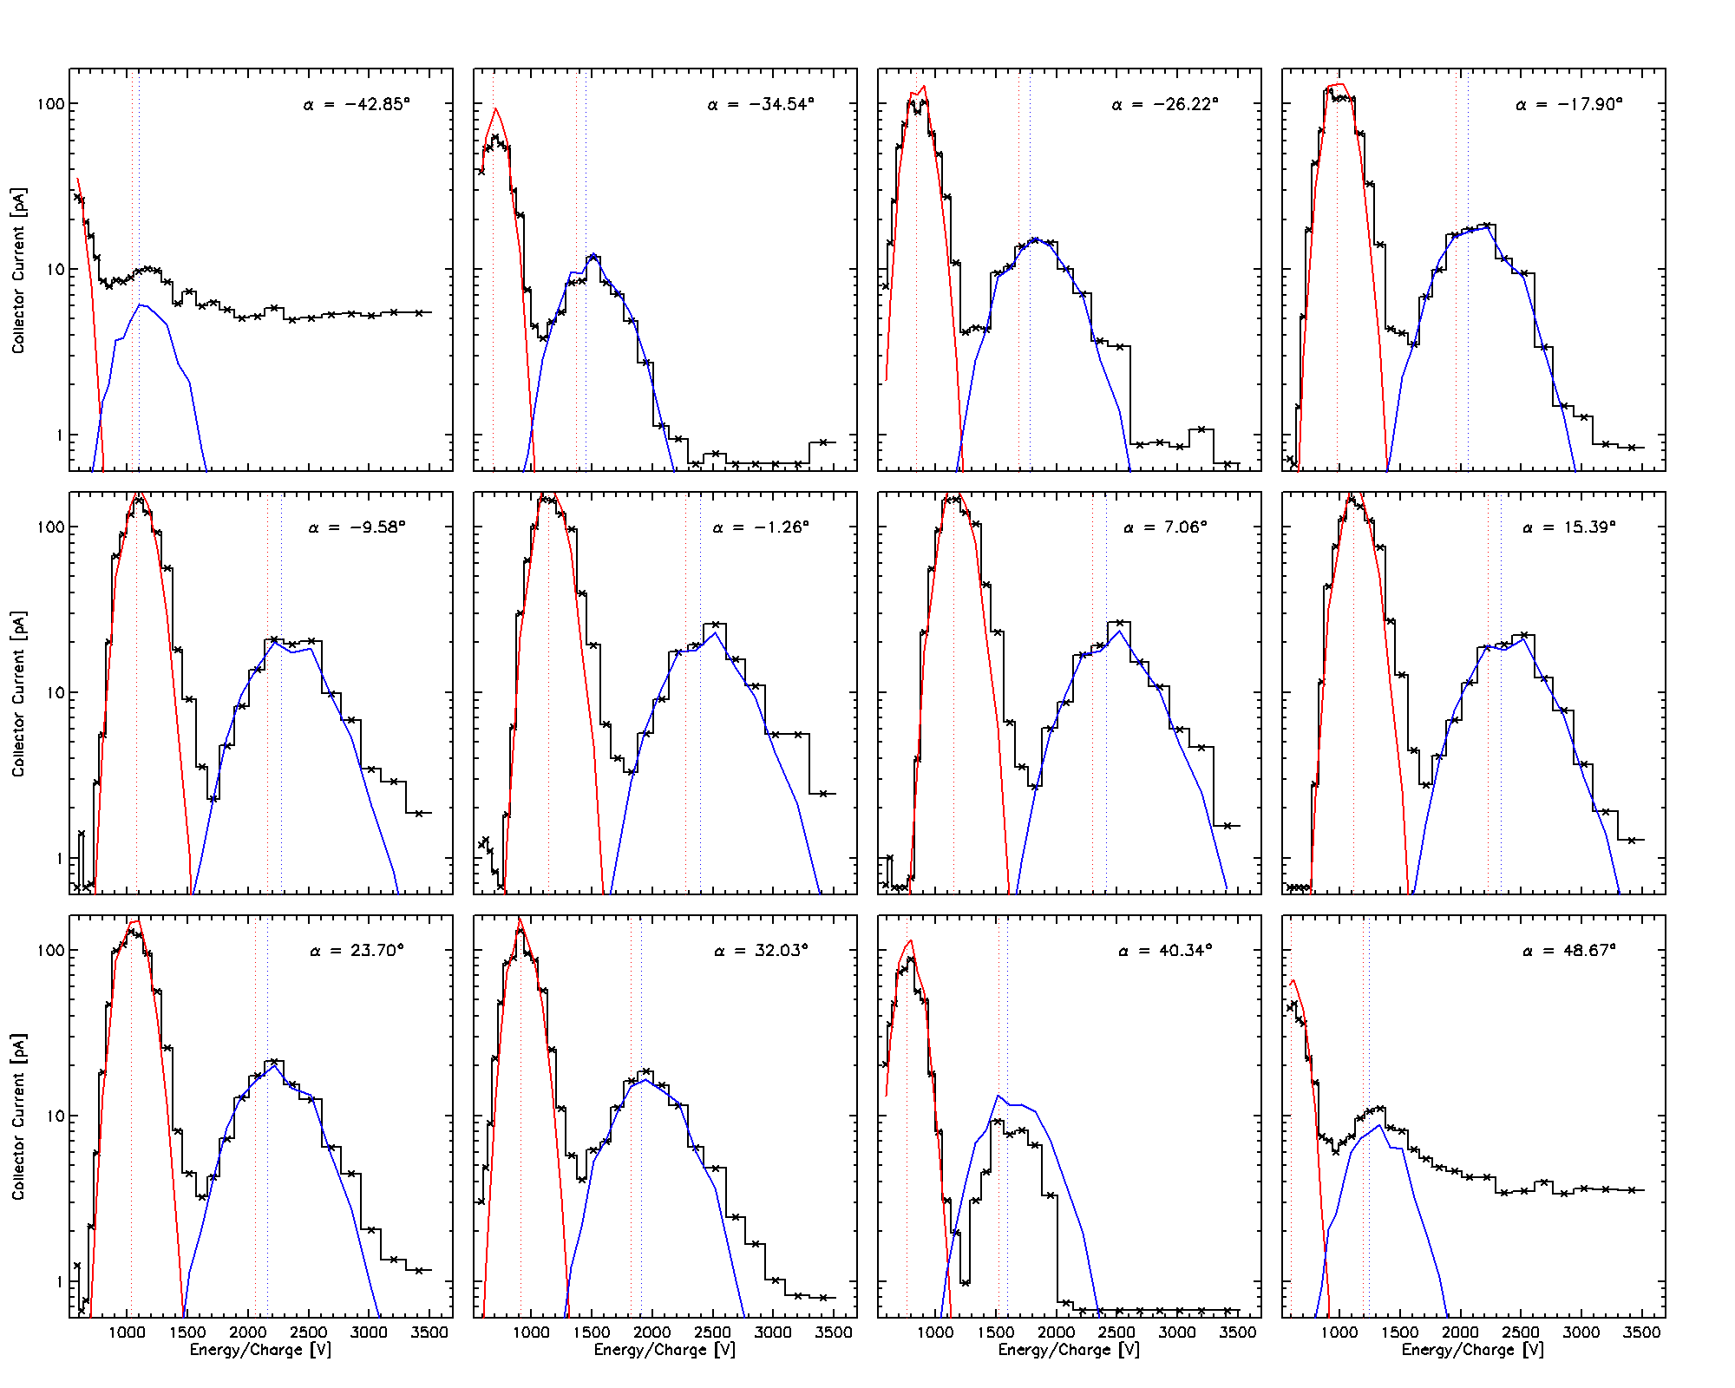
Case study
12
initial velocity drop
velocity bend
CRR termination
Ion energy spectra for different azimuthal angles:
As the proton velocity decreases, the proton beam gradually disappear.
Collector current [pA]
Energy/charge [V]
Assuming a bi-Mawellian VDF of incoming ions, SWE Faraday cup collector current can be expressed as a function of its collecting area $A$ and the location of the energy window $\left[V_{0},V_{0}+ΔV\right]$:
$$I=\frac{Anq_{i}}{2}\left[\frac{w_{i}}{\sqrt{π}}\left(e^{−z_{0}^{2}}−e^{−z_{1}^{2}}\right)+U_{z}\left(\operatorname{erf}\left(z_{1}\right)−erf(z_{0})\right)\right]$$
$$z_{0}= \frac{V_{0}−U_{z}}{w_{i}}$$
$$z_{1}= \frac{V_{0}+ΔV_{0}−U_{z}}{w_{i}}$$

Slide 14
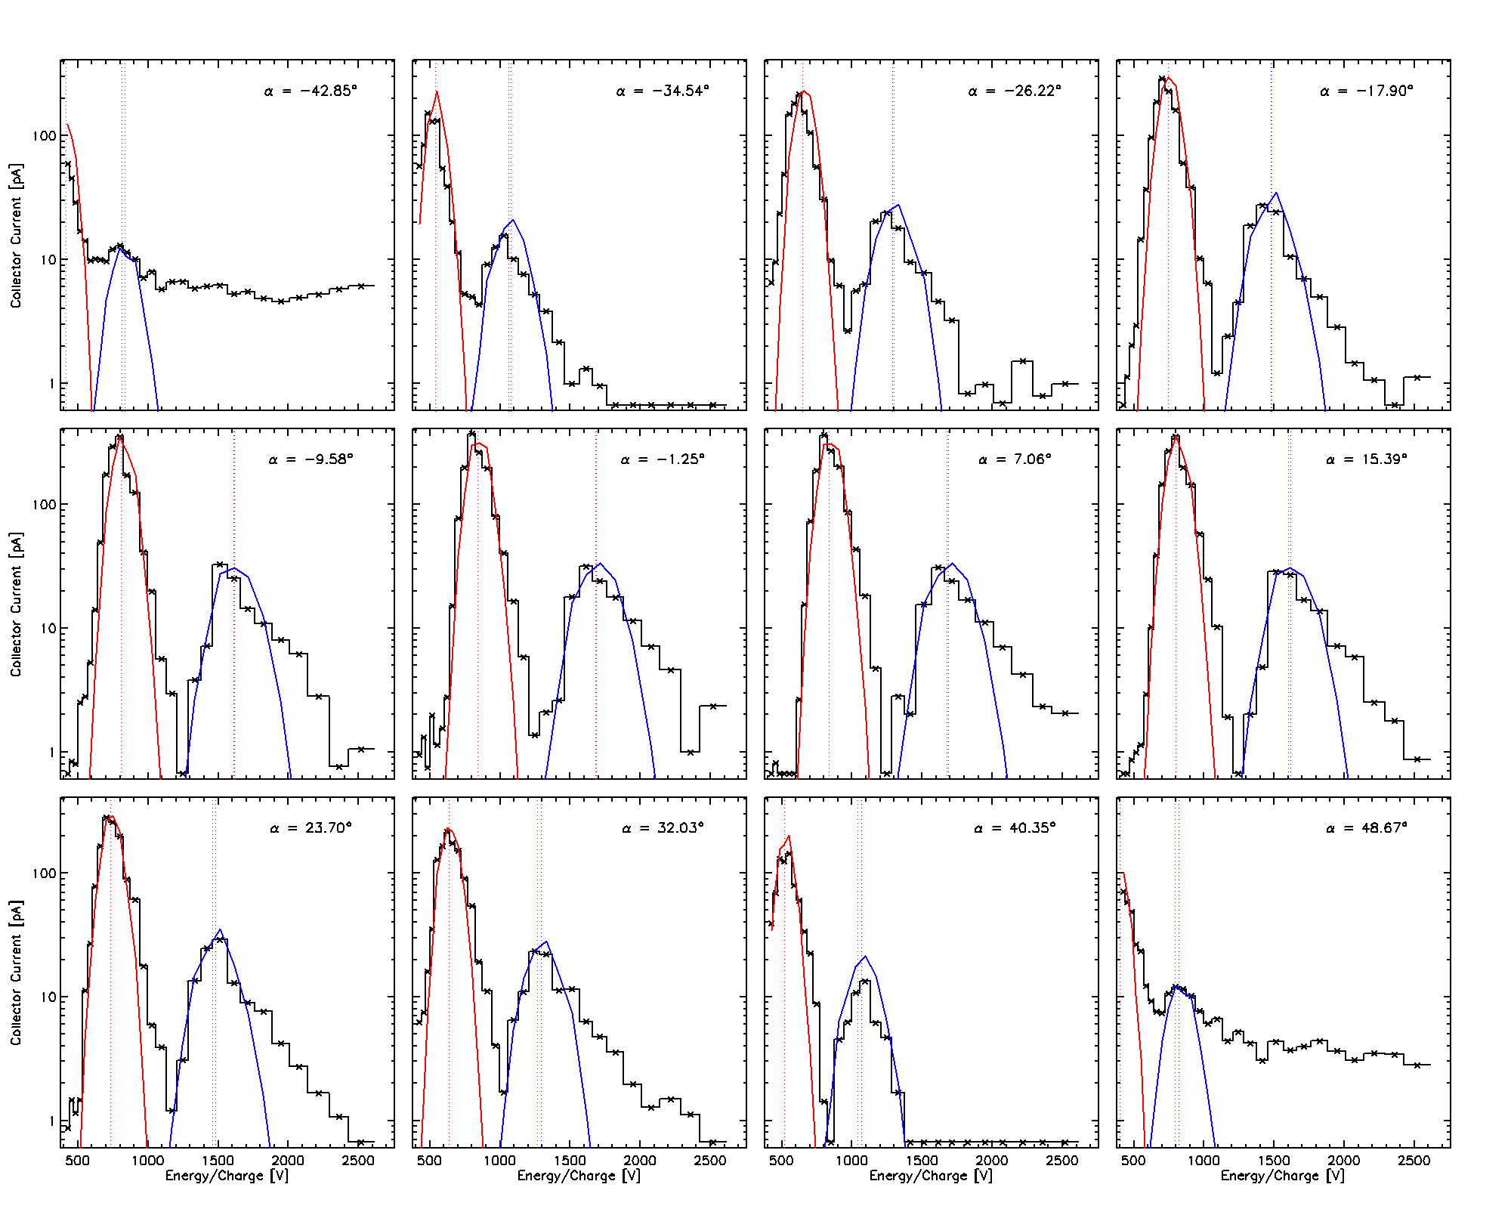
Case study
13
initial velocity drop
velocity bend
CRR termination
Ion energy spectra for different azimuthal angles:
After the velocity bend, the alpha population develops a strong non-thermal tail (marked with blue background), but this feature did not significantly affect the result of fitting.
Collector current [pA]
Energy/charge [V]
Assuming a bi-Mawellian VDF of incoming ions, SWE Faraday cup collector current can be expressed as a function of its collecting area $A$ and the location of the energy window $\left[V_{0},V_{0}+ΔV\right]$:
$$I=\frac{Anq_{i}}{2}\left[\frac{w_{i}}{\sqrt{π}}\left(e^{−z_{0}^{2}}−e^{−z_{1}^{2}}\right)+U_{z}\left(\operatorname{erf}\left(z_{1}\right)−erf(z_{0})\right)\right]$$
$$z_{0}= \frac{V_{0}−U_{z}}{w_{i}}$$
$$z_{1}= \frac{V_{0}+ΔV_{0}−U_{z}}{w_{i}}$$

Slide 15
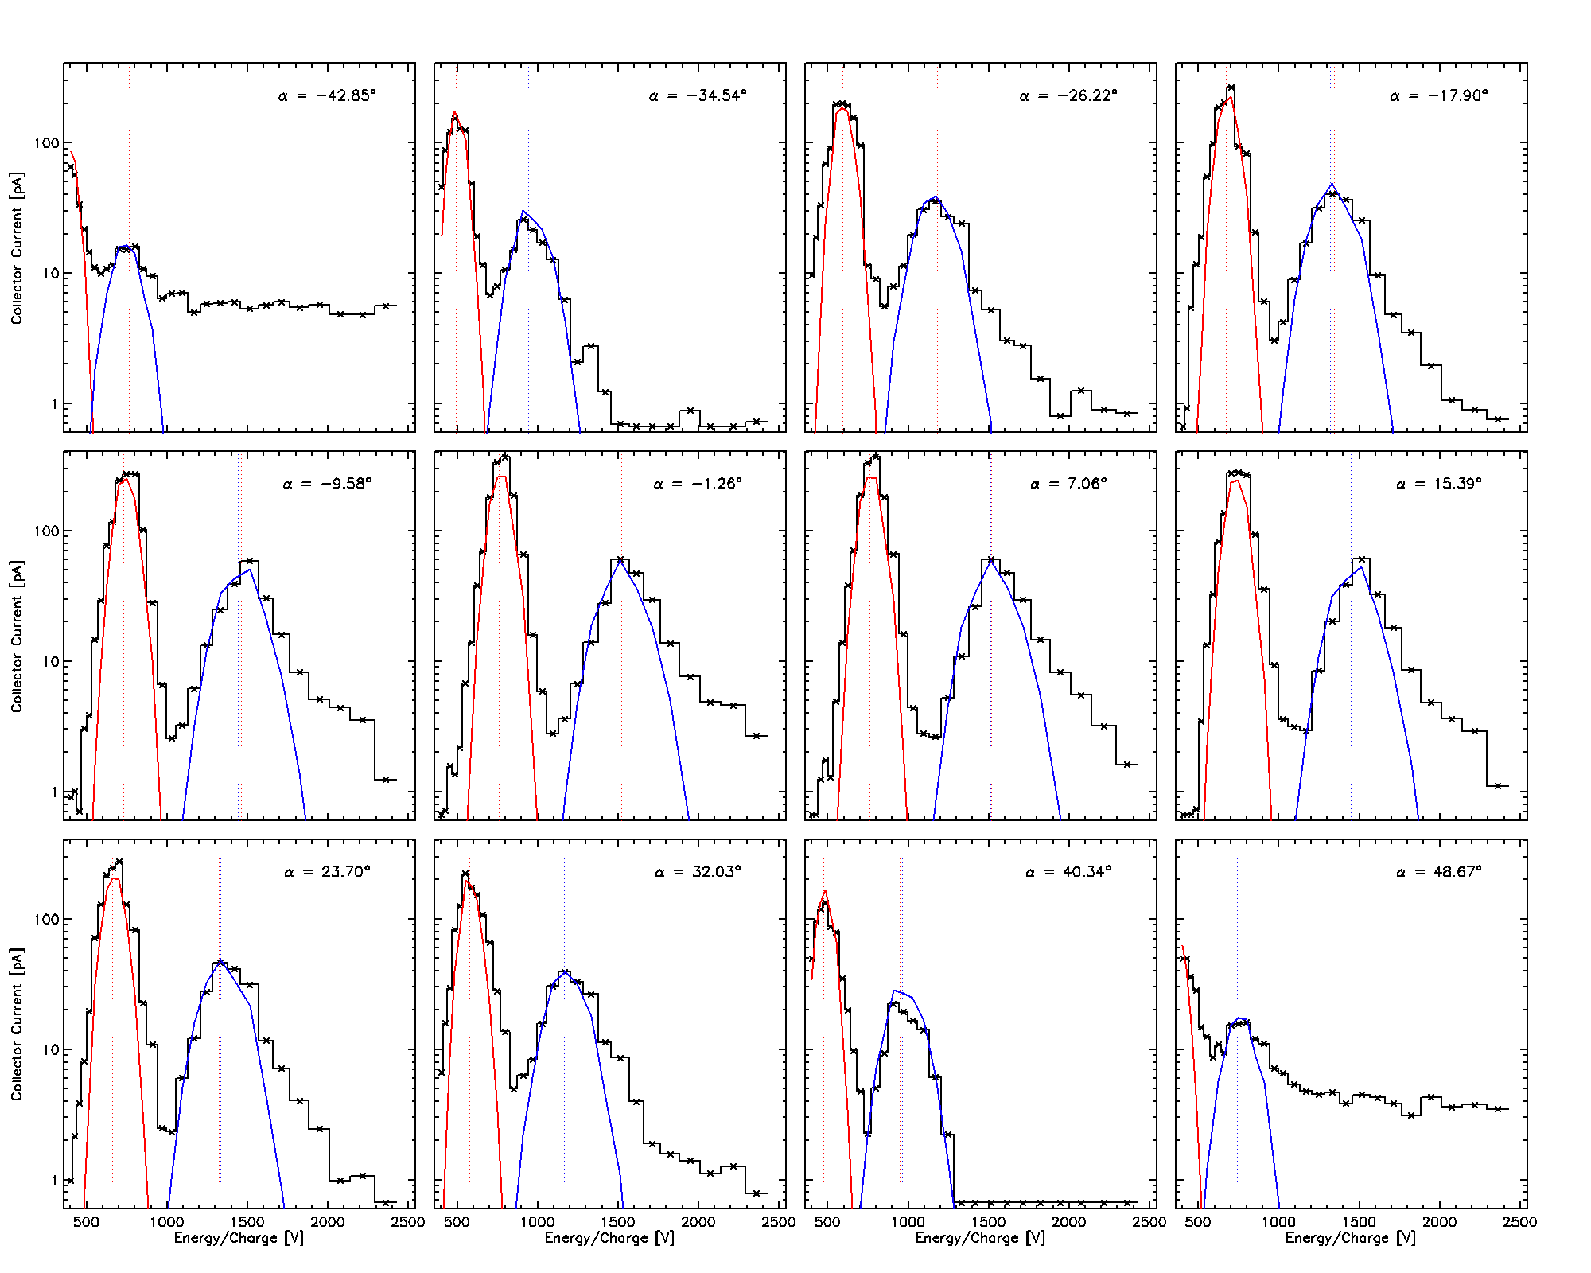
Case study
14
initial velocity drop
velocity bend
CRR termination
Ion energy spectra for different azimuthal angles:
After the velocity bend, the alpha population develops a strong non-thermal tail (marked with blue background), but this feature did not significantly affect the result of fitting.
Collector current [pA]
Energy/charge [V]
Assuming a bi-Mawellian VDF of incoming ions, SWE Faraday cup collector current can be expressed as a function of its collecting area $A$ and the location of the energy window $\left[V_{0},V_{0}+ΔV\right]$:
$$I=\frac{Anq_{i}}{2}\left[\frac{w_{i}}{\sqrt{π}}\left(e^{−z_{0}^{2}}−e^{−z_{1}^{2}}\right)+U_{z}\left(\operatorname{erf}\left(z_{1}\right)−erf(z_{0})\right)\right]$$
$$z_{0}= \frac{V_{0}−U_{z}}{w_{i}}$$
$$z_{1}= \frac{V_{0}+ΔV_{0}−U_{z}}{w_{i}}$$

Slide 16
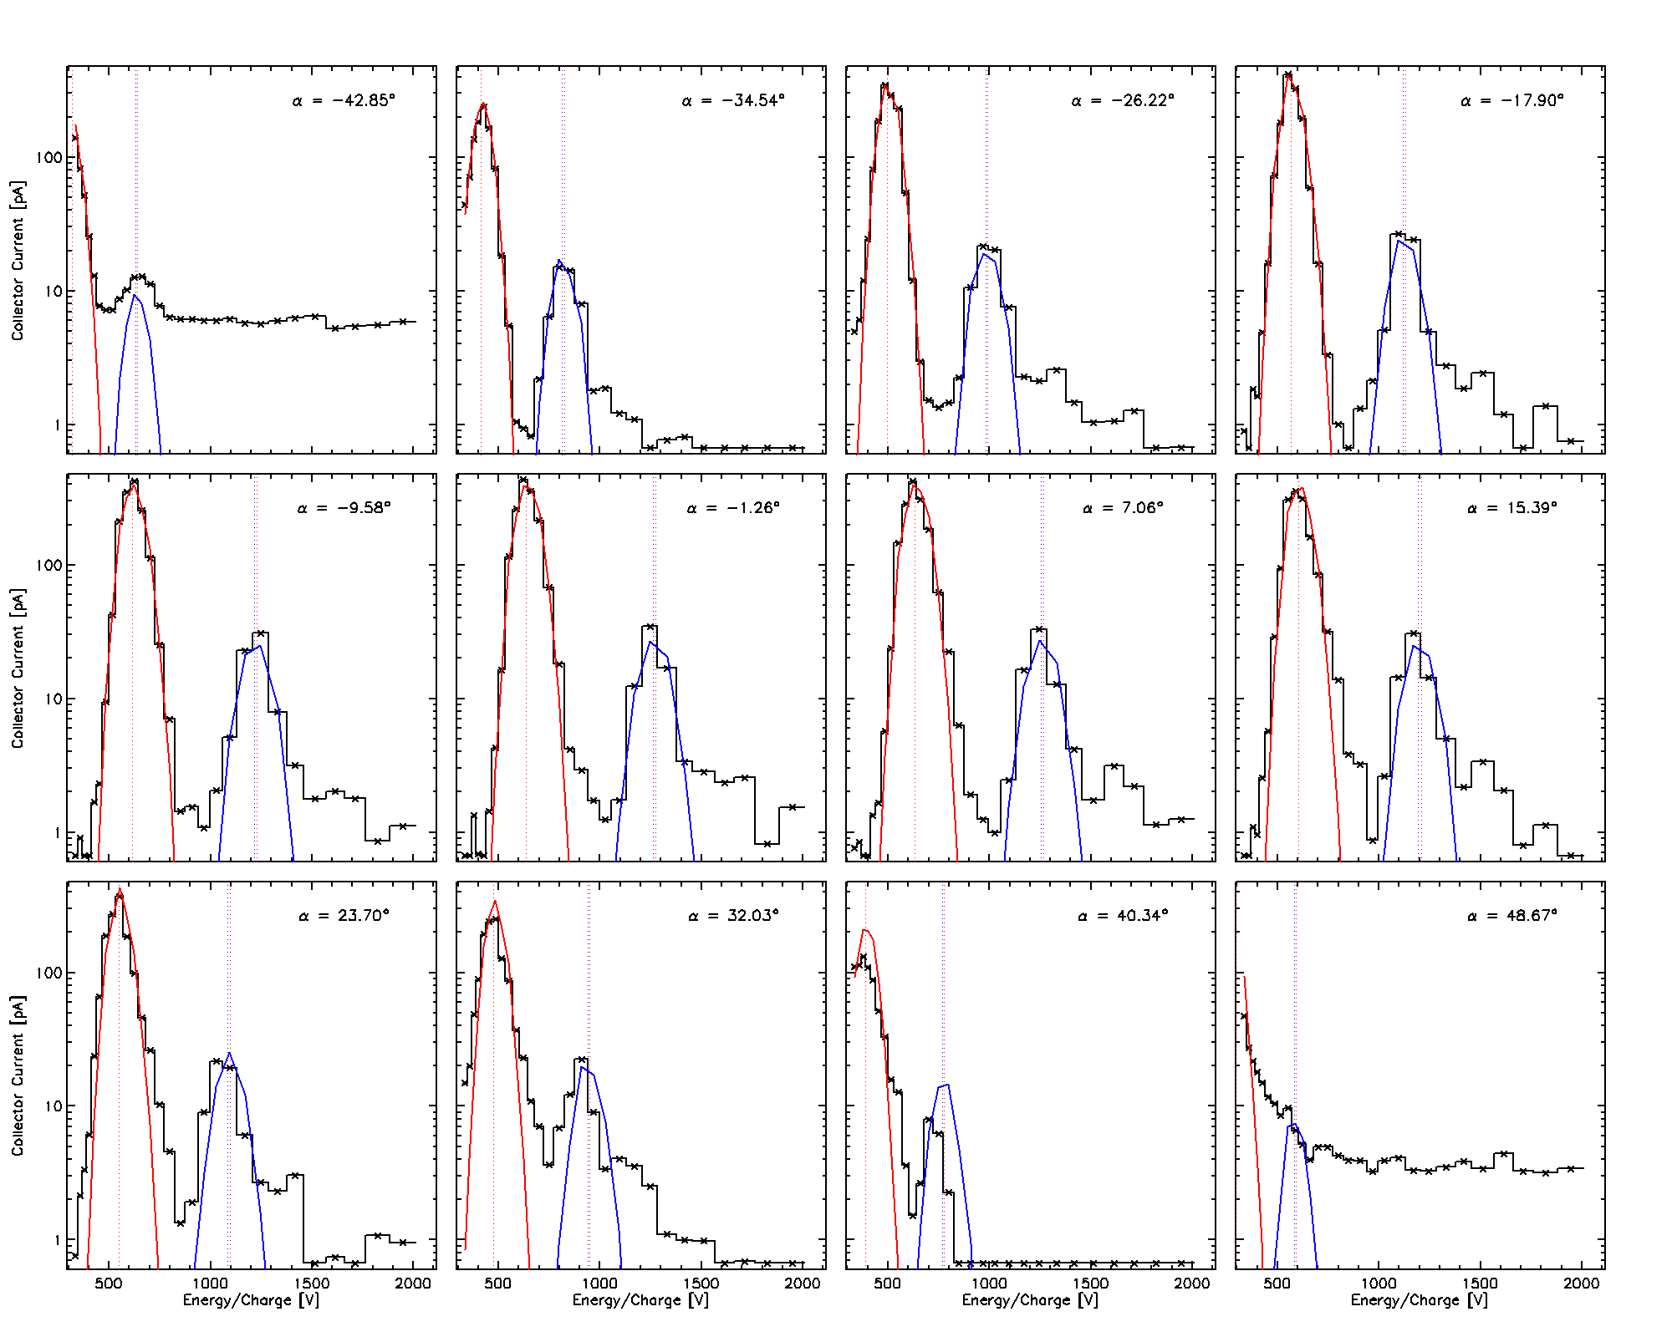
Case study
15
initial velocity drop
velocity bend
CRR termination
Ion energy spectra for different azimuthal angles:
Finally, the solar wind properties begin to match those frequently observed in the slow solar wind streams.
Collector current [pA]
Energy/charge [V]
Assuming a bi-Mawellian VDF of incoming ions, SWE Faraday cup collector current can be expressed as a function of its collecting area $A$ and the location of the energy window $\left[V_{0},V_{0}+ΔV\right]$:
$$I=\frac{Anq_{i}}{2}\left[\frac{w_{i}}{\sqrt{π}}\left(e^{−z_{0}^{2}}−e^{−z_{1}^{2}}\right)+U_{z}\left(\operatorname{erf}\left(z_{1}\right)−erf(z_{0})\right)\right]$$
$$z_{0}= \frac{V_{0}−U_{z}}{w_{i}}$$
$$z_{1}= \frac{V_{0}+ΔV_{0}−U_{z}}{w_{i}}$$

Slide 17
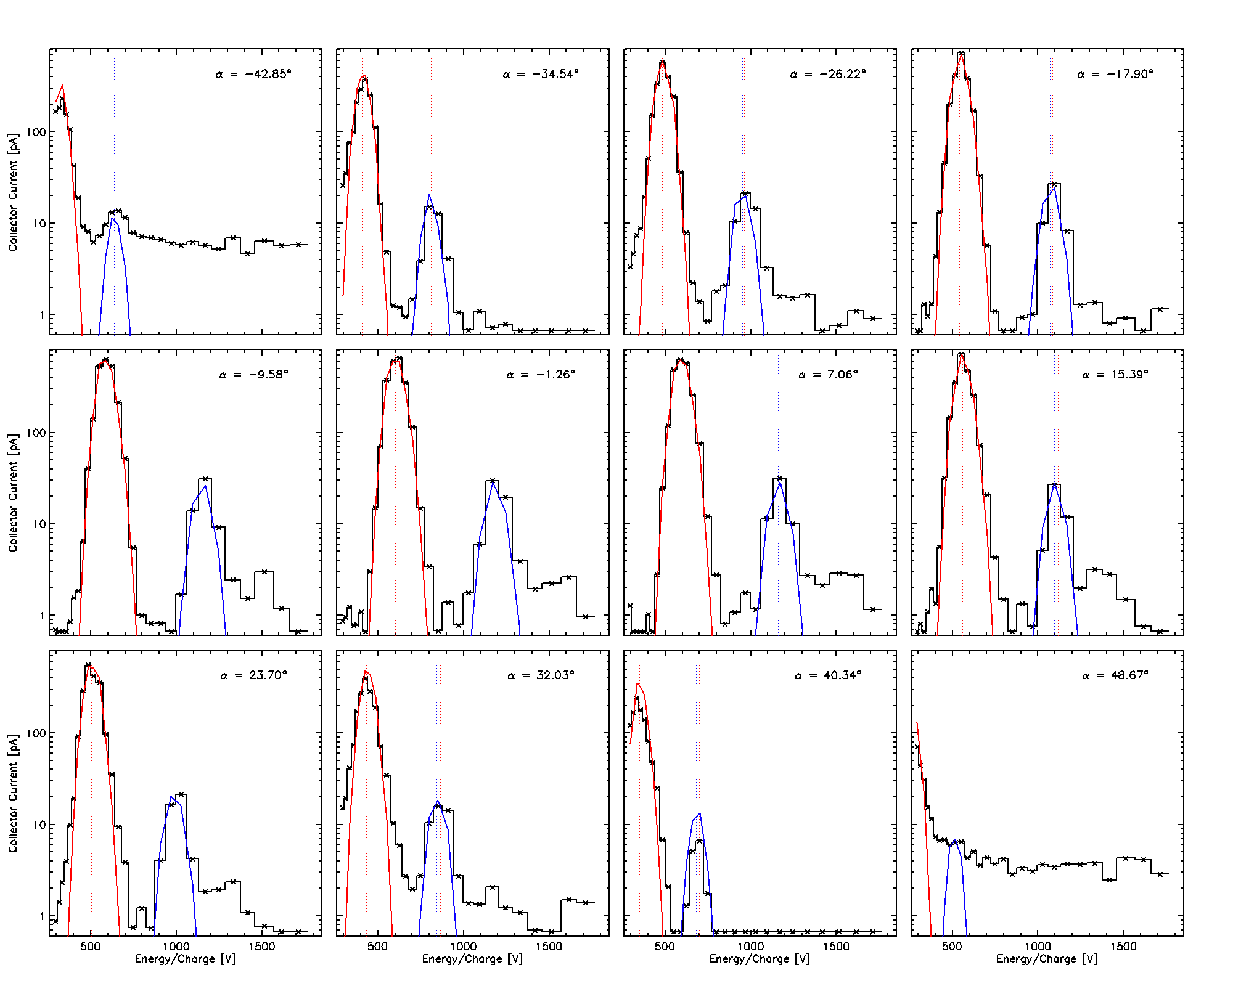
Case study
16
initial velocity drop
velocity bend
CRR termination
Ion energy spectra for different azimuthal angles:
Finally, the solar wind properties begin to match those frequently observed in the slow solar wind streams.
Collector current [pA]
Energy/charge [V]
Assuming a bi-Mawellian VDF of incoming ions, SWE Faraday cup collector current can be expressed as a function of its collecting area $A$ and the location of the energy window $\left[V_{0},V_{0}+ΔV\right]$:
$$I=\frac{Anq_{i}}{2}\left[\frac{w_{i}}{\sqrt{π}}\left(e^{−z_{0}^{2}}−e^{−z_{1}^{2}}\right)+U_{z}\left(\operatorname{erf}\left(z_{1}\right)−erf(z_{0})\right)\right]$$
$$z_{0}= \frac{V_{0}−U_{z}}{w_{i}}$$
$$z_{1}= \frac{V_{0}+ΔV_{0}−U_{z}}{w_{i}}$$

Slide 18
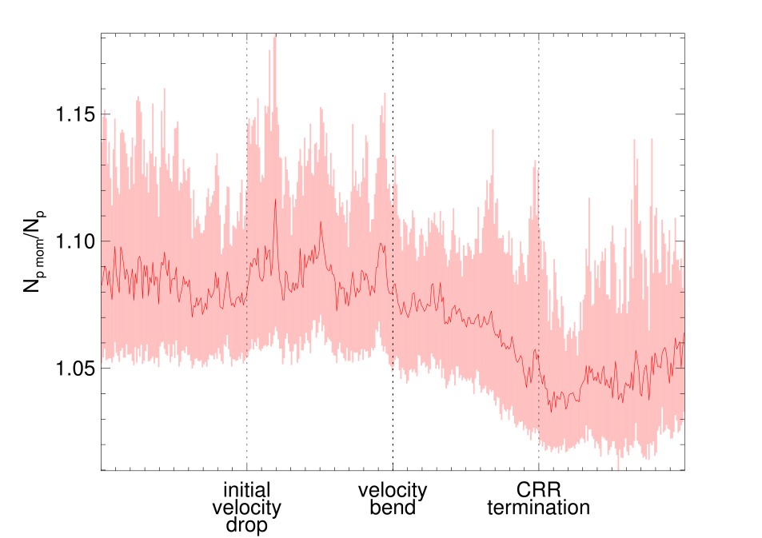
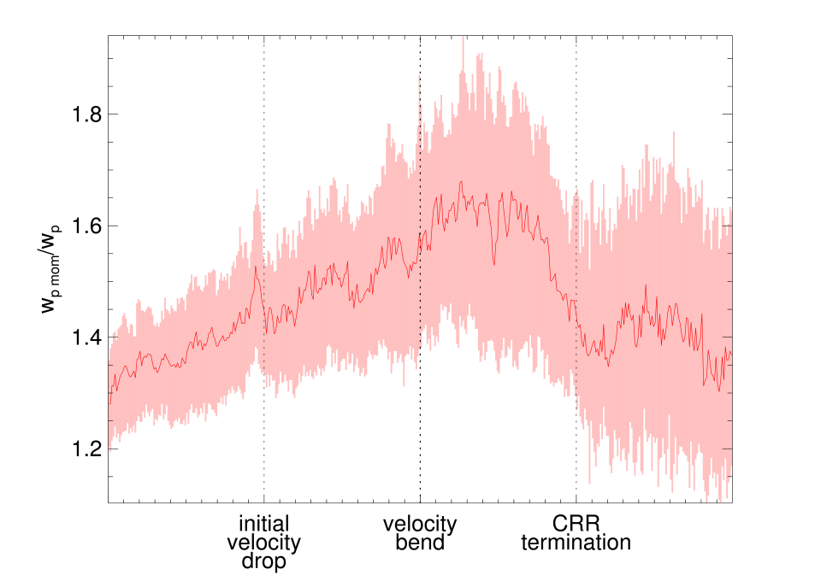
Impact of proton beam decay
17
Could these changes in the relative alpha abundance be a signature of a secondary proton population (proton beam)?
The ratio of the proton thermal speed calculated as a VDF moment and the fitted proton thermal speed indicates the presence of a more significant non-thermal part of the proton VDF within CRR
This feature disappears when the relative alpha abundance reaches values typical for the slow solar wind
However, the proton density differs from the density moment by only a few percent. Thus, this cannot fully explain the observed changes in $\frac{n_{α}}{n_{p}}$ .

Slide 19
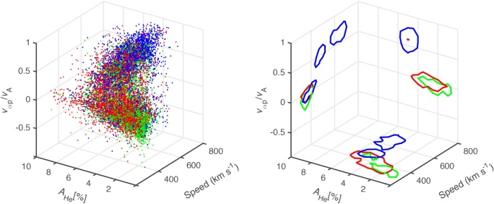
Connection between the alpha properties and other source identifiers
18
(Fu, 2018)
In order to identify possible source regions for the streams observed in the CRRs, we investigated the connection between the alpha properties and other solar wind source identifiers. We started with the differentiation proposed by Fu (2018).
coronal hole active region quiet Sun
initial velocity drop
velocity bend
CRR termination

Slide 20
Connection between the alpha properties and other source identifiers
19
(Fu, 2018)
The position of the measurement points in the parameter space proposed by Fu (2018) confirms that the solar wind observed in front of the velocity bend originates from the coronal hole. However, behind the velocity bend, streams from all the basic source regions are seemingly observed.
coronal hole active region quiet Sun
initial velocity drop
velocity bend
CRR termination

Slide 21
Connection between the alpha properties and other source identifiers
20
Another possible differentiation of the solar wind is by its collisional age, $A_{C}$ which is the ratio of the local collision rate to the local expansion time. A slightly collisionally older solar wind is observed in front of the velocity bend, but no clear correlation between $A_{C}$ and $\frac{n_{α}}{n_{p}}$ is present. Behind the velocity bend, $\frac{n_{α}}{n_{p}}$ decreases with decreasing collisional age. This is associated with a strong correlation between $\frac{n_{α}}{n_{p}}$ and the proton thermal speed
initial velocity drop
velocity bend
CRR termination

Slide 22
Summary and conclusions
21
Using the CRR collection found by Borovsky et al. (2016) we found a global profile of alpha properties across the CRR and compare it with those of protons
We found that changes in different alpha properties are temporally separated:
Behind an initial velocity drop, the velocities of alphas and protons gradually decrease. Since the deceleration of protons occurs more slowly than in the case of alphas, both populations reach almost the same speed already near the velocity bend
Around the velocity bend, the increase in the relative alpha abundance is observed. Thereafter, it decreases sharply until the CRR termination is reached
The alpha and proton temperature ratio begins to decrease at the velocity bend. When the relative alpha abundance reaches values typical for the slow streams, both temperatures are nearly equal
These changes cannot be fully explained by proton beam decay alone
Comparison between the alpha properties and other solar wind source identifiers suggests that there is a continuous transition from fast to slow solar wind between the velocity bend and the termination of the CRR. This would be consistent with the idea of open field lines moving across the coronal hole boundary proposed by Schwadron et al. (2002). This may produce streams with compound alpha properties

Slide 23
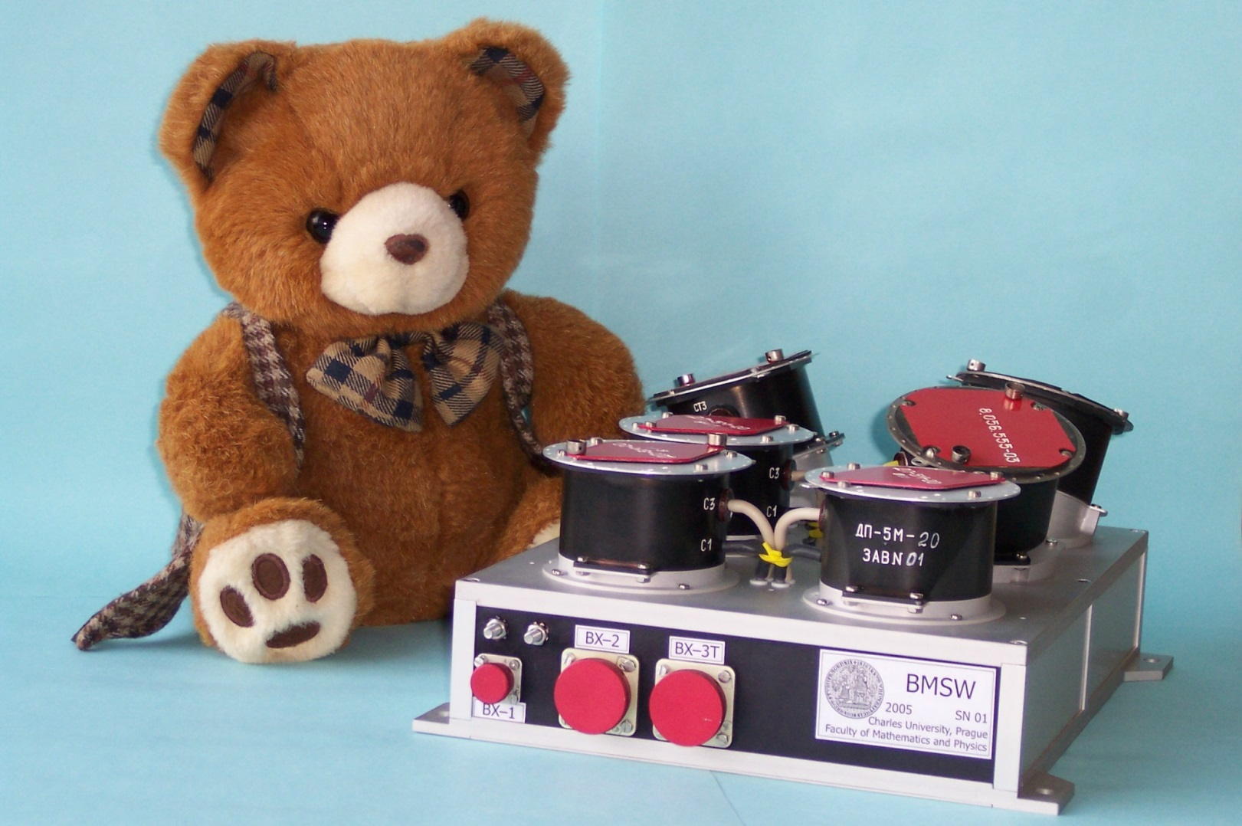
Thank you for your attention
22
Acknowledgement
This project was supported by the Grant Agency of the Charles University under the project number 264220. We would also like to thank professor Vítek for his continuous support and valuable insight.
References
Borovsky, J. E., and Denton, M. H. (2016), The trailing edges of high‐speed streams at 1 AU, J. Geophys. Res. Space Physics, 121, 6107– 6140.
Fu, H., Madjarska, M. S., Li, B., Xia, L., and Huang, Z. (2018), Helium abundance and speed difference between helium ions and protons in the solar wind from coronal holes, active regions, and quiet Sun, Mon. Notices Royal Astron. Soc., 478, 2, 1884–1892.
Murphy, N., Smith, E. J., and Schwadron, N. A. (2002), Strongly underwound magnetic fields in co‐rotating rarefaction regions: Observations and Implications, Geophys. Res. Lett., 29(22), 2066.
Schwadron, N. A. (2002), An Explanation for Strongly Underwound Magnetic Field in Co‐rotating Rarefaction Regions and its Relationship to Footpoint Motion on the the Sun, Geophys. Res. Lett., 29(14).

