Slide 1


A Constructive Heuristic approach for solving Mixed Integer Nonlinear cascade optimization
Considering an hydrological uncertainty model
Daniel Firmo Kazay, Carlos Roberto Mendonça da Rocha
Universidade Estadual do Oeste do Paraná – Unioeste, Brazil
Case Study
Results
Overview
Formulation
Conclusions
Resolution Method
PICO Navigation
The orange ‘Home’
Button takes you to
the section menu
The left/right arrows
take you to the
next page

Slide 2
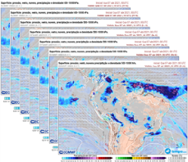

A Constructive Heuristic approach for solving Mixed Integer Nonlinear cascade optimization
Considering an hydrological uncertainty model
Daniel Firmo Kazay, Carlos Roberto Mendonça da Rocha
Universidade Estadual do Oeste do Paraná – Unioeste, Brazil
Overview
Challenge: NL formulation + Consistent Scenarios
High-dimensional problems, Mixed Integer Nonlinear Programming solution.
Use of Constructive Heuristics
Scenarios
Ensemble Forescast
Hydrological Simulations
Overview
Formulation
Detailed representation of
hydropower plant cascade
operation
NLP Solver + CH
Case study
Photo: Itaipu Binacional

Slide 3
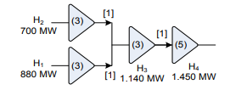
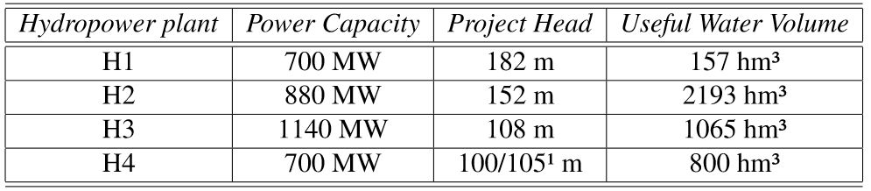
Scuzziato (2011)
Case Study
¹ There are two turbine groups in H4 with different technical characteristics
General Information
Four hydropower plants: H1, H2, H3 and H4.
H1, H2 and H3 have three turbines; H4 has five turbines.
The time delay between the hydropower plants are one hour
Photo: Itaipu Binacional

Slide 4
Conception
Scenarios
Objetive function: Minimize the discharge
Mass balance
Energy balance
Formulation
Turbine efficiency equation
Power generation equation
Hydraulic, mechanical and electrical losses equations.
Formulation
Max and min power generation
Upstream and downstream level
Resolution
Complete formulation
Photo: Itaipu Binacional

Slide 5
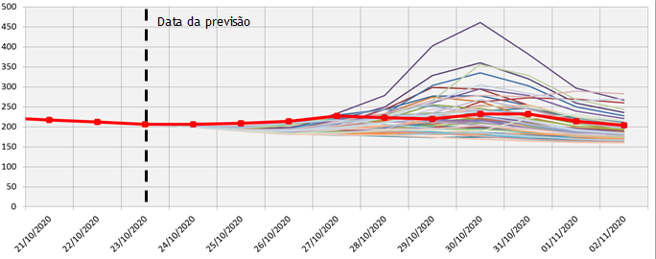
Choice of the best power scheduling for the hydropower plant cascade
Considering several precipitation scenarios
t is the set of hours considered for scheduling
s is the set of considered scenarios.
Conception
Forecast date
Daily Inflow (m³/s)
Photo: Itaipu Binacional

Slide 6
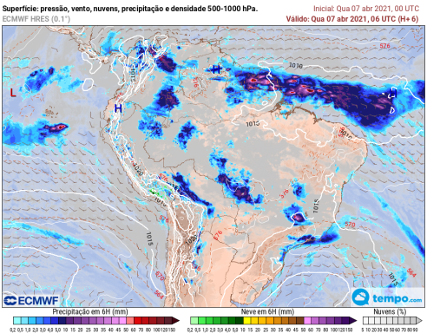

ECMWF Ensemble (51 members)
Hydrological model
Scenarios
Forecast date
Daily Inflow (m³/s)
Photo: Itaipu Binacional

Slide 7

Z is the objective function.
a is a coefficient considered in the proposed Constructive Heuristic.
Q is the outflow of the turbine.
Objectve Function
This objective function aims to supply a fixed demand using the minimum of water
Photo: Itaipu Binacional

Slide 8
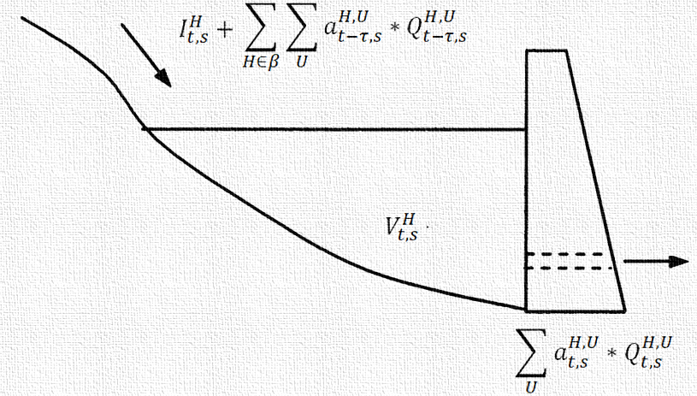
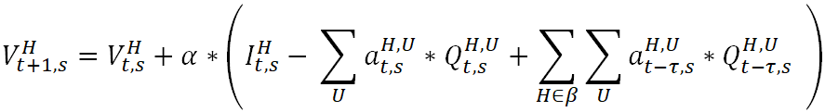
Mass Balance Equation
α is a conversion term.
τ is the time delay of the hydropower plants.
β is the set of hydropower plants located upstream of the hydropower plant.
I is the incremental flow.
V is the volume of the reservoir
Photo: Itaipu Binacional

Slide 9
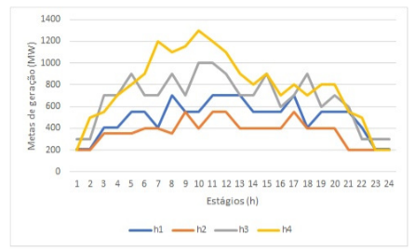

Each hydropower plant needs to supply a power demand
Adapted from Scuzziato (2011)
Power demand (MW)
Energy balance
Time (h)
D is the power demand.
Pg is power generated per turbine
Photo: Itaipu Binacional

Slide 10
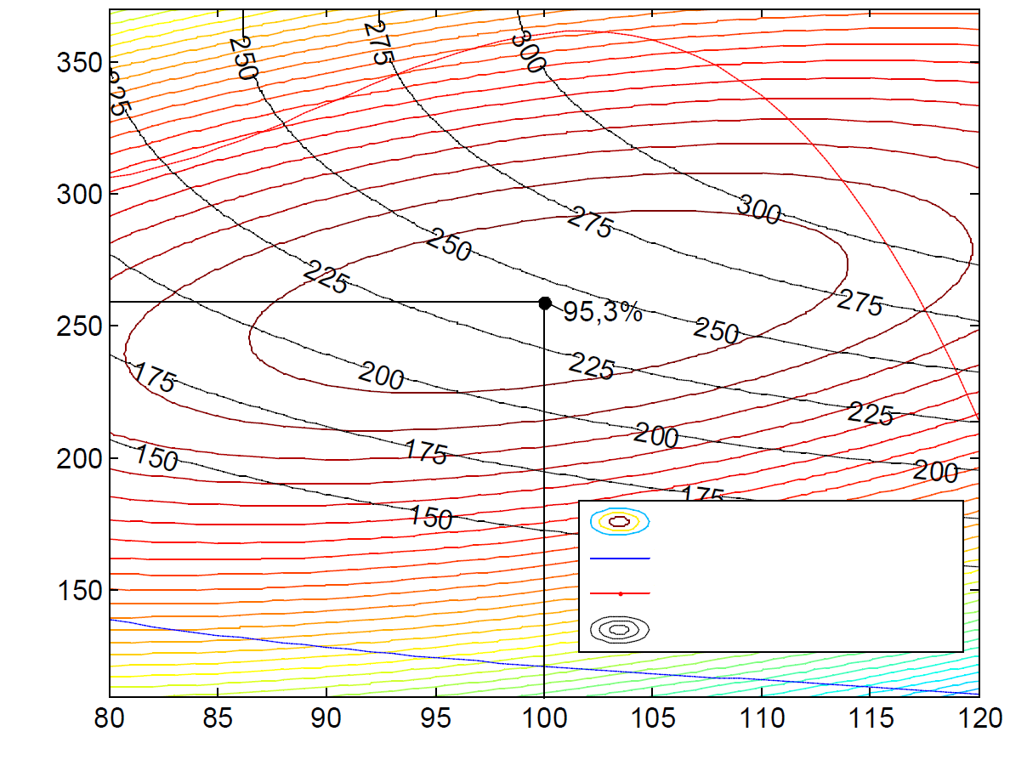
Adapted from Scuzziato (2011)
Outflow of the turbine (m³/s)
Turbine efficiency equation
Efficiency
Max and min outflow of the turbines
Power generated
Hydraulic net head (m)
ρ is the turbine efficiency.
HH is the hydraulic net head.
f6, f7 and f8 are polynomial functions.
Photo: Itaipu Binacional

Slide 11

Pst is the brut power generated per turbine
G is a constant
Q is the outflow of the turbine
HH is the hydraulic net head.
ρ is the turbine efficiency.
Power generation equation
Classical approach to estimate the power generated per turbine
Photo: Itaipu Binacional

Slide 12

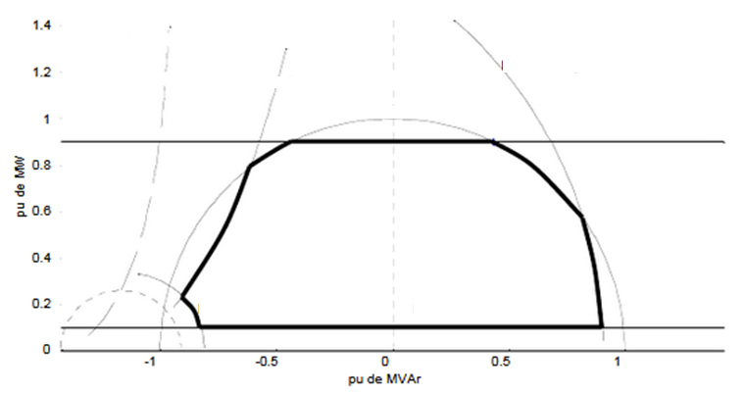
Pg is power generated per turbine.
Pmin and Pmax are the thresholds of power of the turbine.
Max and min power generation
Pmax
Pu of MW
Pmin
Pu of MVar
Photo: Itaipu Binacional

Slide 13




Pg is power generated per turbine.
Pst is the brut power generated by the turbine.
Pgg are the electrical losses of the generator.
Pmt are the mechanical losses of the generator.
Losses
HH is the hydraulic net head.
UP is the upstream level.
Down is the downstream level.
Lo are the hydraulic and mechanical losses.
Losses equations
f1 and f5 are polynomial equations.
f2 is an exponential equation.
Photo: Itaipu Binacional

Slide 14
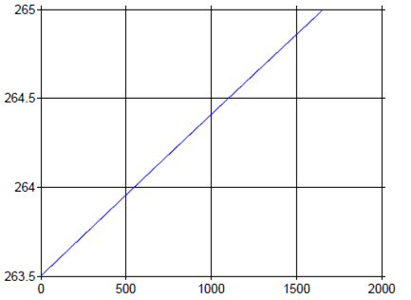
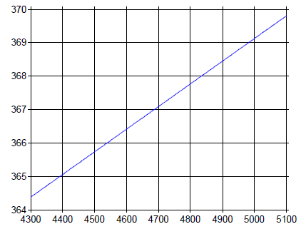
Up is the upstream level.
Down is the downstream level.
f3 and f4 are polynomial equations.
Upstream and downstream level
Downstream level
Upstream level
Turbine outflow
Reservoir volume
Adapted from Scuzziato (2011)
Photo: Itaipu Binacional

Slide 15
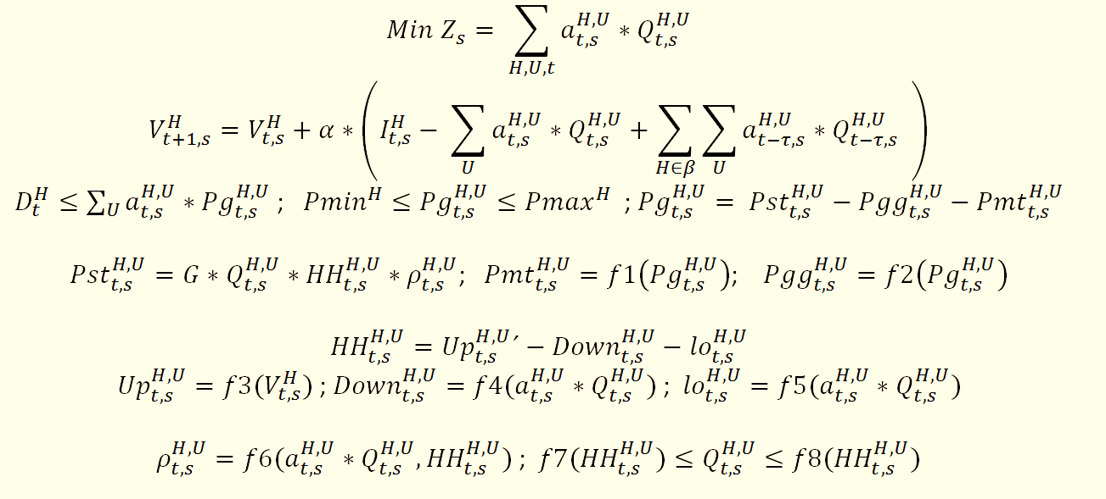
For each scenario s
Complete formulation
Z is the objective function. a is a coefficient considered in the proposed Constructive Heuristic. Q is the outflow of the turbine. H is the set of hydropower plants. U is the set of turbines. t is the set of hours considered in the problem. s is the set of considered scenarios. α is a conversion term. τ is the time delay of the hydropower plants. β is the set of hydropower plants located upstream of the hydropower plant. I is the incremental flow. V is the volume of the reservoir. D is the power demand. Pg is power generated per turbine. Pmin and Pmax are the thresholds of power of the turbine. Pst is the net power generated by the turbine. Pgg are the electrical losses of the generator. Pmt are the mechanical losses of the generator. f1, f2, f3, f4, f5, f6, f7 and f8 are functions. HH is the hydraulic net head. UP is the upstream level. Down is the downstream level. Lo are the hydraulic and mechanical losses. ρ is the turbine efficiency curve.

Slide 16

Conception
Non linear equations with integrity restrictions
Constructive Heuristic approach
Sensivity factor is the variable “a” that represents the aperture of the turbine
Software GAMS
Solver CONOPT
Resolution
The left/right arrows
take you to the
next page
Photo: Itaipu Binacional

Slide 17
The proposed CH
Consider a continuum variable (a);
Values between 0 and 1 ;
For
  each turbine
  of each hydropower plant
  of each time step
Resolution
Photo: Itaipu Binacional

Slide 18
The proposed CH
The proposed CH has two parts:
1ª part: Definition of integer part
  The NLP solver get a solution for a real value of “a”.
  The "a" values ​​of all turbines in each plant for each time step are added together.
  The truncated sum value is the number of turbines whose "a" is set to 1.
  The values ​​of the variables "a" of the last remaining turbines subtracted from 1 are fixed at 0.
  Only one turbine position per plant per time step remains free "a".
  In other words, only the fractional part of the sum value remains free for the optimization problem.
Resolution
Photo: Itaipu Binacional

Slide 19
Example
1ª part: Definition of the integer part of the project
t = 3
Resolution
H4
a(u1) = 0.8
a(u2) = 0.8
a(u3) = 0.8
a(u4) = 0
a(u5) = 0
Photo: Itaipu Binacional

Slide 20
Example
1ª part: Definition of the integer part of the project
t = 3
Resolution
H4
a(u1) = 0.8
a(u2) = 0.8
a(u3) = 0.8
a(u4) = 0
a(u5) = 0
Sum = 2.4
Photo: Itaipu Binacional

Slide 21
Example
1ª part: Definition of the integer part of the project
a(u1,u2,u4,u5) – fixed
a(u3) - variable
t = 3
Resolution
H4
a(u1) = 0.8
a(u2) = 0.8
a(u3) = 0.8
a(u4) = 0
a(u5) = 0
a(u1) = 1
a(u2) = 1
a(u3) = ?
a(u4) = 0
a(u5) = 0
Sum = 2.4
Photo: Itaipu Binacional

Slide 22
The proposed CH
The proposed CH has two parts:
1ª part: Definition of integer part
2ª part: Definition of the fraction part
  The problem is solved two times for the two possibilities of the free “a” values [0;1]
  The Objetive Function (OF) values are compared
Resolution
Photo: Itaipu Binacional

Slide 23
Example
2ª part: Definition of the fraction part of the problem.
a(u1) = 1
a(u2) = 1
a(u3) = ?
a(u4) = 0
a(u5) = 0
Resolution
1
2
a(u1) = 1
a(u2) = 1
a(u3) = 0
a(u4) = 0
a(u5) = 0
a(u1) = 1
a(u2) = 1
a(u3) = 1
a(u4) = 0
a(u5) = 0
Photo: Itaipu Binacional

Slide 24
Example
2ª part: Definition of the fraction part of the problem.
a(u1) = 1
a(u2) = 1
a(u3) = ?
a(u4) = 0
a(u5) = 0
Resolution
2
1
2
No
a(u1) = 1
a(u2) = 1
a(u3) = 0
a(u4) = 0
a(u5) = 0
a(u1) = 1
a(u2) = 1
a(u3) = 1
a(u4) = 0
a(u5) = 0
Solution?
Solution?
No
1
Photo: Itaipu Binacional

Slide 25
Example
2ª part: Definition of the fraction part of the problem.
a(u1) = 1
a(u2) = 1
a(u3) = ?
a(u4) = 0
a(u5) = 0
Resolution
2
1
1
2
No
Yes
Yes
a(u1) = 1
a(u2) = 1
a(u3) = 0
a(u4) = 0
a(u5) = 0
a(u1) = 1
a(u2) = 1
a(u3) = 1
a(u4) = 0
a(u5) = 0
Solution?
OF(1)<OF(2)?
Solution?
Yes
No
No
1
2
Photo: Itaipu Binacional

Slide 26
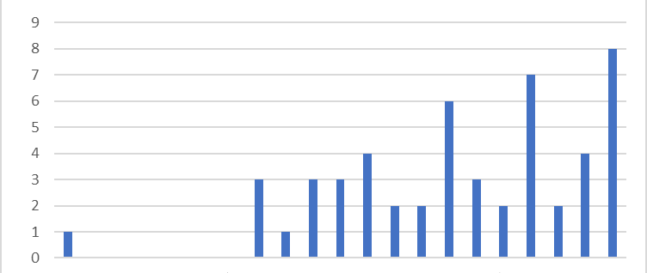
Hystogram of Objective Function Value
Results
Number of scenarios
52.590
52.595
52.600
Photo: Itaipu Binacional

Slide 27
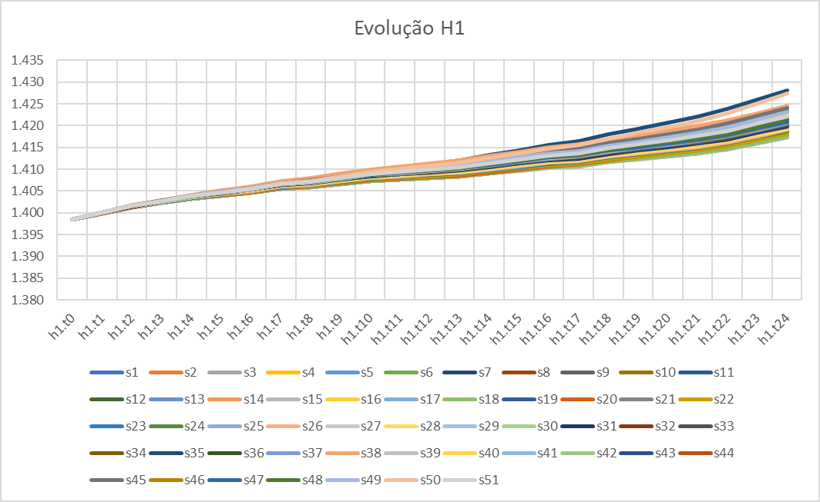
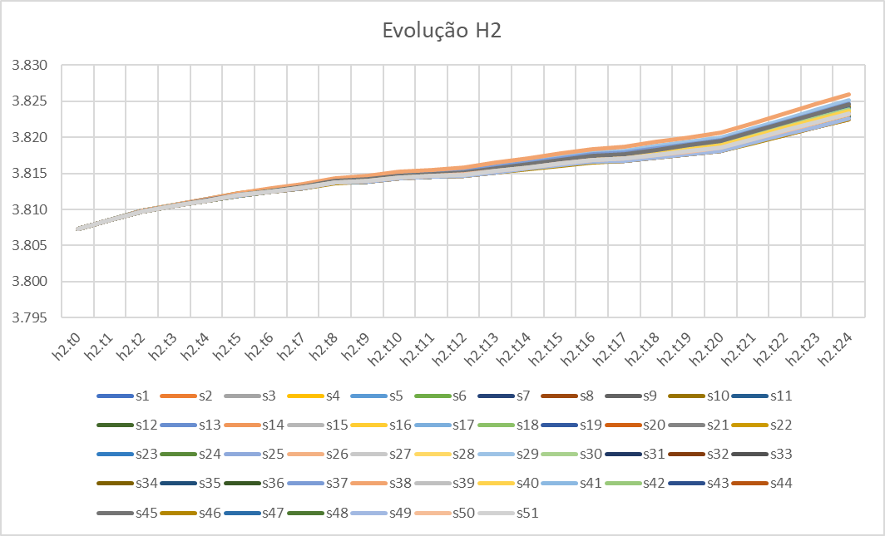
Results of reservoir volume
H1
H2
Results
Scenarios
Photo: Itaipu Binacional

Slide 28
Further information
Conclusions
The results of the Constructive Heuristic were compared with other similar works with perfect correspondence.
The system was tested for 51 ECMWF precipitation forecast scenarios as input of the hydrologic model MGB (Large Basin Model) with coherent results.
The proposal is a feasible approach to reach unique optimal solutions for high-dimensional non-linear problems considering integer variables.
Conclusions
Scuzziato (2011)
Photo: Itaipu Binacional

