Slide 1
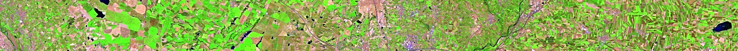

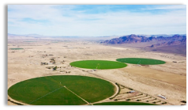
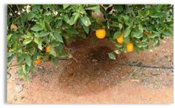






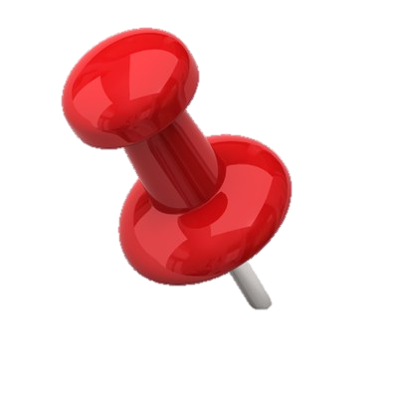
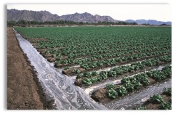
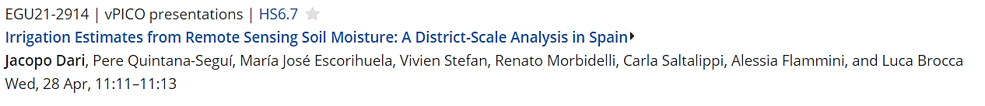
EGU General Assembly 2021, Online
Irrigation Estimates from Remote Sensing Soil Moisture:
A District-Scale Analysis in Spain
Jacopo Dari ^{(1,4)}, Pere Quintana-Seguí ⁽²⁾, Maria José Escorihuela ⁽³⁾, Vivien Stefan ⁽³⁾, Renato Morbidelli ⁽¹⁾, Carla Saltalippi ⁽¹⁾, Alessia Flammini ⁽¹⁾, and Luca Brocca ⁽⁴⁾
⁽¹⁾ University of Perugia, Dept. Of Civil and Environmental Engineering, Perugia, Italy
⁽²⁾ Ebro Observatory, Ramon Llull University – CSIC, Roquetes, Spain
⁽³⁾ isardSAT, Parc Tecnòlogic Barcelona Activa, Barcelona, Spain
⁽⁴⁾ National Research Counchil, Research Institute for Geo-Hydrological Protection, Perugia, Italy

Slide 2
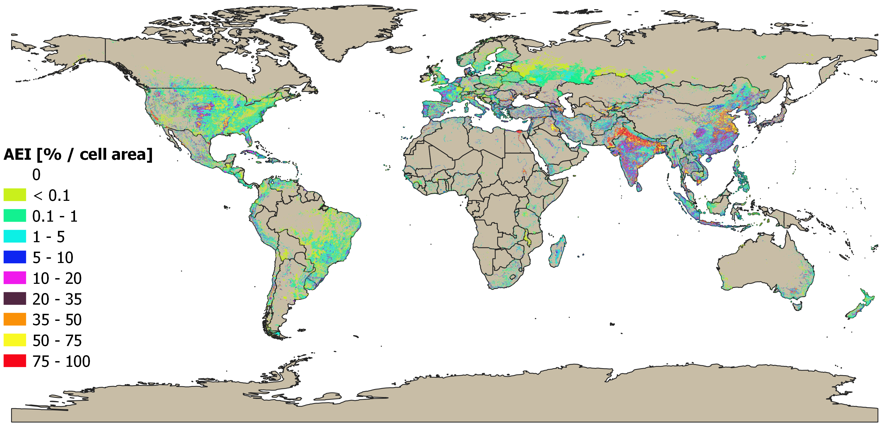

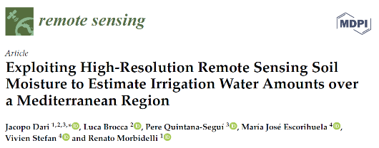
Why focusing on irrigation?
Irrigation is the anthropogenic activity introducing the largest imbalances in the natural water cycle from the local to the global scale (over 70% of global freshwater used for irrigation).
Irrigation detection (mapping of irrigated areas);
Irrigation quantification;
Detection of irrigation timing.
Area Equipped for Irrigation – GMIA (Siebert et al., 2013)
Two irrigation-estimate experiments: one exploiting SMAP at 1 km data (period: January 2016-September 2017) and one exploiting SMOS at 1 km data (period: January 2011-September 2017).
Both products are obtained through the DISPATCH downscaling algorithm (Merlin et al., 2008).
Irrigation Estimates from Remote Sensing Soil Moisture: A District-Scale Analysis in Spain
2/12
Notes:
Irrigation is a primary source of anthropogenic water consumption, but a detailed knowledge of the amounts of water actually applied for irrigation practices is generally missing worldwide.
The remote sensing technology is useful to retrieve information about irrigation volumes. In this presentation, a method to retreive the volumes of water applied for irrigation by exploiting remote sensing soil moisture is presented.

Slide 3
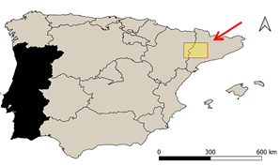
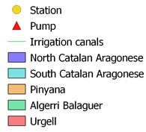
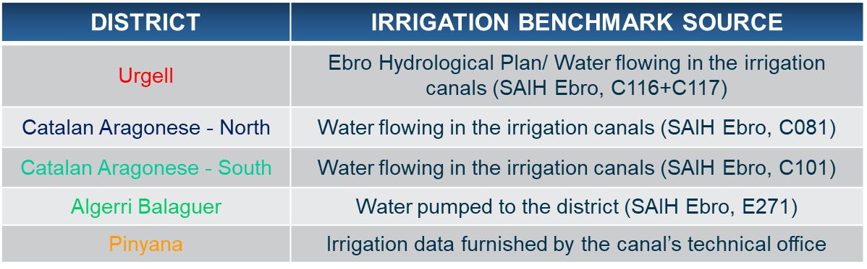
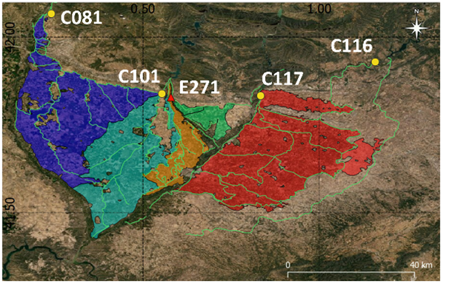
Study area:
Urgell:
Flood irrigation, each 15 days.
Algerri Balaguer:
Recently developed district. Drip irrigation is used for fruit trees and sprinkler for crops.
Catalan and Aragonese:
Flood irrigation (18% of the area), sprinkler irrigation (54% of the area) and drip irrigation (28%).
Pinyana:
No detailed information.
Irrigation Estimates from Remote Sensing Soil Moisture: A District-Scale Analysis in Spain
3/12
Notes:
We selected an intensely irrigated area located in the Northern-Eastern of Spain.
Five pilot irrigation districts have been considered.
The data about the volumes of water flowing through the irrigation canals (provided by the SAIH Ebro system and available at : http://www.saihebro.com/saihebro/index.php?url=/datos/canales network) have been used as a benchmark.

Slide 4
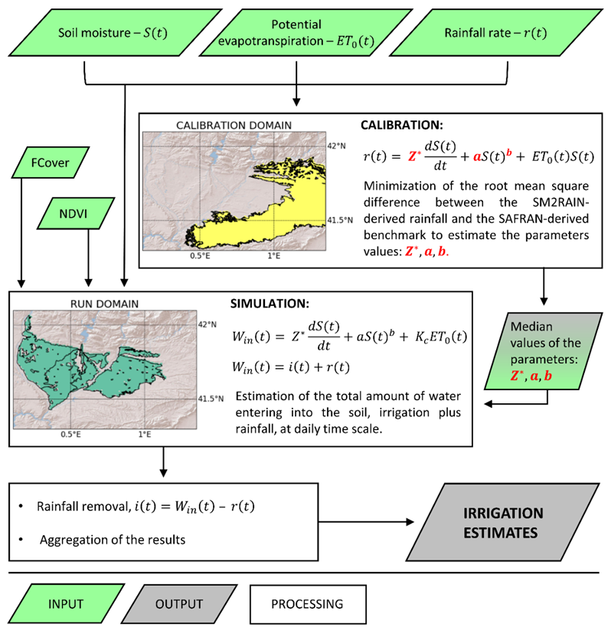
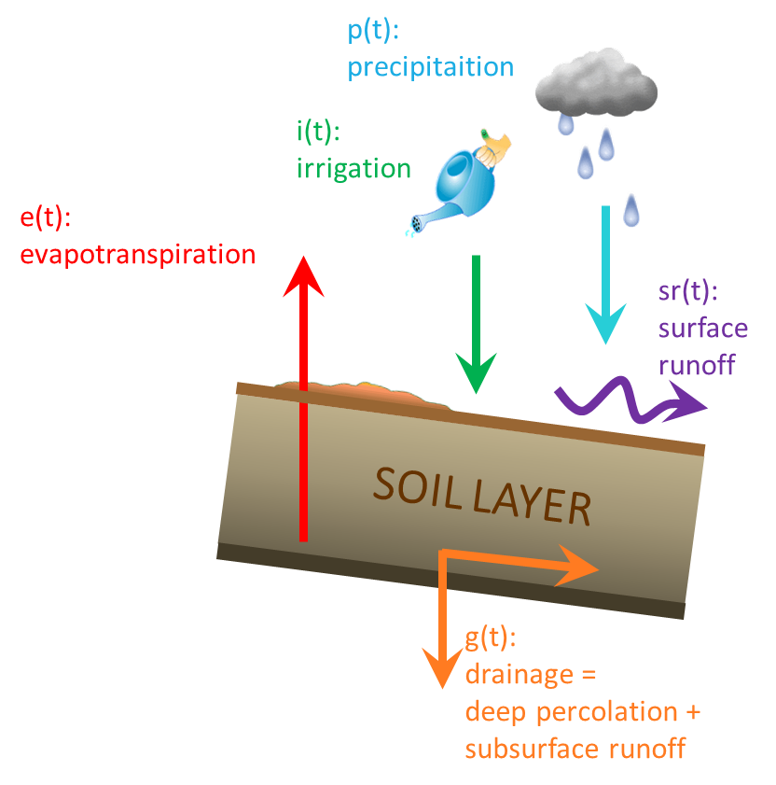


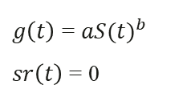

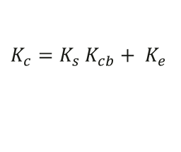
Modified version of the SM2RAIN algorithm:
(Brocca et al., 2018)
(1)
$nZ\frac{dS(t)}{dt}=i\left(t\right)+r\left(t\right)−g\left(t\right)−sr\left(t\right)−e\left(t\right)$
$g\left(t\right)$ = ${aS(t)}^{b}$
$sr\left(t\right)$ = 0
(2)
$$W_{in}\left(t\right)= nZ\frac{dS(t)}{dt}+g\left(t\right)+e(t)$$
Calibration step:
SM2RAIN-derived rainfall compared with rainfall rates from SAFRAN (Quintana-Seguí et al., 2016).
$$W_{in}\left(t\right)=r\left(t\right) e\left(t\right)={ET}_{0}\left(t\right)S(t)$$
Irrigation estimates step:
Implementation of the dual crop approach proposed in the FAO-56 model into SM2RAIN.
$$W_{in}\left(t\right)=r\left(t\right)+i(t) e\left(t\right)={K_{c}ET}_{0}\left(t\right)$$
$K_{c}=K_{s} K_{cb}+ K_{e}$
Irrigation Estimates from Remote Sensing Soil Moisture: A District-Scale Analysis in Spain
4/12
Notes:
The method used to estimate the irrigation amounts is an adapted version of the SM2RAIN algorithm. The method is based on the inversion of the soil water balance (1) and allows to estimate the total amount of water entering into the soil, i.e. rainfall plus irrigation. The method has been calibrated over a non-irrigated area, where the water entering into the soil is determined by rainfall only. Over this domain, the actual evapotranspiration has been modeled as the potential one multiplied by the available water content. For the irrigation estimates step the guidelines provided by the FAO 56 paper have been implemented into SM2RAIN for a proper modeling of the crop evapotranspiration.

Slide 5
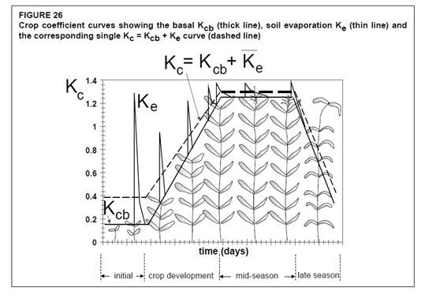
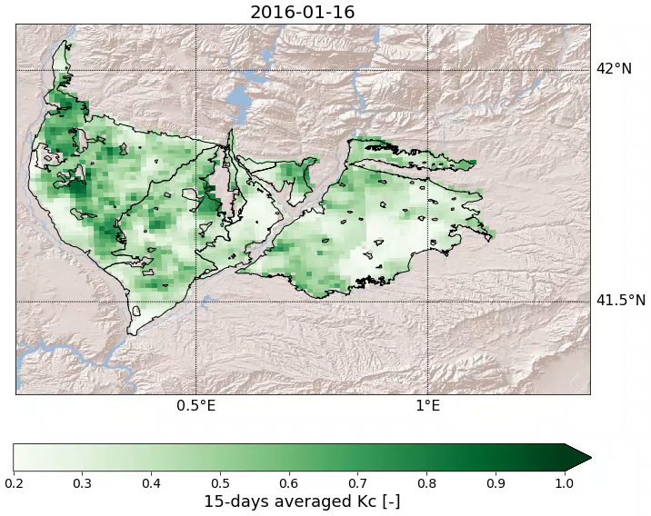

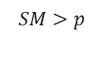

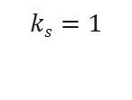
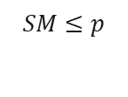


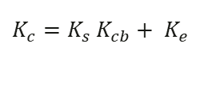
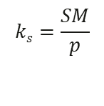


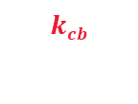




Implementation of the FAO paper n.56 into the SM2RAIN algorithm:
$$e\left(t\right)={K_{c}ET}_{0}\left(t\right)$$
$K_{c}=K_{s} K_{cb}+ K_{e}$
$$e\left(t\right)=\left[ks ∗kcb+\left(1 −fc\right)∗ ke\right]∗{ET}_{0}\left(t\right)$$
$$ks$$
Water stress coefficient
(Allen et al., 1998)
$$kcb$$
Basal crop coefficient
$$ke$$
Coefficient linked to the evaporation from bare soil
Proposed parametrizations:
$$ks=\frac{SM}{p}$$
$$SM≤p$$
$$ks$$
$$p=0.45$$
$$ks=1$$
$$SM>p$$
Modeled $K_{c}$
$$kcb$$
Obtained by scaling the NDVI
NDVI v2.2 and Fraction of Vegetation Cover (Fcover) v2 delivered by the Copernicus Global Land Service.
$$ke$$
$$\left(1 −fc\right)∗ ke$$
$$ke=SM$$
Irrigation Estimates from Remote Sensing Soil Moisture: A District-Scale Analysis in Spain
5/12
Notes:
In order to compute the crop coefficient, Kc, parametrizations based on optical data have been proposed. A kc dynamic both in space and time has been obtained (see the animation on the right). ET0 has been calculated according to the Penman-Monteith method.

Slide 6
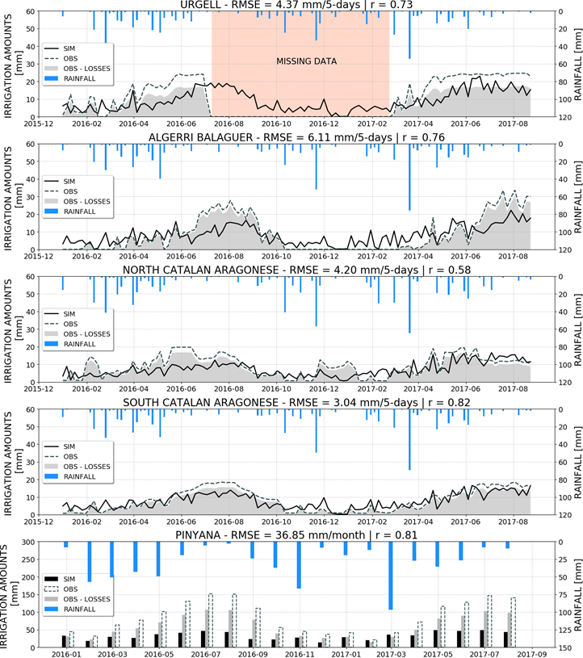
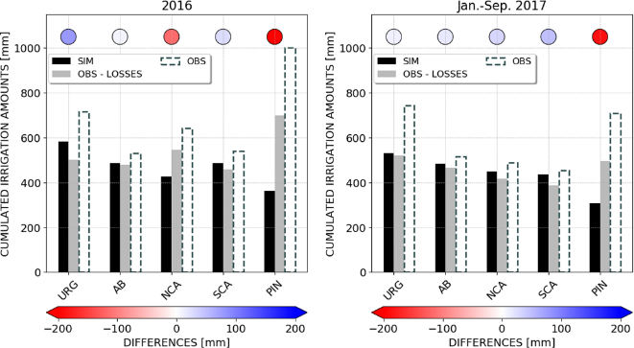
SMAP experiment – Irrigation estimates:
Period: January 2016 – September 2017
Except for the Pinyana district, good agreement between estimated and benchmark irrigation amounts are obtained.
Irrigation Estimates from Remote Sensing Soil Moisture: A District-Scale Analysis in Spain
6/12
Notes:
Two experiments have been carried out; the first one exploits SMAP at 1 km soil moisture, disaggregated through the DISPATCH algorithm. The experiment covers the period from January 2016 to Semptember 2017.
Right side: time series of the benchmark irrigation volumes (light grey shaded area), of the irrigation estimates (black line), and of the rainfall (blue bars).
Bar chart: same kind of information but cumulated during 2016 and Januray-September 2017. The colors of the circles above the bars express the underestimates (red) or overestimates (blue).
Over 4/5 of the pilot districts (all the distrcits except Pinyana) a good agreement is found.

Slide 7
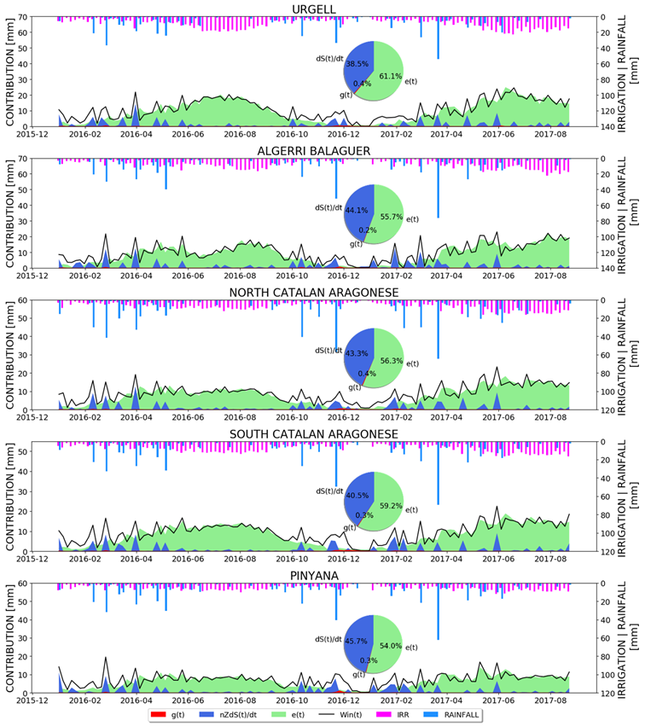
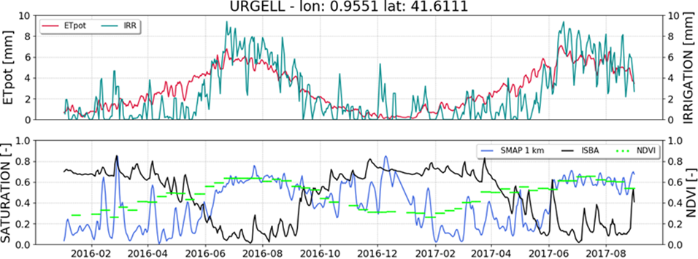
SMAP experiment – Which term of the SM2RAIN equation is the leading one?
Contribution of the drainage term:
Negligible, < 0.5% of the total.
Direct contribution of soil moisture variation:
Between 38.5% and 45.7% of the total.
Contribution of the evapotranspiration term:
Between 54.0% and 61.1% of the total.
Soil moisture also plays indirect roles.
Irrigation Estimates from Remote Sensing Soil Moisture: A District-Scale Analysis in Spain
7/12
Notes:
Right side: time series of the cotributions of each SM2RAIN term.
The evapotranspiration term plays the leading role in determining the SM2RAIN output; its contribution is higher than the direct one of soil moisture variation, but soil moisture also plays an indirect role that is difficult to be quantitatively assessed. In fact, soil moisture modulates the potential evapotranspiration (see time series in the left side referred to a control point located in the Urgell district).

Slide 8
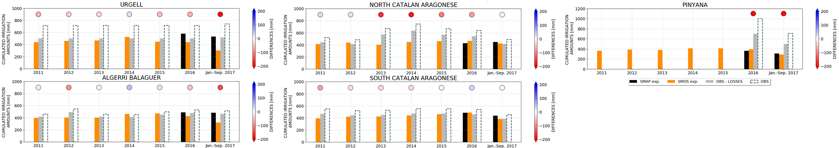
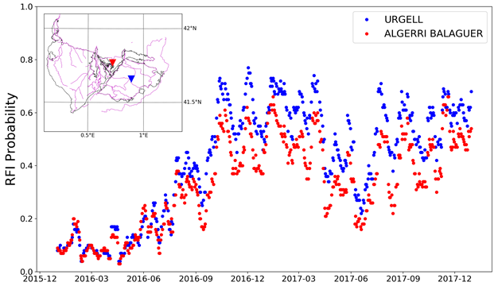
SMOS experiment – Irrigation estimates:
Period: January 2011 – September 2017
Good agreement between SMAP- and SMOS-derived estimates, except for the Urgell and the Algeri Balaguer districts.
Good performances of the SMOS-derived estimates in reproducing the actually occurred irrigation, except for the Pinyana district and for Northern partition of the Catalan and Aragonese district during the period 2013-2015.
(Dari et al., 2021)
Irrigation Estimates from Remote Sensing Soil Moisture: A District-Scale Analysis in Spain
8/12
Notes:
The second experiment exploits SMOS at 1 km soil moisture (DISPATCH downscaled).
Bar chart: SMOS-derived estimates (orange), SMAP-derived estimates (black), benchmark values (grey). The circles above the bars quantify the performances of the SMOS-derived estimates.
When both the experiments are available, a good agreement is found. The exceptions are Urgell and Algerri Balaguer, where a RFI source affecting SMOS data has been identified (see fig. in the right side). Overall good performances of SMOS –derived estimates can be observed. For Pinyana the benchmark values for the years before 2016 are not available, but the similar performances between SMOS- and SMAP-derived estimates suggest that the difficulty in reproducing the actually occurred irrigation over this district is confirmed.

Slide 9
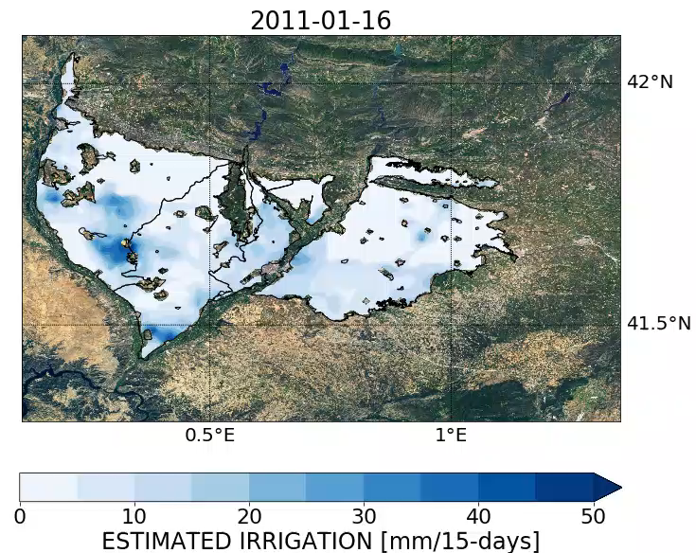
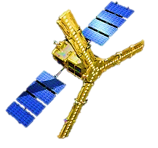
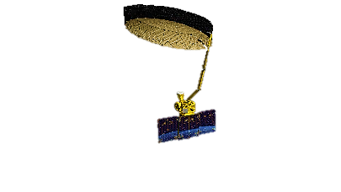
Merging of the SMOS and SMAP experiments:
Almost 7 years of irrigation estimates, from January 2011 to September 2017.
2011-01-01
2016-01-01
2017-09-01
DISPATCH SMOS
DISPATCH SMAP
The method is able to quantitatively estimate the actually occurred irrigation amounts over 4/5 pilot districts. It is noteworthy that the evapotranspiration term cannot be neglected in SM2RAIN applications aimed at estimating irrigation over semi-arid regions.
Irrigation Estimates from Remote Sensing Soil Moisture: A District-Scale Analysis in Spain
9/12
Notes:
By merging the results of the two experiments, a data set of almost 7 years of irrigation estimated through remote sensing soil moisture has been obtained.

Slide 10

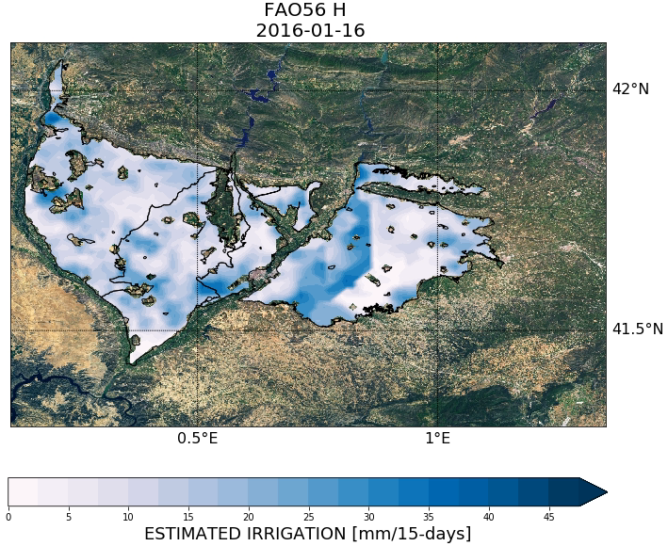
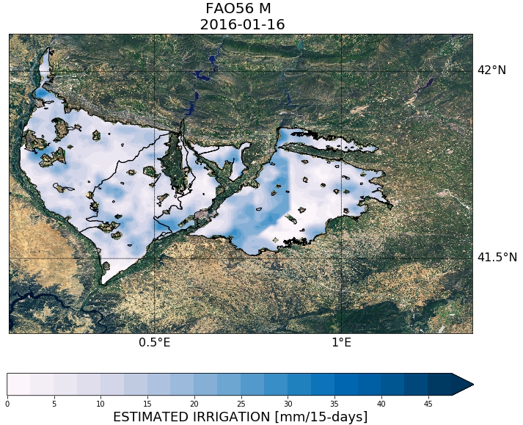


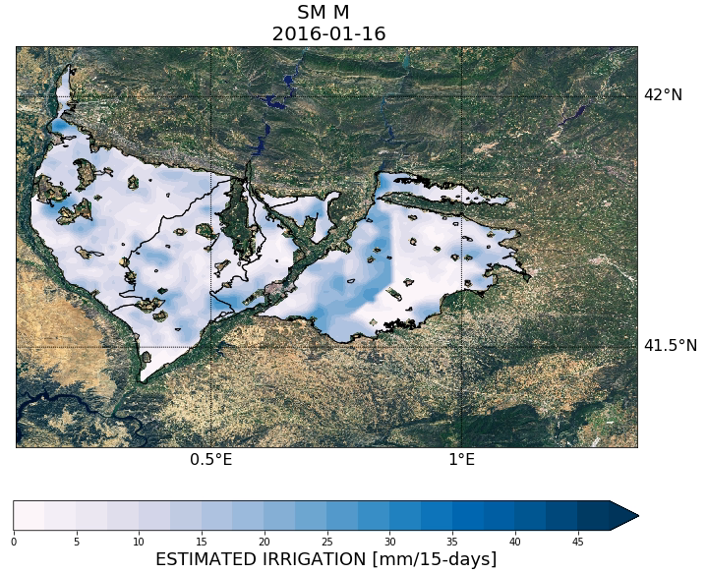
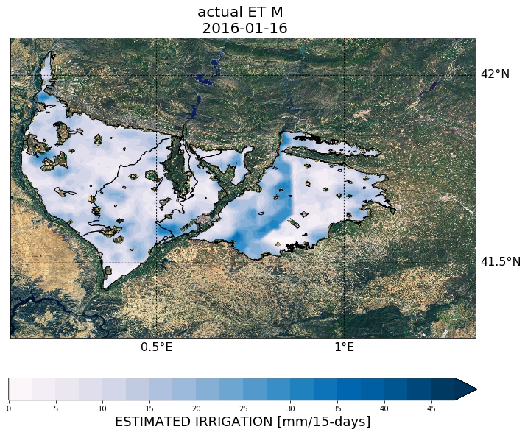
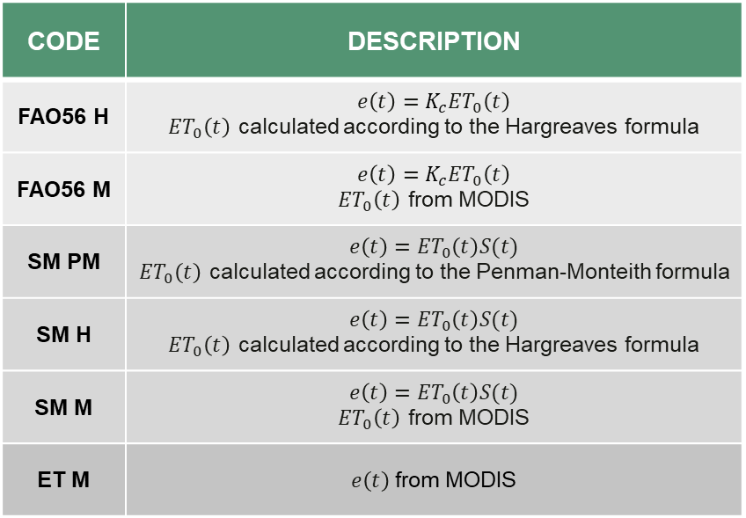
Trying alternative $ET$ sources – ongoing activity:
The SMAP experiment has been repeated by implementing several approaches to model the evapotransiration term.
Six additional simulations have been carried out.
CODE | DESCRIPTION
FAO56 H | $$e\left(t\right)={K_{c}ET}_{0}\left(t\right)$$ ${ET}_{0}\left(t\right)$ calculated according to the Hargreaves formula
FAO56 M | $$e\left(t\right)={K_{c}ET}_{0}\left(t\right)$$ ${ET}_{0}\left(t\right)$ from MODIS
SM PM | $$e\left(t\right)={ET}_{0}\left(t\right)S(t)$$ ${ET}_{0}\left(t\right)$ calculated according to the Penman-Monteith formula
SM H | $$e\left(t\right)={ET}_{0}\left(t\right)S(t)$$ ${ET}_{0}\left(t\right)$ calculated according to the Hargreaves formula
SM M | $$e\left(t\right)={ET}_{0}\left(t\right)S(t)$$ ${ET}_{0}\left(t\right)$ from MODIS
ET M | $e\left(t\right)$ from MODIS
Irrigation Estimates from Remote Sensing Soil Moisture: A District-Scale Analysis in Spain
10/12
Notes:
New ongoing activity:
The SMAP experiment has been repeated by testing several ET sources and approaches.
Acknowledgement: Elena Giugliarelli

Slide 11
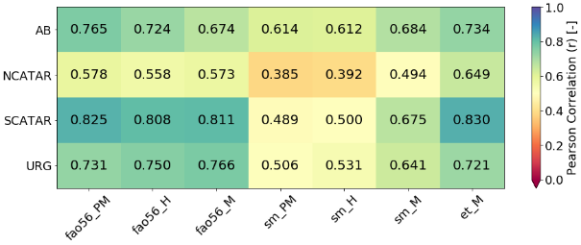
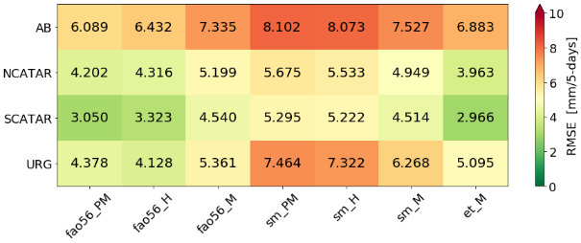
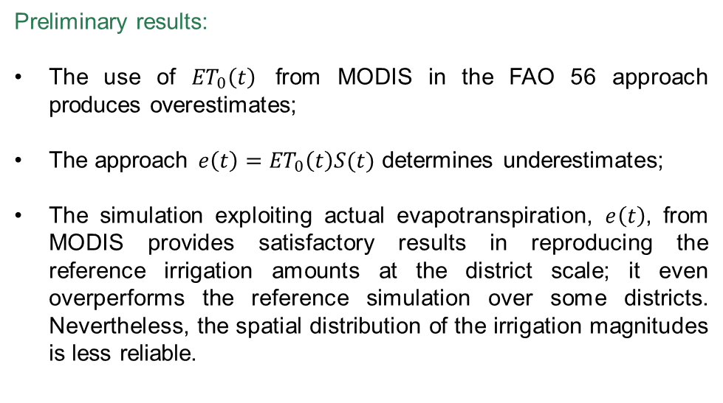
Trying alternative $ET$ sources – ongoing activity:
Preliminary results:
The use of ${ET}_{0}\left(t\right)$ from MODIS in the FAO 56 approach produces overestimates;
The approach $e\left(t\right)={ET}_{0}\left(t\right)S(t)$ determines underestimates;
The simulation exploiting actual evapotranspiration, $e\left(t\right)$, from MODIS provides satisfactory results in reproducing the reference irrigation amounts at the district scale; it even overperforms the reference simulation over some districts. Nevertheless, the spatial distribution of the irrigation magnitudes is less reliable.
Irrigation Estimates from Remote Sensing Soil Moisture: A District-Scale Analysis in Spain
11/12
Notes:
Heatmaps of the Pearson correlation and of the RMSE considering the comparison between each simulation and the benchmark values. The first column is referred to the main simulation, namely the one using the FAO 56 approach and ET0 calculated according to the Penman-Monteith method.

Slide 12


References:
Allen, R.G., Periera, L.S., Raes, D., Smith, M., 1998. Crop Evapotranspiration: Guidelines for Computing Crop Requirements, Irrigation and Drainage Paper No. 56. FAO, Rome, Italy.
Brocca, L., Tarpanelli, A., Filippucci, P., Dorigo, W., Zaussinger, F., Gruber, A., Fernández-Prieto, D., 2018. How much water is used for irrigation? A new approach exploiting coarse resolution satellite soil moisture products. Int. J. Earth Obs. Geoinformation, 73, 752-766.
Dari, J., Brocca, L., Quintana-Seguí, P., Escorihuela, M.J., Stefan, V., Morbidelli, R., 2020. Exploiting high-resolution remote sensing soil moisture to estimate irrigation water amounts over a Mediterranean region. Remote Sens., 12, 2593.
Dari, J., Quintana-Seguí, P., Escorihuela, M.J., Stefan, V., Brocca, L., Morbidelli, R., 2021. Detecting and mapping irrigated areas in a Mediterranean environment using remote sensing soil moisture and a land surface model. J. Hydrol., 596, 126129.
Merlin, O., Walker, J. P., Chehbouni, A., Kerr, Y., 2008. Towards deterministic downscaling of SMOS soil moisture using MODIS derived soil evaporative efficiency. Remote Sens. Environ., 112, 3935–3946.
Quintana-Seguí, P., Peral, C., Turco, M., Llasat, M.C., Martin, E., 2016. Meteorological analysis systems in North-East Spain: Validation of SAFRAN and SPAN. J. Environ. Inform., 27(2), 116-130.
Siebert, S., Henrich, V., Frenken, K., Burke, J., 2013. Global Map of Irrigation Areas version 5. Rheinische Friedrich-Wilhelms-University, Bonn, Germany / Food and Agriculture Organization of the United Nations, Rome, Italy.
For further information do not hesitate to contact:
Jacopo Dari, PhD
jacopo.dari@unipg.it
Irrigation Estimates from Remote Sensing Soil Moisture: A District-Scale Analysis in Spain
12/12

