Slide 1



Ocean Shelf Exchange, NW European Shelf Seas:
measurements, estimates and comparisons
John Huthnance, Jo Hopkins, Mark Inall (FASTNEt* leader), Jason Holt and FASTNEt team
*Fluxes across sloping topography of the North East Atlantic
NERC consortium grant NE/1030224/1 (FASTNEt)
NERC National Capability grant NE/R015953/1 (Climate Linked Atlantic Sector Science)
SSB = Shelf Sea Biogeochemistry cited here
FASTNEt aims
(i) To determine through measurements the seasonality of physical gradients and exchange across the shelf edge;
(ii) To quantify key exchange mechanisms and obtain new data
to test and improve fine-resolution models of the shelf edge,
by carrying out process studies in contrasting shelf-edge sectors.

Slide 2
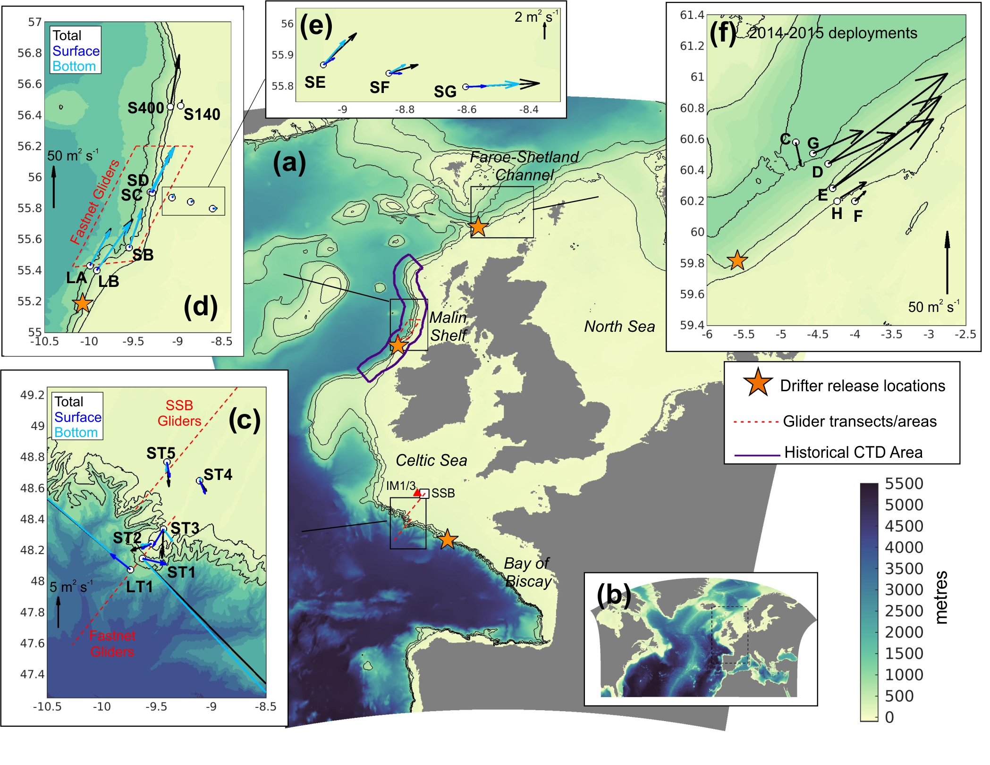
(a,b) AMM60 Atlantic Margin Model domain, bathymetry.
(c) Celtic Sea (FASTNEt June 2012, SSB 2014-2015) mooring sites, deployment mean fluxes. Broad shelf, steep slope, many deep canyons; internal tides
(d,e) Malin-Hebrides shelf (FASTNEt July 2013,
SES 1995-1996) mooring sites, deployment mean fluxes. Density-driven slope current, meanders (onto shelf), secondary circulation, Ekman Drain, shallow canyon influence, wind forcing
(f) Faroe-Shetland Channel (2014-2015) mooring locations, deployment mean fluxes. Strong slope current, winds, fluxes
Orange star: drifter release location
Red lines: glider transects / areas
Purple slope sector: historical CTD area

Slide 3
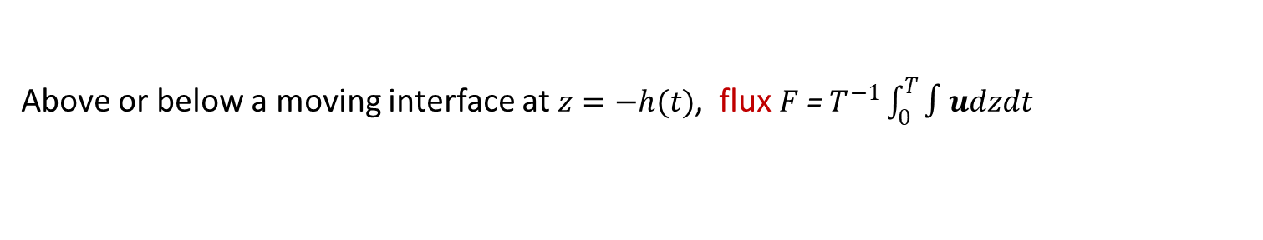


Definitions and Methodologies
Flux $F$ = the net transport through depth (-H<z<0) in a layer: $F$ =$∫\overline{u}dz$
where $\overline{u}$ is the profile of current $u$ averaged over time $T$.
Exchange = $½∫|u^{′}|dz$
where $u^{′}=u−\overline{u}$ is the local instantaneous departure from the time-mean flow
|..| denotes magnitude (also averaged over time $T$)
Above or below a moving interface at $z=−h(t)$, flux $F$ = $T^{−1}\int_{0}^{T}{∫udzdt}$
Effective diffusivity equivalence with exchange. $\overline{u^{′}C^{′}} \text{↔} −K ∂C/∂x$
$½ \left|u^{′}\right|h$~$½ Kh/L_{X}$
Atlantic margin model “AMM60” resolution 1/60 ° (~ 1.8 km), 51 hybrid s-sigma layers (Guihou et al. 2018).
Lateral viscosity 50 m²s⁻¹, lateral diffusion Smagorinsky (1963; k_{H} = 0.7), vertical mixing GLS Canuto A (k-ε), background ν = 10⁻⁷ m²s⁻¹.
ERA-interim atmospheric forcing (Dee et al. 2011). Boundary input from Northern North Atlantic (NEMO) model “NNA” using same atmospheric & tidal forcing (Holt et al. 2014). River inputs from synthesized data (Guihou et al. 2018). Initial conditions (T, S, SSH) from 5-day-mean NNA output. Run 05/01/2010 to 31/12/2013

Slide 4
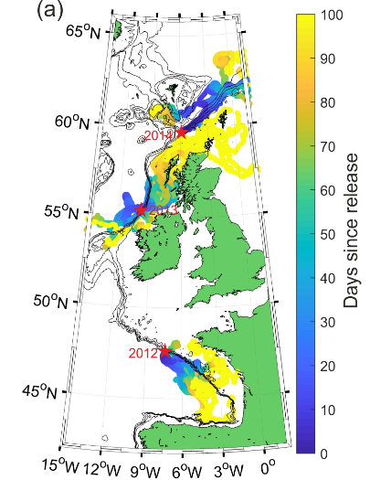
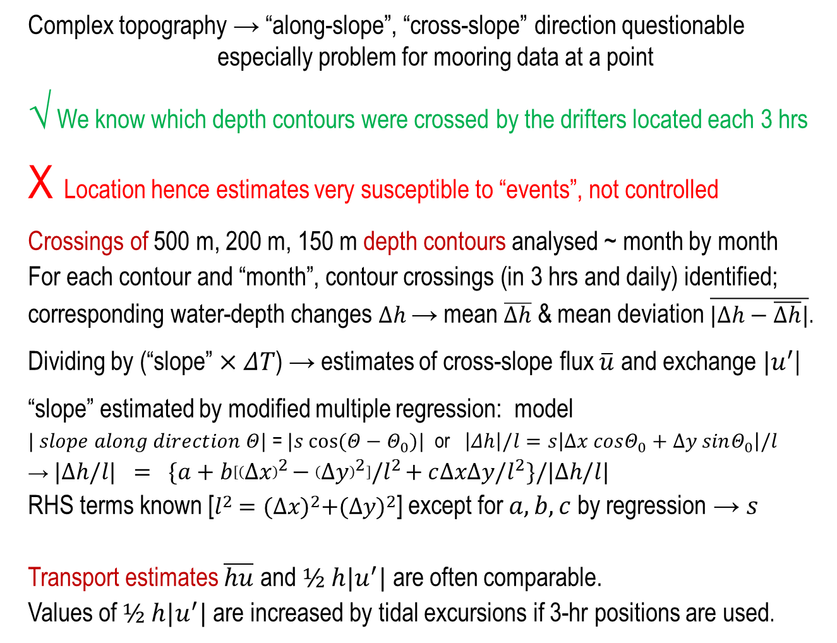
Drifters
Complex topography → “along-slope”, “cross-slope” direction questionable
especially problem for mooring data at a point
√ We know which depth contours were crossed by the drifters located each 3 hrs
X Location hence estimates very susceptible to “events”, not controlled
Crossings of 500 m, 200 m, 150 m depth contours analysed ~ month by month
For each contour and “month”, contour crossings (in 3 hrs and daily) identified;
corresponding water-depth changes $∆h$→ mean $\overline{∆h}$ & mean deviation $\overline{|∆h−\overline{∆h}|}$.
Dividing by (“slope” $×ΔT$) → estimates of cross-slope flux $\overline{u}$ and exchange $|u^{′}$|
“slope” estimated by modified multiple regression: model
$| slope along direction Θ|$ = $|s cos(Θ−Θ_{0})|$ or $\left|Δh\right|/l=s\left|∆x cosΘ_{0}+∆y sinΘ_{0}\right|/l$
→ $|∆h/l| = \{a+b\left[{\left(∆x\right)}^{2}−{\left(∆y\right)}^{2}\right]/l^{2}+c∆x∆y/l^{2}\}/|∆h/l|$
RHS terms known [$l^{2}={(∆x)}^{2}+{(∆y)}^{2}$] except for $a, b, c$ by regression $\text{→} s$
Transport estimates $\overline{hu}$ and $½ h|u^{′}|$ are often comparable.
Values of $½ h|u^{′}|$ are increased by tidal excursions if 3-hr positions are used.

Slide 5
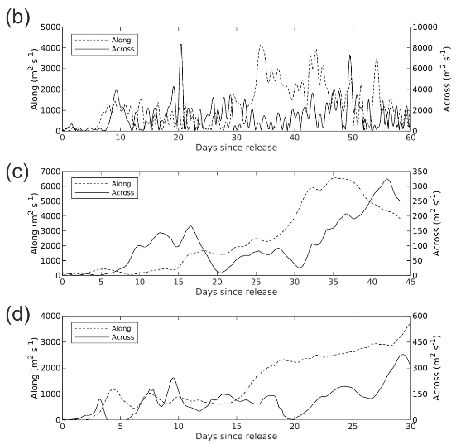
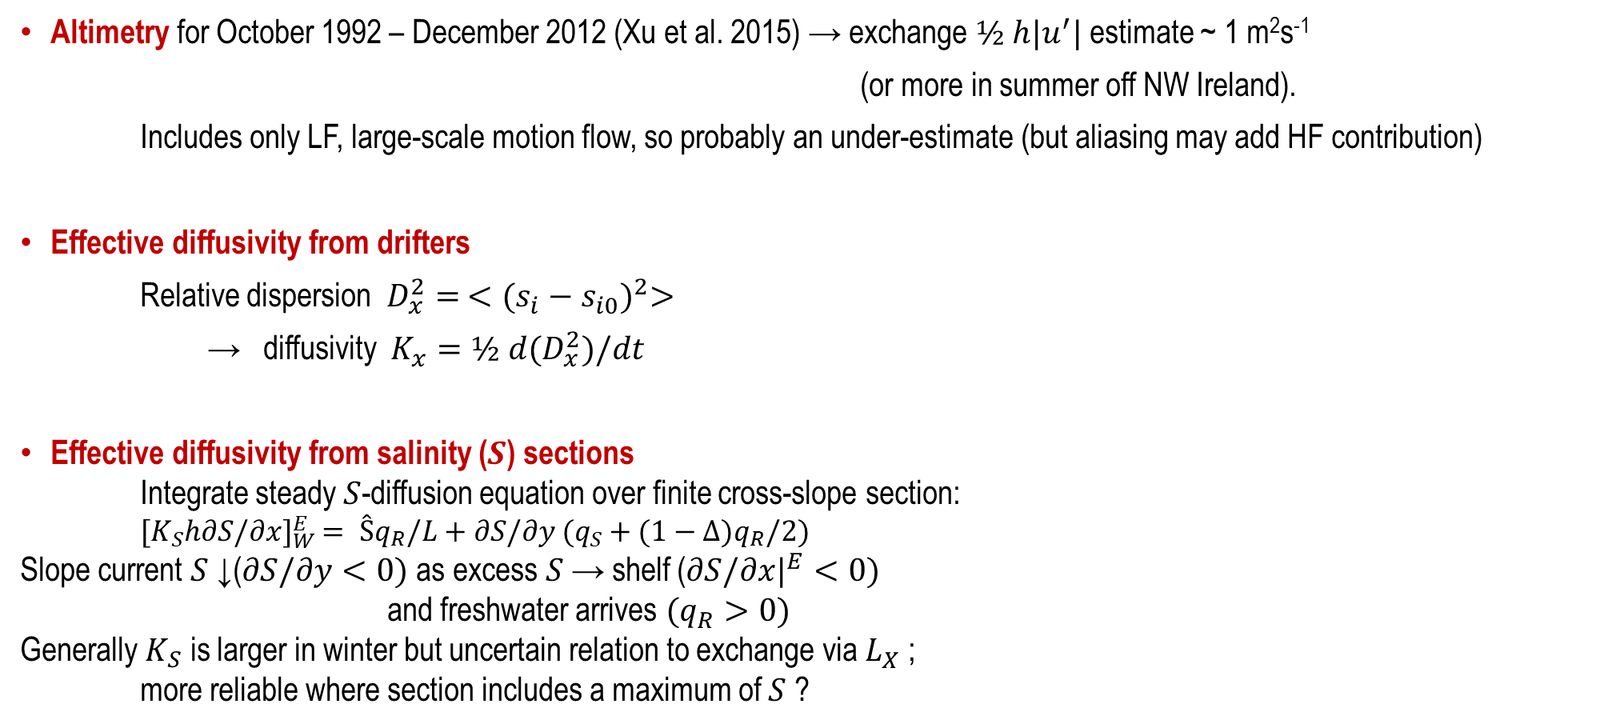
Other estimates
Altimetry for October 1992 – December 2012 (Xu et al. 2015) → exchange $½ h|u^{′}|$ estimate ~ 1 m²s⁻¹
(or more in summer off NW Ireland).
Includes only LF, large-scale motion flow, so probably an under-estimate (but aliasing may add HF contribution)
Effective diffusivity from drifters
Relative dispersion $D_{x}^{2}= <{(s_{i}−s_{i0})}^{2}>$
→ diffusivity $K_{x}=½ d(D_{x}^{2})/dt$
Effective diffusivity from salinity ($S$) sections
Integrate steady $S$-diffusion equation over finite cross-slope section:
${[K}_{S}h∂S/∂x]_{W}^{E}= Ŝq_{R}/L+∂S/∂y (q_{S}+(1−∆)q_{R}/2)$
Slope current $S$↓($∂S/∂y<0)$as excess $S$→ shelf ($∂S/∂x|^{E}<0)$
and freshwater arrives $(q_{R}>0)$
Generally $K_{S}$ is larger in winter but uncertain relation to exchange via $L_{X}$;
more reliable where section includes a maximum of $S$ ?
Celtic
Malin
Faroe-Shetland

Slide 6
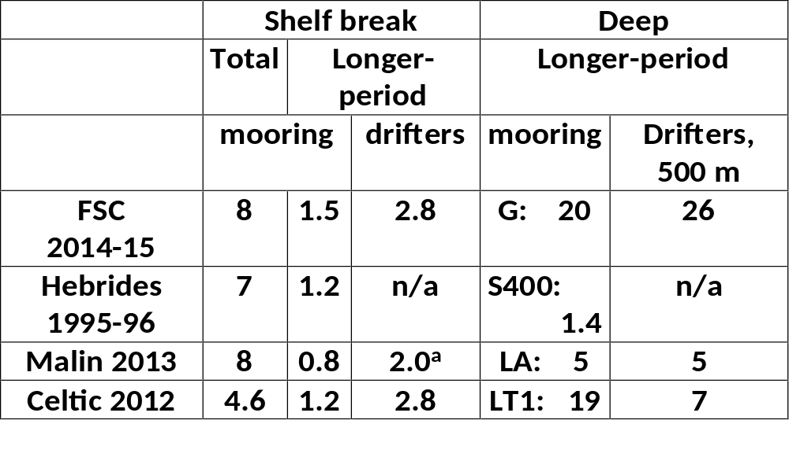
Summary of cross-slope exchanges (m²s⁻¹)
Generally LF << total;
large but often ineffective tidal contribution
Less at shelf break than deeper
Mostly moorings < drifters
(possibly ↔ “along-slope” definition)
Process contributions (not necessarily additive; question for future?)
lenses O(0.1 m²s⁻¹), internal waves Stokes transports O(0.4 m²s⁻¹), Celtic
Ekman transport from wind, typically O(0.5 m²s⁻¹), max. 4 m²s⁻¹ (Scotland)
Bottom Ekman transport (Malin-Hebrides) 0.7 m²s⁻¹ to 2.7 m²s⁻¹ (record averages); max. 20 m²s⁻¹
Slope current mis-alignment, Malin O(0.2 Sv) in 100 km
Eddies, possibly less than 0.1 m²s⁻¹
Tides & wind-driven (HF) O(5-15 m²s⁻¹) >> tidal shear dispersion

Slide 7
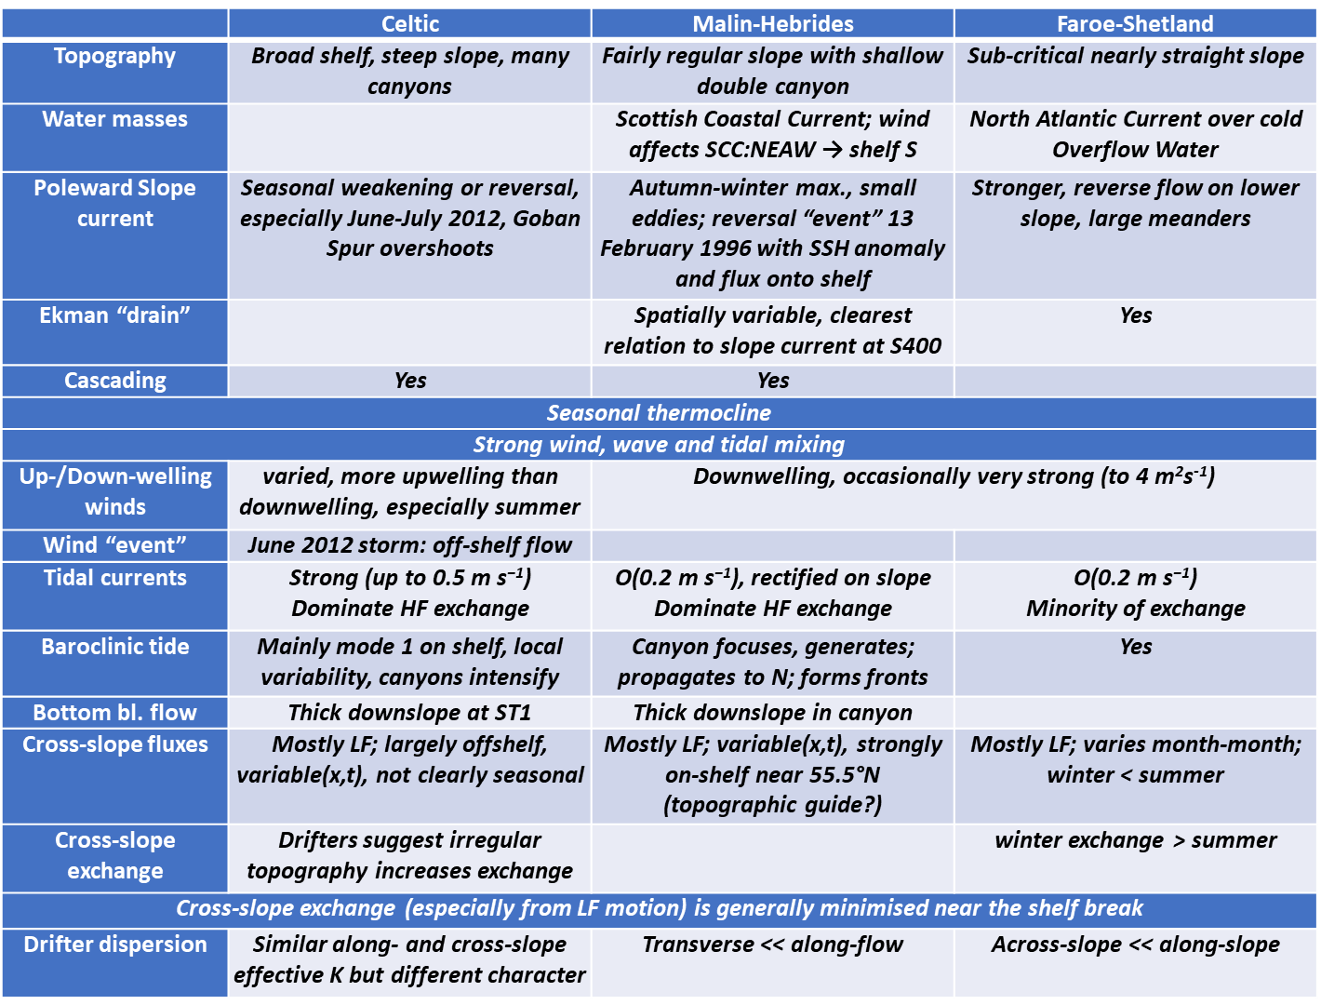
Distinctive characteristics of FASTNEt areas
For the NW European shelf edge: wide range of distinctive observations to test and validate models
necessary for spatial and temporal coverage;
complex context,
cross-slope transports enabled by small-scale processes.

Slide 8
Conclusions
Relatively large shelf-break exchange here ≥ 1 m²s⁻¹ (for time-scale > 1 day) c.f. most regions
strong winds + along-slope flow
Elsewhere: boundary currents meander, converge/diverge, deflected by topography, dense water down canyon
Tidal exchanges several m²s⁻¹,
but reversals @ ~6.2 hours → ineffective for transport of slowly evolving constituents
Globally, 1 m²s⁻¹ × shelf-edge extent O(500,000 km) → transport 500 Sv or more
Significance depends on distinctive properties of water or contents (e.g. nutrients, carbon).
Transports across shelf edge are large majority of NW European shelf nitrogen supply
enabling it to greatly exceed its area-based proportion of global marine CO₂ “pump”.
Small-scale processes enable cross-slope transports & complex context
═> spatial and temporal coverage from models
AMM60 → UK Met Office operational suite (resolution) and UK Environmental Prediction system (UKEP)
Future – sensitivities to climate change? (already Holt et al. 2018, GRL)

