Slide 1
RIMurban – A generalized GPU-based model for urban pluvial flood risk modelling
Heiko Apel, Sergiy Vorogushyn, Nguyen Viet Dung,Mostafa Farrag, Heidi Kreibich, Bruno Merz
Section 4.4 Hydrology, GFZ German Research Centre for Geoscience, Potsdam
Melanie Karremann – Institute of Meteorology, KIT Karlsruhe, Germany

Slide 2
RIMurban – A generalized GPU-based model for urban pluvial flood risk modelling
Problem setting
More frequent occurrence of heavy precipitation events, causing urban inundation and damage
Climate change will very likely increase both frequency and intensity of heavy precipitation
Urban risk management need to be reassessed and adapted
Complex task → difficult for many communes, high demand on data availability and quality, computing capabilities, and labour input; particularly for probabilistic risk assessments using the required combined simulation of surface inundation and sewer system

Slide 3
RIMurban – A generalized GPU-based model for urban pluvial flood risk modelling
Goal of RIMurban
Development of a simple but efficient (fast) 2D urban hydraulic inundation model that considers the specific urban fabric:
  Buildings
  effect of the sewer system on surface inundation
Use of public and spatially available data sources
Simple model setup with optimised transfer to all/most communes in Germany and beyond
Development of a Germany-wide event catalogue and design rainfalls for urban pluvial hazard analysis
Germany-wide damage estimation (private houses) for risk assessment

Slide 4
RIMurban – A generalized GPU-based model for urban pluvial flood risk modelling
Methods behind RIMurban
2D raster based hydraulic modell implemented on GPUss
De-coupled (x-, y-direction) simplified shallow water equations (“inertial formulation” without Advection, Bates et al. 2010)
Numerical diffusion for improved stability (Almeida et al. 2012)
Capacity-based approach for drainage from sealed surfaces and roofs (effective sewer capacity [mm/h])
Capacity-based for infiltration from pervious (non-sealed) surfaces (stationary saturated infiltration rate, [mm/h])
Caclulation of area-cumulated sewer drainage
Hydraulic
Urban environment
Bates, P. D., Horritt, M. S., and Fewtrell, T. J.: A simple inertial formulation of the shallow water equations for efficient two-dimensional flood inundation modelling, Journal of Hydrology, 387, 33-45, 10.1016/j.jhydrol.2010.03.027, 2010.
Almeida, G. A. M. d., Bates, P., Freer, J. E., and Souvignet, M.: Improving the stability of a simple formulation of the shallow water equations for 2-D flood modeling, Water Resources Research, 48, W05528, doi:10.1029/2011WR011570, 2012.

Slide 5
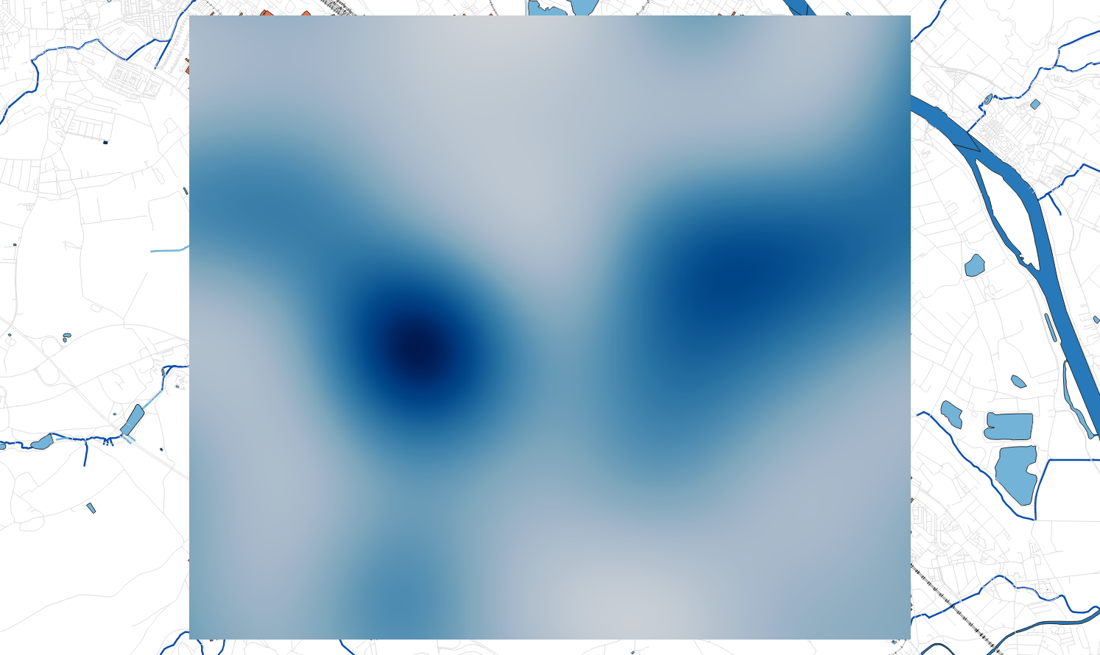
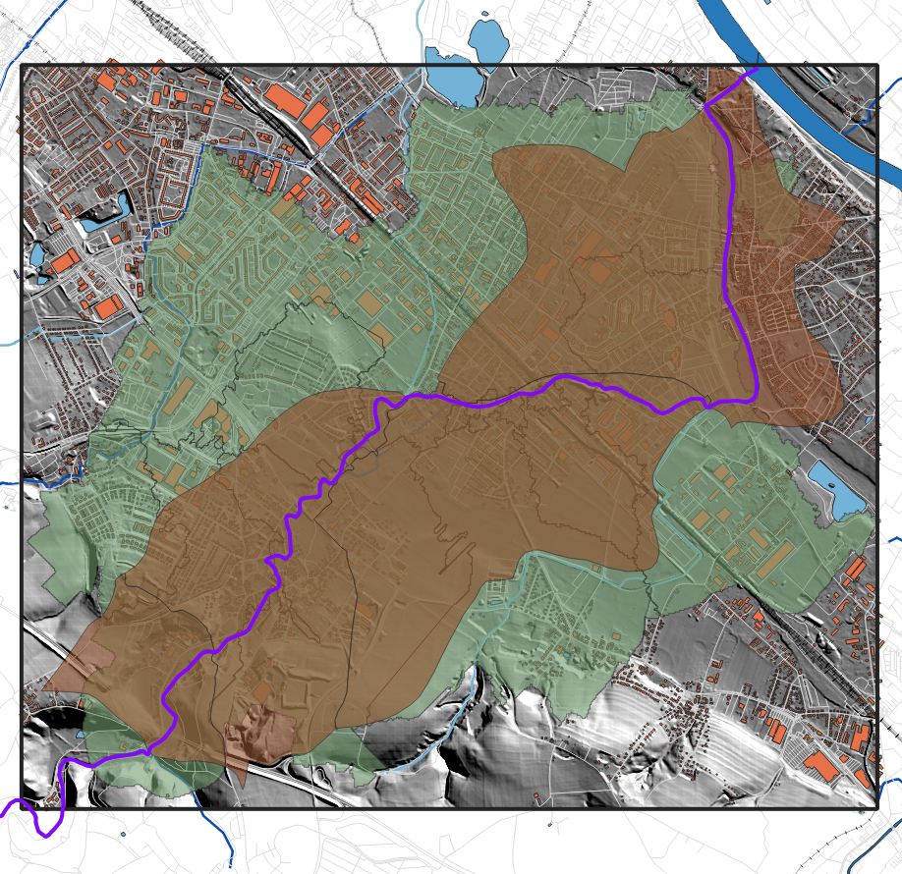
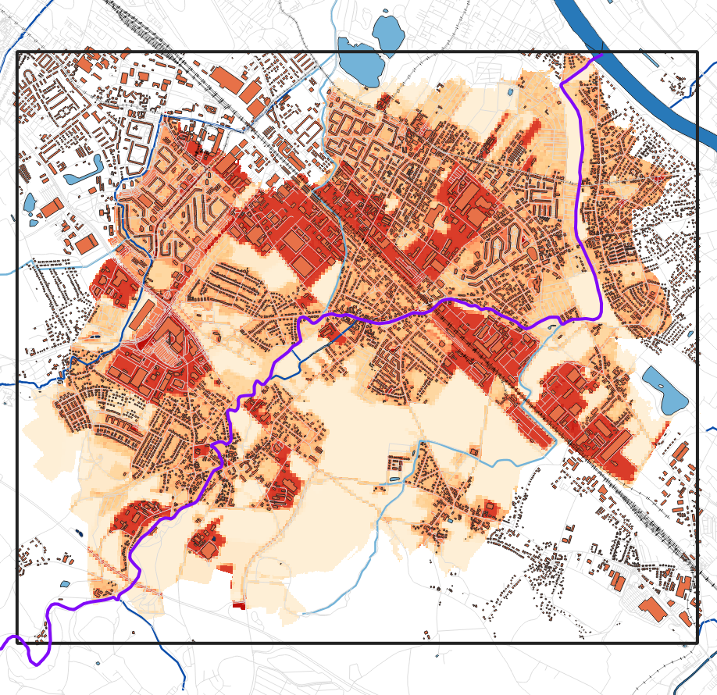
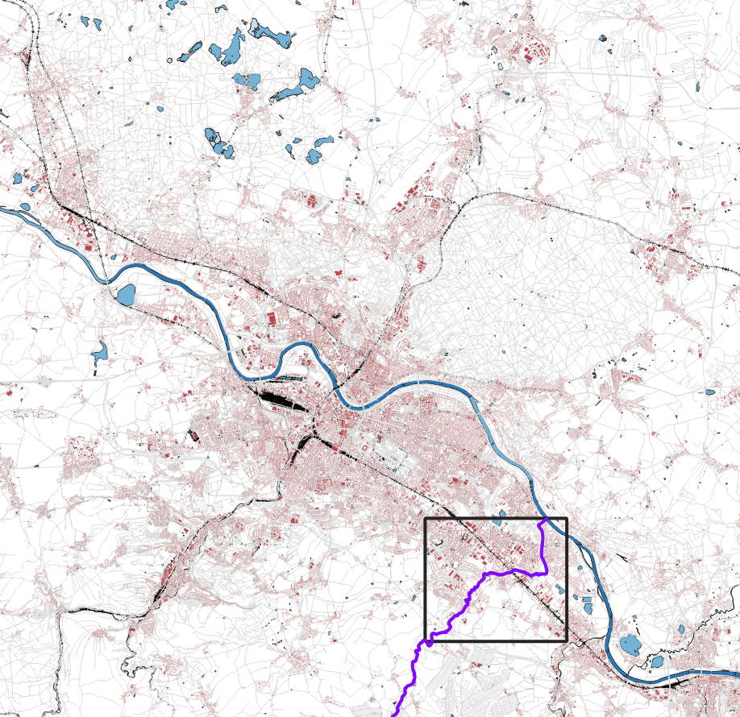
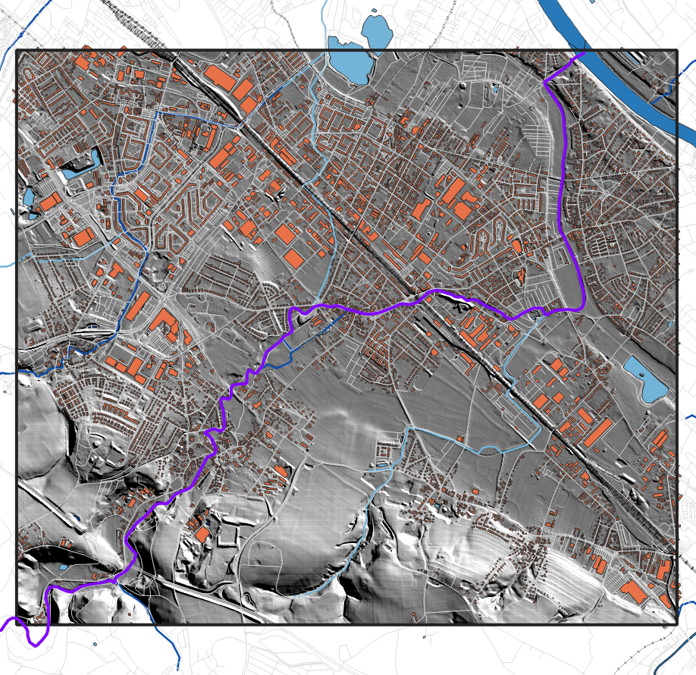
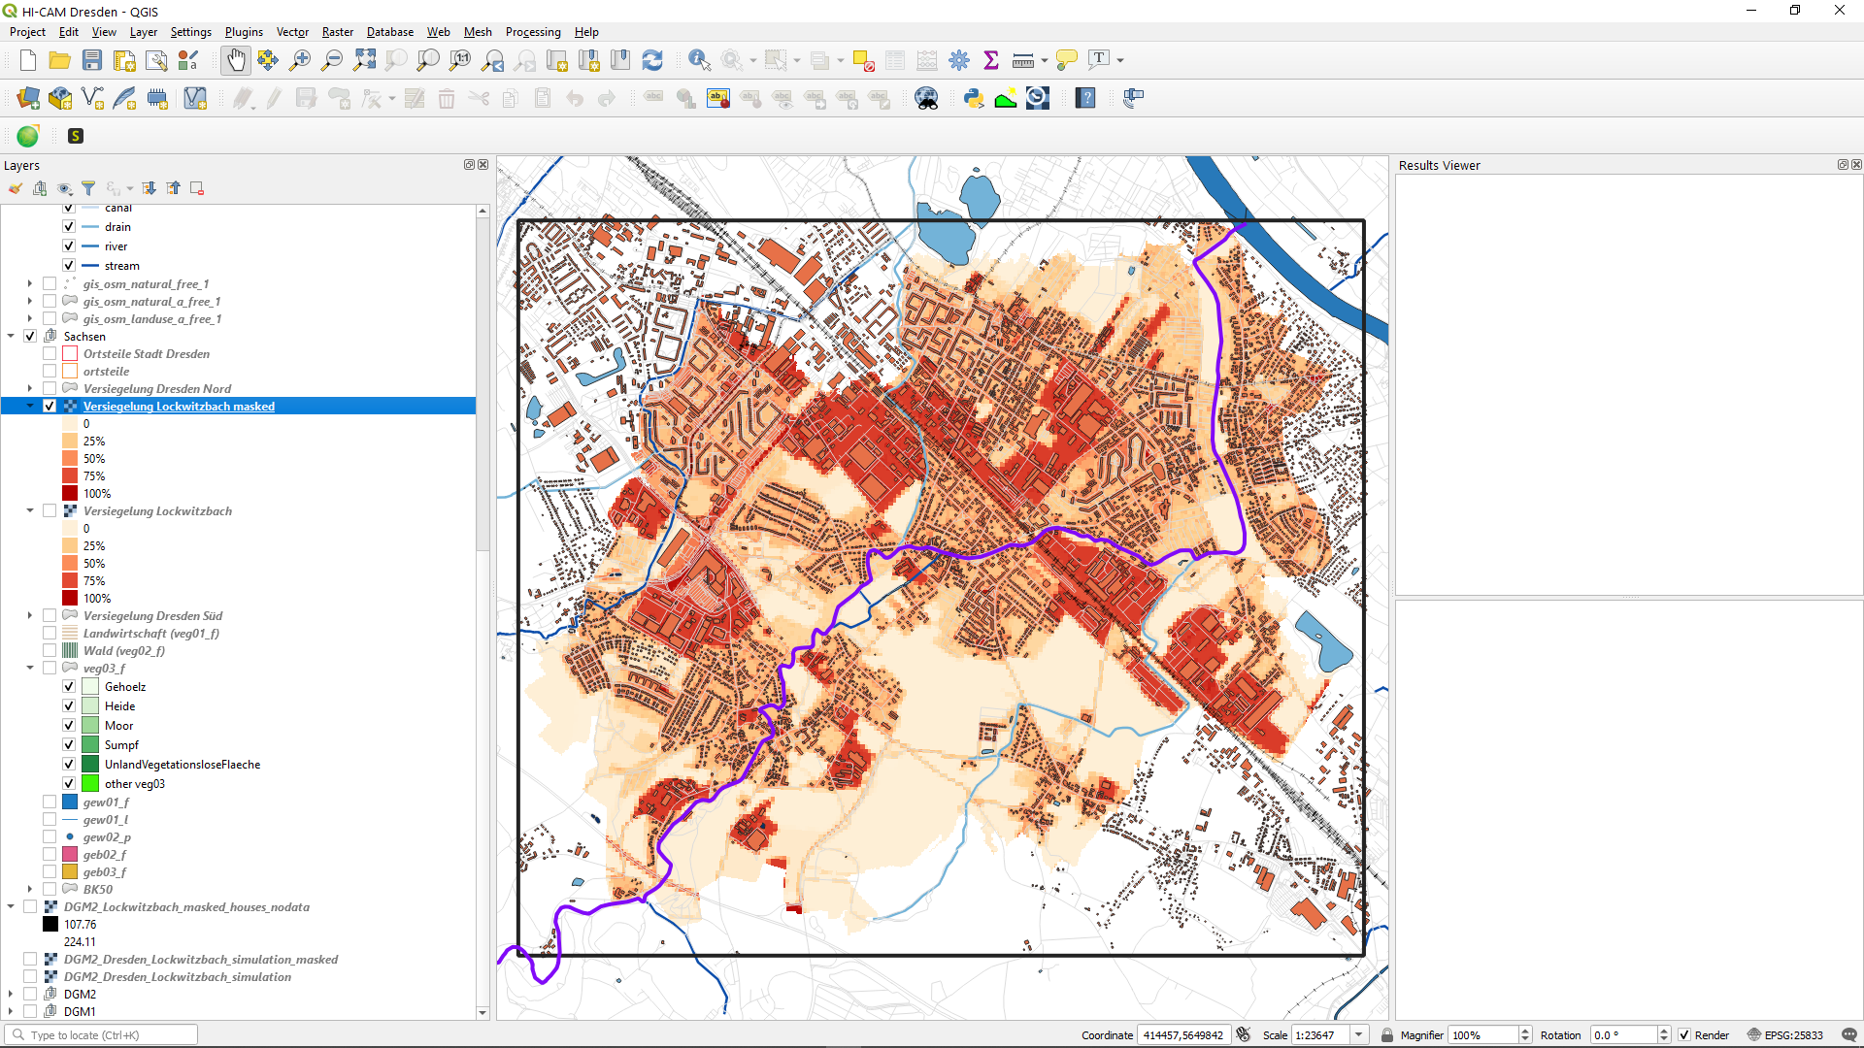
RIMurban – A generalized GPU-based model for urban pluvial flood risk modelling
Rain fields
(radar, Interp. station data, …)
Test area Lockwitzbach,
Dresden, Germany
26 km², ~ 1 Mill. grid cells
Watershed
surface, sewer
DEM Analysis,
User decision
EZG
Oberfläche
EZG
Kanalnetz
(Un)sealed surfaces
or land use
OSM/CORINE
Dresden
roughness;
sewer drainage, infiltration
High resolution DEM ≤ 5m
Building footprints (OSM)
Minimum data required
for model setup
Lockwitzbach area

Slide 6

RIMurban – A generalized GPU-based model for urban pluvial flood risk modelling
Plausibility test / determination of the effective sewer capacity (typically inknown)
Event | Area within Dresden | Max precip. [mm/h], [mm/5min] | Discharge measurement in sewer system | Inundation information
2018-08-18 | Lockwitzbach [26 km²] | 22.6, 4.7
2020-08-30/31 | Lockwitzbach | 8.1, 0.67*
2014-05-27 | Lockwitzbach | 26.2, 17.4
2013-06-20 | Klotzsche [4 km²] | 21.2, 5.5
2020-08-30/31 | Klotzsche | 6.8, 0.57*
*only hourly radar precipitation (RADOLAN) data available; uniform distribution with one hour assumed

Slide 7
RIMurban – A generalized GPU-based model for urban pluvial flood risk modelling
Comparison with measured sewer discharge
Lockwitzbach (26 km²)
Event 2020-08-30/31
Sewer subsystem MS5 |  |  | Volume difference
Inf. Rate [mm/h] | Sewer cap. [mm/h] | Threshold [m] | 00:00 - 05:00 | 20:00 - 05:00
10 | 20 | 0.005 | -3.92% | -4.73%
10 | 25 | 0.005 | -0.99% | -1.98%
10 | 30 | 0.005 | 1.16% | 0.02%
15 | 30 | 0.005 | -25.99% | -22.54%
10 | 20 | 0.002 | 1.68% | 1.27%
10 | 25 | 0.002 | 4.59% | 4.05%
10 | 30 | 0.002 | 6.82% | 6.12%
Event duration: 12 h
Simulation time: ~35 min

Slide 8
RIMurban – A generalized GPU-based model for urban pluvial flood risk modelling
Summary Plausibility test
Maximum specific discharge acc. to KOSTRA and DWA-A 118* Lockwitzbach, T = 2a:
~ 6.5 mm/15min
→ 26 mm/h
 |  | mean over all plausibility tests sewer discharge
Inf. Rate [mm/h] | Sewer cap. [mm/h] | Threshold [m] |  | Mean difference
10 | 20 | 0.005 |  | -12.73%
10 | 25 | 0.005 |  | -9.01%
10 | 30 | 0.005 |  | -6.07%
15 | 30 | 0.005 |  | -24.25%
10 | 20 | 0.002 |  | -4.68%
10 | 25 | 0.002 |  | -0.61%
10 | 30 | 0.002 |  | 0.25%
Sewer capacity can be estimated by standard guidelines (2 year design rainfall)
Selected parameterization of sewer capacity
*KOSTRA: heavy precipitation catalogue of the German Weather Service DWD
DWA-A 118: guideline on urban inundation management of the German association for water management DWA

Slide 9
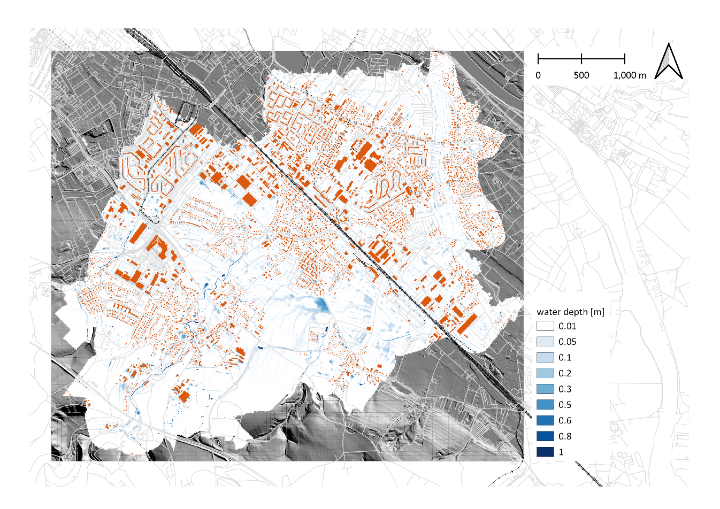
RIMurban – A generalized GPU-based model for urban pluvial flood risk modelling
2014-05-27, Lockwitzbach, 5 min Radolan precipitation, maximum inundation depths

Slide 10
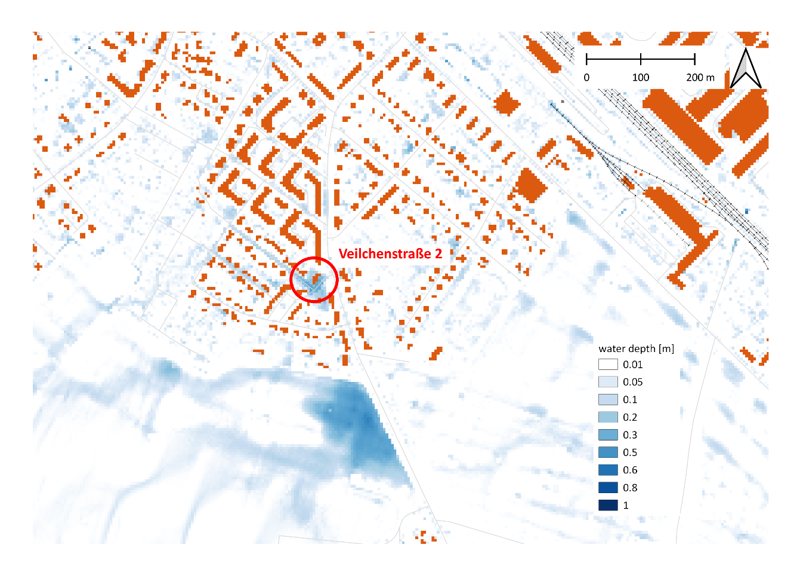
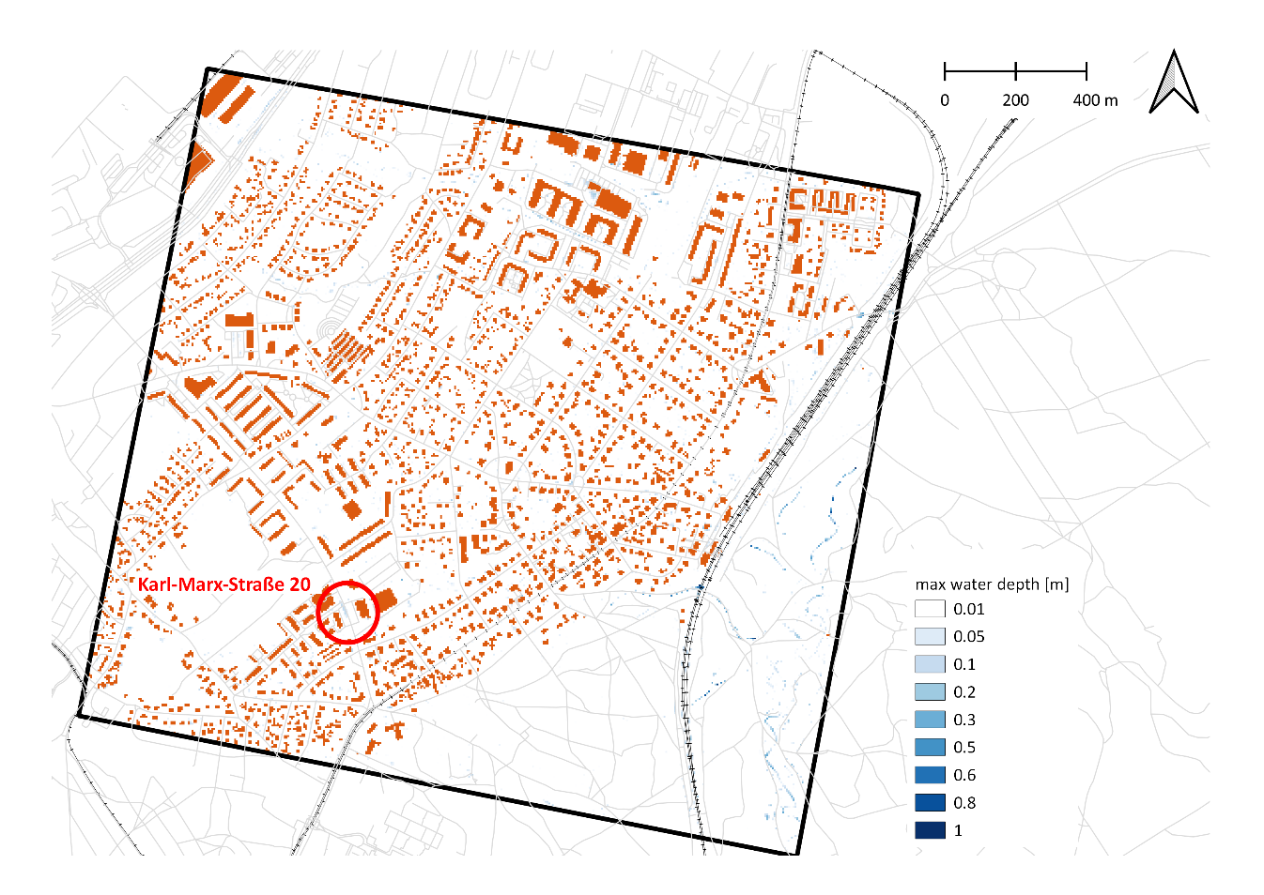
RIMurban – A generalized GPU-based model for urban pluvial flood risk modelling
2014-05-27, Lockwitzbach, 5 min Radolan precipitation, maximum inundation depths
2020-08-30, Klotzsche, hourly Radolan precipitation, maximum inundation depths
Surface inundation plausibility check:
Inundation simulated where inundation were recorded by fire brigade in different events

Slide 11
RIMurban – A generalized GPU-based model for urban pluvial flood risk modelling
Pluvial flood hazard analysis – Germany-wide event catalogue / extreme value statistics (KIT)
Core concept:
Convective heavy precipitation events are stochastic i.e. can occur randomly everywhere
Method:
Germany-wide analysis of RADOLAN rain radar data of the past 19 years
Collection of heavy precipitation events from most arts of Germany (event catalogue convective heavy precipitation)
Extreme value statistics of the whole event catalogue (very large sample size!)
Inundation simulation of selected probabilities for pluvial urban flood hazard analysis in almost every commune in Germany possible with low effort
Estimation of future climate change induced changes in heavy precipitation by ΔT-climate change scenarios (+1,5K, +2K, +3K) → relative ΔP of max. daily rainfall from model ensemble
Work in progress!

Slide 12
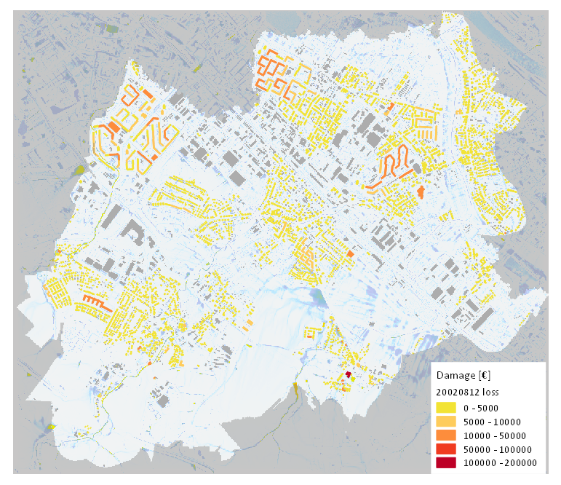
RIMurban – A generalized GPU-based model for urban pluvial flood risk modelling
Risk analysis – damage estimation
GFZ damage model BN-FLEMOps pluvial
Bayesian Network model; probabilistic relative damage estimation using inundation depth and duration (Rözer et al. 2019)
Estimation of replacement costs on the basis auf GDP values, which were regionalised Europe-wide and disaggregated to the OSM building data set (Lüdtke et al. 2019)
Plausability test
12. August 2002
Damage estimation
Private households
~6000 affected building
Total damage: 8 Mill. €
Average: 1400€ per building
Rözer, V. et al.: Probabilistic Models Significantly Reduce Uncertainty in Hurricane Harvey Pluvial Flood Loss Estimates, Earth’s Future, 7(4), 384–394, doi:10.1029/2018EF001074, 2019.
Lüdtke, S. et al. : A Consistent Approach for Probabilistic Residential Flood Loss Modeling in Europe, Water Resources Research, 55, 10616-10635, 10.1029/2019wr026213, 2019.
Notes:
Pluvial flood loss estimation for private households (building damage only, based on replacement costs) for the rain event on August 12, 2002
This is the final output of the model chain. Combining all rainfall events and associated uncertainties will result in a risk estimation for the area.
Details about the damage estimation:
Relative damage calculation using the method of Rözer et al (2019): zero inflated Bayesian beta regression model
Building values derived from an European-wide approach estimating the replacement costs based on regional GDP per capita (Lüdtke et al. (2019)); the replacement costs are disaggregated to OSM buildings (OBM)
The average damage value per building is a reasonable figure based on past flood events of this type, thus the damage estimation is plausible, at least in this example.
Rözer, V., Kreibich, H., Schröter, K., Müller, M., Sairam, N., Doss‐Gollin, J., Lall, U. and Merz, B.: Probabilistic Models Significantly Reduce Uncertainty in Hurricane Harvey Pluvial Flood Loss Estimates, Earth’s Future, 7(4), 384–394, doi:10.1029/2018EF001074, 2019.
Lüdtke, S., Schröter, K., Steinhausen, M., Weise, L., Figueiredo, R., and Kreibich, H.: A Consistent Approach for Probabilistic Residential Flood Loss Modeling in Europe, Water Resources Research, 55, 10616-10635, 10.1029/2019wr026213, 2019.

Slide 13
RIMurban – A generalized GPU-based model for urban pluvial flood risk modelling
Summary
RIMurban offers
Simple hydraulic model setup on the basis of mostly open access data sources and information
Fast hydraulic simulation of urban inundation dynamics and sewer discharge
Easy transfer and applicability to every commune in Germany and beyond
In combination with heavy precipitation catalogue and statistic (or other appropriate rainfall input) an urban pluvial hazard analysis is possible for most communes in Germany
In combination with BN-FLEMOps pluvial risk assessments can be performed for most communes in Germany as the basis for flood risk management and planning
Outlook
Fluvial and combined fluvial-pluvial floods can also be simulated (as in Apel et al. 2016).
RIMurban will be published in licence for consultants, communes, etc.
Apel, H. et al.: Combined fluvial and pluvial urban flood hazard analysis: concept development and application to Can Tho city, Mekong Delta, Vietnam, Nat. Hazards Earth Syst. Sci., 16, 941-961, 10.5194/nhess-16-941-2016, 2016.c
Notes:
More information and contact:
heiko.apel@gfz-potsdam.de
https://www.helmholtz-klima.de/adaptation/projekt-urbane-extreme

Slide 14
RIMurban – A generalized GPU-based model for urban pluvial flood risk modelling
Comparison with measured sewer discharge
Lockwitzbach (26 km²)
Ereignis 2018-08-18
Teilsystem MS5
Inf. Rate [mm/h] | Kanalkap. [mm/h] | Schwellen-wert [m] | Volumen-differenz 23:00 - 01:30
10 | 20 | 0.005 | -4.02%
10 | 25 | 0.005 | 4.30%
10 | 30 | 0.005 | 11.69%
15 | 30 | 0.005 | 1.85%
10 | 20 | 0.002 | 4.94%
10 | 25 | 0.002 | 14.42%
10 | 30 | 0.002 | 10.90%
Event duration: 4 h
Simulation time: ~600-800 sec
Notes:
Plausability test sewer discharge Nr. 2 sewer discharge Lockwitzbach

Slide 15
RIMurban – A generalized GPU-based model for urban pluvial flood risk modelling
Comparison with measured sewer discharge
Lockwitzbach (26 km²)
Ereignis 2020-08-30/31
Teilsystem MS2 |  |  | Volumendifferenz
Inf. Rate [mm/h] | Kanalkap. [mm/h] | Schwellen-wert [m] | 20:00 - 05:00 | 00:00 - 05:00 | 00:00 - 05:00
10 | 20 | 0.005 | -20.59% | -18.91% | -18.91%
10 | 25 | 0.005 | -18.28% | -16.31% | -16.31%
10 | 30 | 0.005 | -16.72% | -14.51% | -14.51%
15 | 30 | 0.005 | -33.54% | -34.24% | -34.24%
10 | 20 | 0.002 | -15.57% | -15.21% | -15.21%
10 | 25 | 0.002 | -13.29% | -12.71% | -12.71%
10 | 30 | 0.002 | -11.78% | -11.00% | -11.00%
Event duration: 12 h
Simulation time: ~35 min
Notes:
Plausability test sewer discharge Nr. 3 sewer discharge Lockwitzbach

Slide 16
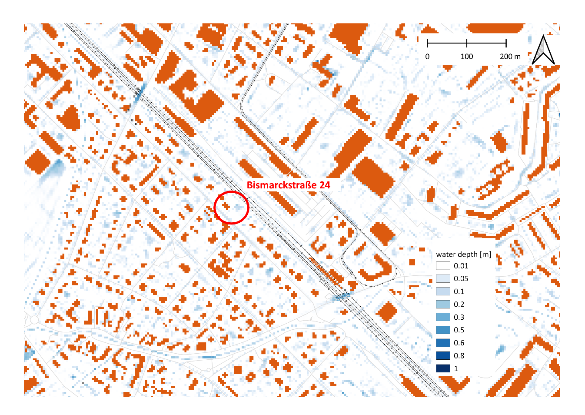
RIMurban – A generalized GPU-based model for urban pluvial flood risk modelling
2014-05-27, Lockwitzbach, 5 min Radolan precipitation, maximum inundation depths
Surface inundation plausibility check:
Inundation simulated where inundation were recorded by fire brigade in different events
Notes:
Red circles indicate locations, where the fire brigade recorded inundations with affected houses

Slide 17
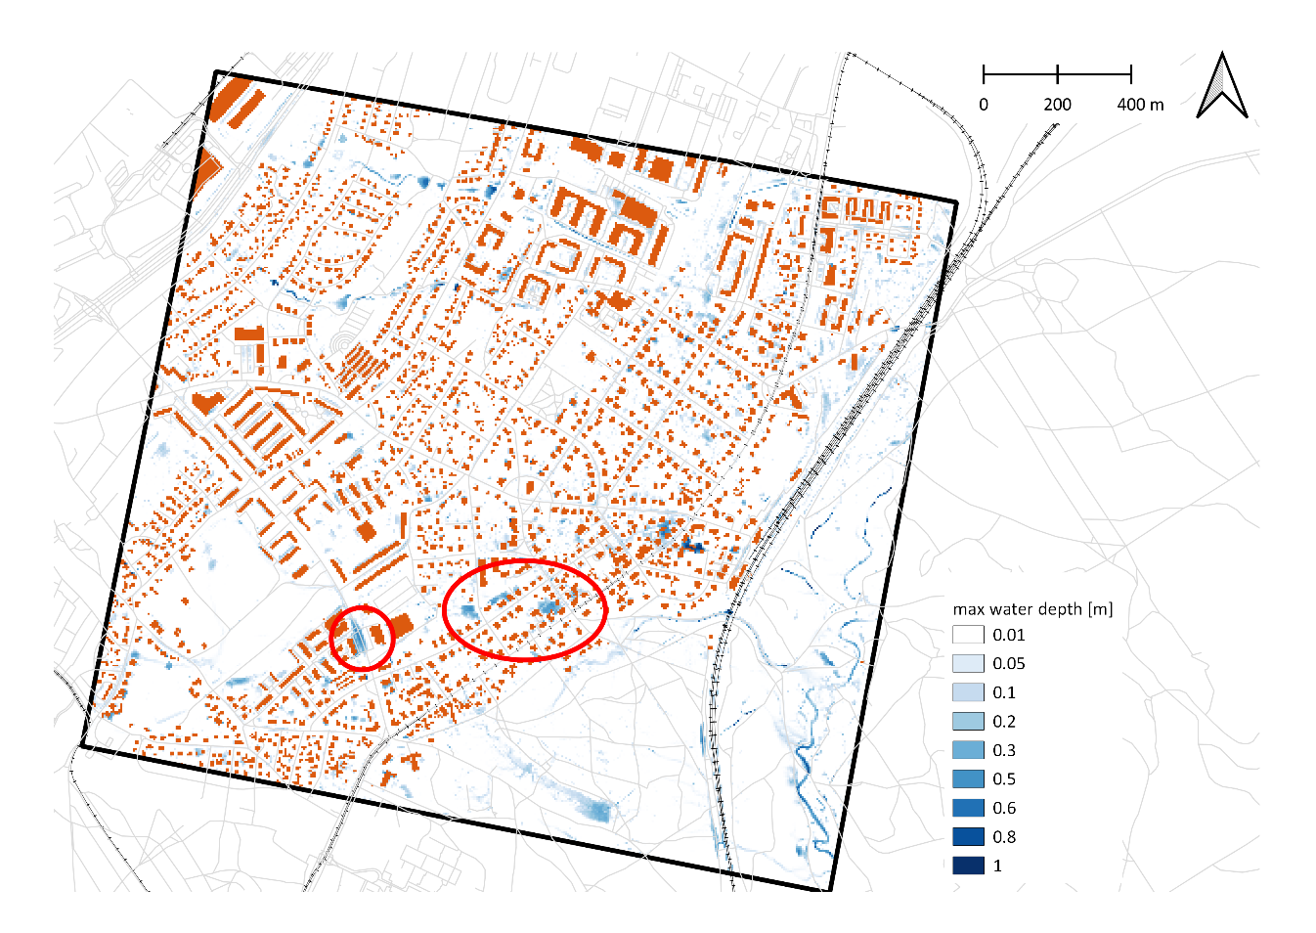
RIMurban – A generalized GPU-based model for urban pluvial flood risk modelling
2013-06-20, Klotzsche, 5 min Radolan rainfall, maximum water depth
2020-08-30, Klotzsche, hourly Radolan rainfall, maximum water depth
Low inundation (3-13 cm) simulated where low inundation was reported
Similar inundation pattern as detailed 2D-1D coupled simulations
Notes:
Left: Comparison with detailed inundation simulations with coupled 2D surface hydraulics and 1D sewer system hydraulics
Right: comparison of simulation results with reported low inundation that almost flooded the basement of house Karl-Marx-Str. 20

