Slide 1

Accounting for high dimensional predictors in RFA with MARS
Amina Msilini
Pierre Masselot
Taha B.M.J. Ouarda
April 26th 2021

Slide 2

Plan
Context of research
Problematic definition
Study area and data
4. Methods
5. Results
6. Conclusions

Slide 3

Contexte
Context of research
Hydrometric stations
Historical data
Statistical models
Hydrological risk assessment and
water resources management.

Slide 4
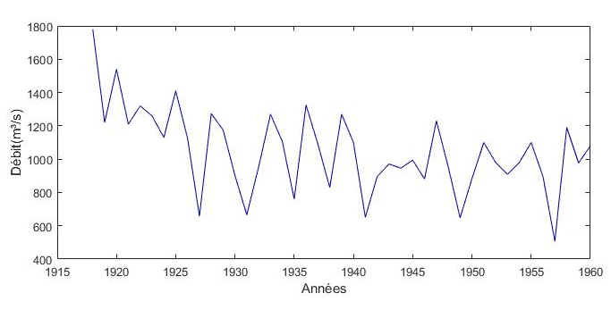
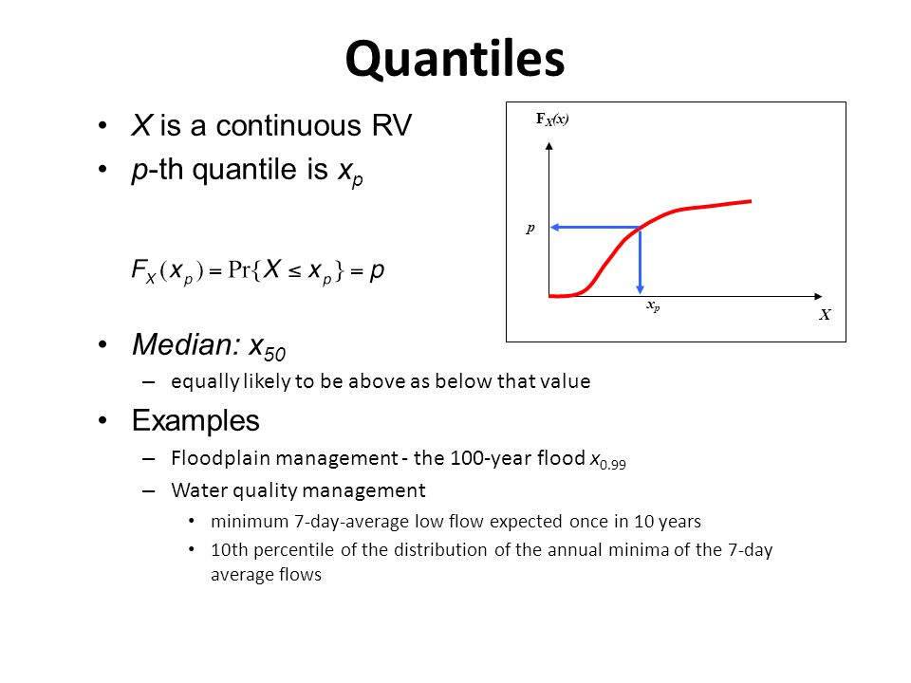
Contexte
Contexte
Context of research
At-site Frequency Analysis (FA)
General process
Flow
Extract a sample of maximum annual flow from observed data.
Verify basic assumptions.
Fit adequate statistical distribution.
Estimate parameters.
Estimate quantiles (At-site quantiles).
Years

Slide 5
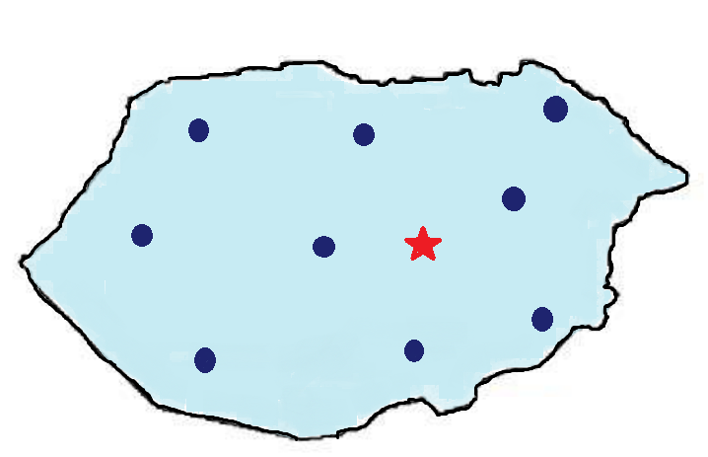
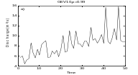

Mise en contexte
Mise en contexte
Context of research
Regional Frequency Analysis (RFA)
Frequency Analysis (FA)
In each gauged site:
X: physio-meterological variables
Y: hydrological variables
Quantiles estimation at gauged sites.
Gauged sites
Ungauged site

Slide 6
Mise en contexte
Contexte
Contexte
Contexte
Context of research
Regional Frequency Analysis (RFA)
2. Delineation of homogeneous regions (DHR)
Regroup sites with physiographical and meteorological attributes similar to the target site.
Gauged sites
Ungauged site
6

Slide 7
Mise en contexte
Contexte
Contexte
Contexte
Context of research
Regional Frequency Analysis (RFA)
3. Regional estimation (RE)
Transfer of hydrological information from the gauged sites to the ungauged one within the homogeneous region.
Quantiles estimation at ungauged sites.
.
Gauged sites
Ungauged site
7

Slide 8
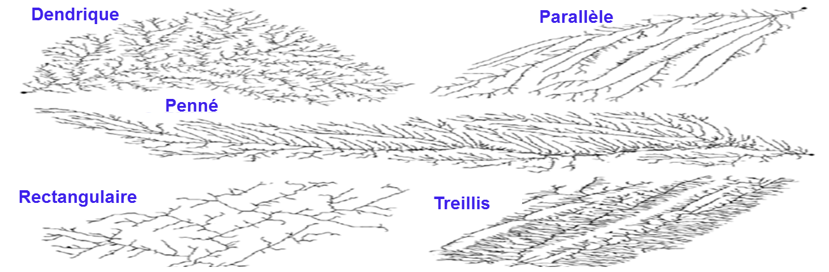
Problématiques
Contexte
Contexte
Contexte
Problematic definition
Additional physiographical variables considered for estimation.
Different forms of drainage networks.
Dendritic
Parallel
Pinnate
Rectangular
Trellis
Source : Mejia et al., 2008

Slide 9
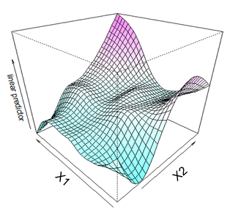
Problematic definition
High dimensional data with strongly correlated and interact variables.

Slide 10
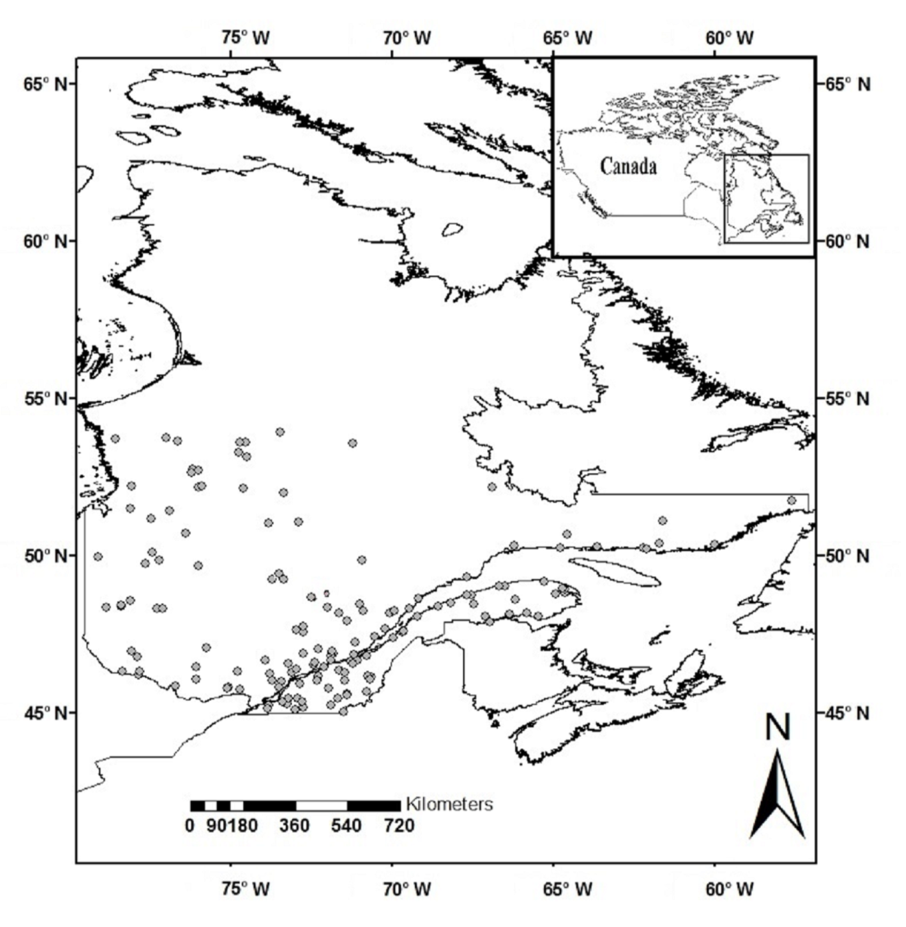
Problématiques
Zone d’étude et données
Contexte
Contexte
Contexte
Contexte
Study area and data
Data bases
2 databases : 151 hydrometric stations in southern Quebec, Canada :
STA : Variables commonly used in RFA.
EXTD: STA + Additional physiographical variables.
3 hydrological variables : QS10, QS50 and QS100.

Slide 11
Méthodologies : Méthodes
Problématiques
Contexte
Contexte
Contexte
Methods
Considered Regional models :
DHR approaches :
Canonical correlation analysis (CCA): statistical technique of multivariate analysis which allows describing the linear dependence relations between two sets of random variables based on correlations.
Region of influence (ROI) : technique based on a Euclidean distance measuring the similarity of watersheds in a multidimensional physio-meteorological space.

Slide 12
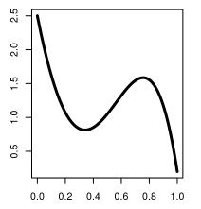
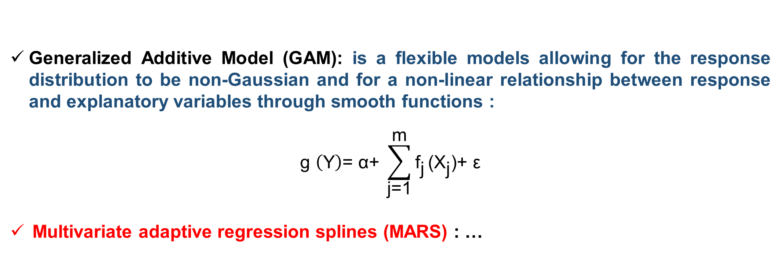
Méthodologies : Méthodes
Méthodologies : Méthodes
Problématiques
Contexte
Contexte
Contexte
Methods
RE approaches:
Generalized Additive Model (GAM): is a flexible models allowing for the response distribution to be non-Gaussian and for a non-linear relationship between response and explanatory variables through smooth functions :
$$\text{g} \left(\text{Y}\right)\text{= }\text{α}\text{+ }\sum_{\text{j}\text{=1}}^{\text{m}}{{\text{f}}_{\text{j}}}\text{(}{\text{X}}_{\text{j}}\text{)+ }\text{ε}$$
Multivariate adaptive regression splines (MARS) : …
fj (Xj)
Xj

Slide 13
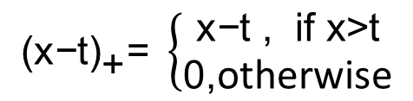
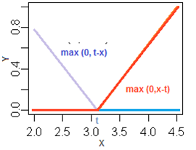
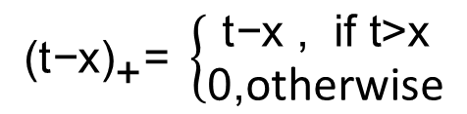
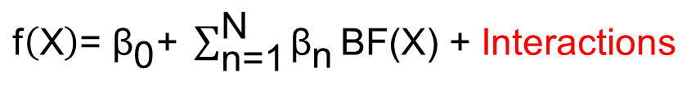
Méthodologies
Methods
A simple and efficient RE model integrating interaction and non-linearity :
Multivariate adaptive regression splines (MARS) : simple and efficient non-linear model based on linear splines (basic functions BF (x)) and able to easily introduce the interaction between variables :
BF(X) :
$${\text{(}\text{t}\text{−}\text{x}\text{)}}_{\text{+}}\text{= }\left\{\begin{aligned}\text{t}\text{−}\text{x}\text{ , }\text{if} \text{t}\text{>}\text{x} \\ \text{0,}\text{otherwise}\end{aligned}\right.$$
$${\text{(}\text{x}\text{−}\text{t}\text{)}}_{\text{+}}\text{= }\left\{\begin{aligned}\text{x}\text{−}\text{t}\text{ , }\text{if} \text{x}\text{>}\text{t} \\ \text{0,}\text{otherwise}\end{aligned}\right.$$
MARS :
$\text{f}\left(\text{X}\right)\text{= }{\text{β}}_{\text{0}}\text{+ }\sum_{\text{n}\text{=1}}^{\text{N}}{{\text{β}}_{\text{n}}}\text{BF}\text{(}\text{X}\text{)}$ + Interactions

Slide 14
Méthodologies
Methods
The MARS process goes through two phases :
Construction phase: Addition of BFs resulting in the greatest decrease in the model error.
Large model which generally overfits the data.
Selection phase: deletion of less significant terms based on GCV.
Best model.

Slide 15
Méthodologies
Methods
Adopted regional models
RE
DHR
GAM
MARS
STA/EXTD
ALL
ALL-GAM
ALL-MARS
Interaction and non-linearity
CCA
CCA-GAM
CCA-MARS
ROI
ROI-GAM
ROI-MARS

Slide 16
Résultats
Results
Jackknife Validation Results
RRMSE (%)

Slide 17
Résultats
Results
Relative error differences associated to the at site quantile${\text{QS}}_{\text{100}}^{}$
Relative error differences (MARS-GAM)
Erreur GAM < Erreur MARS (44%)
Erreur GAM > Erreur MARS (56%)
Sites (Increasing areas)

Slide 18
Résultats
Results
Smooth functions generated with GAM and MARS
Log (QS100)
PLAKE
DD
Log (QS100)
DDBZ
LONGC
GAM spline
CI-GAM
MARS spline
CI-MARS

Slide 19
Résultats
Results
Multivariate effects produced by GAM and MARS (interactions)
GAM
MARS

Slide 20
Méthodologies : Méthodes
Problématiques
Méthodologies : Résultats préliminaires
Contexte
Contexte
Contexte
Conclusions
MARS captures more information from EXTD than GAM, leading to more accurate estimates
GAM results in a more complex and large model than MARS:
More progressive and complex response surfaces.
More continuous and complexes smoothing functions.

Slide 21
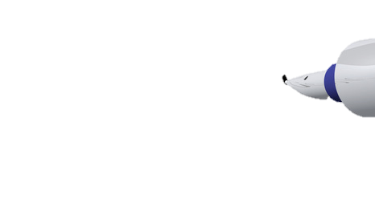
Méthodologies : Méthodes
Problématiques
Méthodologies : Résultats préliminaires
Contexte
Contexte
Contexte
Thank you for your attention!
E-mail : Amina.Msilini@ete.inrs.ca

