Slide 1

Learning to estimate losses of compound inland flooding with Bayesian multilevel models
M. Sc. Guilherme S. Mohor
samprognamoh@uni-potsdam.de
Prof. Dr. Oliver Korup, Prof. Dr. Annegret Thieken

Slide 2
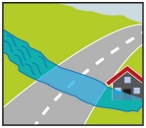
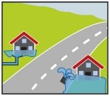
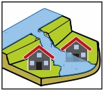


Summary
The co-occurrence of different flood pathways has been reported in several flood events in Germany.
Usually, models for the estimation of flood losses assign a flood event to a single flood pathway.
We trained a Bayesian multilevel model to estimate flood losses of compound inland floods, where each building may have suffered the effect of one or more flood pathways during the same event.
The final loss is a composition of the effects from different flood pathways, i.e. a weighted sum. However, the model requires the pre-definition of weights - the model does not learn the weights.
We estimate weights using a simpler model and a subset of the data and check the results compared to a model with uniform weights.
The weight estimation is still challenging. Is our procedure reasonable?
We would like to discuss this with you!
The next slides are a summary of each section

Slide 3
Background
Floods are usually distinguished between COASTAL, FLUVIAL or PLUVIAL floods
However, PLUVIAL floods is an umbrella term for excessive rainfall-triggered events, which can have different pathways, such as:
Saturated soil and rising groundwater
Rapid runoff in steep channels (flash flood)
Stormwater exceeds drainage system (urban flood)
When different flood pathways (= flood types) occur simultaneously they may be termed compound floods
Compound events can be understood as (Zscheischler et al., 2020):
Preconditioned events (e.g., rain-on-snow, rainfall on saturated soil)
Co-occurrence of multiple hazards in the same region
Spatially compound (e.g., different catchments flooded at the same time when nearby levees breached)
“Compound floods” are commonly referred to as the co-occurrence of COASTAL floods and FLUVIAL floods.
To avoid confusion, we term the combination of different flood pathways, except for coastal floods, as compound INLAND floods.

Slide 4
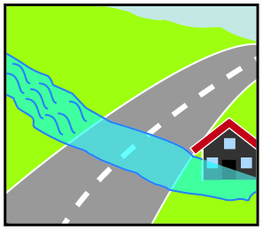
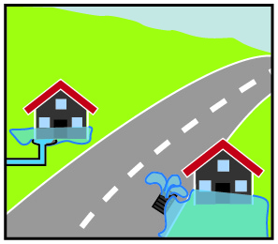
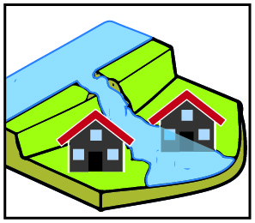


Flood Pathways
Under the umbrella of PLUVIAL FLOOD
On the right are the flood pathways considered in this study and using the umbrella terms.
Data are from surveys undertaken after flood events in Germany.
The co-occurrence of multiple pathways in the same flood event, even in the same city, has been reported.
Flash Flood
Urban Flood
Under the umbrella of FLUVIAL FLOOD
Levee Breach
River Flood
Groundwater

Slide 5
Data summary
Germany has been hit by several severe floods in the past years.
Surveys were undertaken of affected households after the floods of 2002, 2005, 2006, 2010, 2011, 2013, 2014, and 2016 across Germany.
The surveys address several aspects of the flooding event and the damaging process:
  flood parameters, characteristics of the building, socio-economic factors, and indicators of early warning and preparedness.
This dataset has been used for loss modelling under different model structures and previous studies pointed to differences across flood types (Mohor et al., 2020, WRR).
In our latest approach (Mohor et al., accepted to NHESS), seven predictor variables were selected, including flood parameters, one characteristic of the building, and indicators of preparedness.
Navigate to more details of the dataset in slide 11 >
or continue with the summary

Slide 6
Method summary
We trained a Bayesian model to estimate flood losses.
We hypothesize that the effect of each predictor (e.g. water depth) is different for different flood pathways. This can be estimated using a multilevel model.
Moreover, each datapoint (each residential building) may have suffered the effects of multiple flood pathways in the same flood event. For those cases, the final loss is a composition of the effects from the different flood pathways.
This composition is a weighted sum of the effects. For that we need to determine the weights. The model does not estimate the weights.
Without any information, one could assume the pathways are equally important (uniform weights) or determine that some flood pathways are more important to the final loss than others (different weights).
However, there are infinite possibilities of weight sets.
Navigate to more details of the Bayesian model in slide 13 >
or continue with the summary

Slide 7
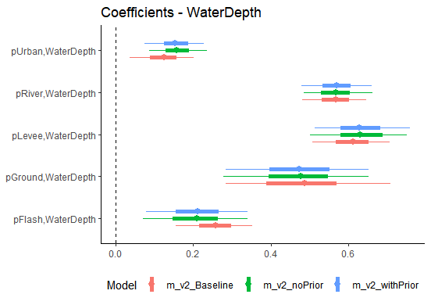
Weights setting summary
We use a subset of the data from the flooding events between 2002 and 2006 (n=1052)
We fit a single-level model, a linear regression of the previously selected seven predictors including the occurrence of each flood pathway as a dichotomous (latent) variable.
The coefficients for these variables should indicate which flood pathway is in general more damaging. Those estimates where re-scaled to sum up 1.0, resulting in the „prior“ weight set:
We fit three model variants to assess the gain of using these weights with data from the flooding events between 2010 and 2016 (n=1058):
Levee breach | Flash flood | River flood | Groundwater | Urban flood
0.245 | 0.216 | 0.197 | 0.179 | 0.162
Base model
(one pathway)
Multi-pathway
Equal weights
Multi-pathway
Prior-weights
Navigate to more details on the weights estimation in slide 18 >
or continue with the summary

Slide 8
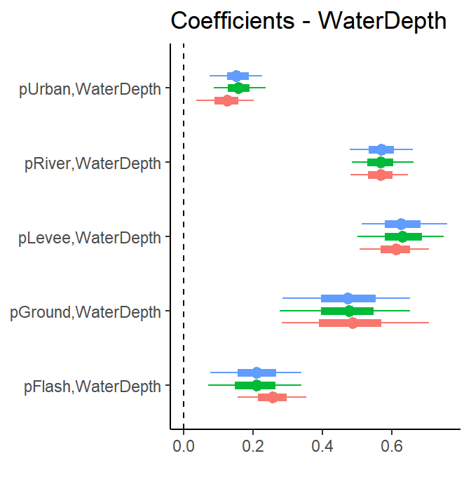

Fitted model summary
For example, we see the effects of water depth for each flood pathway.
The bars show the 89% highest density interval of estimates. Here, all estimates are credibly positive.
The effect of water depth by urban or flash floods is credibly lower than that by river floods or levee breaches.
For levee breaches, the base model (in red) resulted in a more certain estimate. The opposite is found for groundwater floods.
There is very little difference between using uniform weights (in green) and the prior weights we assigned (in blue).
Navigate to all results for all predictor variables in slide 20 >
or continue with the summary

Slide 9
Discussion summary
Our model estimates of different weights for each flood pathway resulted in values not far from uniform weights.
Model parameters were also very similar between both model variants that allow for multi-pathways but with different weight sets.
This suggests that there are no credible differences across flood pathways
Alternatively, our specification of weights is not representative.
As there is little in the scientific literature addressing this challenge, we would like to hear your comments, suggestions, and ideas.
If an adjustment of the weights could improve flood loss modelling, how to improve the weights estimation?
Navigate to a more detailed discussion in slide 27 >

Slide 10



See more details in the following slides
I look forward to the live chat and comments
M. Sc. Guilherme S. Mohor,
samprognamoh@uni-potsdam.de
Prof. Dr. Oliver Korup, Prof. Dr. Annegret Thieken
@NatRiskChange

Slide 11
Survey Data from Germany
Collected after the floods of 2002, 2005, 2006, 2010, 2011, 2013, 2014, and 2016.
Households were asked about different aspects of the flood and damage.
Warning
Federal state
Flood parameters
Flood type
Event year
Early warning lead time
Warning source
Gap time warning-action
Water depth
Contamination
Quality of warning
Warning information
Duration
Velocity
Loss ratio
Building characteristics
Preparedness
Building type
Building value
Building quality
Emergency measures
Socio-economic factors
Floor space of building
Area of the house/flat
Precautionary measures
Flood experience
Household size
Age
Income
Number of flats
Basement
Efficiency of precautionary measures
Awareness of flood risk
Ownership of building
Number of children
Socio-economic status
Number of elderly
Insured

Slide 12
Selected
Predictor Variables
The variable selection used only data from 2002 – 2013 using a single-level model.
New data was added after the floods of 2014 and 2016.
Warning
Federal state
Flood parameters
Flood type
Event year
Water depth
Contamination
Duration
Loss ratio
Building characteristics
Preparedness
Socio-economic factors
Floor space of building
Precautionary measures
Flood experience
Back to > summary
Insured

Slide 13

Bayesian Model
Bayes Theorem in modelling
Intrinsically accounts for uncertainty
Prior: (Hyper-)Parameters
  Learn from other groups (in case of a multilevel model)
  Reconciles data with previous knowledge or belief (= uncertainty)
Likelihood: distribution families and transformation (link function)
Posterior:
  Full distribution of all parameters
  Can be summarised by credible intervals
Prior belief
Likelihood
Posterior distribution
Marginal Likelihood (Evidence)

Slide 14
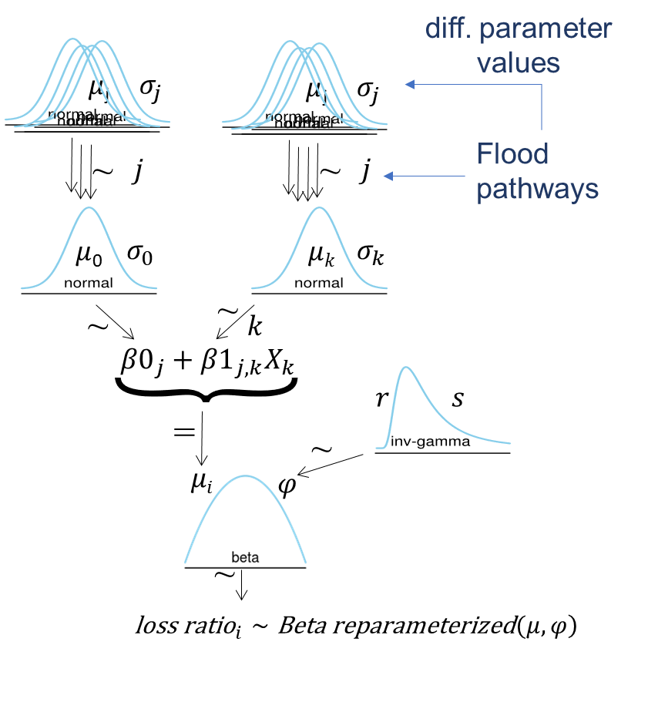
Bayesian Multilevel Model
Model selection:
  Leave-one-out Cross Validation
Predictors selected:
  Water Depth
  Building Area
  Contamination
  Duration
  Private-level Precautionary measures
  Insurance
  Flood experience indicator

Slide 15
Stan – R – brms lme4 syntax
The Bayesian model is solved through the probabilistic programming language Stan (version 2.26) implemented through the package brms (version 2.14; Bürkner, 2018), a Stan interface for R.
Each household may have reported up to 5 flood pathways
mm() stands for multi-membership, i.e. assigned to several groups
mo() stands for monotonic effects
loss_ratio ~ 1 + WaterDepth + BuildingArea + Duration + Insured +
mo(Contamination) + mo(PLPM) + mo(FloodExperience) +
( WaterDepth + BuildingArea + Duration + Insured +
mo(Contamination) + mo(PLPM) + mo(FloodExperience) ||
mm(Path1,Path2, Path3, Path4, Path5,
weights = cbind(w1,w2,w3,w4,w5) ) )

Slide 16
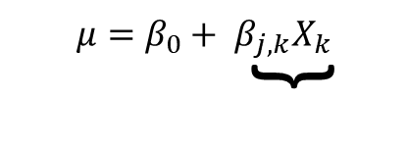
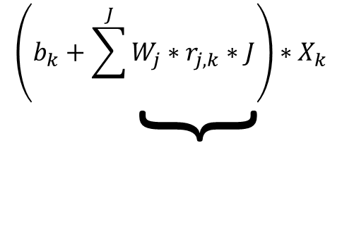


Stan – R – brms
Multi-membership
Predictor variable k
Intercept
Population-level effects
Sum of group-level effects
Weight of group J * Group-level coeff r * member indicator J [yes/no]
$$μ=inverse.logit(μ)$$
$$φ=precision parameter$$
$$loss.ratio=Beta(μ∗φ, \left(1−μ\right)∗φ)$$

Slide 17
Stan – R – brms
Multi-membership
Predictor variable k
Intercept
Population-level effects
Sum of group-level effects
Weight of group J * Group-level coeff r * member indicator J [yes/no]
Weights are input data.
How to define them?
$$μ=inverse.logit(μ)$$
$$φ=precision parameter$$
$$loss.ratio=Beta(μ∗φ, \left(1−μ\right)∗φ)$$
Back to > summary

Slide 18
Setting a prior for the weights
Using the surveys from 2002-2006, a single-level model was fitted having flood pathways as dummy variables.
Estimates are proportionally re-scaled for the weights across flood pathways, assuming that with less controlling variables (a simpler model) the differences are accounted for in the dummy variables.
Scaled result: 0.245 0.197 0.162 0.216 0.179
These are the weights for the presence of all five flood pathways. Not very different from the uniform weights (0.20 for all five pathways)
If a house reported e.g. Riverine and Urban floods, the weights
would be 0.1974 and 0.1623 re-scaled to sum=1.0
loss_ratio ~ 1 + WaterDepth + BuildingArea + Duration + Insured +
Contamination + PLPM + FloodExperience +
pLeveeBreach + pRiver + pUrban + pFlash + pGround

Slide 19
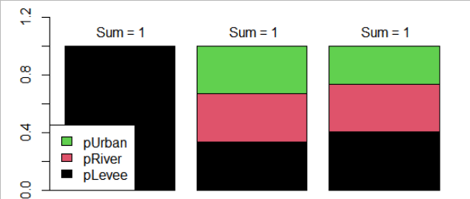
Setting a prior for the weights
To test the gain of this implementation, we trained three model variants:
  Baseline – single flood pathway, the „worst“ one reported (based on the prior weights)
  No Prior - multi-pathways, uniform weights
  With Prior- multi-pathways, unequal weights based (prior weights)
Example with 3 pathways – River flood, Urban flood and Groundwater flood:
 | pLevee | pRiver | pUrban
Base model | 1.0 | 0 | 0
Equal Weights | 0.333 | 0.333 | 0.333
Prior Weights | 0.404 | 0.326 | 0.269
larger
than avg.
~ avg.
lower
than avg.
Base model
(one pathway)
Multi-pathway
Equal weights
Multi-pathway
Prior-weights
Back to > summary

Slide 20
Results
Coefficients
for each flood pathway a different parameter estimate, for each predictor
The effect of water depth is positive, meaning the higher the water depth, the higher the loss ratio.
The effect of the same water depth by urban floods is much lower than that by river floods, levee breaches or groundwater floods.
Comparing model variants, in some cases the single-pathway model show higher certainty in the estimates, in other cases it is less certain (bars are broader).

Slide 21
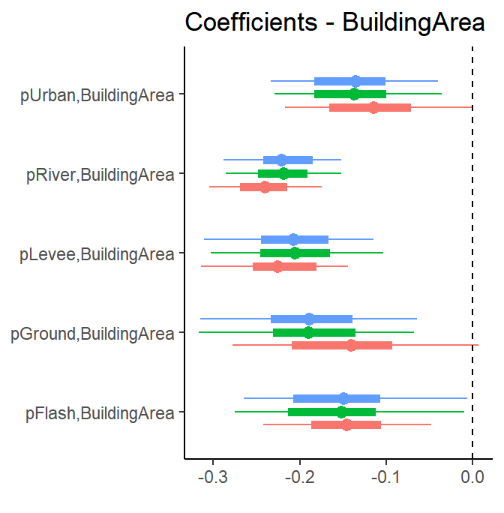
Results
Coefficients
The effect of the building area is negative, meaning the larger the building, the lower is the loss ratio – considering that all other variables are the same.
Most coefficient estimates overlap, meaning they are not credibly different across pathways.
The variance of estimates (HDI 89% - fine line) changes more between the model of single flood pathway („Baseline“) than between the models with uniform or unequal weights. This pattern is shown for all predictor variables

Slide 22
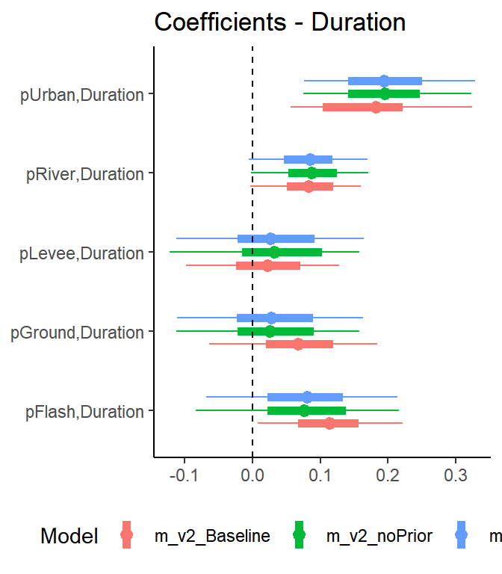
Results
Coefficients
Here, some estimates cross the zero line, meaning they are not credibly different from a null effect.
By flash floods, the single-pathway model variant is the only to show a credible effect - the highest density interval, the bar, does not include zero.

Slide 23
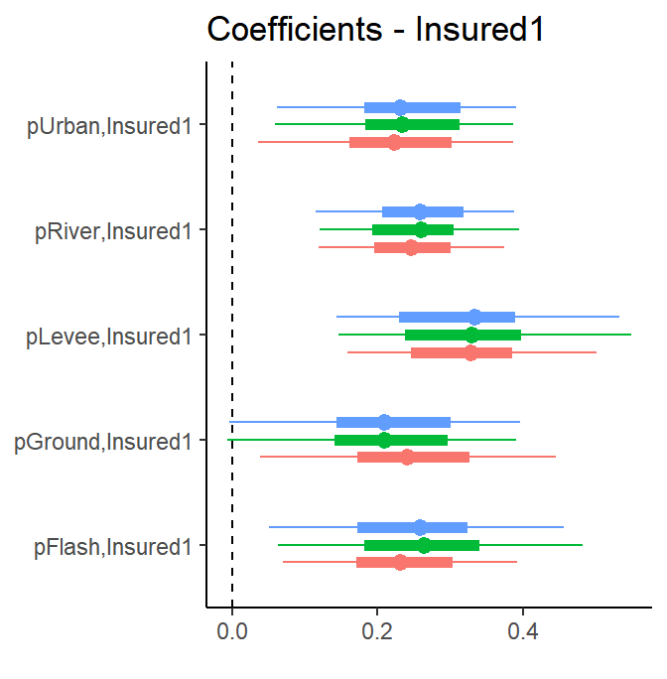
Results
Coefficients
The variable “Insured” is dichotomous, indicating whether the household had an insurance against flood before the flooding event.
A positive effect means that having an insurance led, in general, to an increase in loss ratio.
That can be the result of maladaptation (Surminski & Thieken, 2017).

Slide 24
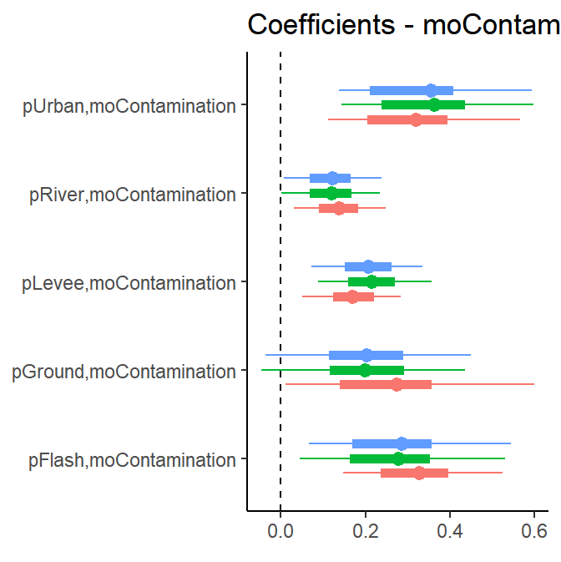
Results
Coefficients
Coefficients - moContamination
Monotonic effects are adopted for ordered (not continuous) variables.
The step between levels may not be linear, but they are monotonic (either positive or negative).
For contamination, the effect is positive to loss ratio.

Slide 25
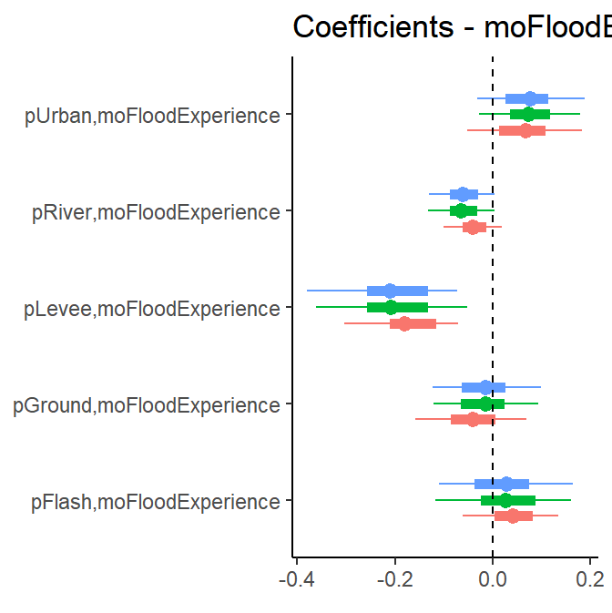
Results
Coefficients
Coefficients - moFloodExperience
The variable indicates whether the household had experienced a previous flood before the surveyed flooding event.
By levee breaches and river floods the effect is negative, meaning that previous experience led to a lower loss ratio.
By groundwater floods, flash floods and urban floods the effect is close to zero, indicating that previous experience had no effect.

Slide 26
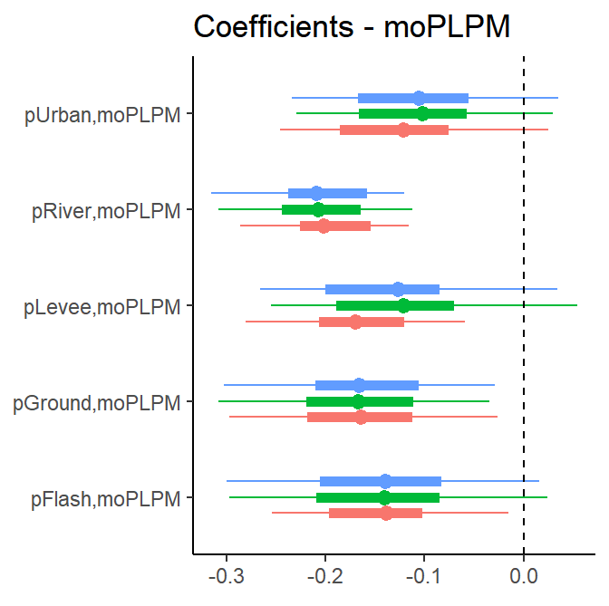
Results
Coefficients
The Private-Level Precautionary Measures is a score of permanent precautionary measures implemented before the flooding event.
Despite some estimates crossing zero, the effect signal is negative, meaning those measures could reduce the loss ratio.
Despite a large overlap across flood pathways, the estimate is slightly stronger by river floods, meaning the measures were in general more effective in reducing loss ratio to those cases.
Back to > summary

Slide 27
Discussion
In a few cases the multi-membership model variants led to non-credible parameter estimates (includes zero). In other cases, the opposite was observed.
Using Leave-One-Out Cross Validation, which gives an estimate of the predictive accuracy for unobserved data, there are no significant gains (difference in elpd < standard error of the difference) by using a multi-pathway model.
Indicators of performance (root means square error of the central estimates) and the R² coefficient of determination adapted for Bayesian models (Bayes R²) also show little difference across the three model variants
 | elpd difference | std error of elpd_diff | Training data (2010-2016) |  | Test data (2002-2006)
 |  |  | RMSE | Bayes R² | RMSE | Bayes R²
Base model (single pathway) | 0 (reference) | 0 | 0.105 | 0.311 | 0.114 | 0.355
Multi-pathway (equal weights) | -4.6 | 5.4 | 0.105 | 0.314 | 0.114 | 0.302
Multi-pathway (prior- weights) | -3.4 | 5.0 | 0.105 | 0.315 | 0.114 | 0.309

Slide 28
Discussion
There is little or no gain from the use of a multi-pathway model.
The result suggests that there are no credible differences across flood pathways.
Or our procedure for the pre-determination of weights is not representative.
If an adjustment of the weights could improve modelling,
how to improve the weights estimation?
We would like to discuss this with you!

Slide 29
Discussion
The precision parameter phi 𝜑 of the reparametrized Beta (see slide 8), is currently uninformed.
It is possible that a more informed modelling of this parameter could increase model performance greatly. [ongoing work]
As water depth is the most important controlling variable, larger water depths should mean larger uncertainty in loss estimates
is 𝜑 ~ f(WaterDepth) reasonable?
We would like to discuss this with you!
Back to > summary

Slide 30
References
Bürkner, P.-C. (2018): Advanced Bayesian Multilevel Modeling with the R Package brms, The R Journal, 10, 395–411.
Mohor, G.S., P. Hudson, A.H. Thieken (2020): A comparison of factors driving flood losses in households affected by different flood types. Water Resources Research 54(6), p. 1-20, doi:10.1029/2019WR025943
Mohor, G.S., A.H. Thieken , O. Korup (accepted to NHESS): Bayesian multilevel modelling to improve the transferability of residential flood losses model.
Surminski, S., & Thieken, A. H. (2017). Promoting flood risk reduction: The role of insurance in Germany and England. Earth's Future, 5, 979–1001. doi:10.1002/2017EF000587
Zscheischler, J., O. Martius, S. Westra, et al. (2020): A typology of compound weather and climate events, Nature Reviews Earth & Environment, 1, 333–347, doi:10.1038/s43017-020-0060-z

Slide 31
I look forward to the live chat and comments
M. Sc. Guilherme S. Mohor,
samprognamoh@uni-potsdam.de
Prof. Dr. Oliver Korup, Prof. Dr. Annegret Thieken
@NatRiskChange

