Slide 1

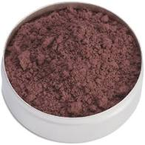
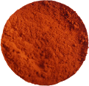
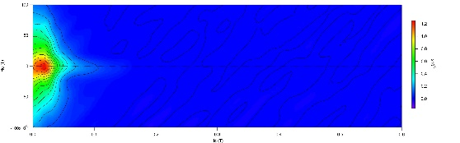
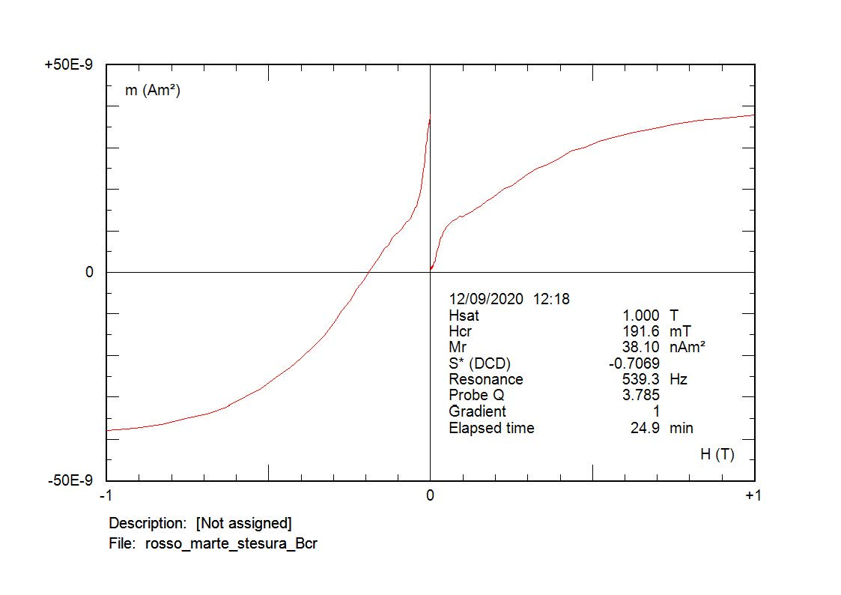
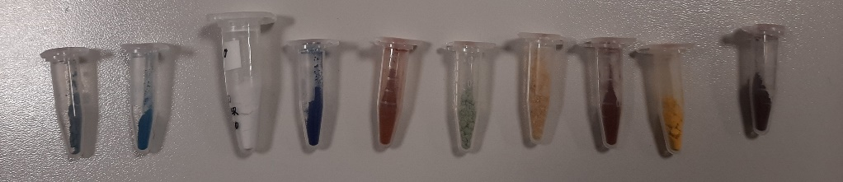
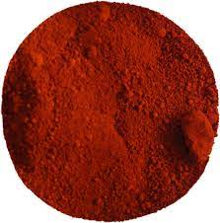
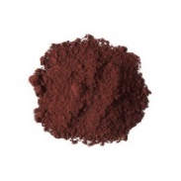
The magnetic properties of natural pigments: preliminary analyses for their identification in Fine Arts: "the red pigments dilemma"
Chiara Anselmi¹, Antonio Sgamellotti^{2, 3}, Manuela Vagnini⁴, Aldo Winkler⁵
¹ CNR-IRET, Research Institute on Terrestrial Ecosystems, Porano (TR), Italia; ² Università degli Studi di Perugia, Italia; ³ Accademia Nazionale dei Lincei, Roma, Italia; ⁴ Laboratorio di Diagnostica per i Beni Culturali, Spoleto (PG), Italia; ⁵ Istituto Nazionale di Geofisica e Vulcanologia, Roma, Italia
1800
K (e-6)
700
K (e-6)
Caput Mortuum
1200
1600
K (e-6)
Red Ochre
600
1400
1000
1200
500
1000
400
800
«Hematite»
1/Kt
800
300
600
1/Kt
600
200
400
400
200
T (°C)
100
T (°C)
0
200
0
T
T
[°C]
0
0
[°C]
T
(°C)
600
600
700
0
100
200
300
400
500
600
700
800
0
100
200
300
400
500
600
700
800
700
0
Ferrimagnetic properties. Accurate Néel (Curie?) temperature. It could be maghemite, but the cooling and heating curves are similar (except for the «bump»).
Hematite + maghemite, weak antiferromagnetism (high saturation), cooling below heating (maghemite to hematite)
0
100
200
300
400
500
600
700
800
Wide susceptibility decrease spectrum: hematite nanoparticles? Cooling curve well below the heating: maghemite inversion to hematite. Morin's transition is barely visible. Weakly antiferromagnetic hysteresis properties.
Red Earth
Mars Red
Pigments have discriminable magnetic properties.
Open questions: Role of the grain size, oxidised magnetite (magnetite core with maghemite outer shell), Fe-Al substitution; differences between powders and draftings, commercial and hystorical pigments (green earth).
See the full presentation for yellow, green and blue pigments
Antiferromagnetism; hematite+goethite.
Hematite + new magnetite on heating. Morin transition
Notes:
The red pigments dilemma: This work is included in the framework of a series of activities about the rock magnetism methods applied to Fine Arts and cultural Heritage. I started measuring the magnetic properties of recent commercial pigments for fine arts, to compare them with similar colours from the eighteenth and nineteenth centuries. Some experiments on archeological pigments were made too. All the pigments showed distinctive and peculiar magnetic properties, controversial and difficult to be understood, especially in the case of red pigments, consisting in a complex mix of oxidised magnetite, hematite and maghemite at various grainsizes. Also green, blue and yellow pigments were interestingly characterized for their magnetic properties.
The idea is to go on with tests on different brands of recent pigments and sources for the ancient ones, with a multidisciplinary approach where the magnetic properties can be complementary to XRF and chemical analyses for their discrimination, restoration and identification in fine arts. This study is coupled to another research about the influence of particulate matter on hystorical buildings, as deduced with magnetic biomonitoring methods.

Slide 2
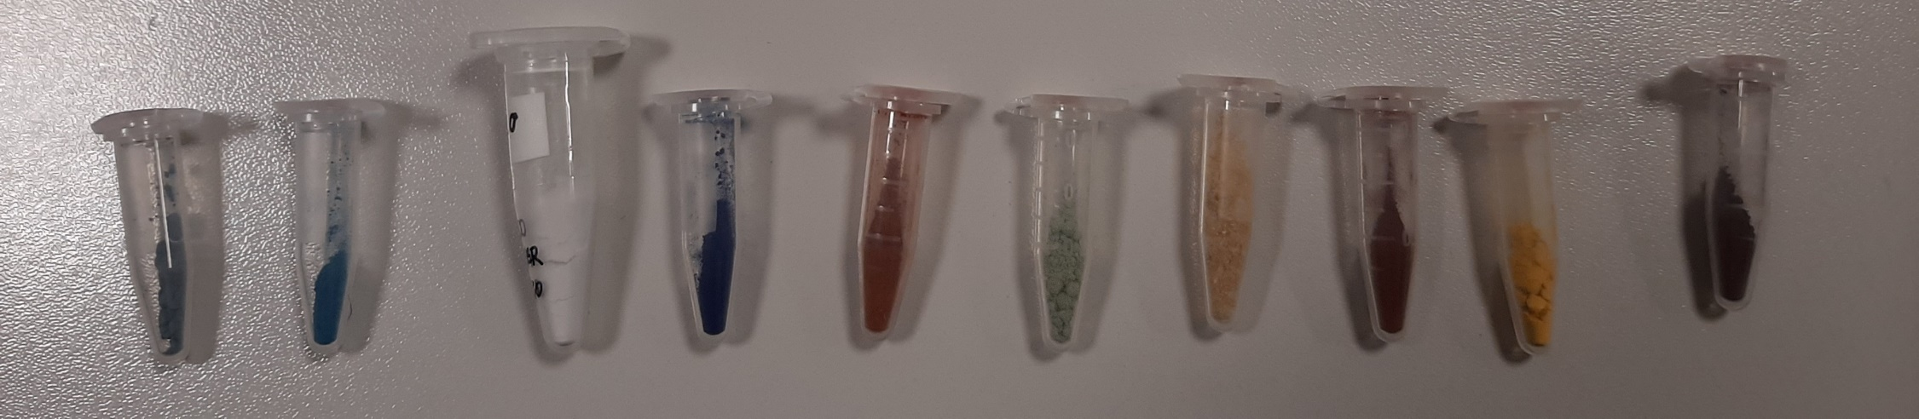
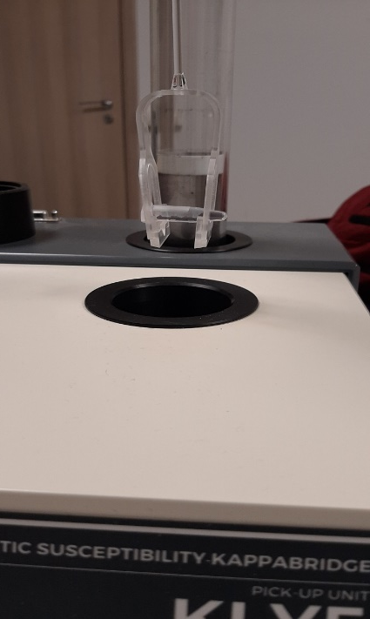
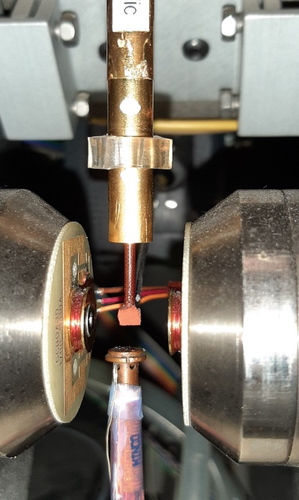
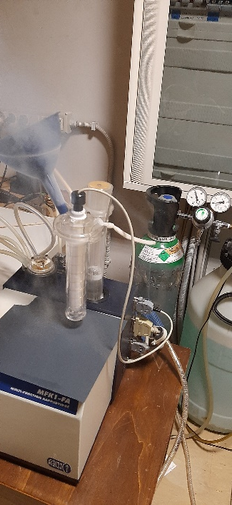
The magnetic properties of natural pigments: preliminary analyses for their identification in Fine Arts: "the red pigments dilemma"
Chiara Anselmi¹, Antonio Sgamellotti^{2, 3}, Manuela Vagnini⁴, Aldo Winkler⁵
¹ CNR-IRET, Research Institute on Terrestrial Ecosystems, Porano (TR), Italia; ² Università degli Studi di Perugia, Italia; ³ Accademia Nazionale dei Lincei, Roma, Italia; ⁴ Laboratorio di Diagnostica per i Beni Culturali, Spoleto (PG), Italia; ⁵ Istituto Nazionale di Geofisica e Vulcanologia, Roma, Italia
Mass magnetic susceptibility
AGM hysteresis properties
Low and high temperature variations of magnetic susceptibility

Slide 3
Magnetic susceptibility of the pigments

Slide 4

The red pigments dilemma:
Hematite, Red Ochre , Red Earth , Mars Red, Caput Mortuum

Slide 5

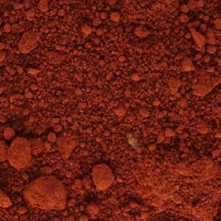
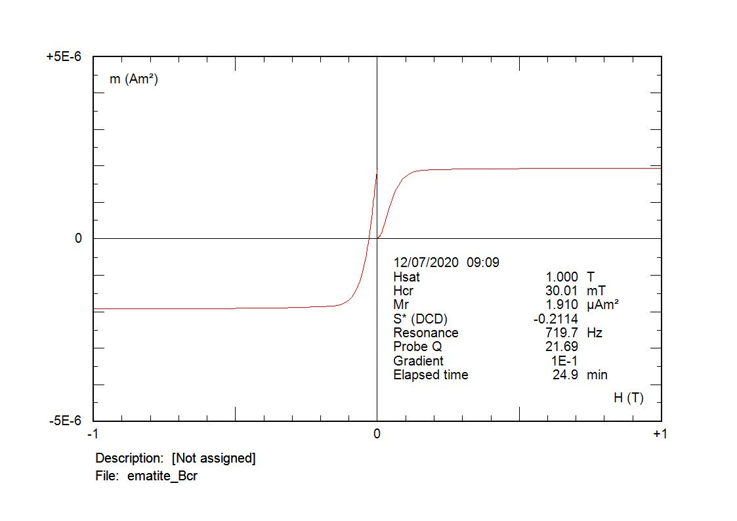
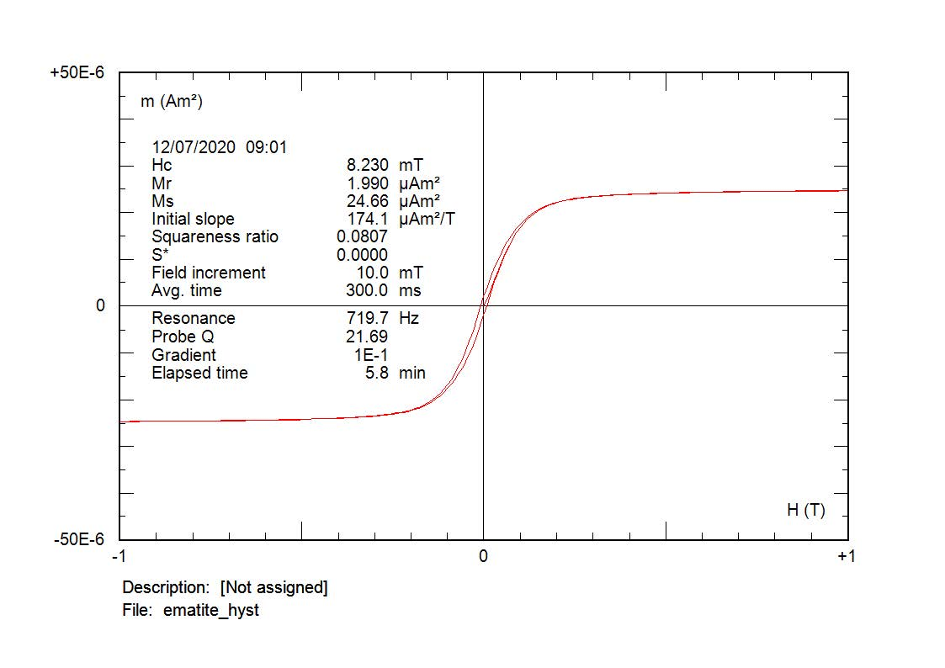
5 – «Hematite»
α−Fe₂O₃; antiferromagnetic, susceptibility 0.10-7.60 · 10⁻⁶ m³/kg
1800
Sample: 135 ·10⁻⁶ m³/kg
Too much high for hematite...
Kt
[E-6]
1600
1400
1200
1000
1/Kt
1/Kt
800
600
T
T
[°C]
0
[°C]
0
400
200
T
[°C]
600
600
700
0
700
0
100
200
300
400
500
600
700
800
412
Kt
410
[E-6]
408
406
404
402
400
398
396
T
[°C]
394
-200
-180
-160
-140
-120
-100
-80
-60
-40
-20
0
20

Slide 6
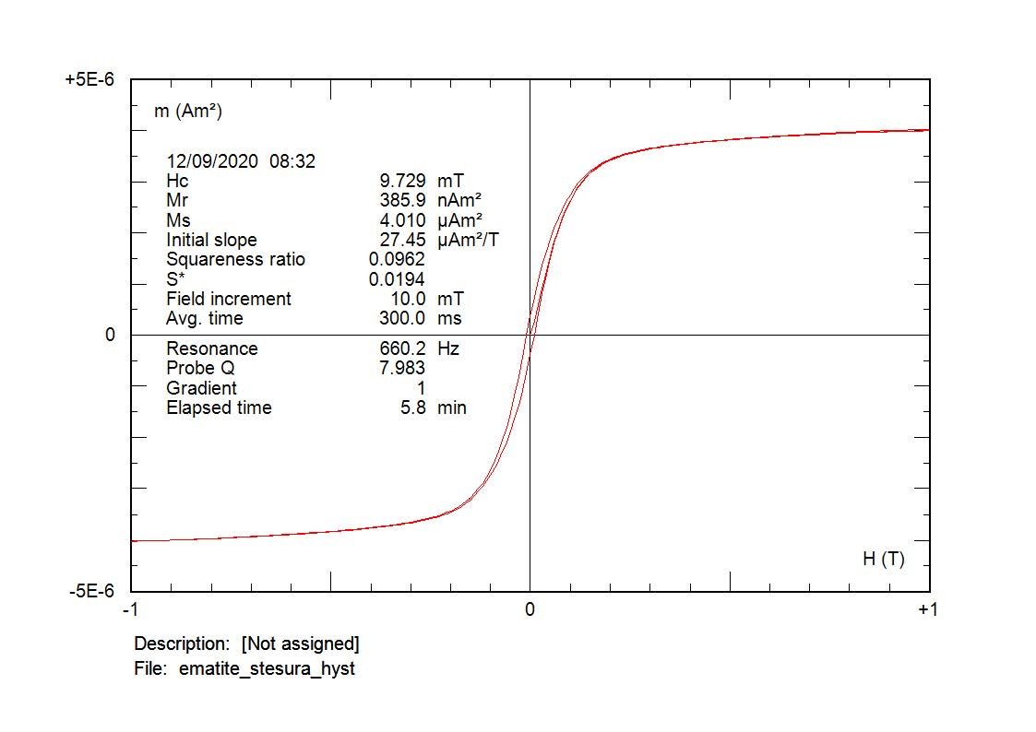
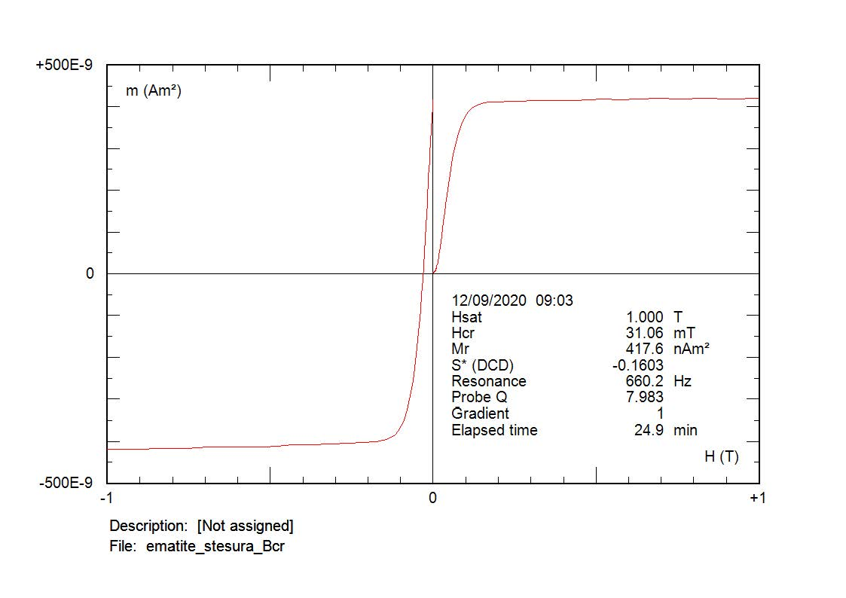
«Hematite» drafting
Mostly ferrimagnetic behaviour, probably ascribable to maghemite. The Neél temperature is very precise, probably due to maghemite inversion during heating. The cooling curve is comparable to the heating, this is strange... The bump in the heating curve is typical for maghemite. Very weak unsuturated feateres are present in the drafting; different pigments or steadiness of the sample?

Slide 7
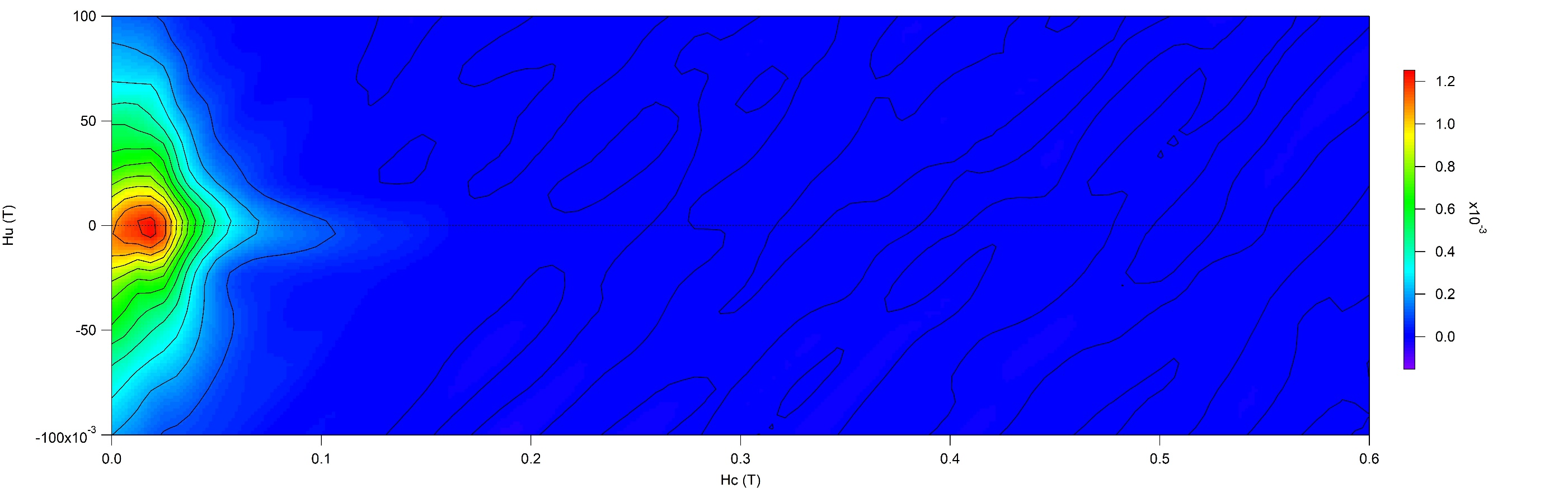
«Hematite» FORC
Ferrimagnetic PSD FORC features, grainsize 1 to 20 μm for maghemite

Slide 8
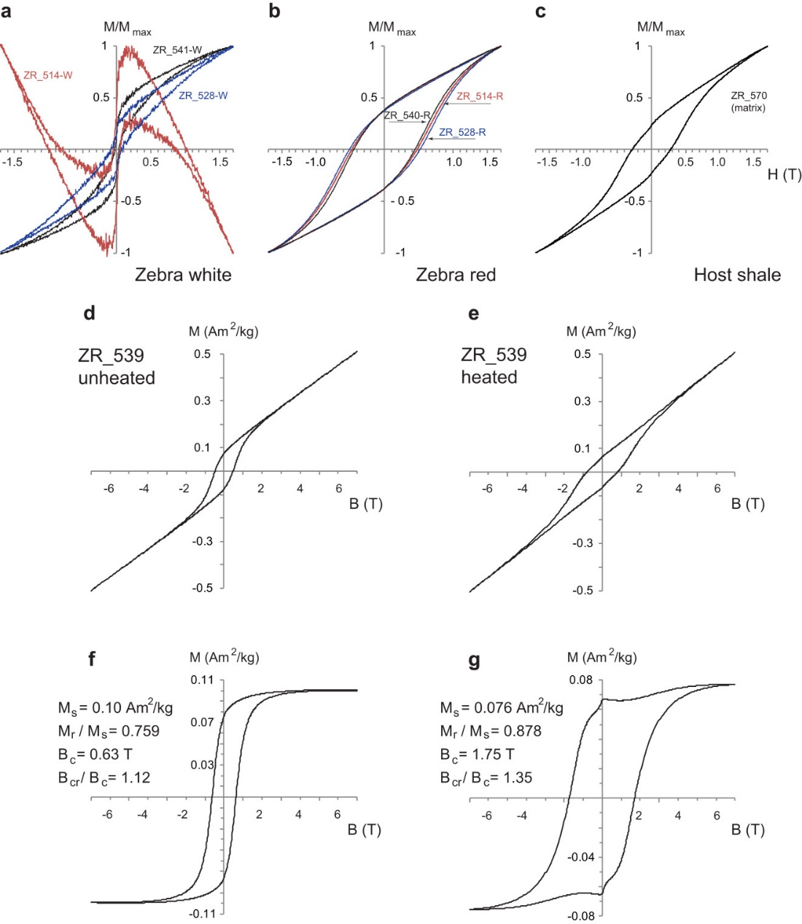
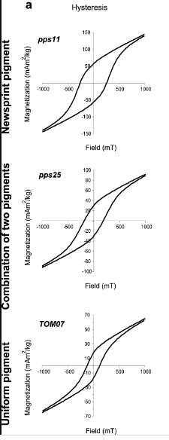
Pigmentary Hematite: examples in literature
Magnetic Properties and Paleomagnetism of Zebra Rock, Western Australia: Chemical Remanence Acquisition in Hematite Pigment and Ediacaran Geomagnetic Field Behavior
Abrajevitch et al., 2018 https://doi.org/10.1002/2017GC007091
Haematite pigmentation events and palaeomagnetic recording: implications from the Pilbara Print Stone, Western Australia
Abrajevitch et al., 2014, https://doi.org/10.1093/gji/ggu293

Slide 9
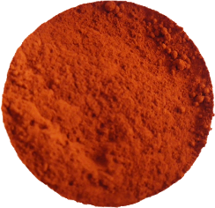
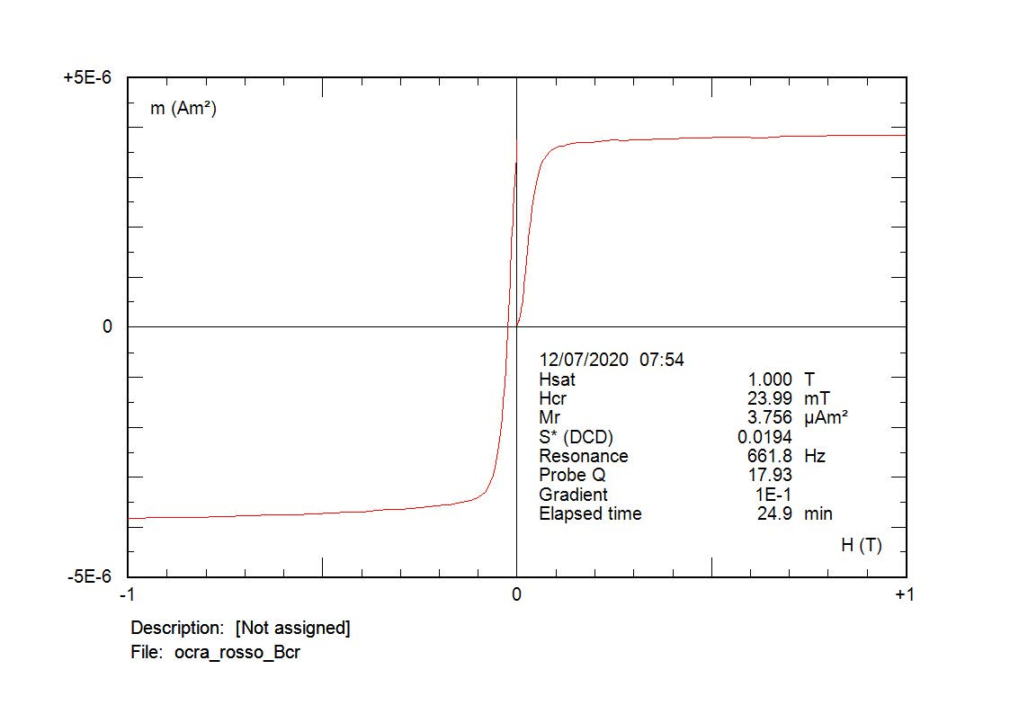
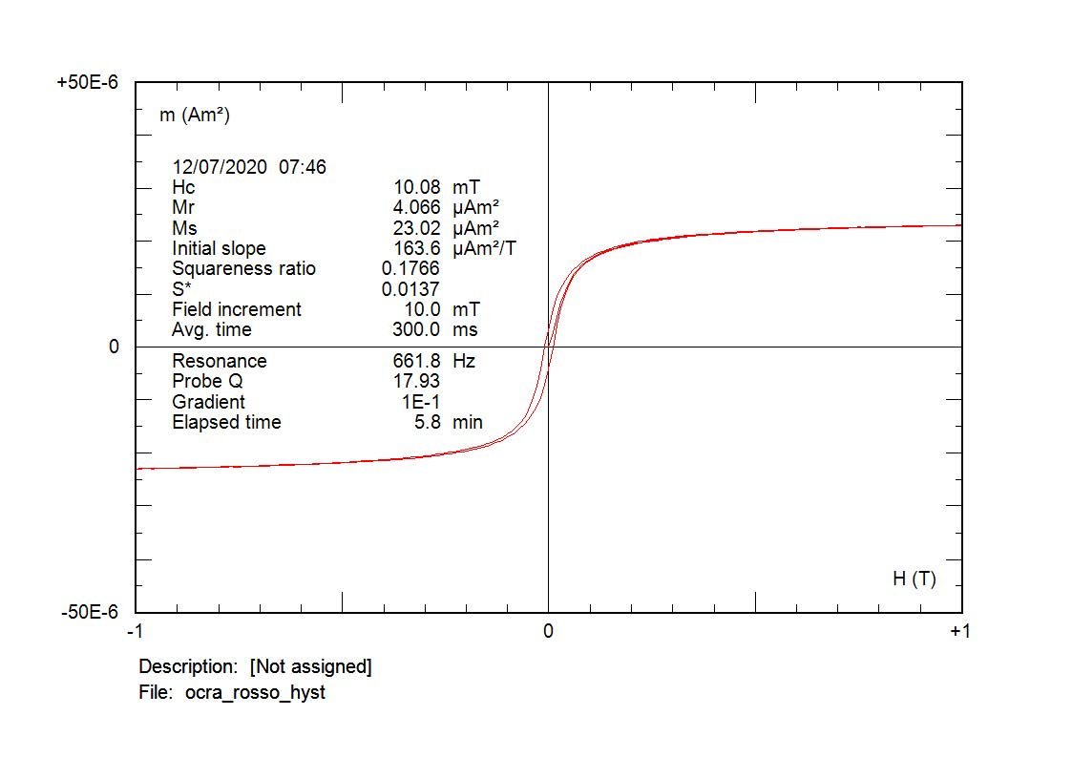
8 – Red Ochre Fe₂O₃ (ferric oxide); maghemite susceptibility (400-600 ·10⁻⁶ m³/kg)
1200
Kt
[E-6]
1000
800
600
1/Kt
1/Kt
400
200
0
0
T
T
[°C]
[°C]
T
[°C]
600
600
700
700
0
0
100
200
300
400
500
600
700
800
150
Kt
140
[E-6]
130
120
110
100
90
Sample: 91.7·10⁻⁶ m³/kg; too low for maghemite, coexistence of maghemite and hematite
80
T
[°C]
70
-200
-180
-160
-140
-120
-100
-80
-60
-40
-20
0
20

Slide 10
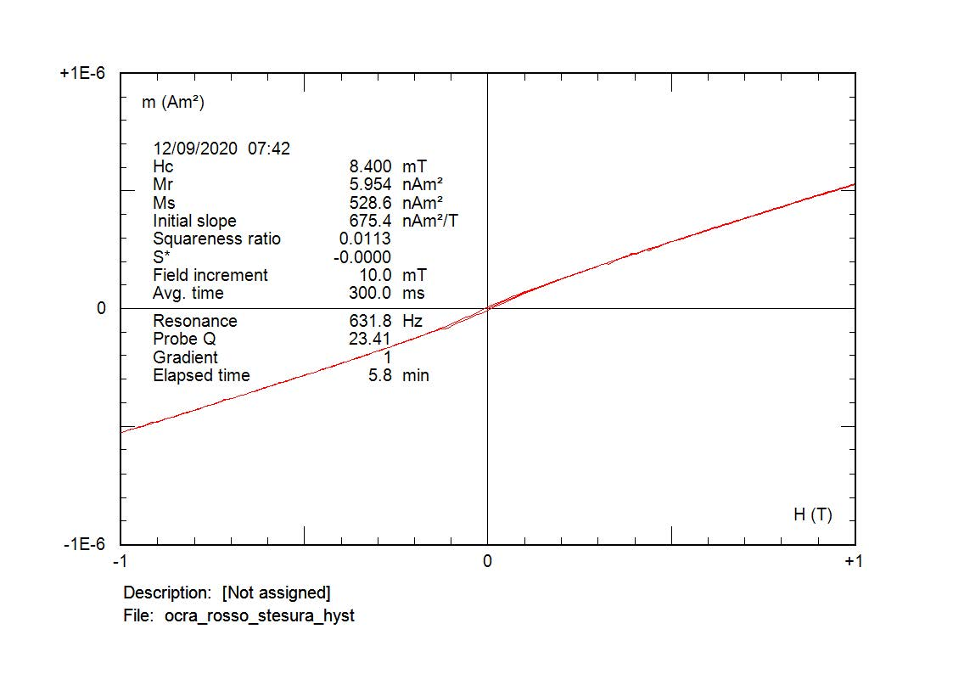
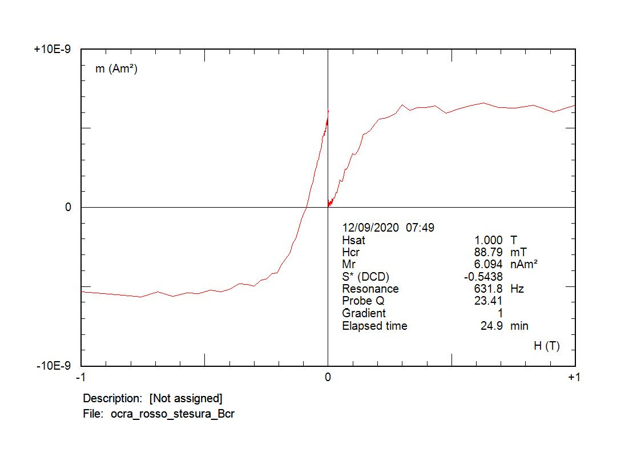
Red Ochre drafting
The unblocking spectrum between 475 and 675 ° C suggests that hematite nanoparticles dominate the sample, without the drastic drop around the Neél temperature that would be expected for well-formed hematite crystals. The cooling curve is well below the heating as typical for maghemite inversion to hematite. The Morin's transition is barely visible as a change of slope. Weak antiferromagnetic hysteresis properties are present.

Slide 11

Red Earth Fe₂O₃ (hematite)
Morin transition

Slide 12
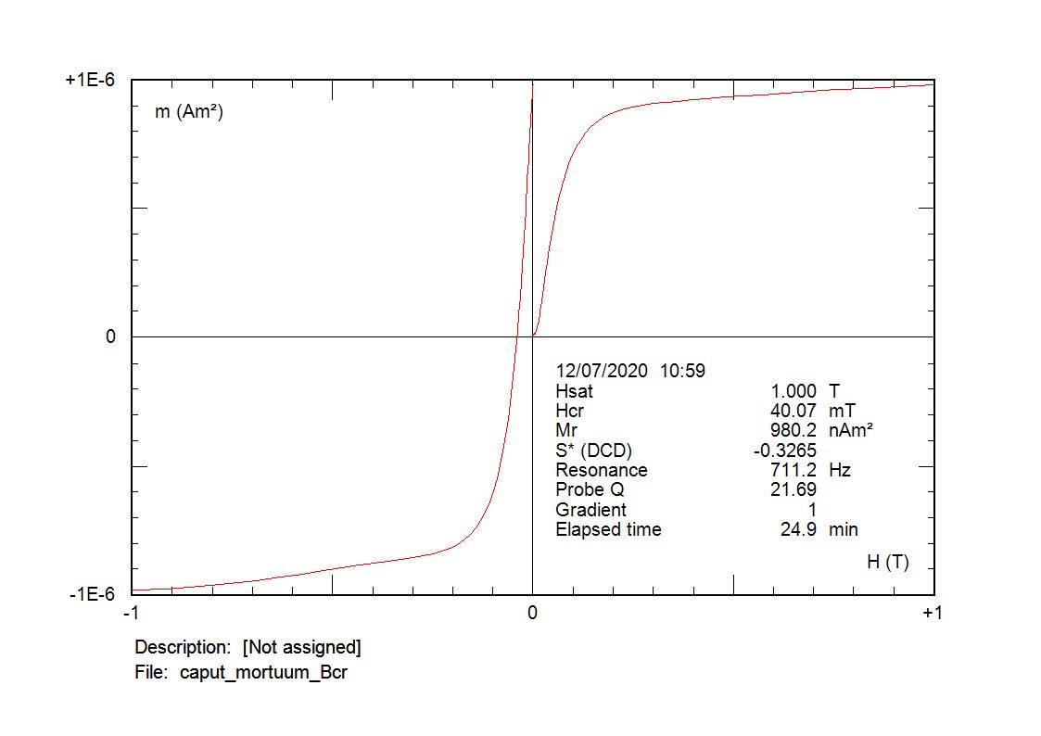
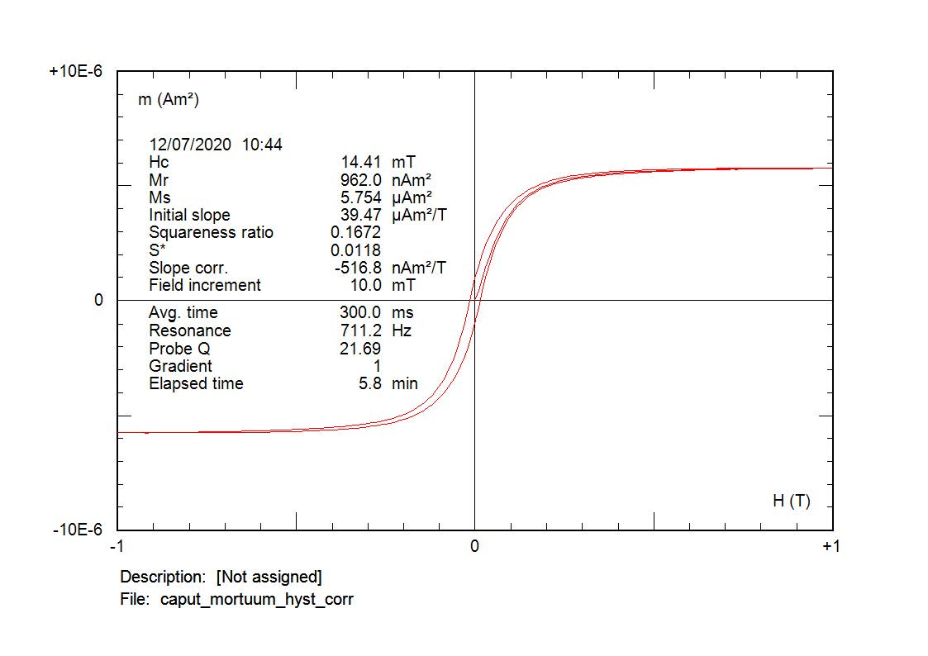
10 – Caput Mortuum; Fe₂(SO₄)₃
Campione: 53.1 ·10⁻⁶ m³/kg
700
Kt
600
[E-6]
500
400
300
200
100
T
[°C]
0
0
100
200
300
400
500
600
700
800
Oxidised magnetite/maghemite + hematite

Slide 13
Maghemite which is intergrown with hematite, mainly inverts to hematite after heating at about 650 °C, well above its Curie temperature of 610 °C. Al-substitution presumably stabilizes the maghemite structure (γ-Fe_{2-x}Al_{x}O₃). The transformation degree is shown to be grain-size dependent and thus kinetically related. In thermomagnetic runs, the three smallest grain-size fractions show an additional inflection point at 350°C, a value commonly reported in the literature for inversion of submicron maghemite

Slide 14
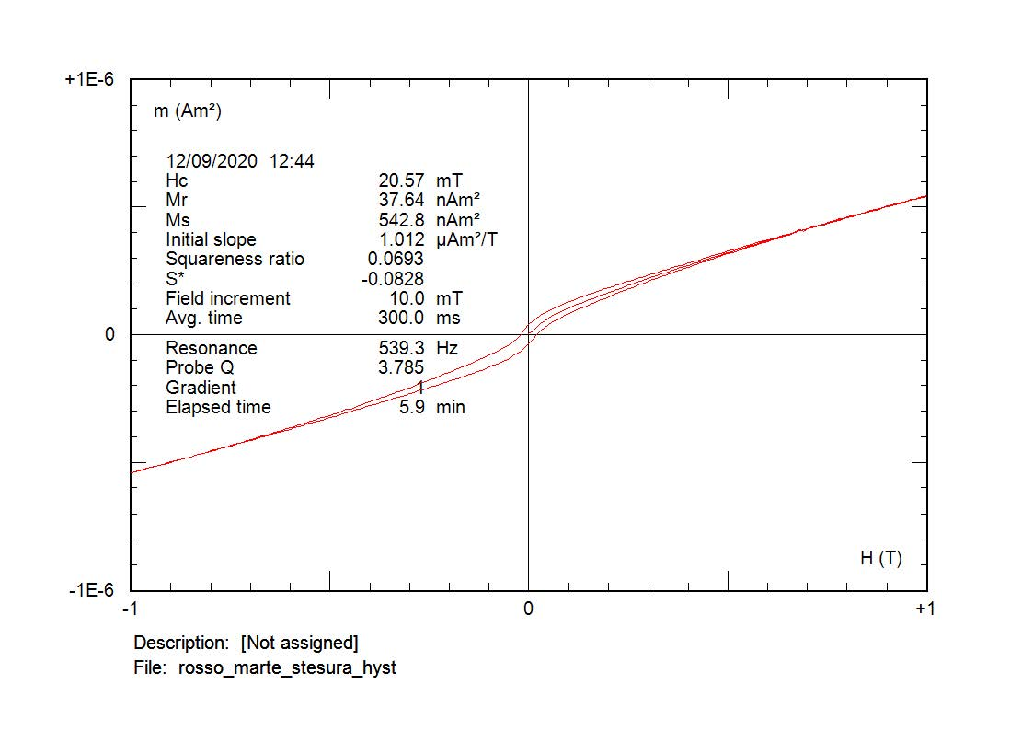
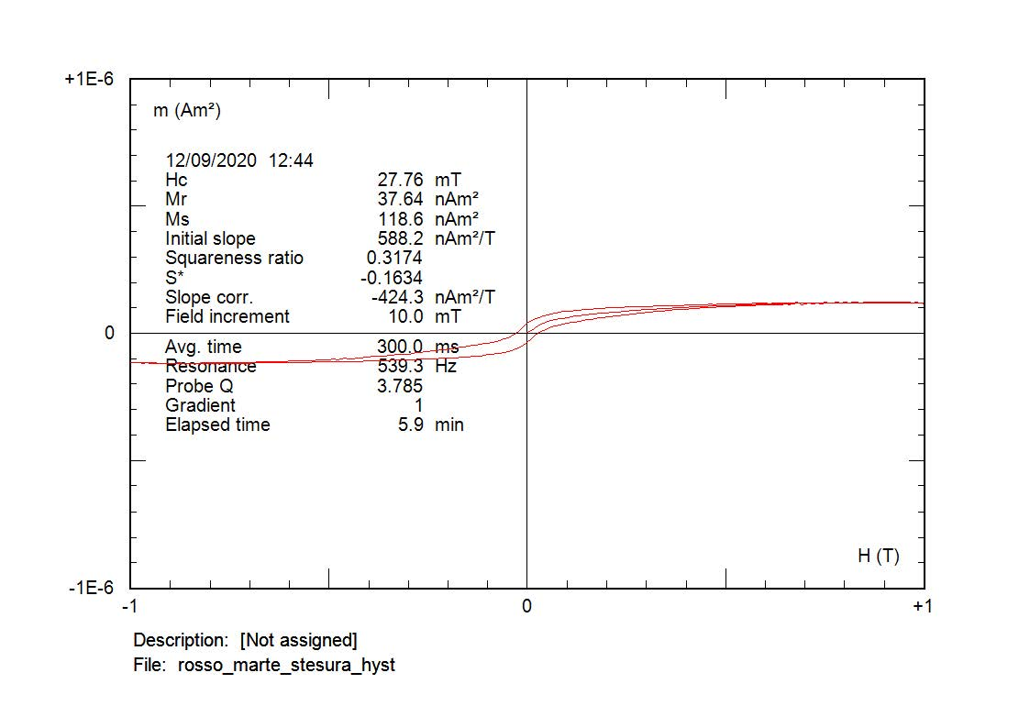
Mars Red Drafting (Rosso Marte Stesura) FeO₃ * nH₂O + Al₂O₃
2
Kt
[E-6]
1
0
-1
T
[°C]
-2
0
100
200
300
400
500
600
700
800
Goethite + hematite?

Slide 15
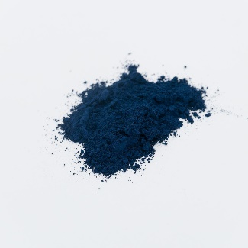
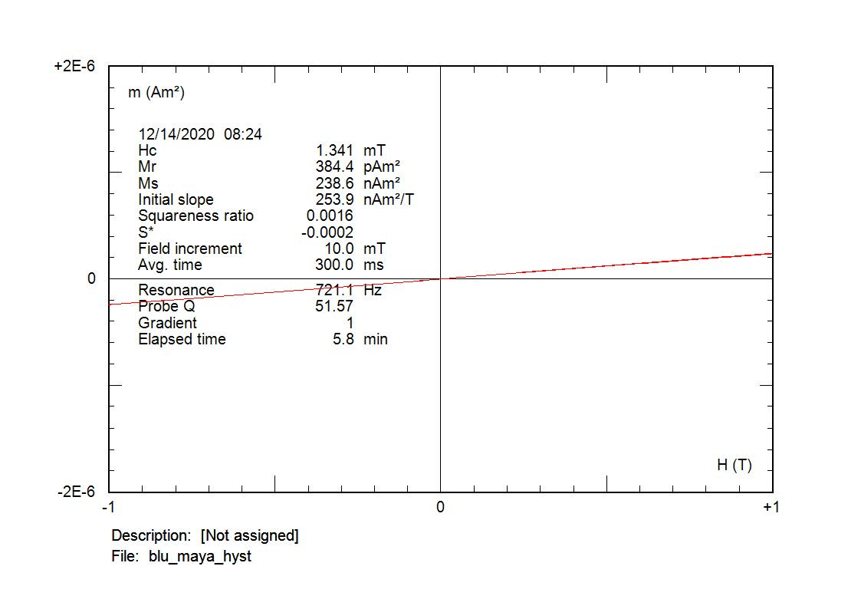
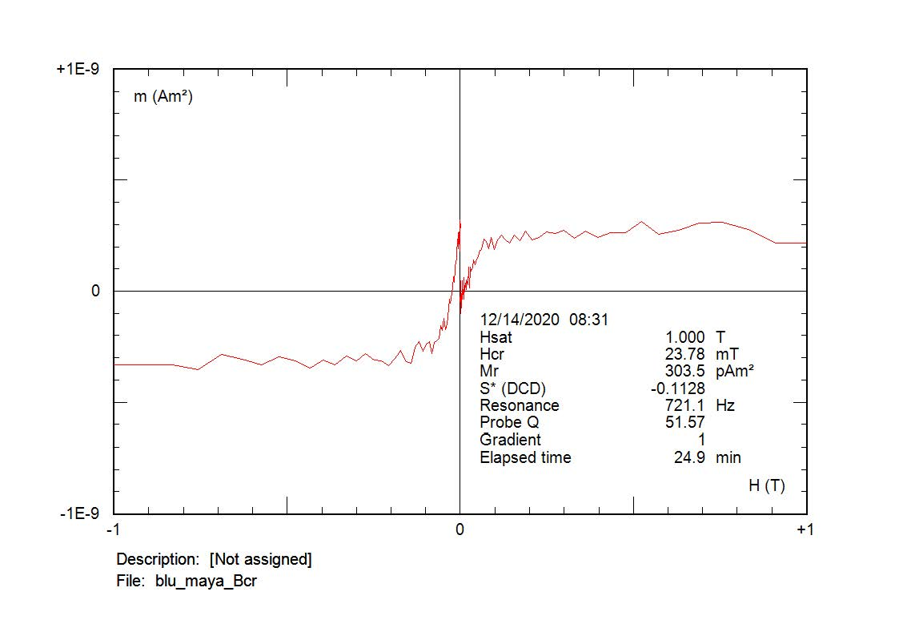
2 – Blue Maya: Vegetal indigo with clay
Sample: 0.05·10⁻⁶ m³/kg
3
Kt
[E-6]
2
1
0
-1
T
[°C]
-2
0
100
200
300
400
500
600
700
800
Very weak susceptibility and hysteresis properties

Slide 16
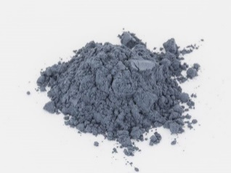

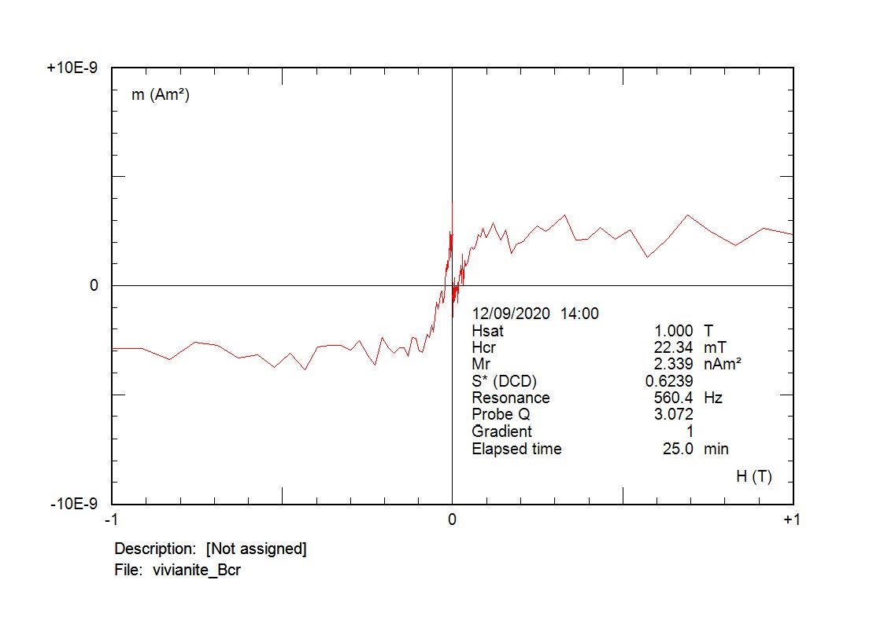
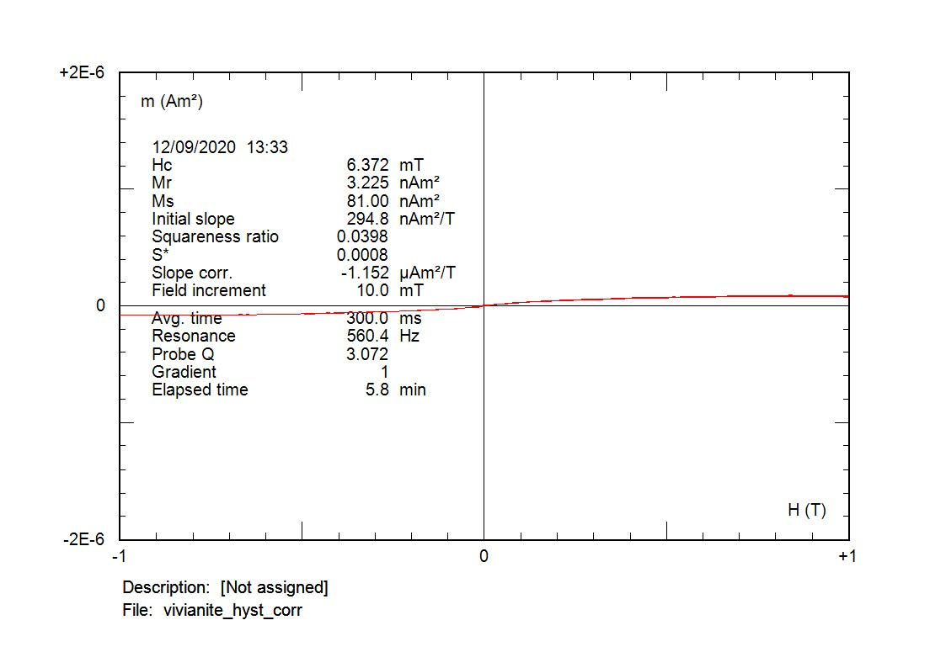
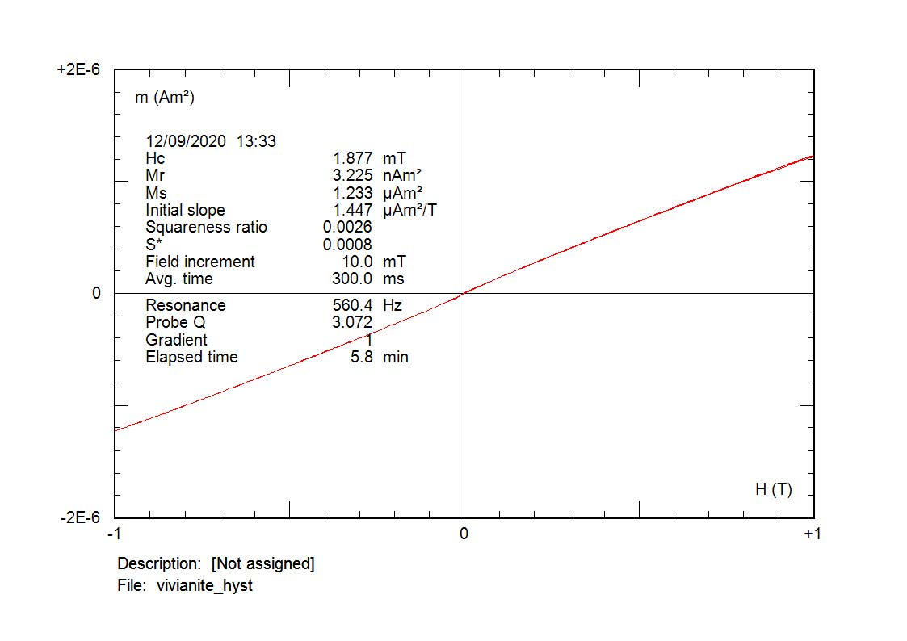
1 –Vivianite
Fe₃(PO₄)₂·8(H₂O); paramagnetic, susceptibility between 0.8 e 1.7·10⁻⁶ m³/kg
Sample: 0.79·10⁻⁶ m³/kg
12
Kt
[E-6]
10
8
6
4
2
T
[°C]
0
0
100
200
300
400
500
600
700
800
Paramagnetism, susceptibility decrease with temperature until the formation of new iron oxides (magnetite and hematite).
Weak ferrimagnetic hysteresis properties.

Slide 17
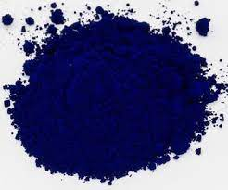
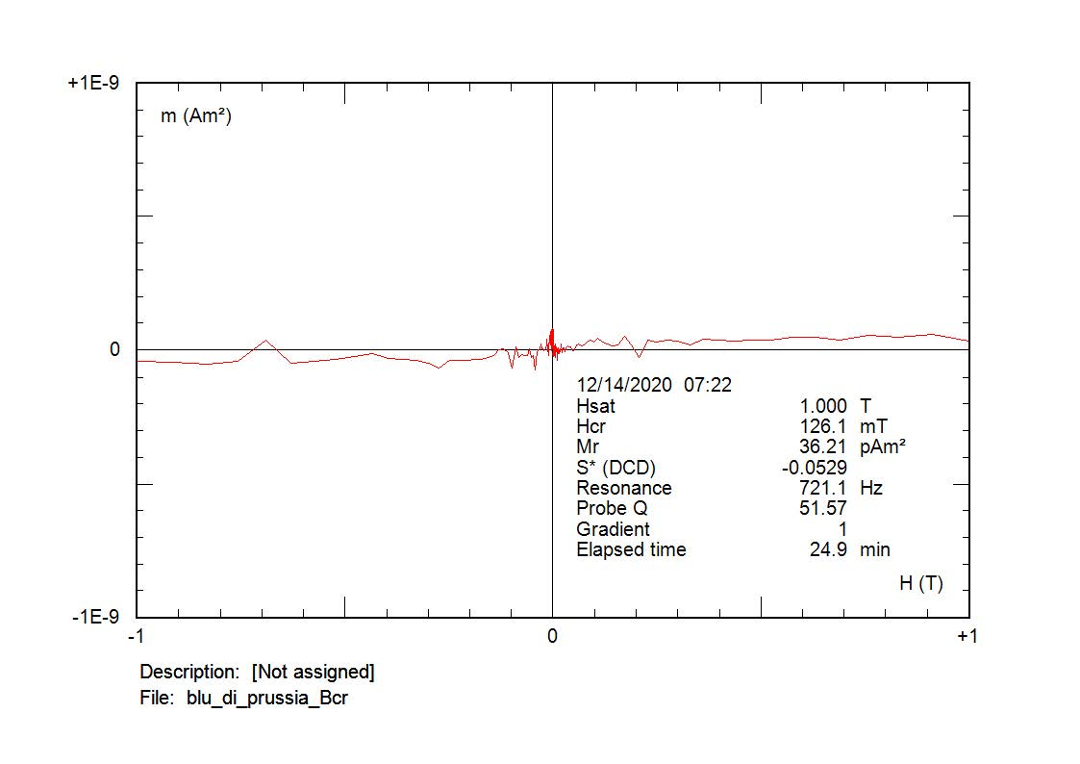
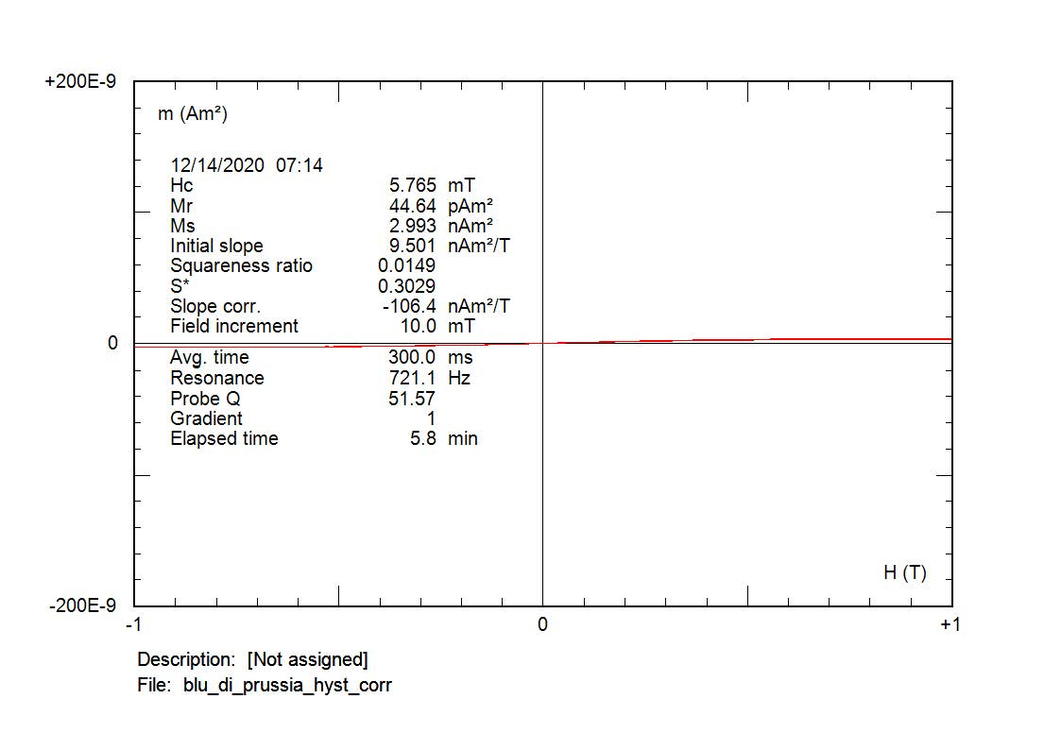
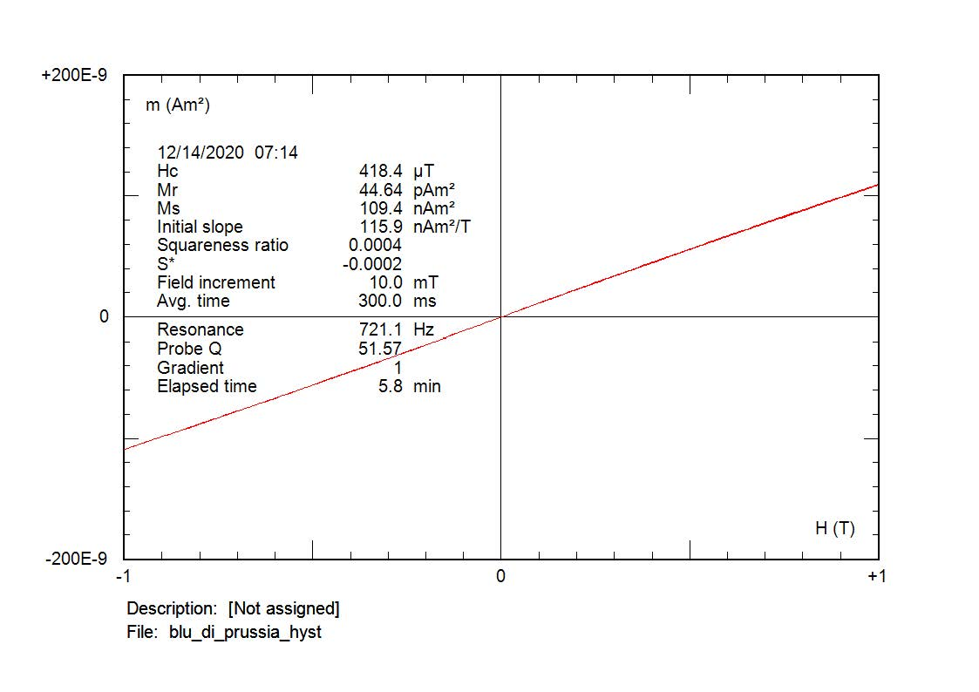
4 –Prussian Blue Fe₄[Fe(CN)₆]₃
Sample: 0.54·10⁻⁶ m³/kg
100
90
Kt
[E-6]
80
70
60
50
40
30
20
10
T
[°C]
0
-10
0
100
200
300
400
500
600
700
800
Weak magnetic susceptibility and very weak hysteresis properties, relevant formation of magnetic minerals during heating, susceptibility increases during cooling at T<520 °C

Slide 18
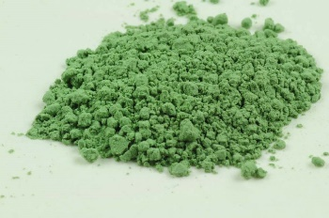
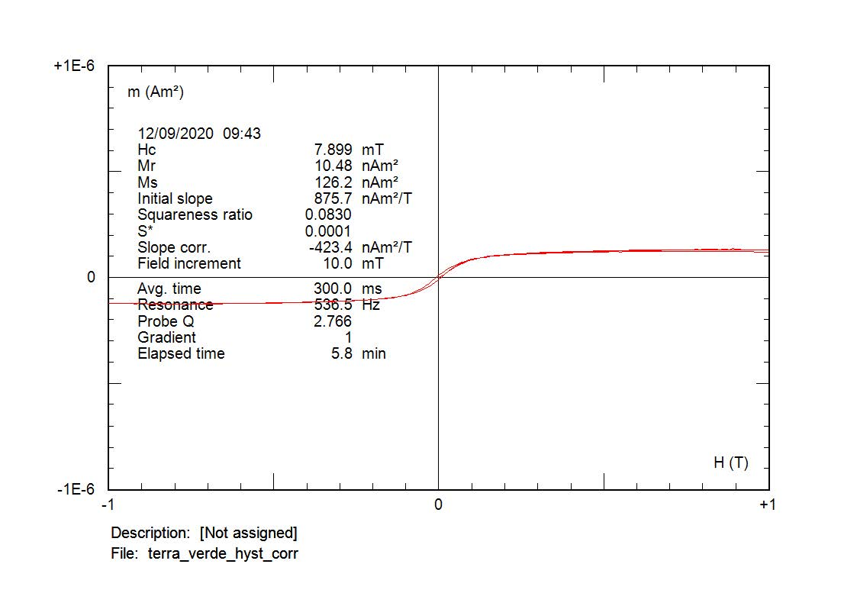
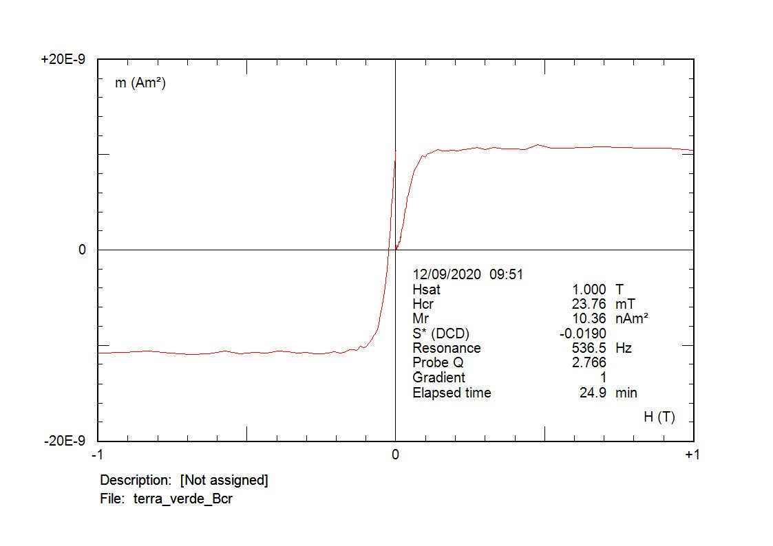
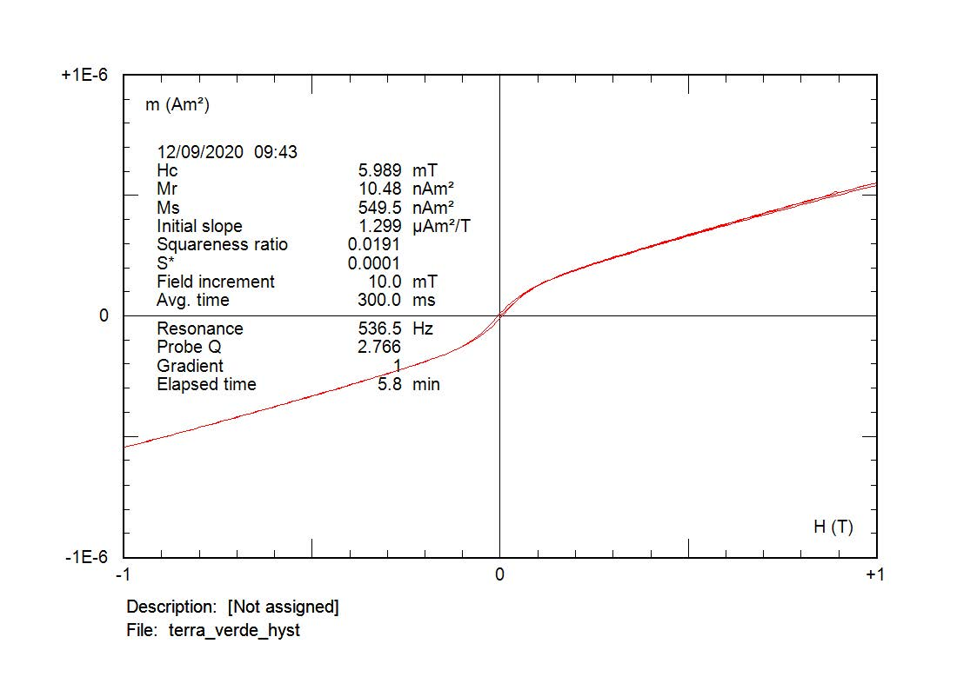
6 –Green Earth (commercial): Fe and Mg aluminosilicates; K[(Al,Fe^{III}),(Fe^{II},Mg](AlSi₃,Si₄)O₁₀(OH)₂
Sample: 5.07 ·10⁻⁶ m³/kg
70
Kt
60
[E-6]
50
40
30
20
10
0
T
[°C]
-10
0
100
200
300
400
500
600
700
800
Coexistence of low coercivity magnetic minerals (magnetite with iron sulfides or maghemite)

Slide 19
Green Earth (historical): Fe and Mg aluminosilicates; K[(Al,Fe^{III}),(Fe^{II},Mg](AlSi₃,Si₄)O₁₀(OH)₂
Sample: 0.93 ·10⁻⁶ m³/kg
The two peaks are shifted towards lower temperatures, with respect to modern sample
Paramagnetic hyperbola

Slide 20
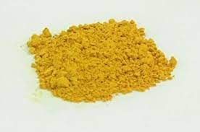
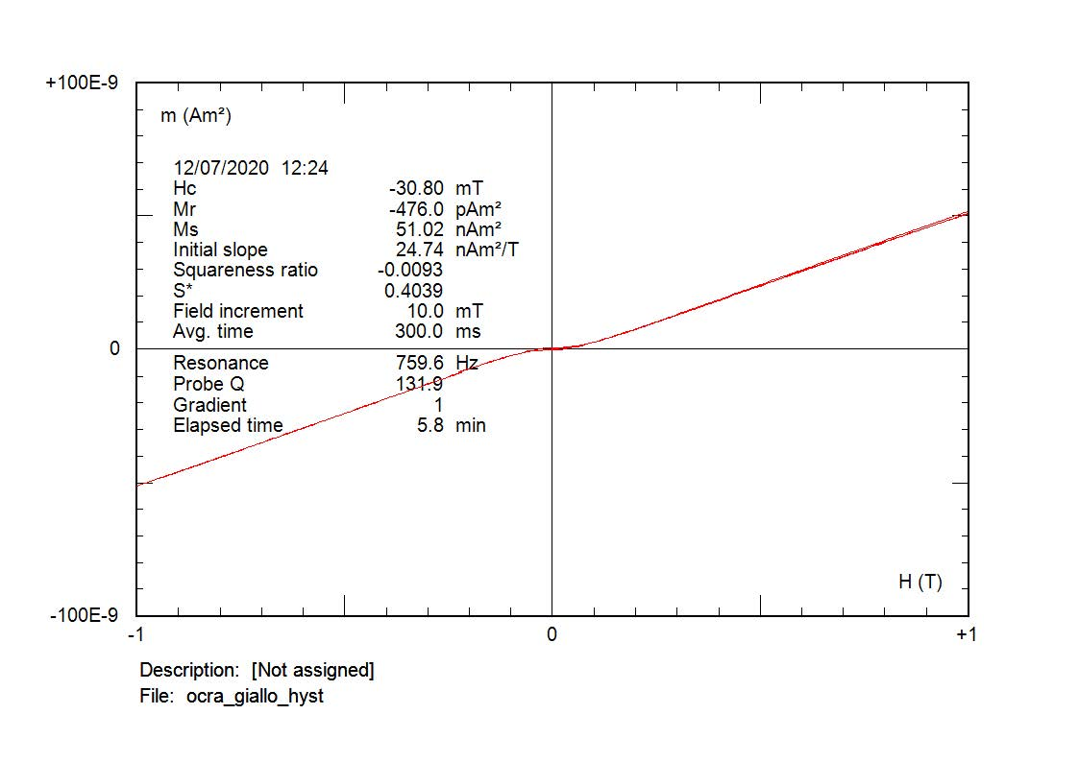
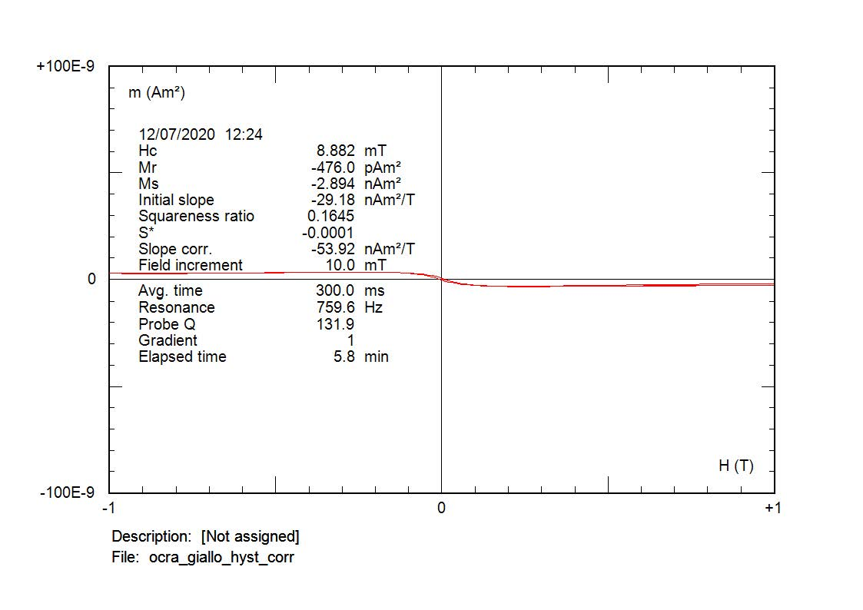
9 – Yellow Ochre
Limonite (2Fe₂O₃·3H₂O, susceptibility 0.7·10⁻⁶ m³/kg ); iron hydroxides (FeOOH), goethite (αFeOOH)
Sample: 0.07·10⁻⁶ m³/kg
3
Kt
[E-6]
2
1
0
-1
T
[°C]
-2
0
100
200
300
400
500
600
700
800

Slide 21
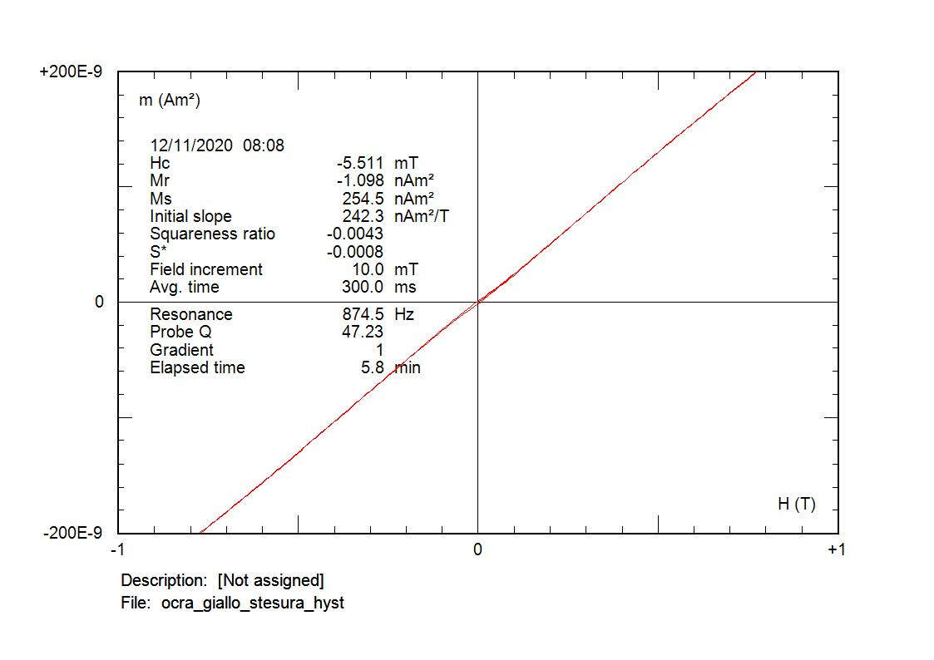
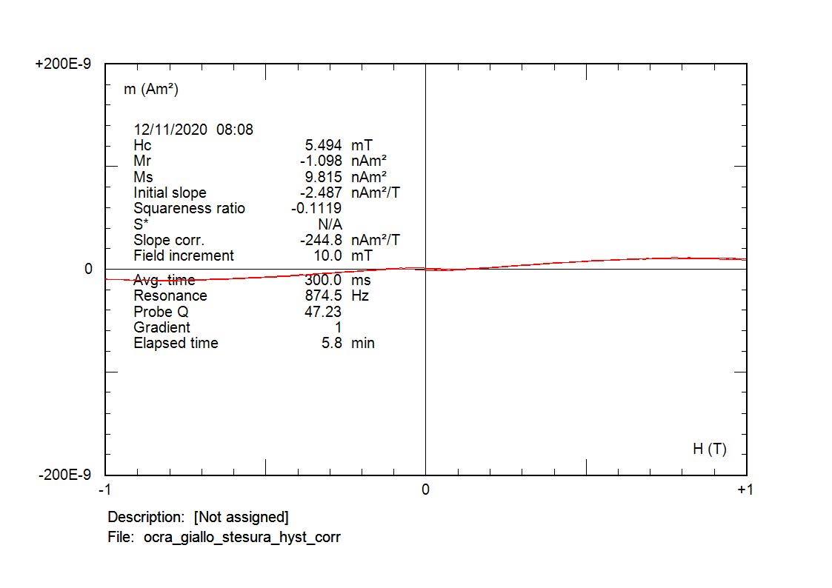
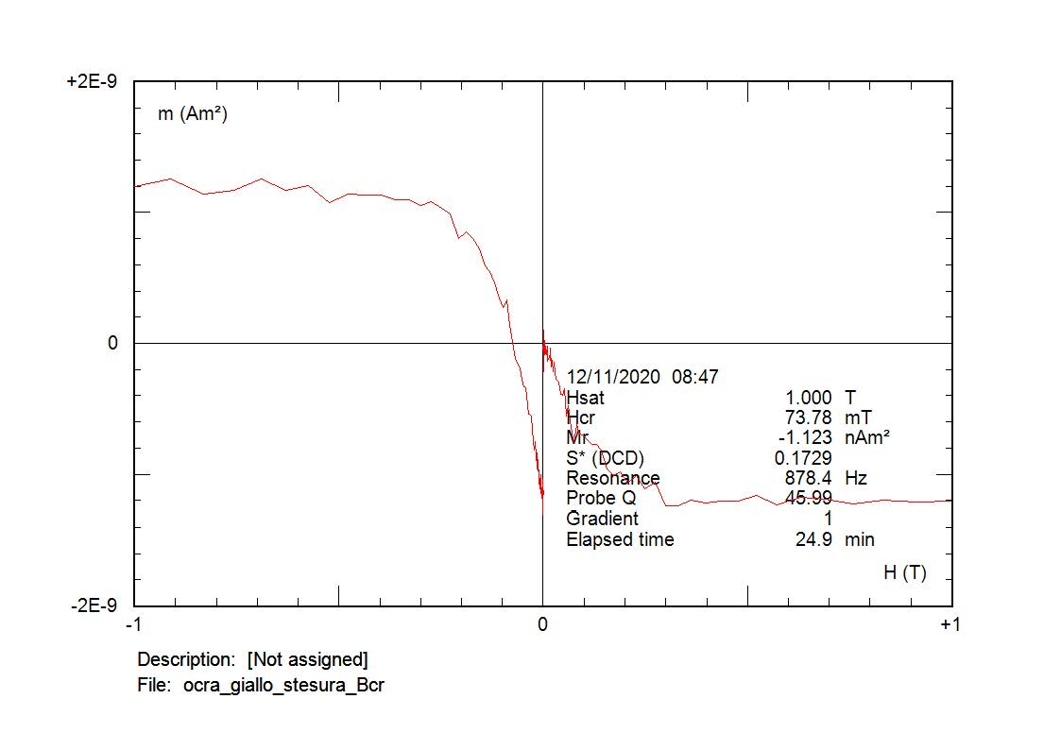
Yellow Ochre Drafting
Upside down! Higher coercivity (73 mT)

Slide 22
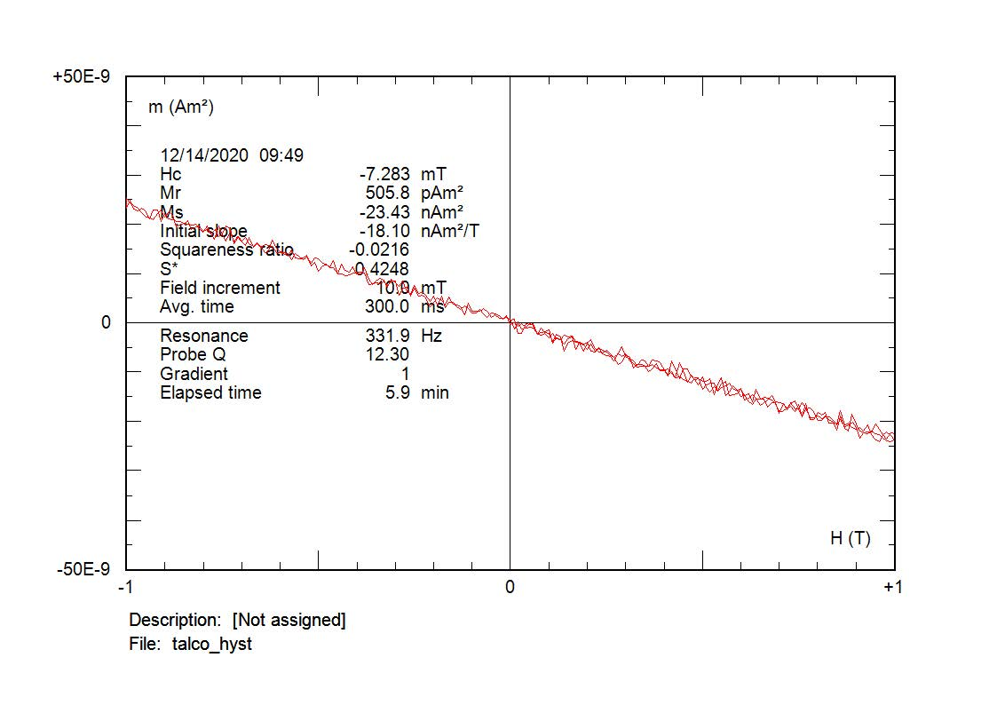




Draftings (glues)
Talcum glue
Vinavil glue
Rabbit glue

Slide 23
Thermae Traianae – susceptibility vs temperature
40
Kt
140
P07
Kt
P08
35
[E-6]
[E-6]
120
30
100
25
80
20
15
60
10
40
5
20
0
0
T
[°C]
T
[°C]
-5
-20
0
100
200
300
400
500
600
700
800
0
100
200
300
400
500
600
700
800
Prevailing titanomagnetite behaviour, the influence of lithics

Slide 24






Thermae Traianae – hysteresis properties
P07
P08
P09

Slide 25

Pigments have discriminable magnetic properties.
Hematite: Ferrimagnetic properties. Accurate Néel (Curie?) temperature. It seems maghemite, but the cooling and heating curves are similar (except for the «bump»).
Red Ochre: wide susceptibility decrease spectrum: hematite nanoparticles? The cooling curve is well below the heating: maghemite inversion to hematite. Morin's transition is barely or not visible. Weakly antiferromagnetic hysteresis properties.
Caput Mortuum: hematite + maghemite, weak antiferromagnetism (high saturation), cooling below heating (maghemite to hematite)
Red Earth: hematite + new magnetite on heating. Morin transition
Mars Red: Antiferromagnetism; hematite+goethite.
Green Earth: Similar shape of the magnetothermic curves for modern commercial and hystorical pigments, but the temperatures of peaks are shifted
Yellow Ochre: possible presence of goethite, bad data quality, slight differences between powders and draftings, mechanical effects upon powder hysteresis?
Vivianite, Blue Maya and Prussian Blue: low susceptibility and weak hysteresis properties, different proportions of newly formed magnetite during heating (Prussian Blue > Vivianite > Blue Maya)
Glues: Talcum and Rabbit glues are diamagnetic, vinavil has a ferrimagnetic component superimposed to diamagnetism
Thermae Traianae: The pigment is barely visible on lithic fragments. Thermomagnetic curves of titanomagnetite
Open questions: Role of the grain size, oxidised magnetite (magnetite core with maghemite outer shell), Fe-Al substitution stabilizing maghemite; annealing processes; differences between powders and draftings.

