Slide 1
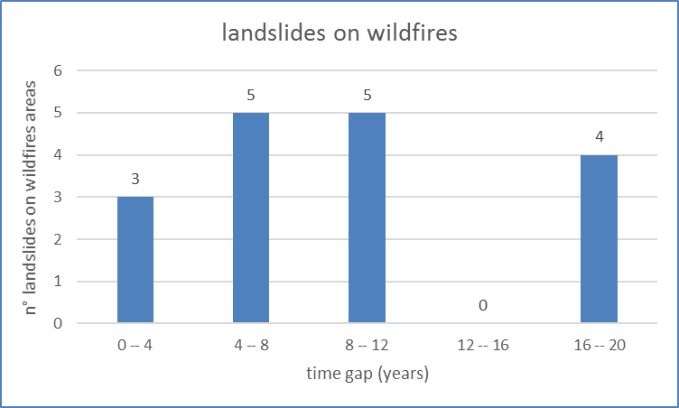
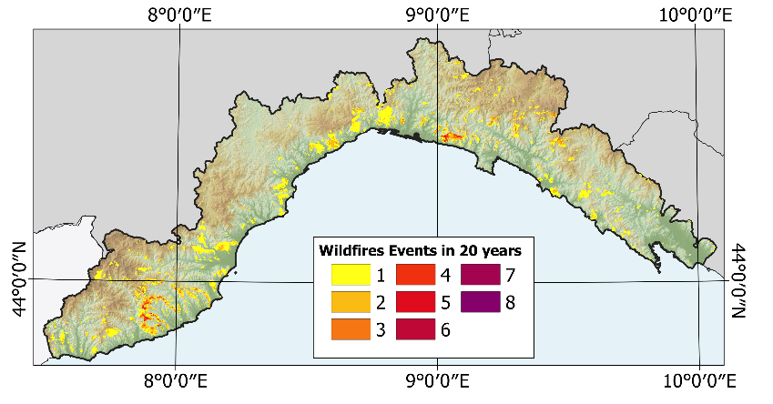
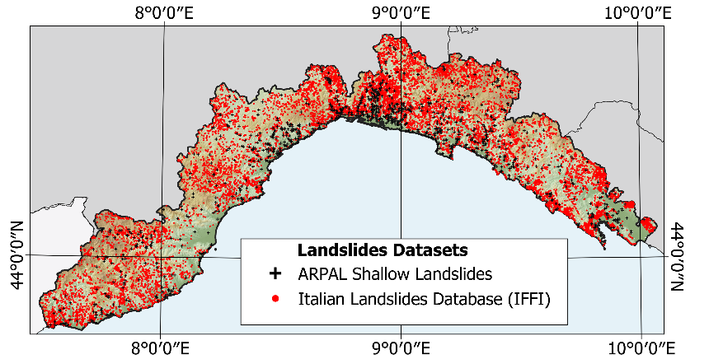
Wildfire and shallows landslides: a preliminary statistics in Liguria (North-West Italy)
Possible wildfire high frequency and landslides high frequency correlation
Wildfire spatial analysis and recurrence;
Finding causal relationship between wildfires and shallow landslides
Filtering landslides typology and state activity:
ACTIVE, RAPID, MUD/EARTH/DEBRIS FLOW
Liguria Region (North-West Italy). Period 1996 - 2016
Historical Burnt areas (areal features per year) collected by Italian Fire Brigade (Corpo dei Vigili del Fuoco) survey.
Lanslides database collection from different sources and anlysis.
Only 17 out of 14’817 studied landslides were potentially linked to wildfires events. The temporal difference between landslide and wildfire events (time gap) has a maximum value of 18 years and minimum value of 2 years. Only 3 landsildes have a time gap less then 4 years (strong correlation).
Terrone M.¹ Faccini F.^{1,2} Paliaga G.² Solimano M.³
¹ Department of Earth, Environmental and Life Sciences, University of Genoa, Genoa, Italy, ² National Research Council, Research Institute for the Geo-Hydrological Protection, Turin, Italy, ³ Regional Agency for Environmental Protection Liguria (ARPAL)
RLOF18ASSRIC/60/1 “Tecnologie per il monitoraggio integrato e la mitigazione del rischio geomorfologico da frana nella gestione delle reti di sottoservizi”

