Slide 1
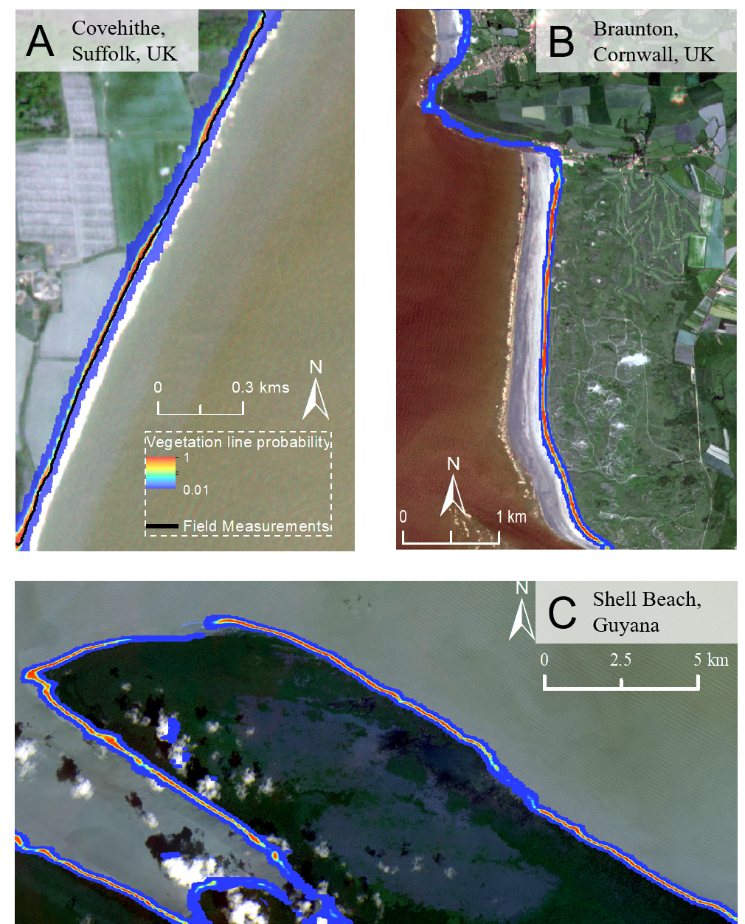
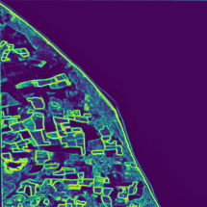
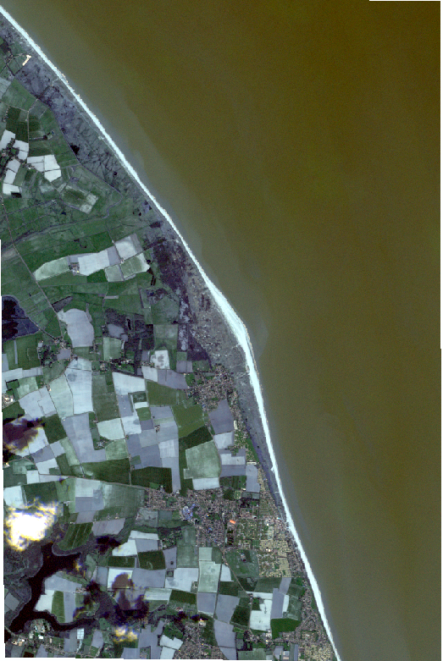
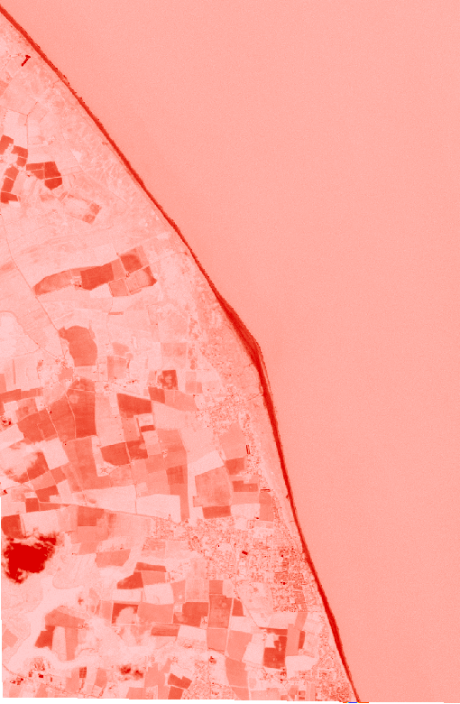
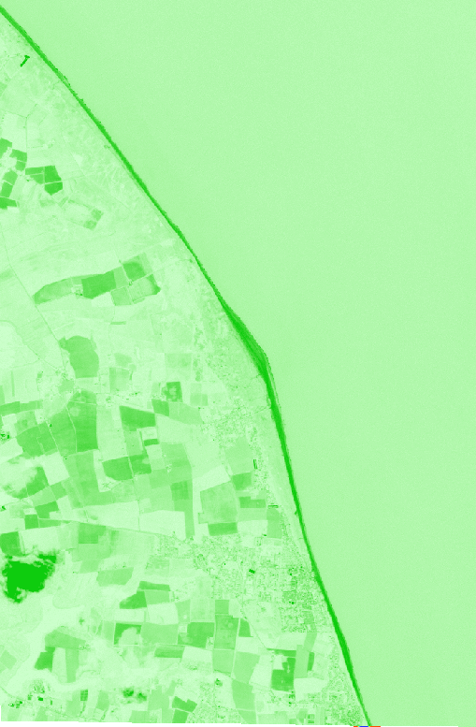
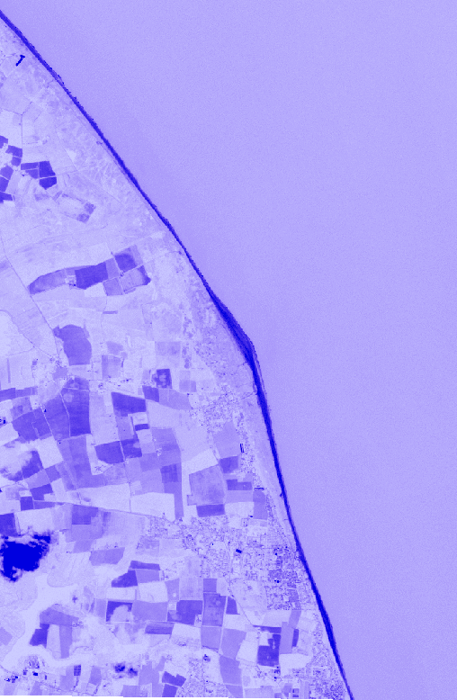
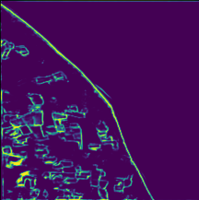
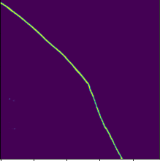
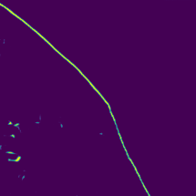
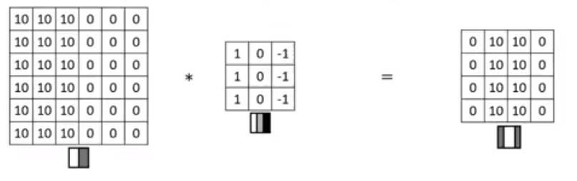
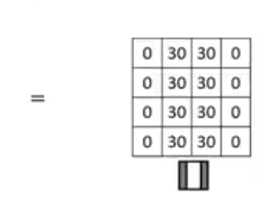
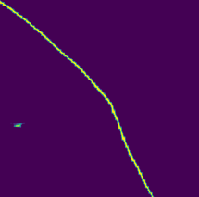
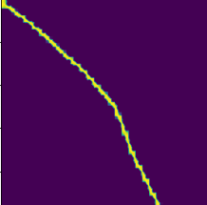




Vedge_Detector: Convolutional Neural Networks for automated coastal vegetation edge detection
Covehithe,
Suffolk
Perranuthnoe,
Cornwall
Input
image
Input 480*480*3
Resize
480
480
Ground
truth
Input image
Convolutional kernel
Output
Martin Rogers
msjr2@cam.ac.uk
Twitter: @martinsjrogers
Supervisors: Dr Mike Bithell, Prof. Tom Spencer
Side outputs
Convolution
Max pooling
Rogers, M.S., Bithell, M., Brooks, S.M. and Spencer, T., 2021. VEdge_Detector: automated coastal vegetation edge detection using a convolutional neural network. International Journal of Remote Sensing, 42(13), pp.4809-4839.

