Slide 1
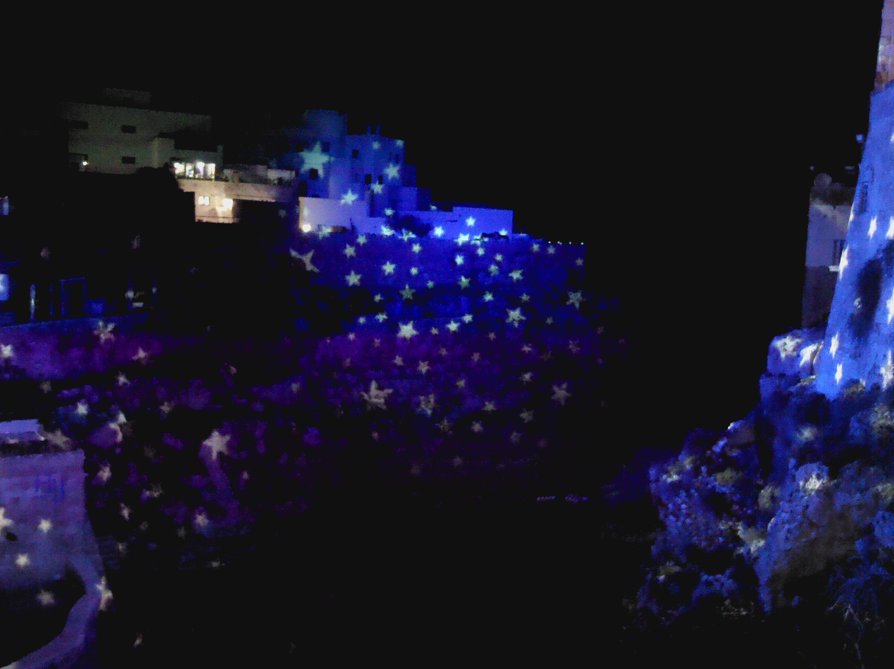



SESSION NH3.6 LANDSLIDE INVESTIGATION USING REMOTE SENSING AND GEOPHYSICS
IMPLEMENTATION OF INFRARED THERMOGRAPHIC SURVEYS IN COMPLEX COASTAL AREAS: THE CASE STUDY OF POLIGNANO A MARE (SOUTHERN ITALY)
Lidia Loiotine^{1,2}, Marco La Salandra ², Gioacchino Francesco Andriani ²,
Eliana Apicella ³, Michel Jaboyedoff ¹, Mario Parise ², and Marc-Henri Derron¹
¹ Institute of Earth Sciences, University of Lausanne, 1015 Lausanne, Switzerland
² Department of Earth and Environmental Sciences, University of Bari Aldo Moro, 70125 Bari, Italy
³ Monitoring & Infrastructure Division, Trimble Company, 20871 Vimercate, Italy
Supplementary material for
vPICO presentation – 26 April 2021
Corresponding author: lidia.loiotine@unil.ch

Slide 2
BACKGROUND OF THE RESEARCH
InfraRed Thermography (IRT) is of recent development in the Earth Sciences, especially in the field of geostructural and geomechanical surveys in rock masses.
Being a non-destructive diagnostic technique, IRT could be a useful method for the identification of fractures and voids in rock masses, which could lead to local instabilities.
However, at present, few studies on its application have been presented and the effectiveness of this technique in different contexts is still unknown.
We present the results of the application of InfraRed Thermography on a complex karst coastal area in Polignano a Mare (southern Italy), a 20 m high cliff made up of Calcarenite di Gravina Fm overlying Calcare di Bari Fm.
The rock mass is characterized by fine to medium-bedded layers whose lithology and fracture frequency moderately vary along the carbonate succession. In addition, the rock mass is affected by disturbances such as vegetation and human artifacts.
Several tests were carried out in order to estimate the most appropriate period and time for performing the IRT surveys in the study area.
The IRT surveys aimed at detecting major discontinuities and voids within the rock mass, potentially represented by thermal anomalies.
Correlations between the temperature profiles of the different thermograms along a vertical section and the corresponding stratigraphic and GSI profiles were investigated.

Slide 3
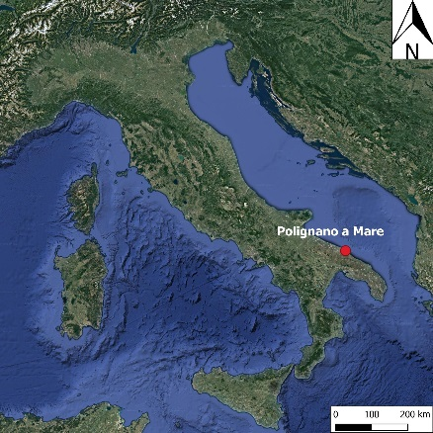
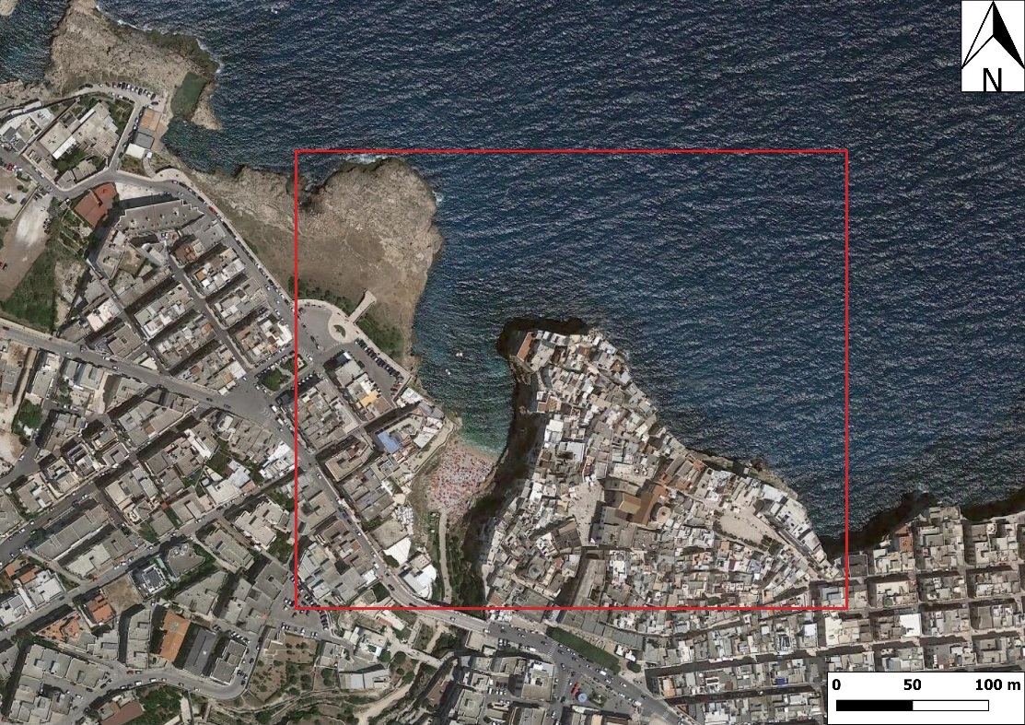
MATERIALS AND METHODS
Acquisition
The IRT surveys were performed on a subvertical cliff at Lama Monachile site in Polignano a Mare (southern Italy) on 22/12/2020.
The thermal images were acquired from the opposite side of the cliff every 20 minutes for 24 hours by means of a FLIR T-660 thermal imager mounted on a fixed tripod.
The ambient air temperature, relative humidity, apparent temperature and distance from the rock cliff were measured in order to calibrate the thermal imager and derive the real temperatures in the processing phase.

Slide 4
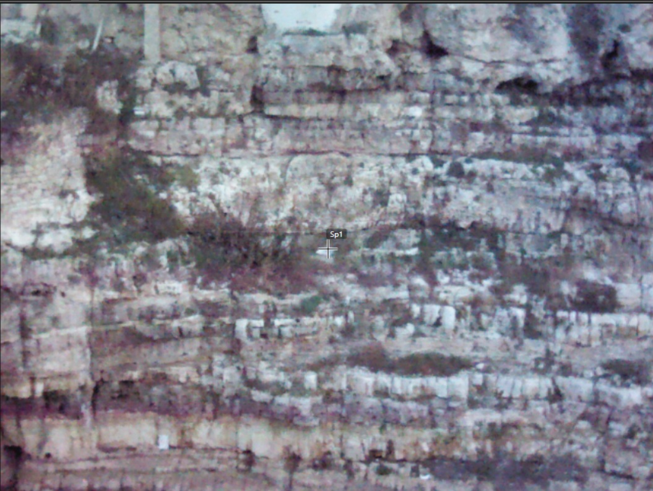
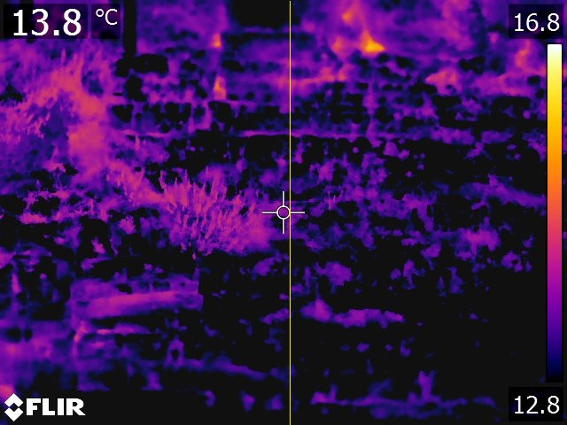
MATERIALS AND METHODS
Temperature profile
Processing
The thermograms were processed by means of FLIR Tools software.
The reflected apparent temperatures measured by the thermal imager were corrected by entering the parameters previously registered, in order to filter out the ambient radiations and obtain the temperature values of the rock surfaces.
The colour scale of the thermal images was adjusted in order to easily detect colder and warmer thermal anomalies and filter out the data deriving from the sky and the sea below the cliff.
High resolution photos acquired by means of Unmanned Aerial Vehicle (UAV) techniques helped to detect elements of disturbances for the thermal images, such as vegetation and human artifacts.
Temperature profiles were drawn on each thermogram along the same trace and further processed into a spreadsheet.

Slide 5
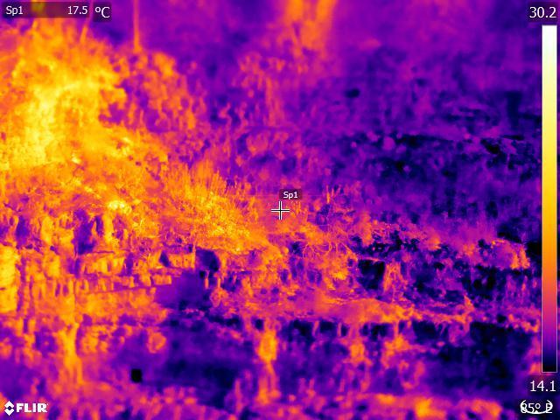
RESULTS
Which is the most appropriate moment for carrying out the IRT surveys?
The best moment for performing the IRT surveys is during the night.
Infact, during the morning, the fractures and voids are not clear, as the vegetation heats up and the direct radiation of the sun produces sea reflection and shadows.
Irradiation of the sun
At midday the sun illuminates differently the rock mass, therefore the overhanging blocks get warmer than the «hidden» features (i.e. bedding planes and fractures) which appear darker in the thermal images.
This could lead to a misinterpretation of the thermal images.

Slide 6
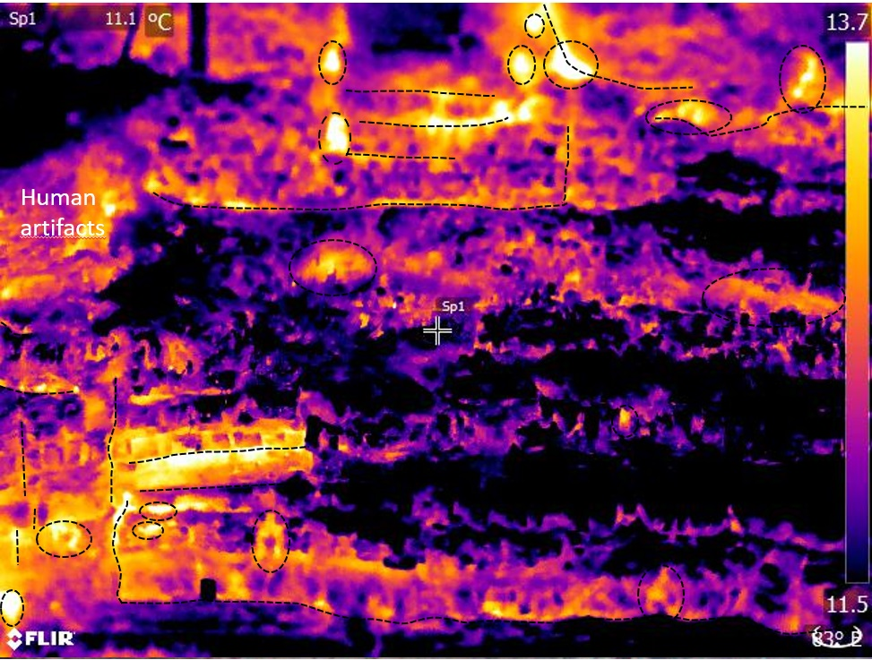
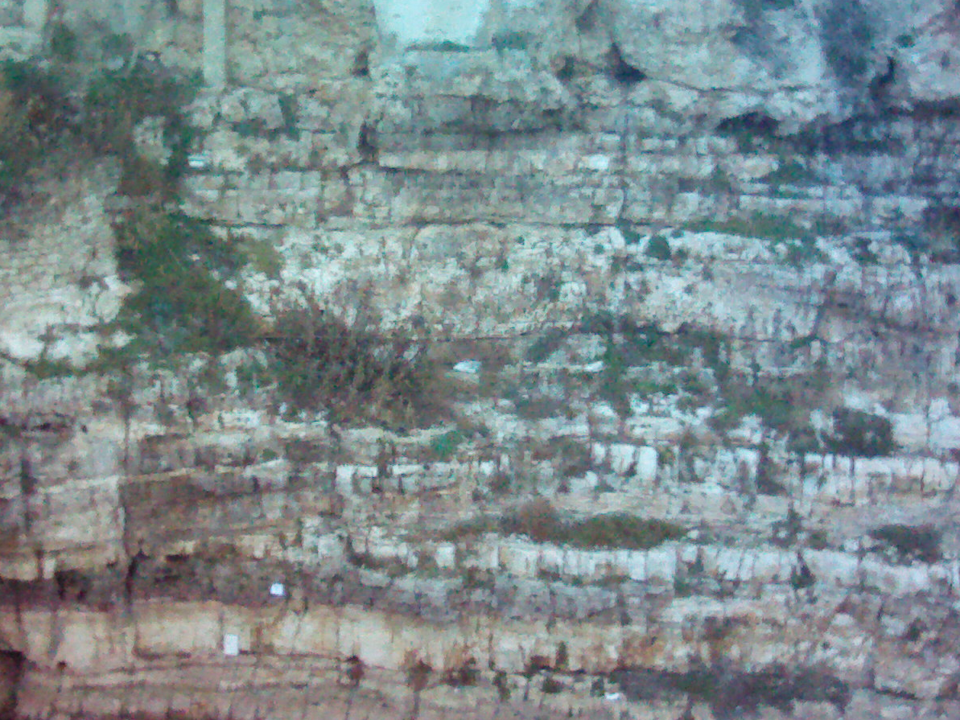
RESULTS
Interpretation
Cooling cycle
After the sunset, the fractures, voids and more fractured/porous zones start releasing the heat acquired during the day (dotted lines and circles of the figure on the right), while the vegetation becomes colder.
The intact rock, which has a major thermal inertia, assumes darker colours in the thermal images.
By applying a proper colour scale, it is thus possible to identify the discontinuities and more fractured areas within the rock mass.
Some warmer anomalies might be related to dark layers which absorbed more heat during the day.

Slide 7
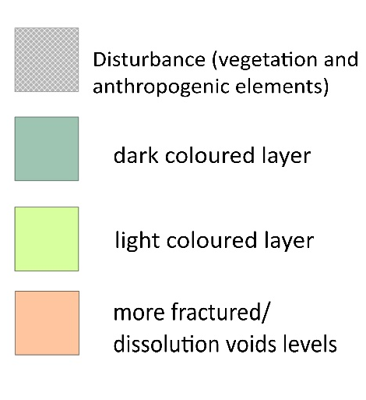
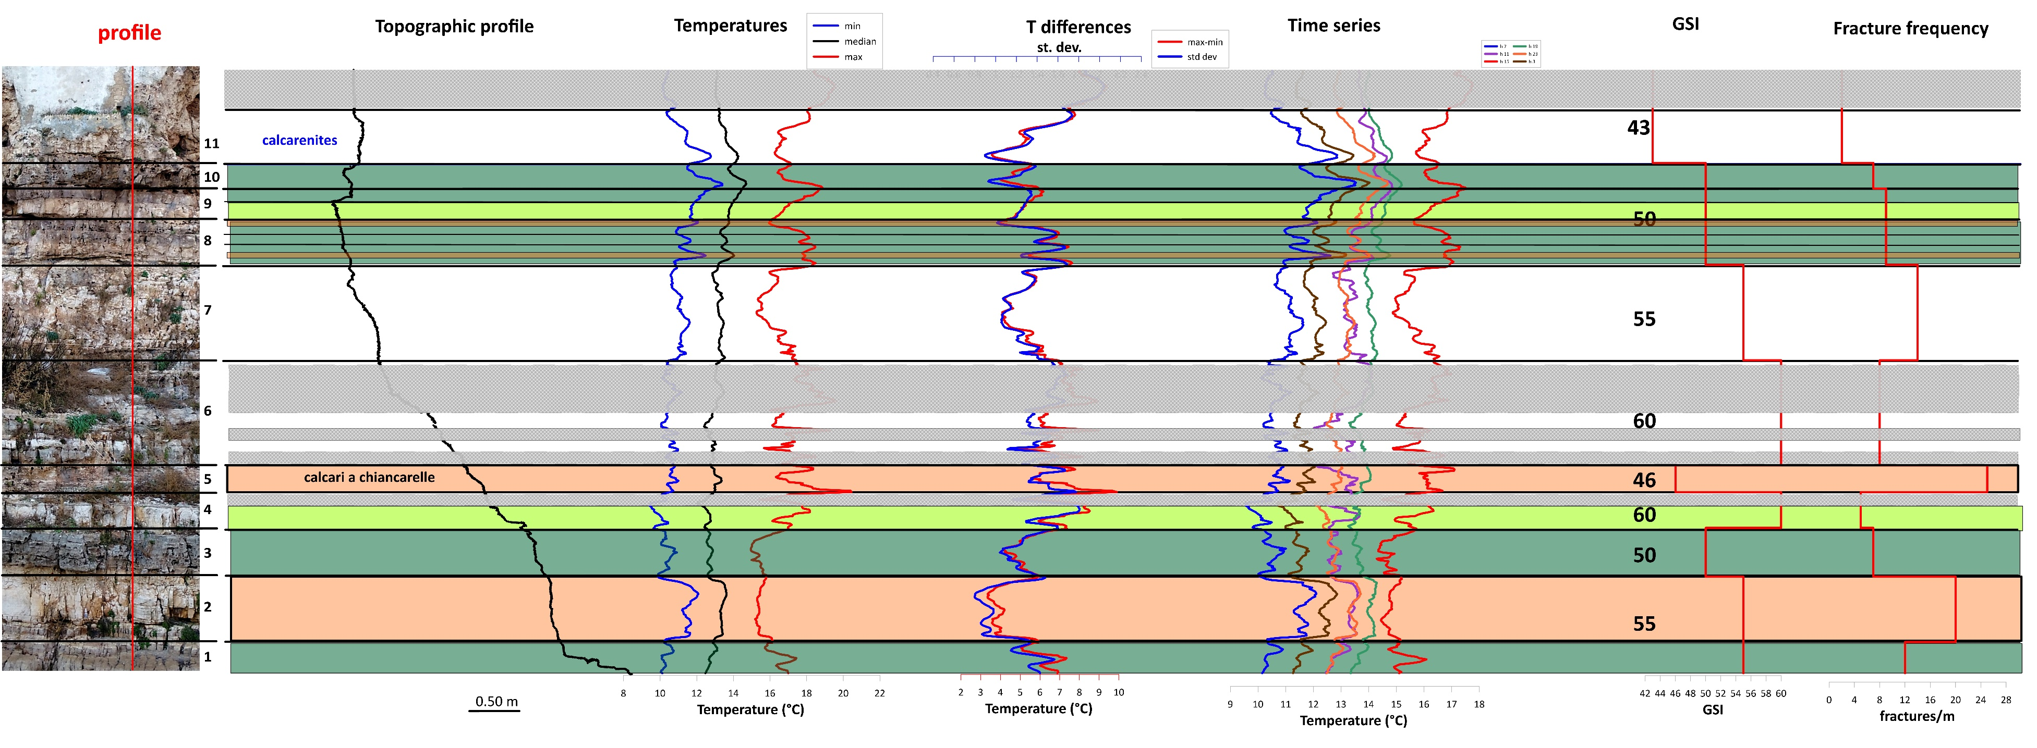
The temperatures extracted along the same vertical profile depend on the interaction between several factors:
- topography;
- lithology;
fracture pattern;
- disturbances (vegetation and human artifacts).

Slide 8
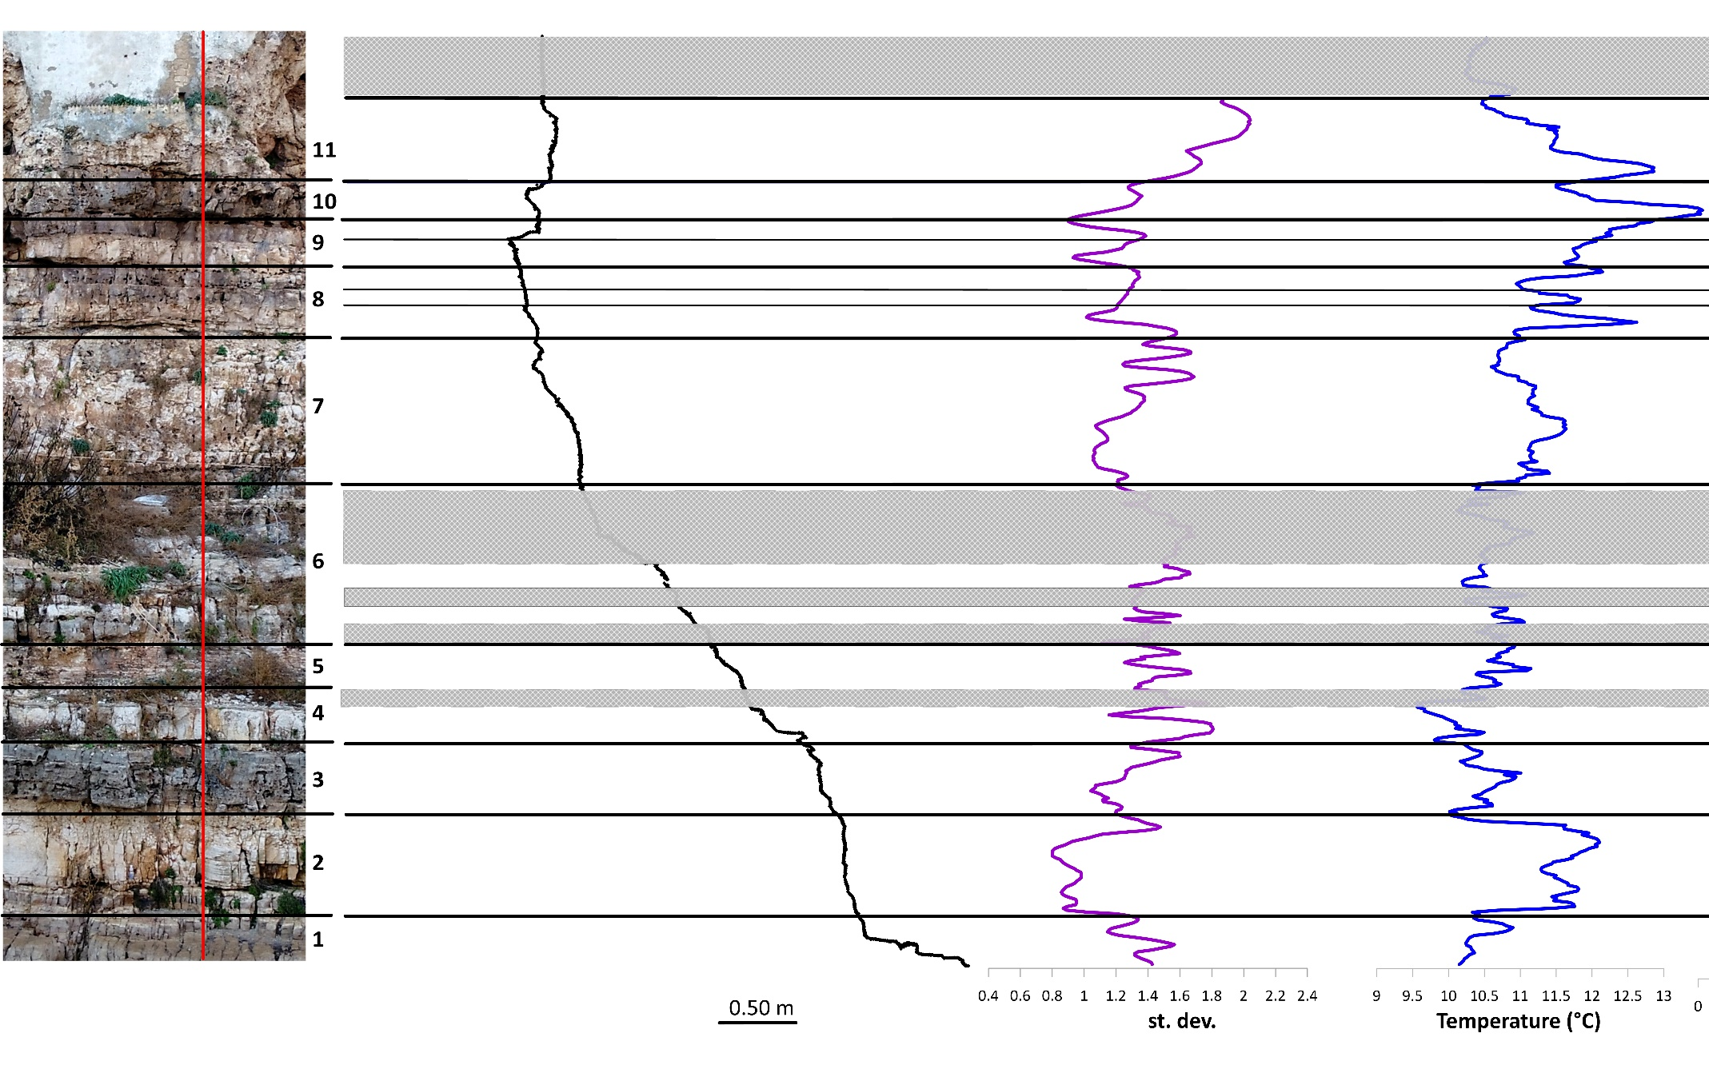
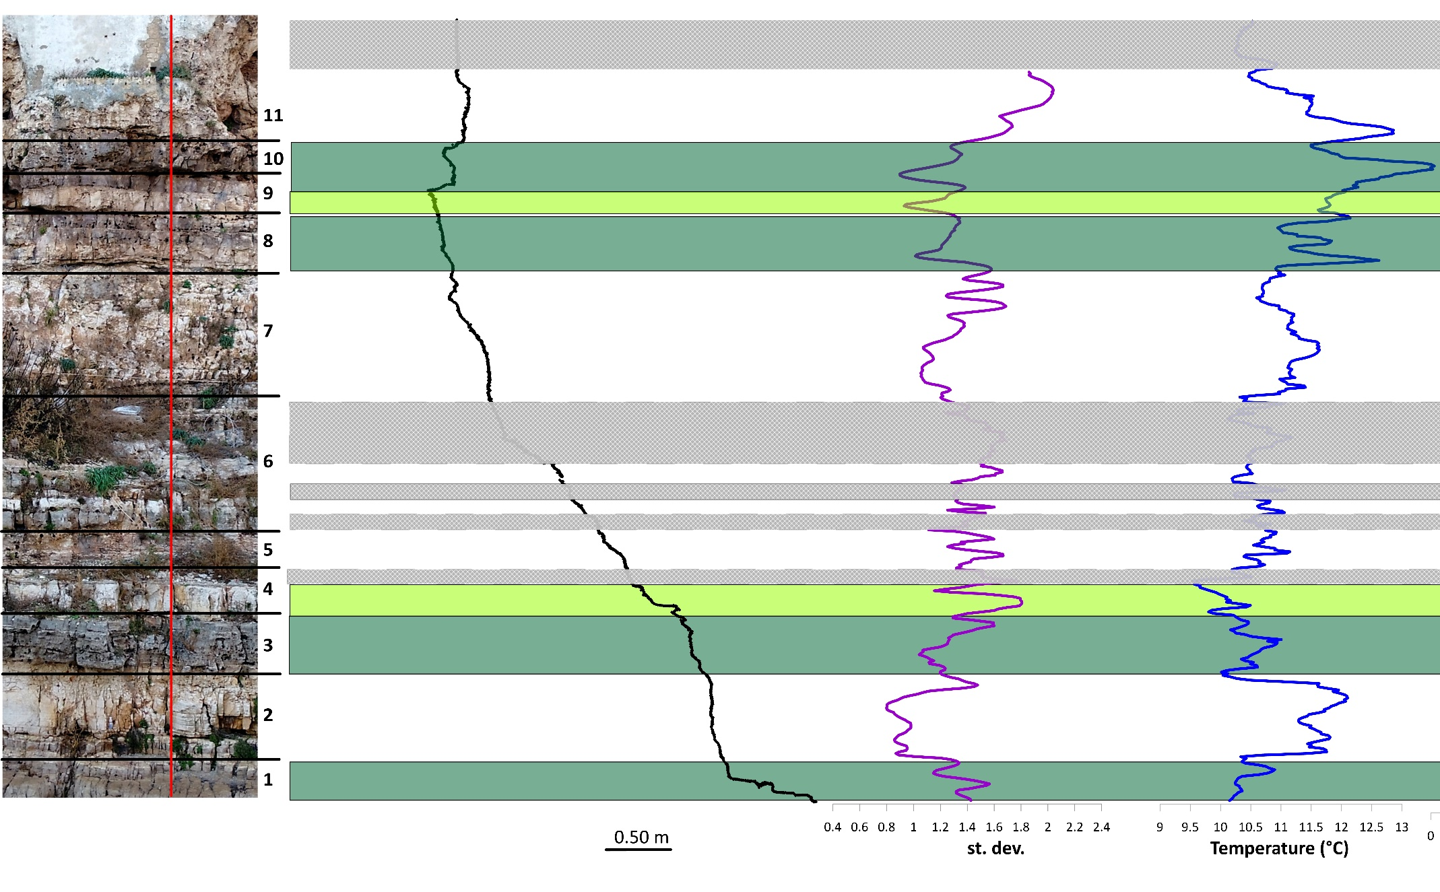
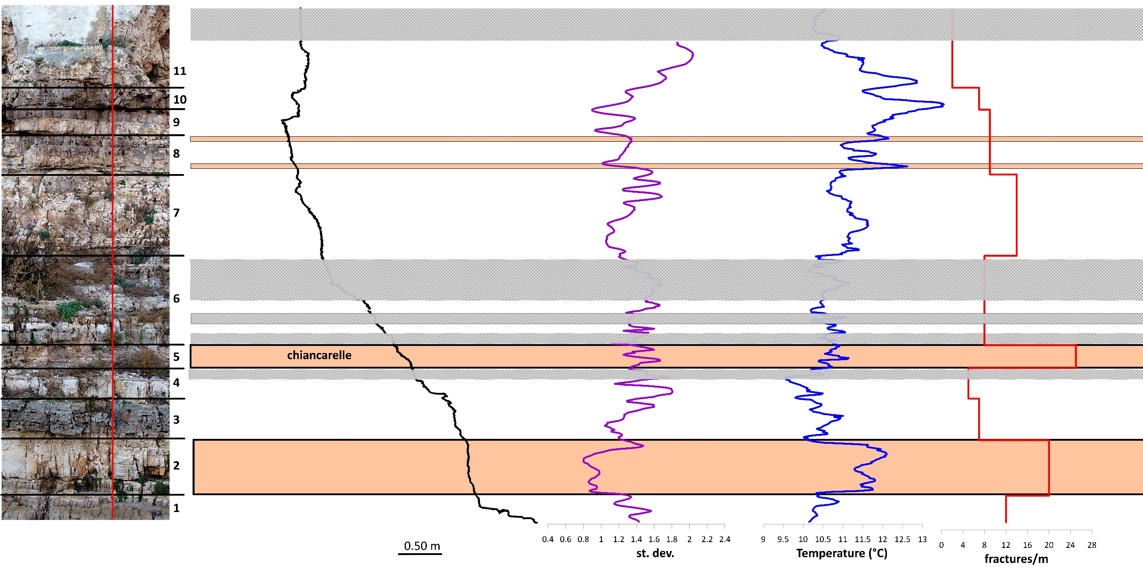
In detail:
Topography: lower temperatures are related to indented surfaces (i.e. layer interfaces and dissolution voids).
Lithology: higher temperatures correspond to darker levels (i.e. dolomitic facies), while lower temperatures belong to light-coloured limestones (i.e. micritic facies).
Topographic profile
Standard deviation of T
T at 7:00 am
Fracture frequency
Fracture pattern: higher temperatures are associated to levels with a higher fracture frequency and/or more dissolution voids.
Note: disturbances (vegetation and human artifacts) were excluded from the analysis.

Slide 9
CONCLUSION
With this study the InfraRed Thermography technique was tested in order to evaluate its efficacy in complex coastal and karst areas, such as the described case study, with the aim of detecting voids and fractures which could cause failures within the rock mass.
Several tests led to the conclusion that accurate results can be achieved by performing the surveys during the night, thus avoiding disturbances produced by different light conditions in the rock mass, sea reflections and vegetation.
Despite the slight variation in temperature along the traced profiles, it was possible to extrapolate correlations with the lithological, morphological and structural setting of the rock mass.
On the basis of this research, it is believed that the IRT technique can be a useful non-destructive tool for the geostructural and geomechanical characterization of rock masses, especially when dealing with not accessible sites.
In addition, this study showed that the thermal images and the processing of the derived data could help to detect discontinuities and more fractured levels even with low thermal excursions and gradational contacts between the strata.

