Slide 1




NEW GEOID MODELS COMPUTATION IN THE BRAZILIAN SOUTHEAST
V. Silva (1), G. N. Guimaraes (2), D. Blitzkow (1,3) , A.C. Oliveira Cancoro de Matos (3)
ABSTRACT : EGU21-3284
https://doi.org/10.5194/egusphere-egu21-3284
1 Universidade de São Paulo, Departamento de Engenharia de Transportes, USP/PTR, Sao Paulo, Brazil.
2 Universidade Federal de Uberlândia, UFU, Monte Carmelo, MG.
3 Centro de Estudos de Geodesia, CENEGEO, Sao Paulo, Brazil.

Slide 2
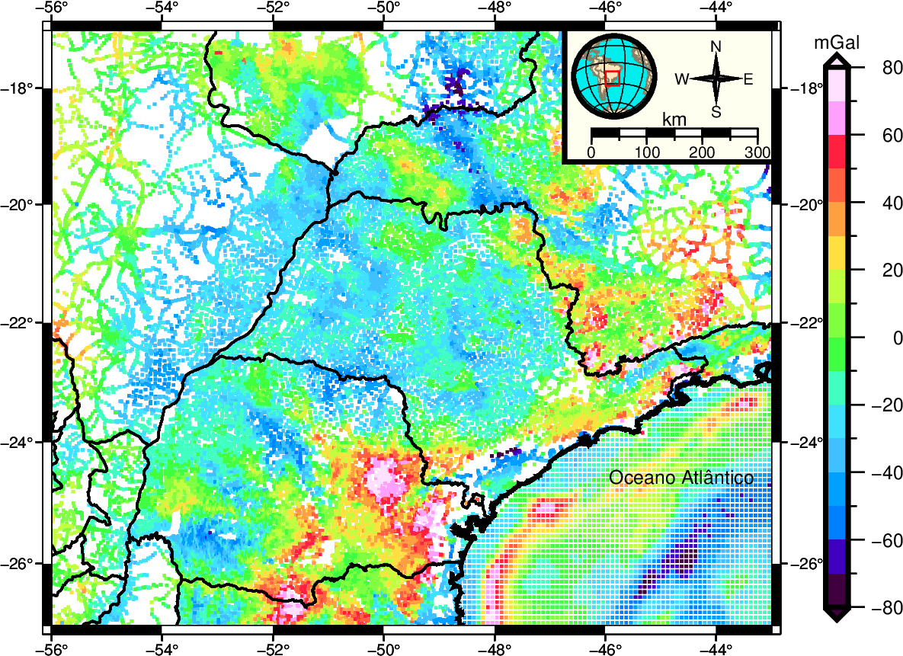
QUASIGEOID MODEL OF SÃO PAULO STATE
São Paulo state and surrounding have gravity data coverage almost completed in terms of 5’ resolution (Figure 1);
In its 2018 realization, the Brazilian Vertical Reference Frame (BVRF), adopted the normal height system (Luz 2016, IBGE 2019).
The official geoid model in the country is still MAPGEO2015 (Blitzkow et al. 2016);
Currently, the determinations on the levelling network had a discrepancy, in terms of Root Mean Square (RMS) difference with MAPGEO2015 of 30 cm approximately.
Considering the present scenario, a quasigeoid model is most suitable to be consistent with the normal height system.
For this purpose, two quasigeoid models for the São Paulo state was computed using:
    50432 terrestrial gravimetric points
    XGM2019e
    DTU13
    SRTM15+
Figure 1: Molodensky gravity anomalies.

Slide 3
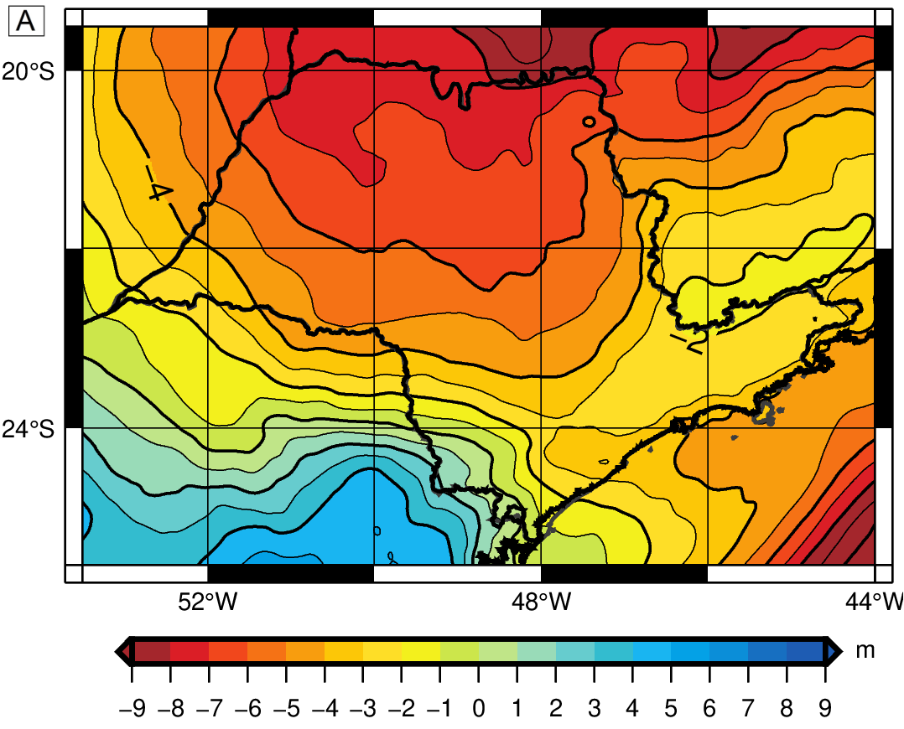
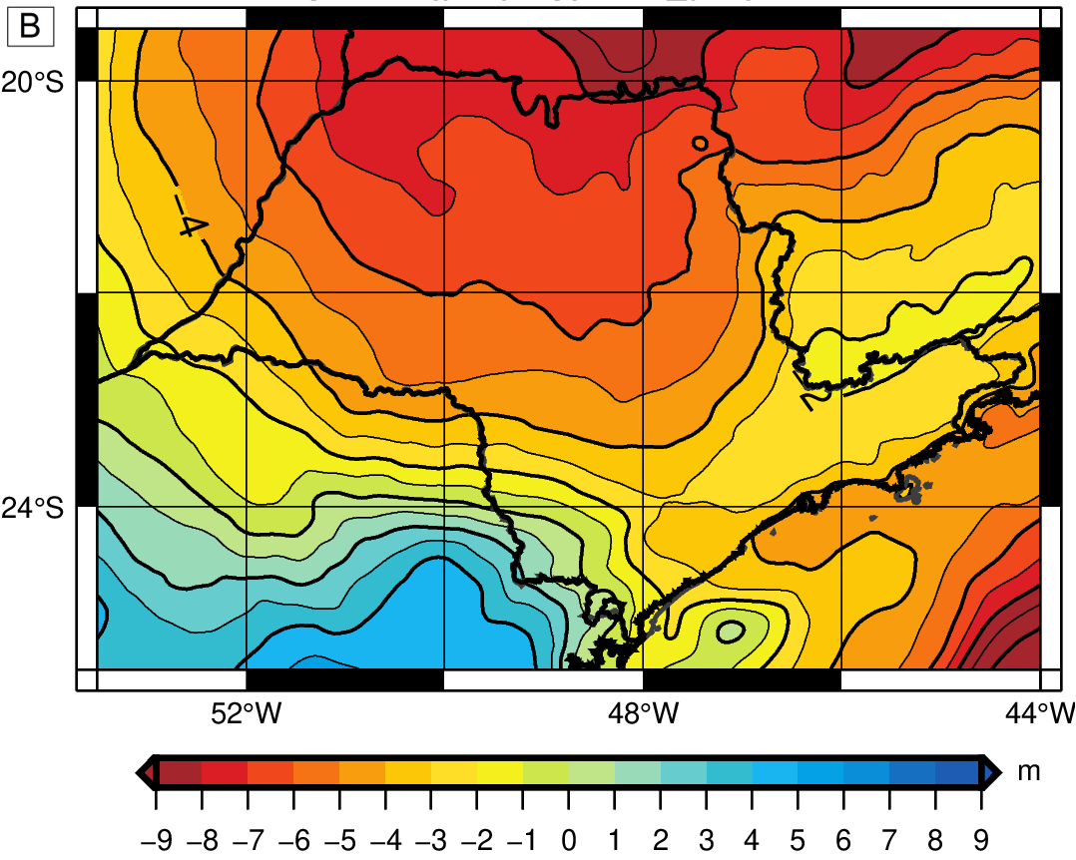
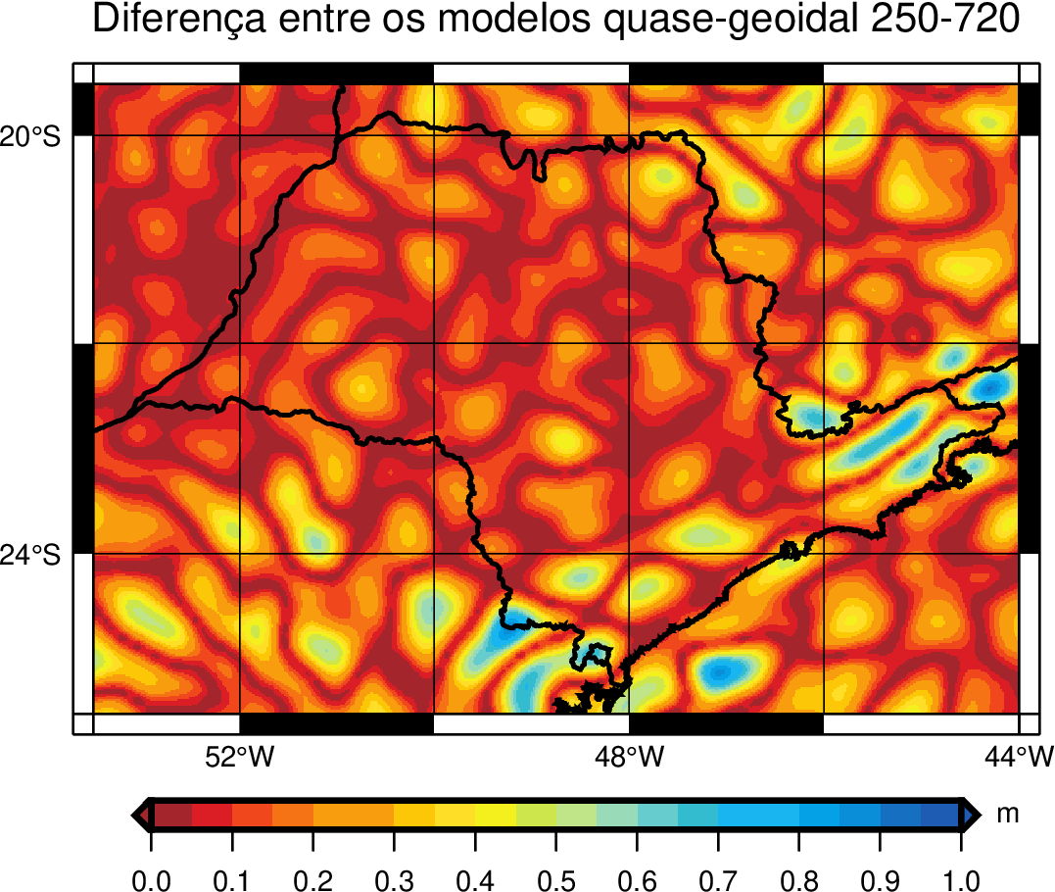

QUASIGEOID MODEL OF SÃO PAULO STATE
The homogeneous distribution of gravimetric data in the continent contribute for the nmax=250 and nmax=720 solutions be similar (Figure 2).
In the ocean region and close to the coast the discrepancies can reach 1.02 m (Figure 3 and Table 1).
Figure 2: Quasigeoid model for São Paulo (A-nmax= 250; B-nmax= 720).
Figure 3: Absolute difference between quasigeoid models.
Table 1: Statistics of quasigeoid difference between nmax=250 e 720 (m).
Statistics | Min | Max | Mean | SD | RMS
 | 0.00 | 1.02 | 0.15 | 0.13 | 0.21

Slide 4
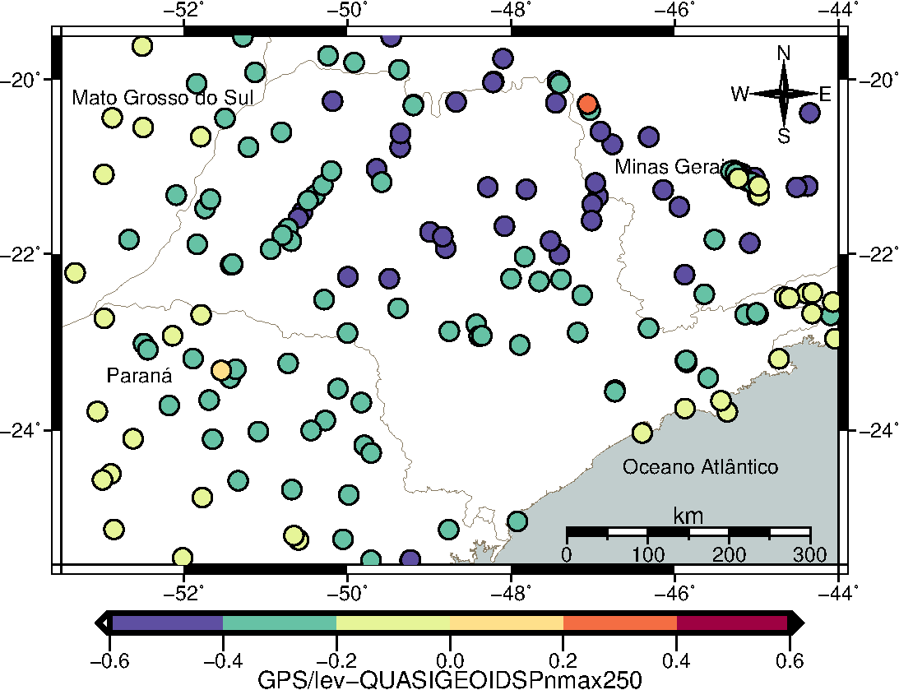
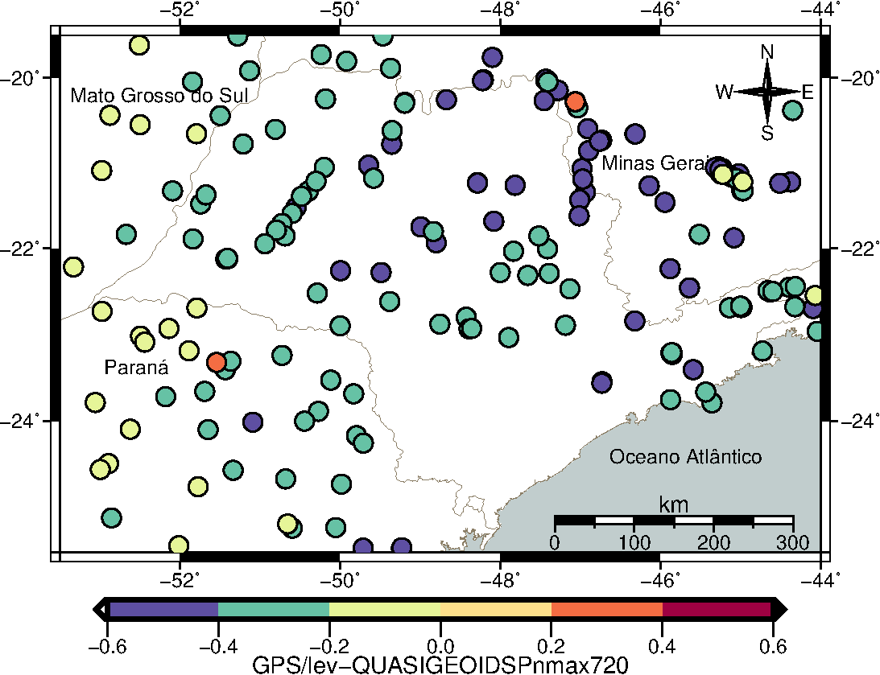
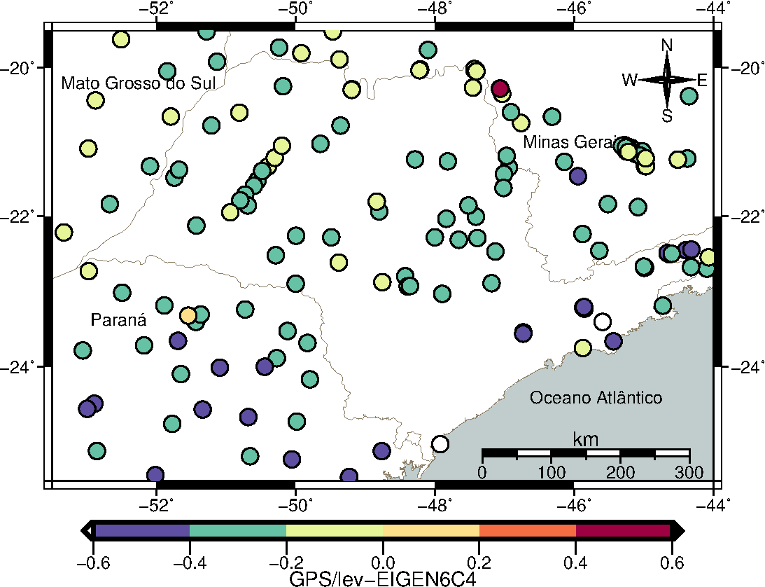
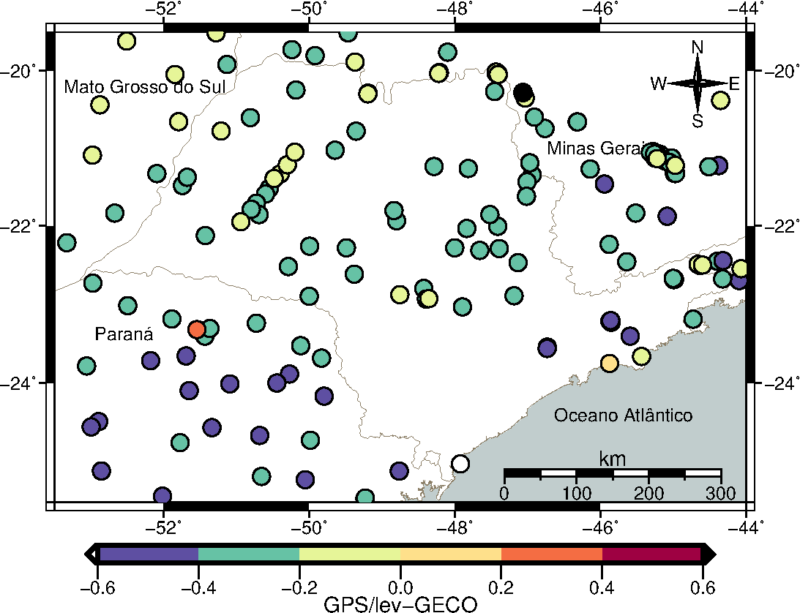
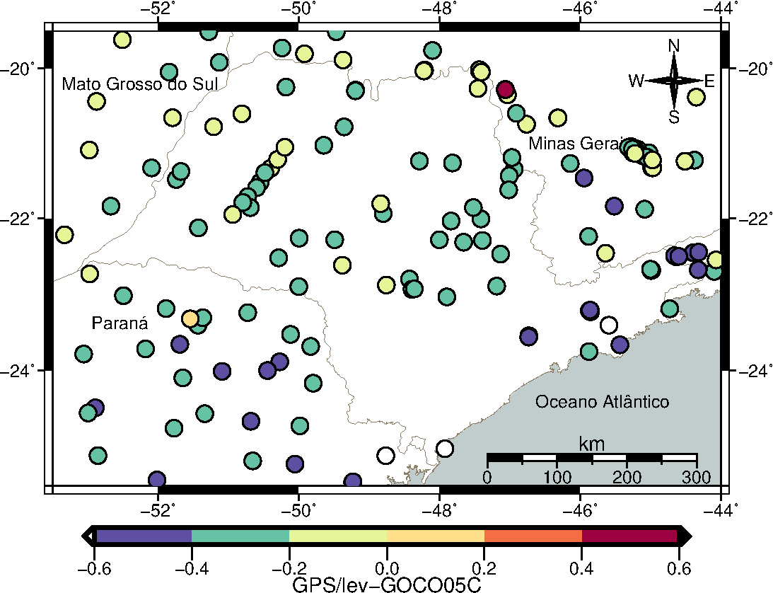

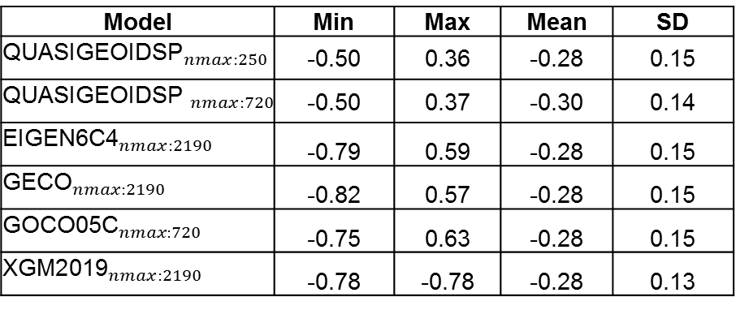
VALIDATION
Comparing the solutions results with 246 GNSS determinations on the leveling network, it results in a RMS difference of 15 cm (Figure 4). The evaluation also has been undertaken for some Global Geopotential Models (Figure 5). The statistical results are shown in Table 2.
Figure 4: GPS/levelling and QUASIGEOIDSP comparison.
Figure 5: GNSS/levelling and GGMs comparison
Model | Min | Max | Mean | SD
$${\text{QUASIGEOIDSP}}_{nmax:250}$$ | -0.50 | 0.36 | -0.28 | 0.15
$${\text{QUASIGEOIDSP} }_{nmax:720}$$ | -0.50 | 0.37 | -0.30 | 0.14
$${\text{EIGEN}\text{6}\text{C}\text{4}}_{nmax:2190}$$ | -0.79 | 0.59 | -0.28 | 0.15
$${\text{GECO}}_{nmax:2190}$$ | -0.82 | 0.57 | -0.28 | 0.15
$${\text{GOCO}\text{05}\text{C}}_{nmax:720}$$ | -0.75 | 0.63 | -0.28 | 0.15
$${\text{XGM}\text{2019}}_{nmax:2190}$$ | -0.78 | -0.78 | -0.28 | 0.13
Table 2: Statistical values of the comparison (in meters)

Slide 5
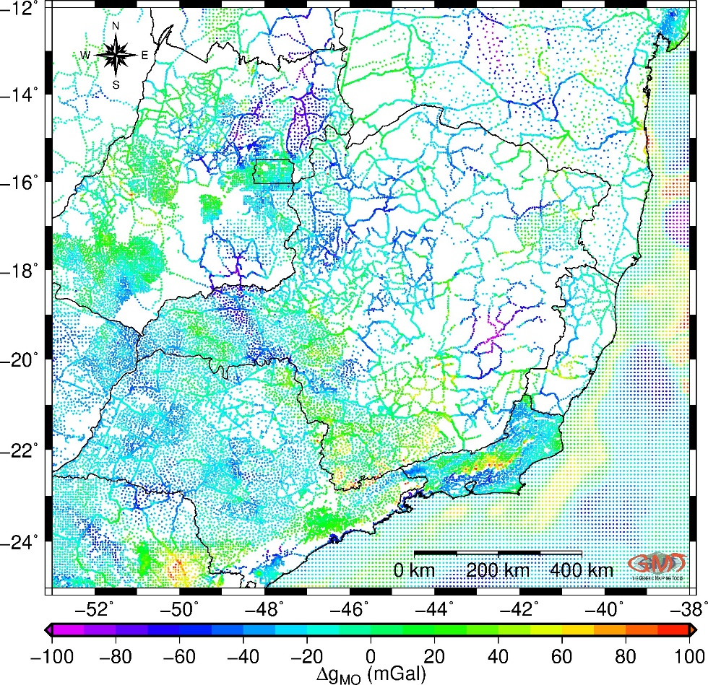
QUASIGEOID MODEL OF MINAS GERAIS STATE
Minas Gerais state has partial gravity data coverage (South and West) in terms of 5’ resolution (Figure 6).
In recent years, some efforts have been carried out to fill in the gaps in the state.
The computation procedure is similar to the quasigeoid model of São Paulo except for two processes:
  The long-wavelength component was removed up to degree and order 200.
  In the “compute” step, Least Squares Collocation applying Fast Collocation was used.
    49103 terrestrial gravimetric points
    XGM2019e
    DTU13
    SRTM15+
Figure 6: Molodensky gravity anomalies.

Slide 6
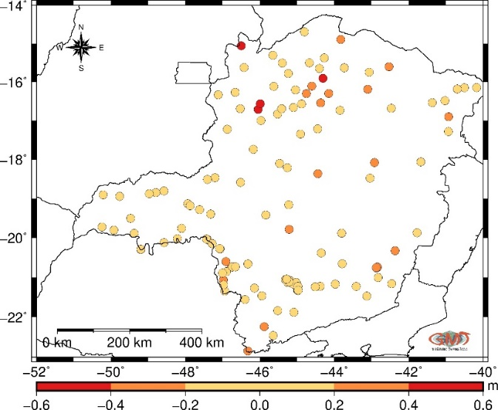
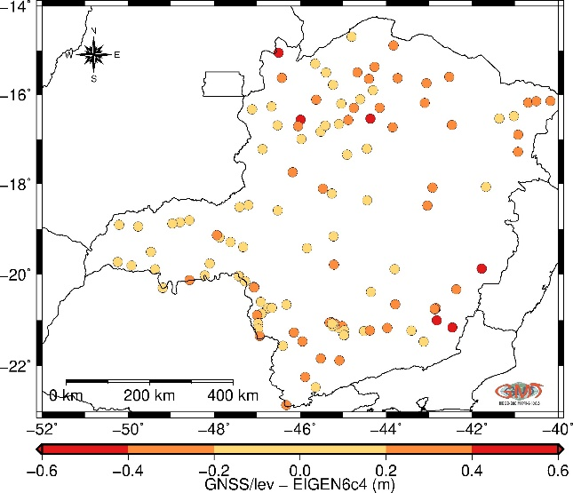
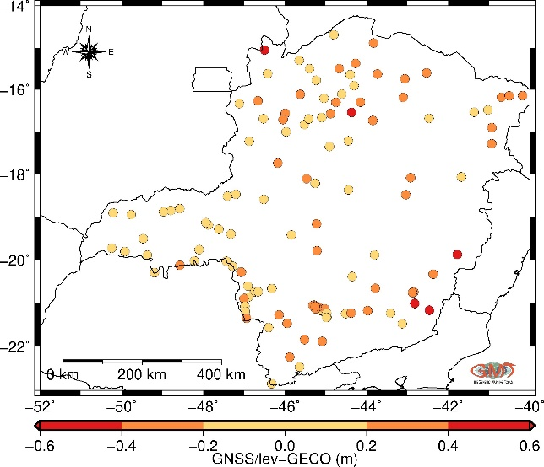
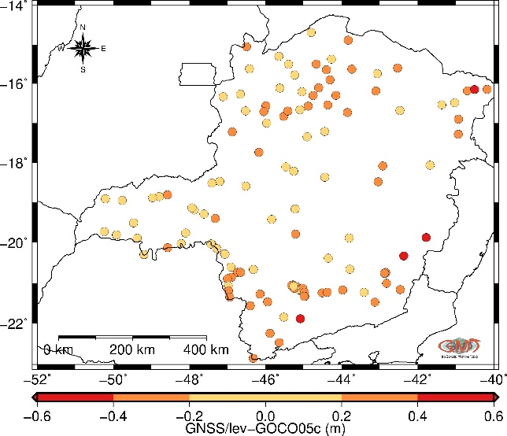
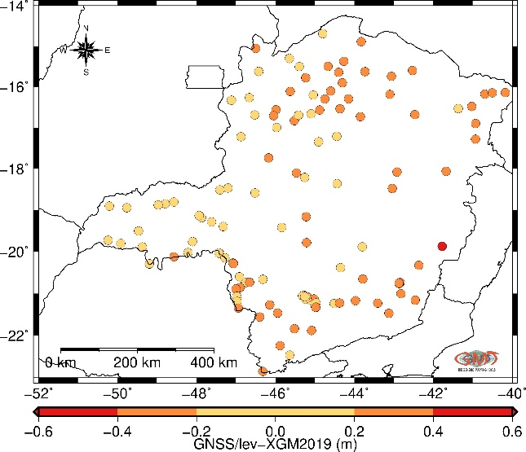
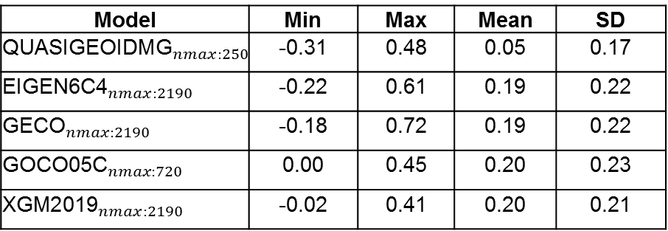
VALIDATION
The height anomalies of the quasigeoid model were compared with 136 GNSS/levelling stations on the benchmark (Figure 7). It results in a RMS difference of 17 cm (see Table 3). Some comparisons involving recent GGMS (EIGEN-6c4, GECO, GOCO05c, and XGM2019e) were also undertaken (Figure 8).
Figure 7: GNSS/levelling with 136 points
Figure 8: GNSS/levelling and GGMs comparison
Model | Min | Max | Mean | SD
$${\text{QUASIGEOID}\text{MG}}_{nmax:250}$$ | -0.31 | 0.48 | 0.05 | 0.17
$${\text{EIGEN}\text{6}\text{C}\text{4}}_{nmax:2190}$$ | -0.22 | 0.61 | 0.19 | 0.22
$${\text{GECO}}_{nmax:2190}$$ | -0.18 | 0.72 | 0.19 | 0.22
$${\text{GOCO}\text{05}\text{C}}_{nmax:720}$$ | 0.00 | 0.45 | 0.20 | 0.23
$${\text{XGM}\text{2019}}_{nmax:2190}$$ | -0.02 | 0.41 | 0.20 | 0.21
Table 3: Statistical values of the comparison (in meters)

Slide 7
FINAL REMARKS
São Paulo State
The conclusion is that the quasigeoid using nmax=250 is the best model because the mean indicates that the quasigeoid surface with nmax=250 has a smaller systematic component.
Considering the terrestrial gravity points are compatible to a 5’ grid and the uncertainty up to 15 cm of GPS-levelling heights of the 2018 BVRF, the results are better than the current MAPGEO2015 difference (30 cm), and therefore the quasigeoid model is satisfactory.
The improvement of the quasigeoid models requires an improvement of the geodetic infrastructure in south region and the use of high-resolutions DTMs and altimetry data.
Minas Gerais State
The quasigeoid model is consistent with GNSS/levelling stations at a level of 17 cm. As the São Paulo model, this model has an improvement with respect to the current MAPGEO2015.
The most difference in the comparison is in the North region of the state. Some efforts, in terms of gravity coverage, should be done in that region.

