Slide 1

Methods for determining focal mechanisms in laboratory experiments
Natalia Shikhova, Andrey Patonin
Borok Geophisycal Observatory IPE RAS, Borok, Yaroslavl Region
2021

Slide 2
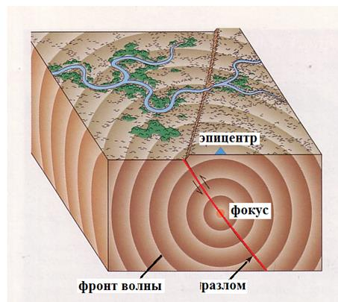
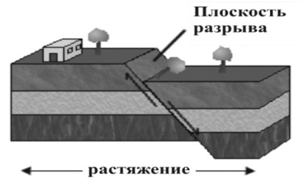
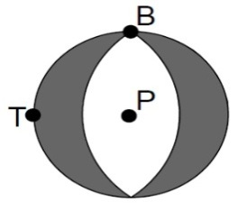
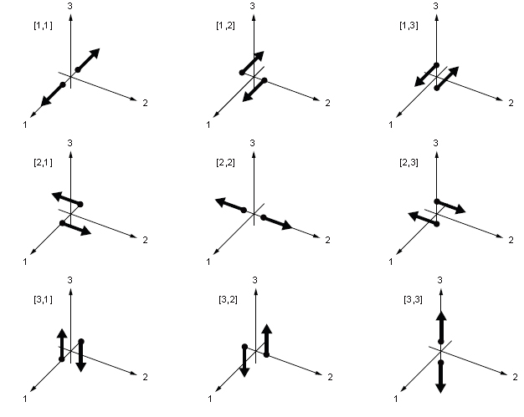
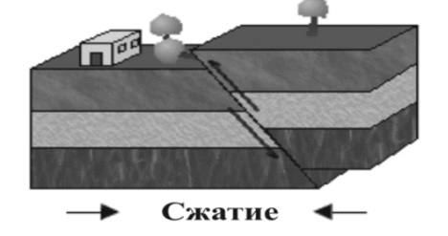
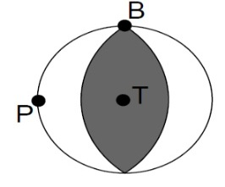
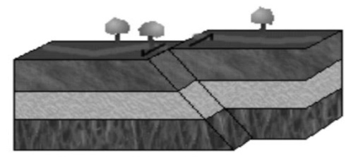
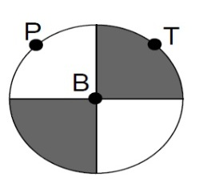
Earthquake-spatial orientation of the main stress axes of possible motion planes
The main types of ruptures on the Earth's surface and the corresponding mechanisms of the focus
epicenter
focus
wave front fault
tension
compression
Set of nine couples of equivalent dipole forces forming
the moment tensor

Slide 3
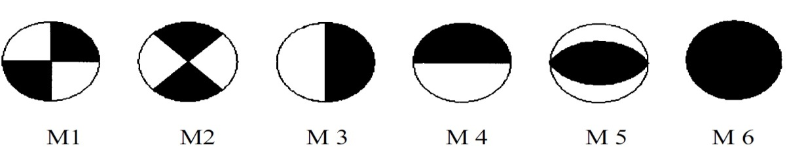
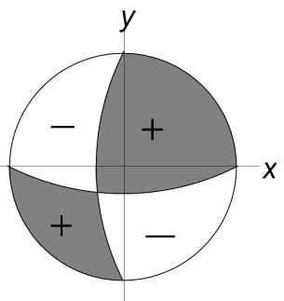
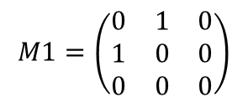
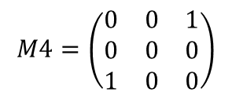
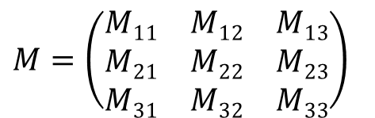
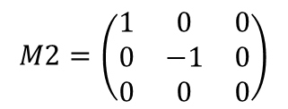
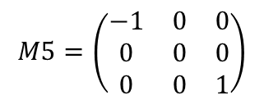
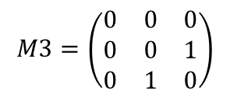
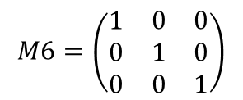
Moment Tensor Decomposition
Moment Tensor Decomposition into elementary tensors
Slip on stretch
Thrust fault on the E-W platform
Slip on stretch
Thrust fault at an angle of 45º
Thrust fault on the N-S platform
Explosion

Slide 4
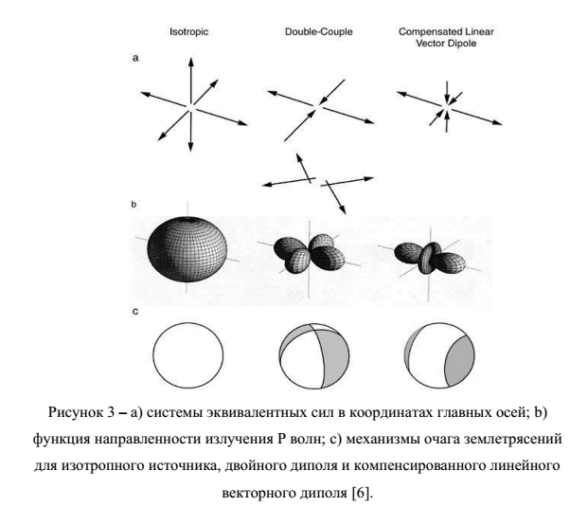

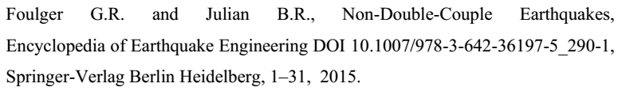
Moment Tensor Decomposition
equivalent forces
To determine which type of seismic source is represented by the found moment tensor, we use the decomposition of the moment tensor into three elementary parts: isotropic (ISO), double dipole (DC), and compensated linear vector dipole (CLVD) :
Source radiation patterns
non-DC
volume changes in the source:
explosions, collapses
the opening of cracks with the rarefaction
of the environment around,
anisotropy of the medium, the influence of fluids
Beach-ball diagrams of the mechanisms
double dipole
Shear source type,
sliding occurs on a single plane of discontinuity

Slide 5
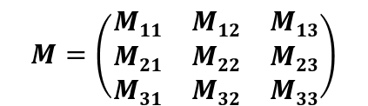
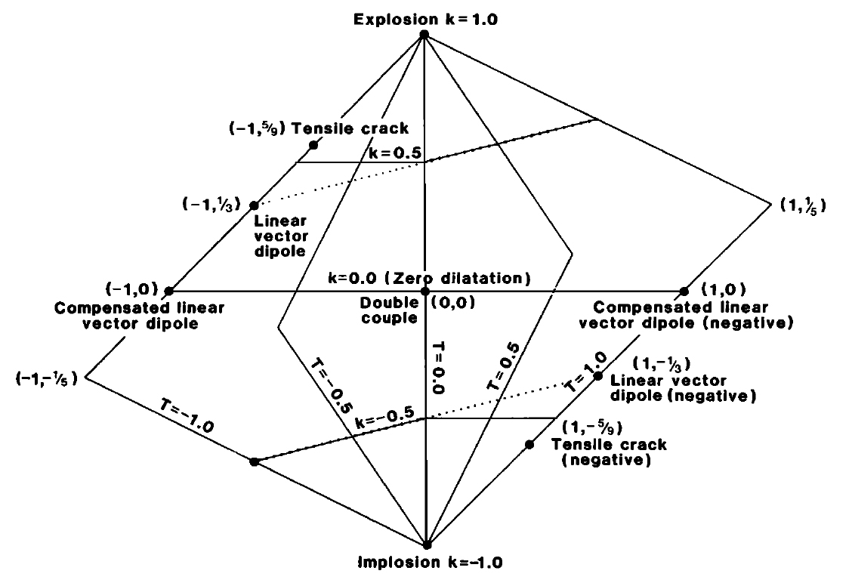
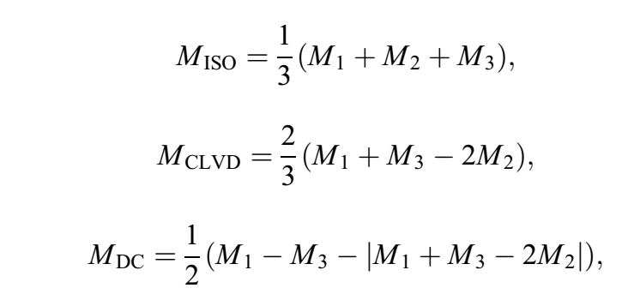
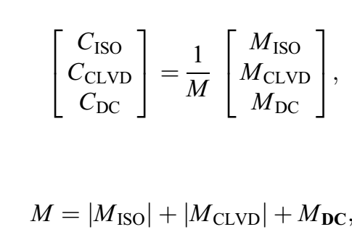

Calculation of the seismic moment tensor
Compression axis P = î⁻ M₃
Intermediate axis B = î⁺ ^ î⁻ M₂
Extension axis T = î⁺ M₁
М₁ ≥ М₂ ≥ М₃
1,1,1
М = |M_{iso}|+|M_{clvd}|+M_{dc}
Ṁ₁=1
Ṁ₃
Ṁ₃= -1
Ṁ₂
1,0,-1
1,1,-1
1,-1,-1
Ṁ₁
Ṁ_{i}=M_{i}/max(M_{1:3})
-1,-1,-1
J.A.Hudson Source Type Plot for Inversion of the Moment Tensor JOURNAL OF GEOPHYSICAL RESEARCH, VOL. 94, NO. B1, PAGES 765-774, JANUARY 10, 1989
V.Vavrycuk Moment tensor decompositions revisited J Seismol (2015) 19:231–252

Slide 6
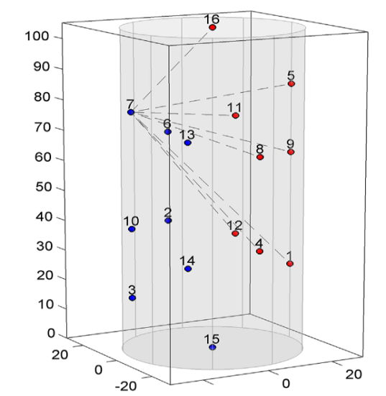
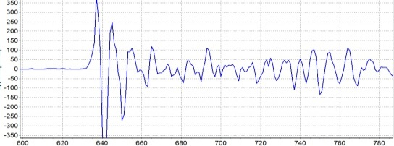
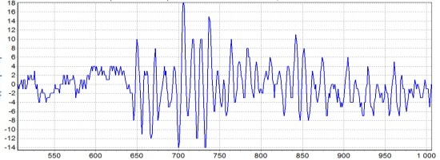
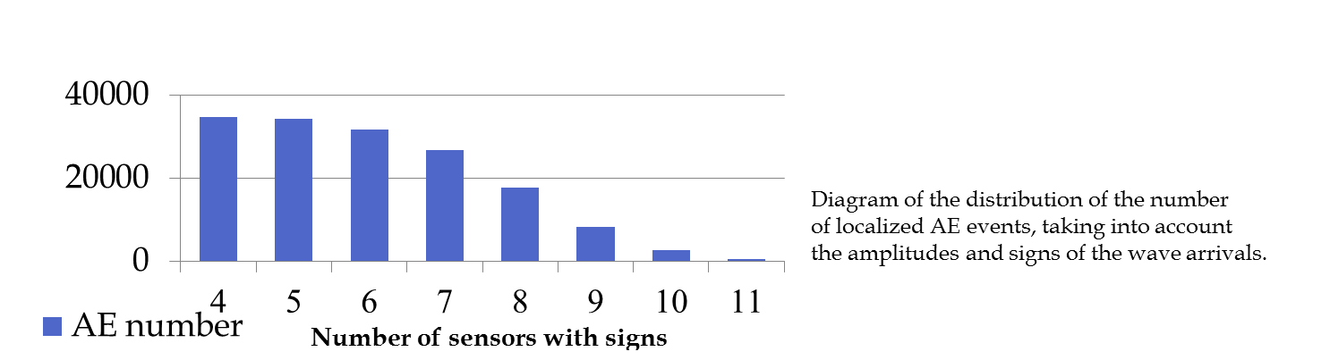
Determination of the mechanisms of events in samples during laboratory tests
Difficulties:
Weak signal
The number of possible definitions of the polarity of the incoming elastic wave is 4-9
The sign definition is sometimes erroneous due to the automatic algorithm missing the first half-period of a weak signal
Strong signal
Number of recorded AE signals 59827 ev.
Number of localized signals 34752 ev.
Discrepancy error 0.5 mks.
Weak signal

Slide 7
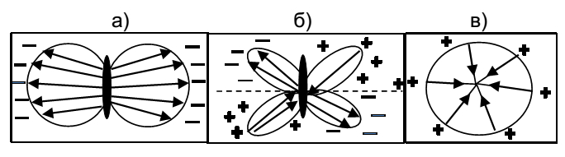
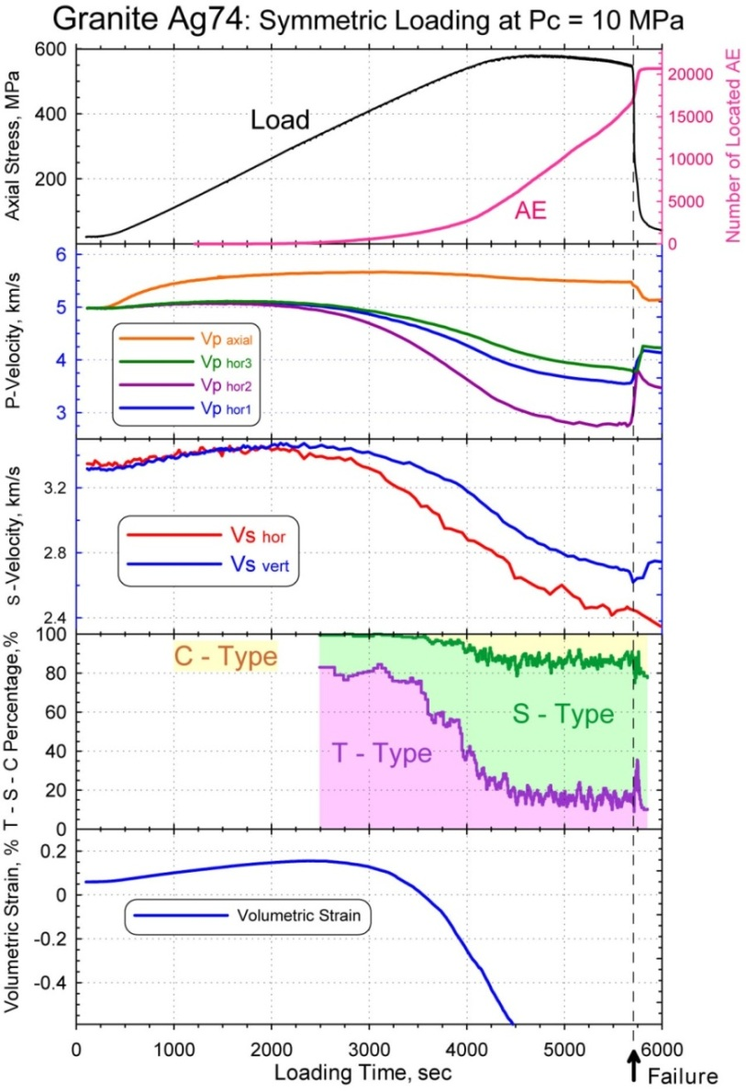
Typification of AE events using ONLY signs of the first arrivals
Sign(A_{i}) -the sign of the first arrival of the elastic wave on the i-th sensor ;
n is the number of sensors for which the sign is determined reliably
pol>0.25 С-type (Collapse)
-0.25≤ pol ≤0.25 S-type (Shear)
pol<-0.25 T-type (Tensile)
Experiment on granite with the determination of signal types by the polarity method
Zang, A., Wagner, F., Stanchits, S., Dresen, G., Andresen, R., Haidekker, M. A. Source analysis of acoustic emissions in Aue granite cores under symmetric and asymmetric compressive loads// Geophys. J. Int.1998. V.135. № 3. P.1113—1130.
  7

Slide 8
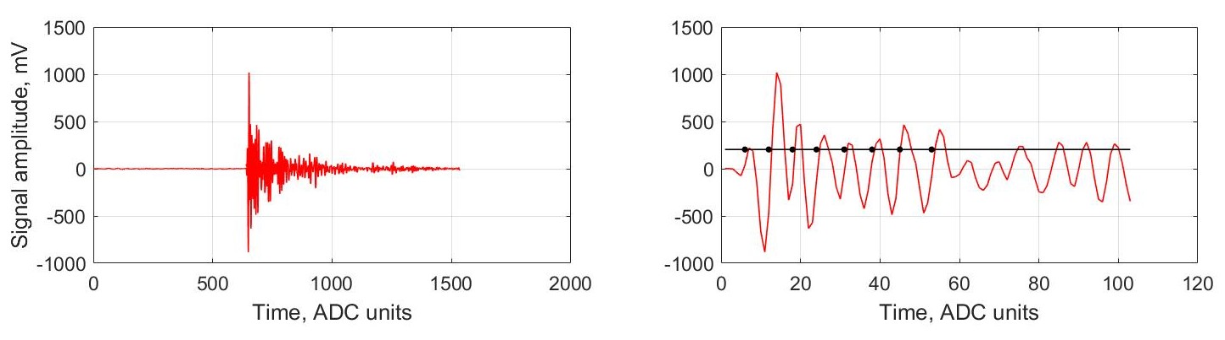
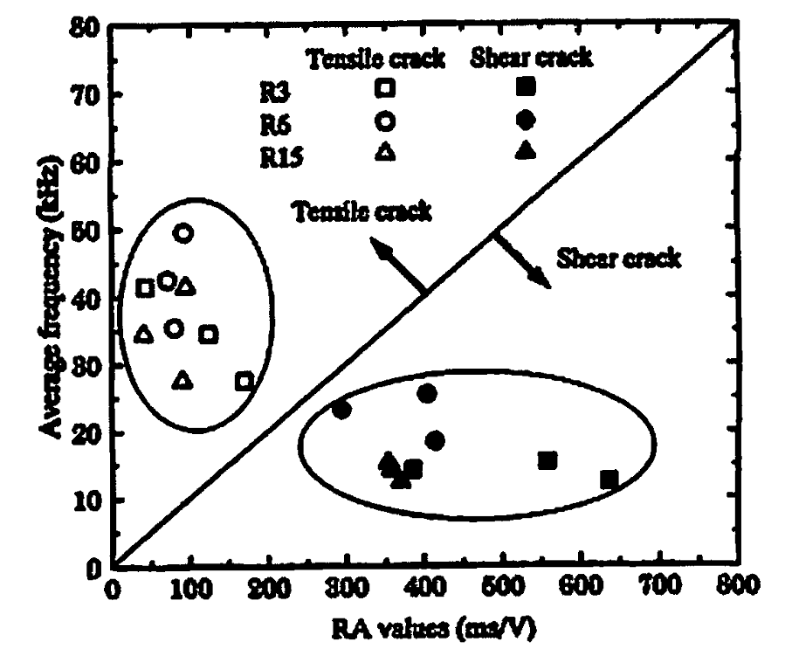
RA-AF-relationship assessment
Duration time
count
rise time
RA = rise time/maximum amplitude
AF = Ncounts/ duration time
Disadvantages :
Sharp start of the AE signal
Threshold level uncertainty
The separation line has the slope
dependent on various conditions
Oho Kanji. Application of acoustic emission for structure diagnosis. 56 konferencja naykowa. Kielce-Krynica. 2010
Typification by the method RA-AF

Slide 9
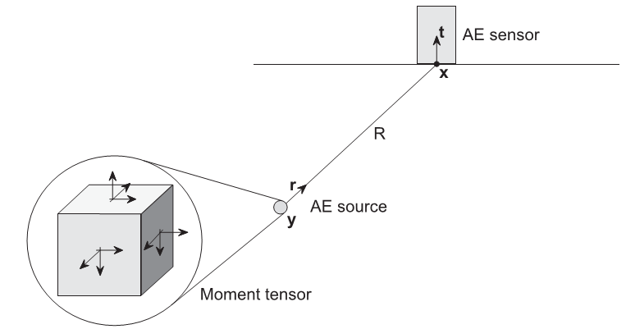

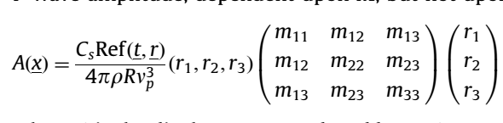
Method of inversion of the seismic moment tensor
u(x,t) – the displacement of the medium at point x at time t
G(x,y,t) - Green's function describing the field of a point source y
Mpq – symmetric seismic moment tensor
S(t) – source influence function
M. Ohtsu Acoustic Emission Theory for Moment Tensor Analysis
Res Nondestr Eval .1995. № 6. P.169-184

Slide 10
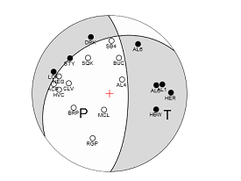
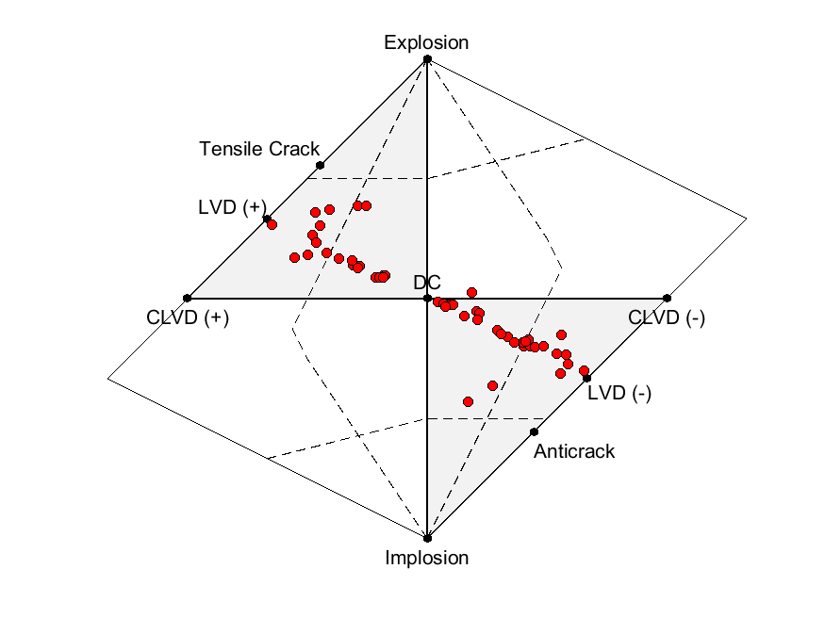
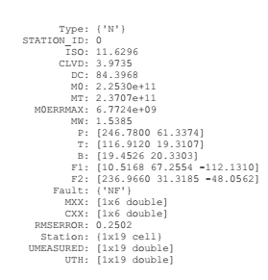
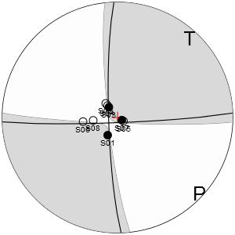
HybridMT: A MATLAB/Shell Environment Package for Seismic Moment Tensor Inversion and Refinement
The method is intended for seismic data and is adapted to laboratory data
HybridMT: A MATLAB/Shell Environment Package for Seismic Moment Tensor
Inversion and Refinement/ Kwiatek et. al, 2016

Slide 11
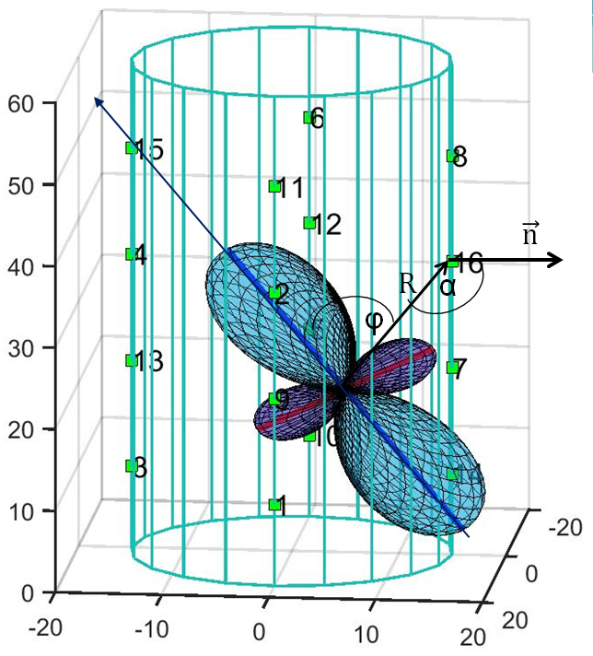
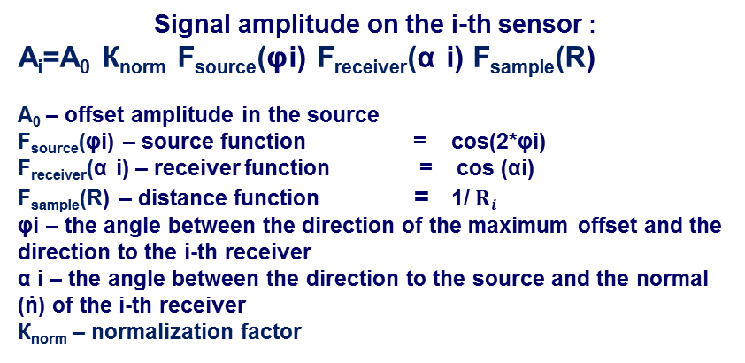
The proposed algorithm for determining the values and directions of the compression and tension axes in the AE source-Acoustic Emission Source Axial Method (AESAM)
A⁻ /A⁺ <0.1 T- type
A⁻ /A⁺ ≥ 0.1 S- type A⁺ /A⁻ ≥0.1
The source model is a double dipole with the directions of the compression and tension axes.
ῑ ⁺ A⁺
ῑ ⁻ A⁻
A⁺ /A⁻ <0.1 C- type
Axes coordinates and modules in the source
separation events into types
Select three sensors with large amplitudes of the first arrivals of the same signs. By successive iterations, we change the offset amplitude A₀ and the direction of the vector ῑ . We choose the direction, corresponding to the minimum of total difference error of the calculated and registered amplitude on each of these sensors.

Slide 12
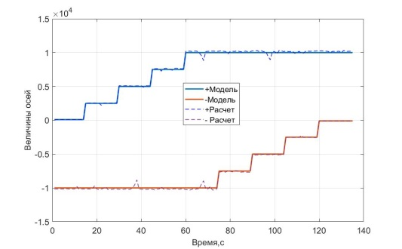
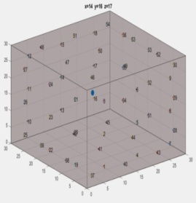
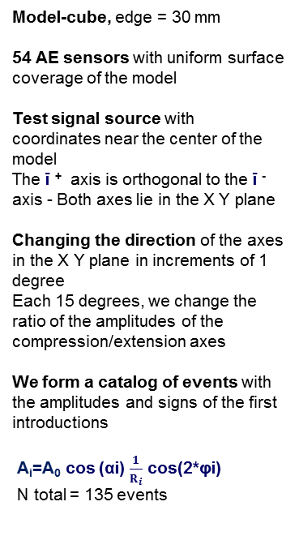

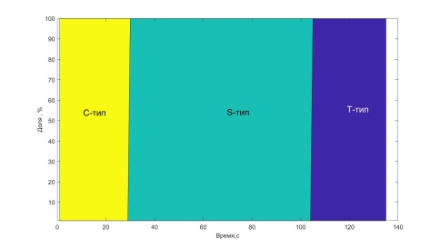
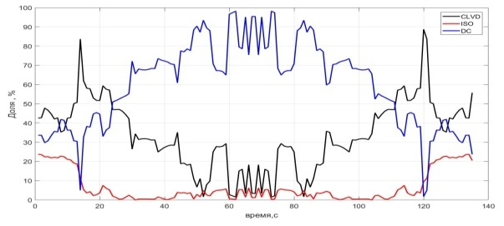
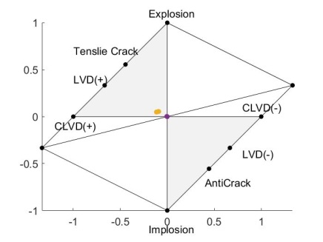
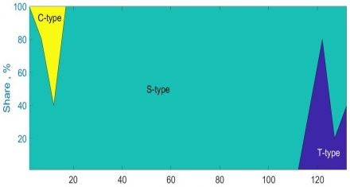
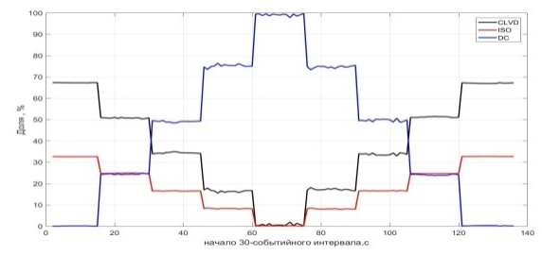
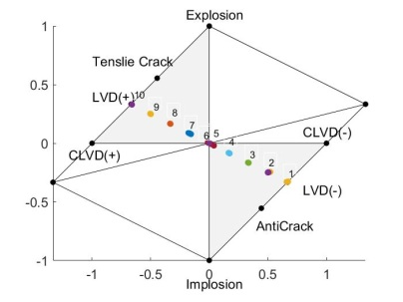
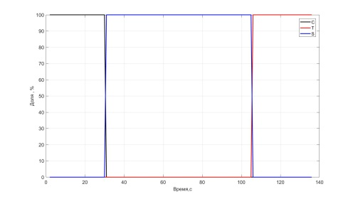
Testing the algorithm on a numerical model
We determinate the mechanisms and types of events using three methods.
Model
AESAM
P,T amplitude values
Typification
№ of model event
Zang (1998)
C_{iso} C_{clvd} C_{dc}
Hudson diagram
HybridMT
HybridMT
HybridMT
Percentage share Percentage share
AESAM
AESAM
AESAM
№ of model event
№ of model event

Slide 13
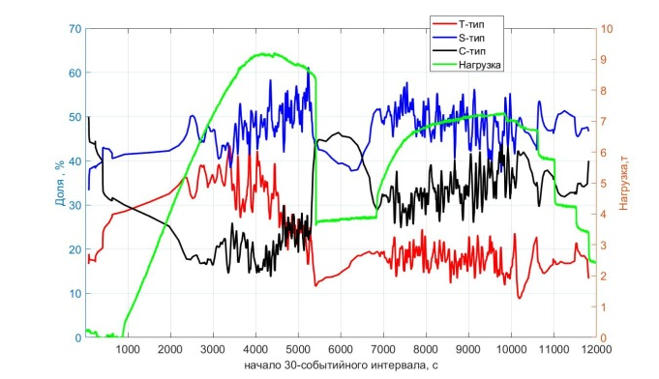







Experiment of Sandstone
Porosity 18%.
Sample strain rates 10⁻⁶ s⁻¹ .
Load, МПа.
HybridMT AESAM Zang (1998)
Percentage share Percentage share Percentage share
Load, МПа Load, МПа Load, МПа
AE activity, ev/s
Рс, МПа.
Loading history
Time, s
Number of events , total : 59827 ev.
Used by:
HybridMT 11520 ev.
AESAM 11071 ev.
Time, s
Start of 20-event’s window, s

Slide 14


Dynamics of the seismic moment tensor components
Load, МПа
Percentage share Percentage share
Load, МПа Load, МПа
Load, МПа
Start of 20-event’s window, s
Time, s

Slide 15


Hudson Diagram
AESAM method
HybridMT method

Slide 16










Dynamics of the distribution of AE event types
events
Load, МПа.
Pc, MPa
AE activity, ev/s
Time, s
events

Slide 17









Experiment on granit
Porosity 0.4%.
Sample strain rates 10⁻⁶ s⁻¹ .
Рс=10МПа
Load, МПа.
AE activity
Рс*8, МПа.
Рр*8, МПа.
number of events: total 34752 ev.
Participate in processing :
HybridMT 2730 ev.
Original 2664 ev.
Time, s
Loading history
HybridMT AESAM Zang (1998)
Percentage share Percentage share Percentage share
Percentage share Percentage share
Time, s
C_{iso} C_{clvd} C_{dc}
Time, s.
Hudson diagram
С-type S-type Т-type

Slide 18








Dynamics of the distribution of AE event types
events
Load, МПа.
AE activity
Pc, МПа.
Time, s
events

Slide 19
Conclusion
Acoustic Emission Source Axial Method (AESAM) for determining the mechanism of the source of acoustic emission signals recorded in laboratory experiments has been developed.
The method is based on determining the values and directions of the compression and tension axes in the signal source by the amplitudes and signs of the arrival of elastic waves on piezoelectric sensors.
A comparison of different methods for determining the mechanisms of sources based on data from model and real experiments is carried out.
It is shown that the AESAM method is in good agreement with the method of Zang(1998) both on model data and on real experimental data. The method has good reproducibility of model data and a more physical representation of real experiments.
The AESAM method allows you to calculate the seismic moment tensor and set the source type and the direction of the compression-tension axes for the minimum number of definitions of the entrance signs.

Slide 20

Thanks for your attention!
Dynamics of hypocenters of acoustic events during the sandstone test
Blue line – axial load Mpa
Green line – AE activity, ev/s.
Sample strain rate: 10⁻⁶ s⁻¹
Рс=10 Mpa
Рр=2 MPa.

