Slide 1


The changes in Dyke fish ponds in the Guangdong-Hong Kong-Macao Greater Bay Area over the past 40 years
Presenter: Zhang Wenxin
Institution: School of Geography and Remote Sensing, Guangzhou University, China

Slide 2
Abstract
Mulberry-based fish ponds are representative traditional eco-agriculture in the Guangdong-Hong Kong-Macao Greater Bay Area (GBA). Investigations about the changes in such ponds and the corresponding water environment during rapid urbanization could be a key reference for the protection and sustainable development of these ponds. Using the Landsat imagery obtained after 1986, this study employed supervised classification, visual interpretation, and metrics of water intensity index and synthesized index, to identify the spatial patterns of the changes in the GBA. The results indicated that, during the period 1986-2013, the total surface area of fish ponds increased significantly, with a total increase of 84.17%. In the following period 2013-2019, the total surface area gradually decreased, with a total drop of approximately 31.30%. The changes in fish ponds were suspected mainly caused by rapid urbanization and resultant land use change, industrial transfer, policy guidance and financial motives. The shrinkage in fish ponds is expected to remain in the future.

Slide 3
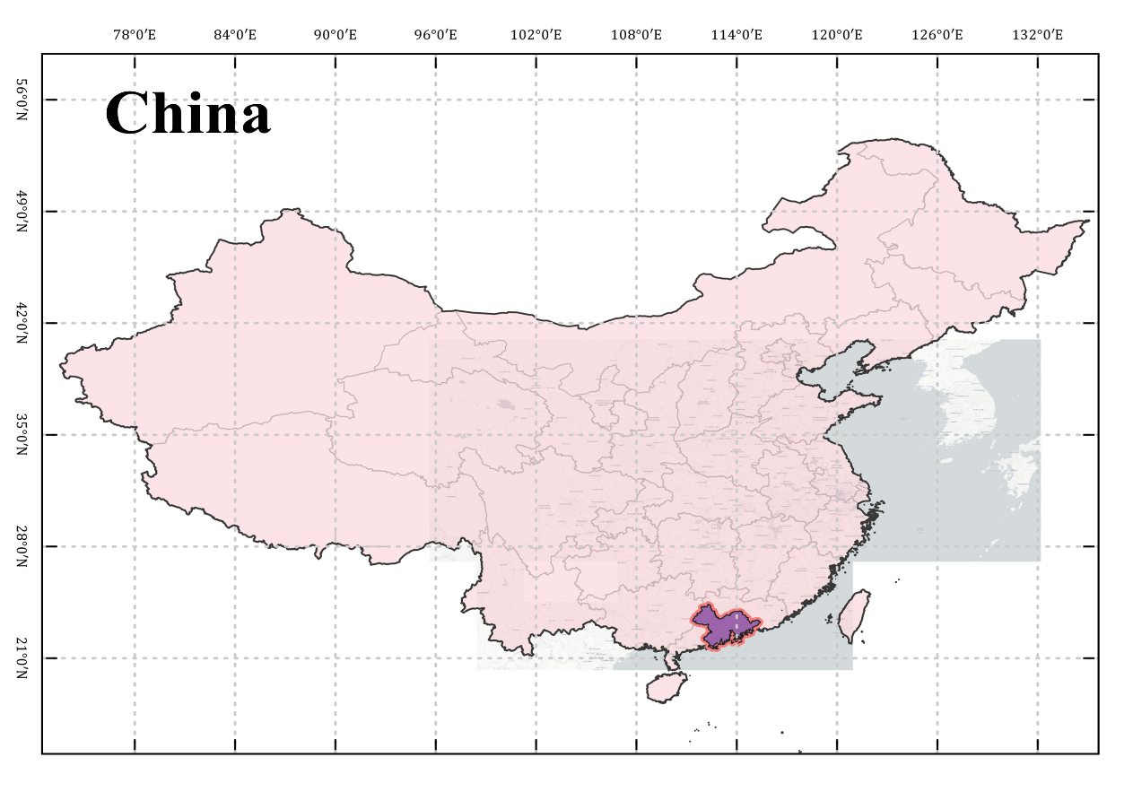
Study Area
Figure 1. Location of Guangdong-Hong Kong-Macao Greater Bay Area (GBA)

Slide 4
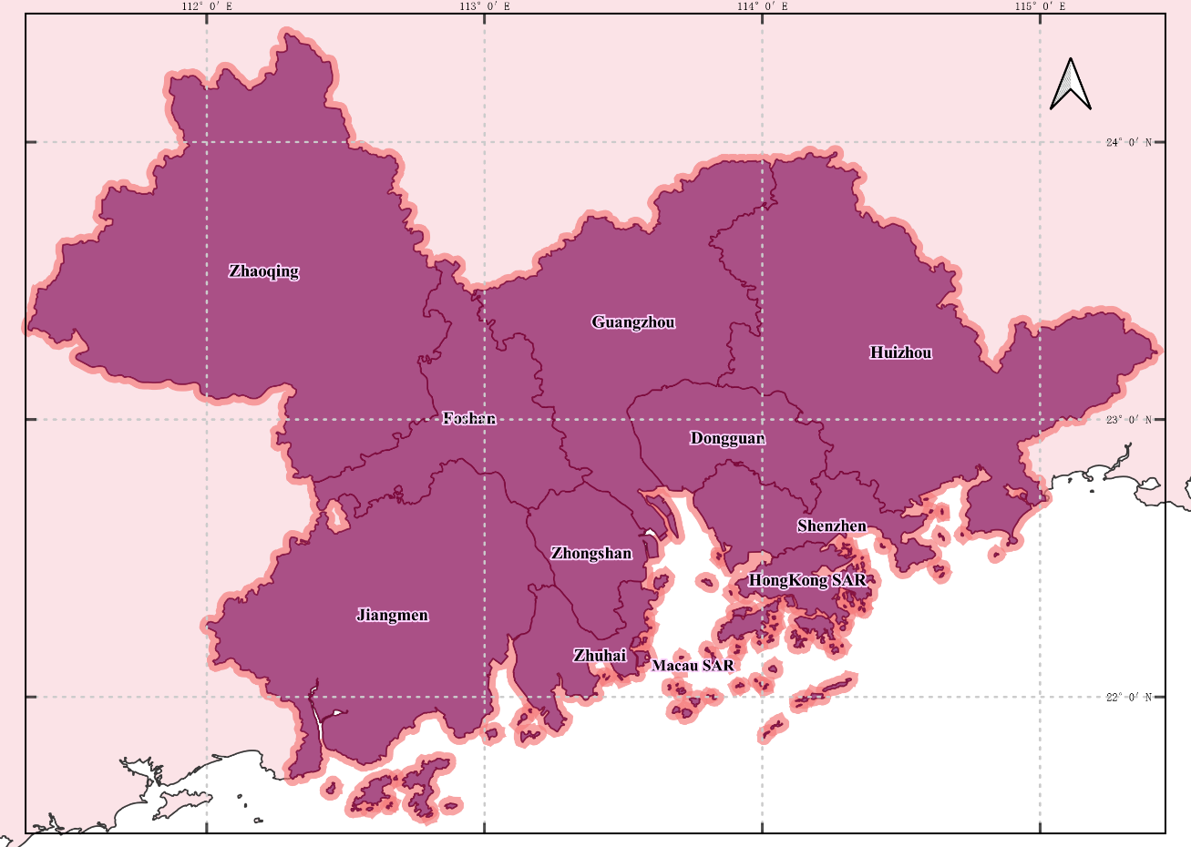
Study Area
Figure 2. Municipal administrative divisions of the GBA

Slide 5
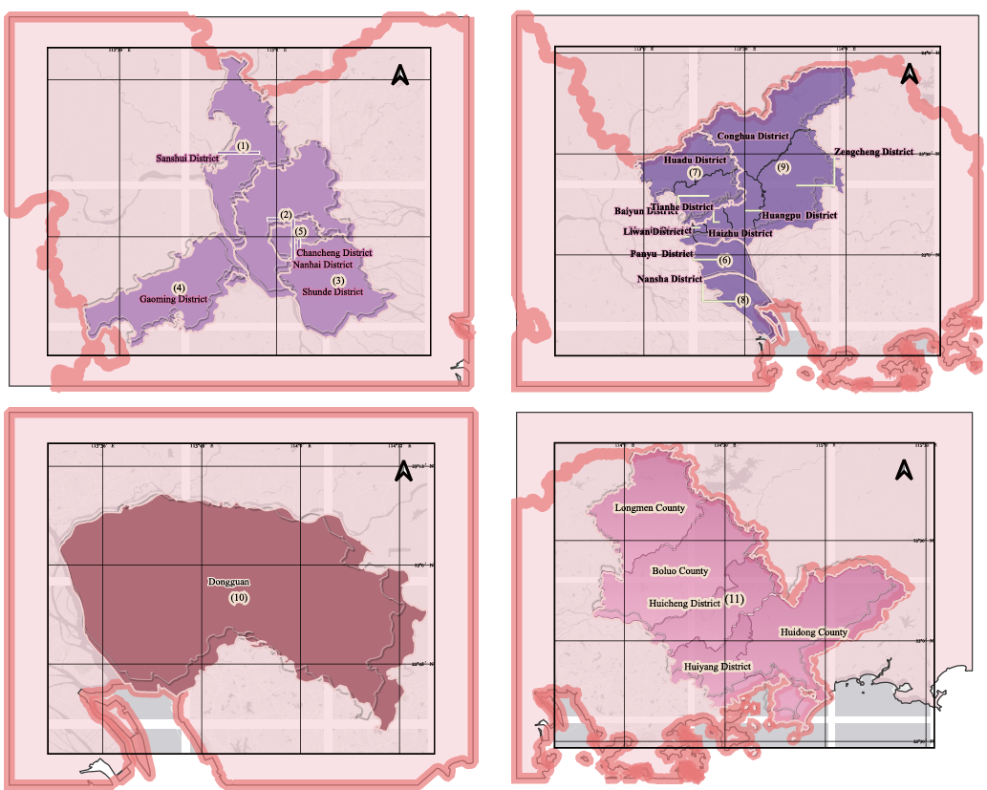
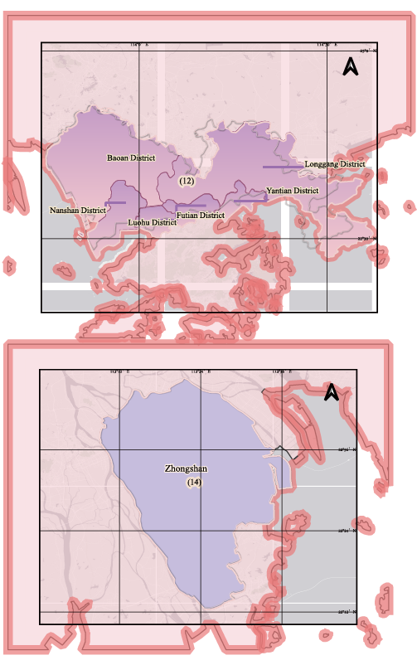
Study Area
Foshan
Guangzhou
Shenzhen
Dongguan
Huizhou
Zhongshan
Figure 3. The location of research units-1

Slide 6
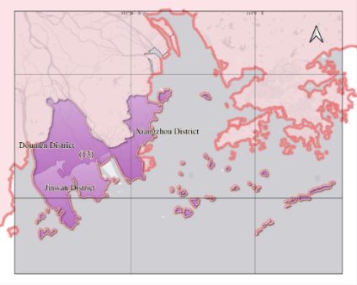
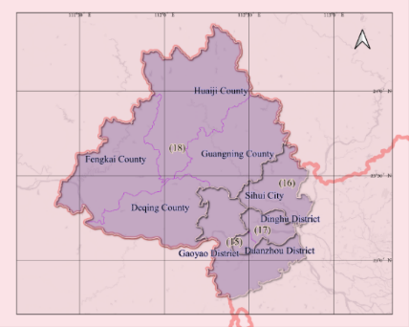
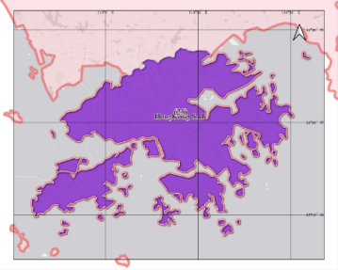
Study Area
Zhaoqing
HongKong SAR
Zhuhai
Figure 6. The location of research units-2

Slide 7
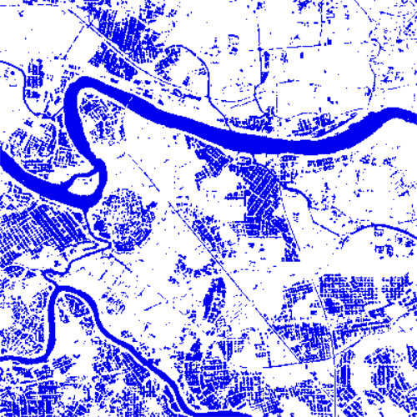
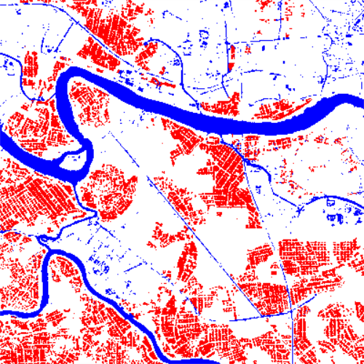
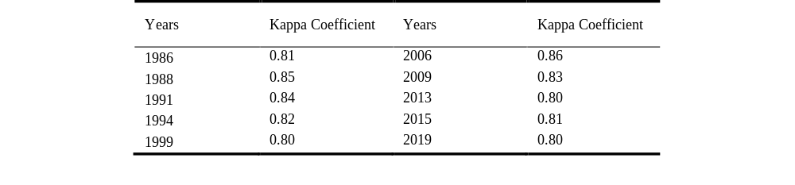
Methods
Table 1.Fish ponds classification interpretation accuracy
(a) Results of the support vector machine (SVM) method in supervised classification
(b) Results of visual interpretation approaches extraction
Figure 8. The classification results and the subsequent visual interpretation results
The results were shown in Table 1. The Kappa coefficients of fish ponds interpretation in each year were all above 0.8, indicating that the interpretation accuracy is good and can be used for subsequent data analysis.

Slide 8
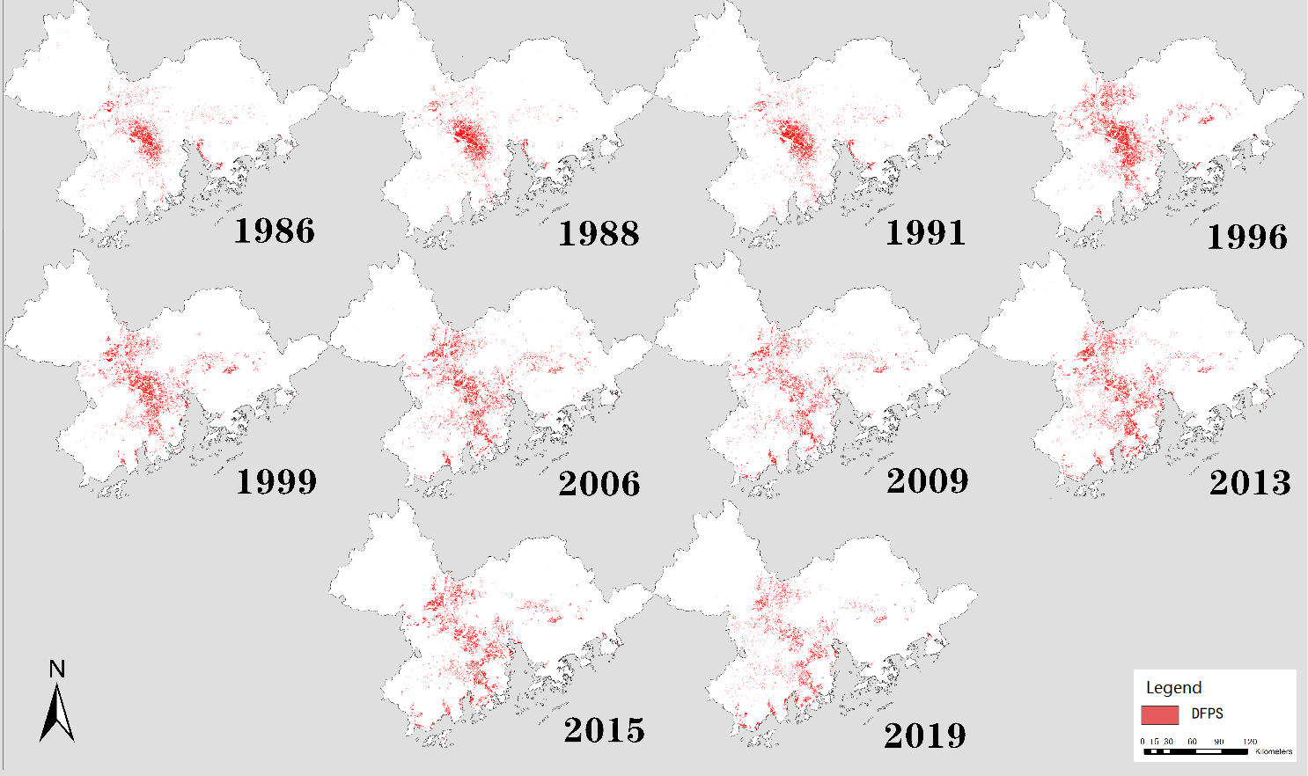
Methods
Figure 9. Fig.3 The corresponding image analysis results for the aforementioned 10 periods.

Slide 9
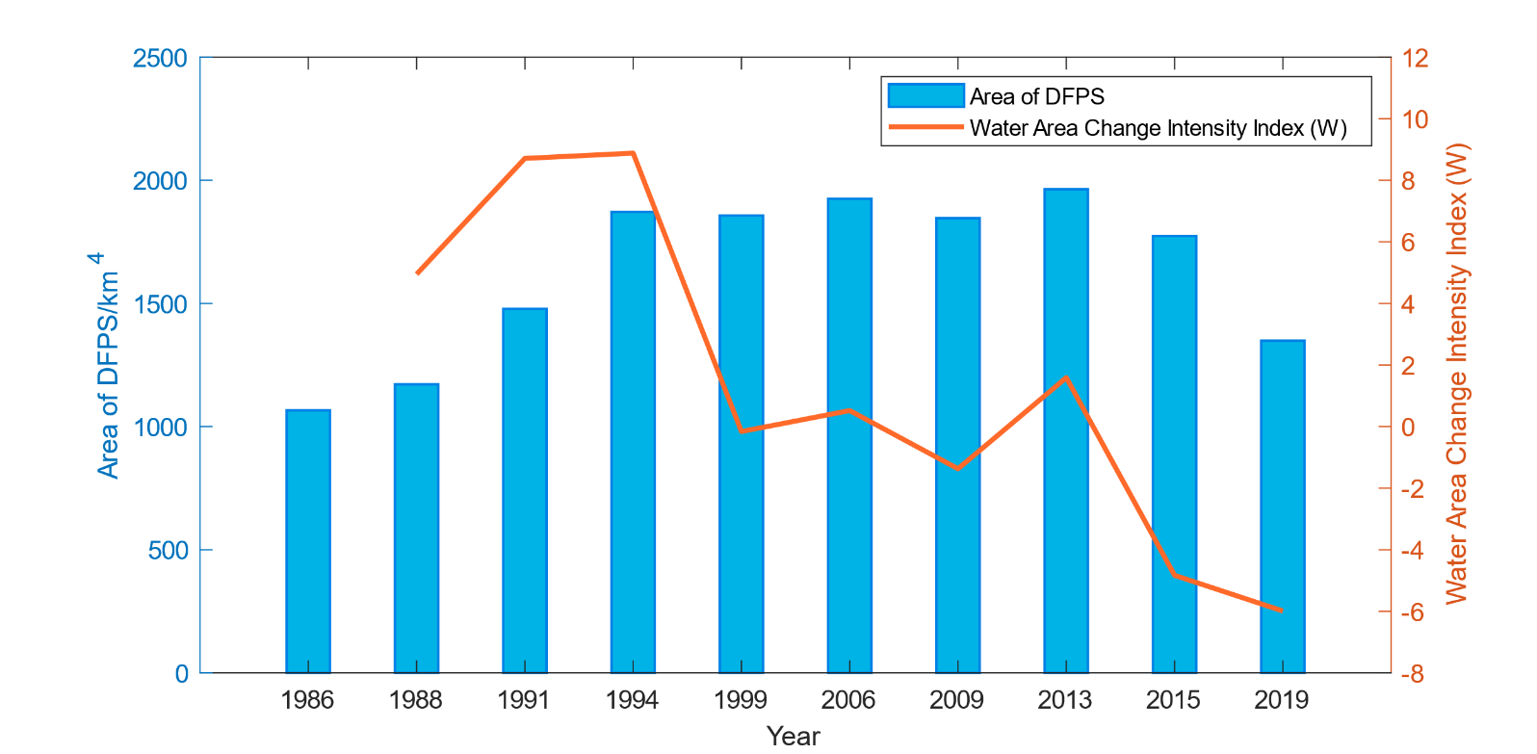
Preliminary Analysis Results
Figure.10 Areal Change fish-ponds in GBA since 1986

Slide 10
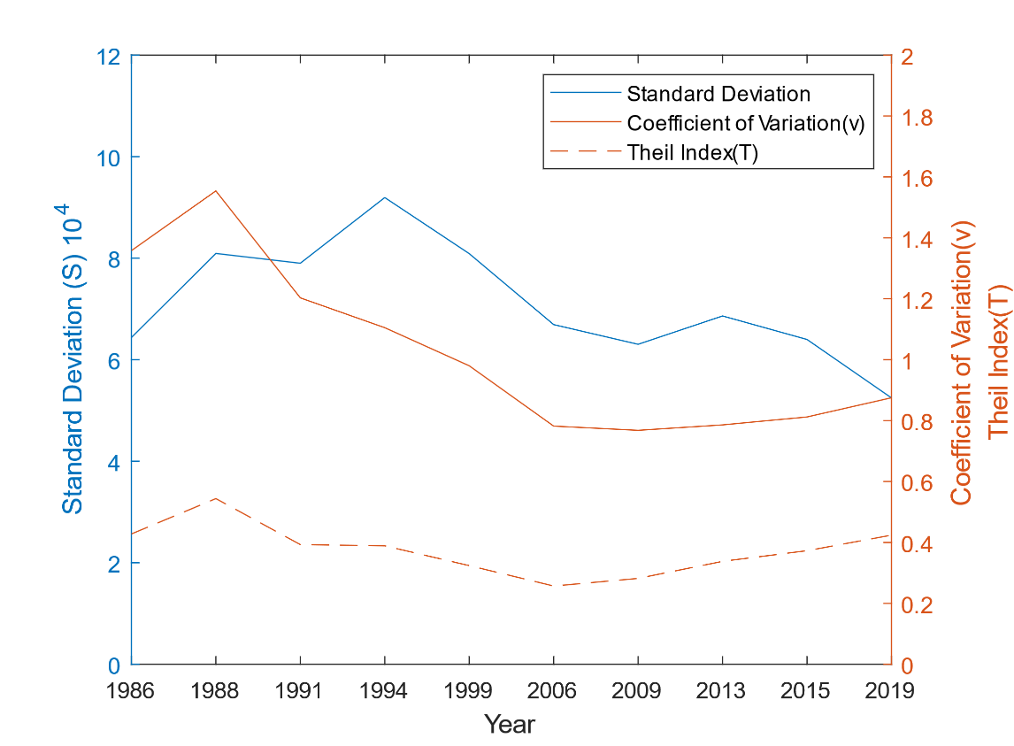
Preliminary Analysis Results
Figure.11 Variation in the statistical disparities of fish-ponds in GBA from 1986 to 2019

Slide 11
Next Step Plan & Futher Expactations
The changes in fish ponds were suspected mainly caused by rapid urbanization and resultant land use change, industrial transfer, policy guidance and financial motives. The shrinkage in fish ponds is expected to remain in the future. The visualization and the under reasons of spatial changes in the whole time scale needs to be further explored and discussed.

Slide 12
THANK YOU

