Slide 1
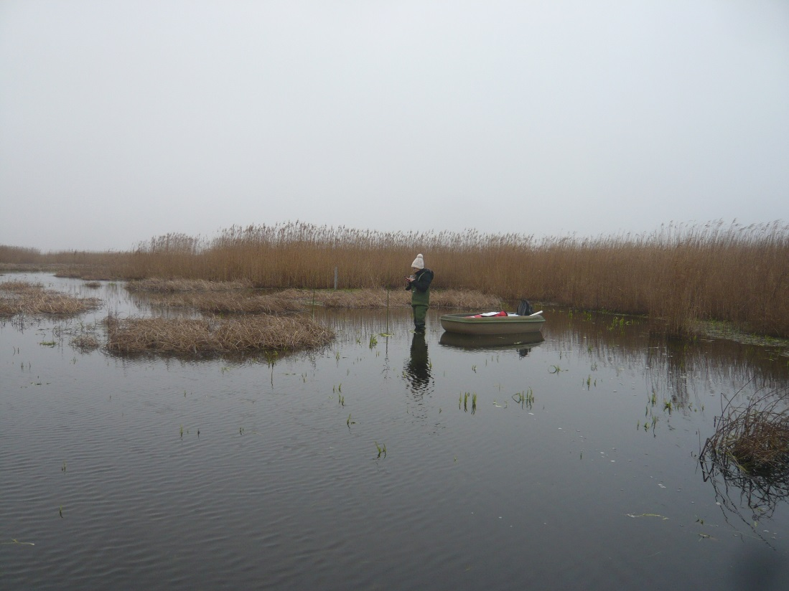
Effects of saltwater intrusion on the methane cycling microbial community of a freshwater rewetted coastal fen
Cordula Gutekunst, Anna K. Jenner, Gerald Jurasinski, Michael E. Böttcher, Franziska Koebsch, Jens Kallmeyer, Klaus-Holger Knorr, Viktoria Unger, Sizhong Yang, Susanne Liebner
Notes:
Keep font sizes

Slide 2
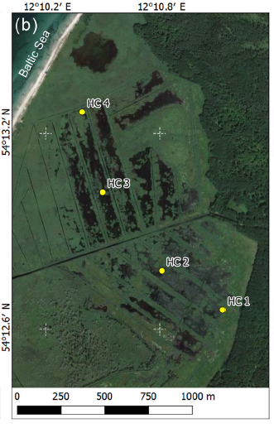
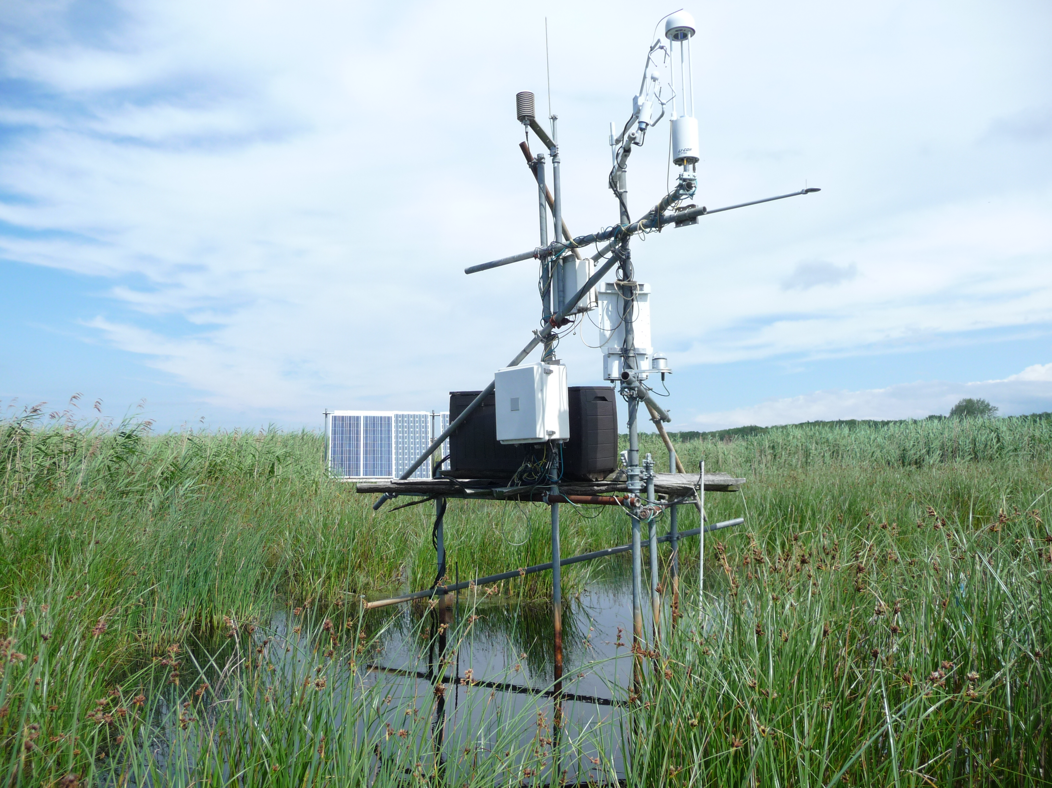
BG5.1 – Session
Brackish water intrusion in January 2019 increased sulfate concentration along a gradient
Eddy covariance and local manual-closed chamber measurements of CO₂ and CH₄
High-throughput sequencing and quantitative polymerase chain reaction (qPCR) of DNA and cDNA
Bacterial and archaeal qPCR target genes were 16S rRNA, mcrA, pmoA, dsrB
Map extracted from Wen et al. 2018

Slide 3
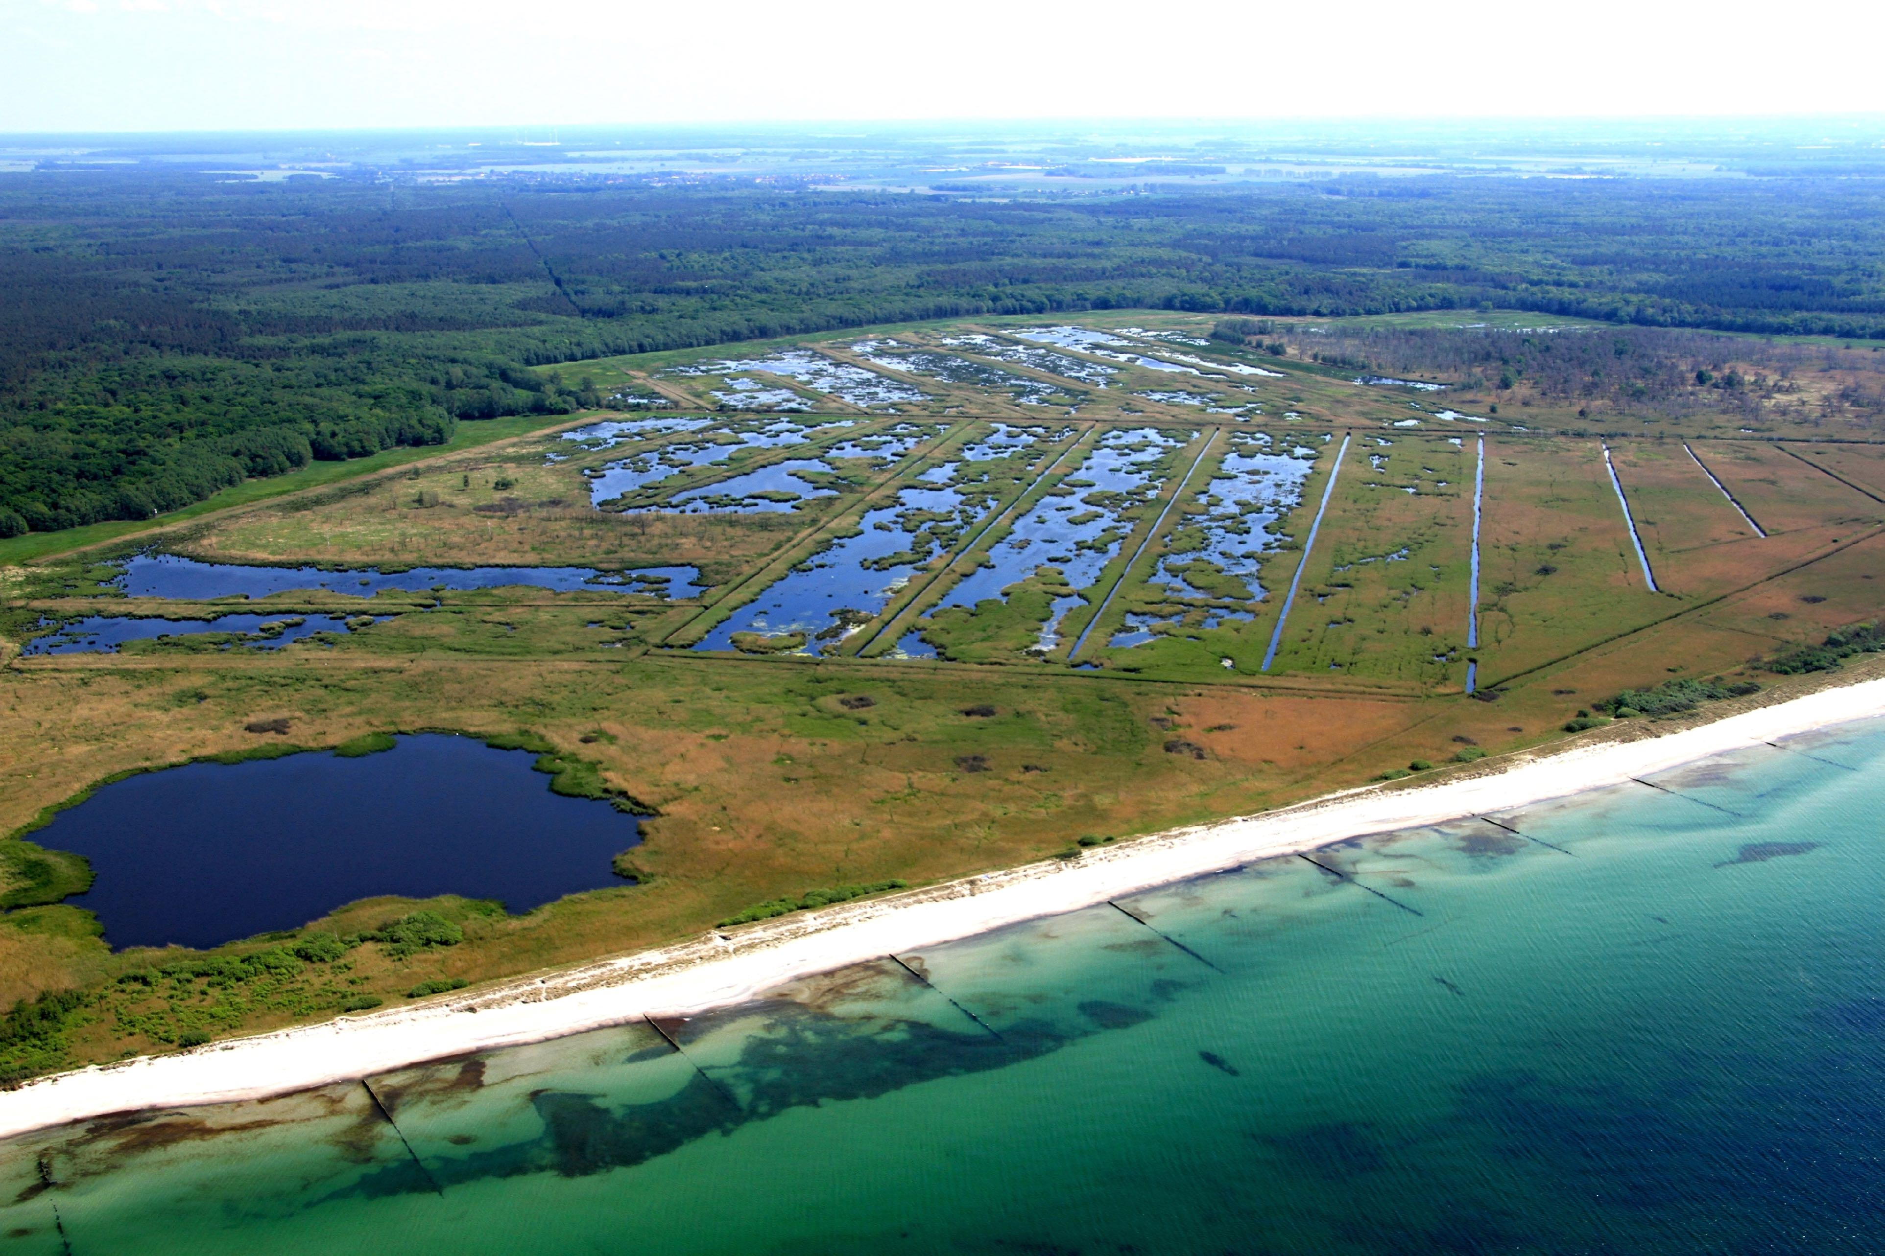
BG5.1 – Session
Methane fluxes decreased in 2019 for first time since rewetting after brackish-water intrusion
Not clear, whether sulfate-containing brackish water or legacy effect of drought in 2018 is the main cause

Slide 4
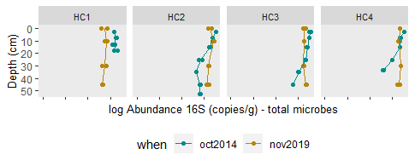
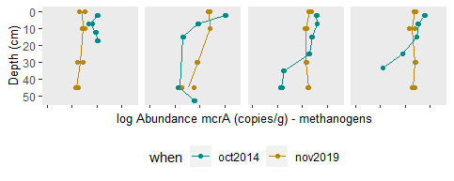
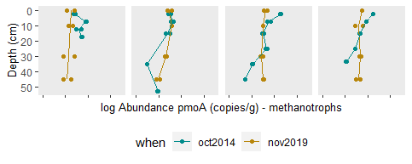
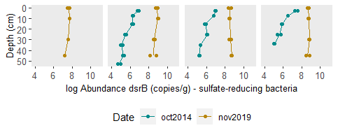
BG5.1 – Session
Sulfate-reducing bacteria increased after brackish water intrusion
Homogeneity along depth increased
Methanogens decreased at surface peat layers
Abundances of sulfate-reducing bacteria increased clearly

Slide 5
BG5.1 – Session
Thank you for your attention!
Baltic TRANSCOAST will be offering
13 new PhD positions
soon!
- Look for calls in August 2021 -
www.baltic-transcoast.com
Email: cordula.gutekunst@uni-rostock.de
Faculty of Agricultural and Environmental Sciences, Landscape ecology, University of Rostock, Germany

