Slide 1



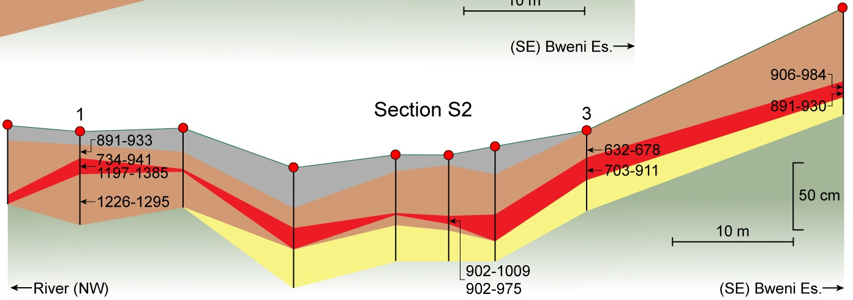
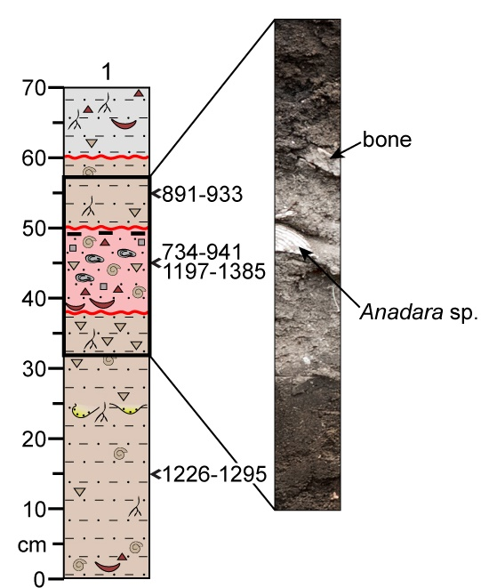
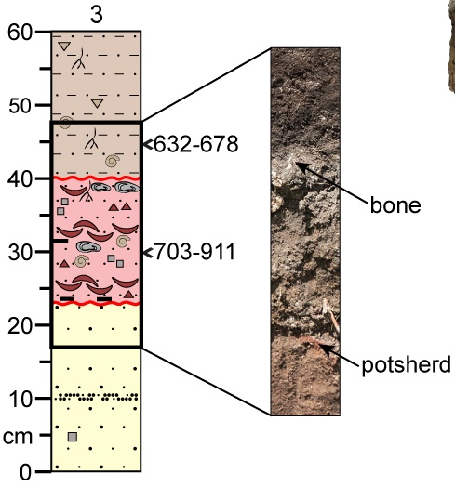
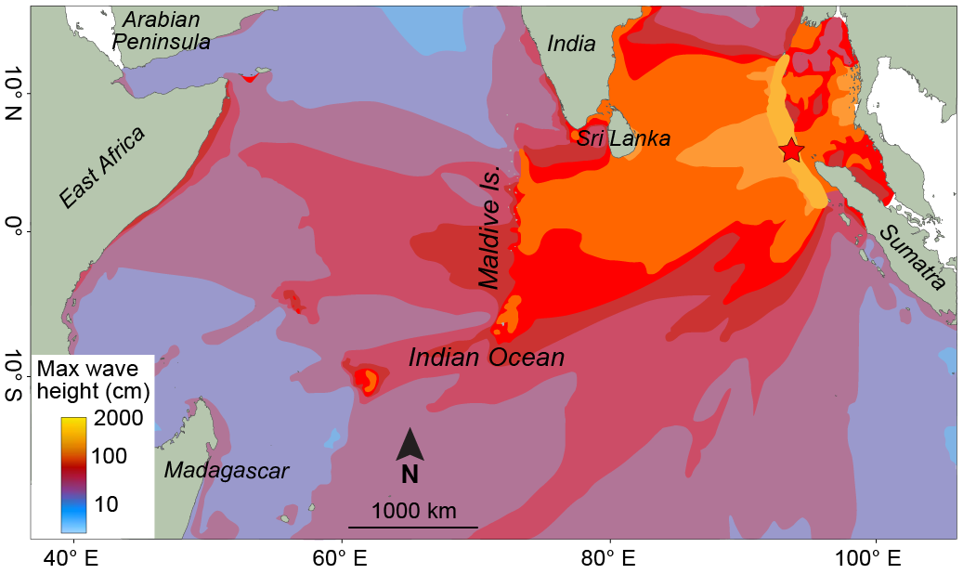
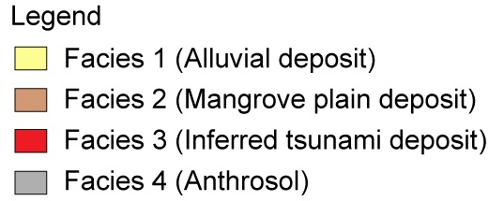
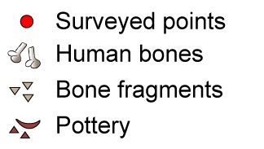
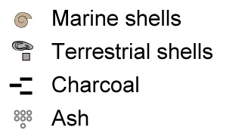
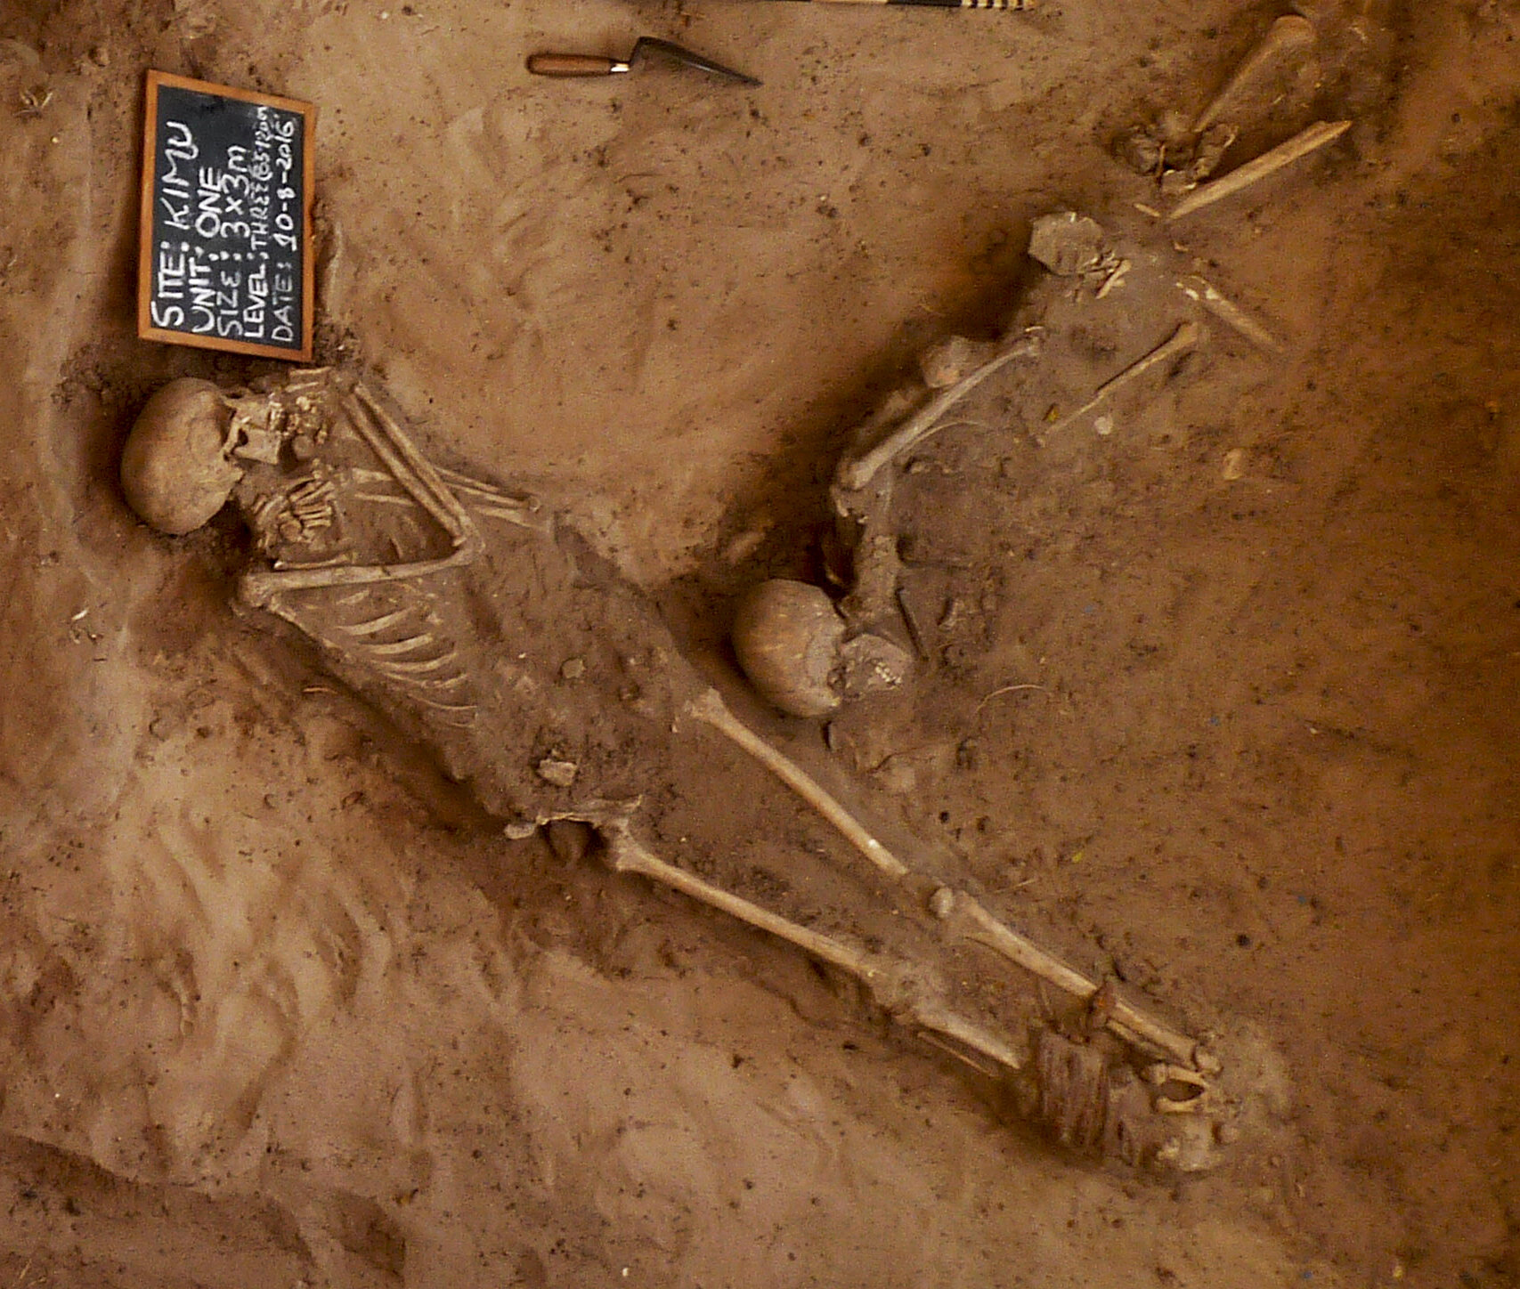
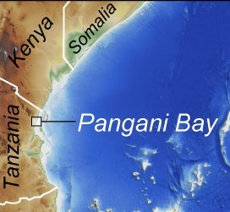
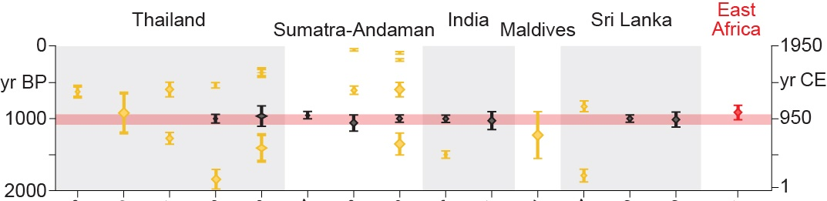
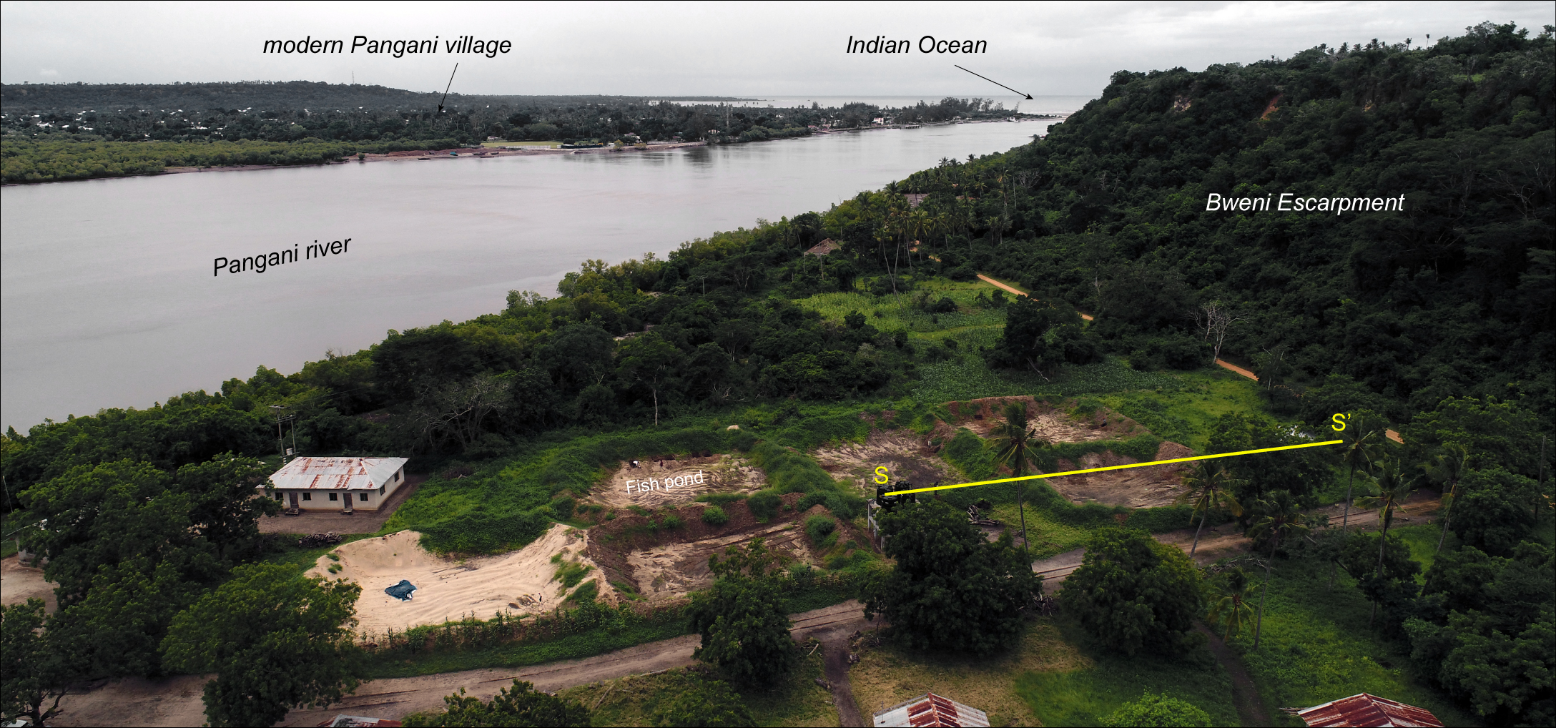
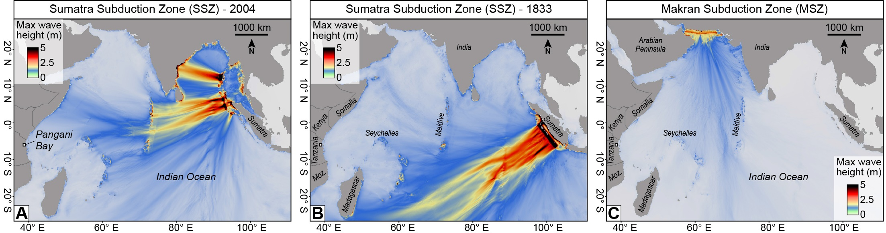
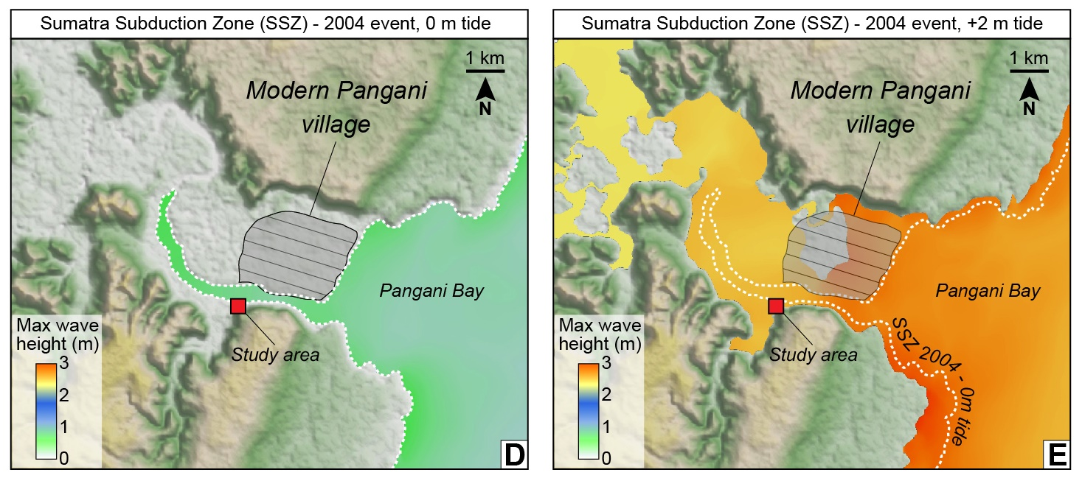
NH5.3 - Geological Records of Tsunamis and Other Extreme Waves
Historical evidence warns about disastrous tele-tsunami risk on the coast of East Africa
Vittorio Maselli, Davide Oppo, Andrew Moore, Aditya Gusman, Cassy Mtelela, David Iacopini, Elisante Mshiu, Elinaza Mjema, Marco Taviani, Joseph Ortiz
contact: vittorio.maselli@dal.ca
RESEARCH QUESTIONS
Is there any evidence of tsunami impacts on Tanzania coastline?
How often should Tanzania anticipate tsunami extreme waves?
FIELD INVESTIGATION RESULTS
1
2
1
2
2004 Sumatra-Andaman earthquake
S S’
?
1,000-yr-OLD TSUNAMIS IN THE INDIAN OCEAN
Source: NOAA
Tsunami records
STUDY AREA – Pangani Bay, Tanzania
- A large rupture of the Sumatra-Andaman plate boundary is the most likely source for the Pangani tsunami.
- Local factors (tide, coastline morphology) amplified the tsunami wave.
- Future field studies are needed to fully evaluate the tsunami risk in East Africa, and the potential sources.
Photo by Elinaza Mjema
TSUNAMI MODELLING INFLUENCE OF LOCAL TIDES

