Slide 1
EGU21-3465
Mechanisms and effects of dry and wet Sahel epochs
John T Bruun, Katy Sheen and Mat Collins
Dr John T Bruun, CPhys
Lecturer in Mathematics specialising in Climate Dynamics and Data Analytics
Diversity Champion, College of Engineering, Mathematics and Physical Sciences
University of Exeter
Chair of the IOP Physics Communicators Group
IOP Women in Physics Group (co-opted)
j.bruun@exeter.ac.uk, johnbruunphysics@gmail.com Funding: NERC, UKRI and Newton Fund

Slide 2
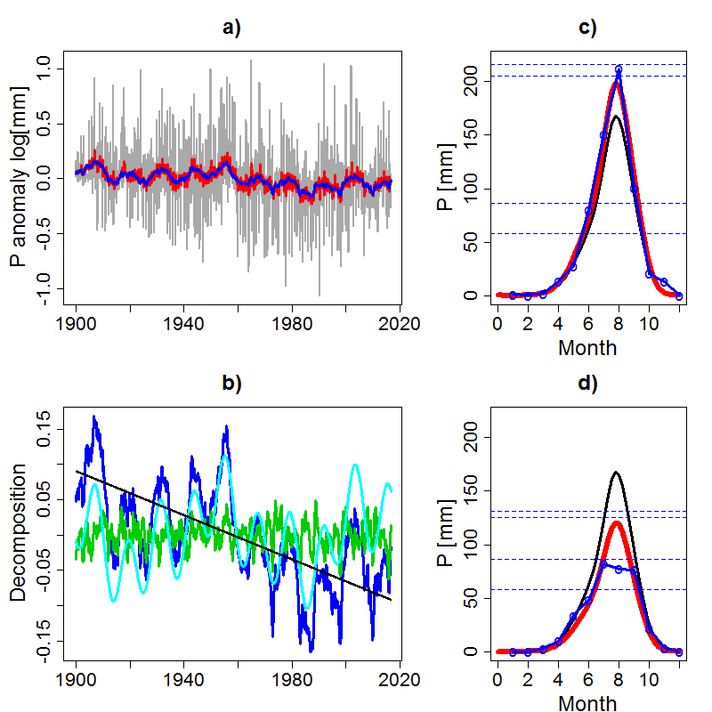
Sahel precipitation P is analysed for its dynamic and teleconnection features
This method helps us identify seasonal modulation to the rainfall pattern, and to help ascertain where extended dry epochs have occurred.
1958
wet
1978 abrupt
change
Long term ${\hat{f}}_{A}$ & $Trend$and some ENSO signal (b: green) modulate rain climate ${\hat{f}}_{s}$ (c, d: black)
1984, dry
Data: this method (Dominant Frequency State Analysis, DFSA) is generic (Bruun et al., 2017; Bruun, Sheen et al., 2019) so can be applied equally to all available simulation and observed records (e.g. Sun et al., 2017). GPCC (1900+) used in this example. Forecast extrapolation approach based on baseline and modulation scenarios.

Slide 3
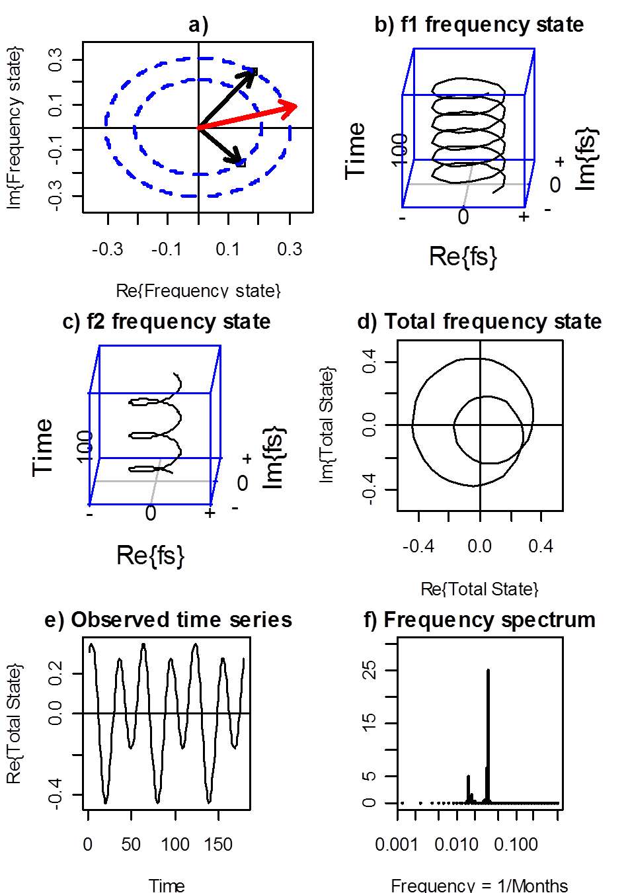
Dominant Frequency State Analysis
Dynamic structure of type:
$\left\{D\left(α\right),ψ\left(r, t\right)\right\}=λ\left(α\right)ψ\left(r, t\right)$
can be resolved from observation and simulation
records as
$y=Re\left\{λψ\right\}+η$
and has frequency states
$λψ=∑f_{m}\left(r,t\right)=f^{S}(r,t)$
This accommodates linear and non-linear dynamics
evaluated at $r=r_{0}$ and tipping parameter $α$
Noise $η$: coloured or white, typically red AR(1)
Extreme Value process tail shape $ξ(α)$
(ENSO analysis: Bruun et al., 2017)
Spatial DFSA analysis: $r→r_{ijl}$ generalises EOF’s (m2d tools)
Fully efficient estimation with likelihood inference: an information entropy approach
Asymptotically no other methods can be more accurate (Cramer-Rao lower bound)
We can accurately identify low signal-to-noise ratio dynamical processes
Hysteresis = the
dynamic characteristic

Slide 4
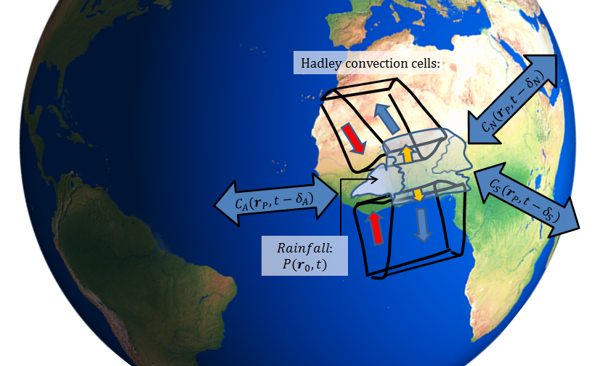
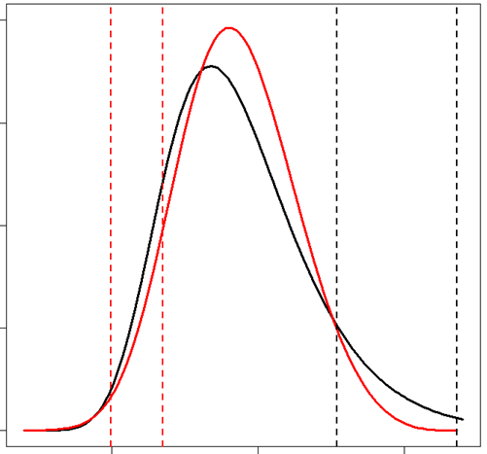
We assess the dry and wet epochs and mechanisms in the Sahel
Use sDFSA for Tropical wave guide transport
zonal velocity $u$ [NCAR]
and Sahel precipitation $P$ [GPCC]
$$P\left(r,t\right)=exp⁡\{f_{S}^{P}\left(r,t\right)+δy^{P}\left(r,t\right)\}$$
$$u\left(r,t\right)=f_{S}^{u}\left(r,t\right)+δy^{u}\left(r,t\right)$$
records: 1900+, monthly. $f_{S}: s$easonal, $δ$: anomaly
Bruun et al. (2019) in submission
Map
Full dynamic process decomposition, including $X$ as Tropical ENSO and Atlantic Dipole $A\left(r,t\right)$
$$δy\left(r,t\right)=μ\left(r\right)+β\left(r\right)X\left(t\right)+{\sum_{m=1}^{n}{f_{m}\left(r,t\right)}}_{ }{+ a\left(r\right)}_{T}{T\left(r,t\right)}^{′} +{a\left(r\right)}_{I} I\left(r,t\right)+a{\left(r\right)}_{A}A\left(r,t\right)+η\left(r,t\right)$$
Nino 3.4 Frequency states $f_{A}$ Trend Interventions Noise (inc. Atlantic)
Noise processes: red noise AR(1) and Extreme Value process $G$
$$G\left(z_{e}^{}, ξ\right)$$
$$η(r,t)={ρ\left(r\right)η\left(r,t−1\right)}^{ }+e(r,t) with e\left(r,t\right)\sim N(0, σ(r))$$
${M(r, t_{a})}_{max}=\max{ \left\{e\left(r,t\right)\right\} ;t∈\left[t_{a}, t_{a}+1 \right), a=1, …, n_{y} }$[e.g. annual max]
$\operatorname{Pr}\left\{{M\left(r_{0}, t_{a}\right)}_{max}≤z_{e}^{}\right\}=G\left(z_{e}^{}\right)=1−p$ ; [$p$ is the return period]

Slide 5
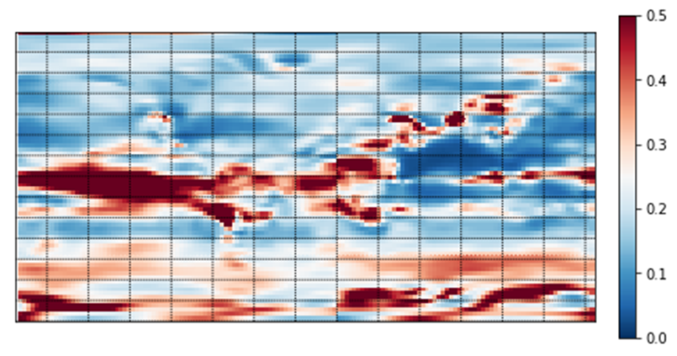
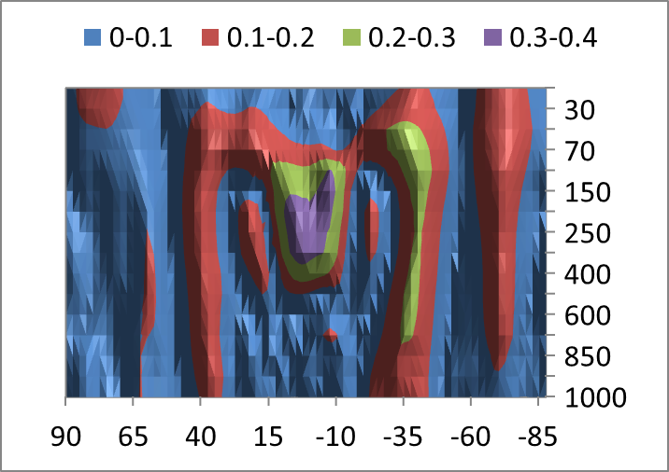
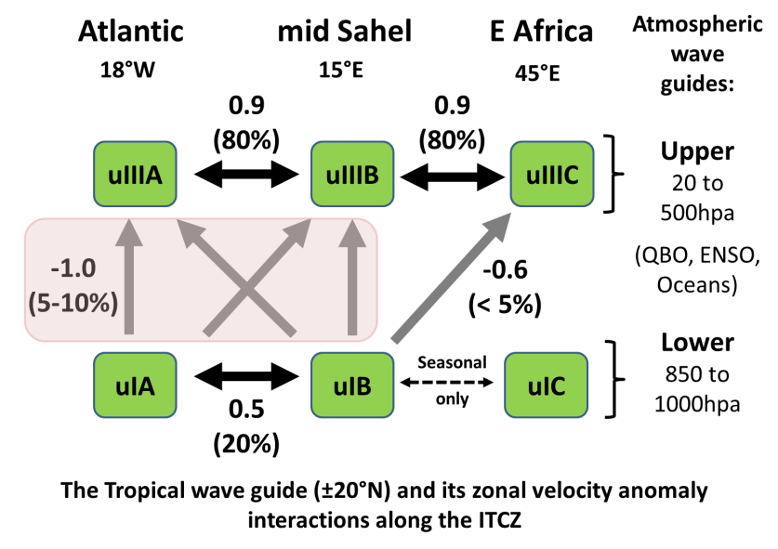
Atlantic - Sahel: tropical wave guide composition
Transport through the wave guide is via wave channels/jets and interactions
$\tilde{u}\left(r=800 hpa\right)$ % spectrum longer than $seasonal$
$\hat{u}\left(r=Atlanitc\right)$ $ENSO effect rms (relative \%)$
Pressure [hpa]
Latitude [ºN]
ENSO effect appears via upper wave channel and Hadley
cell interactions. Note the latitudinal asymmetry…

Slide 6
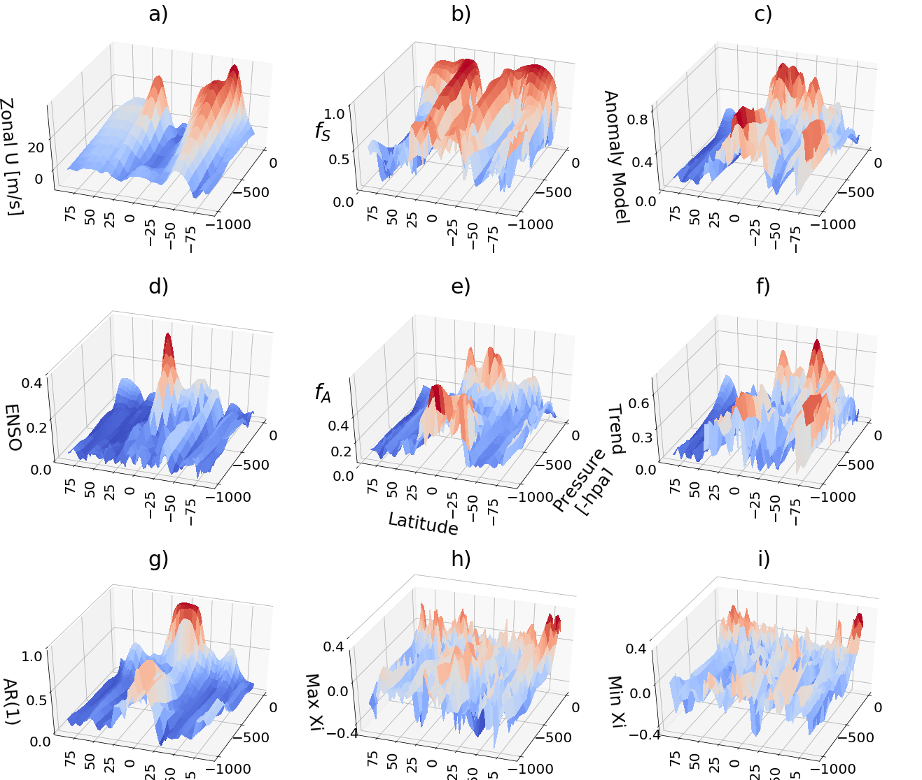
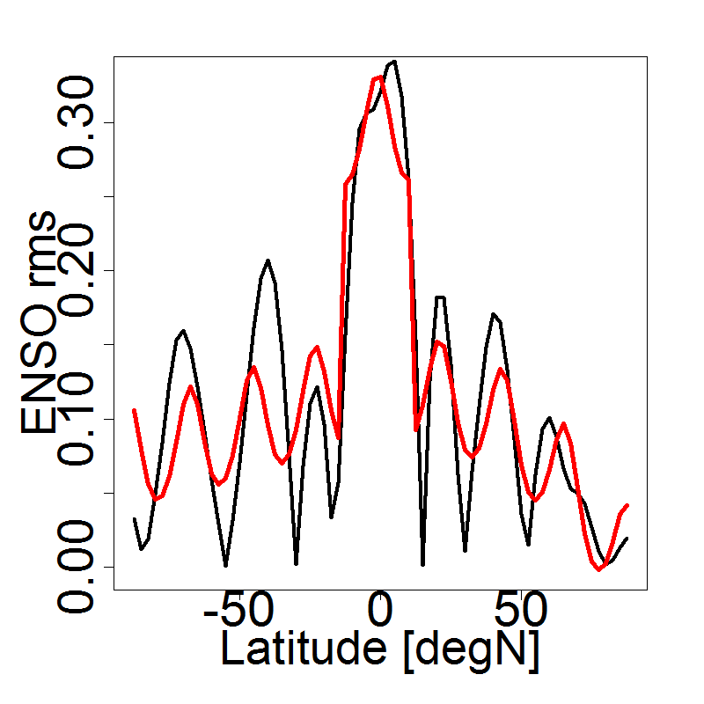
Sahel zonal $\hat{u }decompositions$
The Sahel wave guide properties via sDFSA (m2d tools)
Mid Atlantic ENSO effect
at 300 hpa: $\hat{u}\left(k_{y}\right)$
ENSO effect
Which suggests a tropical –
meridional ENSO
interaction with wave
number 3 in each hemisphere
Atlantic dipole influence
is included in these terms

Slide 7
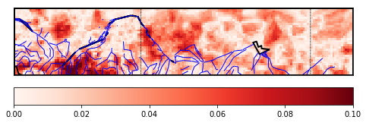
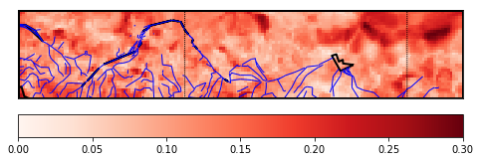
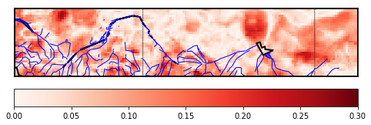
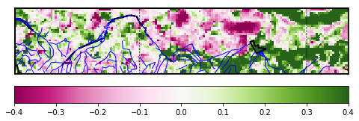
Sahel spatial precipitation characteristic
rms % ( ENSO )
ENSO effect localised
to catchment and Niger
rms % ( $f_{A}$ )
Long term modes
generally homogeneous
Very long term mode
localised to catchments
~ moist static energy…
rms % ( Trend )
Minimum residual
rain, extreme process
Shape (directional):
Higher variability of worst case arid events in West Sahel and
along the rivers: Lake Chad (anthropogenic) dryness feature suggested here
$ξ_{Min}$

Slide 8
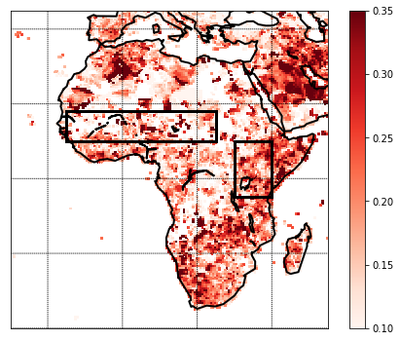
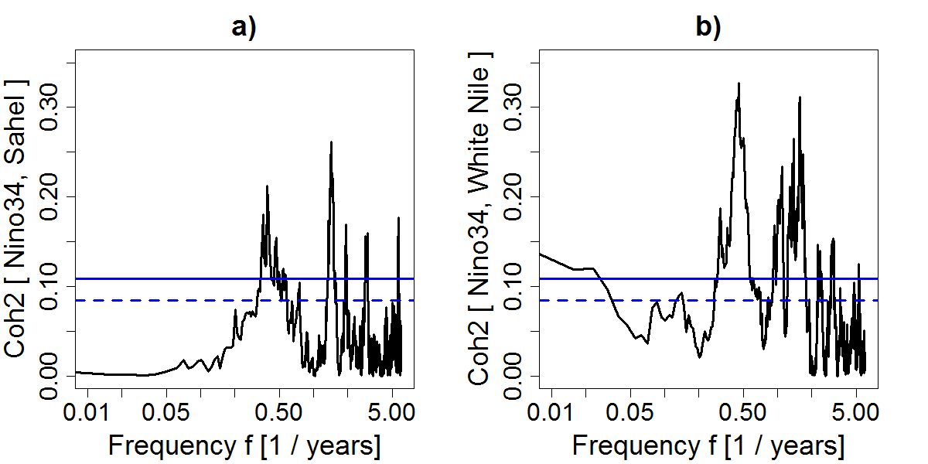
ENSO teleconnection with Sahel and White Nile precipitation via coherence
These coherence spectra show that the Sahel ENSO influence is more subtle than for the White Nile.
Peak $coherence^{2}$
of $ENSO \& Rain$
1.5 to 6 yr band
& significant

Slide 9
Mechanisms and effects of dry and wet Sahel epochs
Dryness linked with modulating convection cells.
ENSO teleconnection through the upper wave channel and potential Latitudinal interaction mechanism
Atlantic dipole effect modules this signal (further investigation in progress)
Increasing aridity of Sahel has more than trends, these combined mechanisms can cause sudden abrupt shifts.
Pronounced dryness in the Lake Chad area
Dominant Frequency State Analysis: sDFSA, m2d tools used to produce model and is being extended to baseline forecasts.

