Slide 1
Gas emissions from the resumption of eruptive activity at Kīlauea Volcano’s summit in December 2020
Christoph Kern¹, Patricia Nadeau¹, Tamar Elias¹, Peter Kelly¹, Allan Lerner¹, Laura Clor¹,
Miki Warren¹, Hannah Dietterich¹, and Taryn Lopez²
¹ U.S. Geological Survey - Volcano Science Center
² University of Alaska Fairbanks

Slide 2
Lava returns to Kīlauea’s summit
Kīlauea Volcano (Hawaiʻi, USA) had been in a state of quiescence since the end of the historic 2018 eruption on its lower East Rift Zone. The 2018 eruption occurred at an elevation of 300 m and drained a large amount of magma from the volcano's summit reservoir and East Rift Zone (ERZ), causing the drainage of a decade-old subaerial lava lake followed by widespread caldera collapse. Before it ended in September 2018, the eruption had erupted more than 1 km³ of lava and released approximately 10 Mt of SO₂ from 24 active fissures in the lower ERZ
(Dietterich et al., 2021, Kern et al., 2020).
Two years later, on the evening of 20 December 2020, the Hawaiian Volcano Observatory (HVO) once again detected a glow within the now vastly deepened Halemaʻumaʻu Crater at Kīlauea’s summit. A new eruption had begun…

Slide 3
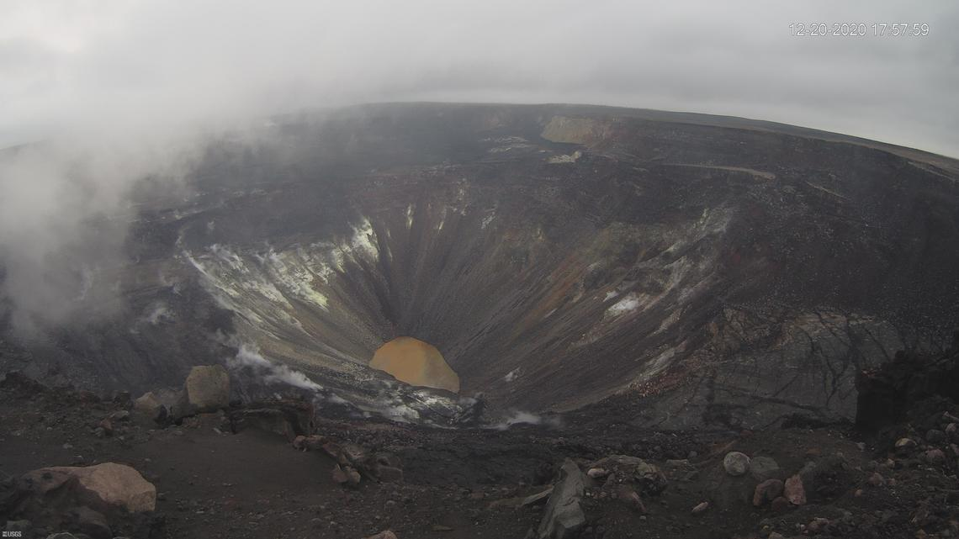
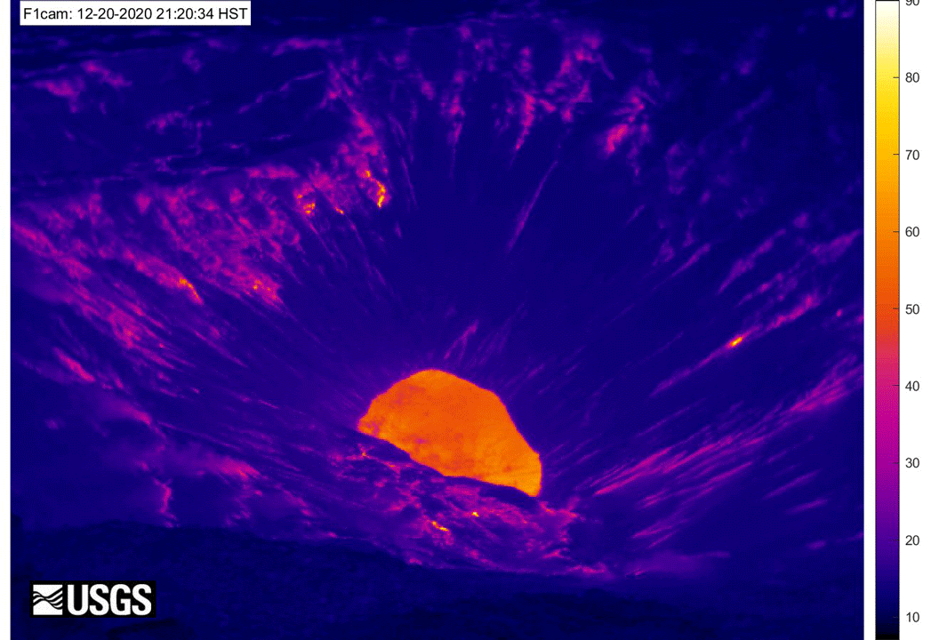
One lake replaces another
Relative Temperature (deg C)
USGS
At approximately 21:30 HST on 20 December 2020, lava began erupting from several vents perched on the northern wall of Halemaʻumaʻu Crater.
As lava flowed down into the crater floor, a water lake which had formed in 2019 – 2020 from groundwater infiltration, boiled off within hours, briefly causing vigorous steaming.

Slide 4
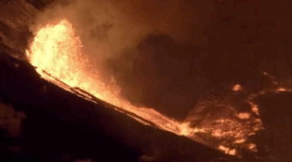
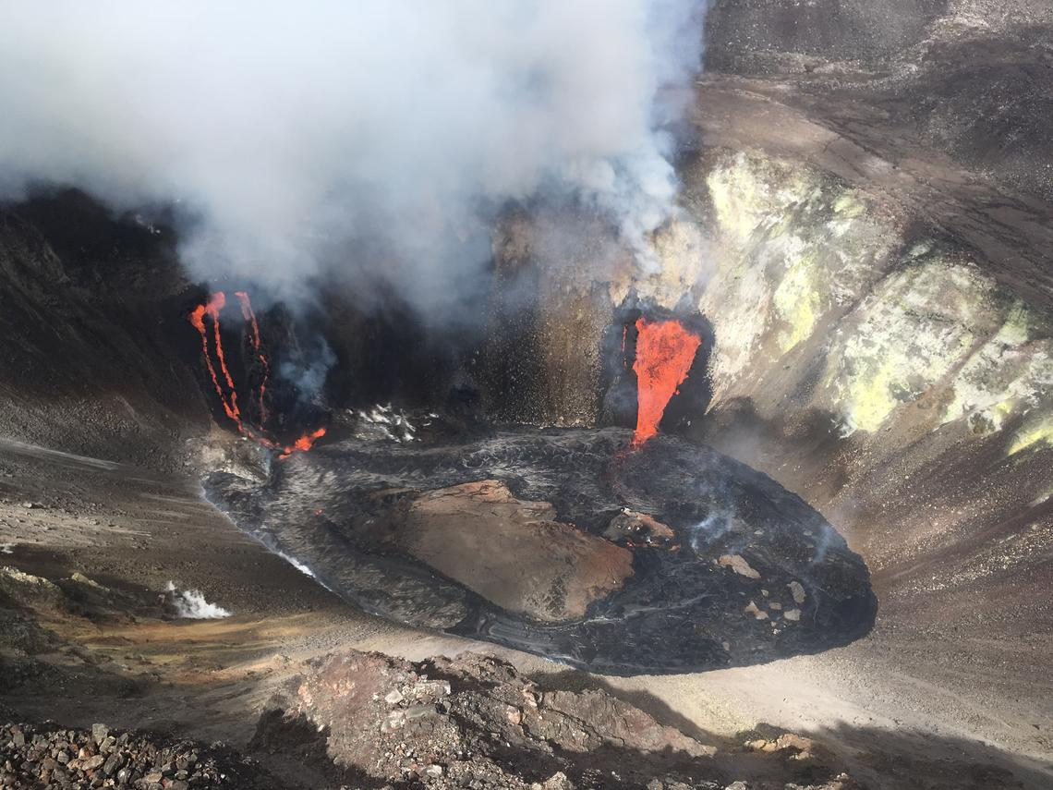
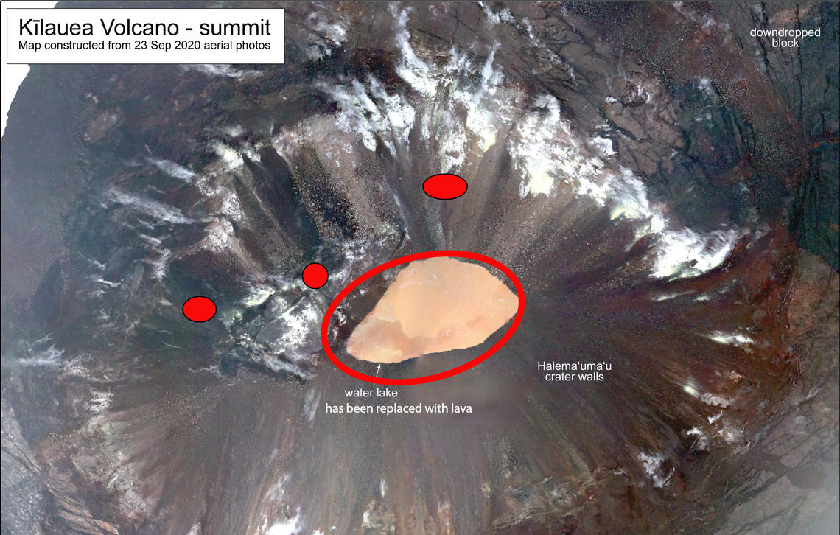
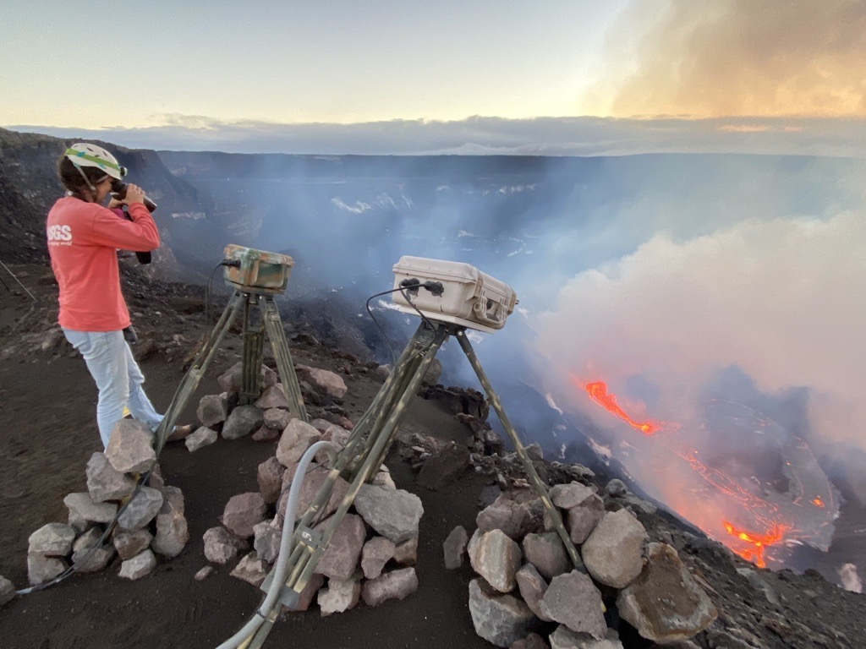
Multiple perched vents feed lava into Halemaʻumaʻu Crater
21 Dec
west vent
north vent
USGS
north vent
USGS
21 Dec
west vent
Aerial imagery from 23 Sep 2020, USGS
300 m
USGS

Slide 5
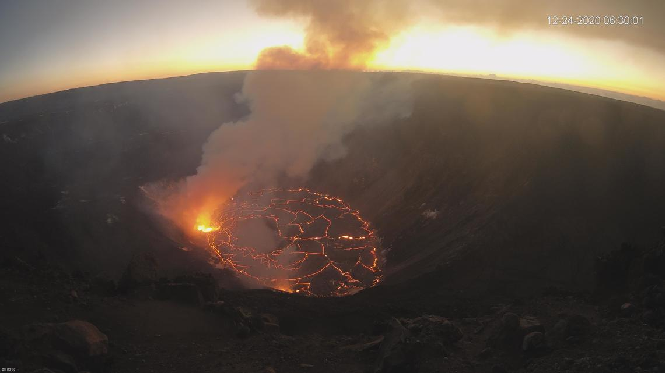
Lava quickly fills the base of Halemaʻumaʻu Crater
20 December
24 December
USGS
USGS
In the first four days of the eruption, the lava level in Halemaʻumaʻu Crater rose by more than 100 m, indicating effusion rates approaching 100 m³/s (see slide 10 for details).
SO₂ emissions associated with this activity initially exceeded 50,000 t/d (see slide 8).

Slide 6
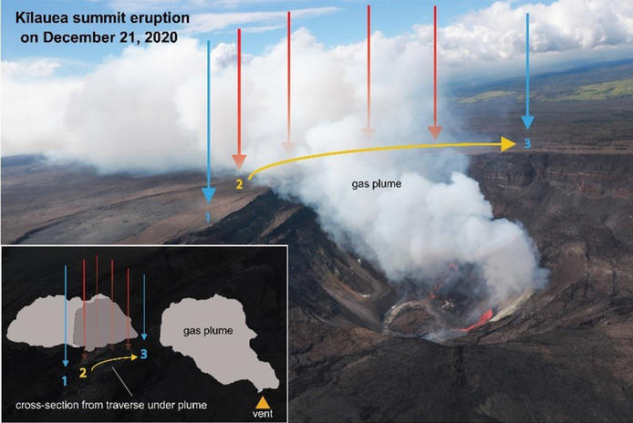
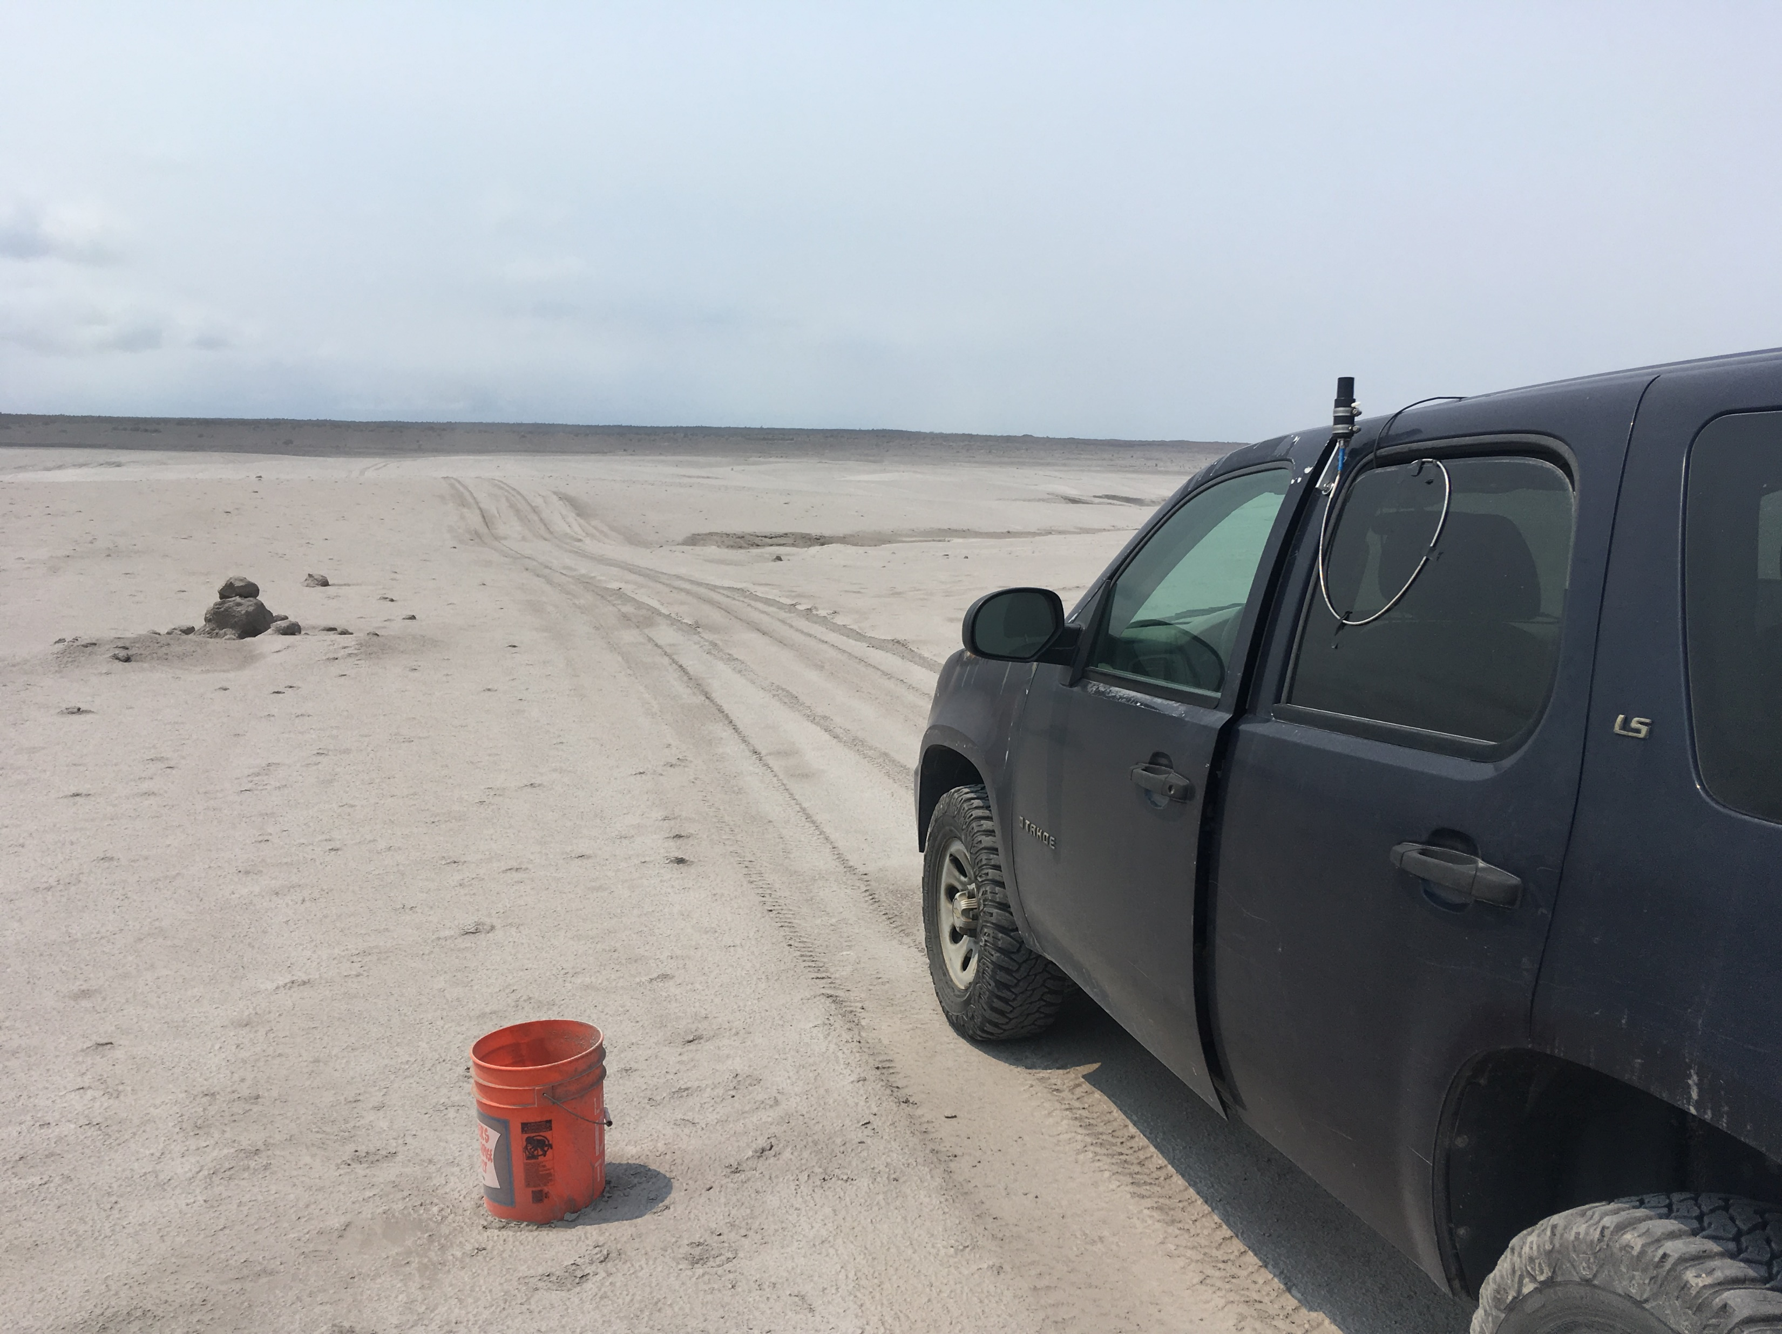
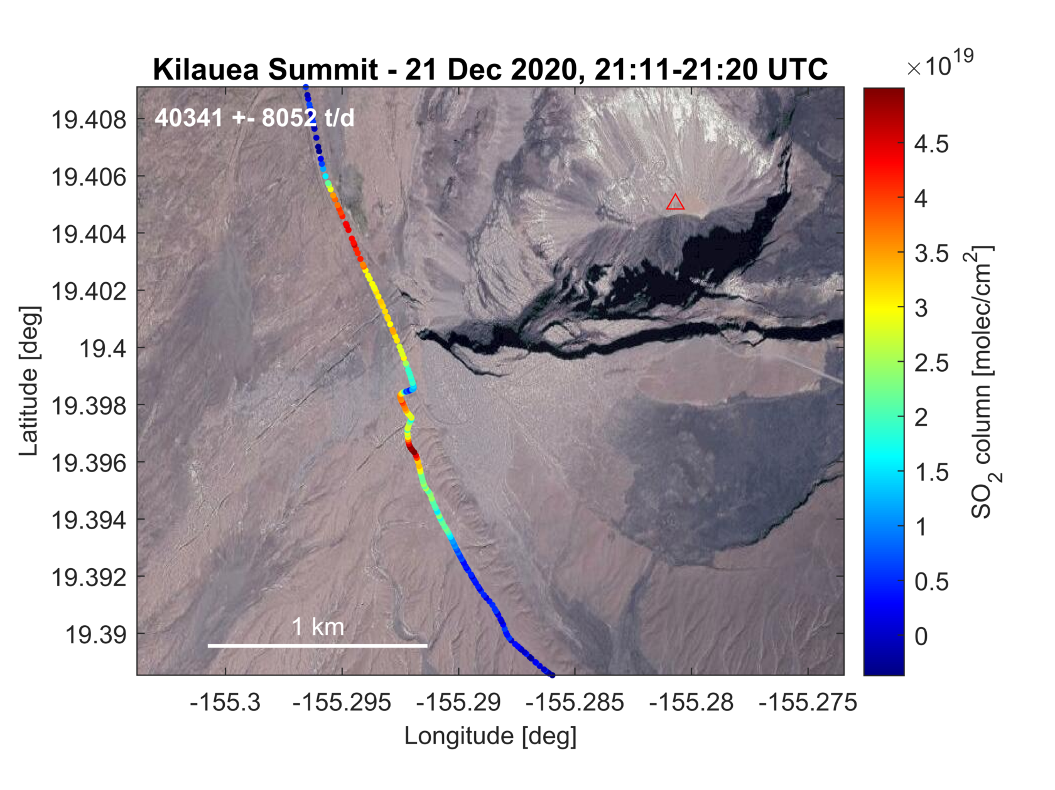
Vehicle-based mobile DOAS traverses yield SO₂ emission rates
Spatial integration of the overhead SO₂ column densities and multiplication with the wind speed allows determination of the emission rate in metric tons per day (t/d)
∼ 40,000 t/d SO₂
[Nadeau 2021]
USGS
Traversing beneath the gas plume, a mobile differential optical absorption spectrometer (mobile DOAS) was used the measure the absorption of scattered sunlight by SO₂ in the overhead plume.
These surveys were repeated on days when trade winds made for accessible, well-defined gas plumes.

Slide 7
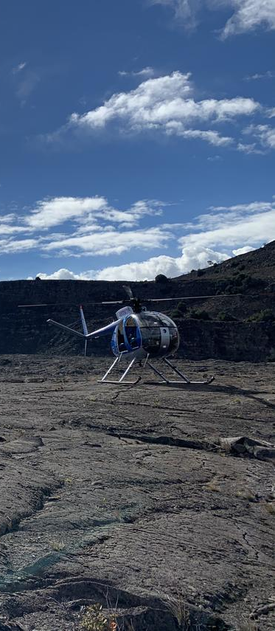
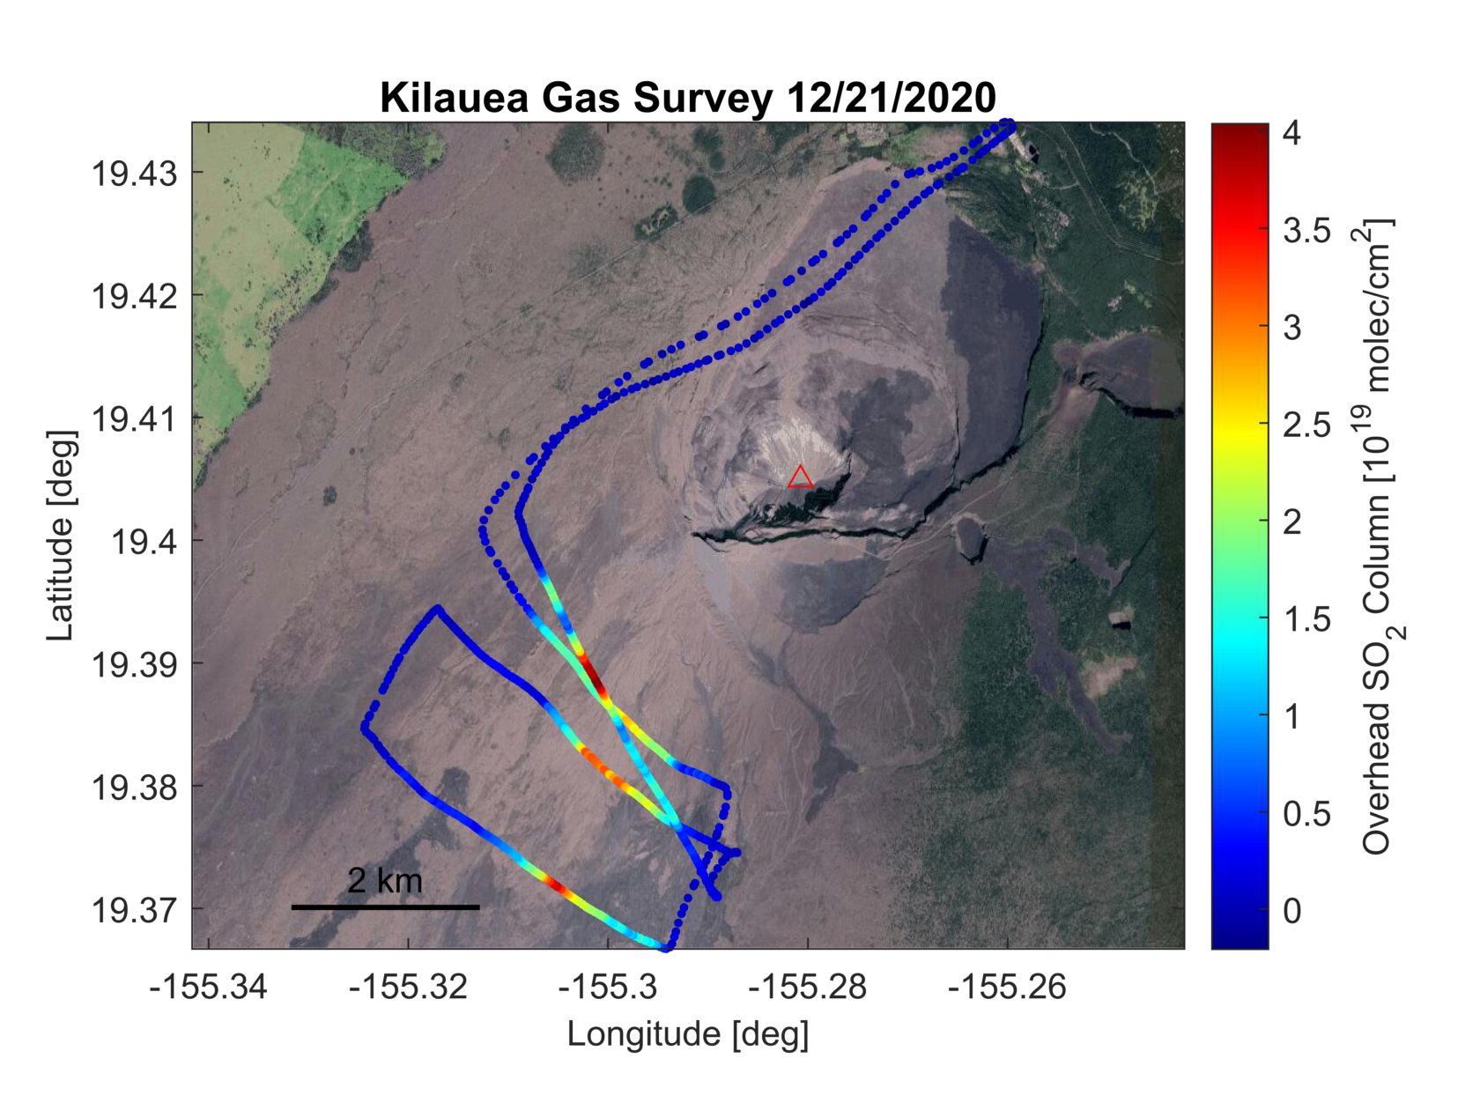
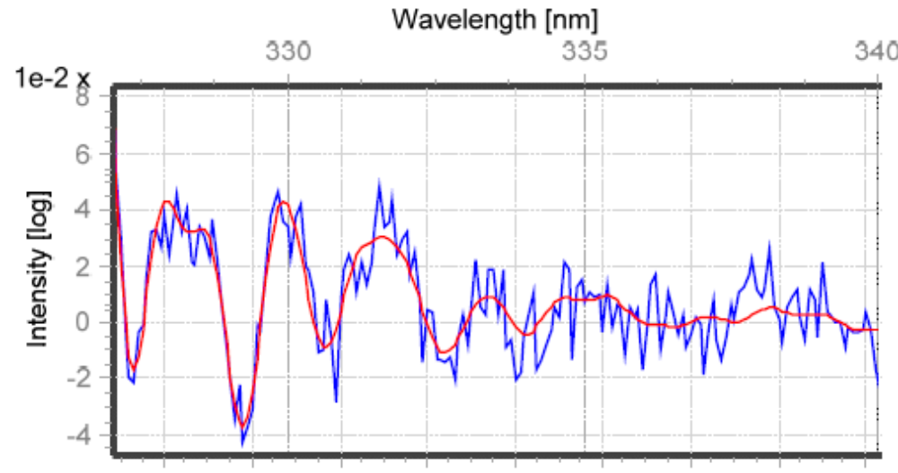
Early on, extreme SO₂ and aerosol emissions presented challenges
During the first several days of the eruption, the optically dense plumes contained extreme SO₂ and aerosol loads, conditions that complicate the radiative transfer of the DOAS measurements.
Moving the spectral analysis to weak SO₂ absorption bands between 326 and 340 nm allowed us to retrieve SO₂ column densities that at times exceeded 50,000 ppm⋅m.
SO₂ = 1.1⋅10²⁰ molecules/cm²
Measured
optical depth
USGS
Helicopter-based DOAS measurements were used to collect data several kilometers downwind where the plume was more dilute.
These data helped constrain emission rates and allowed us to assess the accuracy of different spectral analysis methods for the closer, vehicle-based measurements.
SO₂ absorption
cross-section (modeled fit)

Slide 8
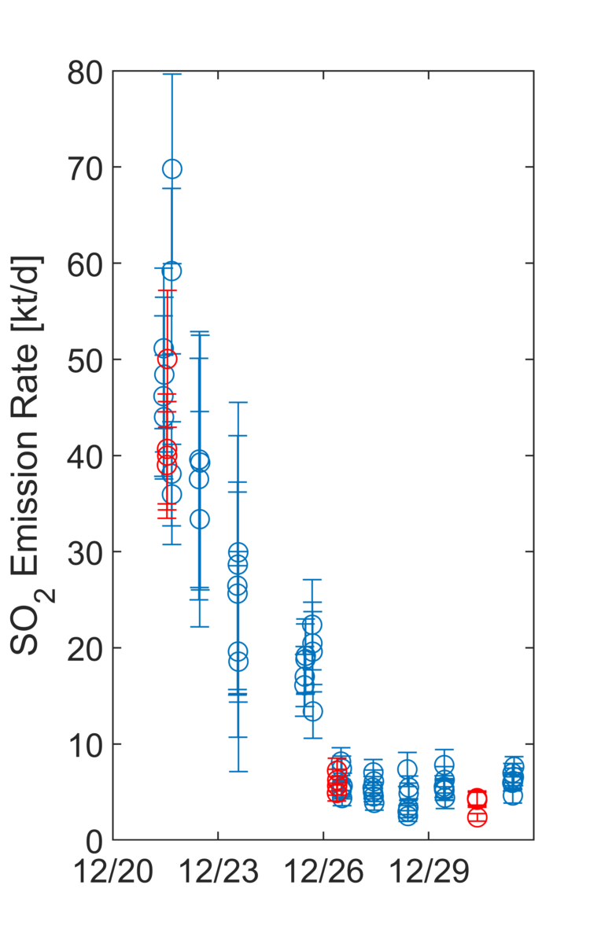
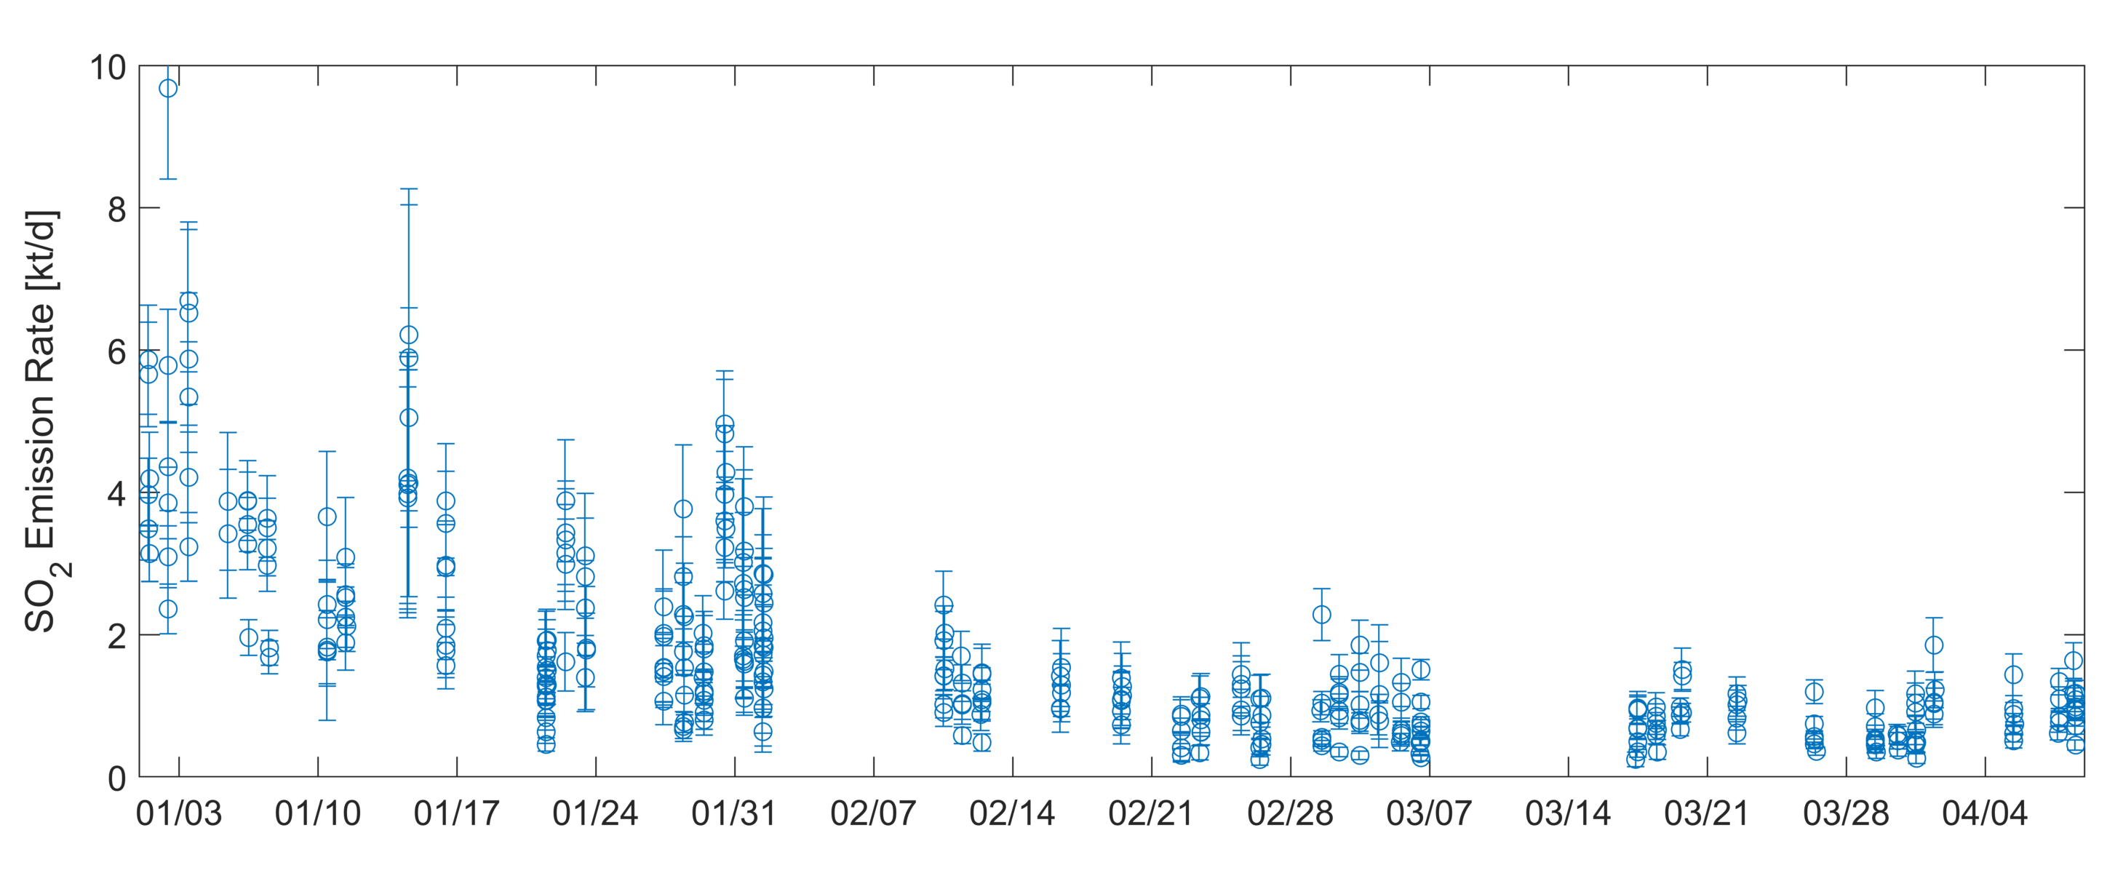
Kīlauea summit SO₂ emission rates 2020-2021
Blue points represent individual vehicle
traverses beneath the plume
note change in vertical scale
Heli-surveys
Date [HST]
Date [HST]
After beginning at about 50,000 t/d at the onset of the eruption, SO₂ emissions rapidly decreased and dropped to less than 10,000 t/d on 26 December.
As of 8 April 2021, ∼ 350 kt SO₂ have been cumulatively emitted from Kīlauea’s summit during the ongoing eruption. This is orders of magnitude less than the ∼ 10 Mt SO₂ emitted from fissures in the lower East Rift Zone during the May - August 2018 eruption.

Slide 9
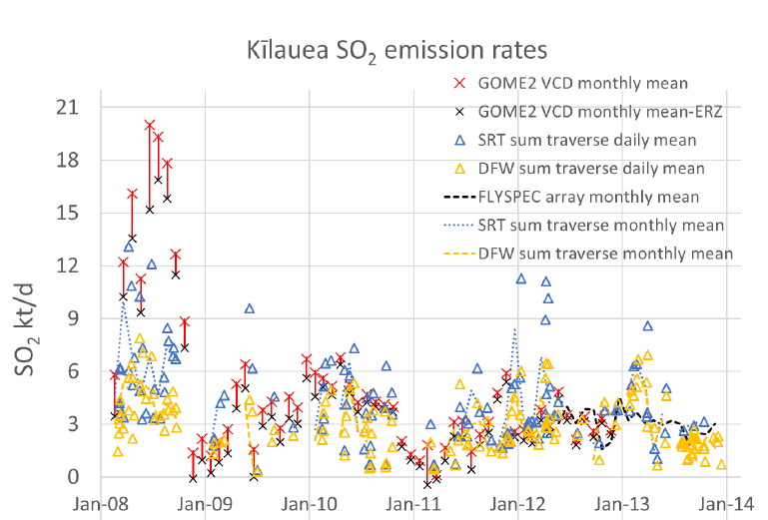
Comparing 2020 to 2008, when the lava lake first appeared
2020
SO₂ emissions began at
> 40 kt/d but dropped much quicker than in 2008.
Currently, SO₂ emissions have dropped to 20% of the 5 kt/d sustained for almost a decade starting in 2008.
∼ 350 kt since December 21
1,000 t/d
Date [HST]
2008
∼ 3.5 Mt in
first year
(2008)
[Elias et al., 2020]
SO₂ emissions remained > 10 kt/d for months, then dropped to ∼5 kt/d.
Approximately an order of magnitude more SO₂ was released in the first year than so far in 2020/21.
2014-2017 avg
4,800 t/d
[Elias et al., 2018]

Slide 10
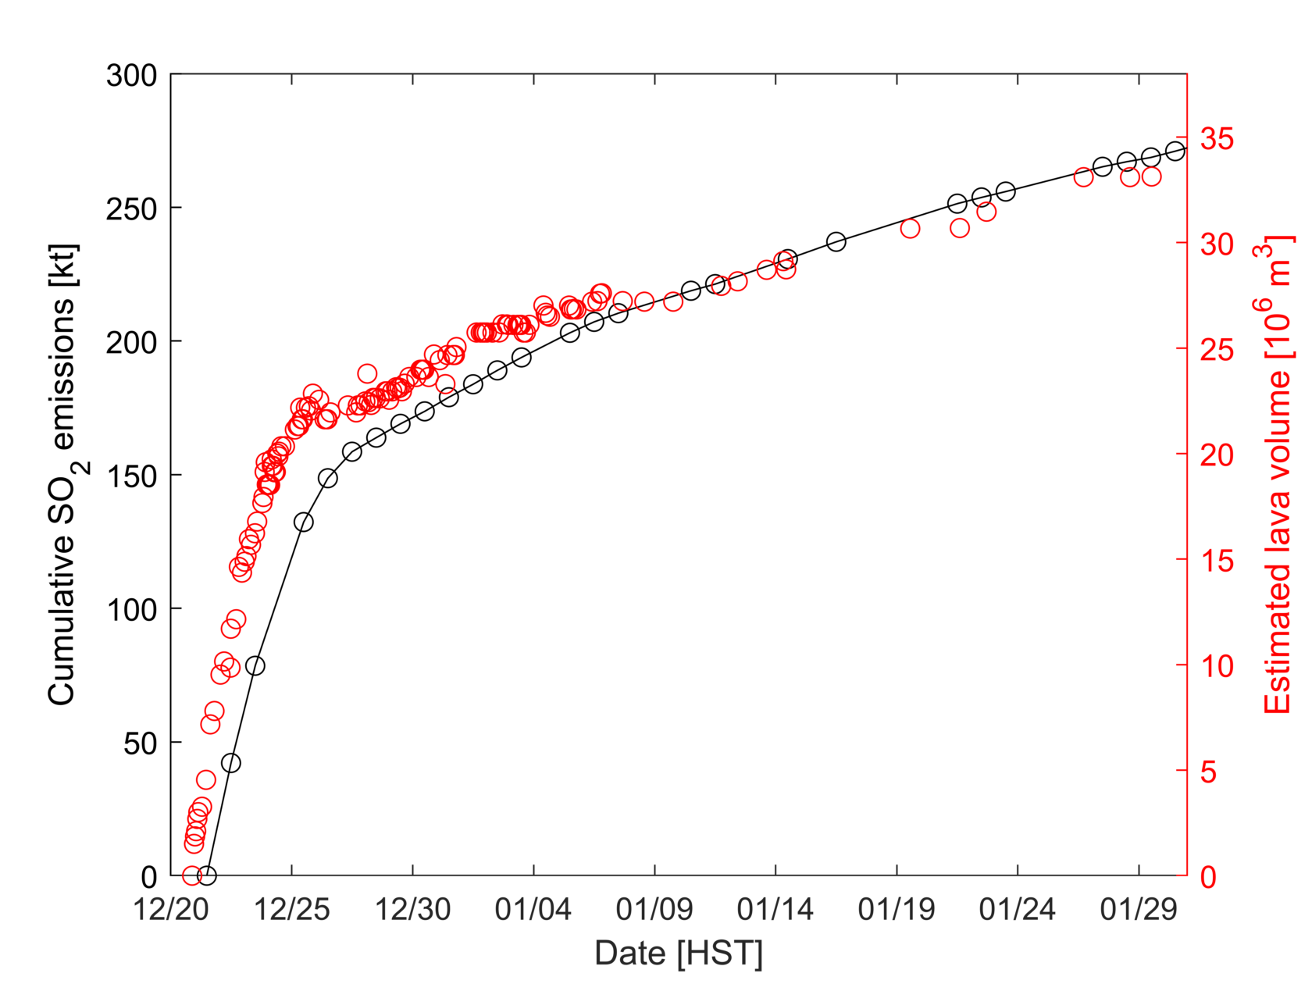
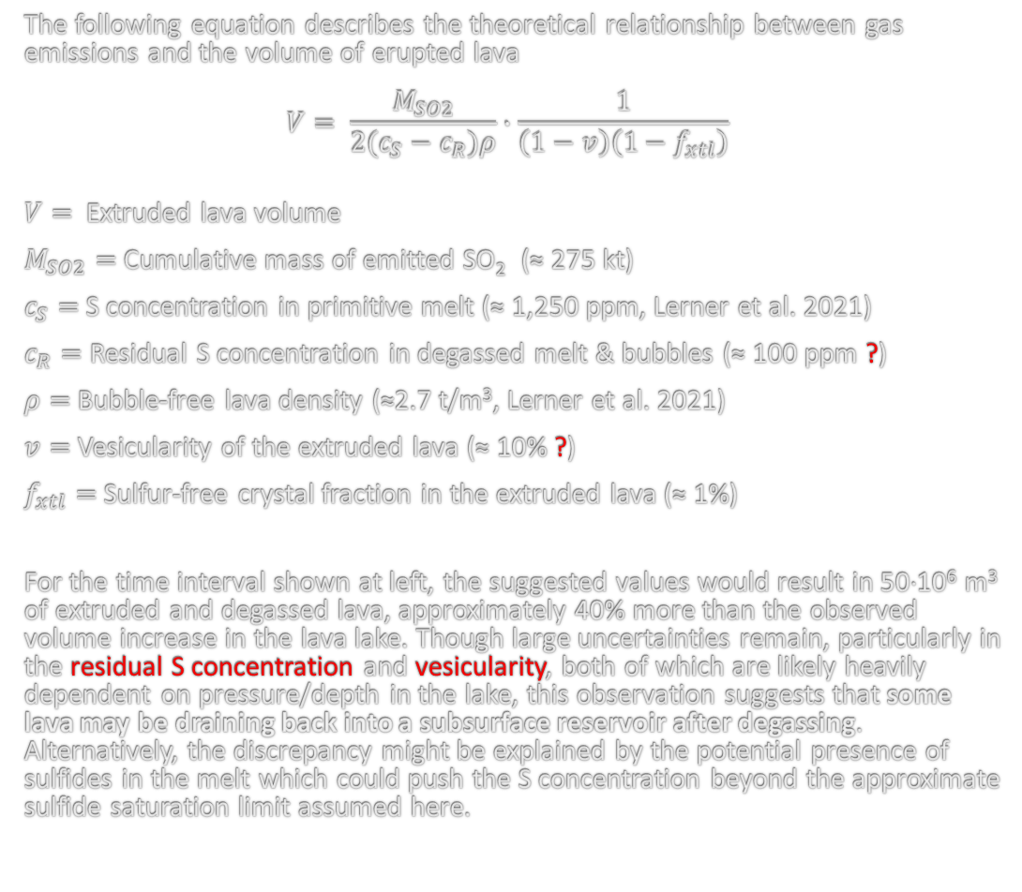
Comparing SO₂ emissions to extruded lava volume
A laser rangefinder was used to measure the increasing level of the lava lake over time. Combined with a digital elevation model of the empty Halemaʻumaʻu Crater, these measurements were used to estimate the volume of erupted lava. Trends in lava volume and cumulative gas emissions are remarkably similar.
The following equation describes the theoretical relationship between gas emissions and the volume of erupted lava
$$V= \frac{M_{SO2}}{2(c_{S}−c_{R})ρ}∙\frac{1}{\left(1−v\right)\left(1−f_{xtl}\right)}$$
$V=$ Extruded lava volume
$M_{SO2}=$ Cumulative mass of emitted SO₂ (≈ 275 kt)
$c_{S}=$S concentration in primitive melt (≈ 1,250 ppm, Lerner et al. 2021)
$c_{R}=$Residual S concentration in degassed melt & bubbles (≈ 100 ppm ?)
$ρ=$Bubble-free lava density (≈2.7 t/m³, Lerner et al. 2021)
$v=$Vesicularity of the extruded lava (≈ 10% ?)
$f_{xtl}=$Sulfur-free crystal fraction in the extruded lava (≈ 1%)
For the time interval shown at left, the suggested values would result in 50⋅10⁶ m³ of extruded and degassed lava, approximately 40% more than the observed volume increase in the lava lake. Though large uncertainties remain, particularly in the residual S concentration and vesicularity, both of which are likely heavily dependent on pressure/depth in the lake, this observation suggests that some lava may be draining back into a subsurface reservoir after degassing. Alternatively, the discrepancy might be explained by the potential presence of sulfides in the melt which could push the S concentration beyond the approximate sulfide saturation limit assumed here.

Slide 11
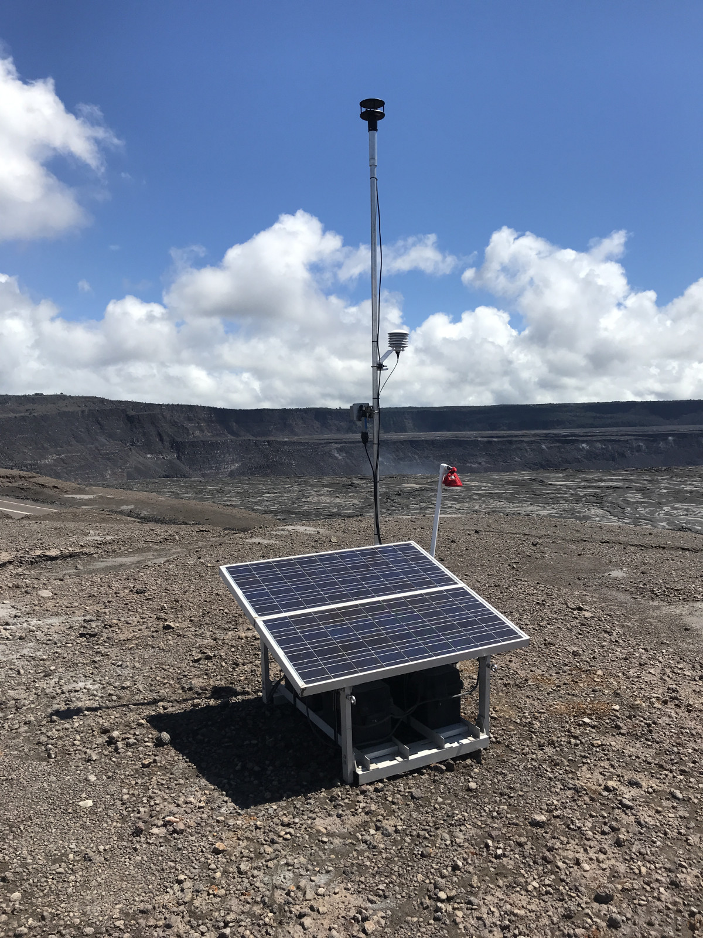
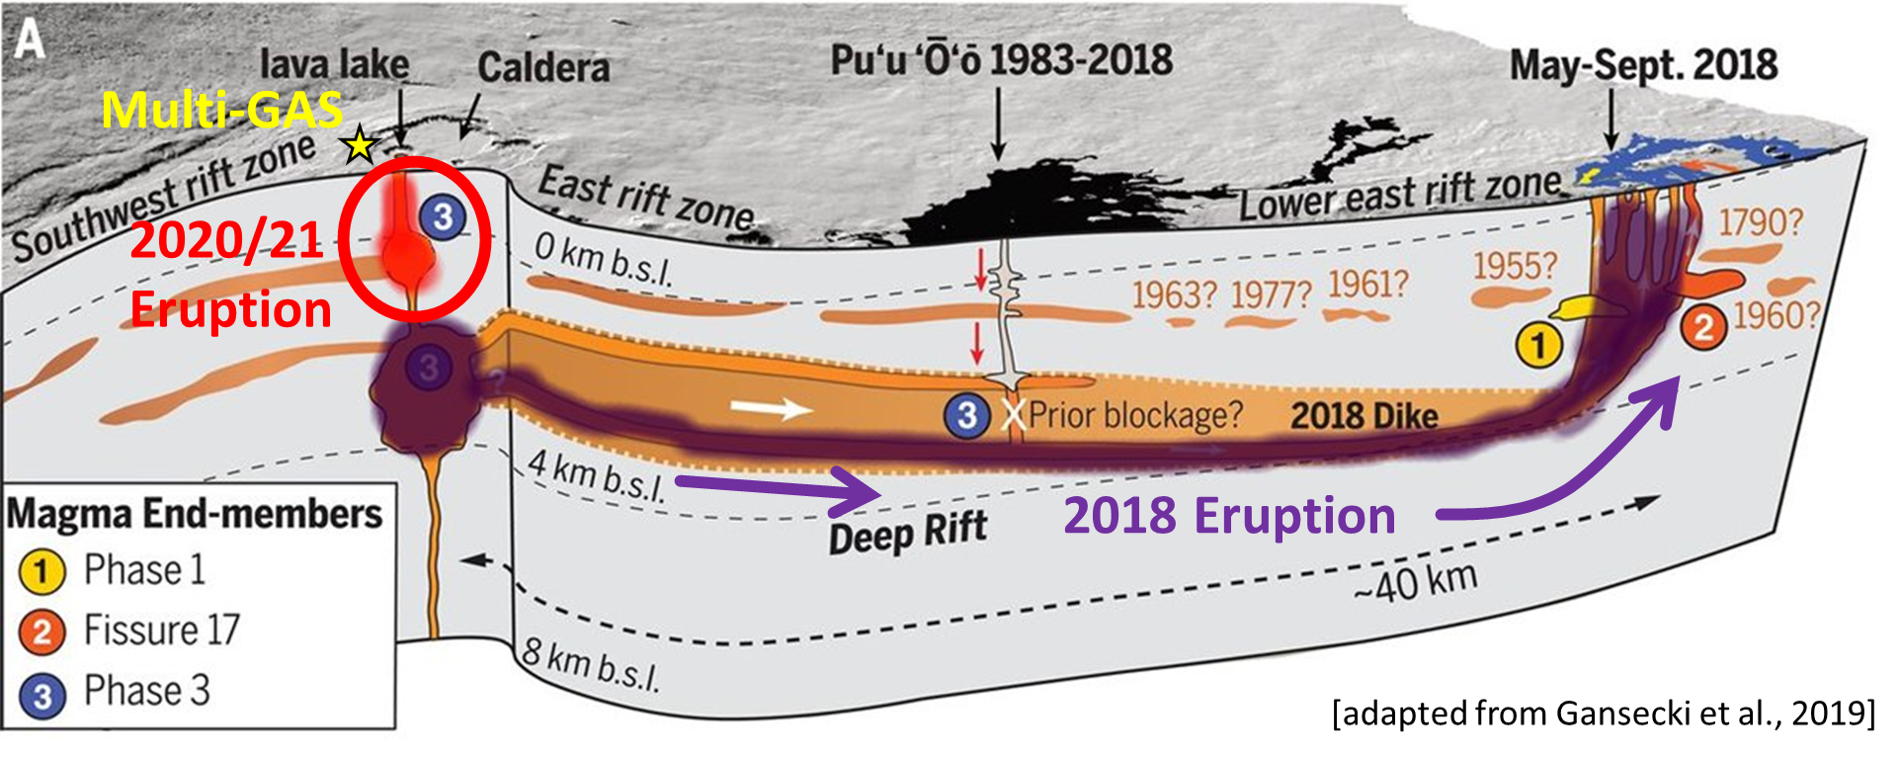
Multi-GAS data suggest shallow source region
Multi-GAS
Multi-GAS instruments installed on the rim of Kīlauea’s summit caldera and flown in the near-field plume measured the major plume speciation. When aimed at the active vents in discrete campaigns, Fourier-transform infrared spectroscopy (FTIR) measurements provided consistent results.
The measurements indicate a carbon-poor, sulfur-rich gas which likely last equilibrated in the shallow magma reservoir 1-2 km beneath the volcano’s summit. The lavas erupted in 2018 exhibited a slightly deeper equilibrium depth, consistent with our model of the Kīlauea plumbing system.
USGS
H₂O/CO₂ ≈ 26-30
CO₂/SO₂ ≈ 0.2-0.3
Equilibrated @ 30-40 MPa
(∼1-2 km lithostatic)

Slide 12
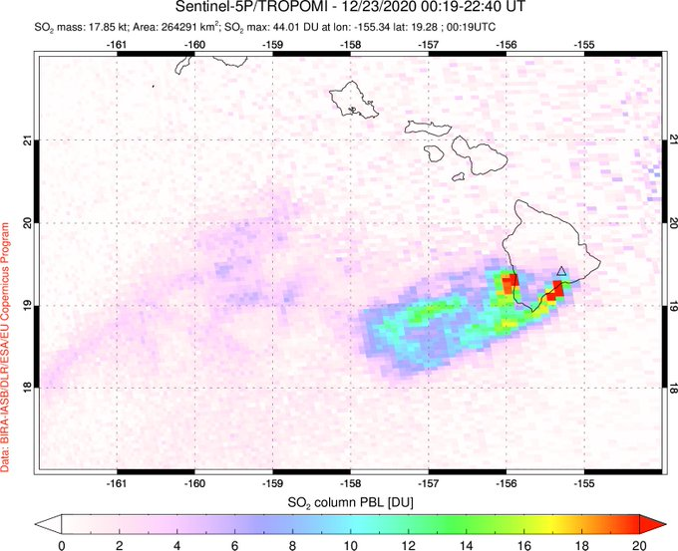
Comparing ground-based SO₂ emission rates with TROPOMI
The TROPOMI UV spectrometer on board ESA’s Sentinel 5 Precursor satellite clearly captured the SO₂ plumes drifting downwind from Kīlauea’s summit. The image below shows high SO₂ columns near the summit and along the southwest coast of the Island of Hawaiʻi.
Date | Ground-based | TROPOMI
21 Dec 2020 | 47 kt/d | 16 kt/d
22 Dec 2020 | 37 kt/d | 11 kt/d
23 Dec 2020 | 25 kt/d | 16 kt/d
26 Dec 2020 | 6 kt/d | 8 kt/d
27 Dec 2020 | 5 kt/d | 1 kt/d
A preliminary analysis of operational SO₂ products from TROPOMI yields mostly lower emission rates than were measured from the ground.
This discrepancy is likely at least in part due to difficulties in retrieving accurate SO₂ columns from space-borne observations in situations where plumes with high SO₂ and aerosol loads are located at low altitudes.
Other potential issues include meteorological clouds hiding portions of the gas plume from the satellite’s view, and the inability to detect dilute SO₂ loads around the plume edges.
Work is ongoing to refine these comparisons.

Slide 13
Summary and Conclusions
After ∼27 months of quiescence, eruptive activity returned to Kīlauea Volcano’s summit on the evening of 20 December 2020.
Lava erupting from multiple vents in the wall of Halemaʻumaʻu Crater quickly flashed the water lake to steam and replaced it with a rapidly growing lava lake.
Ground and helicopter-based mobile DOAS measurements show that SO₂ emissions associated with the eruptive activity initially exceeded 40,000 t/d but dropped to < 10,000 t/d within the first 6 days of the eruptions. Current SO₂ emissions are ∼1,000 t/d.
The time series of SO₂ emissions tracks independent lava volume estimates. Cumulative gas emissions suggest that some degassed lava may have drained back into a subsurface reservoir.
The carbon-poor, sulfur-rich gas composition is consistent with last equilibration in a shallow reservoir 1-2 km below the volcano’s summit.

Slide 14
Cited References
Dietterich, H.R., Diefenbach, A.K., Soule, S.A., Zoeller, M.H., Patrick, M.P., Major, J.J., Lundgren, P.R., 2021. Lava effusion rate evolution and erupted volume during the 2018 Kīlauea lower East Rift Zone eruption. Bull. Volcanol. 83. https://doi.org/10.1007/s00445-021-01443-6
Elias, T., Kern, C., Horton, K.A., Sutton, A.J., Garbeil, H., 2018. Measuring SO2 Emission Rates at Kīlauea Volcano, Hawaiʻi, Using an Array of Upward-Looking UV Spectrometers, 2014–2017. Front. Earth Sci. 6, 1–20. https://doi.org/10.3389/feart.2018.00214
Elias, T., Kern, C., Sutton, A.J., and Horton, K., 2020, Sulfur dioxide emission rates from Kīlauea Volcano, Hawaiʻi, 2008-2013: U.S. Geological Survey data release, https://doi.org/10.5066/P9K0EZII.
Gansecki, C., Lee, R.L., Shea, T., Lundblad, S.P., Hon, K., Parcheta, C., 2019. The tangled tale of Kīlauea’s 2018 eruption as told by geochemical monitoring. Science 1212, 1–9. https://doi.org/10.1126/science.aaz0147
Kern, C., Lerner, A.H., Elias, T., Nadeau, P.A., Holland, L., Kelly, P.J., Werner, C.A., Clor, L.E., Cappos, M., 2020. Quantifying gas emissions associated with the 2018 rift eruption of Kīlauea Volcano using ground-based DOAS measurements. Bull. Volcanol. 82. https://doi.org/10.1007/s00445-020-01390-8
Lerner, A.H., Wallace, P.J., Shea, T., Mourey, A.J., Kelly, P.J., Nadeau, P.A., Elias, T., Kern, C., Clor, L.E., Gansecki, C., Lee, R.L., Moore, L.R., Werner, C.A, accepted. The petrologic and degassing behavior of sulfur and other magmatic volatiles from the 2018 eruption of Kīlauea, Hawaiʻi: melt concentrations, magma storage depths, and magma recycling. Bull. Volcanol.
Nadeau, P., 2021, Volcano Watch — Gas math—how we know how much sulfur dioxide volcanoes emit, https://www.usgs.gov/center-news/volcano-watch-gas-math-how-we-know-how-much-sulfur-dioxide-volcanoes-emit

