Slide 1



Corundum-rich dykes constraining Triassic alkaline magmatism in the Ivrea-Verbano Zone (Southern Alps): a zircon approach
Authors: Bonazzi M., Langone A., Tumiati S., Dellarole E., Giovanardi T.,
Mazzucchelli M., Zanetti A.
Acknowledgments:
The authors thank ERC-StG TRUE DEPTHS (grant number 714936) and MIUR-SIR Mile Deep (grant number RBSI140351) to M. Alvaro.

Slide 2
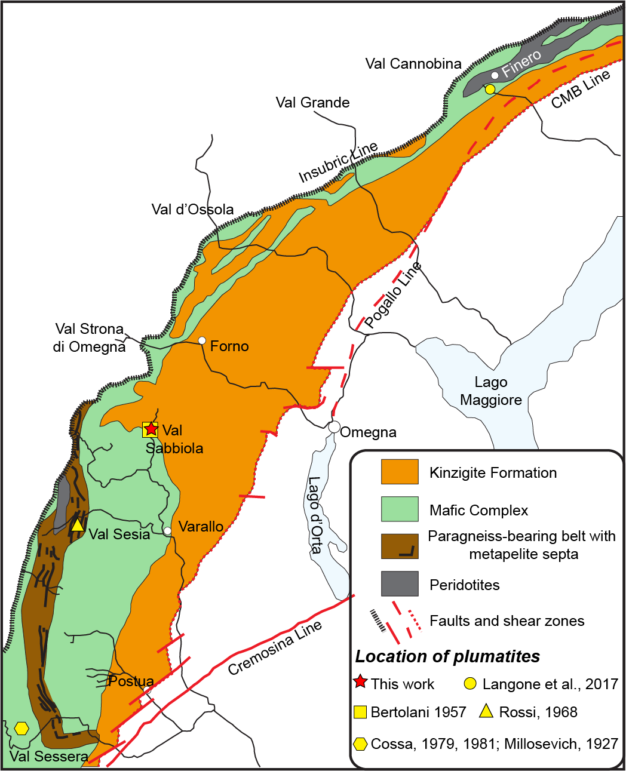
WHAT IS IVREA VERBANO ZONE?
Section of continental crust middle/lower
(e.g. Rudnick e Gao, 2003)
Kinzigite Formation;
Mafic Complex;
Ultramafic body
by Zingg, 1983 and modified by Sinigoi et al., 2010
Notes:
The IVZ is s an uplifted part of the pre-Alpine intermediate lower continental crust located in the Southern Alps of northwest Italy.
The IVZ is traditionally subdivided of three different lithologie: the Kinzigite Formation is metamorphic rocks unit, the mafic complex is an intrusive
crustal mafic to ultramafic rocks, and ultramafic body.

Slide 3
Dykes studied in Ivrea zone
by Zingg, 1983 and modified by Sinigoi et al., 2010
Presence of many dykes intruding into mantle and lower crustal lithologies of IVZ:
Many geocronological studies exclusively focused on the large magmatic bodies
Few geochronological studies on dykes are focused on the Northern part of Ivrea Verbano (near Finero)

Slide 4
Aim of work
Why did we study corundum-bearing felsic dykes?
1) Felsic dykes are commonly zircon-bearing
2) Corundum-bearing felsic dyke are found in several lithologies in all part of IVZ
3) the origin of these dykes is still unknown
Can the geochronology and petrogenesis of corundum-bearing felsic dyke shed light on the Triassic evolution of the IVZ?

Slide 5
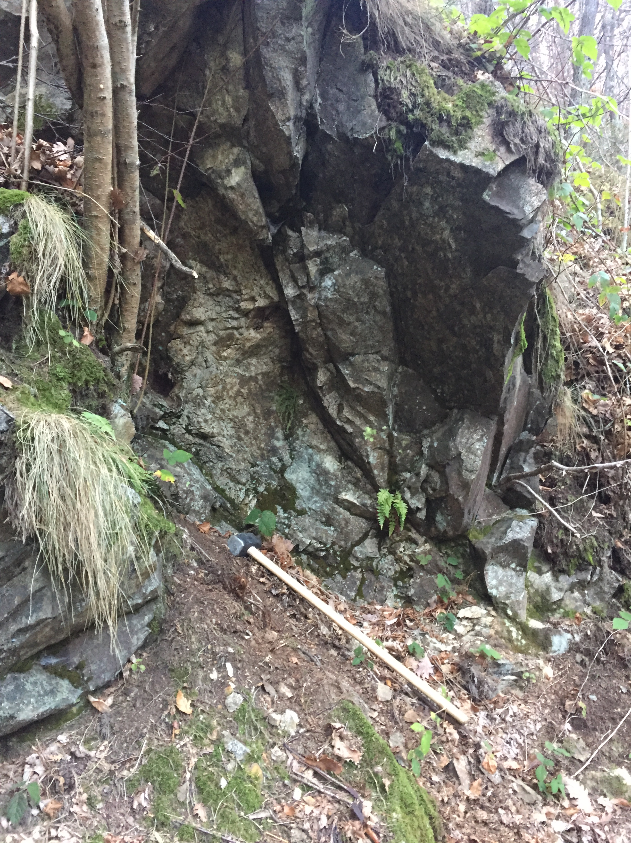
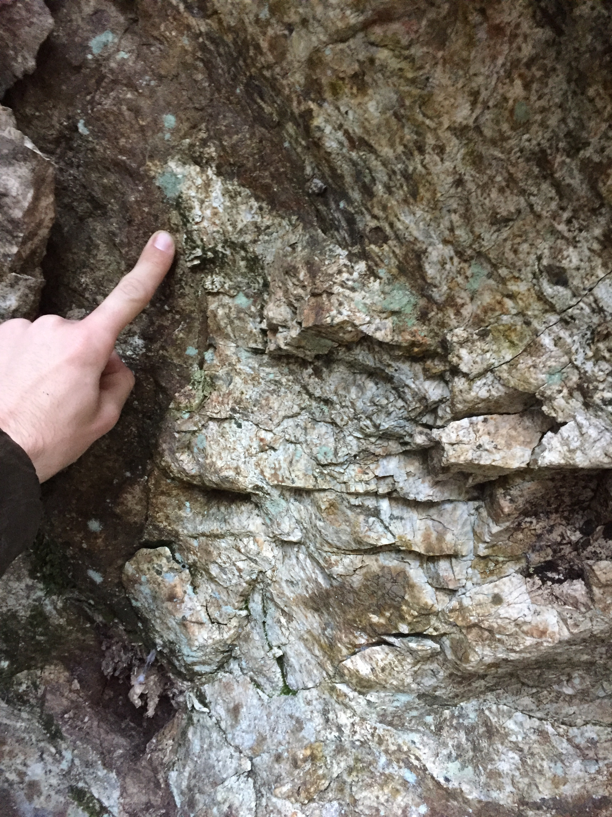

Contact between dykes and host rock in the Val Sabbiola
(Central-sector of the Ivrea-Verbano Zone).
SB8
Mafic Complex

Slide 6
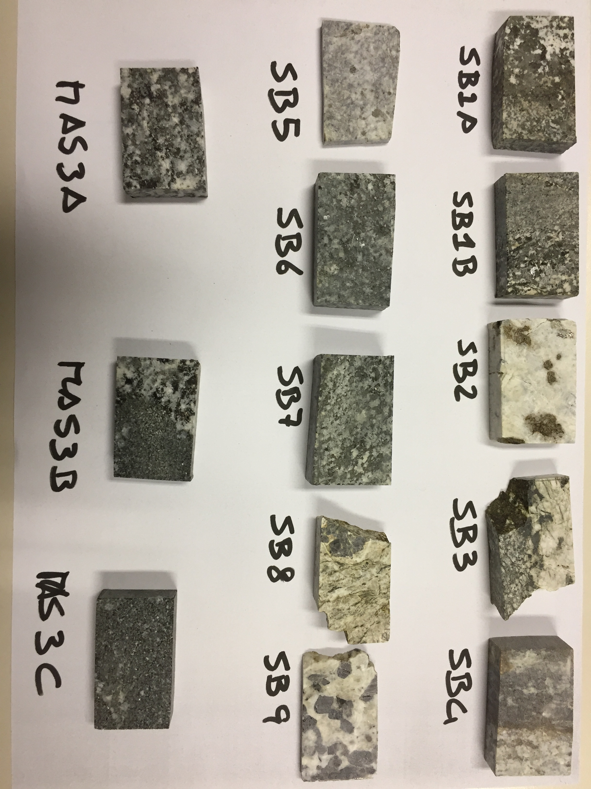
Petrography and chemical compositions
SB9
SB8
Porphyroclastic fabric
Pegmatitic texture
Plg (Olig.) 40-80%;
Crn >16%;
Kfs 0- 30%;
Bt <10%
ACCESORY
Zircon
Spinel
Hercynite
Magnetite
Columbite

Slide 7
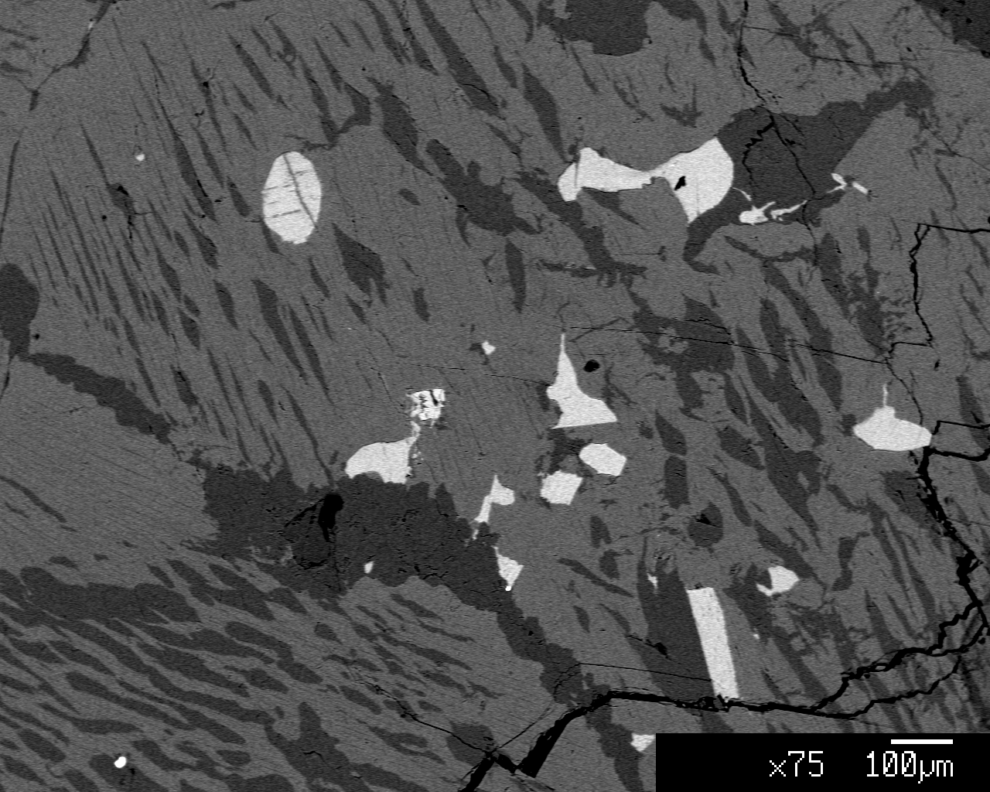
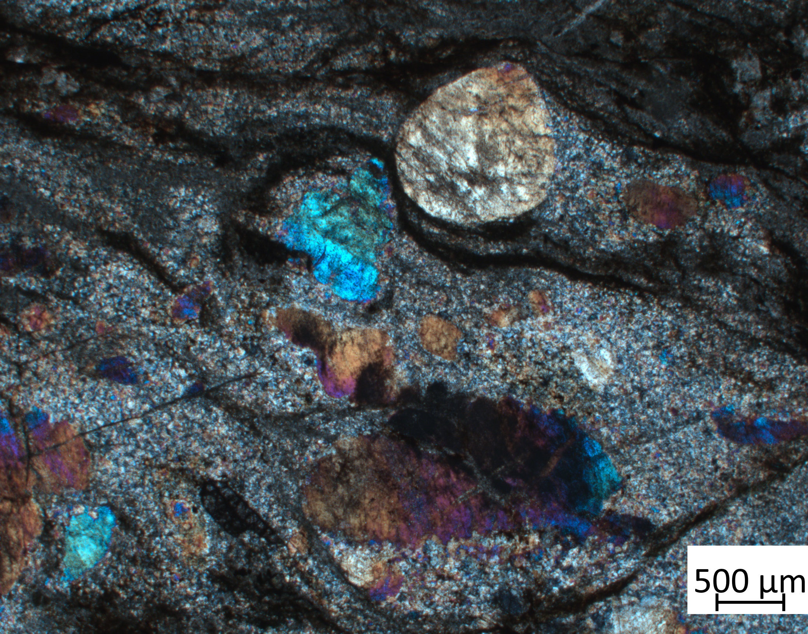
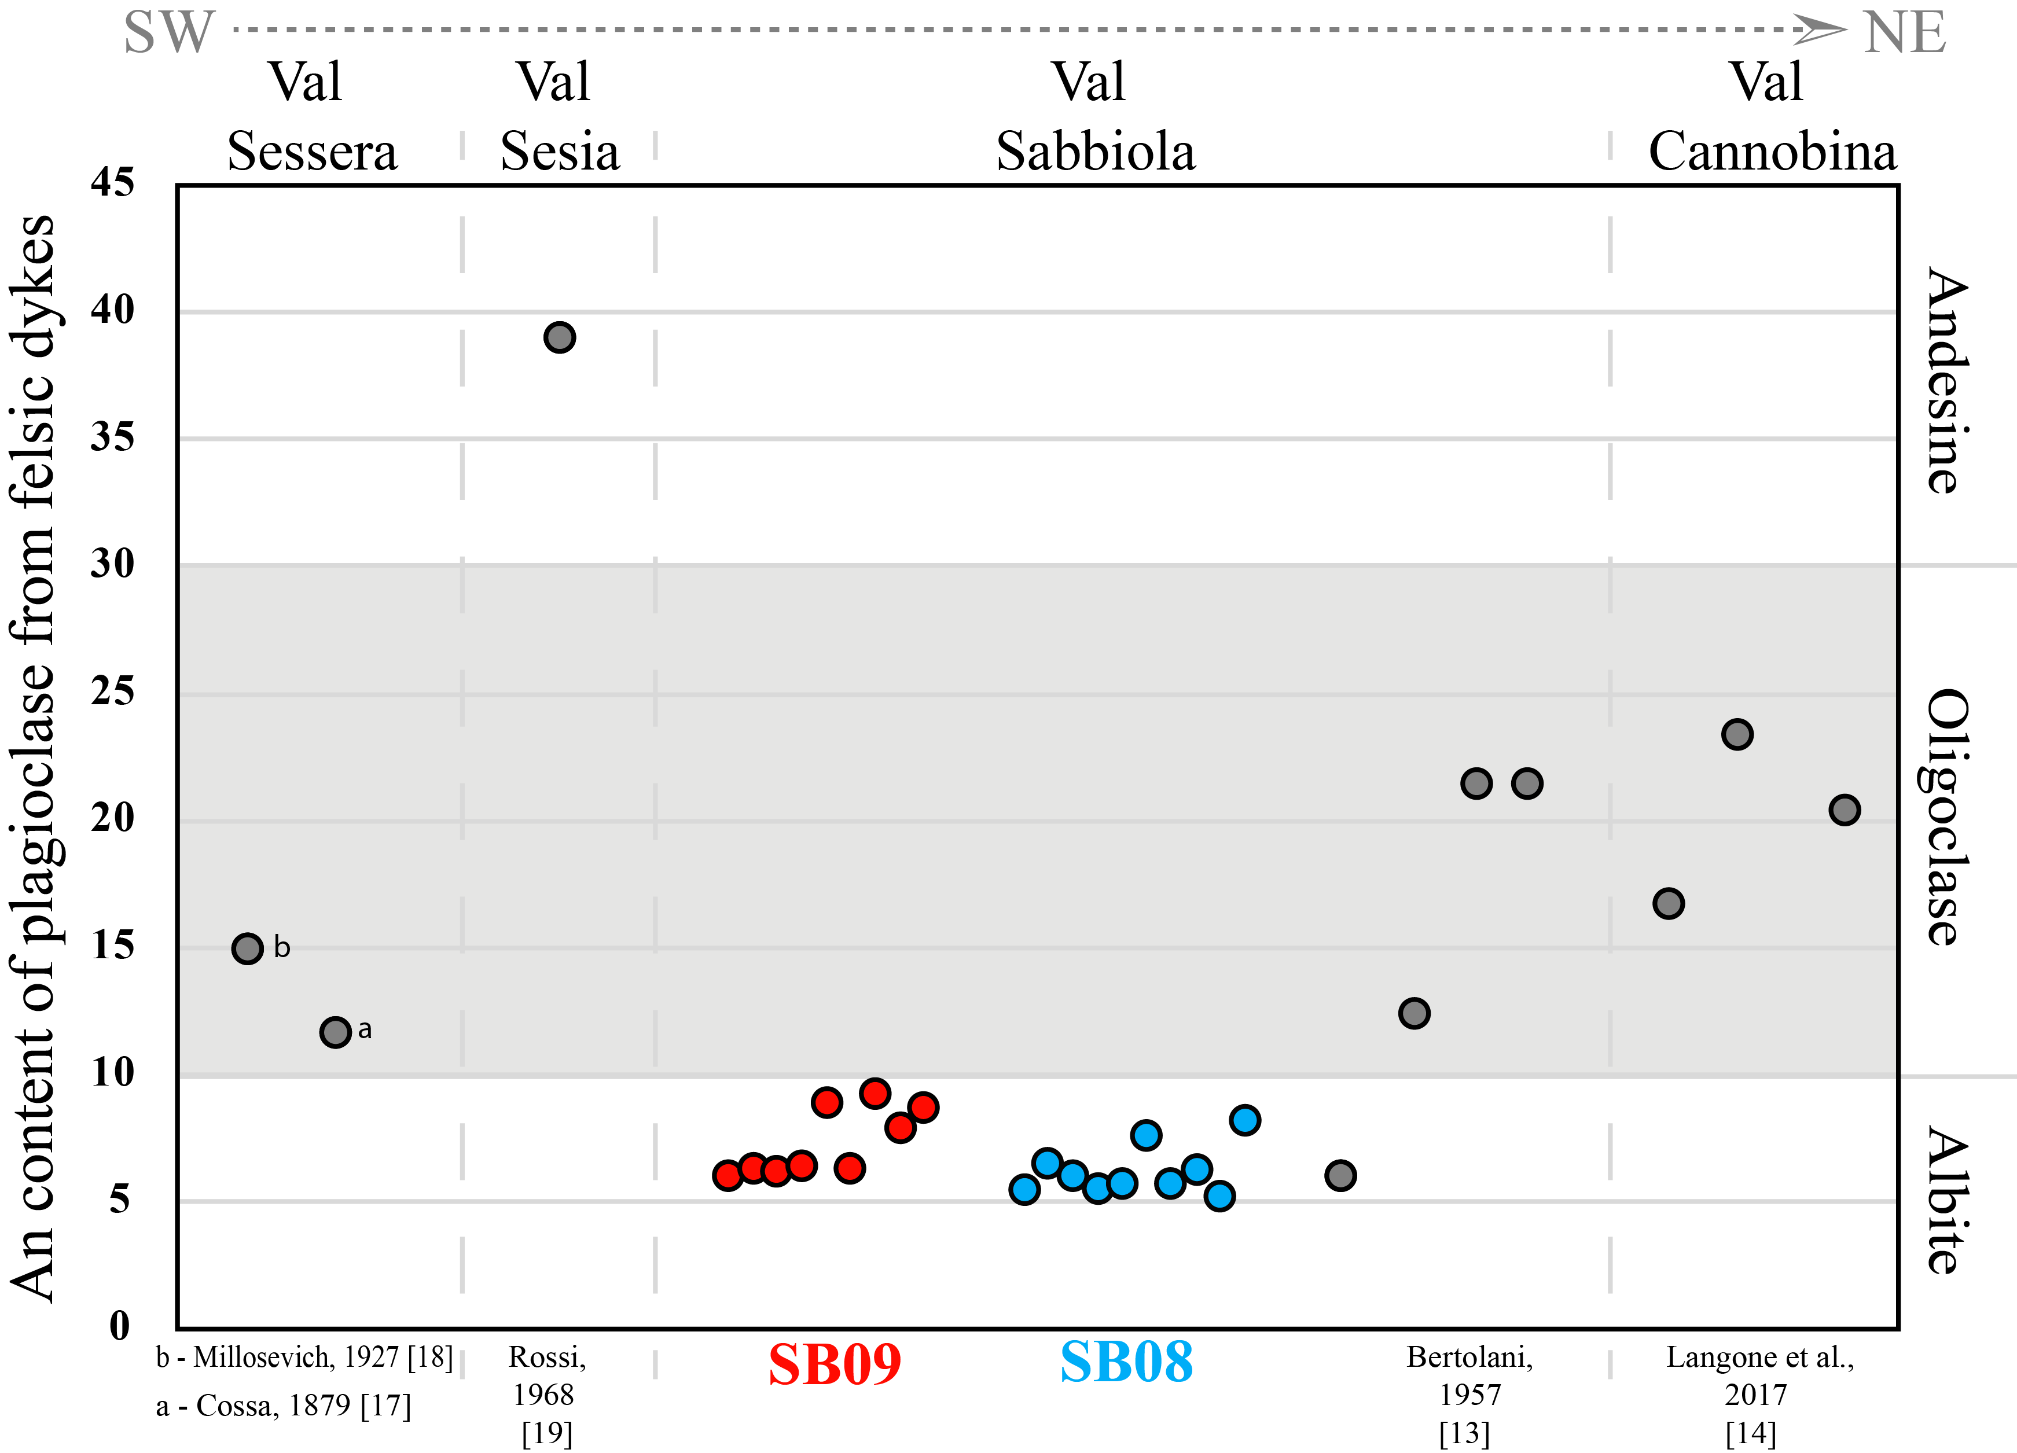
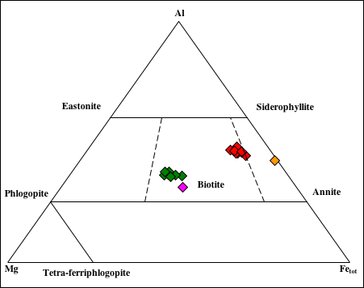
Petrography and chemical compositions
SB9
SB8
Leucomonzonite
Anorthosite
Biotite
Plagioclase
SB09
Host of SB08
Notes:
The studied samples consist of oligoclase, K-feldpars, corundum and the SB9 shows a well preserved igneous texture while SB( shows a myonitic foliation they also contain large zircons from 100 µm to 300 µm in size.
Zircon grains were studied on polished thin section.

Slide 8
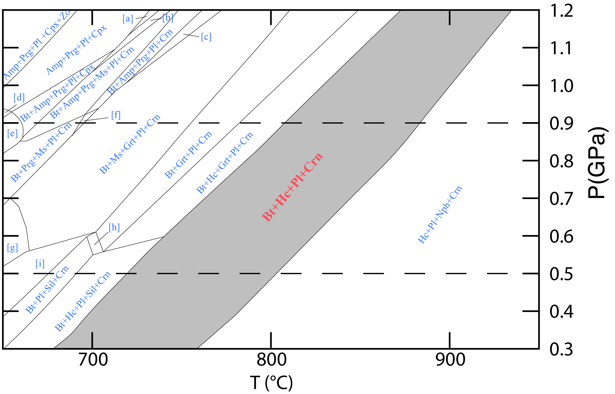
Thermodynamics modelling
P-T pseudosection calculated for the chemical composition of SB08
The grey field corresponds to the mineral
assemblage of SB08 rock.
The dashed line indicates the pressure conditions estimated for the emplacement of the Mafic Complex
The mineral assemblages of SB08 is stable at T from ~700 to 950 °C for the considered Pressure interval

Slide 9
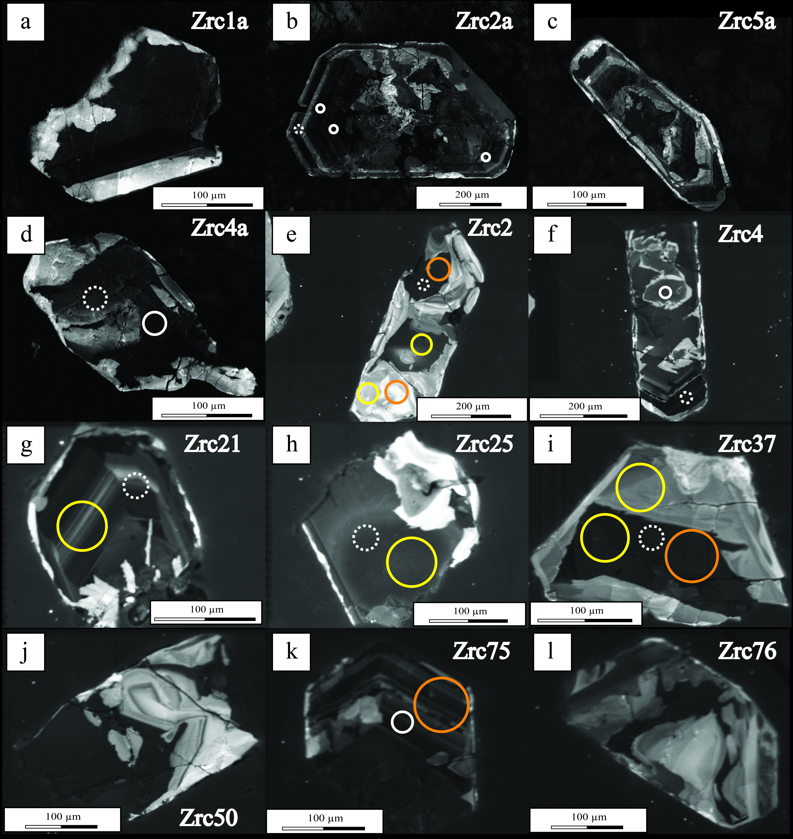
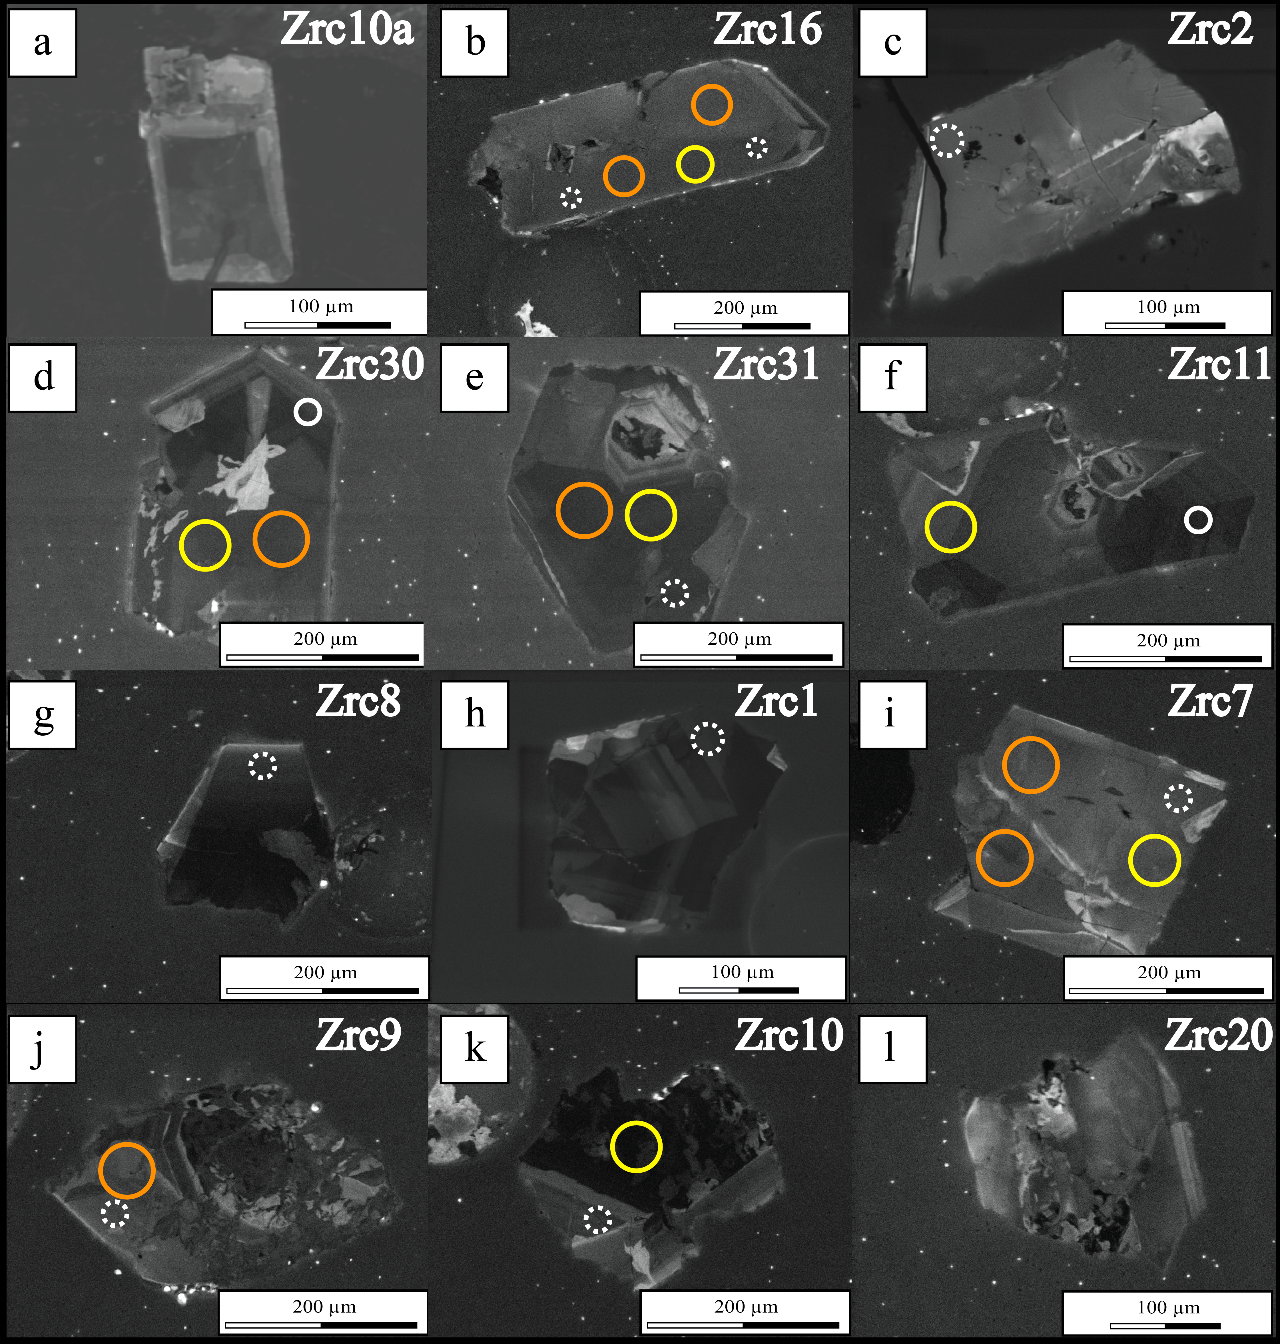
Zircons features
SB8
SB9
CL imagines of zircon crystals

Slide 10
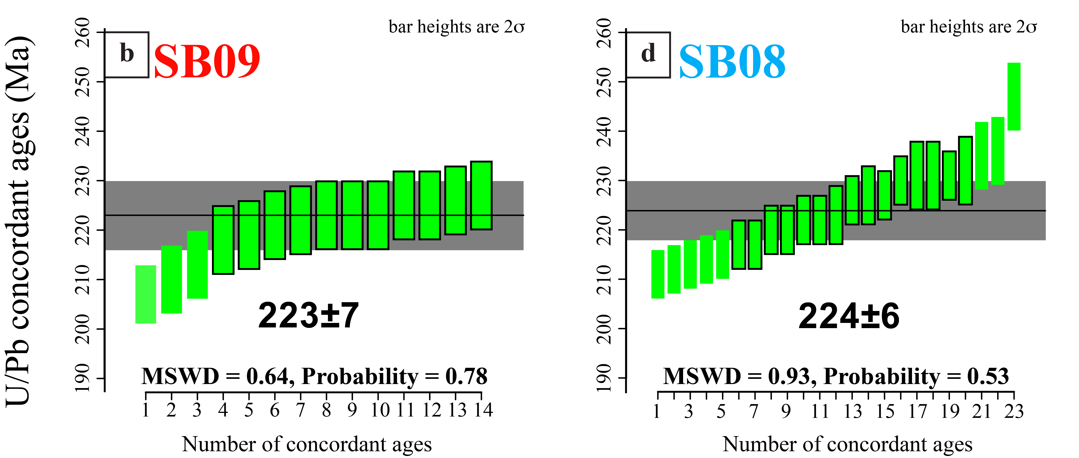
Geochronology: Pb/U data
SB09: On 44 U–Pb analysis obtained 14 concordant ages
SB08: On 51 U–Pb analysis obtained 23 concordant ages
Notes:
we collected 5 analysis on 5 zircon. Preliminary U-Pb zircon data obtained by Laser Ablation U–Pb ages are concordant
And these ages point to Triassic intrusion age.

Slide 11
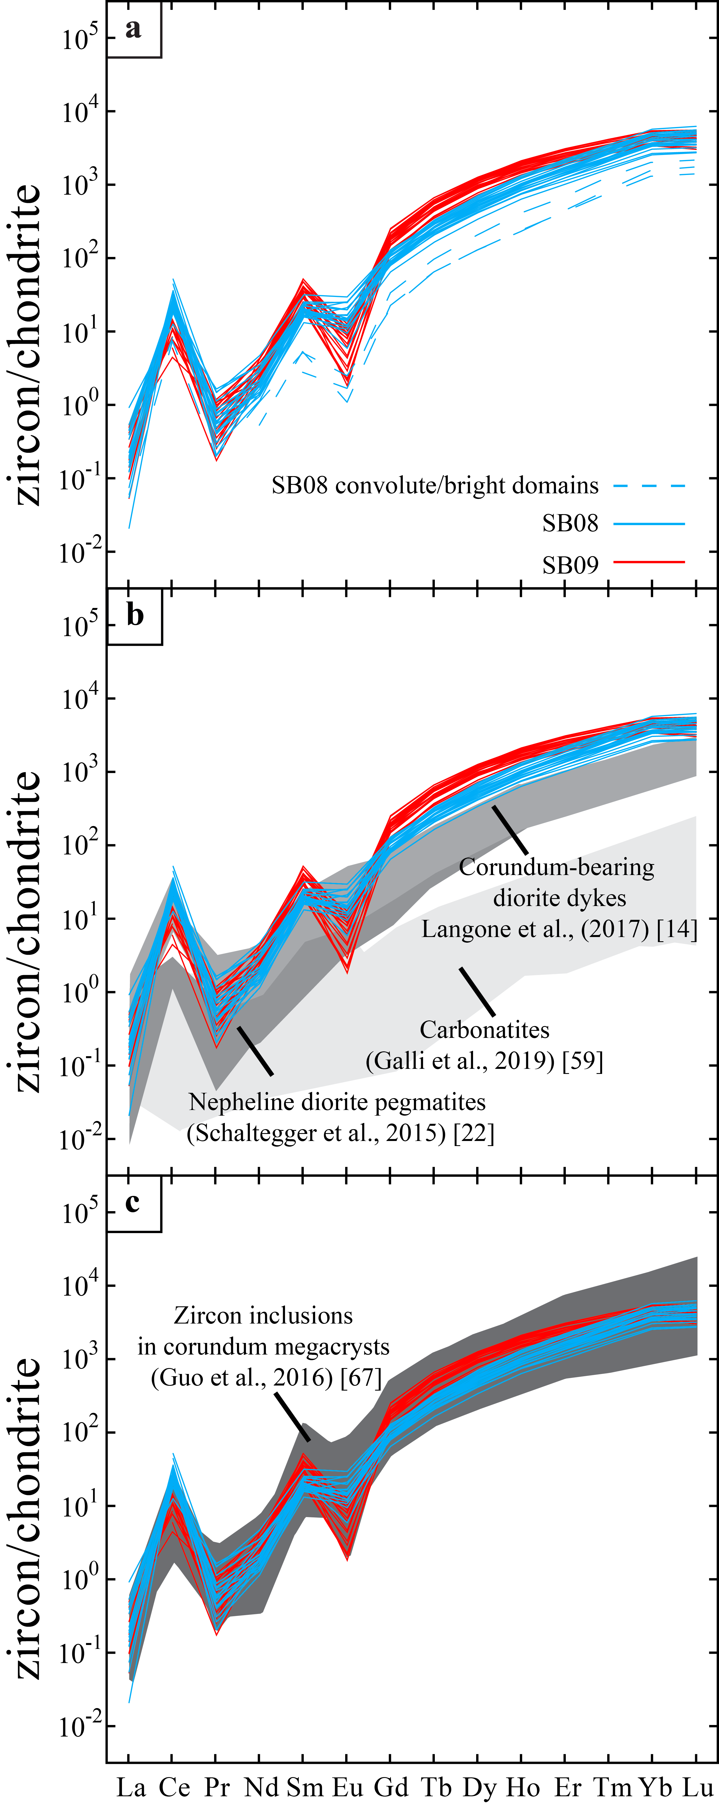
Zircon trace elements
REE features:
Eu negative anomaly
Ce positive anomaly
M-HREE content higher than other Crn bearing-dykes
ZIRCON ARE EXTREMELY ENRICHED IN:
Hf >10000 ppm
Nb and Ta up to ∼ 150 and ∼ 50
U and Y up to ∼3000 ppm and 3800 ppm respectively
SB09: 26 trace elements analysis
SB08: 27 trace elements analysis
Notes:
There are no studies on plumasitic origin. But

Slide 12
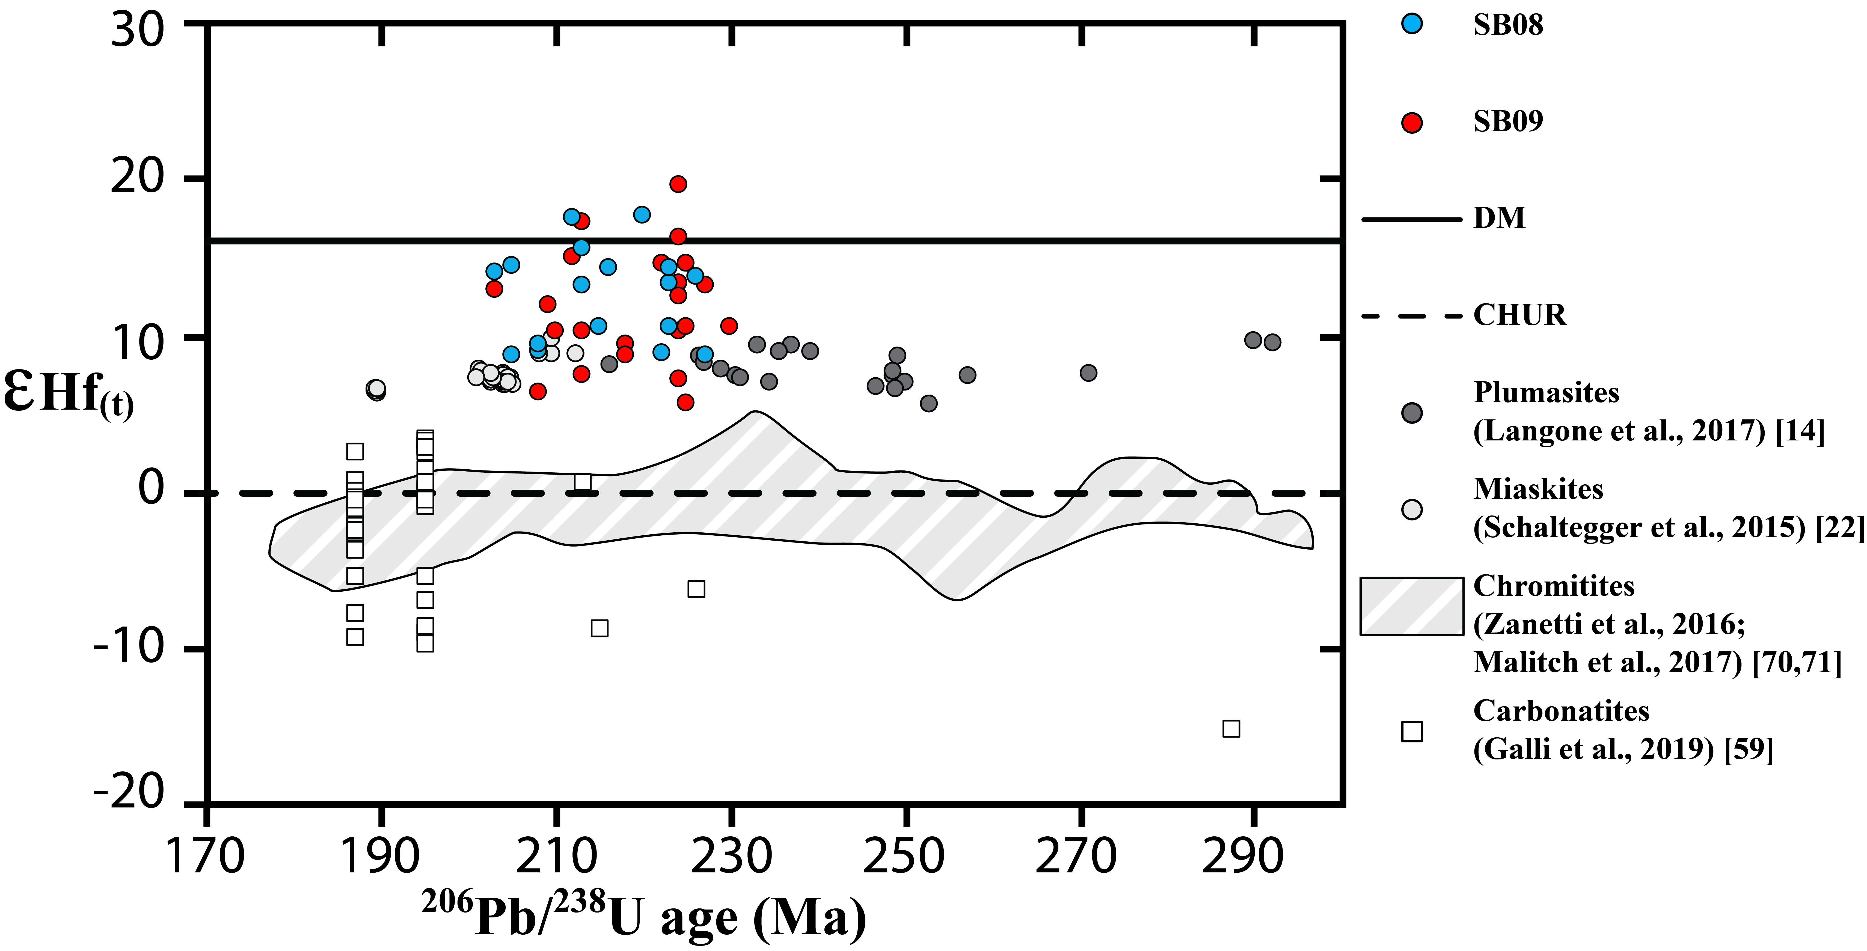
Zircon Hf isotopes
DM
εHf_{(t)} values from several magmatic bodies from IVZ. εHf_{(t)} values are recalculated to the individual spot analysis ²⁰⁶Pb/²³⁸U ages
Notes:
While we collected 5 analysis on the same zircon. The Trace elements are characterize by higher concetnrations of U-Th-Ta and Hf. Hf is always Higher than 10000ppm. we have always a negative anomaly of eu

Slide 13
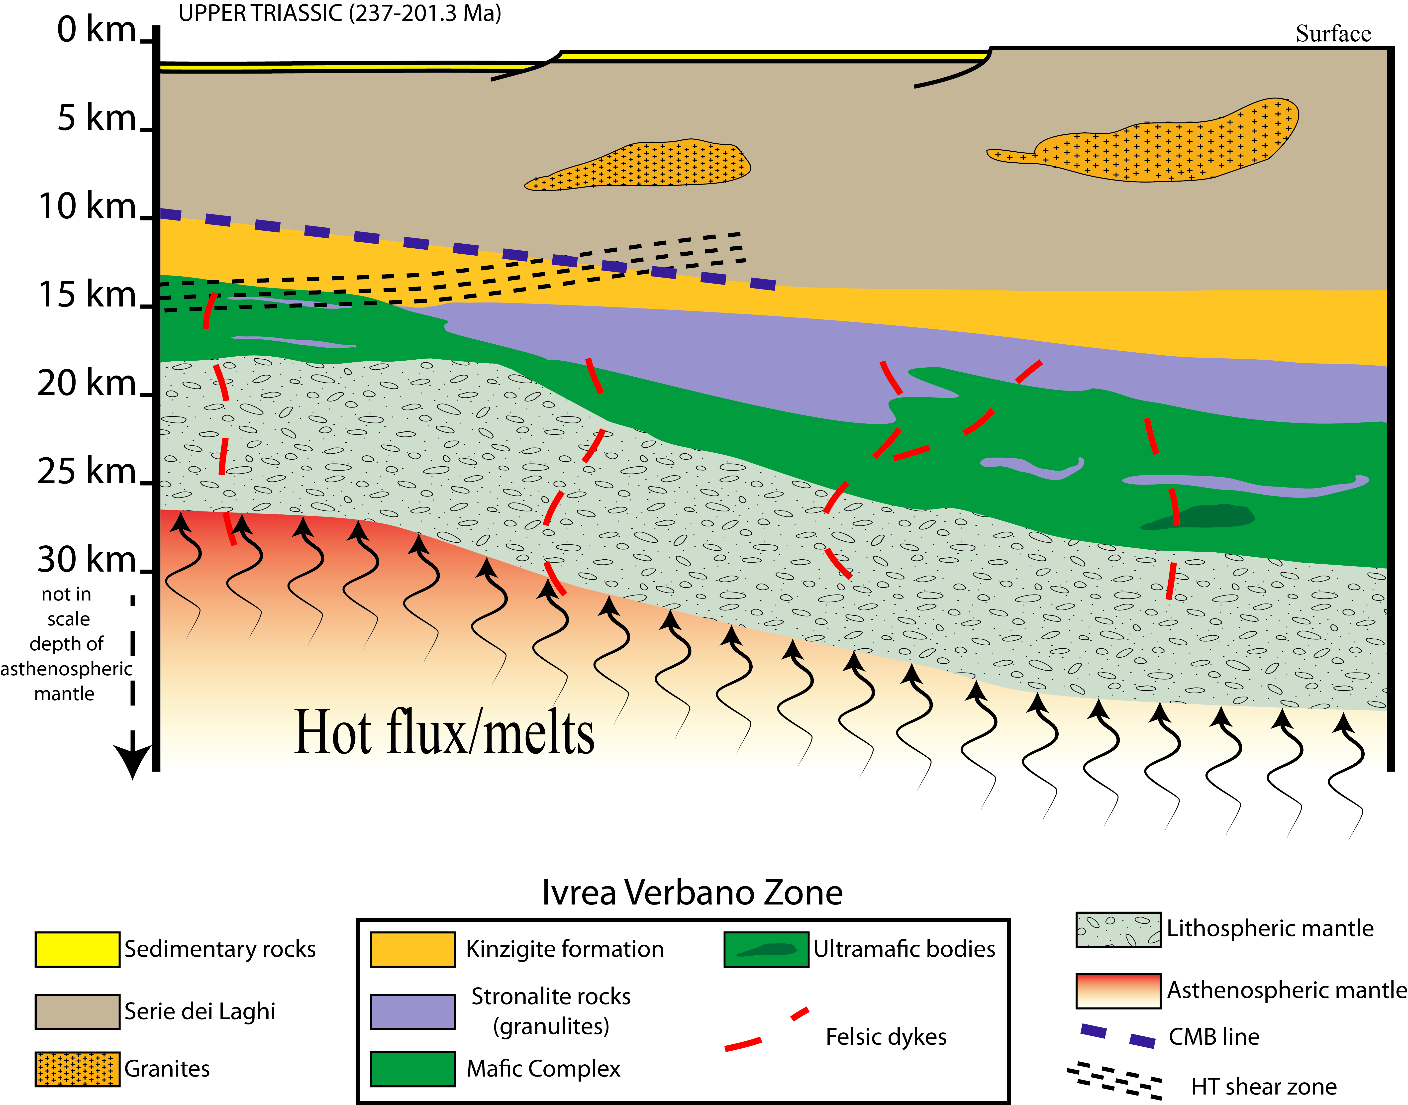
Discussion: a possible origin for corundum-bearing felsic dykes
Major element composition, zircon chemistry point to a segregation of these felsic dykes from extremely differentiated melts.
Corundum oversaturation in uprising mantle melts can be preserved only in bodies/ conduits refractory host rocks
The isotopic Hf support a derivation of the parental melts from an asthenospheric reservoir with depleted mantle to mildly enriched geochemical signature
.
These observations induced to consider such a magmatism as a result of a mantle plume activity, involving the upraise and melting of fertile asthenosphere

Slide 14
Triassic magmatism: implications on the Alps
From shoshonitic to K-rich calc-alkaline, affinity is documented in Southern Alps only in the Eastern (Dolomites area) and Central (Brescian PreAlps) sectors (Middle Triassic ~243–235 Ma; e.g. Cassinis et al., 2002; Casetta et al., 2018)
In the IVZ, tectono-magmatic activity is essentially limited to Ladinian-Carnian ages provided by magmatic and metamorphic zircons
Alkali-rich magmatism with orogenic character similar to that of Middle Triassic lavas and intrusives of Dolomites has been documented in the Finero Complex by Giovanardi et al. 2020
Zircon ages found in the felsic dykes of this study (The Norian 224 and 223 Ma) are significantly younger than those attributed to the magmatic cycles with orogenic affinity and also zircon ages (on average, 225–226 Ma) provided for nepheline-and sodalite-bearing felsic dykes intruding both the mantle Phlogopite Peridotite (Stähle et al., 1990; Stähle et al., 2001)
A transition of the geochemical affinity from orogenic to anorogenic (“transitional”) was also recognized in the 217 Ma melts erupted in the Brescian PreAlps (Cassinis et al., 2009)
These felsic dykes documents the beginning of rifting stages, precursor episodes of the opening of Alpine Tethys
Notes:
The presence of plumasite dykes with different intrusion ages in lower crustal rocks of the entire IVZ may suggest that the same melt-rock interaction process occurred at regional scale and at different time.

