Slide 1

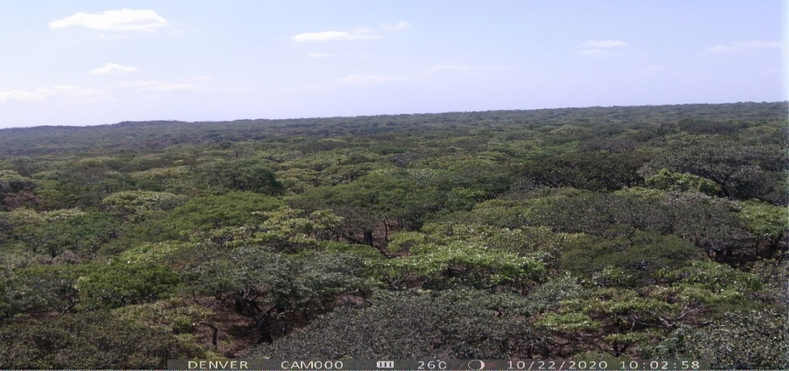







Do field observations agree with satellite based evaporation products in the Miombo Woodland in Southern Africa?
*H. Zimba, M. Coenders-Gerrits, K. Banda, B. Schilperoort, I. Nyambe, H. H. G. Savenije
EGU 2021

Slide 2
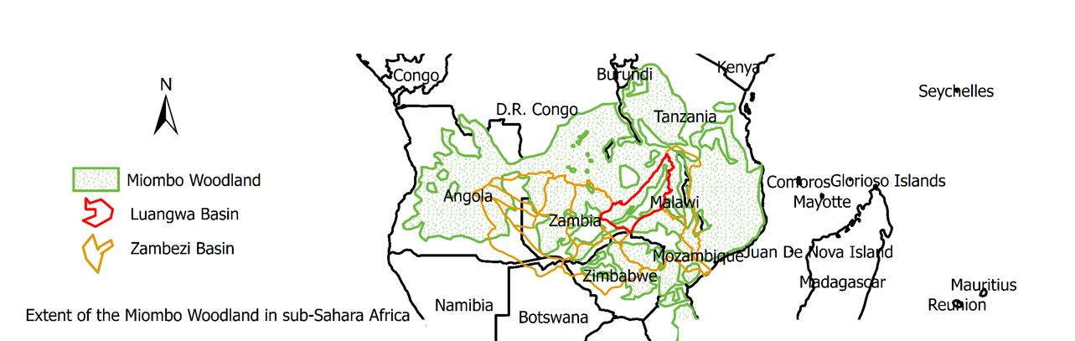
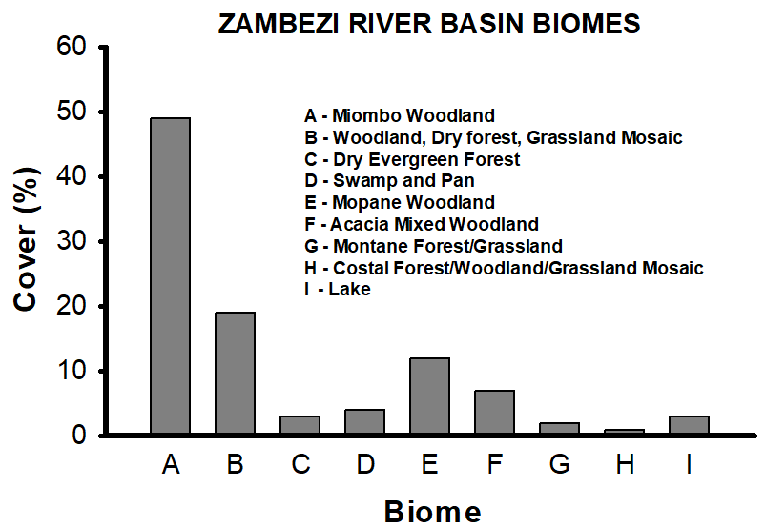
Loacation and Extent
Notes:
A major ecosystem covering 11 countries in sub-Sahara Africa
A major vegetation type in one of the major Basins in Southern Africa, the Zambezi River Basin

Slide 3
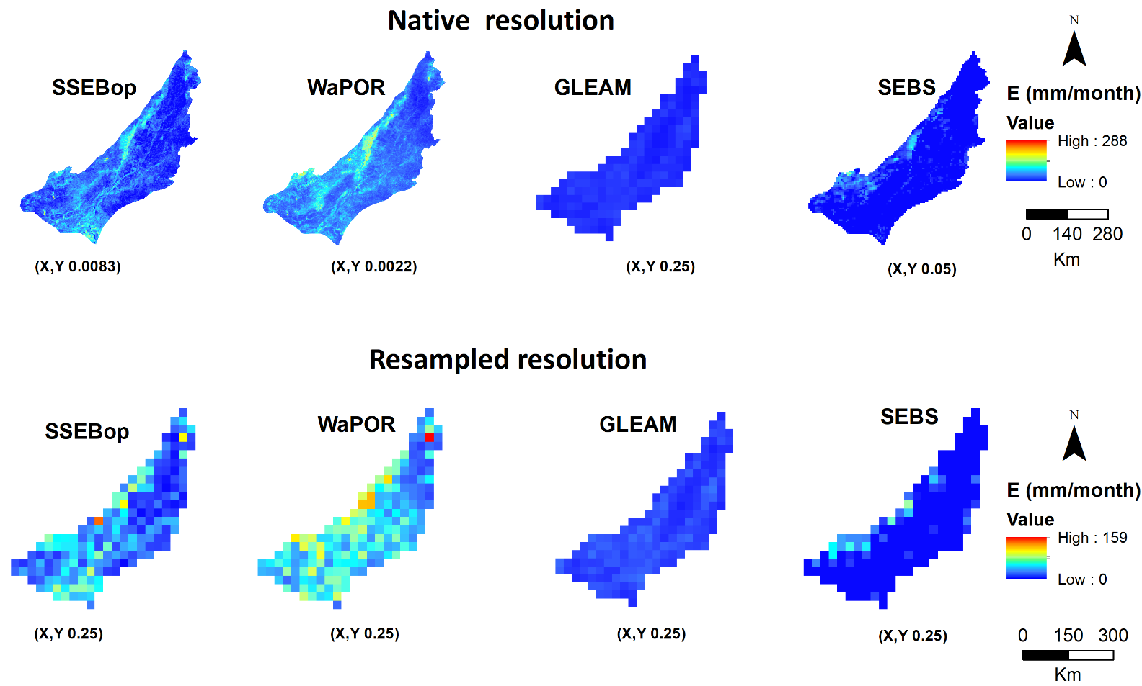
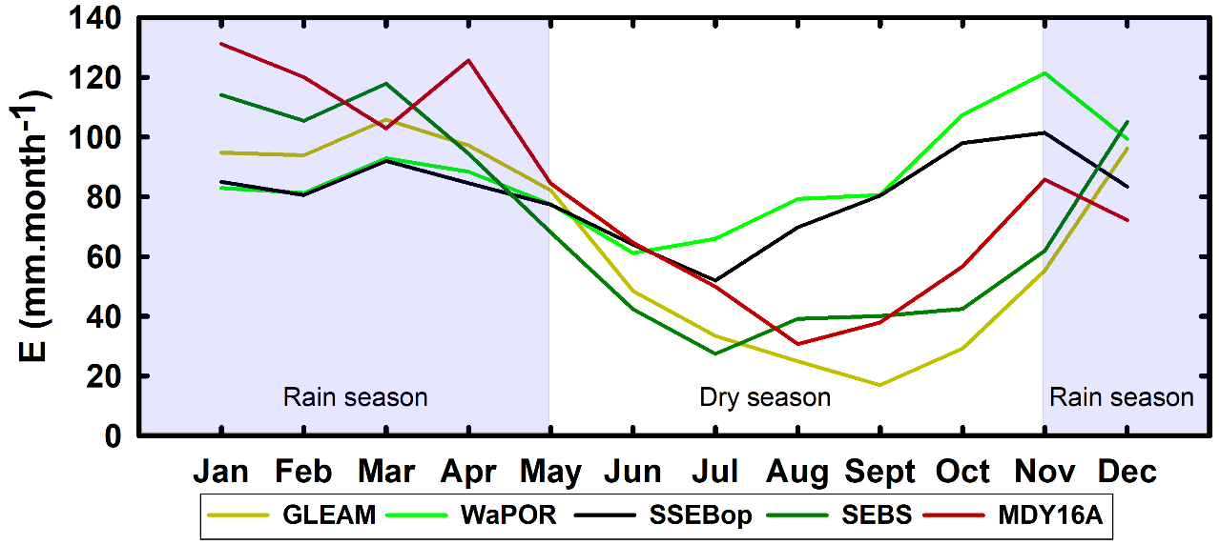
Satellite evaporation products in the Miombo woodland
Spatial variations
Temporal variations
(Five year averages 2015-2019)
Potential reasons for discrepancies
Differences in Model structure
Differences in inputs
Differences in resolution (scale variability)
October 2020
Notes:
Evaporation is a major constituent of the hydrologic cycle with implications on water available for use by various competing needs.
However, it is difficult to estimate evaporation using field methods and has several limitations including being point based
Satellite based evaporation products as an effective alternative to field observations
Several satellite based evaporation products exists but the major challenge facing water resources managers in the Miombo region is knowing which of these models estimates are close to actual Miombo field conditions
There are no flux towers (to our knowledge) in the Miombo region
The structures of these evaporation Models are designed for non Miombo regions
Also the models have been validated with data from non Miombo regions.
There is need to compare satellite based estimates and field estimates based on the Miombo region

Slide 4
Evaporation product | Spatial coverage | Temporal resolution | Spatial resolution | Estimation approach | Source of input data | Reference | Source of data
SEBS | Global | Daily | 5000 m | SEBS equation, residue of the energy balance | MODIS and ERA5 meteorological data | Su (2002) | University of Twente
SSEBop | Global | Decadal | 1000 m | P–M equation, ET fractions from T_{s} estimates | MODIS | (Savoca et al., 2013). | Climate engine
Access: https://clim-engine.appspot.com/climateEngine (Accessed 2020)
WaPOR v 3.5b. | Continental | Decadal | 250 m | P–M Equation, calculates E, T and I separately | MODIS |  | WaPOR Portal
Access: https://wapor.apps.fao.org/home/WAPOR_2/1?theme=L1_AETI_D&dim=DEKAD:%255B2020-08-11%252C2020-08-21)
GLEAM (v3.5b) | Global | Daily | 25000 m | P–T equation, soil stress factor | AMSR-E, LPRM, TRMM | (Martens et al., 2017); (Miralles et al., 2011) | FTP server
Access: https://www.gleam.eu/
MOD16 | Global | 8-day | 500 m | P–M equation, surface conductance model | MODIS | (Mu et al., 2011) | Global subsets tool: MODIS/VIIRS Land Products
Access: https://modis.ornl.gov/globalsubset/
Satellite data based evaporation products

Slide 5
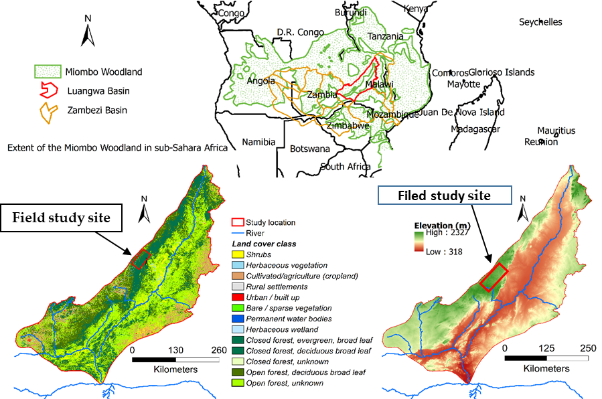
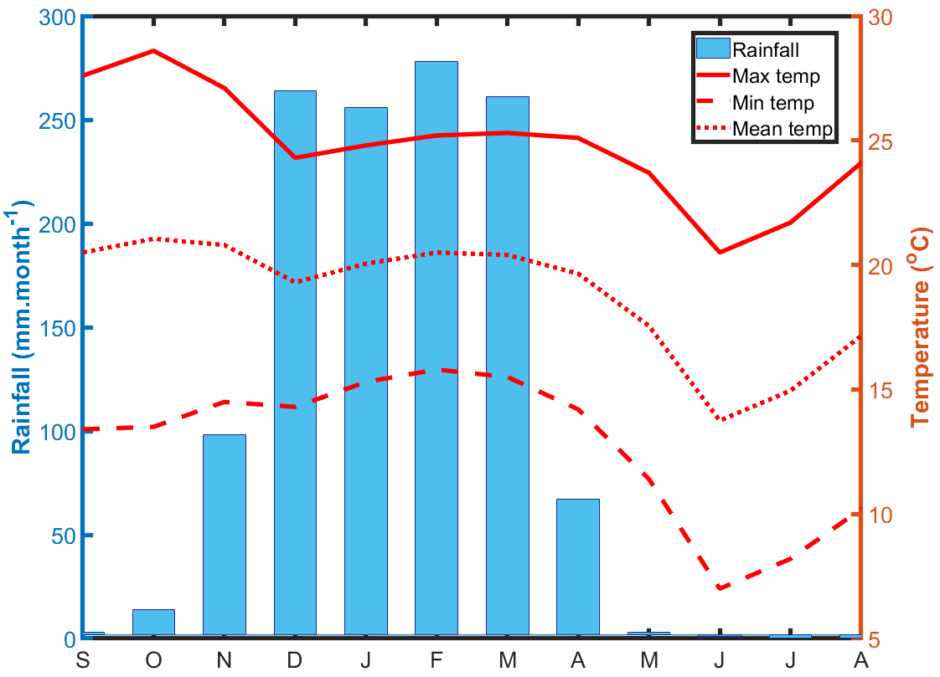
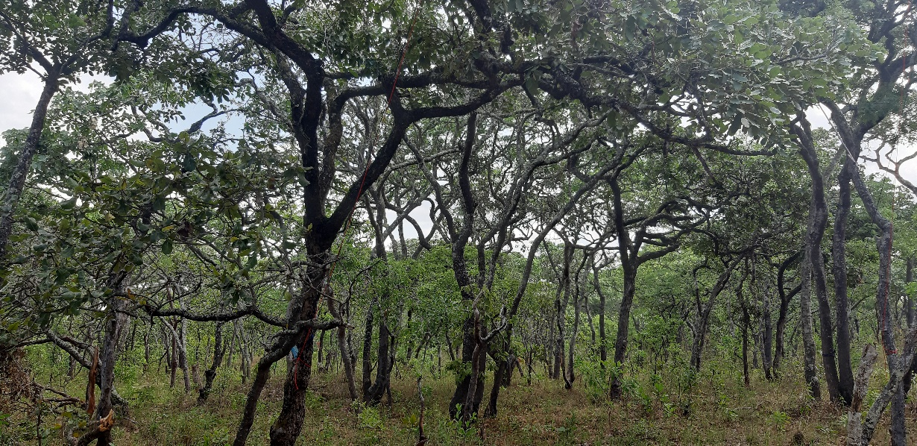
Study site
Aerial view of canopy 22/10/2020
Under canopy 23/10/2020

Slide 6
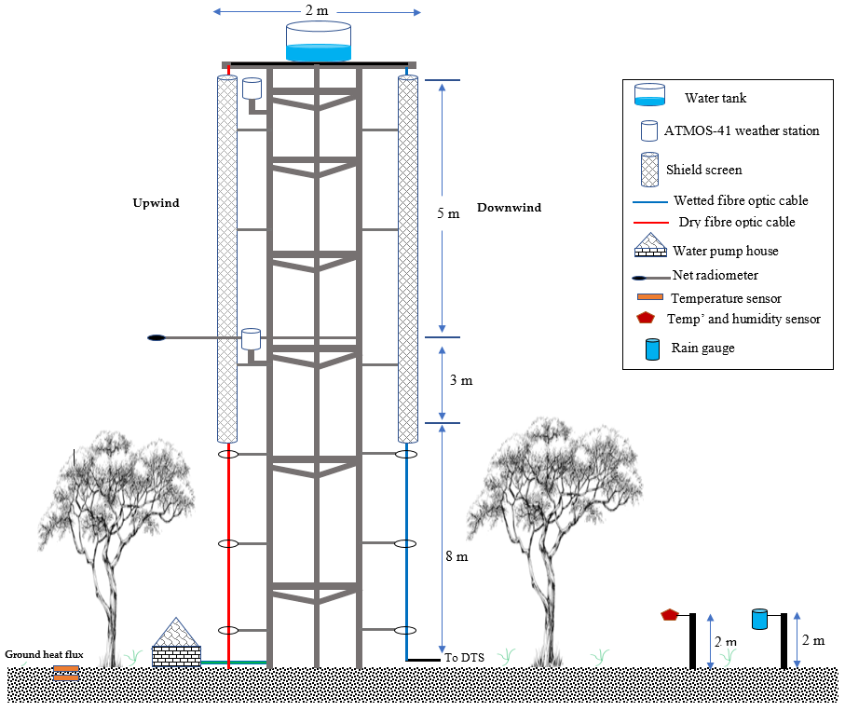
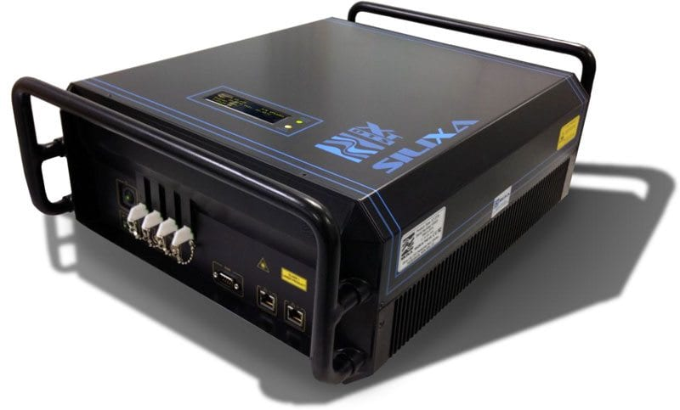
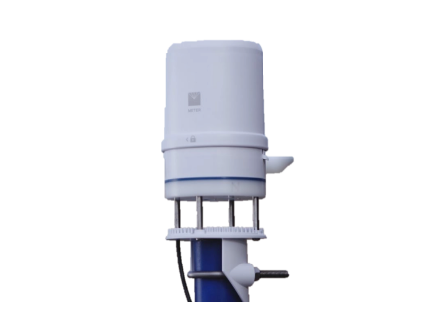
Approach
Field set up
Set up a flux observation tower in a dense Miombo Woodland on the north western side of the Luangwa Basin in Zambia.
Use the Distributed Temperature Sensing (DTS) system to measure the Bowen ratio. The Bowen ratio is calculated using the differences in temperature and actual vapour pressure gradients along the verticle profile (from the forest floor to the top of the flux tower).
Estimate actual evaporation as residue of the energy balance at 15 minutes, 30 minutes, hourly and daily intervals. We then compare the satellite evaporation products estimates to the DTS based evaporation measurements.
The satellite products being evaluated include the surface energy balance (SEBS) model, Global Land Evaporation Amsterdam Model (GLEAM), Moderate-resolution Imaging Spectrometer (MODIS16) and the WAter Productivity through Open access of Remotely sensed derived data
Map (WaPOR)
Distributed Temperature Sensing System using the Silixa XT DTS
ATMOS – 41 weather station
Notes:
We have set up a flux tower to help us try to understand the evaporation dynamics in the Miombo Woodland and see how these compare with satellite based evaporation products

Slide 7
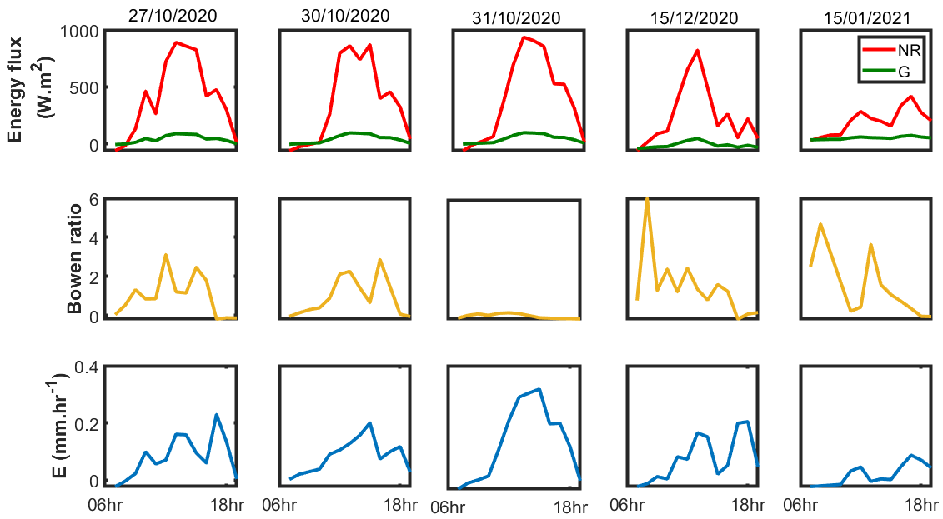
Diurnal energy flux, Bowen ratio and evaporation
Preliminary observations

Slide 8
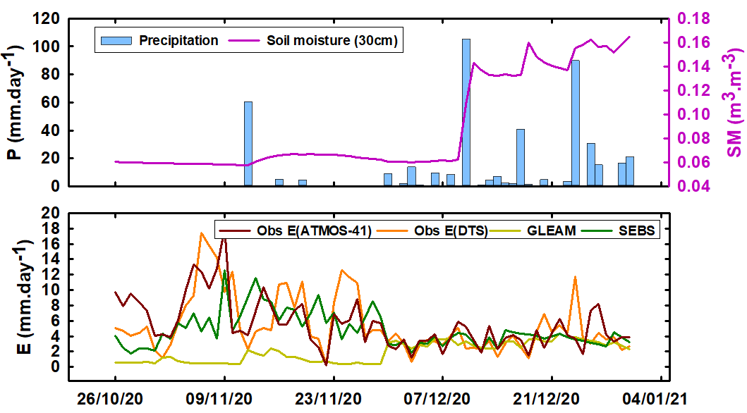
Daily comparison

Slide 9
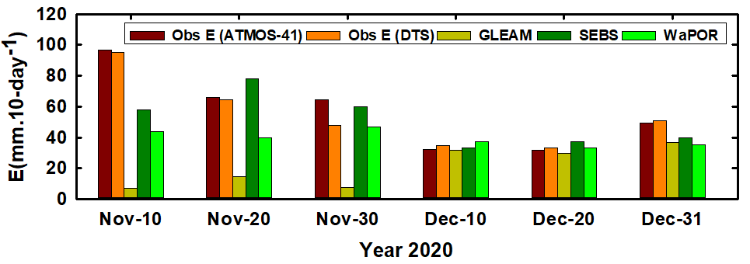
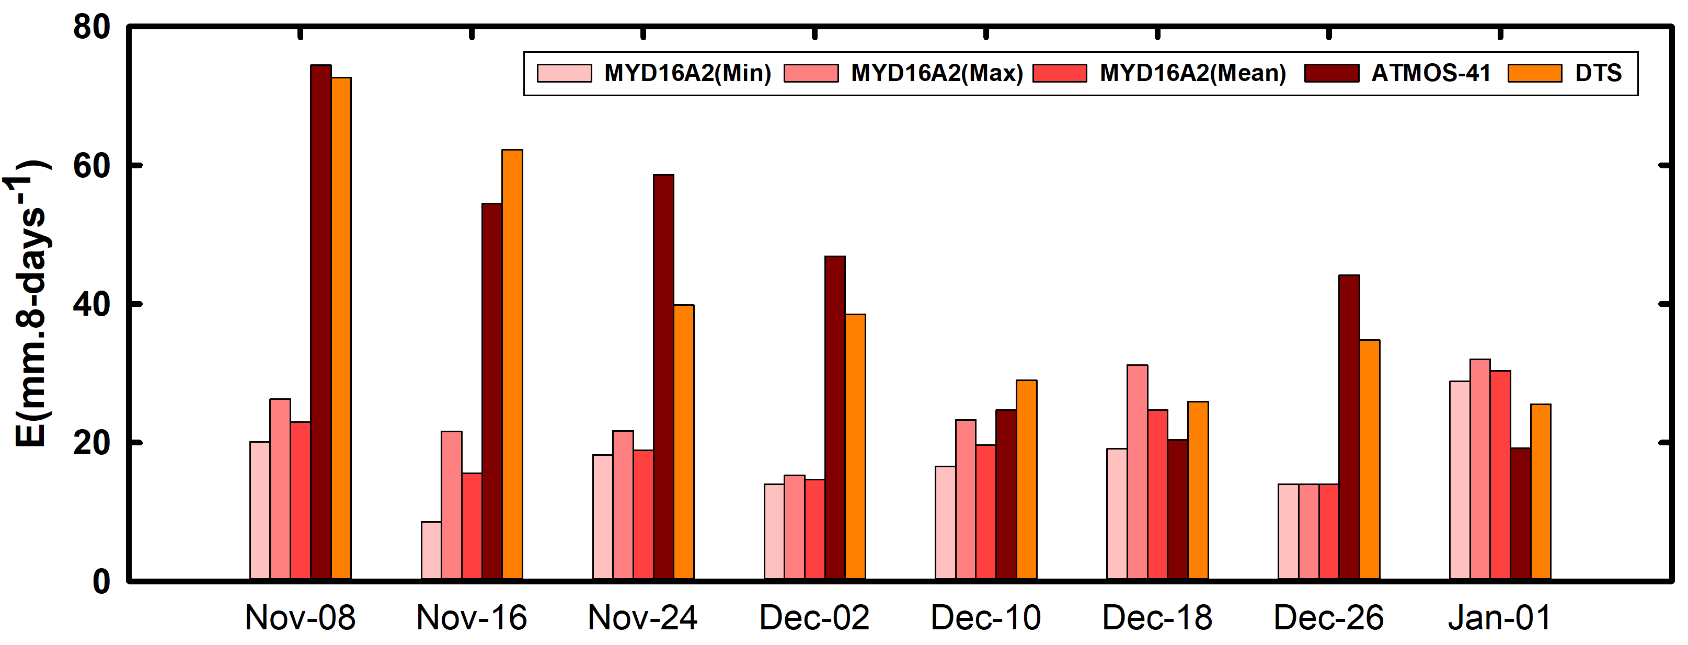
Significant variations during period of low root zone soil moisture and partial canopy cover
Reduced variations during periods of high root zone soil moisture content and full canopy cover
Decadal comparisons

Slide 10
Preliminary indications
Relative to the point measurement and methods used in this study
Satellite evaporation products seem to have difficulties estimating evaporation during period of low root zone soil moisture and partial canopy cover but seem to perform better during the period of high root zone soil moisture content and full canopy cover
Overall, satellite evaporation products seem to underestimate evaporation in the Miombo woodland

