Slide 1


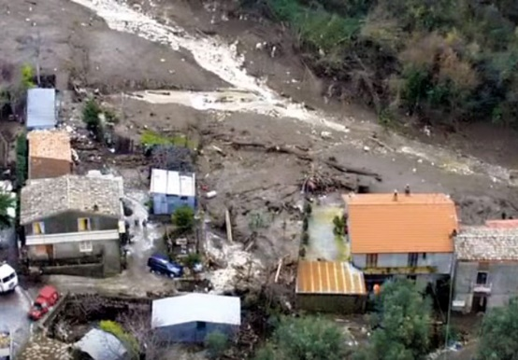
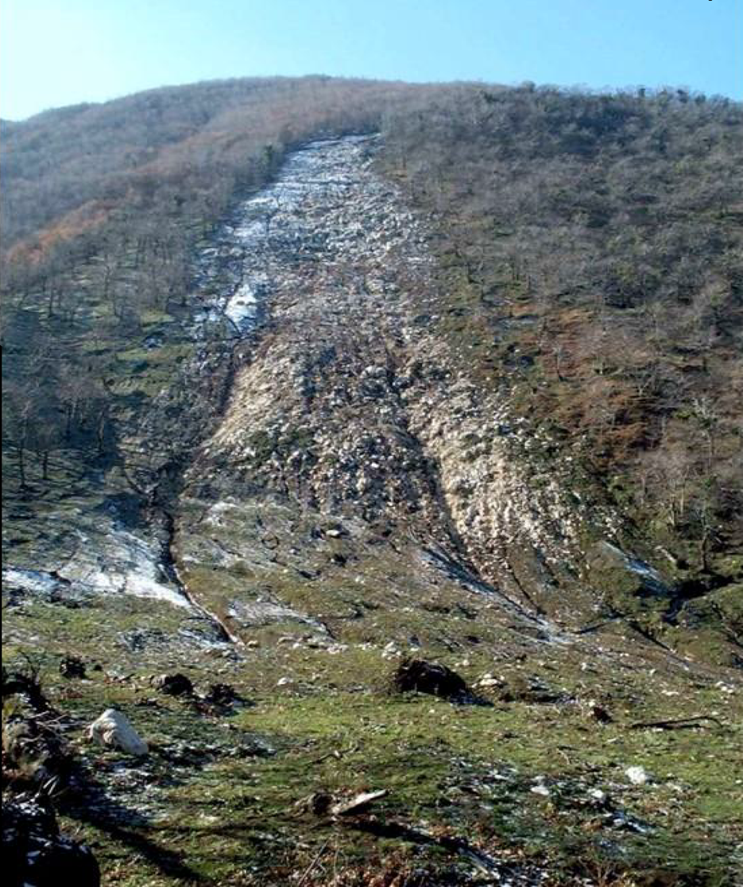
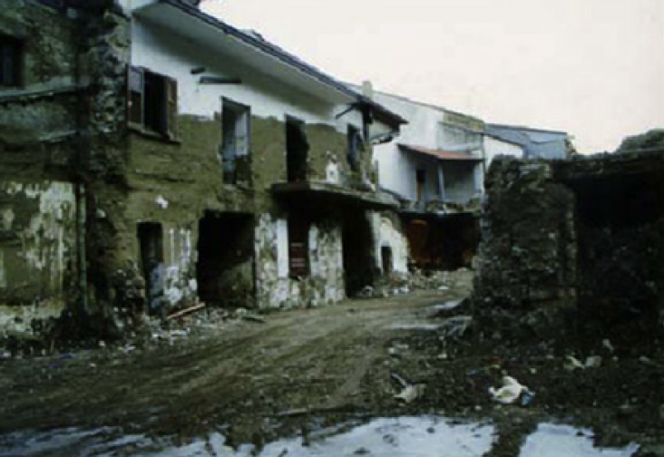
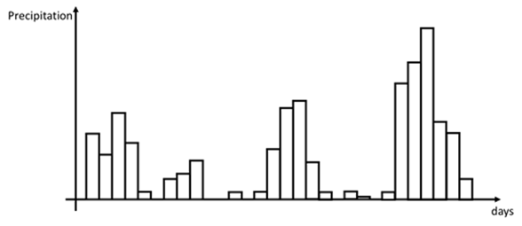
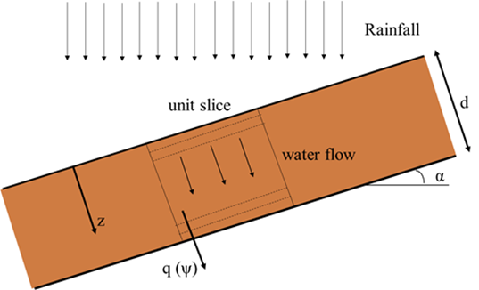

IDENTIFICATION OF HYDRO-METEOROLOGICAL THRESHOLDS FOR RAINFALL-INDUCED LANDSLIDE PREDICTION WITH CLUSTERING TECHNIQUES
Case study: Cervinara slope
Monte Cornito
Naples
Scarp of the landslide of 1999
1) RAINFALL DATASET: 1000 years synthetic hourly rainfall series has been generated with the Neyman-Scott Rectangular Pulse (NSRP) model (calibrated with available data from 1st January 2001 to 31st December 2017 )
2) PHYSICALLY-BASED MODEL OF INFILTRATION: Richards 1D equation (all the parameters have been assigned according to available laboratory and field monitoring observations)
3) SLOPE STABILITY ANALYSIS: geotechnical module for the evaluation of the factor of safety under the inﬁnite slope hypothesis
Leakage
EGU General Assembly 2021 Vienna Austria 19-30 April 2021

Slide 2
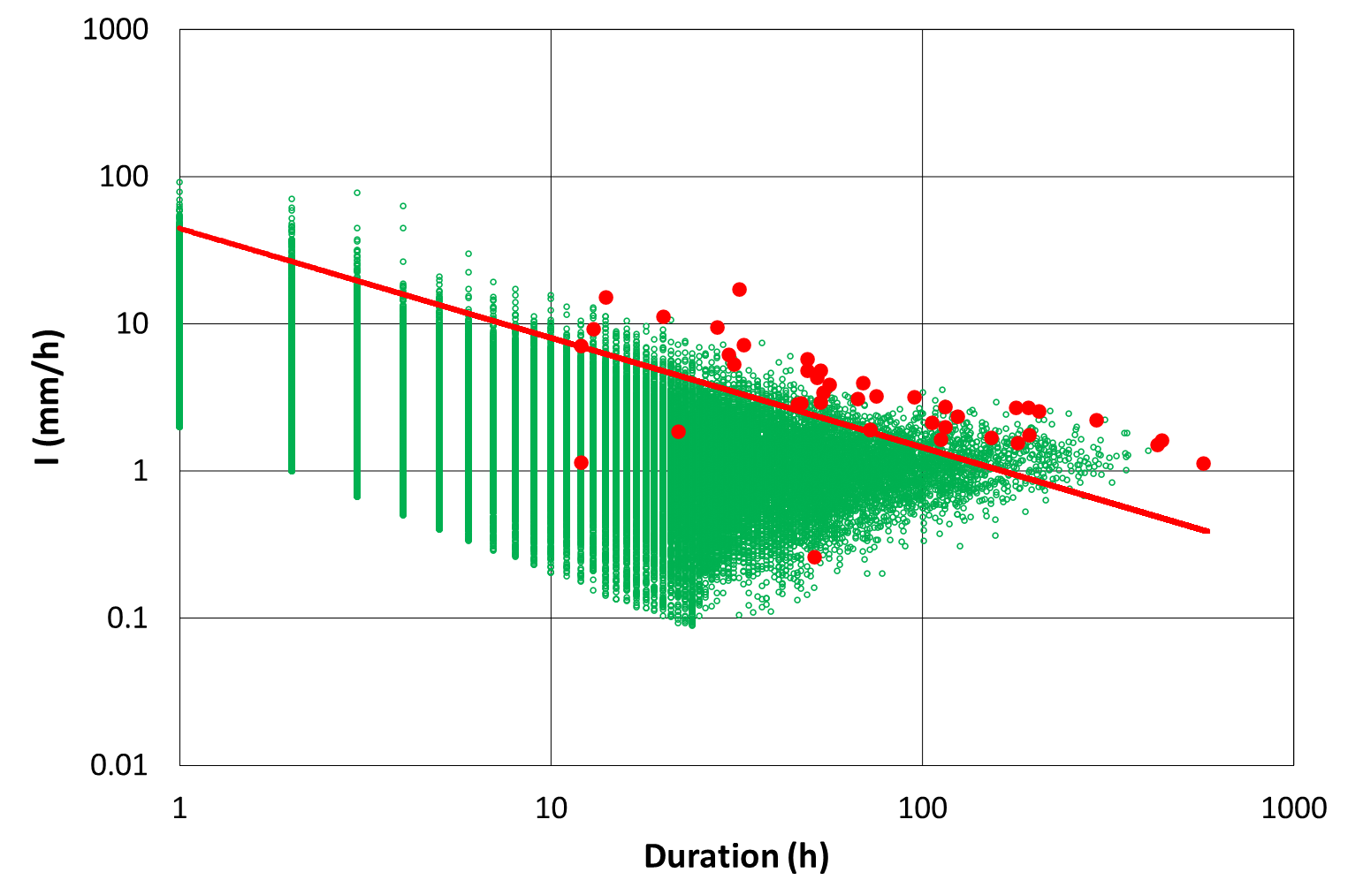
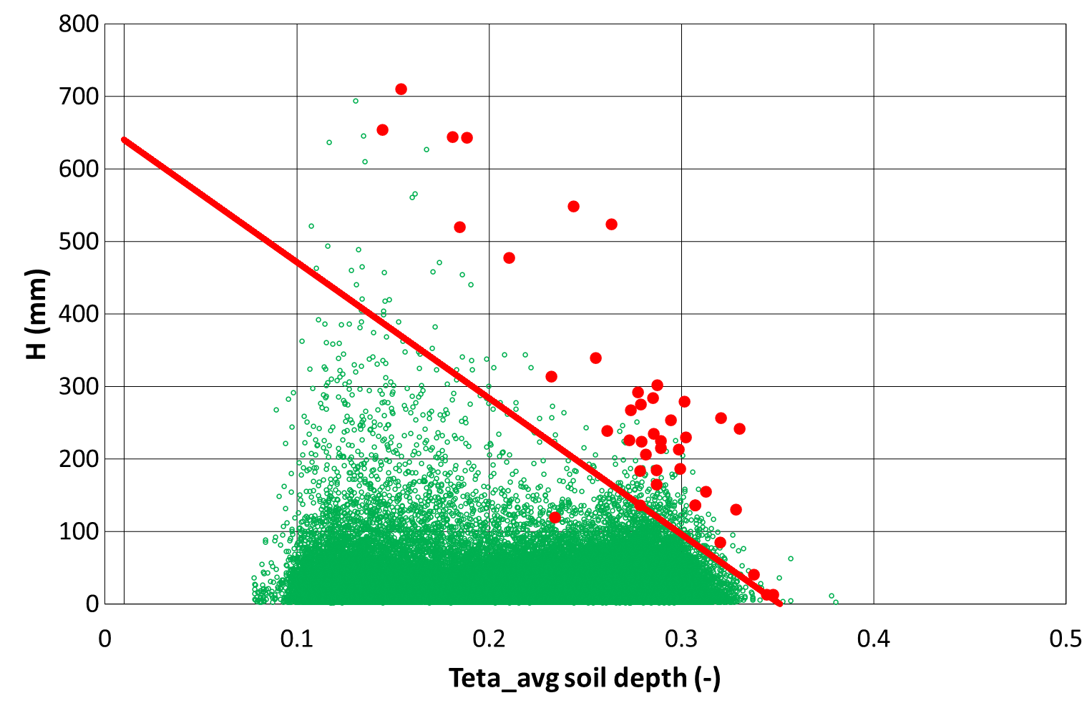

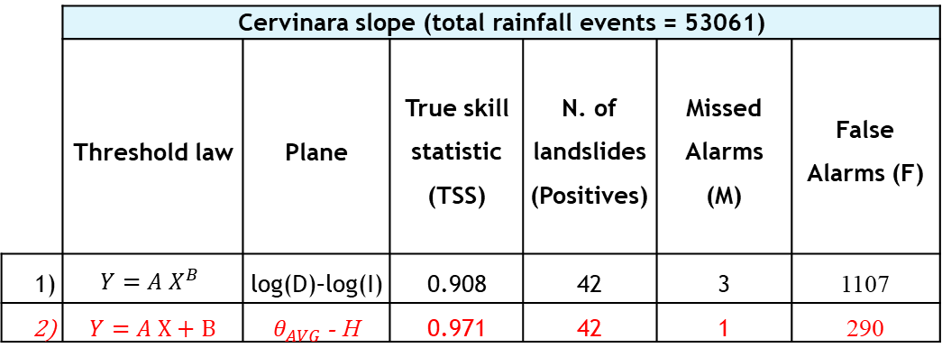

IDENTIFICATION OF HYDRO-METEOROLOGICAL THRESHOLDS FOR RAINFALL-INDUCED LANDSLIDE PREDICTION WITH CLUSTERING TECHNIQUES
Landslide prediction with meteorological and hydro-meteorological thresholds
Meteorological threshold D-I
Hydro-meteorological threshold $θ_{AVG}$ - H
1)
2)
Rainfall events after which no landslide is triggered;
Rainfall events followed by the triggering of a landslide;
The red lines, obtained by maximising the true skill statistic (TSS) for 1000 years long synthetic data sets (rainfall and water content), represents the thresholds separating landslides (P) and no landslides event (N)
 | Cervinara slope (total rainfall events = 53061)
 | Threshold law | Plane | True skill statistic (TSS) | N. of landslides (Positives) | Missed Alarms (M) | False Alarms (F)
1) | $$Y=A X^{B}$$ | log(D)–log(I) | 0.908 | 42 | 3 | 1107
2) | $Y=A$ X + B | $θ_{AVG}$ - H | 0.971 | 42 | 1 | 290
TSS $=1−\frac{M}{P}−\frac{F}{N}$
EGU General Assembly 2021 Vienna Austria 19-30 April 2021

Slide 3
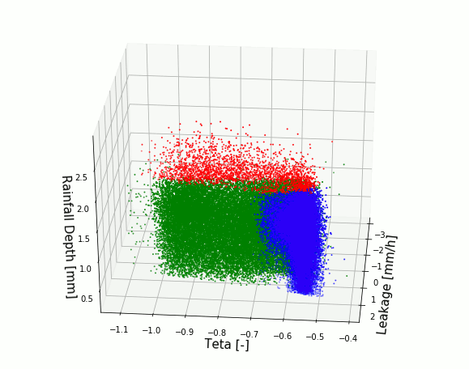
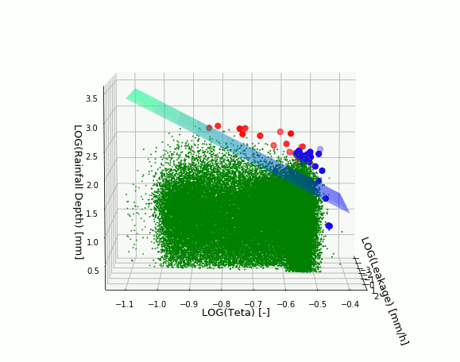

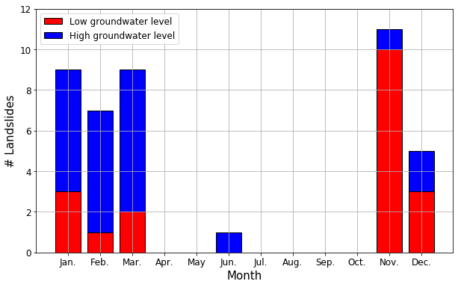

IDENTIFICATION OF HYDRO-METEOROLOGICAL THRESHOLDS FOR RAINFALL-INDUCED LANDSLIDE PREDICTION WITH CLUSTERING TECHNIQUES
Landslide prediction with clustering techniques
Dynamic 3D clustering
Cervinara slope (rainfall events = 53061)
No landslides events (Negatives = 53019)
Landslides events (Positives = 42)
LANDSLIDE FREQUENCY
$$H=1.62 {teta_Avg}^{−2.89}{leakage}^{0.010}$$
EGU General Assembly 2021 Vienna Austria 19-30 April 2021

Slide 4

Identification of hydro-meteorological thresholds for rainfall-induced landslide prediction with clustering techniques
Pasquale Marino, Carlo Giudicianni, Giovanni Francesco Santonastaso, and Roberto Greco
Università della Campania ‘Luigi Vanvitelli’ – Dipartimento di Ingegneria - Aversa (CE), Italy
THANK YOU FOR YOUR ATTENTION!!!
FOR ANY QUESTION ASK IN CHAT
EGU General Assembly 2021 Vienna Austria 19-30 April 2021

