Slide 1



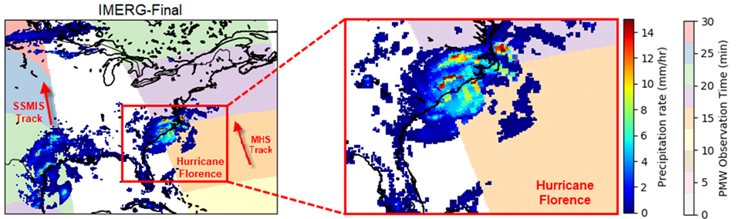
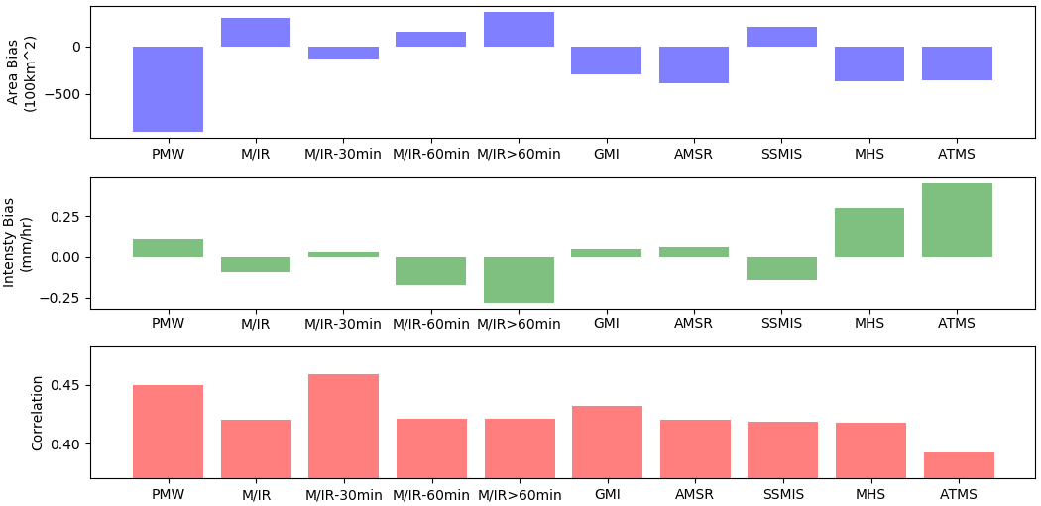
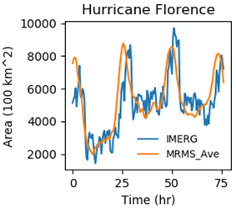
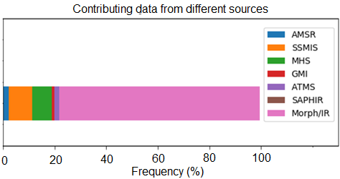
The effect of different contributing sensors in IMERG-Final precipitation estimates
Hooman Ayat¹, Jason Evans¹, Ali Behrangi²
(1) Climate Change Research Centre and ARC Centre of Excellence for Climate Extremes, University of New South Wales,
(2) University of Arizona, Department of Hydrology and Atmospheric Sciences
Motivation:
Satellites observe the storms in the globe with a better coverage. However, it is not still wide enough to cover the whole earth at the same time. So, it is unavoidable to merge multiple sources of data to have a global dataset with high spatio-temporal resolution.
The question is how the uncertainty of contributing different sources data impact the final merged products?
Study Domain: Eastern United States.
Study Period: 2016-2018 focused on 7 land-falling Hurricanes:
Florence, Irma, Nate, Hermine, Harvey, Mathew, Micheal
Satellite Data: Integrated Multi-satellitE Retrievals for GPM (IMERG)
Reference Data: Multi-Radar/Multi-Sensor System (MRMS)
IMERG-Final
All Data
Morph/IR
PMW
Area Bias
(100 km²)
Intensity Bias
(mm/hr)
Data
Correlation
Take Home Messages:
PMW Sensors tend to represent the storms with smaller areas and higher average intensity compared to morphed/IR data
The quality of morph/IR data deteriorates with the longer absence of the PMW observations
The hierarchy of selecting PMW sensors should be adjusted based on the storm properties when there are two or more overpasses over a grid box at a time step
Published paper:
Ayat, H., J. P. Evans, and A. Behrangi, 2021: “How do different sensors impact IMERG precipitation estimates during hurricane days?” Remote Sens. Environ., 259, 112417, https://doi.org/10.1016/j.rse.2021.112417.

