Slide 1
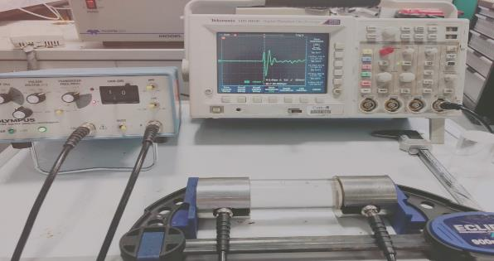

Improved estimation method for dynamic bulk moduli of sandstones subjected to hydrostatic stress
Nazanin Nourifard, Elena Pasternak, Maxim Lebedev.

Slide 2
Significance
Static moduli of rocks are usually different from the corresponding dynamic moduli.
The simultaneous measurement of static and dynamic bulk moduli is rarely reported in literature due to difficult nature of conducting a valid test on soft rocks (sandstones).
The dynamic elastic moduli method is cost efficient, non-destructive and fast to perform.
High precision dynamic measurements provides useful tools for analyses and prediction of rock behaviour.
Modification of this method by knowing the ultrasonic system itself.
Same sample
Same cycle
Same orientation

Slide 3
Potential reasons for the difference between static and dynamic moduli (Fjaer2019)
Strain rate
Dispersion (pore fluid effects)
Insufficient characterization of anisotropy
Different drainage conditions
Heterogeneities
How about accurate calculation of dynamic moduli?
How about system calibration?

Slide 4
Reducing the unknowns for this experiment
We designed an experiment to isolate the potential reasons for the difference between static and dynamic moduli + accurate calculation of the dynamic moduli.
document the dynamic elements in precise details (system and method)
Acoustic system and PEEK calibration (time delay)
Independent measurements of Vp and Vs
Correct S-wave picking method (three peak picking)
Strain amplitude effect on velocity (P and S-waves)
Berea sandstones
Dry condition
Hydrostatic stress
Accurate calculation of dynamic moduli

Slide 5
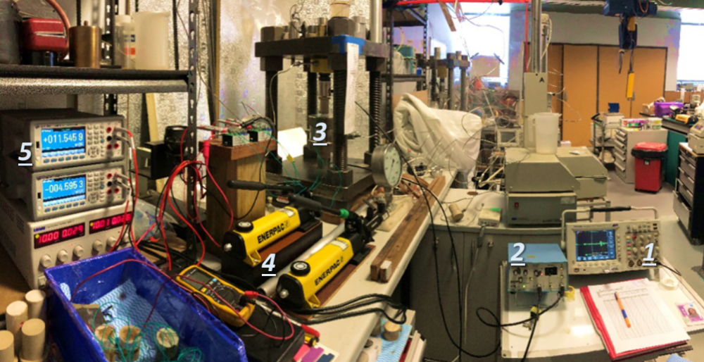
Experimental set-up
1) Oscilloscope, 2) pulser (attached to transducers at top an dbottom of the sample inside the cell), 3) Hook’s cell, 4) pumps, and 5) voltmeters (Nourifard 2019).

Slide 6
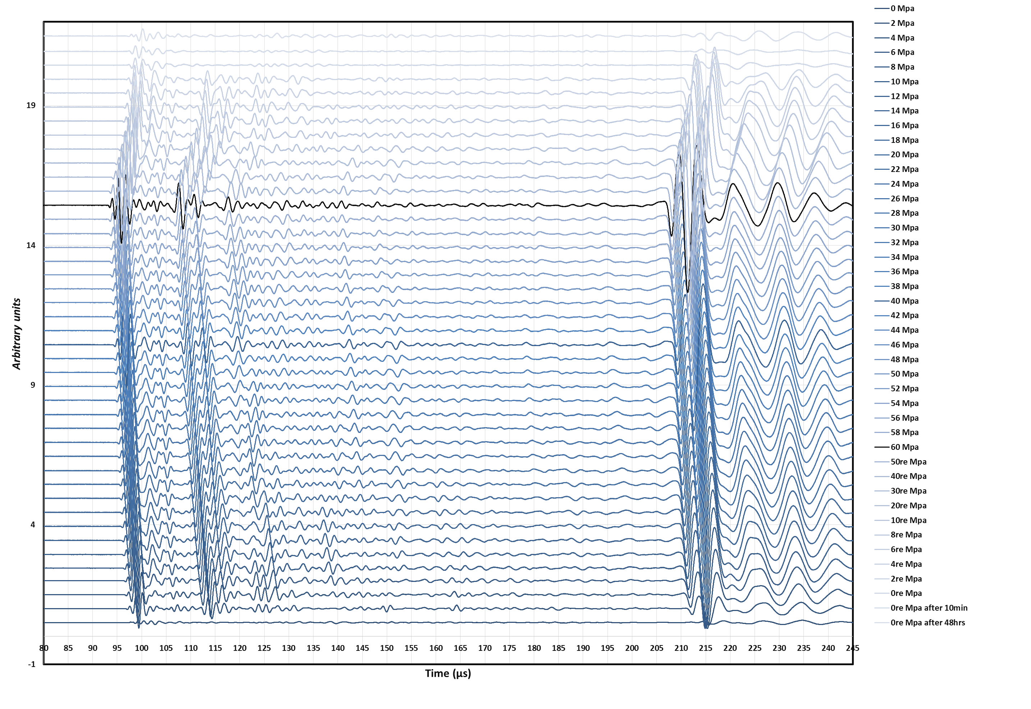

Slide 7
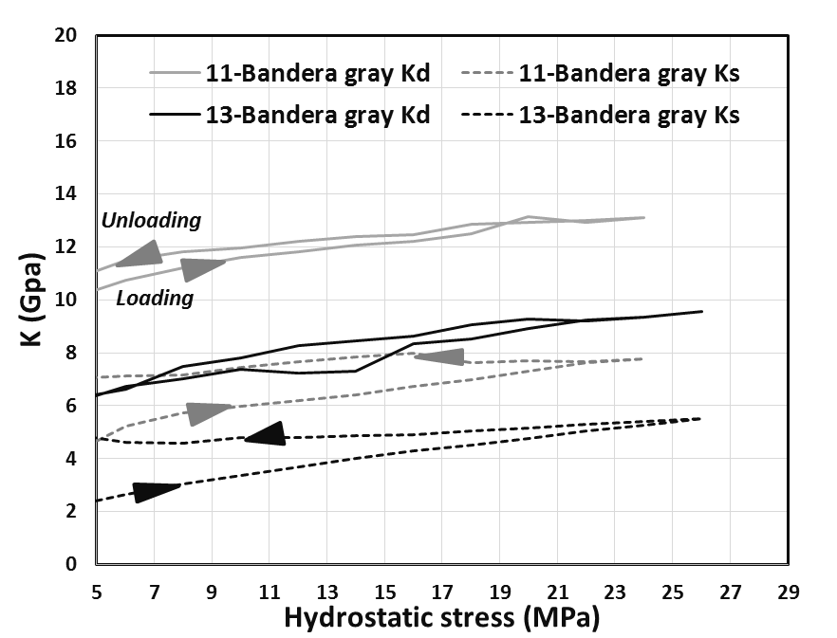
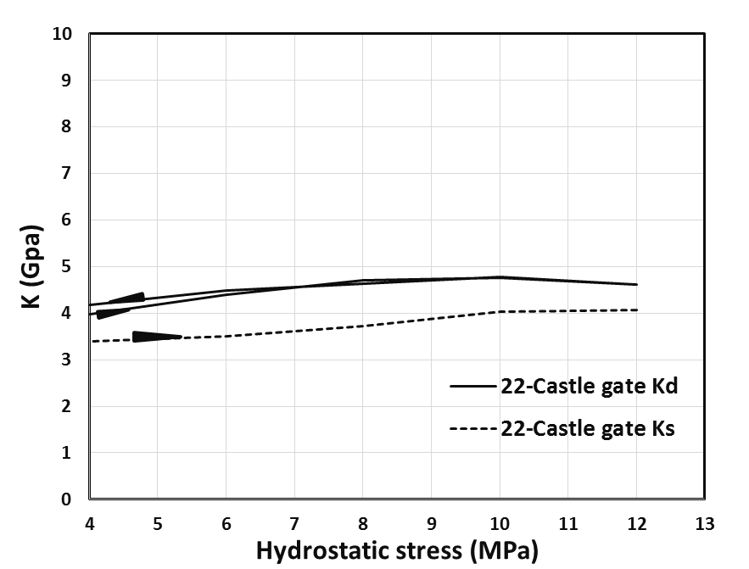
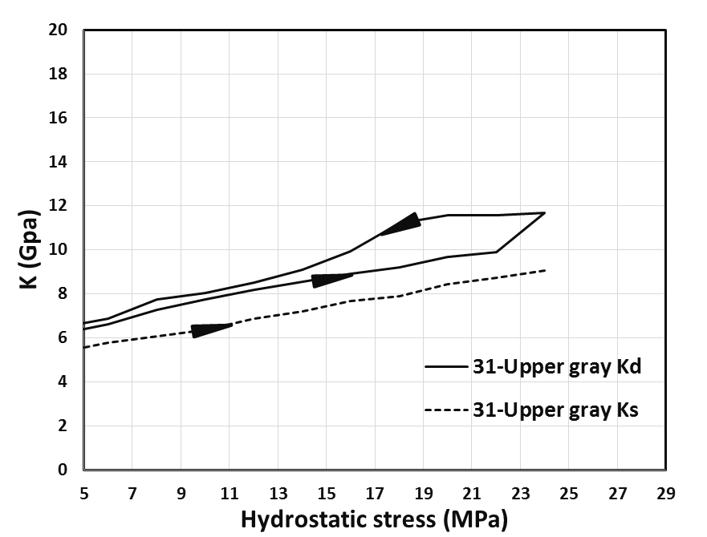
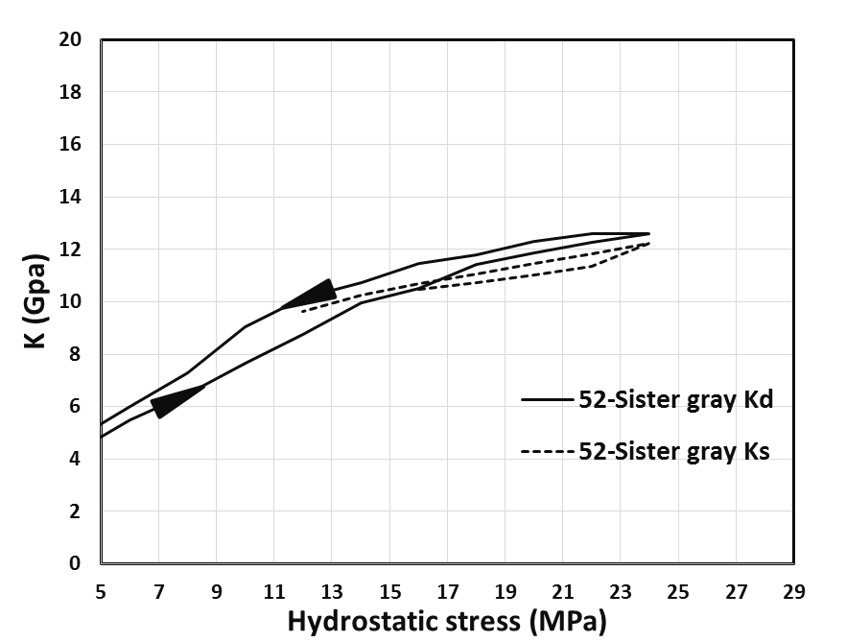
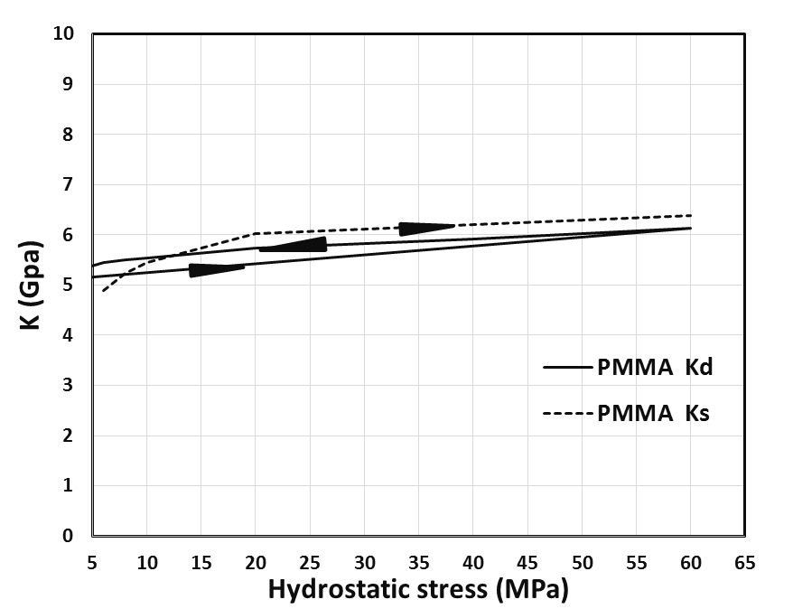
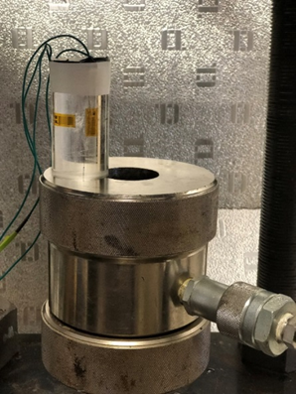
Static and dynamic Bulk moduli as a function of hydrostatic stress for five tested sandstones (Bandara gray, Castlegate, Sister gray, Upper gray) and PMMA.

Slide 8
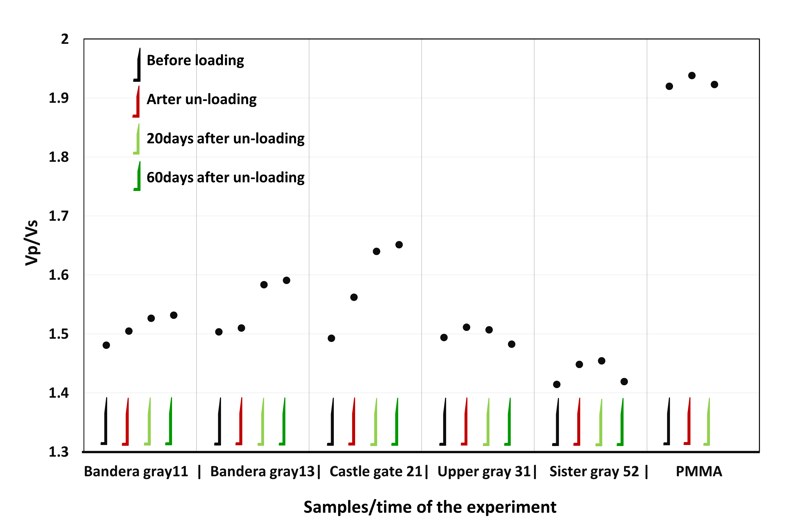
P-and S-wave velocities measured before, immediately after, 20 days after and 60 days after loading cycles to study the effect of the relaxation of stress on velocities (another plus for dynamic method)
The plot of Vp/Vs ratio in pre- and post-stressed conditions for all the tested samples outside the stress cell.

Slide 9
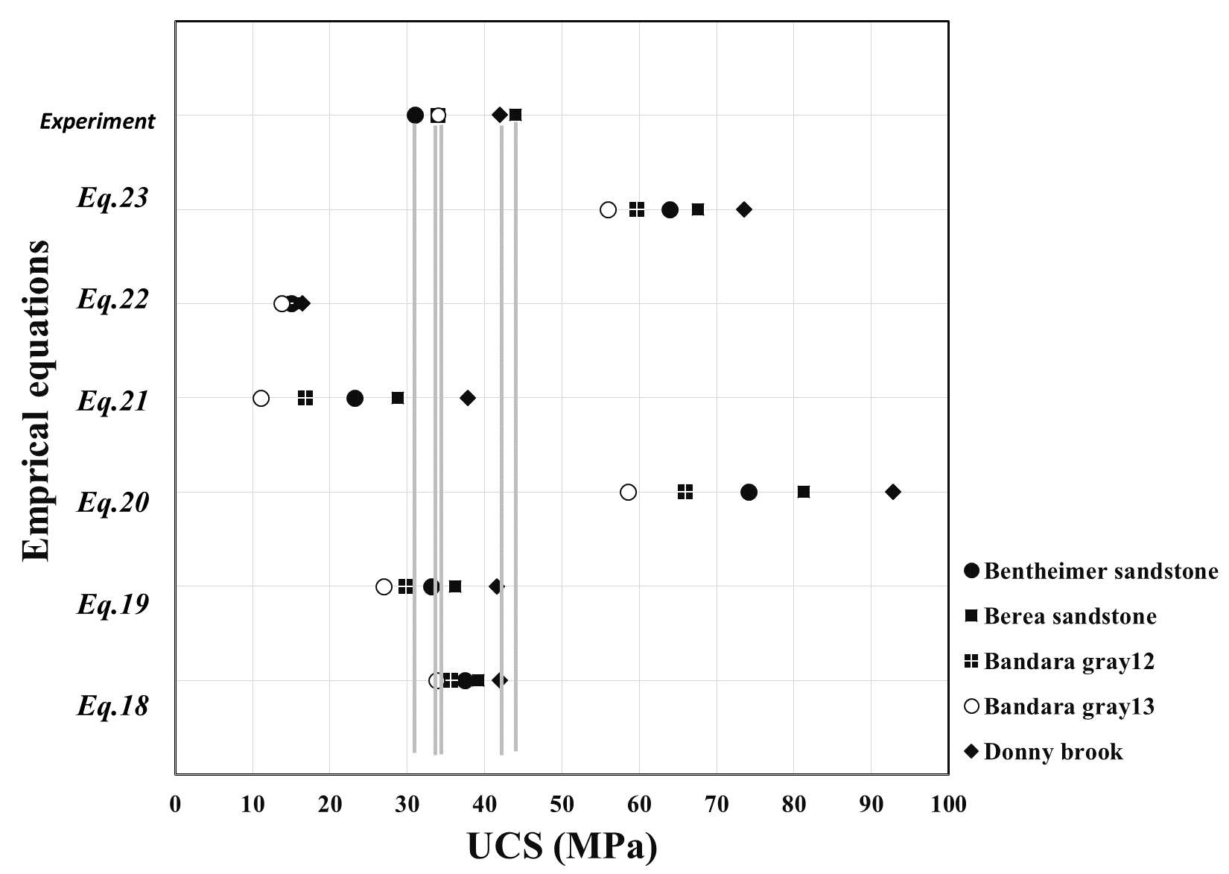
  Strength Analogues (UCS)
Eq. | Reference | Relationship | R² | Rock formation
18 | Kahraman (2001) | UCS=9.95Vp^{1.21} | .83 | Sandstone and limestone
19 | Kilic and Teymen (2008) | UCS=2.304Vp^{2.4315} | .94 | All types
20 | Sharma and Singh (2008) | UCS=0.0642Vp-117.99 | 0.9 | All types
21 | Mishra and Basu (2013) | UCS=0.05Vp-126.4 | .82 | Sandstone
22 | Minaeian and Ahangari (2013) | UCS=0.005Vp | .94 | Weak rocks
23 | Khandelwal (2013) | UCS=0.033Vp-34.83 | .87 | All types
The estimated UCS by empirical equations in table compared to experimental dynamic UCS measured in the lab (illustrated in lines).

Slide 10
Conclusion
Simultaneous results show that the dynamic Bulk modulus is higher than the static Bulk modulus for sandstones from 5% to 40%, which is in agreement with hard rocks results.
Our direct measurement for both P- and S-waves by P and S wave transducers shows that the rough estimation of S-wave from its P-wave is not accurate, and the Vp/Vs ratio does not obey the classic ratio of 1.5 (especially for porous materials).
By applying the accurate P-wave velocity to existing empirical equations, designed for a wide range of the rocks, the UCS value can be accurately estimated, which shows the importance of correct picking of the first arrivals.
Consistency of dynamic data (pre-post loading) greatly expands the understanding of the process of changing the magnitude of elastic modules.

Slide 11
More references on this topic
Authors | Title | Publication | Year
Nourifard, N., Pasternak, E., Lebedev, M. | “Simultaneous experimental study of dynamic and static Young’s moduli in sandstones” | Exploration Geophysics | 2021
Nourifard, N., Lebedev, M. | “Bulk moduli of sandstones subjected to isotropic stress” | Applied geophysics | 2021
Nourifard, N., Pervukhinab, M., Urosevica, M., Lebedev, M. | “The effects of stress and fluid on the anisotropy of reservoir rock: case study of a sandstone from the Harvey 3 CCS site, Western Australia” | Exploration Geophysics | 2020
Nourifard, N. | “Effect of stress magnitude and stress rate on elastic properties of the rocks “ | PhD thesis | 2019
Nourifard, N., Mashinskii, E.I., Lebedev, M. | “The effect of wave amplitude on S-wave velocity in porous media: An experimental study by Laser Doppler Interferometry” | Exploration Geophysics | 2019
Yurikov, A., Nourifard, N., Pervukhina, M., and Lebedev, M. | “Laboratory ultrasonic measurements: Shear transducers for compressional waves” | Leading Edge Quarterly | 2019
Nourifard, N., Lebedev, M. | “Effect of strain amplitude produced by ultrasonic wave on its velocity” | Geophysical Prospecting | 2018

