Slide 1


Marine Hydrophysical Institute
Russian Academy of Sciences
ANALYSIS of MEAN and EDDY ENERGY
of the BLACK SEA CIRCULATION
DERIVED under account the CLIMATICAL
and REAL ATMOSPHERIC FORCING
Olga Dymova, Sergey Demyshev and Dmitry Alexeev
olgadym@yahoo.com
vEGU21: Gather Online | 19 – 30 April 2021

Slide 2
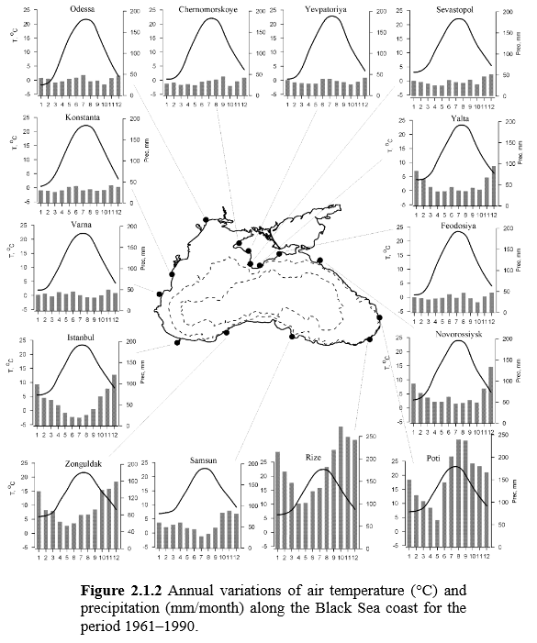
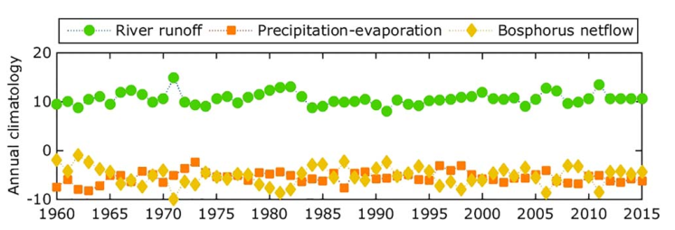
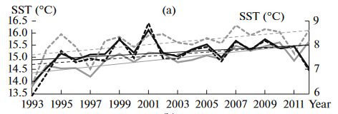
MOTIVATION
The Black Sea is a unique semi-enclosed basin with a narrow shelf and a steep continental slope, where the dynamics and energy strongly depends on annual and seasonal variability of external conditions.
from (Miladinova et al 2017)
from (Ivanov and Belokopytov 2013)
from (Dorofeev and Sukhikh 2017)

Slide 3
AIM
to study variability mechanisms of the Black Sea circulation based on analysis of the Lorenz energy cycles (LEC)
TASKS
climatological and real-forcing simulations of the Black Sea circulation
estimation of the LEC-components by the simulation results
analysis of the contributions of energy generation and dissipation, the barotropic and baroclinic instabilities to the Black Sea dynamics

Slide 4
NUMERICAL EXPERIMENTS
1. Eddy-resolving MHI-model with horizontal resolution about of 1.6 km on latitude and longitude and 27 vertical z-levels (Demyshev 2012).
2. Vertical mixing by the Mellor-Yamada closure model 2.5 (Mellor and Yamada 1982).
3. Atmospheric forcing is wind stress, heat fluxes, precipitation and evaporation.
Exp 1 – climatological forcing (monthly-mean wind and fluxes by long-term data (Demyshev et al 2009))
Exp 2 – SKIRON for 2011 (https://forecast.uoa.gr/en/forecast-maps/skiron/europe)
Exp 3 – SKIRON for 2016
4. Duration of all experiments is one year.

Slide 5
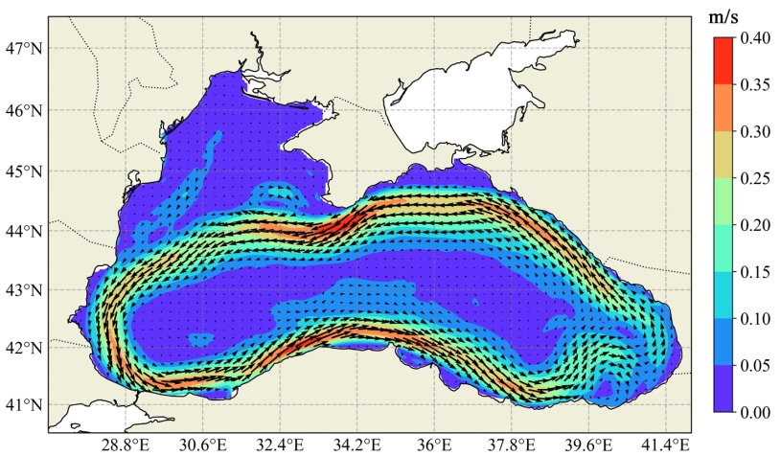
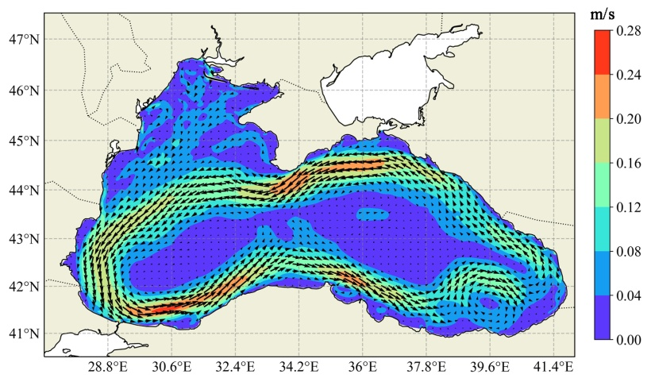
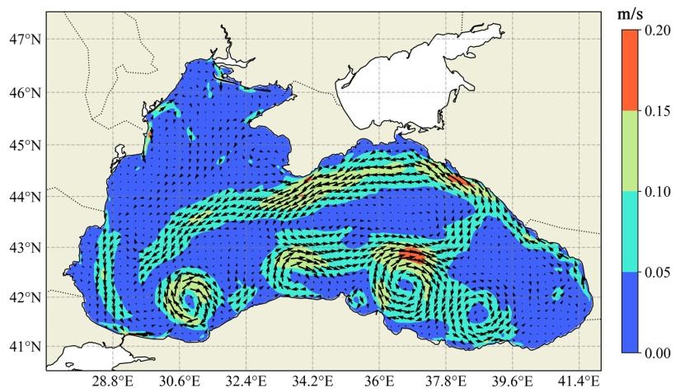
MID-ANNUAL SURFACE VELOCITY FIELDS
climatology
Steady large-scale cyclonic jet current (the Rim Current) and anticyclonic mesoscale coastal eddies (Sevastopol and Batumi anticyclones).
2011
Large-scale circulation structure is closure to climatic pattern, but current velocities are weaker.
There is significant variability in the north-western shelf area.
2016
The Rim Current is destroyed, strong mesoscale variability is observed in the southern part. Current velocities are smallest by the experiments result.

Slide 6
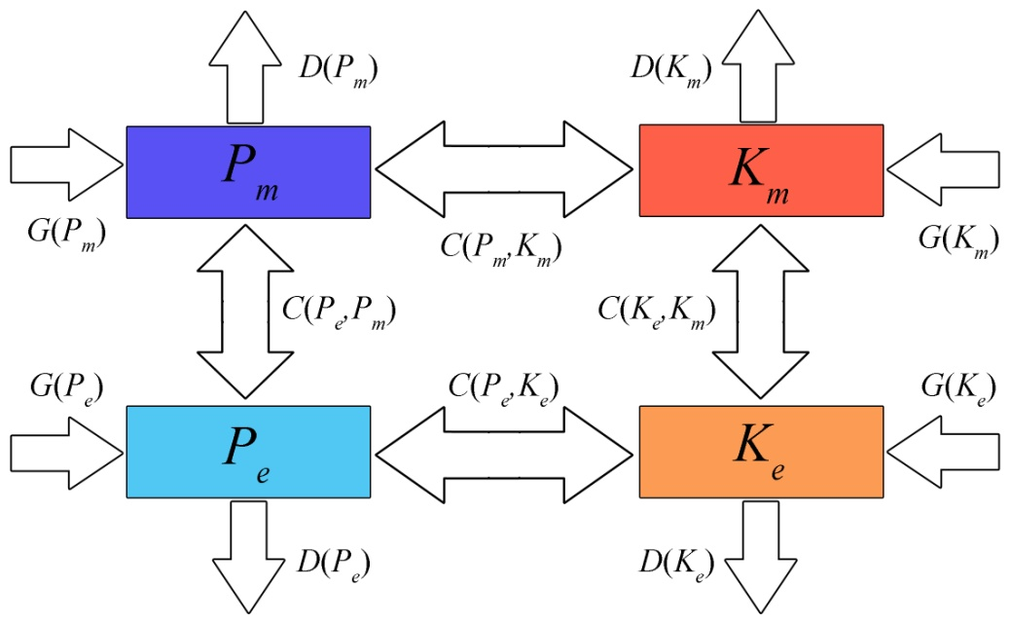
LEC-diagram in the ocean
Schematic diagram of the energy fluxes in the ocean. K and P are the kinetic and available potential energy; m and e are the time-mean (mean) and time-varying (eddy) values; the rates of energy conversion, generation and dissipation are C, G and D.
from
(von Storch 2012)

Slide 7
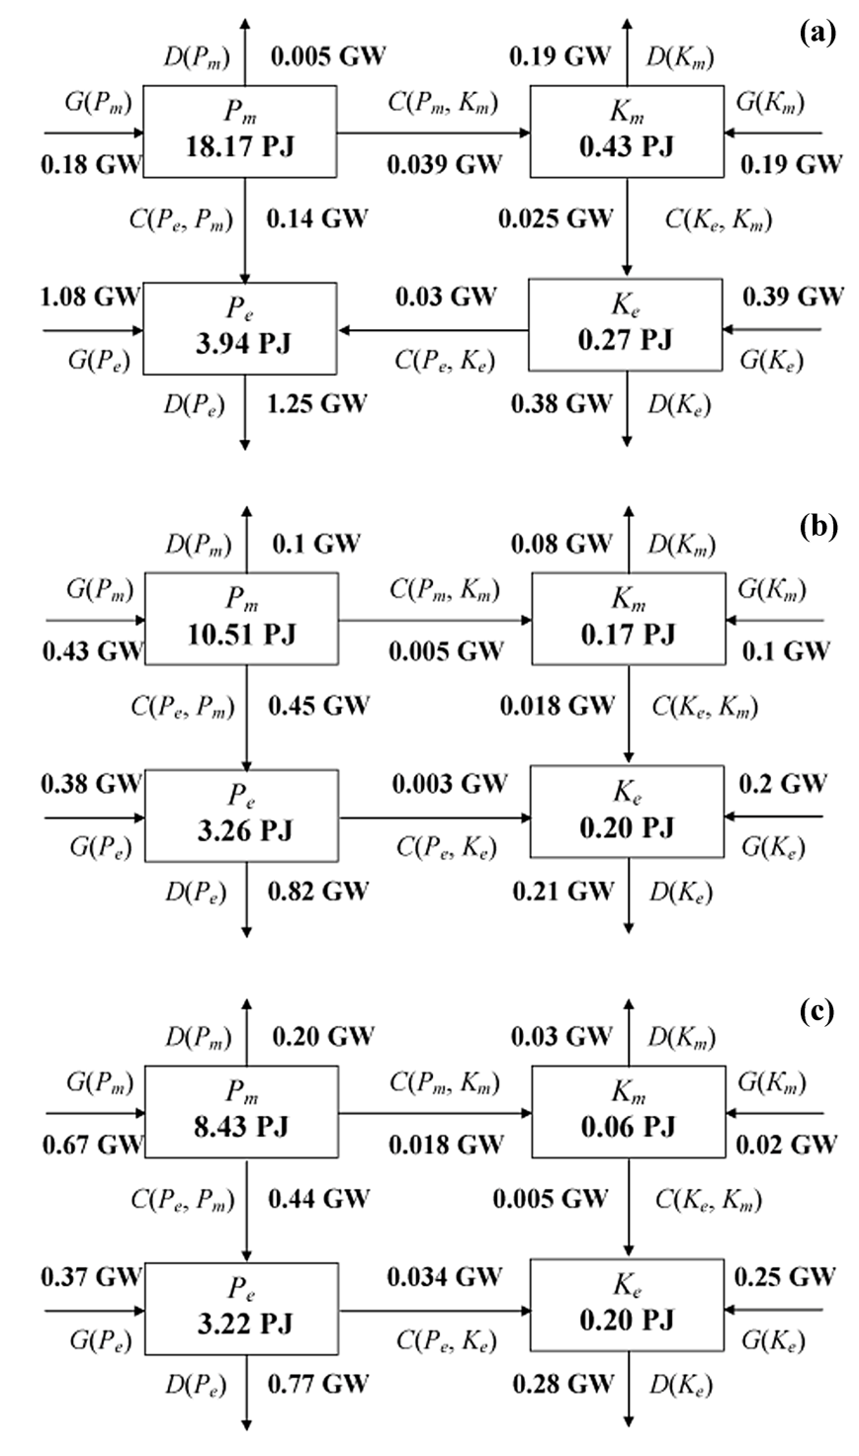
LEC in the Black Sea
climatology
Mean circulation is defined by wind inflow G(K_{m}) and buoyancy work (P_{m} → K_{m}). Eddy variability is due to both barotropic (K_{m}→K_{e}) and baroclinic (P_{m} → P_{e} ↔ K_{e}) instabilities.
2011
Mean circulation is defined by wind inflow G(K_{m}).
The barotropic instability (K_{m}→K_{e}) is the main mechanism of the eddy variability.
2016
Inflow from the wind G(K_{m}) and buoyancy work (P_{m} → K_{m}) are comparable to each other (but these values are much less than climate). Intensive mesoscale variability is associated with baroclinic instability (P_{m} → P_{e} → K_{e}).
PJ = 10¹⁵ J GW = 10⁹ W

Slide 8
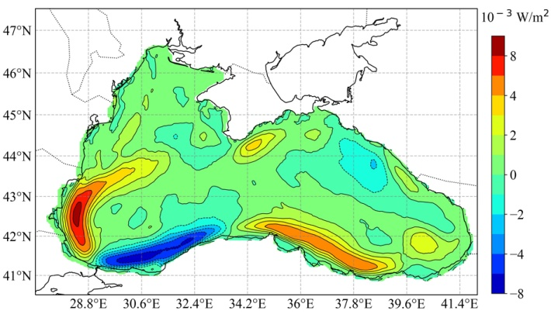
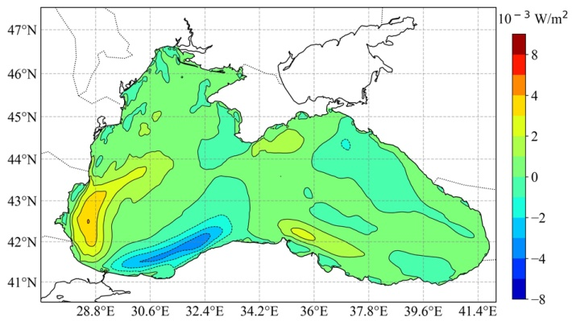
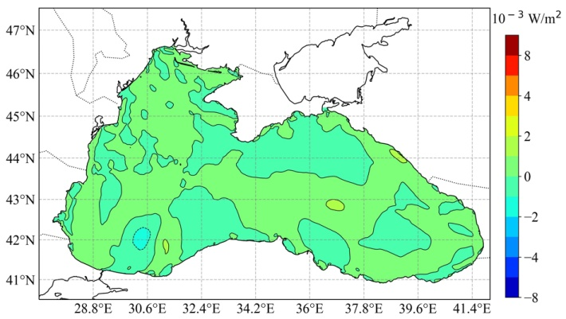
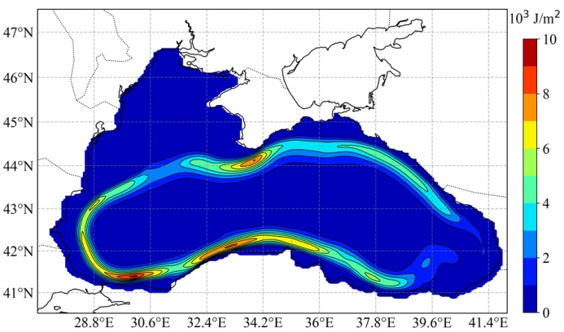
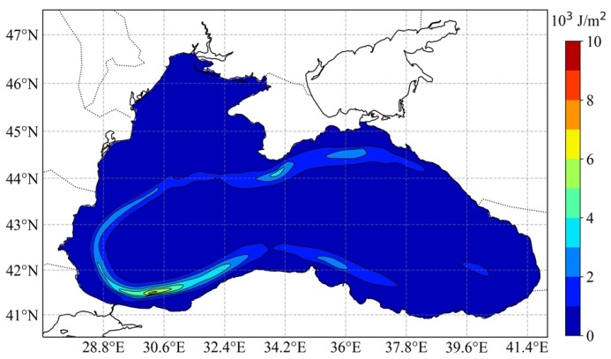
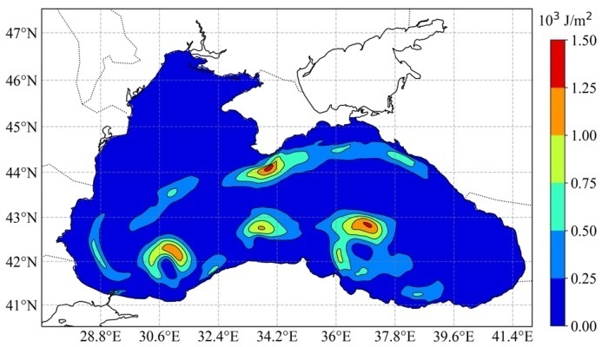
Contribution of the mid-annual wind stress work
to the mean kinetic energy
climatology
2011
2016
The contribution of the wind stress work to K_{m} was decreased for 2011 and 2016, so as a result, it was observed weakening in the mean current, intensive stream meandering and generation of mesoscale eddies not only in the coastal zones but also in the abyssal part of the sea.

Slide 9
CONCLUSION
Transports of kinetic and available potential energies from mean to eddy motions are observed in all experiments, thus it indicates the predominance of mean energy as a reservoir for the formation of eddy energy in the mid-annual energy cycle.
The time-mean buoyancy work enhances the mean current for all experiments, thus the energy transport from P_{m} leads to the barotropization of the mean circulation.
A qualitative difference between the climatology and experiments with real atmospheric forcing is revealed: it is the direction of mid-annual energy transport between K_{e} and P_{e}. K_{e} increases P_{e} in the climatology; by contrast, the energy from P_{e} is conversed to K_{e} for the other two experiments.
Energy fluxes associated with barotropic and baroclinic instabilities were comparable in the experiment 1, while the ratio between of them has changed almost six times in the experiments 2 and 3. The barotropic instability prevailed in 2011, but the baroclinic one dominated in 2016.
The mean Black Sea circulation is defined by wind stress work and buoyancy work. The eddy variability is determined by barotropic instability or by the combined contribution of barotropic and baroclinic instabilities under intense wind; and is due to baroclinic instability under weak wind.

Slide 10
REFERENCES
Demyshev SG (2012) A numerical model of online forecasting Black Sea currents Izv Atmos Ocean Phys 48(1):120-132. https://doi.org/10.1134/S0001433812010021
Demyshev SG, Ivanov VA and Markova NV (2009) Analysis of the Black-Sea climatic fields below the main pycnocline obtained on the basis of assimilation of the archival data on temperature and salinity in the numerical hydrodynamic model Phys Oceanogr 19: 1–12 (2009). https://doi.org/10.1007/s11110-009-9034-x
Dorofeev VL and Sukhikh LI (2017) Study of long-term variability of black sea dynamics on the basis of circulation model assimilation of remote measurements Izv Atmos Ocean Phys 53(2): 224-232. https://doi.org/10.1134/S0001433817020025
Ivanov VA and Belokopytov VN (2013) Oceanography of the Black Sea National Academy of Sciences of Ukraine, Marine Hydrophysical Institute, Sevastopol. https://www.researchgate.net/publication/236853664
Mellor GL and Yamada T (1982) Development of a turbulence closure model for geophysical fluid problems Rev Geophys 20(4):851-875. https://doi.org/10.1029/RG020i004p00851
Miladinova S, Stips A, Garcia-Gorriz E, Macias Moy D (2017) Black Sea thermohaline properties: Long-term trends and variations JGR Oceans 122(7): 5624-5644. https://doi.org/10.1002/2016JC012644
Von Storch J-S, Eden C, Fast I, Haak H, Hernndez-Deckers D, Maier-Reimer E, Marotzke J, Stammer D (2012) An estimate of the Lorenz energy cycle for the World Ocean Based on the 1/10° STORM/NCEP simulation J Phys Oceanogr 42: 2185-2205. http://dx.doi.org/10.1175/jpo-d-12-079.1
OUR WORKS
Demyshev SG and Dymova OA (2016) Analyzing intraannual variations in the energy characteristics of circulation in the Black Sea Izv Atmos Ocean Phys 52: 386–393. https://doi.org/10.1134/S0001433816040046
Demyshev SG and Dymova OA (2017) Calculation and Analysis of Water Circulation Energetics in the Black Sea Coastal Regions Physical Oceanography 3: 45-57 https://doi.org/10.22449/1573-160X-2017-3-45-57
Demyshev SG and Dymova OA (2018) Numerical analysis of the Black Sea currents and mesoscale eddies in 2006 and 2011 Ocean Dynamics 68(10):1335-1352. https://doi.org/10.1007/s10236-018-1200-6

