Slide 1



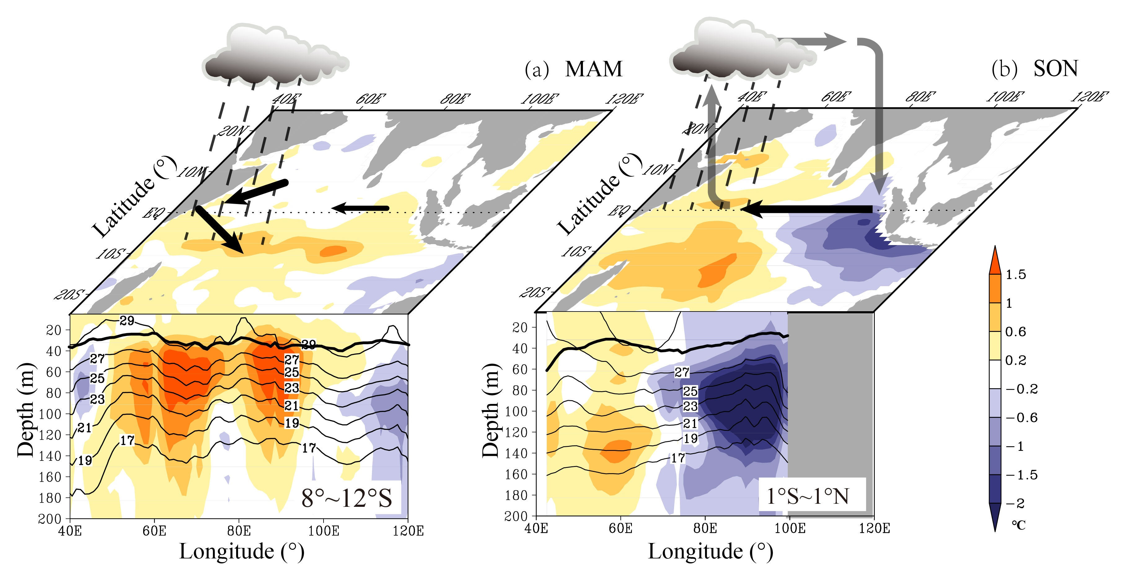
Thermocline Warming Induced Extreme Indian Ocean Dipole in 2019
The oceanic downwelling Rossby waves in the south tropical Indian Ocean is key to the 2019 extreme pIOD.
The Rossby waves induced thermocline warming, triggering Wind-Evaporation-SST feedback thus anomalous easterly winds along the equator.
The easterly wind anomalies further triggered the Bjerknes feedback establishing an extreme IOD.
Presented by Yan Du
Email: duyan@scsio.ac.cn
Ref: Du Y, Zhang Y, Zhang L-Y, et al. 2020. Thermocline Warming Induced Extreme Indian Ocean Dipole in 2019. Geophysical Research Letters, 47(18)

