Slide 1
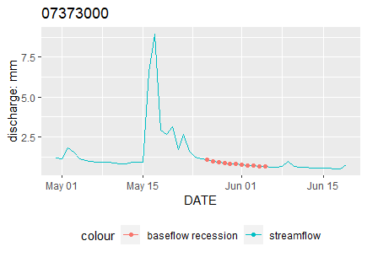
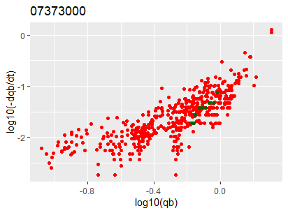
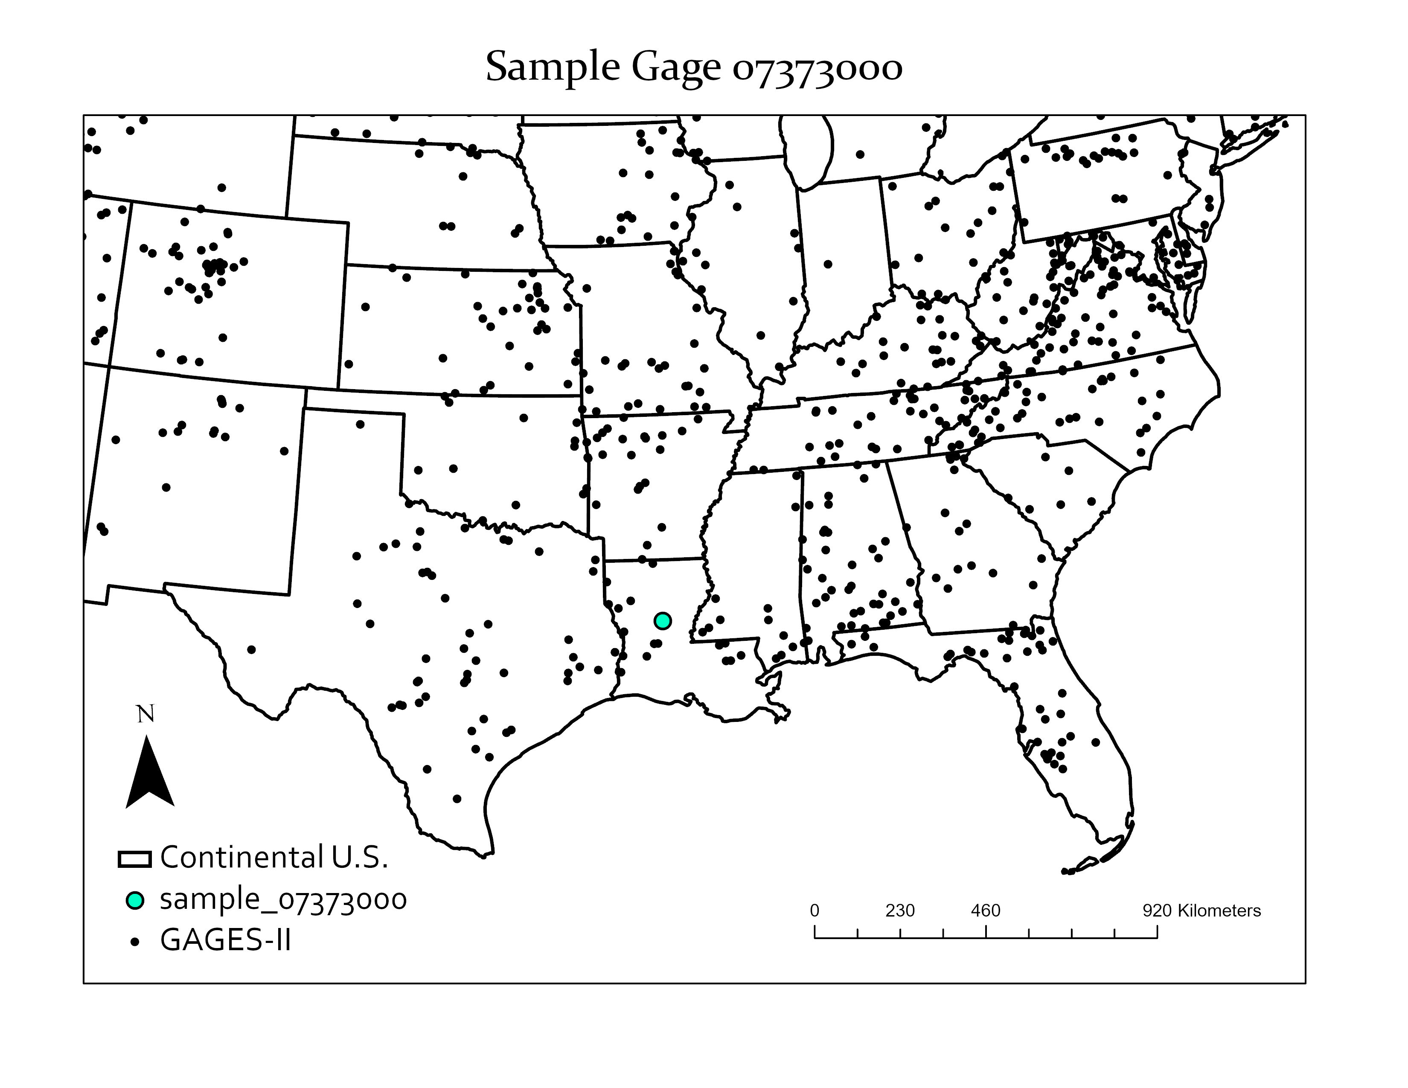
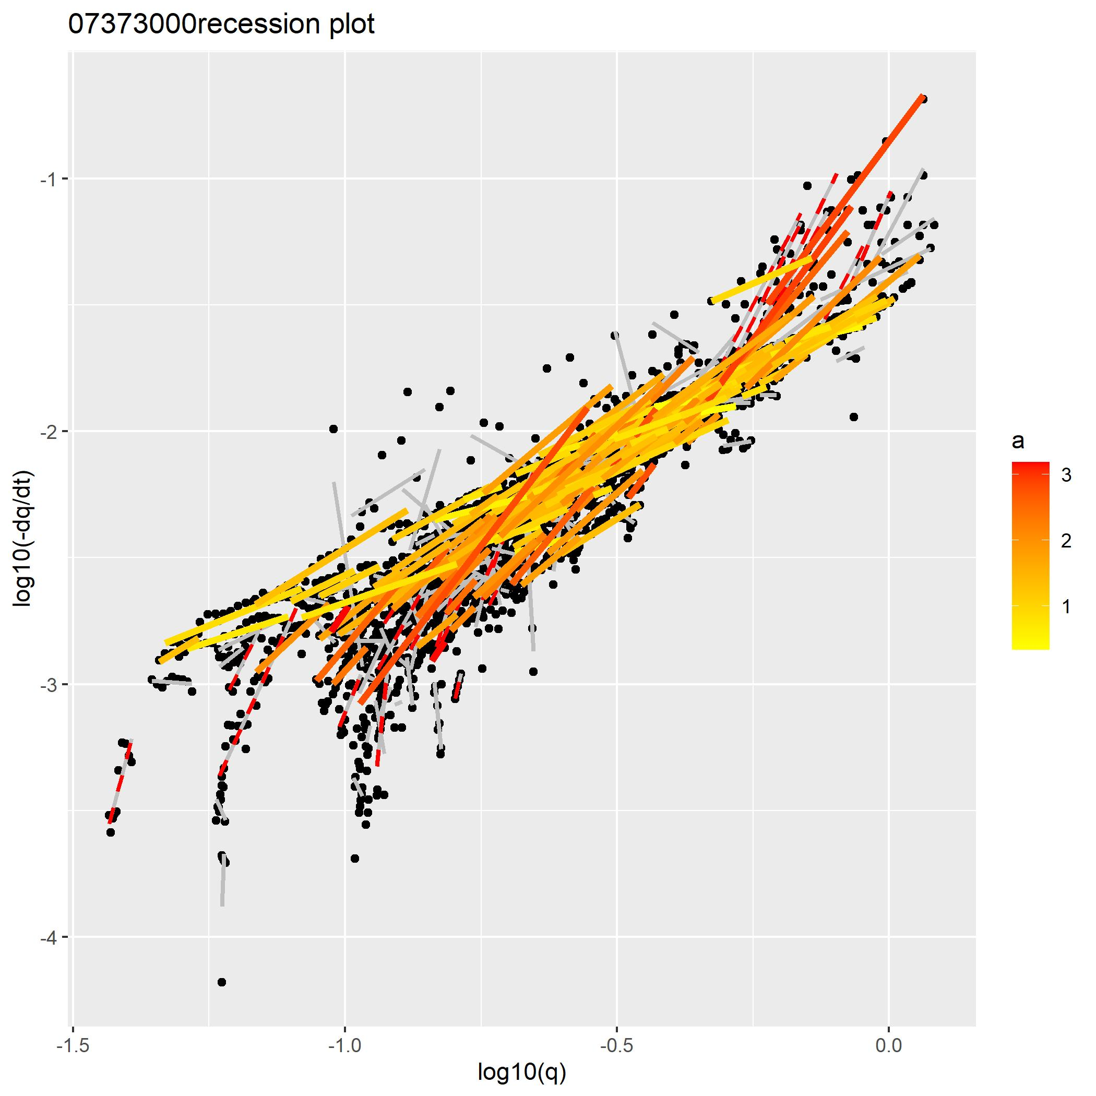
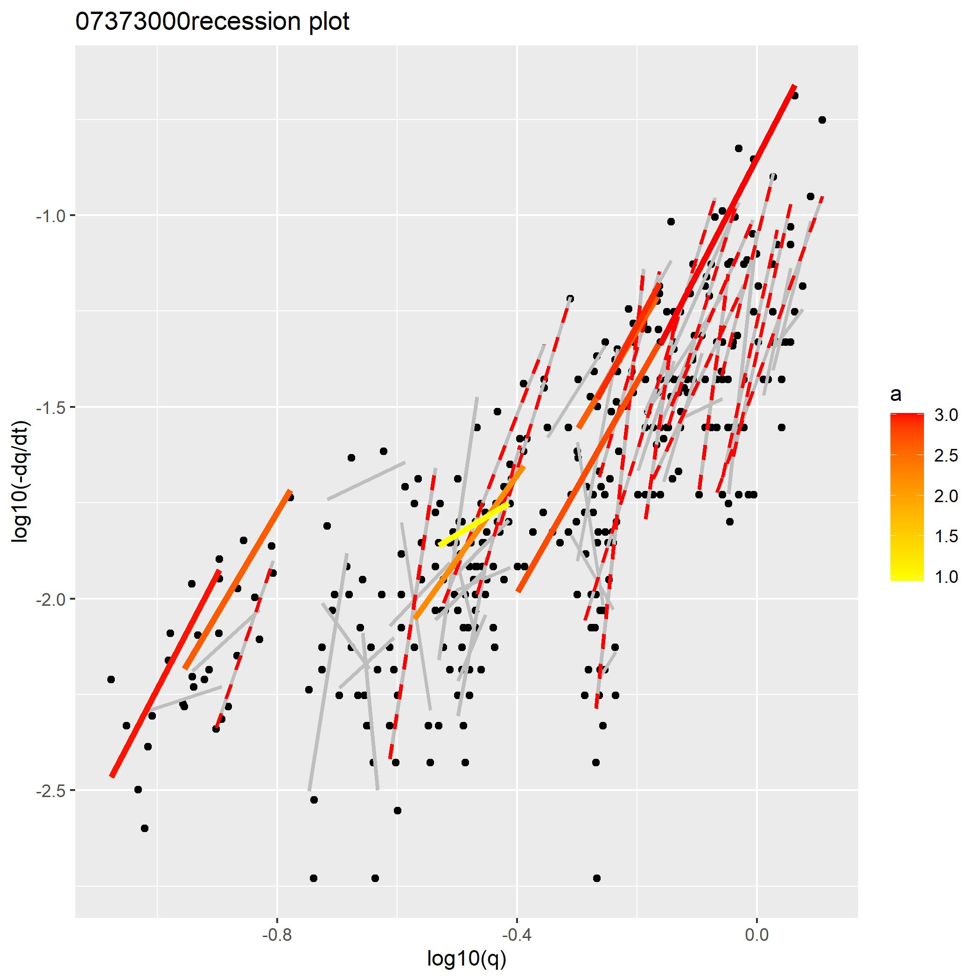
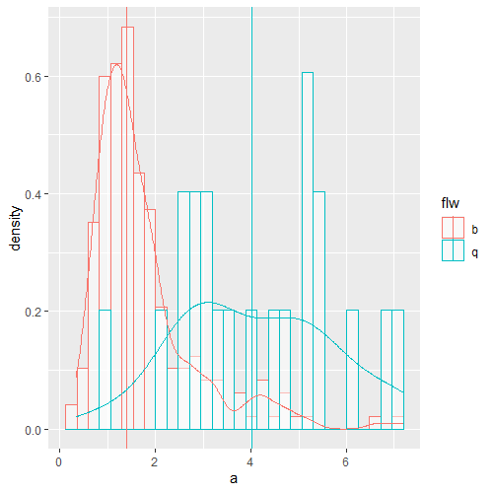
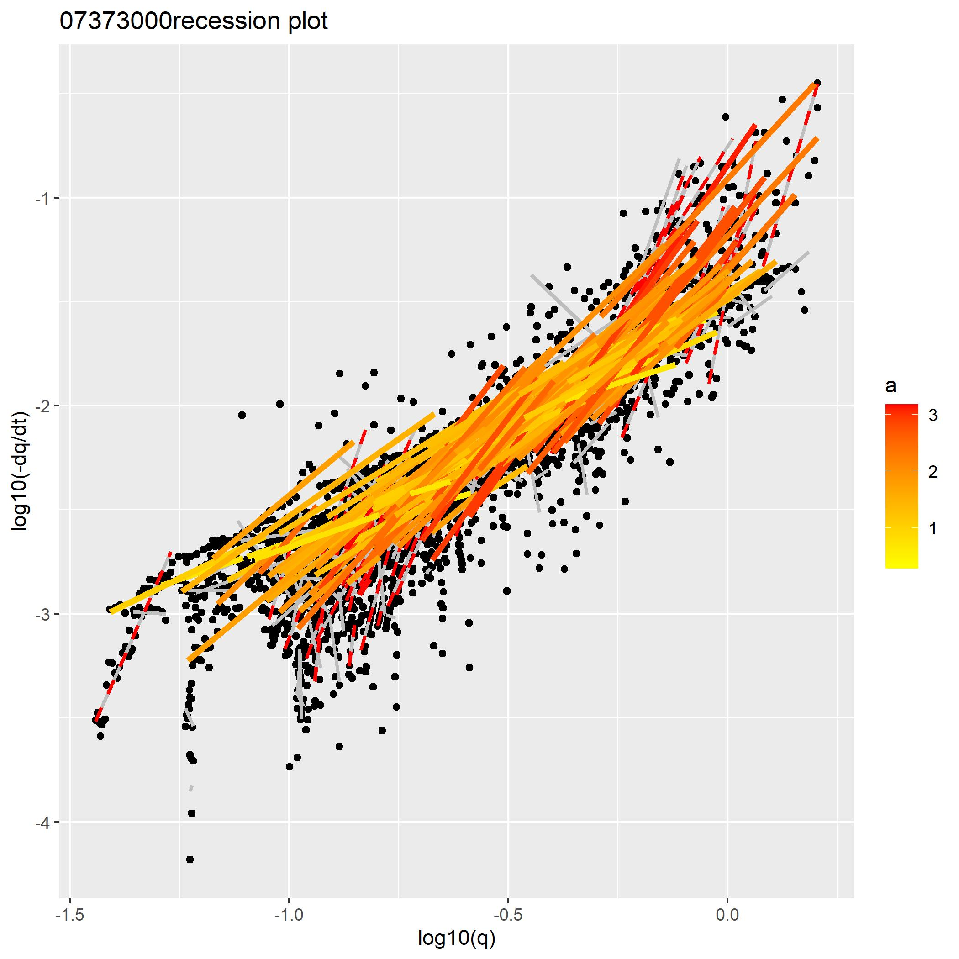
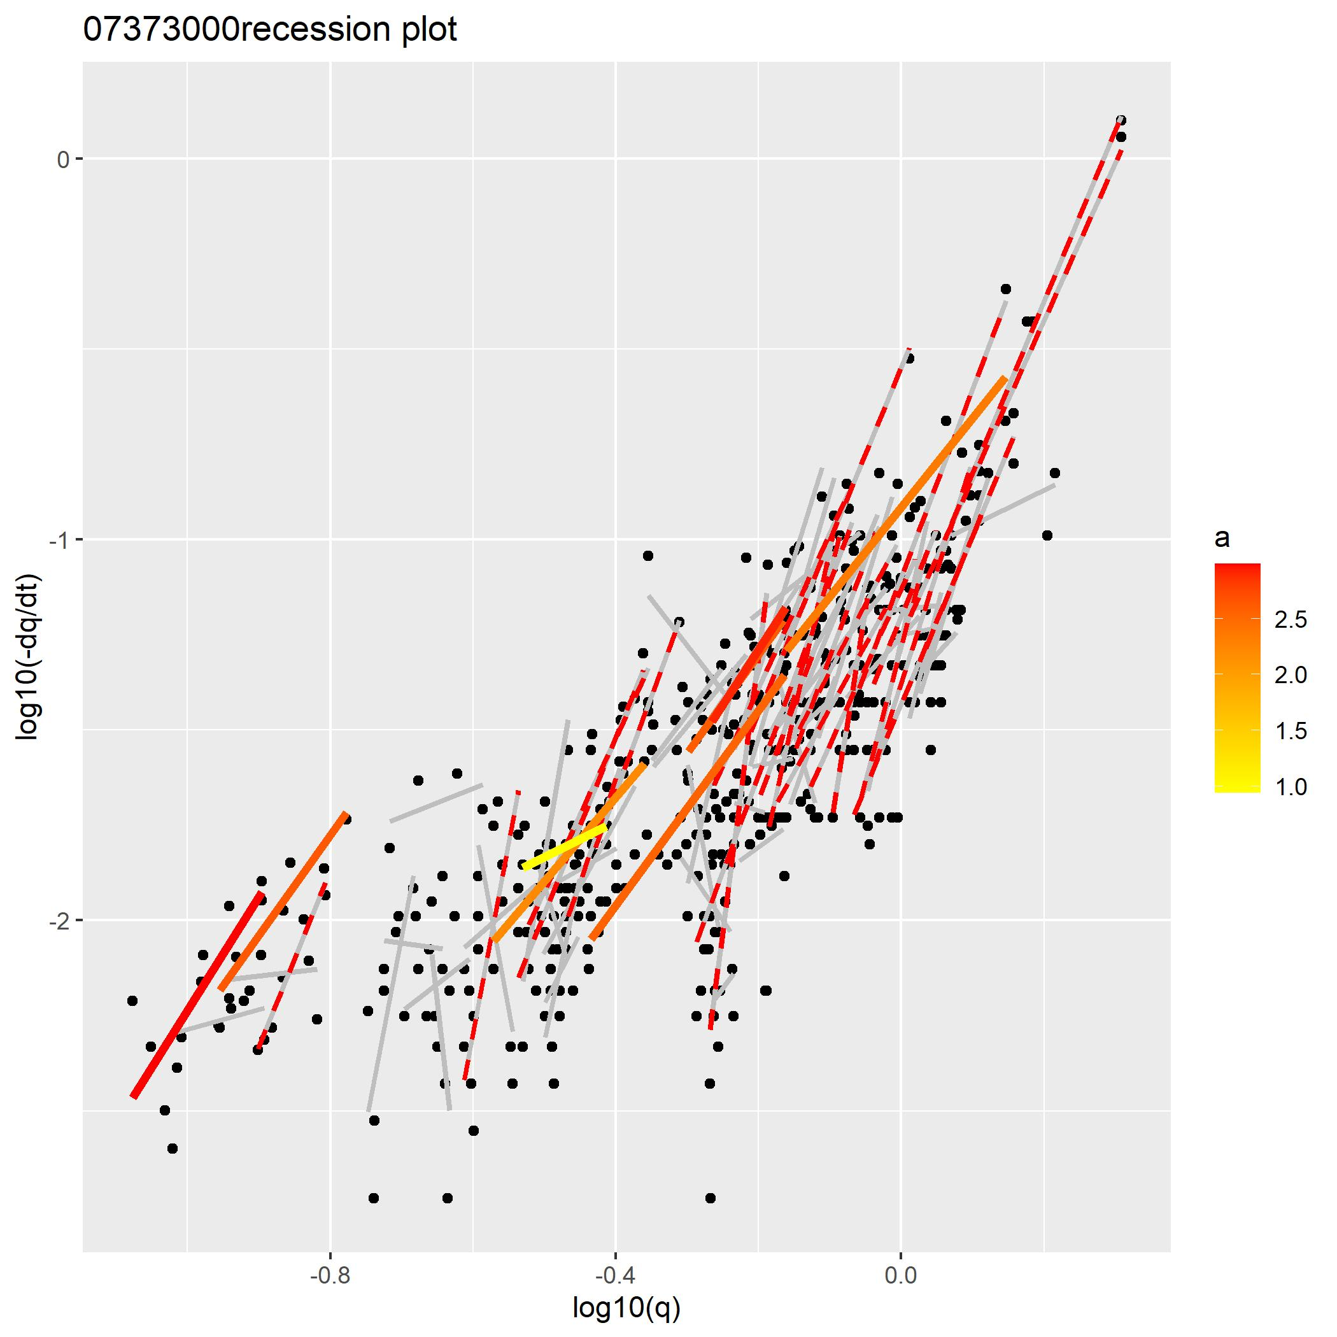
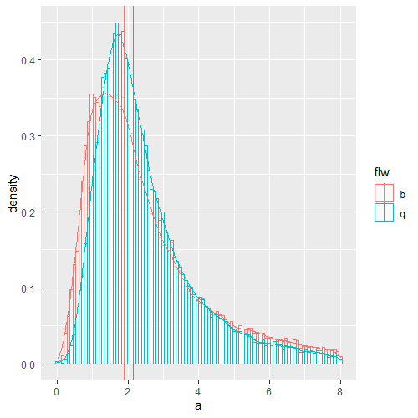
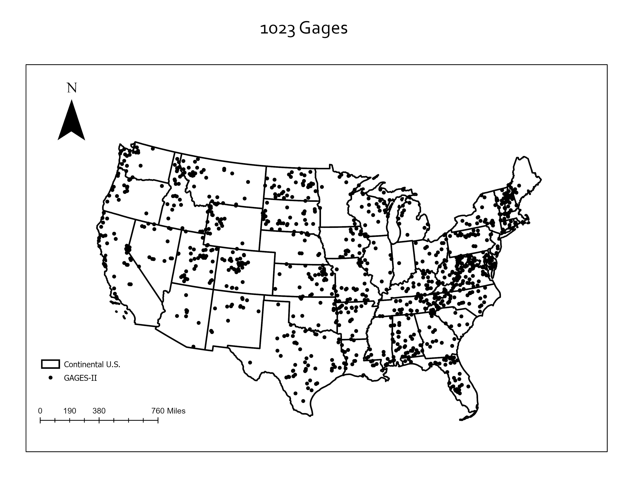
Evaluate recession characteristics from baseflow and separate baseflow via the knowledge guided machine learning
Xiang Li¹*(lixx5000@umn.edu), John L. Nieber¹(nieber@umn.edu)
¹Department of Bioproducts and Biosystems Engineering, University of Minnesota, St. Paul, MN
Introduction
Recession analysis
A stream hydrograph can be separated into rising limb and recession limbs. Recession limbs are fluxes decreasing after rising limbs. This decrease involves complicated hydrological processes since fluxes from both surface storage and groundwater storage decreases. As water table drops down, the streamflow is in a recession period and decreases accordingly. Therefore, the research into recession periods has aimed to investigate catchment groundwater systems, and has developed a widely used hydrologic tool ‘recession analysis’.
Recession analysis is a groundwater theory guided hydrological approach. However, current methods confuse the concept of streamflow recessions and baseflow recessions. This confusion leads to a mixing effect of the fluxes from different storage components and theoretically inconsistent recession analysis results accordingly.
In addition, quantifying baseflow from streamflow is defined as the baseflow separation problem. Streamflow is defined as a collection of water fluxes in the channel while baseflow is the groundwater discharge. Apart from the baseflow, the remaining portion in the streamflow is quick flow. The state-of-the-art baseflow separation tools are in lack of physical rules and have either structural limitations or are inapplicable in regions with insufficient data, which confines the generalization performance.
A modern baseflow recession analysis form was proposed as shown in equation based on theory guided baseflow representation (Brutsaert and Nieber 1977):
Select recessions Q_{b} from streamflow Q
Recession selection criteria:
1. Discharge based:
Flows with negative dQ/dt
3 days after the flow peak.
2. Rainfall based:
Flows with negative dq/dt.
3 days after the major precipitation events.
a
: baseflow
: recession constant
: drainage timescale
2a. Recession selection
K
The empirical approach (workflow in the right) assumes the selected streamflow recessions are baseflow since the recession criteria excludes surface runoff components. Theoretical behaviors of a shall not exceed 3 as indicated from the Boussinesq solution.
Estimate a and K.
$$\log{(}−\frac{dQb}{dt})=a\log{(}Qb)−\log{(}K)$$
2b. Recession plot (data cloud)
Fig 2. classic routine of the recession analysis (gage id: 07373000)
At the example gage station 07373000, the baseflow derived recession constant a is more in agreement with the Boussinesq solution derived theoretical recession behavior (Fig 6).
Across all gages in the GAGES-II dataset, the range of recession parameter a also decreases (Fig 7).
Fig 3. Example gage station map
4a. Q_{b} baseflow
4b. Q streamflow
Fig 6. recession parameter distribution comparison between 4a and 4b (07373000, b – baseflow derived, q – streamflow derived)
Recession events last at least 5 days.
Exclude statistically insignificant recessions (p-value < 0.05)
Color recession events with theoretically consistent a (0<a<3)
Red dashed line: recessions whose estimated a exceeds 3.
Fig 4. Recession analysis plot (recession criterion 2 --- precipitation based)
Data
We used the GAGES-II dataset (Geospatial Attributes of Gages for Evaluating Streamflow, version II) as streamflow data (Fig 1). Its accompanying baseflow dataset was used for evaluating baseflow recessions.
Precipitation data are gridded model data retrieved from the Daymet dataset.
5a. Q_{b} baseflow
5b. Q streamflow
Fig 7. recession parameter distribution comparison (all gages in GAGES-II)
Baseflow separation
Fig 5. Recession analysis plot (recession criterion 1 --- streamflow based)
Among the current baseflow separation methods, although the chemical bass balance approach is able to separate baseflow following physic rules, its application imposes strict requirement to chemical data availability. To address this data scarcity issue but also preserves physics principle, we propose a method coupling machine learning to separate baseflow by utilizing Boussinesq solutions’ recession characteristics.
$$L=L_{RNN}+λ_{r}L_{r}$$
$$L_{RNN}=\sqrt{\frac{1}{N}\sum_{i=1}^{N}{\left(Q_{b,i}−\hat{Q_{b,i}}\right)2 }}$$
Fig 1. GAGES dataset covering the continental U.S.
N is the number of labeled data (with observed baseflow)
$Q_{b,i}$ is the observed baseflow, $\hat{Q_{b,i}}$ is the predicted baseflow
Specific conductance data of gages across the U.S. continents are available in the USGS national water information system.
Fig 6. Flow chart of the KGML (knowledge guided machine learning) framework for separating baseflow

