Slide 1

The impact of diurnal precipitation over Sumatra Island, Indonesia, on synoptic disturbances and its relation to the Madden-Julian Oscillation
2021/04/28 EGU
Ayako SEIKI, Satoru YOKOI, and Masaki KATSUMATA
(JAMSTEC, Japan)
Seiki et al. (2021), JMSJ
https://doi.org/10.2151/jmsj.2021-007

Slide 2
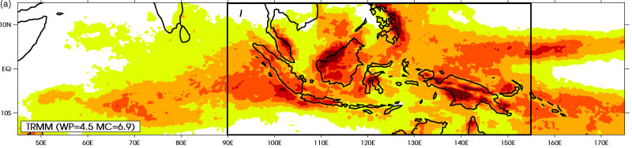
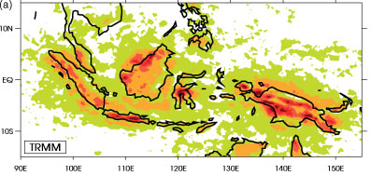
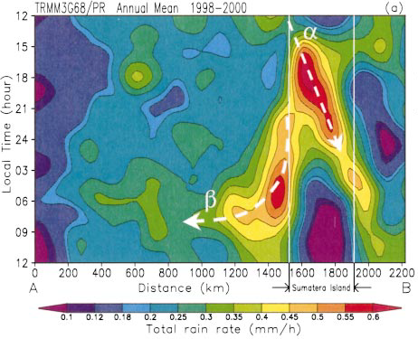
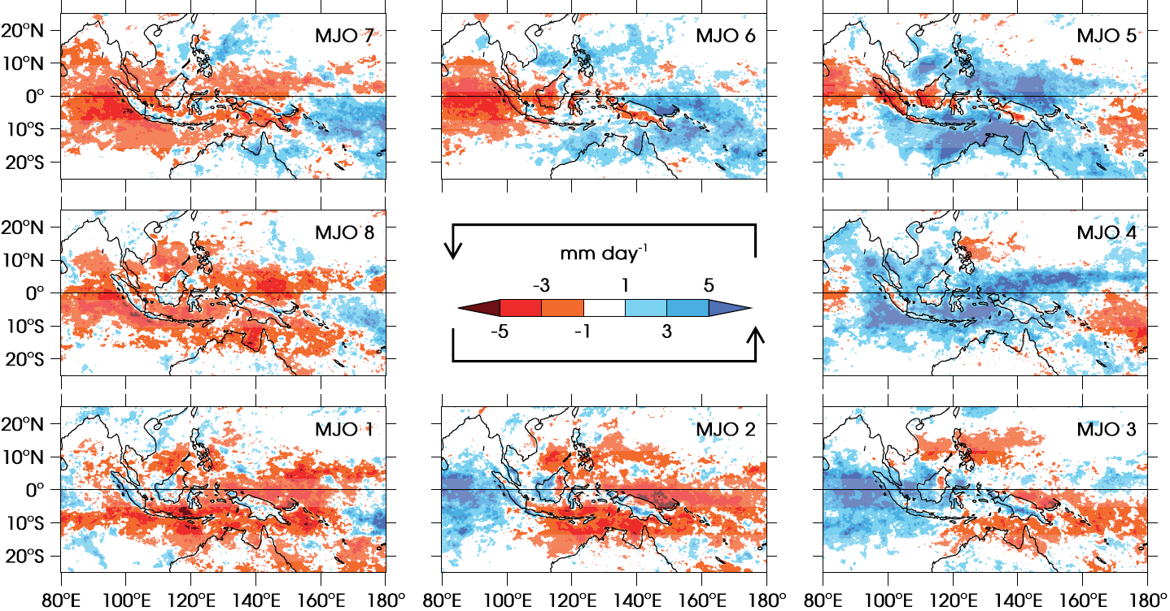
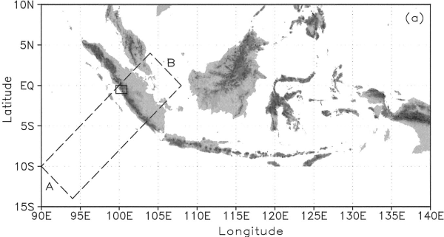
Background -the Maritime Continent (MC)-
Total PR (ONDJFMA)
Diurnal Amp.
(Love etal. 2011)
・Strong DC in the coastal regions
・The diurnal cycle contributes to the significant amount of PR in the MC
(DC)
Offshore migration
Relation to MJO
（Peatman etal. 2014)
land
・Nighttime offshore migration of coastal PR
・Diurnal PR over MC precedes the MJO PR
（cf. Fujita etal. 2011; Peatman etal. 2014)
(Mori etal. 2004)

Slide 3
The objective
to investigate the impact of diurnal precipitation over Sumatra on synoptic disturbances over the the Indian Ocean, and its relationship to the MJO.
Data
・GSMaP (the Global Satellite Mapping of Precipitation) RNL
Precipitation (PR) data : 0.1°hourly
・JRA-55 : atmospheric variables (u, v, etc) : 1.25°daily
・Reynolds OI SST : 0.25°daily
Period：Mar. 2000～Feb. 2014
focus on the rainy season (Sep.-Apr.) (cf. Hamada etal. 2002)
Definition of MJO ： RMM index (Wheeler and Hendon 2004)
・MJO days : RMM Amp > 1 for consecutive 15 days
・Non MJO days : Amp < 0.63 (mean -1 SD)
SD: standard deviation

Slide 4
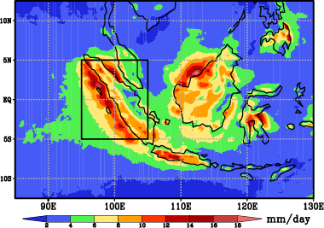
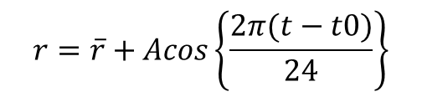
Strong & weak Diurnal PR events over Sumatra
Amplitude of the diurnal PR : A (cf. Love etal. 2011)
$$r=\overline{r}+Acos\left\{\frac{2π(t−t0)}{24}\right\}$$
r：hourly mean PR
r：daily mean PR
Diurnal amplitude（Sep-Apr）
Definition of Diurnal events (DEs)
Strong DEs
Area-averaged A ＞ mean + 1.0 SD
(95-105E, 5S-5N)
Weak DEs
＜ mean - 1.0 SD

Slide 5
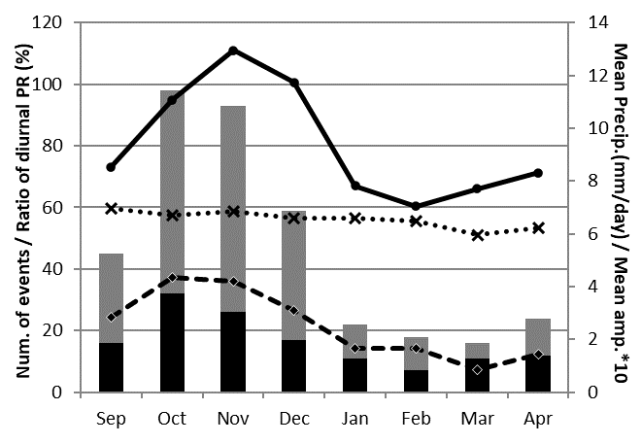
Statistical features of the strong DEs
Monthly distribution of the number (black bars) and accumulated days (gray bars) of strong DEs and mean PR (solid line) averaged for the Sumatra area (95-105E, 5S-5N)
Mean PR
・The DEs occur most frequently in Oct. & Nov. and decrease drastically from Dec. to Jan, varying in parallel with the monthly mean PR amount.
N. of DEs (black bar)
Accum. days (gray bar)
dashed line : the ratio of precipitation amount during the strong DEs to the total monthly precipitation amount, dotted line: mean amplitude of DEs

Slide 6
DAILY mean PR for strong/weak DEs
Strong DEs
Weak DEs
mm/day
・Much higher precipitation amounts, corresponding to large condensation heating, are found around the western coast of Sumatra during the strong DEs, consistent with previous studies.

Slide 7
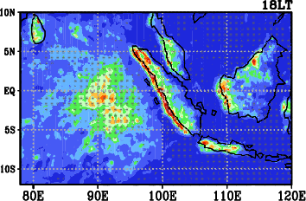
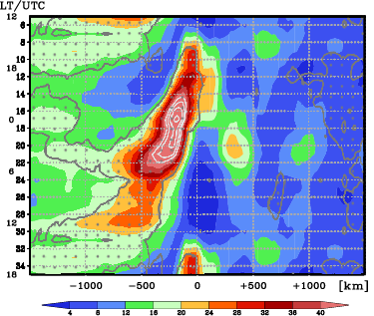
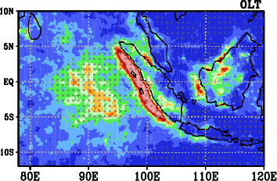
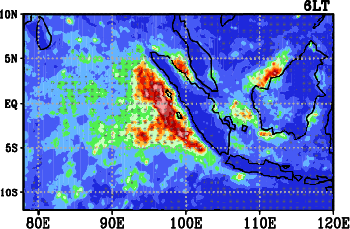
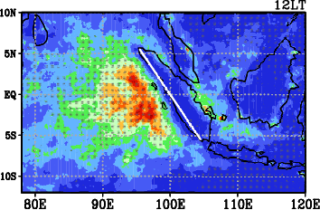
Offshore propagation of diurnal PR
Composite diurnal cycle of hourly PR for the strong DEs as a function of distance from the coastline
Composite
hourly PR →
mm/day
・PR increases over the western coast of Sumatra in the evening and migrates offshore during the night time, reaching 500km off the coast.
（hatch = significant at 95% level）
mm/day

Slide 8
Composite dEKE/dt at 850hPa
Ave: 3N-13N
day
for the strong DEs
day
・The strongest generation of K’ is found south of the equator off the western coast of Sumatra on day 0, which extend southwestward. A large K’ increase is also found west of the northern edge of Sumatra.
Ave: 3S-13S
・A clear westward migration of the K’ increase from the coastline is found from day 0 in both hemispheres, suggesting the influence of the diurnal cycle on the development of synoptic disturbances.
day
E-6
hatch = significant at 95% level
E-6

Slide 9
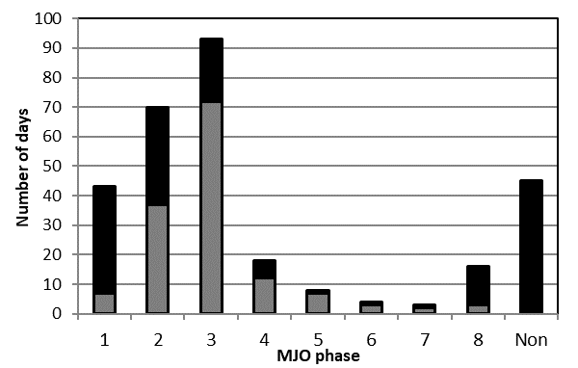
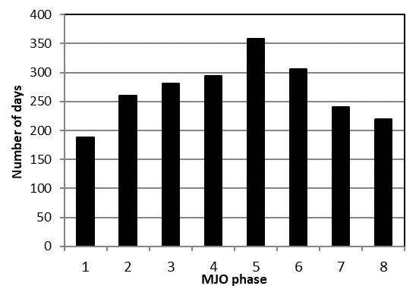
Relation of strong DEs with the MJO phases
Accumulated days for the strong DEs in each MJO phase
Climatology
・Most frequent in phases 2 and 3
Black bar: MJO Amp>1
Gray bars: MJO Amp>1&15days
Non : MJO inactive days
⇒ the strong DEs are classified into three groups
MJO-IO: DEs when MJO phases 2 & 3
Non-MJO: DEs when MJO is inactive
(3. MJO-Pac: DEs when MJO phases 5-7, not shown)

Slide 10
Composite dEKE/dt at 850hPa
for strong DEs during
MJO-IO
(Ph.2-3)
Non MJO
・Twin disturbances straddling the EQ develop & migrate poleward and/or westward rapidly from day 0, resulting in negative values around the EQ.
・Synoptic disturbances develop south of the EQ on day 0 and spreads. its
westward and/or poleward migrations are unclear.
dotted area :
significant at 95% level
: MJO convection
E-6

Slide 11
K→K’
(850hPa)
MJO-IO
Non MJO
(mean horizontal shear)
E-5
APE’→K’
(250hPa)
(synoptic
Convection)
E-5
・K‘ generation straddling the EQ is found.
・Northern one is not clear.

Slide 12
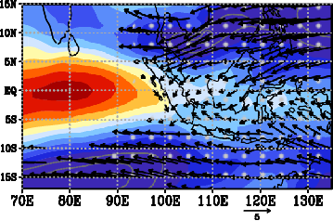
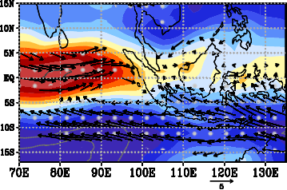
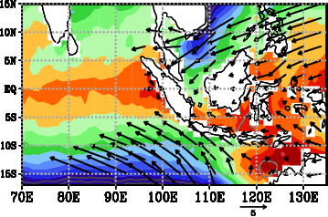
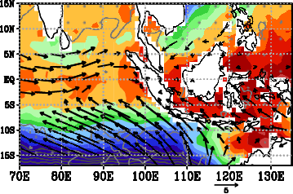
Mean states
MJO-IO
・Northeasterlies blowing into the MJO → strong convergence
Non MJO
U & U;V (850 hPa)
m/s
SST & U;V
(1000 hPa)
・SST around the EQ is broadly high in both groups → Contribution of SST to the K’ generation is small

Slide 13
MJO events with/wo DEs
Composite OLR (color) & intraseasonal OLR anom. (contours) for the MJO events
Day 0: the last day of PH 2 or the first day of the PH 3
day
day
(left) The apparent eastward propagation of intraseasonal convection across the MC is detected, with rapid enhancement of convection off the western coast of Sumatra after day 0.
(right) The intraseasonal convection weakens over the MC and activate again over the Wpac.
hatch = significant at 95% level

Slide 14
Summary
MJO-IO
=MJO convection lies over IO
Non MJO
U & U;V (850 hPa)
: MJO convection
: synoptic disturbance
m/s
: diurnal PR
・ Seed disturbances arising from the diurnal offshore migration of PR from the western coast of Sumatra develop mainly over the southern Indian Ocean. The twin disturbances straddling the EQ are found only during the MJO-IO, suggesting that the Rossby wave response within the MJO is enhanced. The differences in the locations of active synoptic disturbances between the MJO-IO and Non MJO phases are attributed to the strength of the mean horizontal winds in the lower troposphere (northeasterlies blowing into the MJO ).
・ MJO events with the strong DEs show continuing eastward propagation of active convection across the MC, whereas the convection of the other MJO events weaken over the MC and develop again over the western Pacific, suggesting that the DEs facilitate the smooth eastward propagation of the MJO convection across the MC.

Slide 15
Abstract
The impact of diurnal precipitation over Sumatra Island, the Indonesian Maritime Continent (MC), on synoptic disturbances over the eastern Indian Ocean is examined using high-resolution rainfall data from the Global Satellite Mapping of Precipitation project and the Japanese 55-year Reanalysis data during the rainy season from September to April for the period 2000–2014.
When the diurnal cycle is strong, the high precipitation area observed over Sumatra in the afternoon migrates offshore during nighttime and reaches 500 km off the coast on average. The strong diurnal events are followed by the development of synoptic disturbances over the eastern Indian Ocean for several days, and apparent twin synoptic disturbances straddling the equator develop only when the convective center of the Madden–Julian Oscillation (MJO) lies over the Indian Ocean (MJO-IO). Without the MJO, the synoptic disturbances develop mainly south of the equator. The differences in the locations and behaviors of active synoptic disturbances are related to the strength of mean horizontal winds in the lower troposphere. During the MJO-IO, the intensification of mean northeasterly winds in the northern hemisphere blowing into the organized MJO convection in addition to mean southeasterly winds in the southern hemisphere facilitate the formation of the twin disturbances. These results suggest that seed disturbances arising from the diurnal offshore migration of precipitation from Sumatra develop differently depending on the mean states over the eastern Indian Ocean.
Furthermore, it is shown that the MJO events with the strong diurnal cycle tend to have longer duration and continuing eastward propagation of active convection across the MC, whereas the convective activities of the other MJO events weaken considerably over the MC and develop again over the western Pacific. These results suggest that the strong diurnal cycle over Sumatra facilitates the smooth eastward propagation of the intraseasonal convection across the MC.

