Slide 1


Primary productivity driven by sea-ice variability in the Amundsen Sea polynyas, not ice shelf melting
¹ Institute for Marine and Antarctic Studies - IMAS
University of Tasmania - Hobart
² Australian Research Council for Climate Extremes - CLEX
University of Tasmania - Hobart
³ Norwegian Polar Institute
Tromsø - Norway
⁴ Jet Propulsion Laboratory
Pasadena - California
Guillaume Liniger^{1,2}, Sebastien Moreau³, Delphine Lannuzel¹, Fernando Paolo⁴, Peter Strutton^{1,2}
guillaume.liniger@utas.edu.au
EGU 2021
28 / 04 / 21

Slide 2
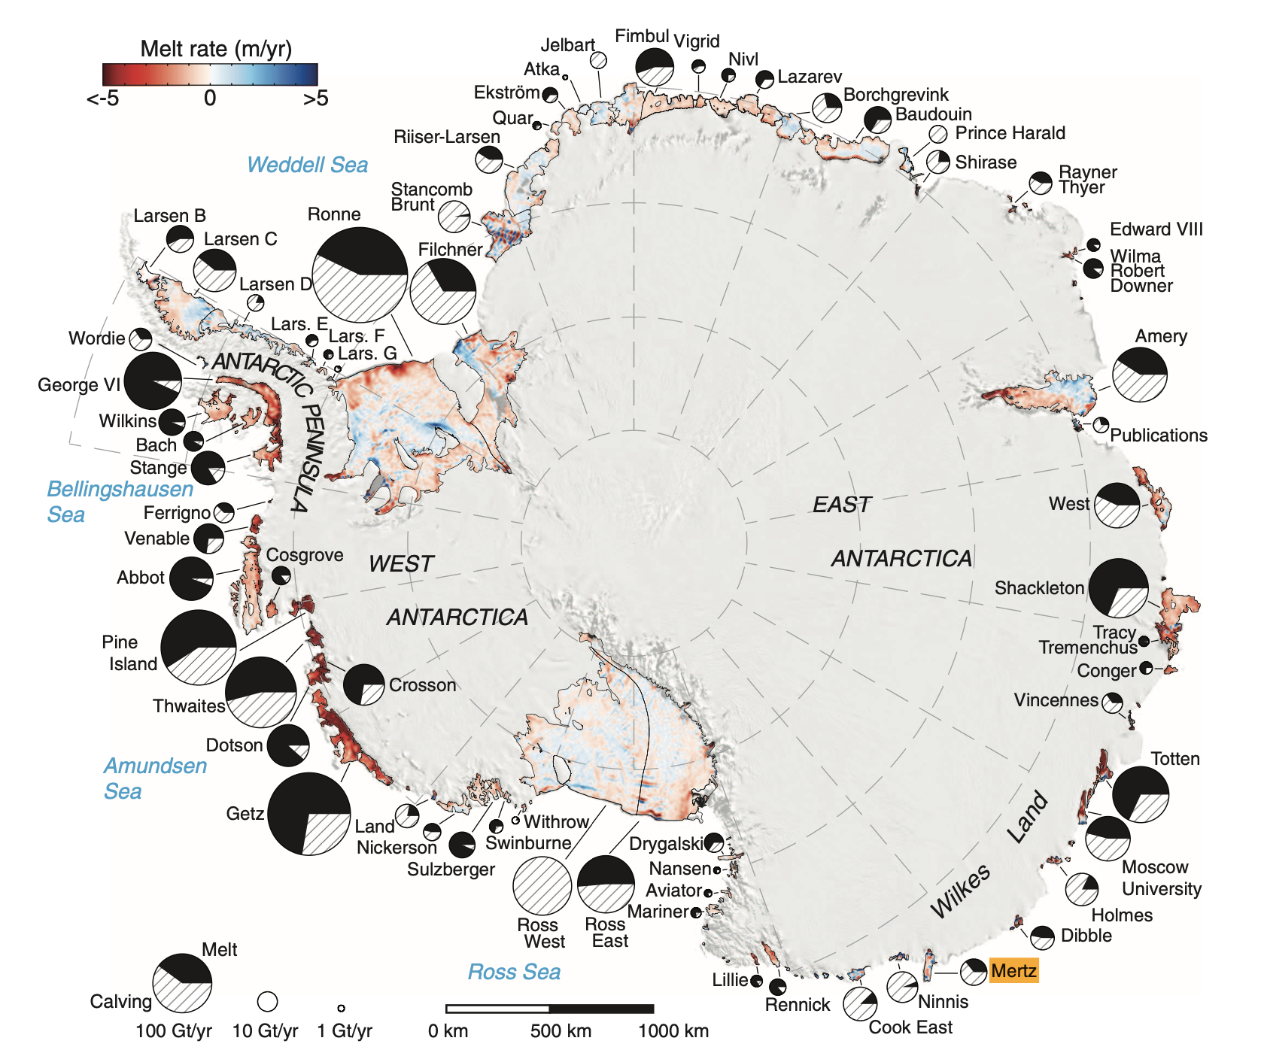
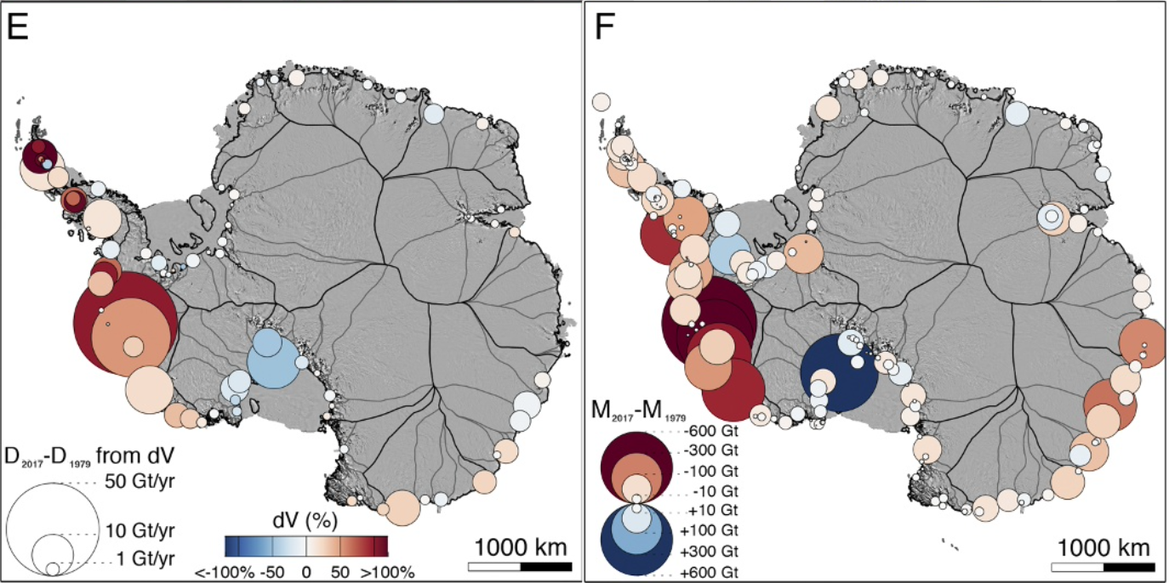
1 Introduction - Aim
(a)
(b)
(a) Change in grounding line ice discharge, (b) total change in mass for the time period 1979 - 2017 (Rignot et al., 2019)
Basal melt rate of Antarctic ice shelf (Rignot et al., 2013)
Thwaites : -634 Gt
Pine Island : -1066 Gt
Getz : -363 Gt
Basal melt rate and mass loss dominated by the Amundsen Sea Embayment in the WAIS

Slide 3
1 Introduction - Aim
What impact such loss can have on the Amundsen polynyas primary productivity ?
Coastal polynyas → The most productive areas relative to their size
Amundsen Sea polynyas → The most productive around Antarctica ! (3.39 Tg C y⁻¹)
The Amundsen Sea
The highest biological productivity
The highest basal melt rate in the WAIS
Can we establish a link between both phenomena?
Hypotheses :
The interannual variability in biological production is driven by glacial melt
A continued increase in ice shelves basal melt rate and ice discharge will translate into an increase in surface ocean primary productivity.
(Arrigo et al., 2015; Morales-maqueda, 2004)

Slide 4
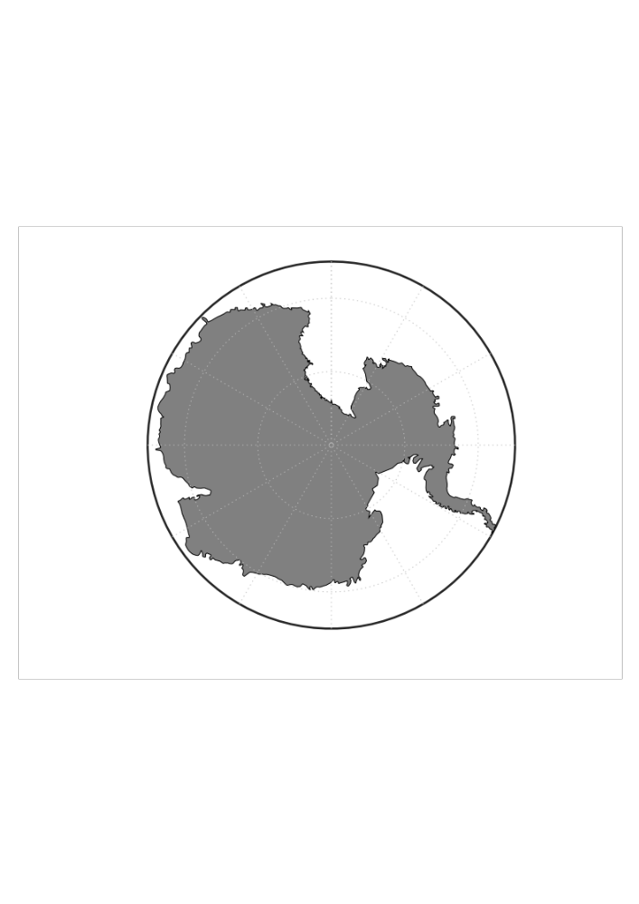
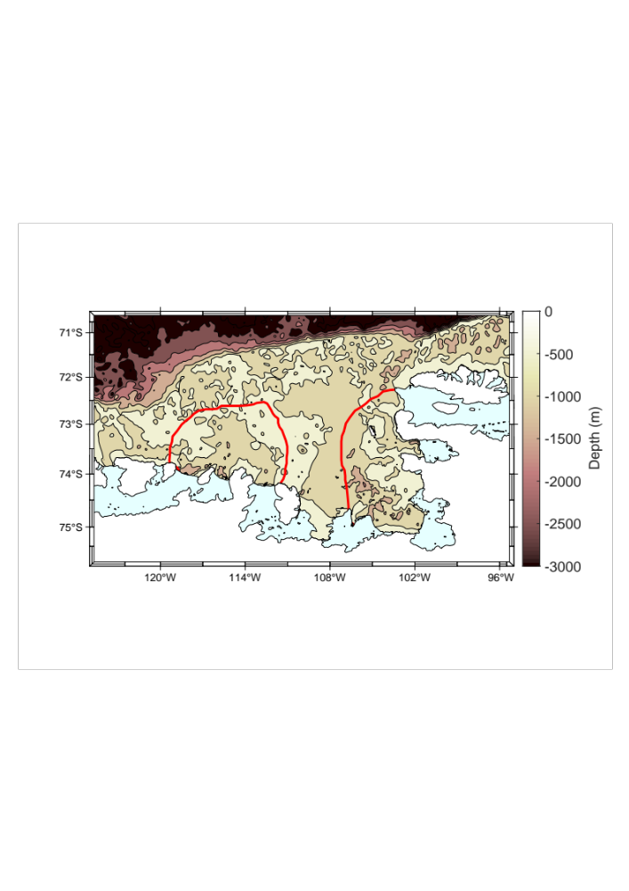
2 Method
Antarctica
2 polynyas : Amundsen Sea (ASP) and Pine lsland (PIP)
6 ice shelves : Abbot (Abb)
Cosgrove (Cs)
Pine Island (PIG)
Thwaites (Tw)
Dotson (Dts)
Getz (Gt)
Abb
ASP
Cs
PIP
Gt
Gt
Dts
Tw
PIG

Slide 5
2 Method
Satellite data
Biological variable
Other variables
Ice variables
Net Primary Productivity (NPP)
Sea-ice concentration (SIC)
Sea Surface Temperature (SST)
Ice fluxes (Rignot et al., 2019)
Basal Melt Rate (Paolo et al., submitted)
Data span 1998 – 2017
Time series, maps and correlation constructed for that time period
Monthly and yearly resolutions

Slide 6
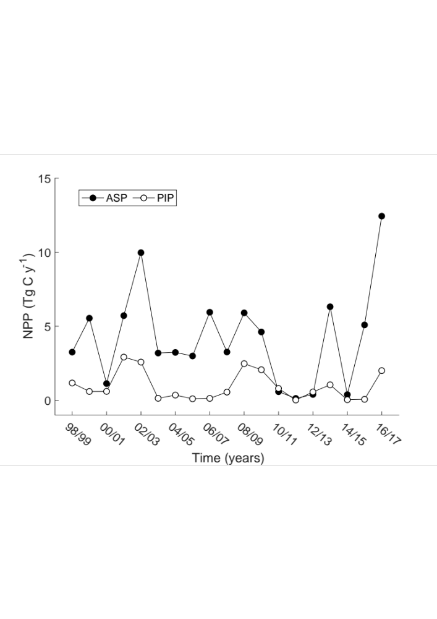
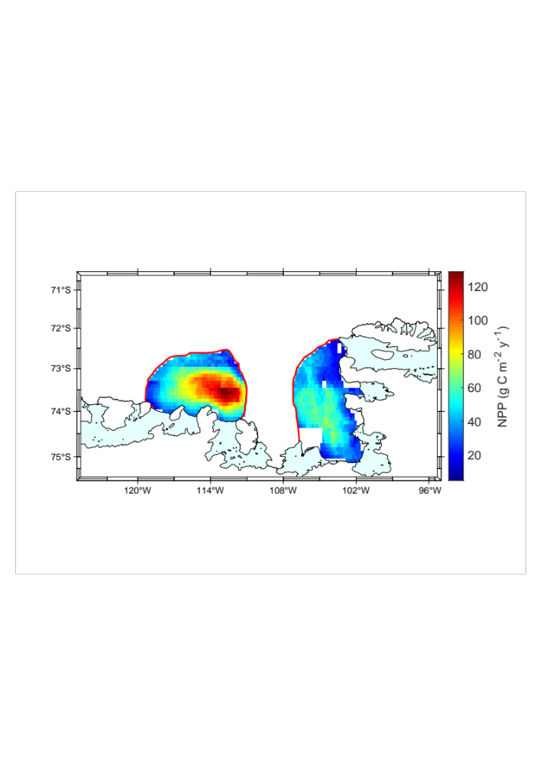
3 Results
Abb
Cos
Gt
Gt
Dts
Tw
PIG
Annual primary productivity climatology for the Amundsen Sea and Pine island polynyas. The red lines represent the polynyas contours
Net primary productivity time series for the Amundsen and Pine island polynyas
Significantly higher NPP in the Amundsen polynya
Max NPP located in central polynya for PIP, center east for ASP

Slide 7
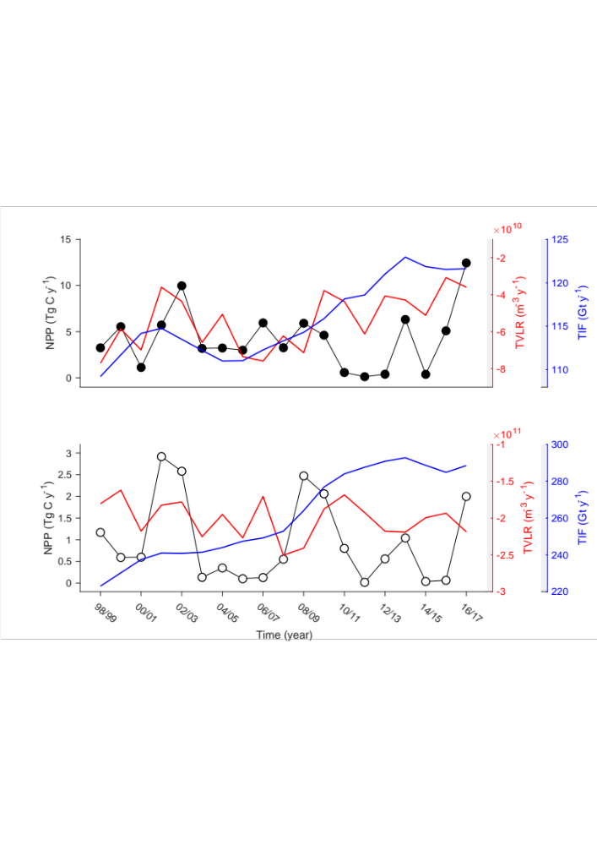
3 Results
ASP
Significant higher TVLR and TIF in the PIP
Significant higher NPP in the ASP
No significant relationships between NPP with both TIF / TVLR in both polynyas
PIP
Time series of net primary productivity (NPP) with total volume loss rate (TVLR; red) and total ice fluxes (TIF; blue). NPP and total volume loss rate are calculated from October to March. Total Ice fluxes are calculated yearly from Rignot et al. (2019). TVLR and TIF annual integrals represent the sum of considered ice shelves for the ASP (Dts, Gt) and PIP (Abb, Cs, PIG, Tw).

Slide 8

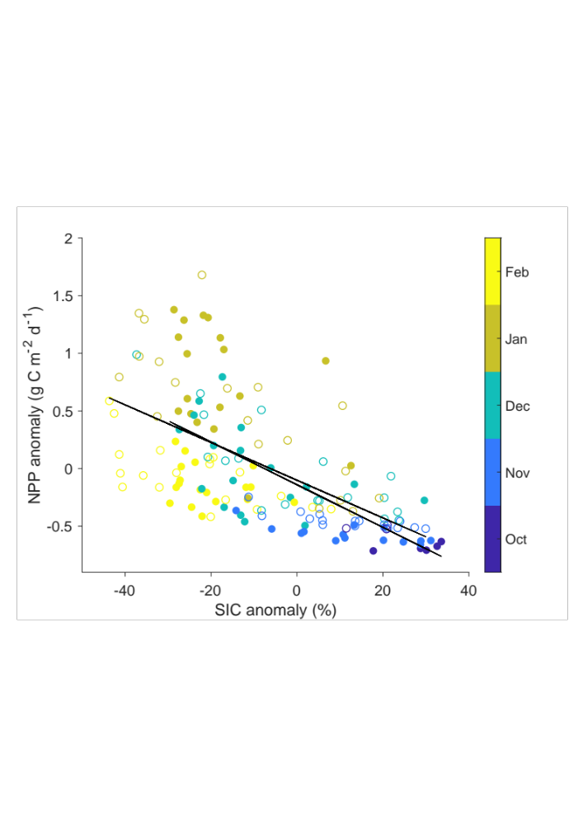
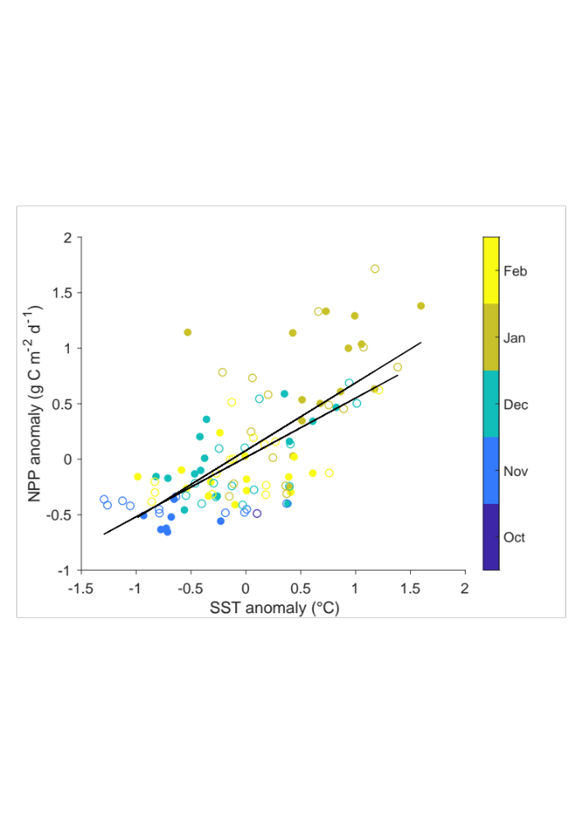
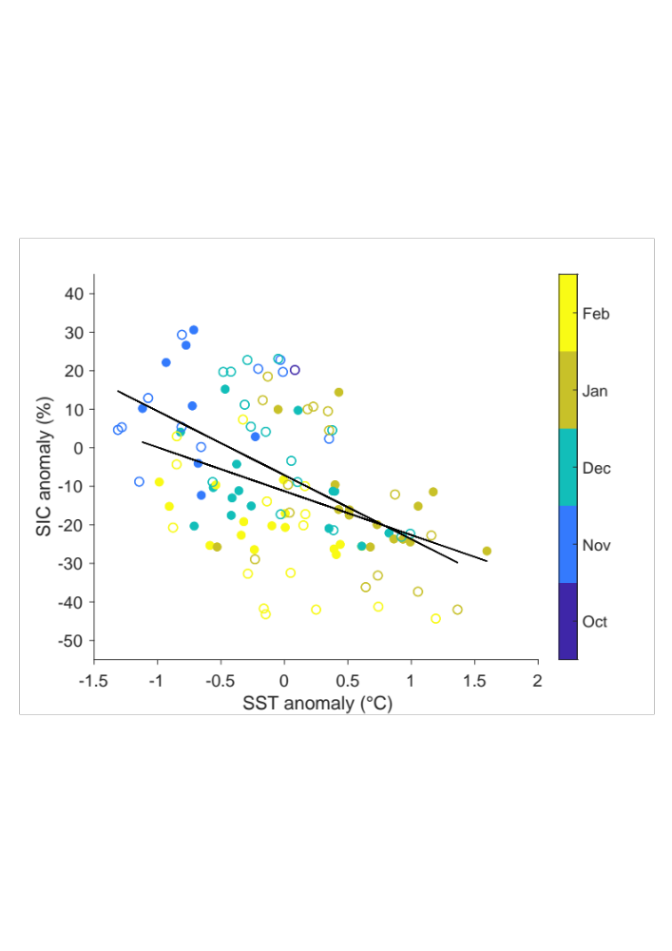
3 Results
(a)
(b)
Significant negative correlation between NPP and SIC anomaly (a)
Significant positive correlation between NPP and SST anomaly (b)
Significant negative correlation between SIC and NPP anomaly (c)
(c)
Net primary productivity (NPP) anomaly against (a) sea-ice concentration (SIC) and (b) sea surface temperature (SST) anomaly. (c) SIC anomaly against SST anomaly. Data are monthly mean from October to March spanning 1998 - 2017

Slide 9
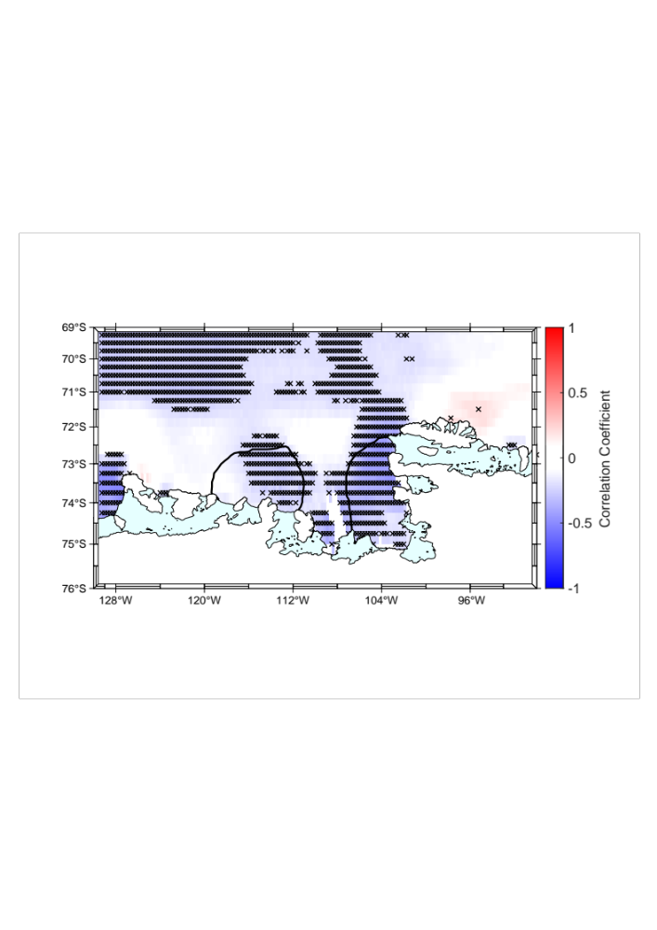
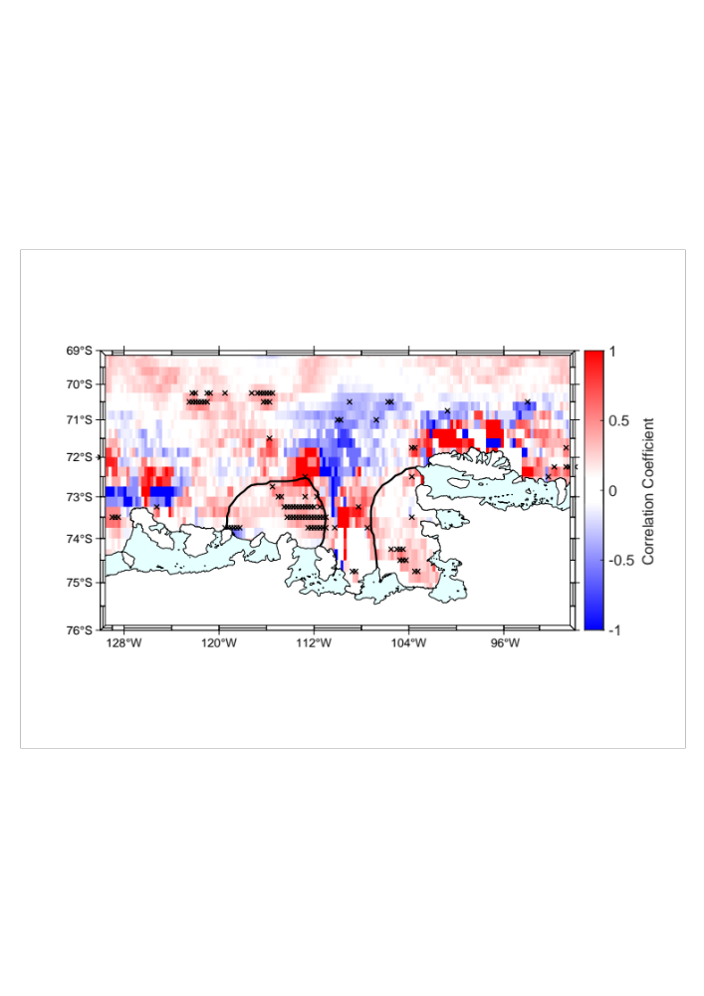
3 Results
SIC x Meridional wind
(a)
Significant negative correlation between SIC and meridional winds in both polynyas
Significant positive correlations between NPP and wind stress curl in east ASP
NPP x Wind stress curl
(b)
Spatial correlation map between sea-ice concentration (SIC) and (a) meridional wind, and net primary productivity (NPP) with (b) wind stress curl. Data span 1998 – 2017 from October to March. The black crosses represent significant correlation at 95% confidence level. The black lines represent the polynyas boundaries

Slide 10
4 Conclusions
We conclude ice shelves melting is not the primary factor impacting biological activity in the ASE polynyas over the last 2 decades
Instead, the SIC variability seems to play a major role, itself influenced by wind
In the ASP : Lower SIC and upwelling where we observed our highest NPP
→ Fe-enriched sediments resuspended from melt-laden pump near the ice shelves flowing to the central polynya and being upwelled to the surface sustain the bloom
→ Fresh water from icebergs helps stratification and sustain productivity with released trapped-iron
In the PIP : SIC drives NPP variability too, but higher SIC on average
Lower NPP compared to the ASP → Potential stronger light limitation due the higher SIC
Regenerated iron as contributor in the PIP sustaining the bloom
(Dinniman et al., 2020; Bett et al., 2020; Park et al., 2017; Gerringa et al., 2020)

Slide 11
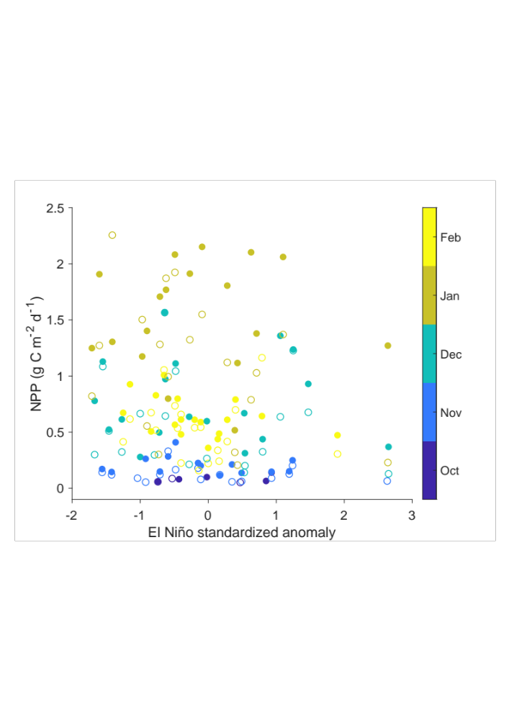
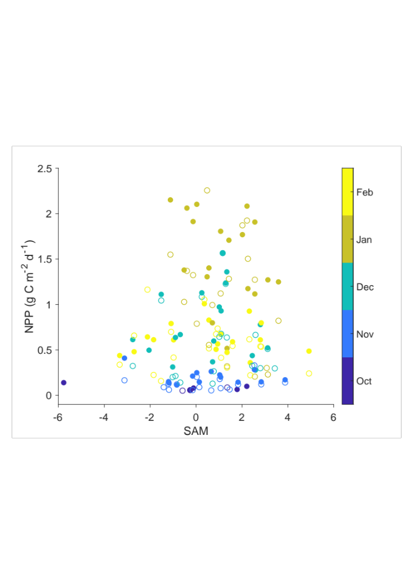
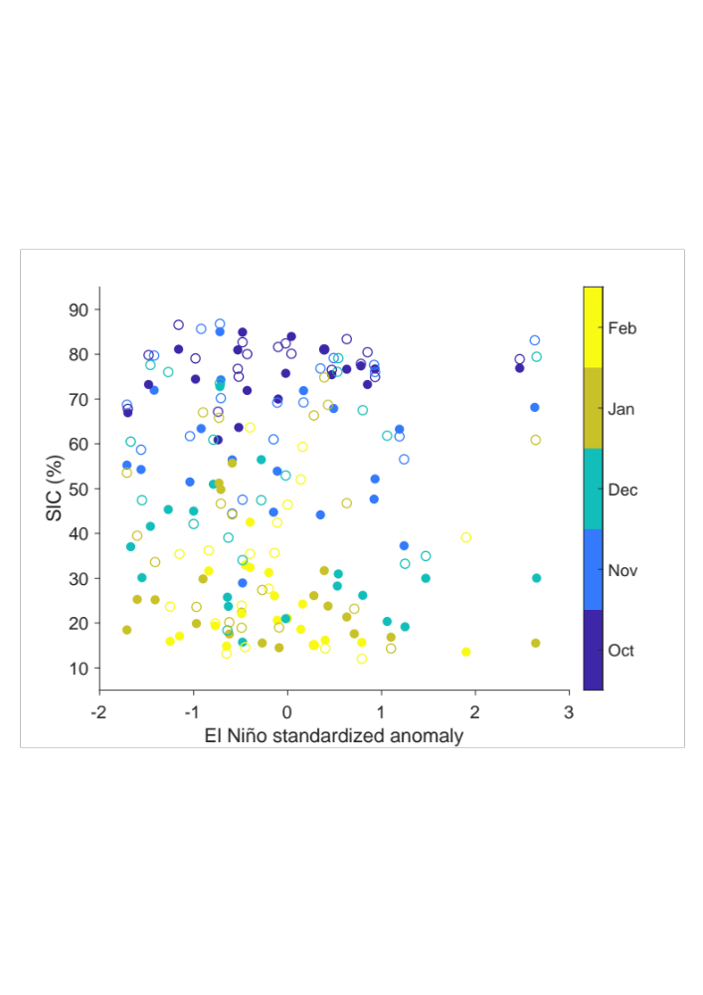
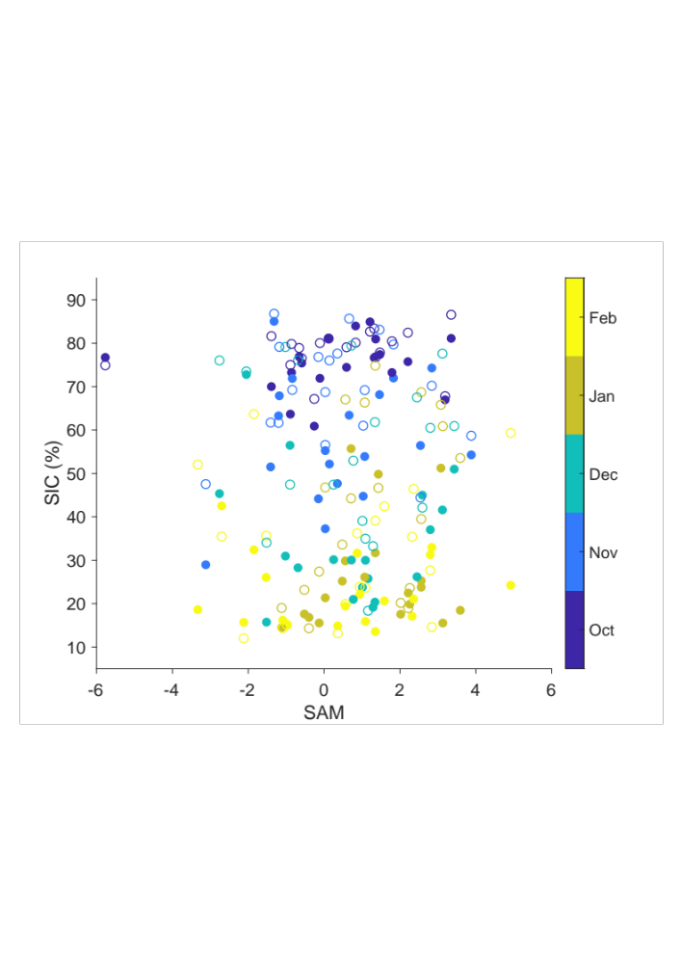
5 Supplementary Materials
We suspected potential impact of larger climate forcing on NPP and SIC
No significant relationships found between NPP / SIC with El Niño standardized anomaly and SAM
Scatter plots of monthly averaged net primary productivity (NPP) against (a) El Niño standardized anomaly and (b) Southern Annual Mode (SAM) and sea-ice concentration (SIC) with (c) El Niño and (d) SAM. Filled circles represent data from ASP, empty circles represent data from PIP. Data are monthly mean spanning October to March from 1998 to 2017.

