Slide 1
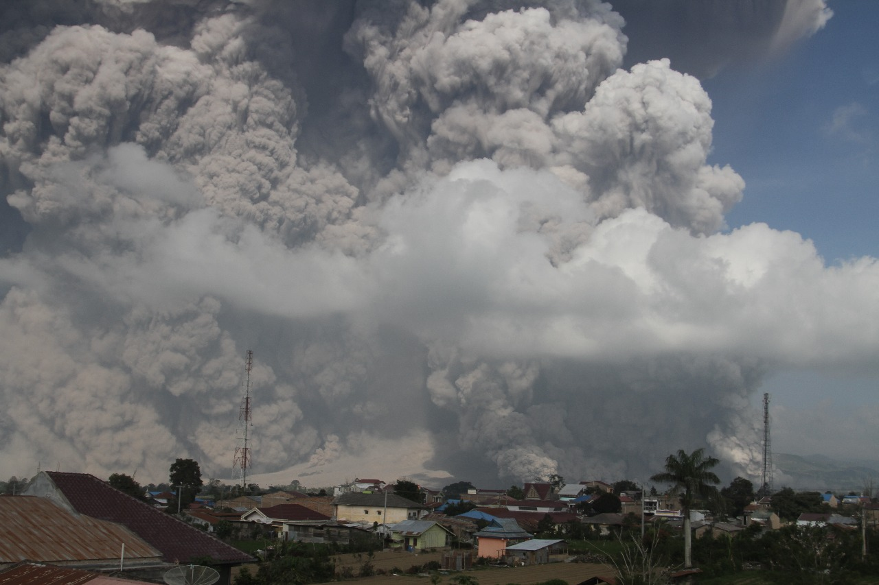
Continuous monitoring of SO₂ emissions from Sinabung Volcano, Indonesia
Syegi L. Kunrat¹, Hilma Alfianti¹, Christoph Kern², Sofyan Primulyana¹, Allan Lerner³, Moh. Nurul Asrori¹, Armen Putra¹, Deri Al Hidayat¹
¹ Center for Volcanology and Geological Hazard Mitigation (CVGHM), Bandung, 40122, Indonesia
² Volcano Disaster Assistance Program, Cascade Volcano Observatory, USGS, Vancouver, WA, 98683, USA
³ Department of Earth Science, University of Oregon, 1275 E 13th Ave, Eugene, OR, 97403 USA
© U. Rosadi - CVGHM

Slide 2
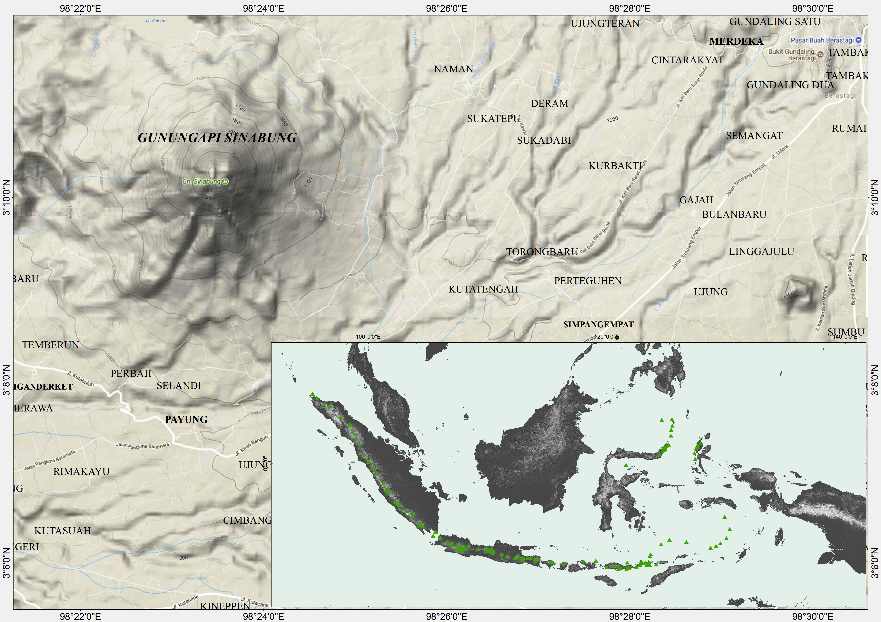
Sinabung Volcano is a 2,460 m high, composite volcano located in North Sumatra, Indonesia.
After > 800 years of dormancy, Sinabung entered a new eruptive phase in 2010 and has since been one of the most active volcanoes in the world.
Sinabung

Slide 3
Sinabung eruptive periods
VEI 4
Last know historical eruption
Explosive eruptions began and became frequent, followed by lava dome growth. Dome collapses produced numerous pyroclastic density currents.
A new eruptive period with lava dome growth and explosions began in August 2020 and continues to the present
2010
2019
Present
810 ±70 y
VEI 2
2013 -2018
Phreatic eruption marked the beginning of unrest of Sinabung.
VEI 4
2020
After a pause for several months, a significant increase in activity occurred in February 2019, followed by a large explosion in May 2019.
Wulandari, Y., Sagala, S.A.H., Sullivan, G.B., 2018, The Role of Community-Based Organization in Disaster Response at Mt. Sinabung, IOP Conf. Series: Earth and Environmental Science 158 (2018) 01203, doi:10.1088/1755-1315/158/1/012035
Global Volcanism Program, 2013. Sinabung (261080) in Volcanoes of the World, v. 4.9.4 (17 Mar 2021). Venzke, E (ed.). Smithsonian Institution. Downloaded 18 Apr 2021 (https://volcano.si.edu/volcano.cfm?vn=261080). https://doi.org/10.5479/si.GVP.VOTW4-2013.

Slide 4
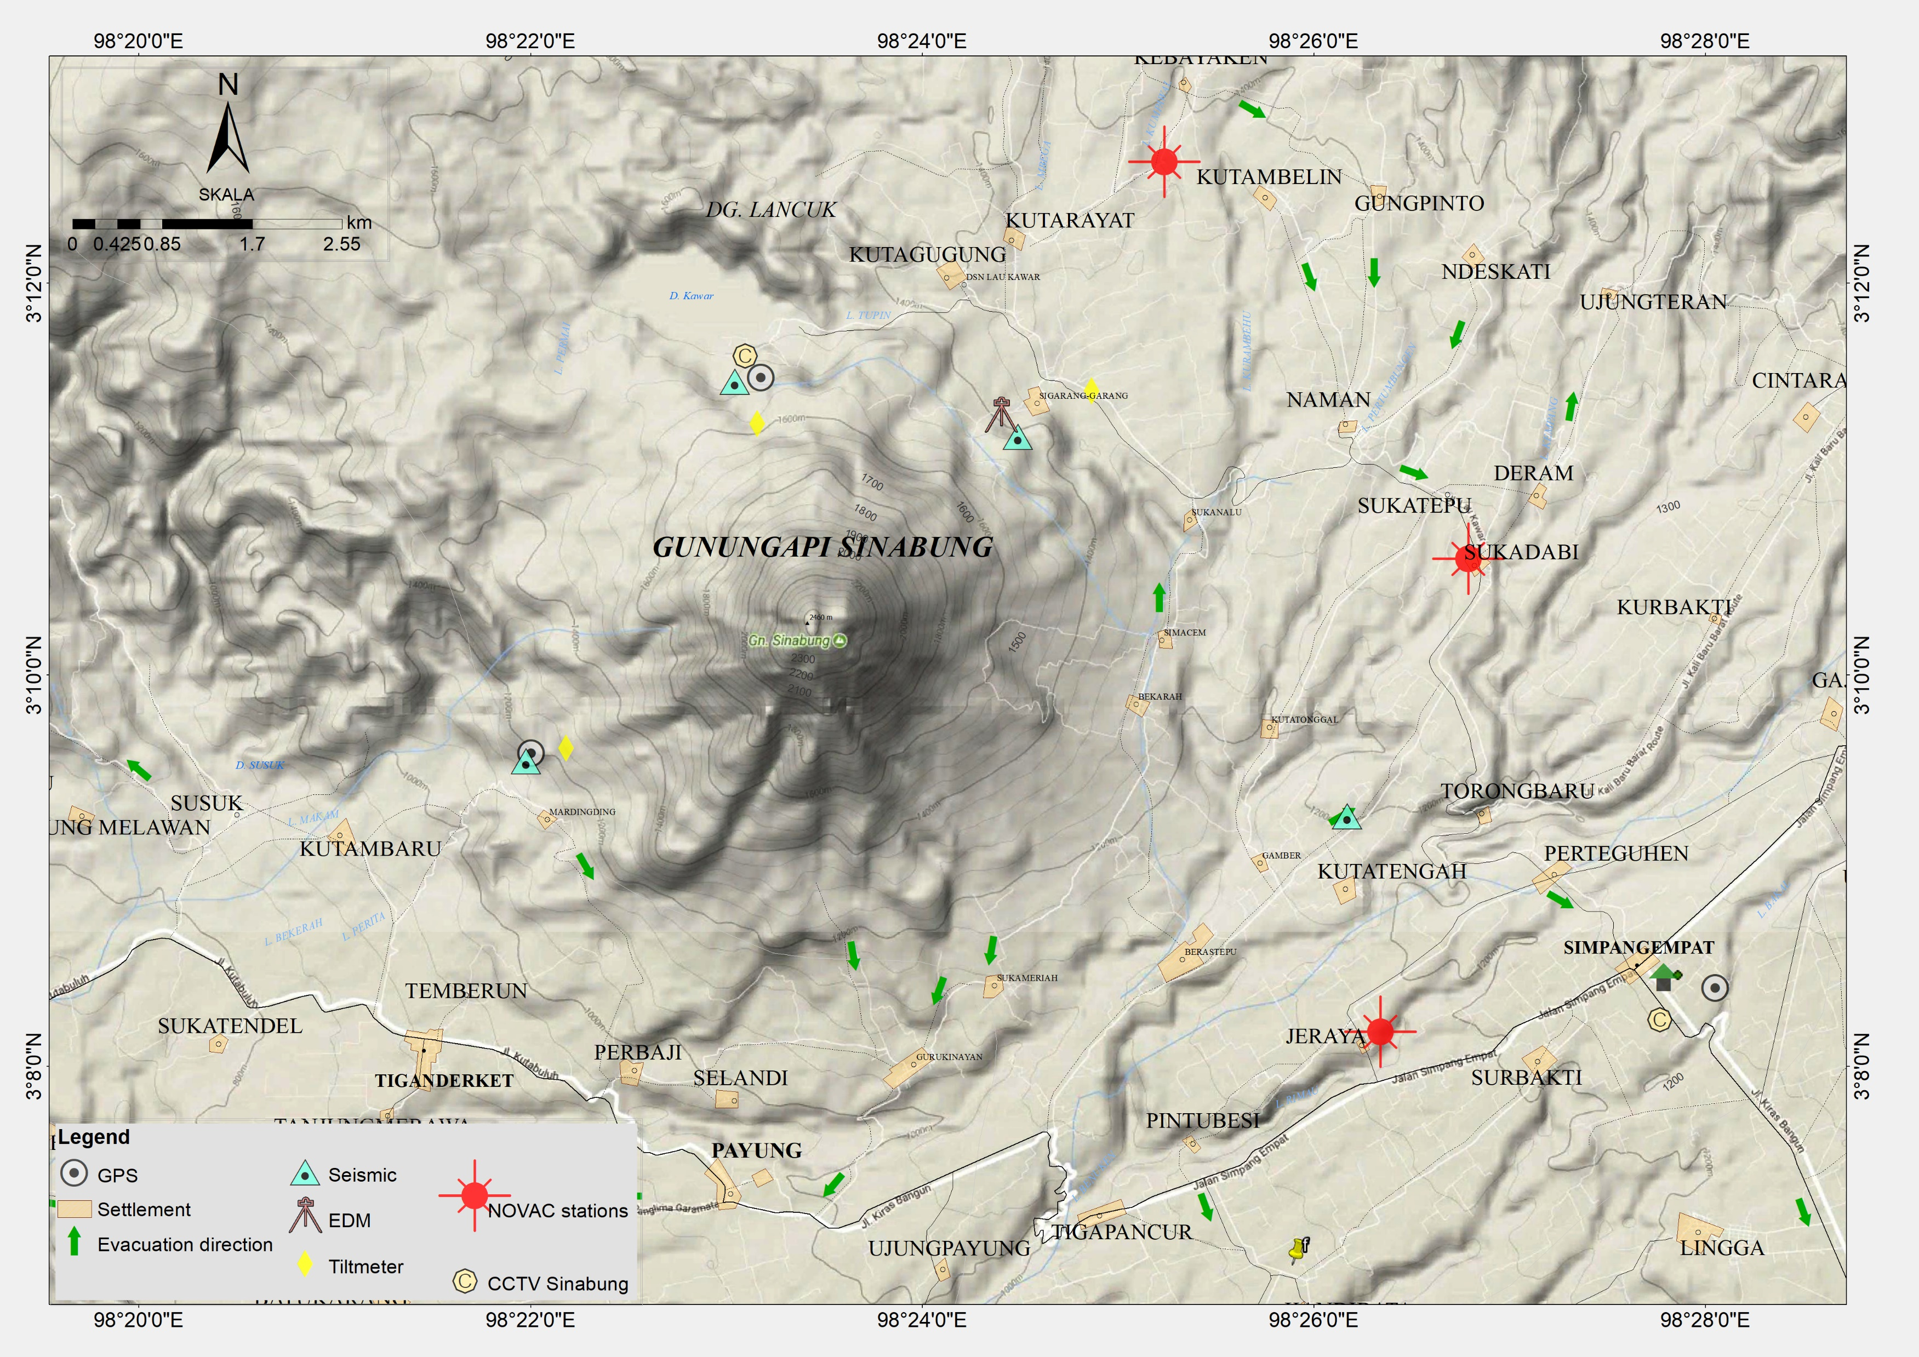

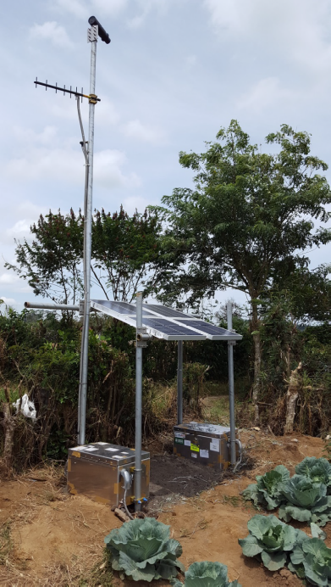
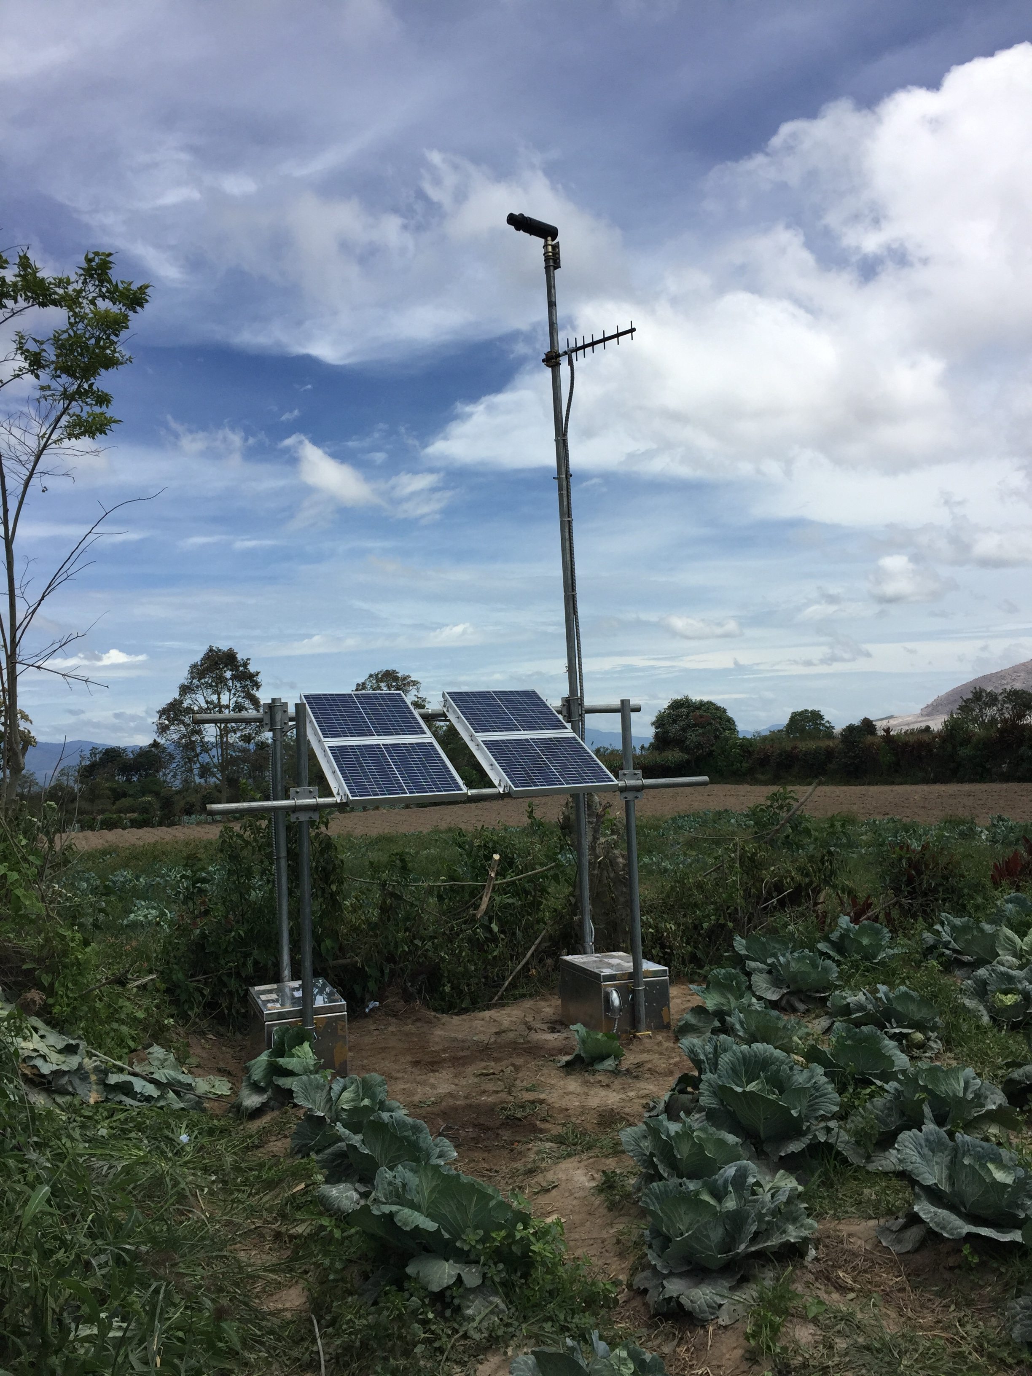
Instrumentation network of Sinabung
In 2016, the CVGHM installed three NOVAC scanning DOAS instruments east of the volcanic edifice, the predominant wind direction.
Data from these instruments is telemetered to the local observatory and provide real-time situational awareness of SO₂ emission rates.
Primulyana, S., Kern, C., Lerner, A.H., Saing, U.B., Kunrat, S.L., Alfianti, H., Marlia, M., 2018. Gas and ash emissions associated with the 2010-present activity of Sinabung Volcano, Indonesia. J. Volcanol. Geotherm. Res. 382. https://doi.org/10.1016/j.jvolgeores.2017.11.018

Slide 5
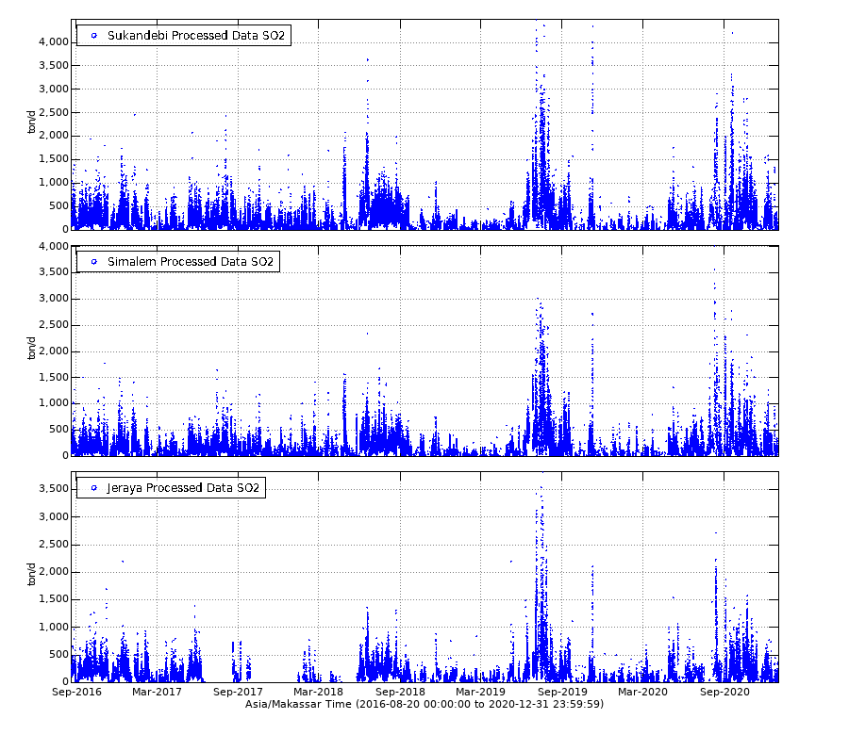
Plume Completeness > 0.5
The NOVAC scanning DOAS instruments have produced a nearly continuous dataset of SO₂ emissions spanning 2016 to present.
Which instrument (if any) reports an emission rate at a given time depends on the plume direction and other meteorological conditions.
These instruments are not well-suited for quantifying SO₂ emission rates during large, ash-rich explosive events. Instead, we focus on passive degassing here.

Slide 6

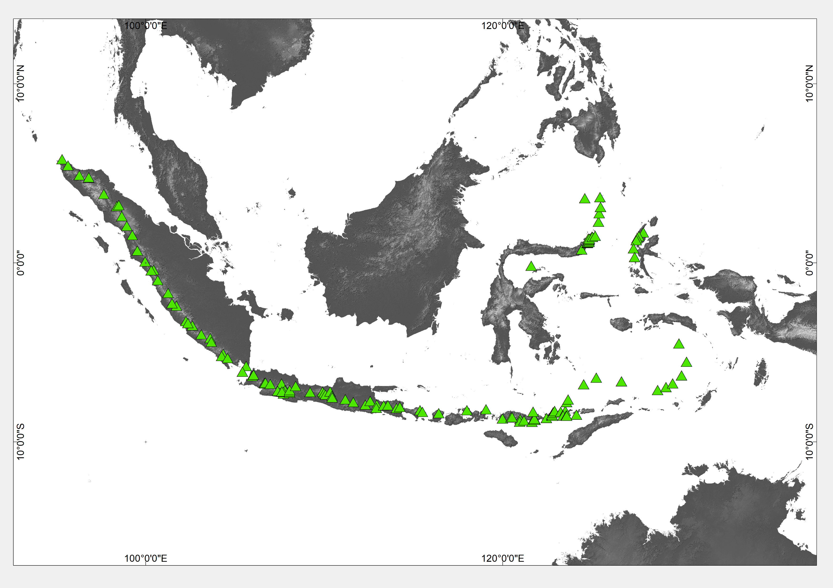
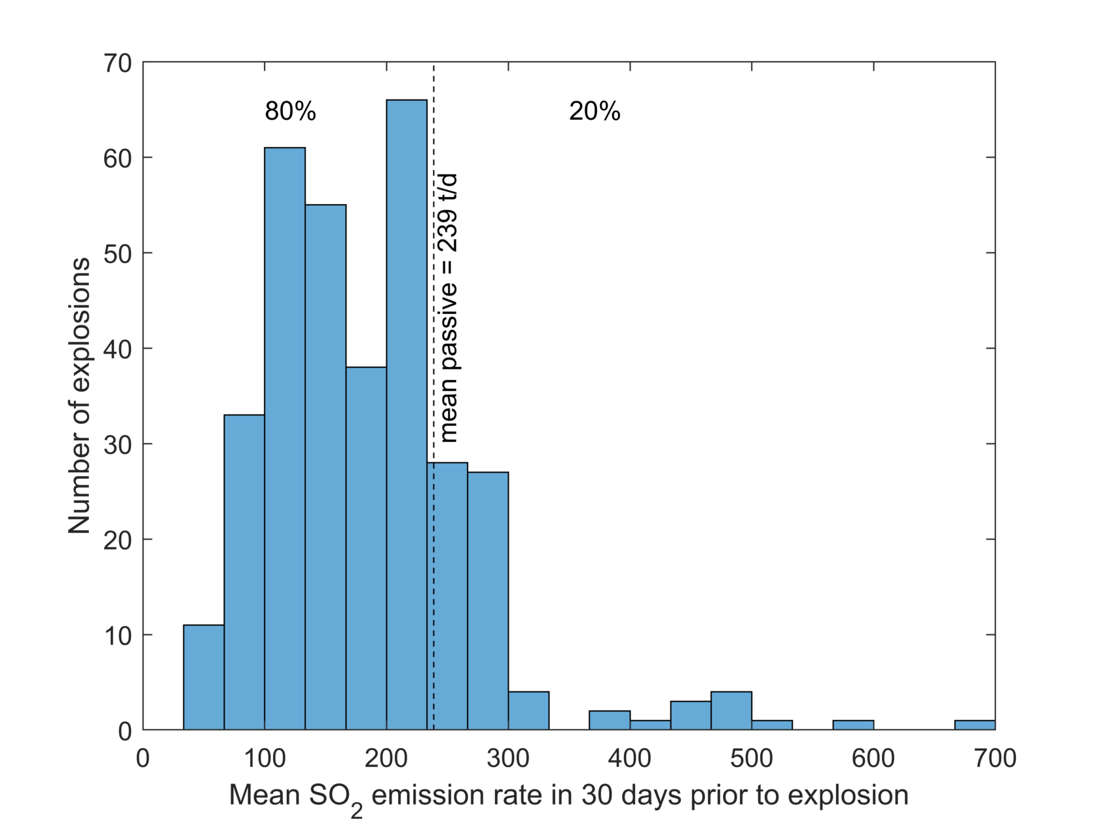
Continuous monitoring of SO₂ emissions from Sinabung Volcano, Indonesia
Syegi L. Kunrat, Hilma Alfianti, Christoph Kern, Sofyan Primulyana, Allan Lerner, Moh. Nurul Asrori, Armen Putra, Deri Al Hidayat
The 2016-2020 mean SO₂ emission rate from passive degassing at Sinabung was 239 t/d.
We find that 80% of explosive events occurred when the average passive emission rate for the previous 30 days was < 239 t/d.
This ‘high risk’ condition is met on 63% of days in the 4-year period, while the remaining 37% of days could be classified as ‘lower risk’ of explosion as long as the processes governing explosive activity at Sinabung do not change.

Slide 7
SO₂ emission rate vs. eruption column height and number of Hembusan seismic events
Hembusan seismic events are impulsive signals that are commonly attributed to degassing (Coudron, et al., 2018)

Slide 8
Summary and Conclusions
A network of three NOVAC scanning DOAS instruments was installed east of Sinabung Volcano in 2016. Since that time, these instruments have produced a nearly continuous dataset of SO₂ emission rates.
The 2016-2020 mean SO₂ emission rate from passive degassing at Sinabung was 239 t/d. Statistical analysis shows that 80% of explosive events occurred when the average passive emission rate for the previous 30 days was below this value.
Using this mean value as a threshold, we find that the ‘high risk’ condition is met on 63% of days in the 4-year period, while the remaining 37% of days could be classified as ‘lower risk’ of explosion as long as the processes governing explosive activity at Sinabung do not change markedly.
Comparison of the SO₂ emission rates with a catalog of seismic events is ongoing, particularly focusing on ‘Hembusan’ events which are commonly attributed to degassing processes.

Slide 9
THANK YOU

