Slide 1
An Assessment of CYGNSS Ocean Wind Speed Products
Matthew Hammond, Giuseppe Foti, Christine Gommenginger, Meric Srokosz, and Nicolas Floury
EGU 2021

Slide 2
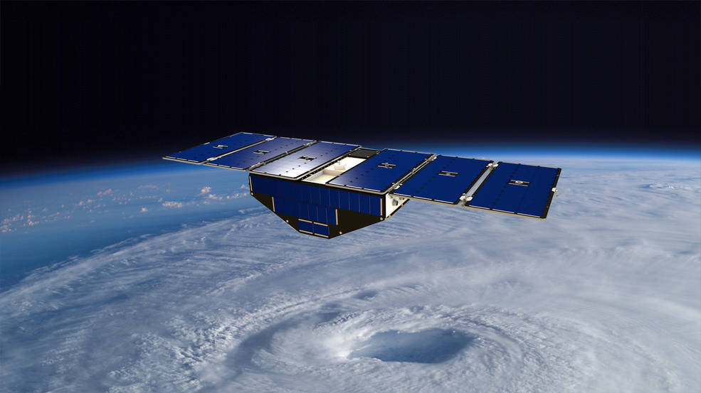
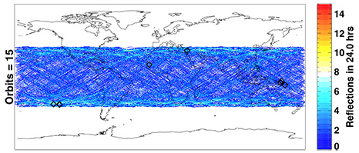
NASA CYGNSS
NASA’s GNSS-Reflectometry mission
Aimed at retrieval of wind speeds - particularly in hurricanes
Constellation of 8 satellites
A first for GNSS-R
Covering latitudes ±38°
Providing rapid revisit times (mean = 7hrs)

Slide 3
Background and Method
Ocean surface roughness is the first-order geophysical driver of Sigma0
Also secondary dependencies (SWH, SST, SSS, etc)
Fixing ocean surface conditions -> reveal non-geophysical effects in L1 data
ECMWF ERA-5 reanalysis model output used as reference
Wind & wave data, 1hr / ~30km resolution, global
CYGNSS reflected signals collocated with ECMWF ERA-5
v3.0 L1 (Aug 2018 – Dec 2019)
~7 Tbytes CYGNSS catalogue

Slide 4
CYGNSS L1 v3.0 NBRCS
Notes:
Instrument: (geometry / antenna / attitude)
Surface: (wave conditions)

Slide 5
NBRCS Geographical patterns
Setup
Single FM
Single SVN
U10 ~7 m/s
Prominent geographical biases in NBRCS

Slide 6
NBRCS Geographical patterns
Setup
Single FM
Single SVN
U10 ~7 m/s
Prominent geographical biases in NBRCS
Geographical pattern strongly correlated with bistatic geometry

Slide 7
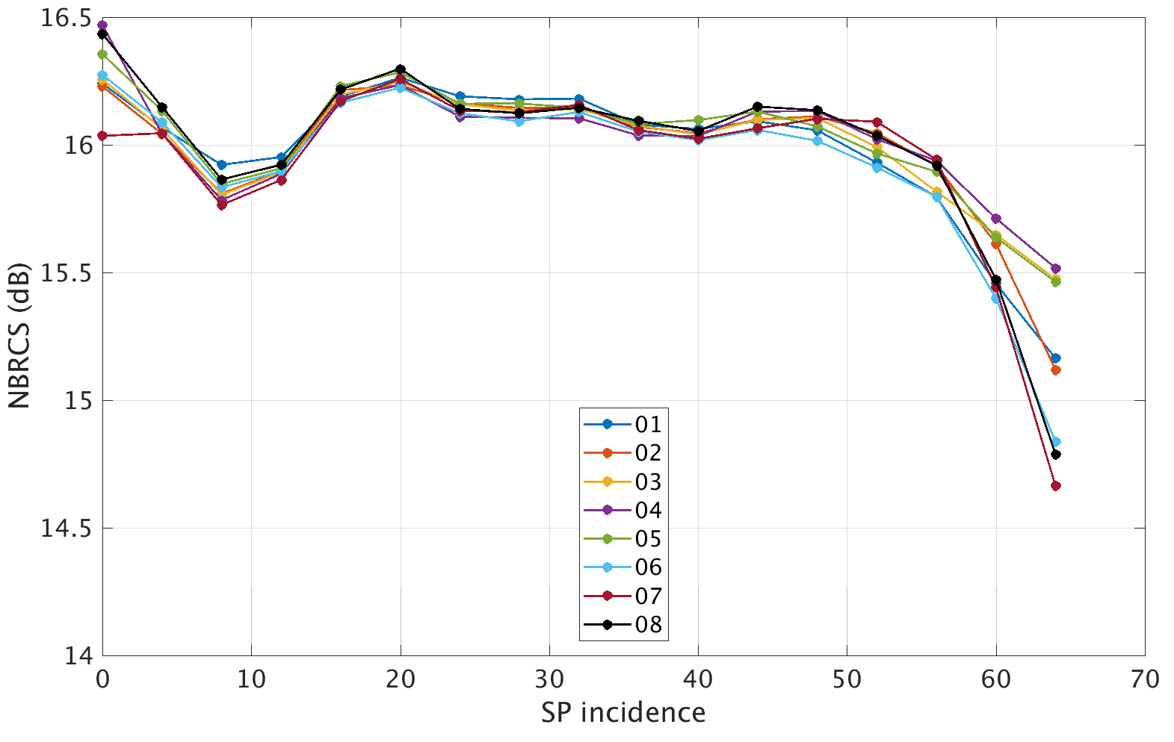
NBRCS vs Incidence Angle
Setup
All SVN
U10 ~7 m/s
Inter-calibration bias ~0.1dB
Sigma0 range up to ~2 dB (for fixed wind speed)

Slide 8
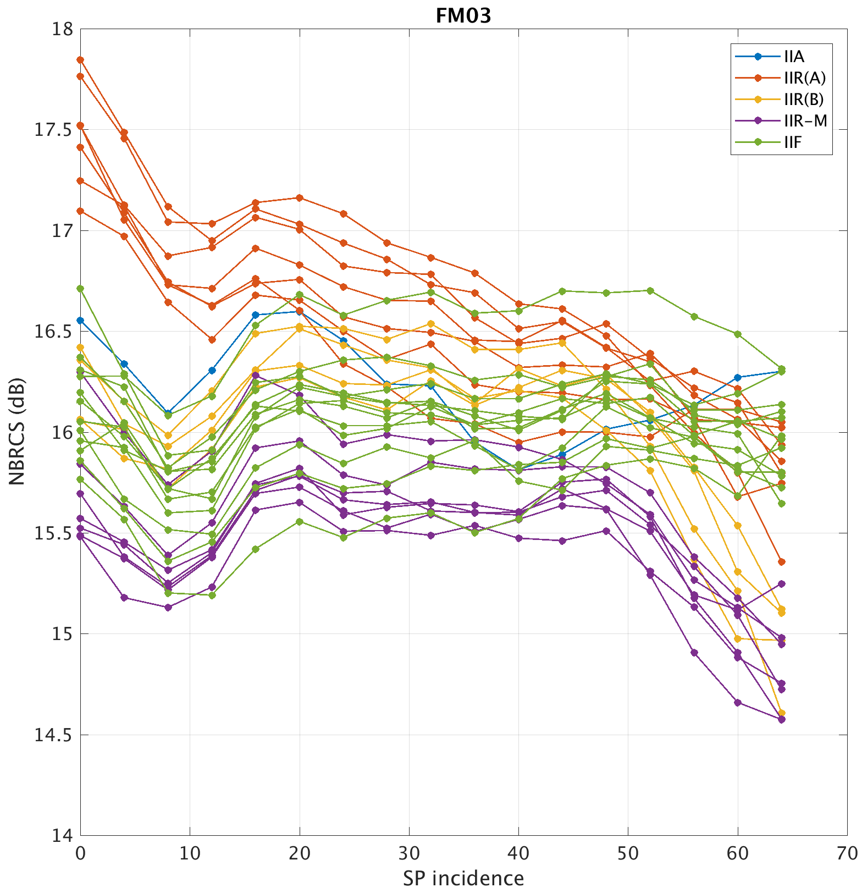
NBRCS vs SVN and Incidence Angle
Setup
Single FM
Split by SVN (all)
Coloured with GPS Block
U10 ~7m/s
Strong dependence on SVN and geometry
Range ~3dB

Slide 9
CYGNSS L1 v3.0 LES
Notes:
Instrument: (geometry / antenna / attitude)
Surface: (wave conditions)

Slide 10
LES Geographical patterns
Setup
Single FM
All SVN
U10 ~7 m/s
Strong spatial pattern in LES
Not wind/wave related
Instead related to geoid
Geoid undulation values w.r.t. WGS84
LES calculation approach?

Slide 11
LES Geographical patterns
Setup
Single FM
All SVN
U10 ~7 m/s
Strong spatial pattern in LES
Not wind/wave related
Instead related to geoid
EGM2008 geoid height (relative to WGS84)
Impact of geoid on LES calculation in DDM?
EGM2008 geoid height

Slide 12
Summary
We fixed ocean surface conditions (U10~7 m/s) to analyse non-geophysical effects in CYGNSS L1 v3.0
Prominent geographical patterns in NBRCS shown
Not associated with geophysical phenomena, but with residual dependence on SVN and bistatic geometry
LES shows similar dependence on SVN and geometry as found for NBRCS
In addition, LES shows geographical patterns linked to the geoid
Likely due to current estimation of LES from DDMs
Biases and variability in CYGNSS L1 data all linked to unresolved instrument and processing issues, or to inaccuracies in the process of signal calibration
Notes:
Instrument: (geometry / antenna / attitude)
Surface: (wave conditions)

Slide 14
Extra

Slide 15
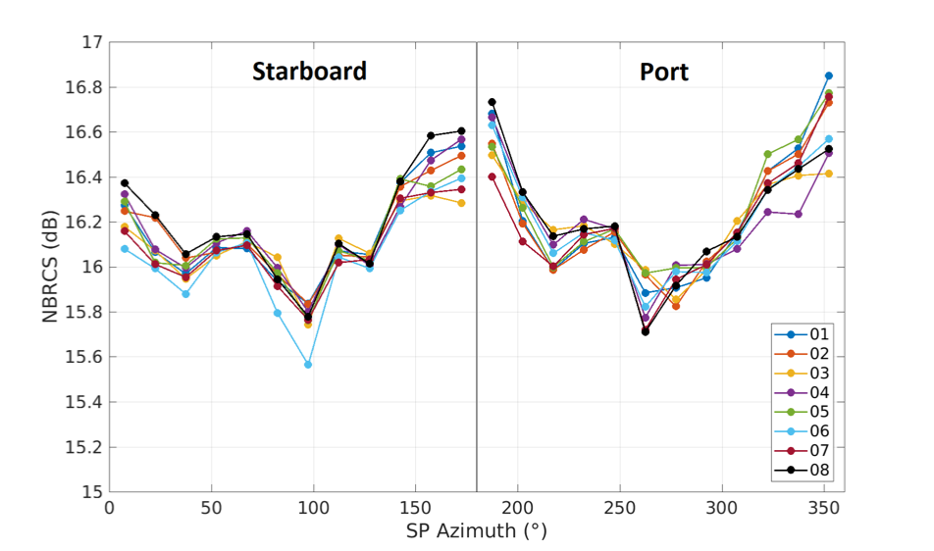
NBRCS vs Azimuth Angle
Setup
U10 ~ 7m/s
All SVN
Split by FM
Azimuthal dependence ~1dB

