Slide 1
Visualizing uncertainty of one-dimensional land subsidence prediction by preparing various local optimal solutions with a genetic algorithm
EGU21-3727
Kento Akitaya and Masaatsu Aichi
Graduate School of Frontier Sciences, The University of Tokyo
Acknowledgement: This study was supported by Cabinet Office, Government of Japan, Cross-ministerial Strategic Innovation Promotion Program (SIP),
“Enhancement of National Resilience against Natural Disasters”.

Slide 2
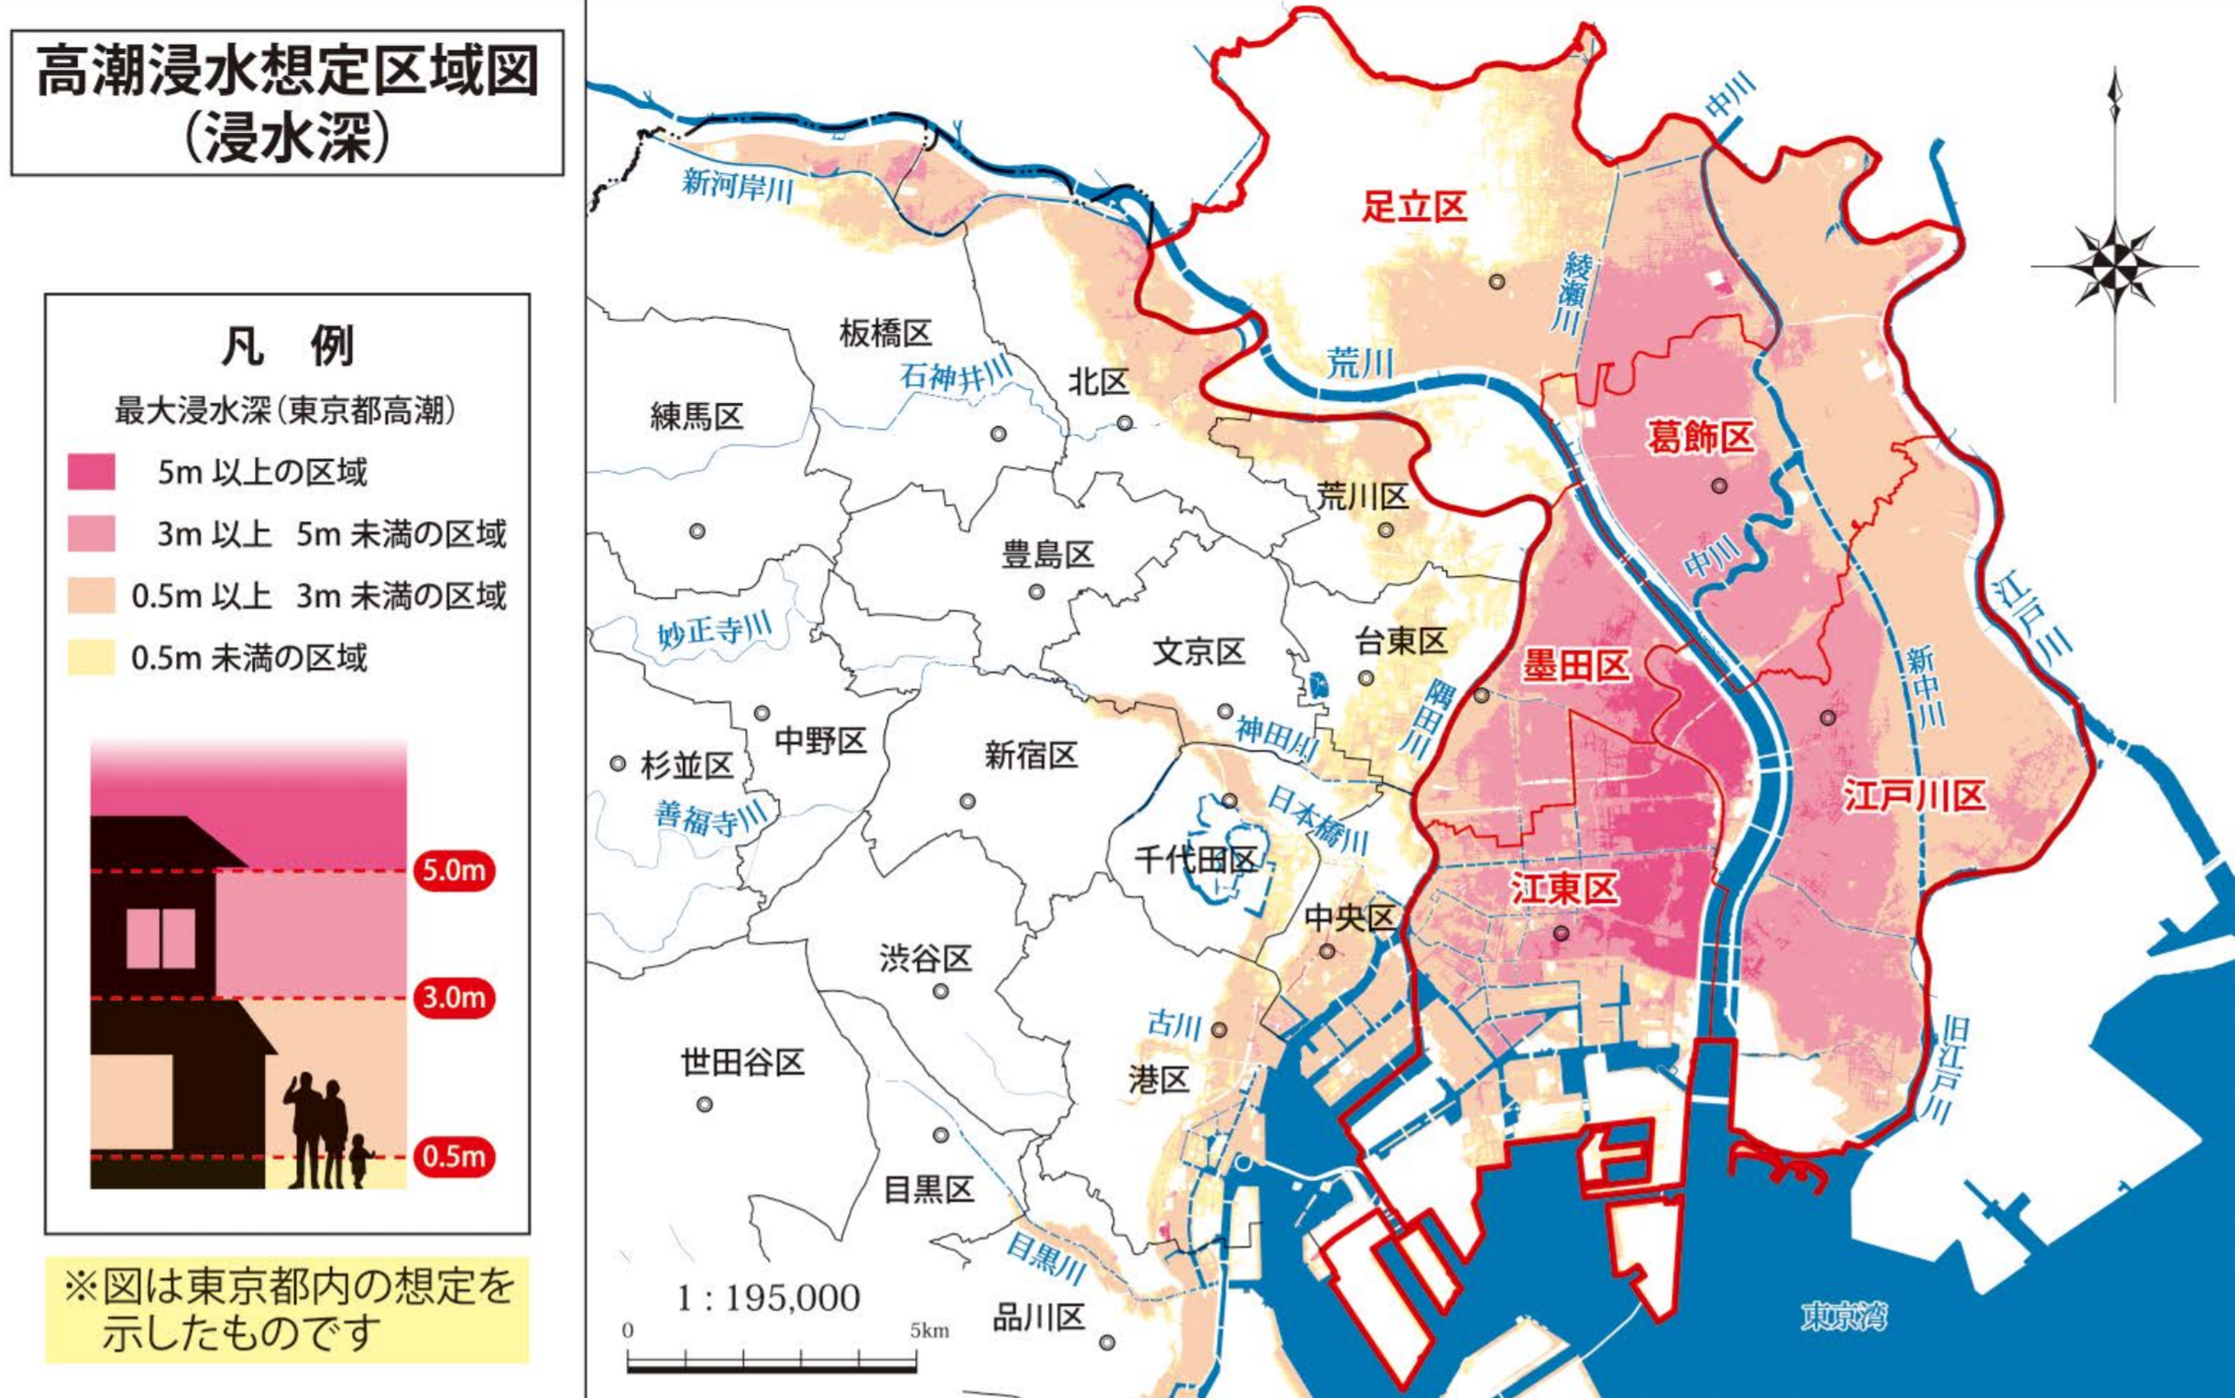
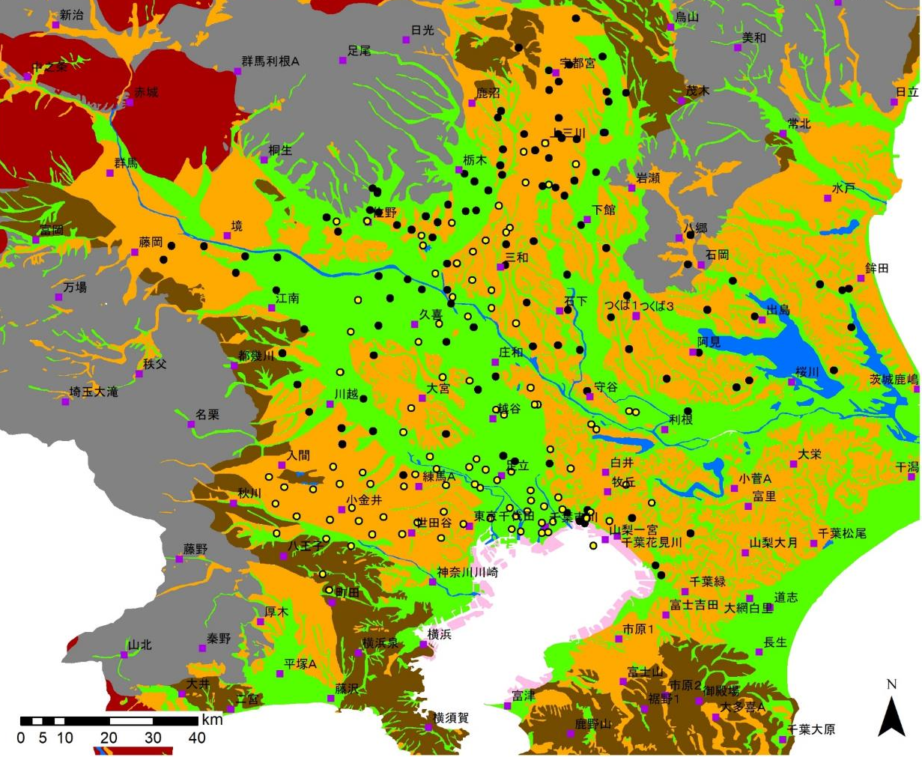
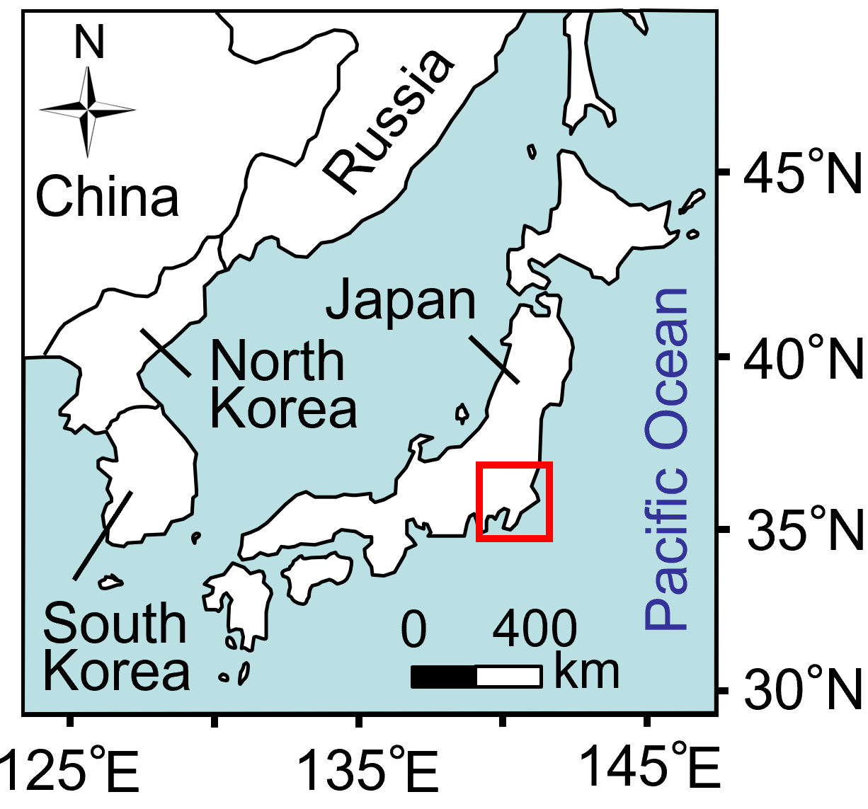
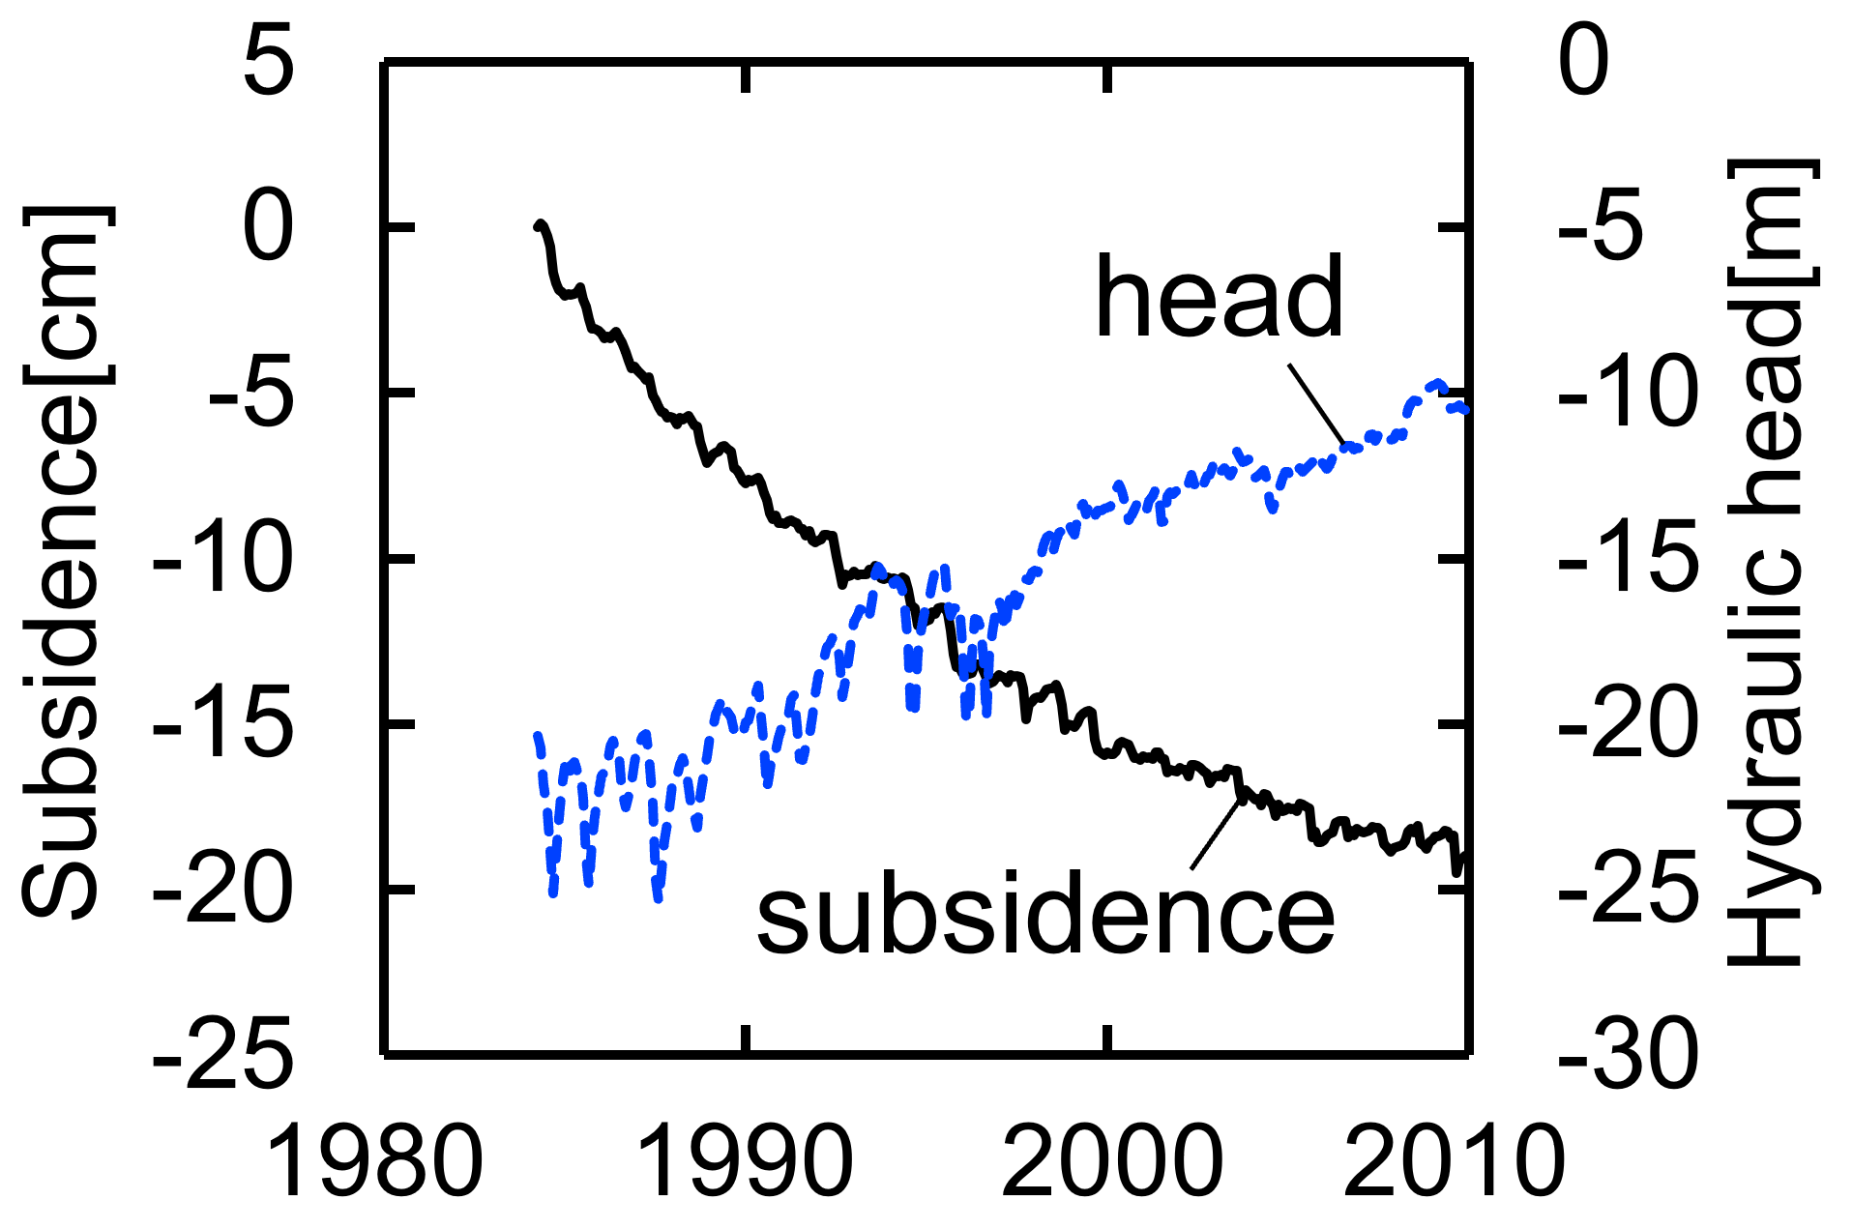
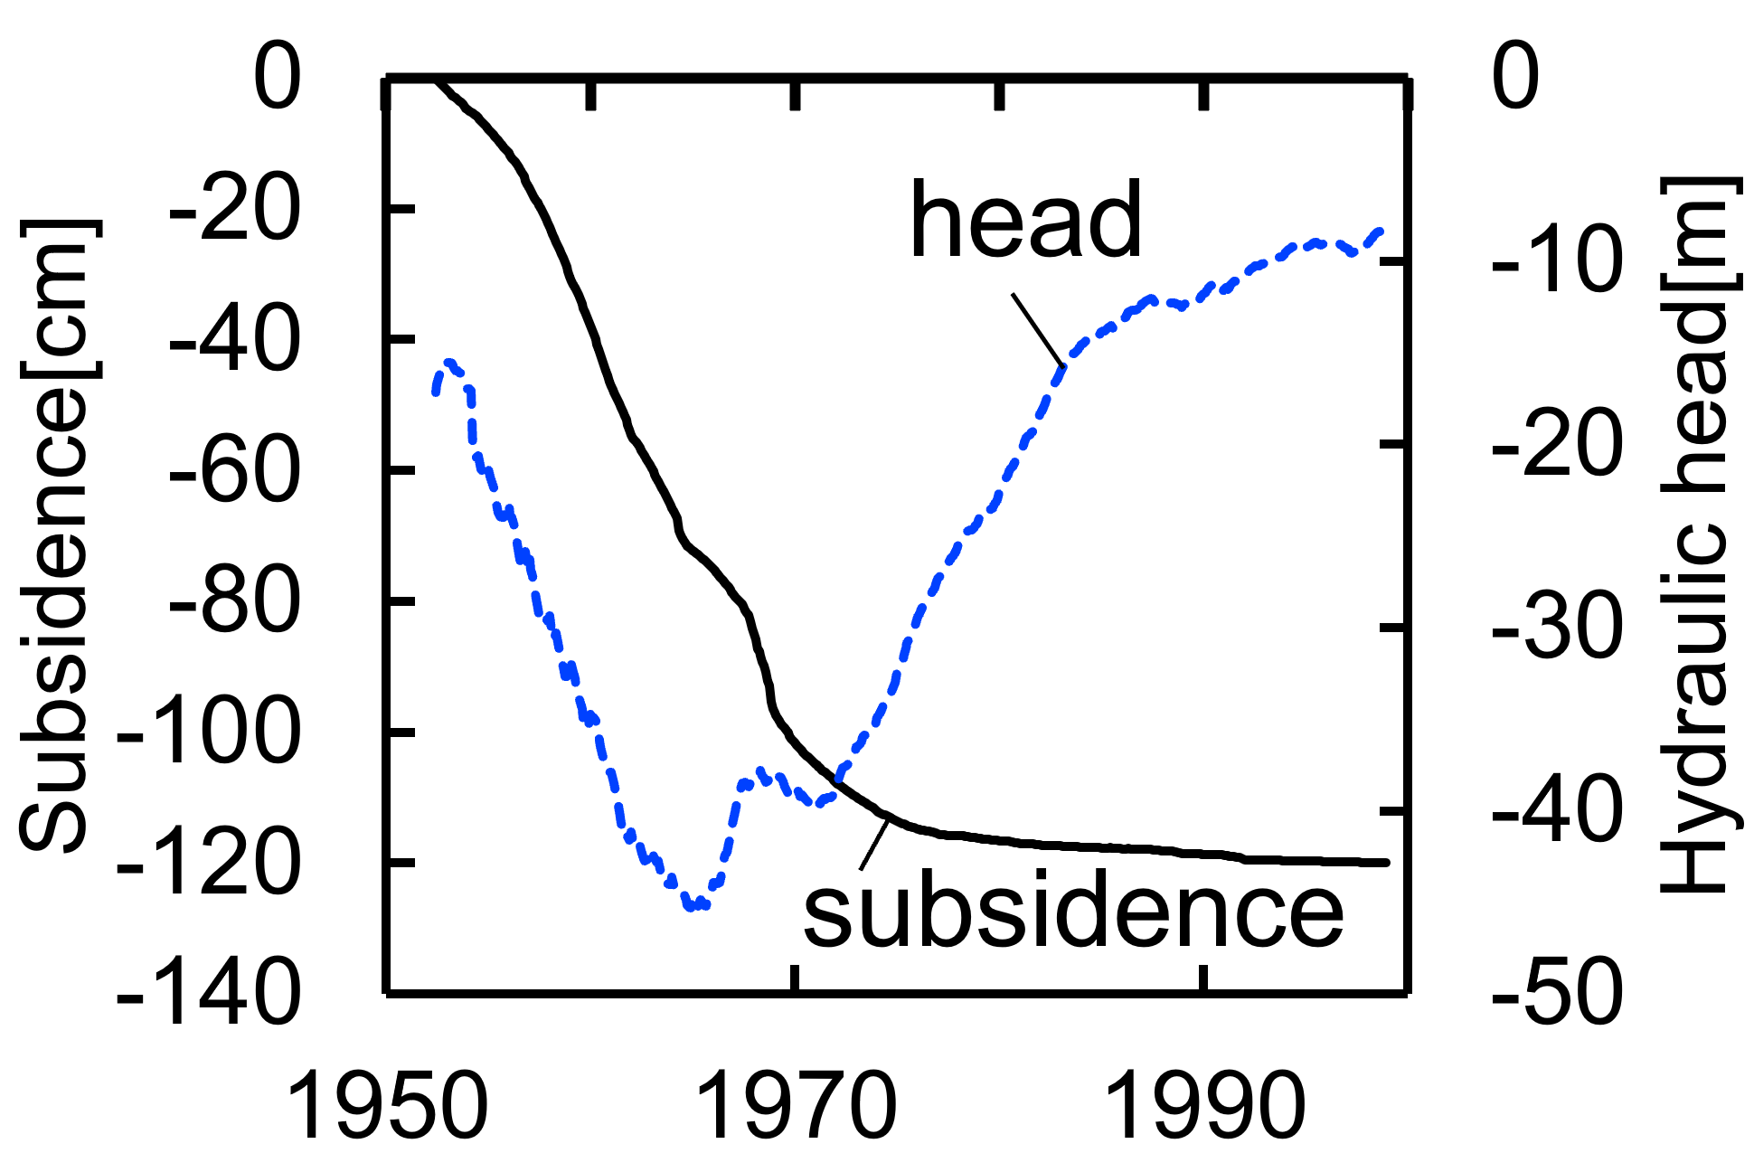
Background:
/14
Land subsidence has threatened lowlands in the coastal area, Tokyo
Recent subsidence occurs in the inland area, Kanto Plain, Japan
Flood hazard map of Eastern Tokyo
Subsidence in Kanto Plain, Japan
Predictive maximum depth of flood
Adachi
5.0 m -
3.0 - 5.0 m
0.5 - 3.0 m
0.0 - 0.5 m
Katsushika
Sumida
Edogawa
Hill
Lowland
Plateau
Reclaimed land
Mountain
Water
Volcano
Koto
Tokyo bay
Tokyo bay
Modified from the hazard map provided by the council of Koto 5 wide-areas evacuation promotion (2018)
https://www.city.koto.lg.jp/057101/bosai/documents/haza-do.pdf

Slide 3
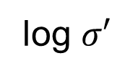

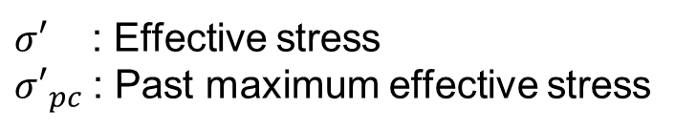

Background:
Heterogeneity of past maximum effective stress
/14
Pore pressure
Void ratio
Surface
Elastic
Holocene
Plastic
Pleistocene
Elastic
Plastic
log $σ′$
log ${σ′}_{pc}$
New log ${σ′}_{pc}$
Depth
1974
1977
1983
Hydrostatic
$σ′$ : Effective stress
${σ′}_{pc}$: Past maximum effective stress
(Modified from Aichi 2008)

Slide 4
Research objective
/14
Uncertainty is a challenge in land subsidence prediction
Heterogeneity of subsurface formations
Historical changes in the subsurface stress state due to past groundwater pumping
Available observation data is limited
Visualizing the predictive uncertainty while predicting future land subsidence caused by groundwater pumping

Slide 5
/14
Concept: We use a genetic algorithm because of its good balance between inversion analysis and uncertainty analysis
Algorithm for inversion analysis
Gradient method
Others
Additional uncertainty analysis is required
The method itself also serves as uncertainty analysis
Null-space Monte Carlo method
Monte Carlo method
Particle filter
Genetic algorithm
Evolutionary programming
Efficient search☺
High bias☹
Inefficient search☹
Low bias☺
Inefficient search☹
Low bias☺
Efficient search☺
High bias☹
Aichi 2020
Ferronato et al. 2006
Field et al. 2016
This study
Notes:
観測沈下量をもとに、それを再現できる物性値分布を推定するには、逆解析が有効です。
また物性値分布を一意に決められないため、その不確実性解析も重要です。
しかし、地盤沈下シミュレーションは非線形性が強く、逆解析と不確実性解析を効率よく行えるアルゴリズムが提案されていないのが現状です。
逆解析アルゴリズムは、目的関数の勾配を使った方法とそうでない方法に分けられます。
勾配法はパラメータの探査効率が良いですが、追加で不確実性解析が必要です。
勾配法以外には、手法自体が不確実性解析を兼ねているものがあります。
モンテカルロ法は、物性値分布を網羅的に検証できますが、計算コストが現実的ではありません。
近年では、粒子フィルタが注目を集めていますが、力学的な一貫性を保証できない欠点を持つため、地盤沈下問題には適さないと考えられます。
遺伝的アルゴリズムは、物性値分布の網羅的な検証はできませんが、その分探査効率が良く、またモデルの多様性で不確実性を解釈できます。
本研究では、地盤沈下問題に適用するにあたり、遺伝的アルゴリズムの逆解析と不確実性解析のバランスが良いと考え、逆解析手法として採用しました。

Slide 6
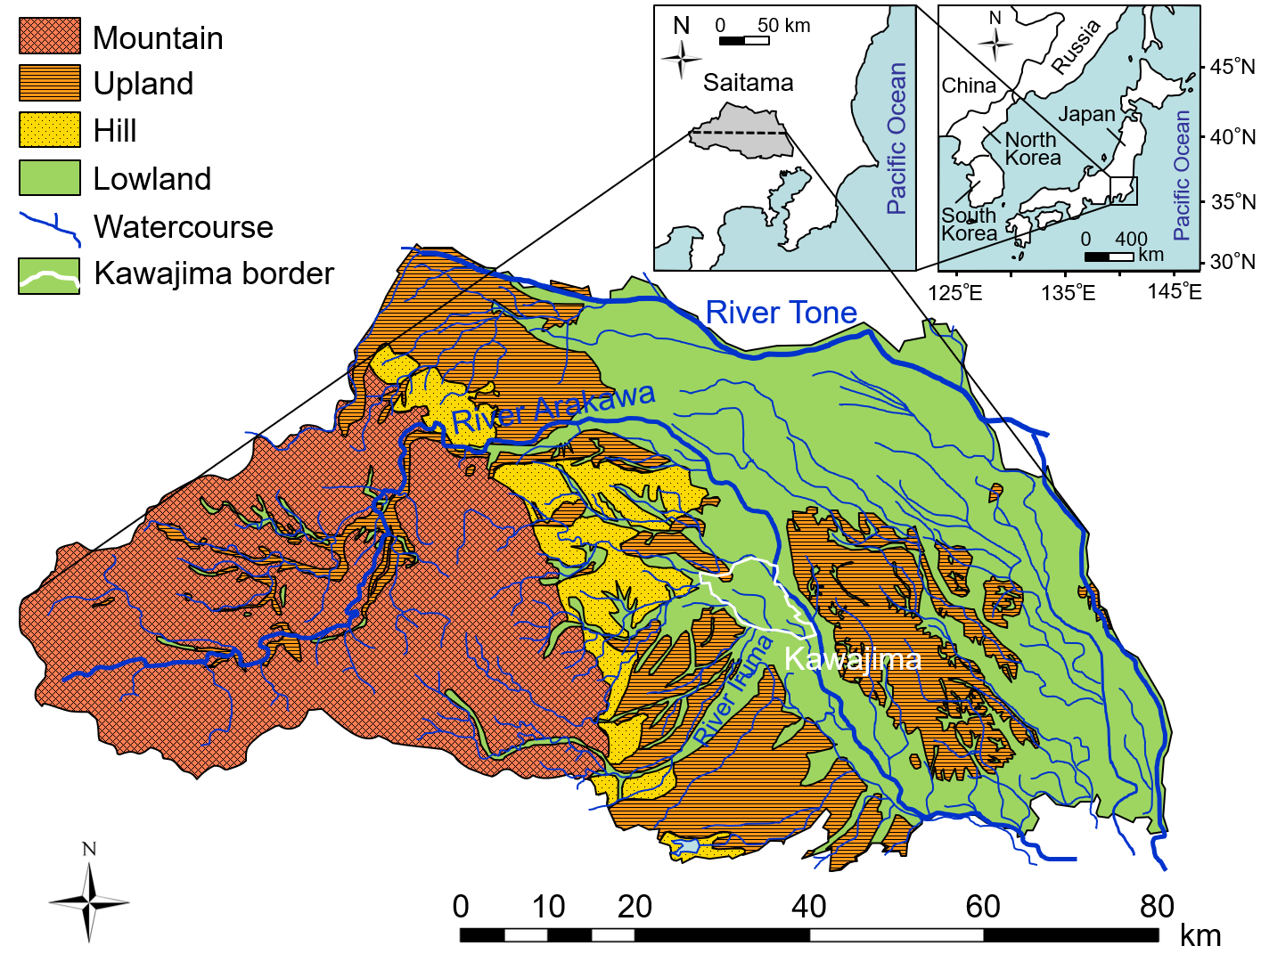
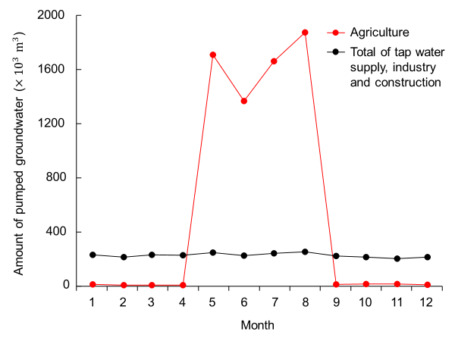
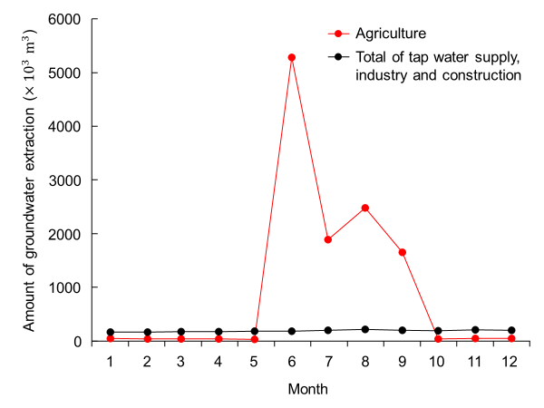

Study site: Kawajima, Saitama, Japan
/14
Groundwater is mostly used for agriculture during summer
1985
Agriculture
Total of others
Amount of pumped groundwater ($×{10}^{3}m^{3}$)
1995
Agriculture
Land subsidence observatory
Total of others

Slide 7
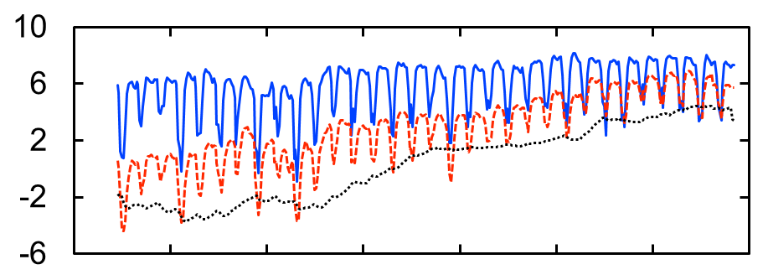
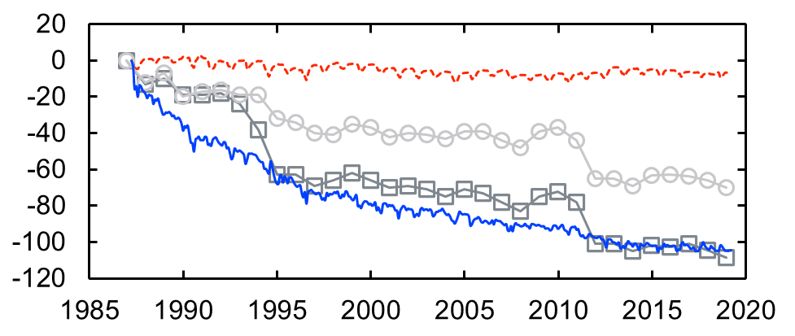
Observed hydraulic head and subsidence
/14
The long-term groundwater level has been recovering
Seasonal groundwater level fluctuations have caused plastic compaction in summer and elastic expansion in winter every year
Subsidence can be explained by deformations in layers of 0-80 m depths
10
6
2
-2
-6
Depth[m]
Well 3
Well 2
Well 1
Well 3
0
Hydraulic head [m]
Well 2
-50
Well 1
-100
-150
2
0
-2
-4
-6
-8
-10
-12
Layers between well 2 and well 3
-200
Cumulative deformation [cm]
Benchmark1 in Kawajima
-250
-300
Well 3
Benchmark2 in Kawajima
Screen
-350

Slide 8



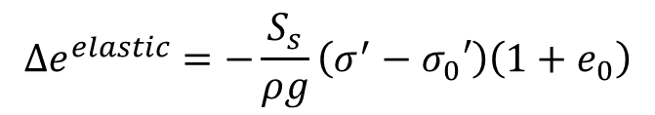




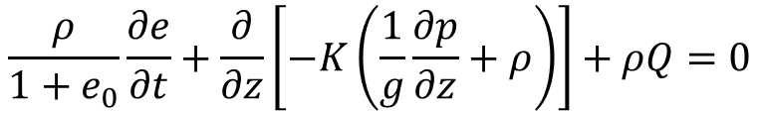










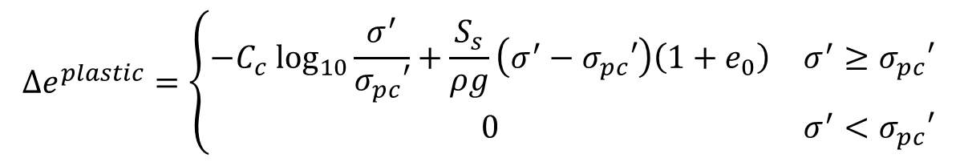



Land subsidence simulator
/14
Mass conservation of groundwater
Void ratio $e$
Linear elasticity
$$\frac{ρ}{1+e_{0}}\frac{∂e}{∂t}+\frac{∂}{∂z}\left[−K\left(\frac{1}{g}\frac{∂p}{∂z}+ρ\right)\right]+ρQ=0$$
$$e_{0}$$
Yield point
$$e_{pc}$$
Modified Cam-Clay
$e$ : Void ratio[-]
$g$ : Gravitational acceleration[m/s²]
$ρ$ : Water density[kg/m³]
$p$ : Pore pressure[Pa]
$K$: Hydraulic conductivity[m/s]
$Q$ : Pumping rate[m³/s]
$$e$$
Modified Cam-Clay model with linear elasticity
$$\log_{10}σ_{0}′$$
$$\log_{10}σ_{pc}′$$
$$\log_{10}σ′$$
$$\log_{10}σ^{′}$$
$$∆e^{elastic}=−\frac{S_{s}}{ρg}\left(σ^{′}−σ_{0}′\right)\left(1+e_{0}\right)$$
$S_{s}$ : Specific storage[1/m]
$σ^{′}$ : Effective stress[Pa]
$$∆e^{plastic}=\left\{\begin{matrix}−C_{c} \log_{10}\frac{σ^{′}}{σ_{pc}′}+\frac{S_{s}}{ρg}\left(σ^{′}−σ_{pc}′\right)\left(1+e_{0}\right) & σ^{′}≥σ_{pc}′ \\ 0 & σ^{′}<σ_{pc}′\end{matrix}\right.$$
$σ_{0}′$ : Initial effective stress[Pa]
$e_{0}$ : Initial void ratio[-]
$C_{c}$ : Compression index[-]
$σ_{pc}′$ : The past maximum effective
stress[Pa]

Slide 9
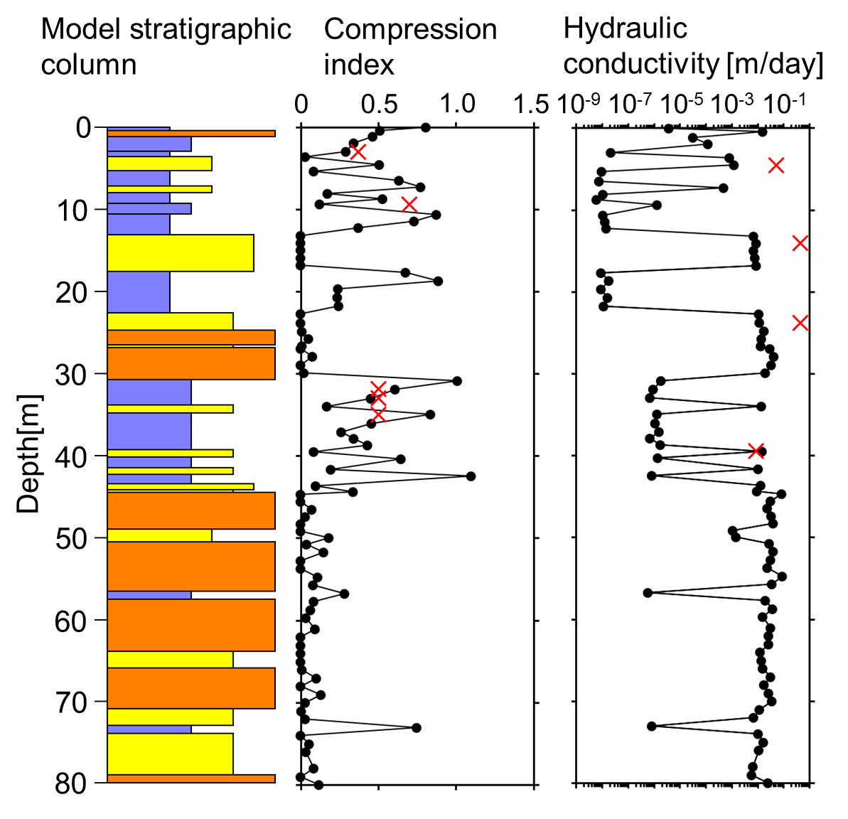
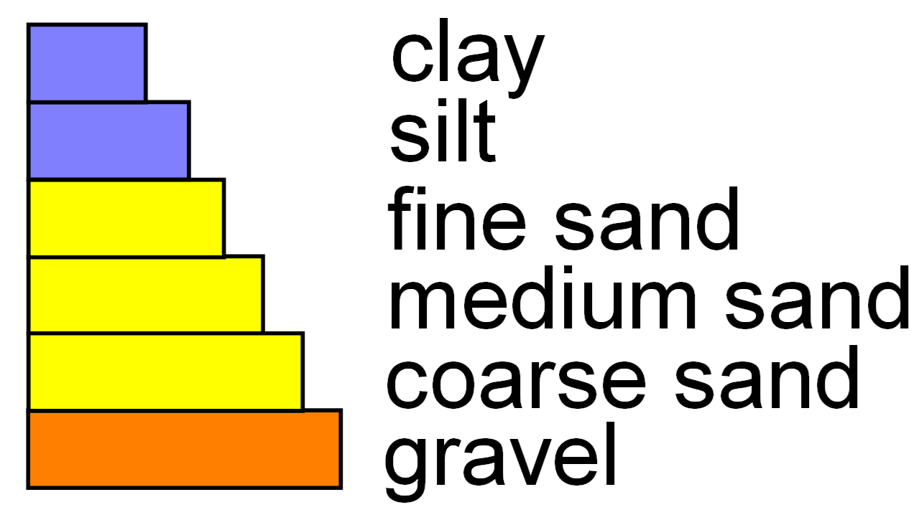
Initial condition and boundary condition
/14
Normal consolidation, hydrostatic
Surface is fixed at atmospheric pressure
Extrapolation from well 2 and well 3 considering the pumping amount
0
0
Pore pressure values are specified
20
-20
Observed head
40
Pressure head[m]
Depth[m]
-40
60
Screen of observation well3
-60
80
Year
-80
Assumption
Observed head is used
Notes:
川島では、季節的な水位変動により地盤沈下が進行しています。
層別観測データから、川島の地盤沈下は３号井に相当する地層の収縮で説明できることがわかります。
そこで、３号井に相当する深度80m以浅を対象にモデリングしました。
初期条件は、全メッシュが静水圧にあり、また応力状態が降伏点にあると仮定しました。
境界条件として、主要な帯水層に対し、観測水位を圧力値に換算した値を指定します。
深度70と80mの帯水層には観測データがありませんが、スクリーン深度から透水性の良い層が続いているため、観測水位を使用しました。
深度30m以浅の帯水層は、川島の井戸の深度分布を考慮すると、揚水量がかなり多く、観測帯水層よりも大きな季節変動が推定されます。
この点と、試行錯誤の結果、2号3号の観測水位を線形外挿した水位をもとに、圧力値を指定しました。
また、川島観測所が設置される以前の水位は、初期状態と観測データが季節変動しつつ滑らかにつながるよう、仮定しました。

Slide 10
Parameter search by genetic algorithm
/14
Searched parameters
Hydraulic conductivity
Specific storage
Compression index
Initial void ratio
The past maximum burial depth
Generating parameters sets by initial guess
Reproduction analysis of observed subsidence
Parents selection by roulette weighted with
individual fitness
Calculate children’s parameters distribution by
random weighted average of parents’ one
In a typical genetic algorithm, selected parents’ values are exchanged for children
Mutation by adding normal random numbers with standard deviation for each parameter
Alternation of generation

Slide 11
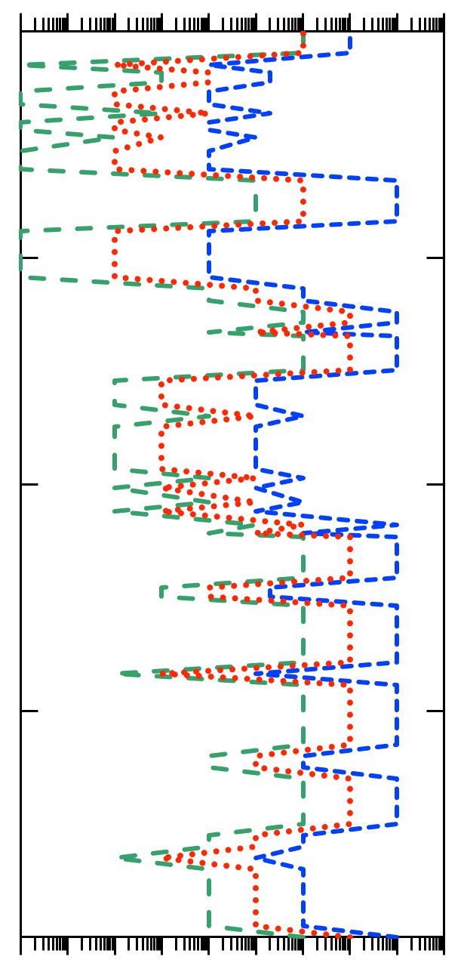
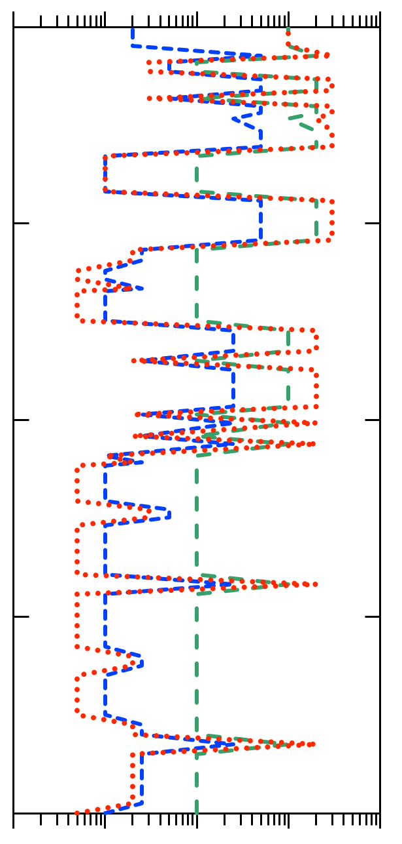
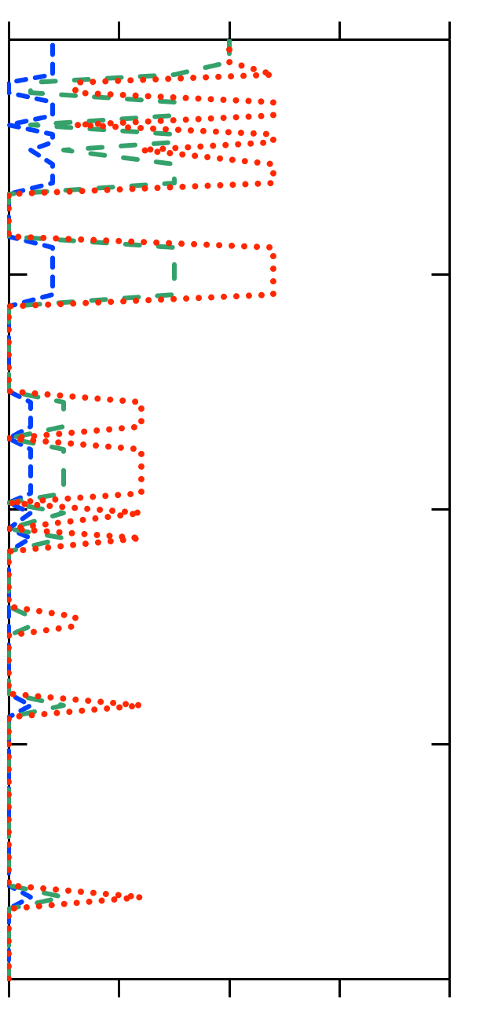
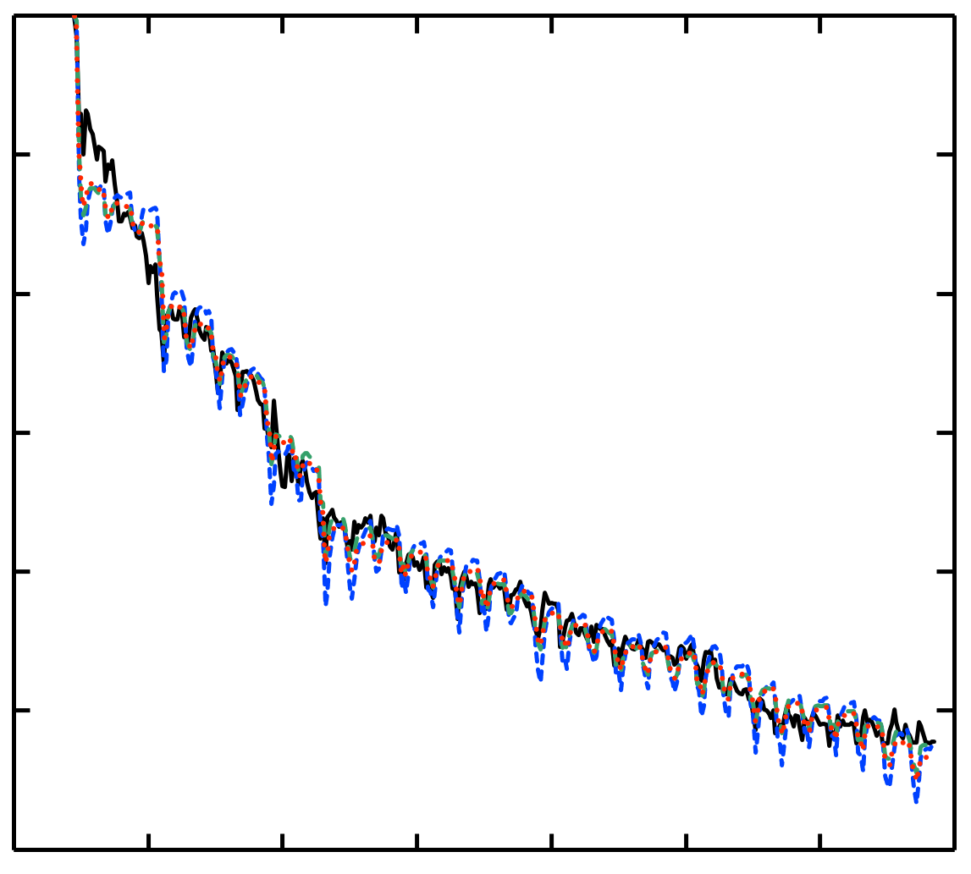
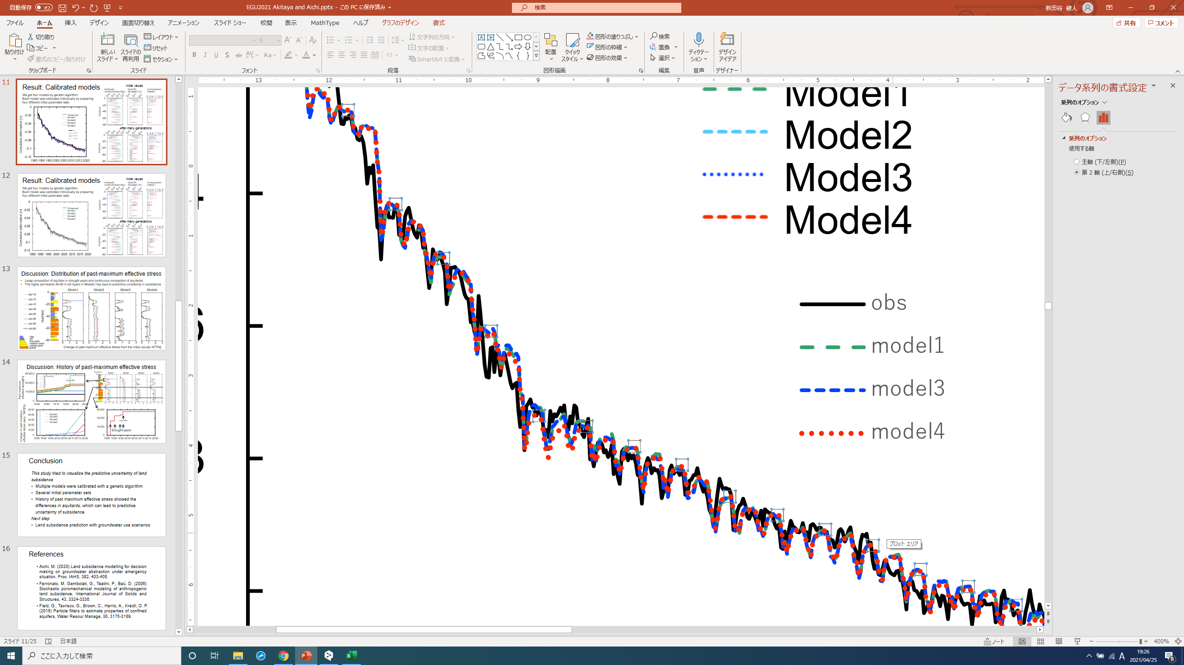
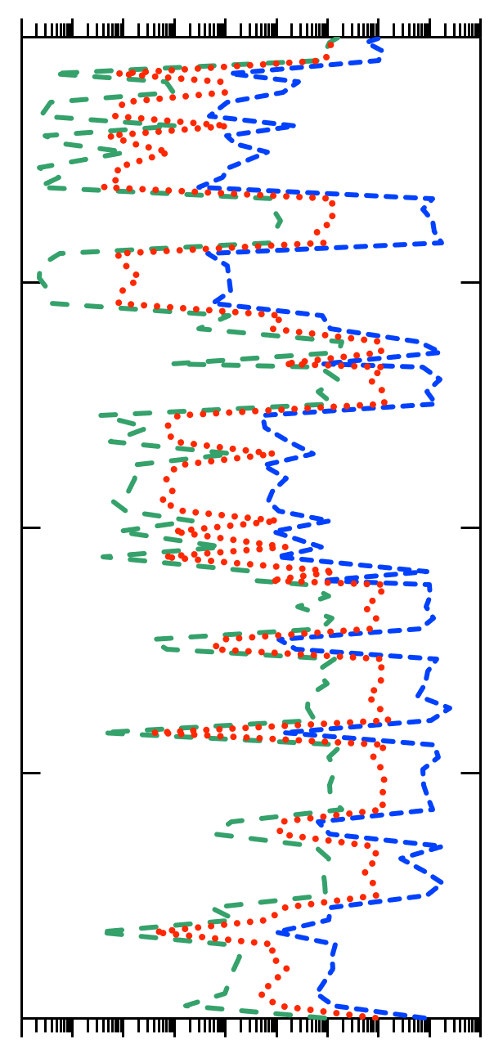
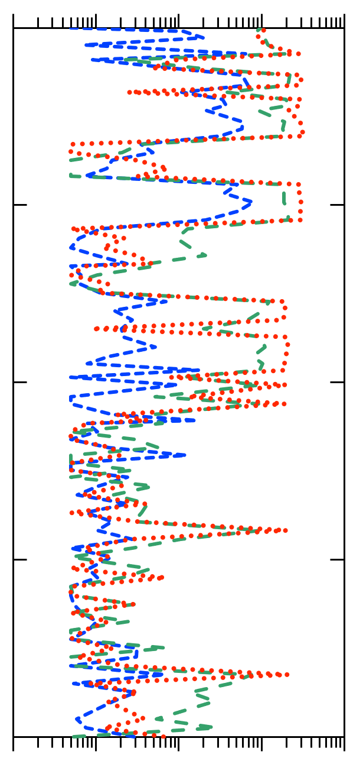
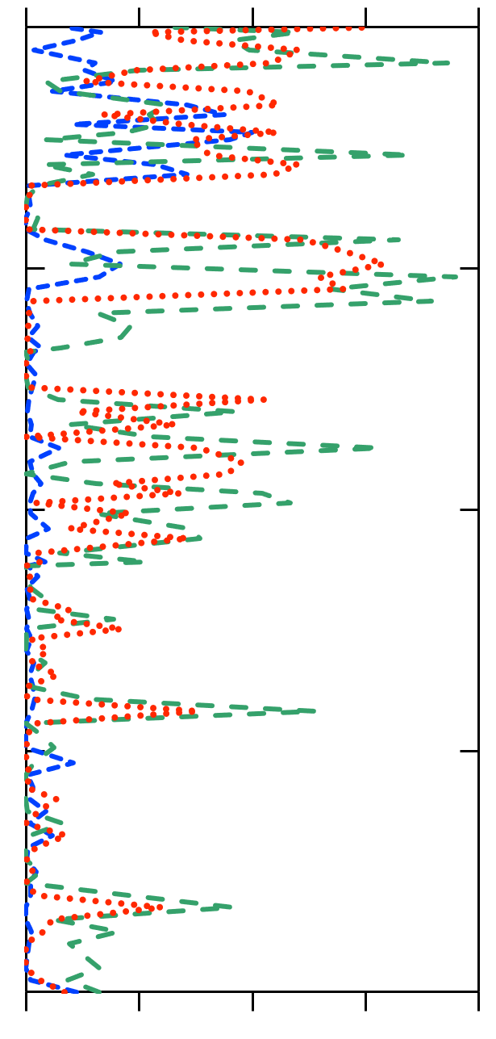
Result: Calibrated models
/14
Initial values
K [m/day]
S_{s} [1/m]
C_{c}[-]
Each model was calibrated individually by preparing three different initial parameter sets
Obtained parameters were within the range of typical values in the existing literature
-9
-6
-3
0
-6
-4
-2
10
10
10
10
10
10
10
0
1
2
0
0
-2
-4
-6
-8
-10
-12
-20
Depth[m]
Observed
Model1 (Highly permeable)
Model2 (Standard)
Model3 (Lowly permeable)
-40
-60
-80
After convergence
Cumulative deformation [cm]
-9
-6
-3
0
-6
-4
-2
10
10
10
10
10
10
10
0
1
2
0
-20
Depth[m]
-40
-60
1985
1995
2005
2015
Year
-80

Slide 12
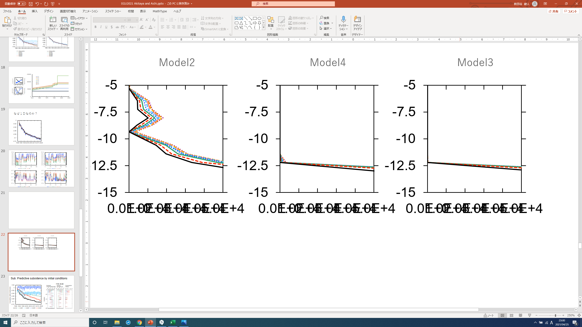
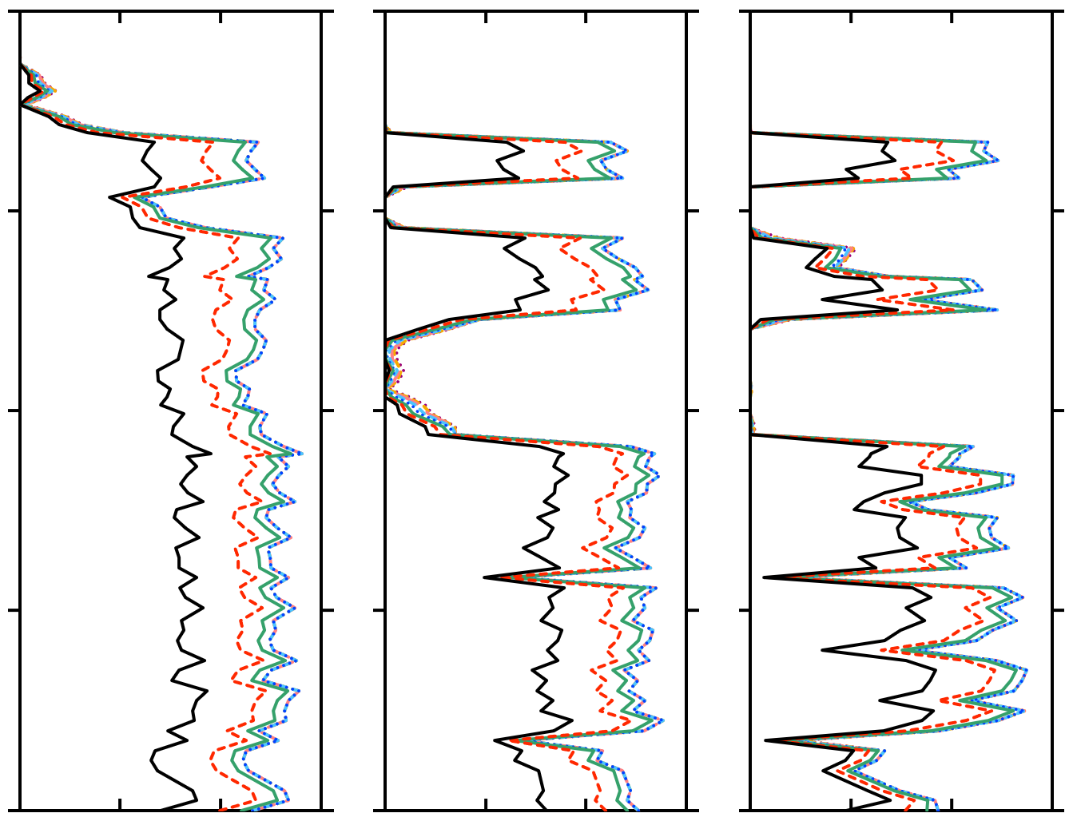

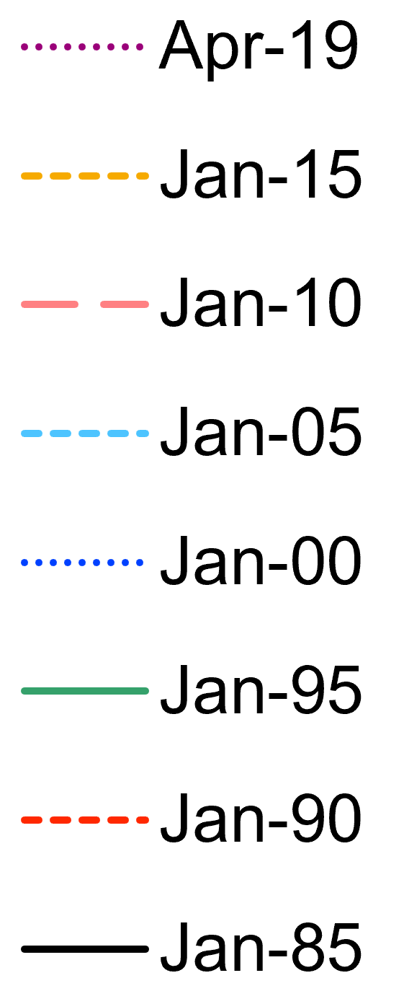
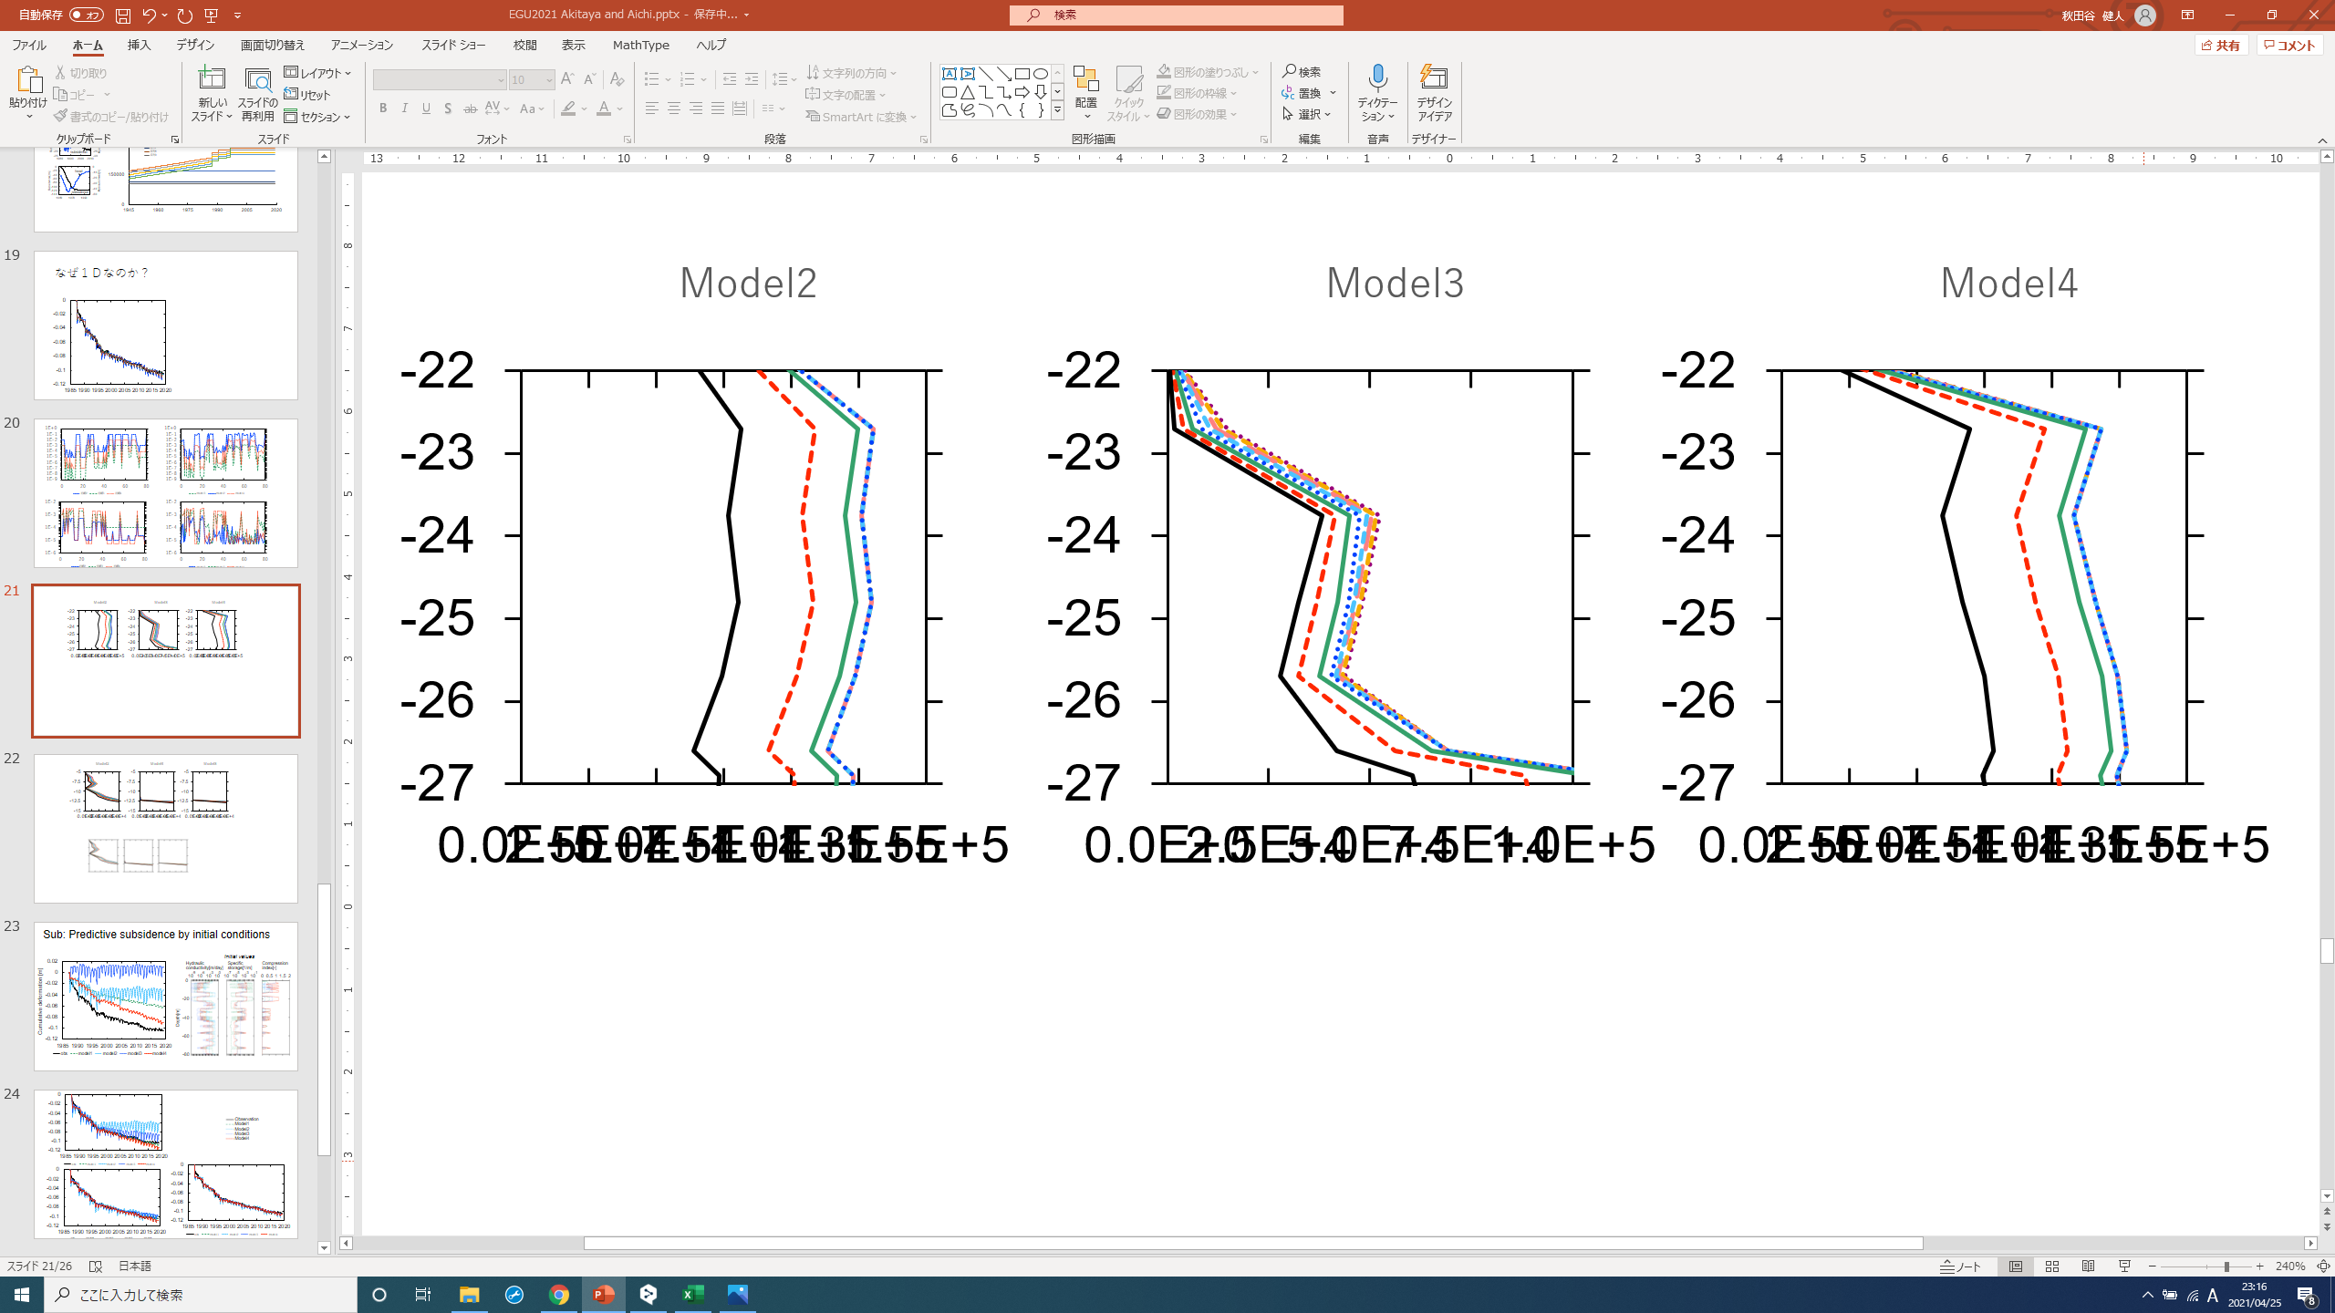
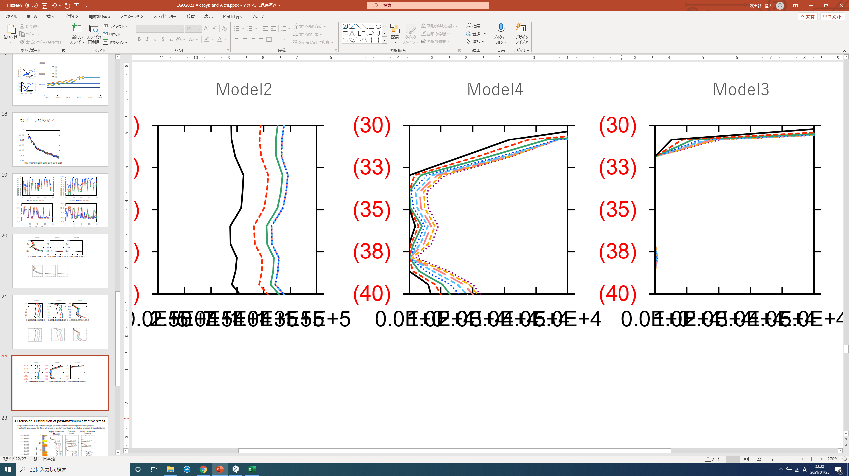
Discussion: Distribution of past-maximum effective stress
/14
Differences in the response of past-maximum effective stress against changes in pore pressure between models can lead to predictive uncertainty in subsidence
Highly permeable
Model1
Standard
Model2
Lowly permeable
Model3
-5
-10
-15
Model1
Model2
Model3
0
-20
0
0.2
0.4
0
0.2
0.4
0
0.2
0.4
-23
-25
-27
-40
Depth[m]
-30
-35
-40
0
0.5
1
1.5
0
0.5
1
1.5
0
0.5
1
-60
-80
0
0.5
1
1.5
0
0.5
1
1.5
0
0.5
1
1.5
0
0.5
1
1.5
0
0.2
0.4
0
0.2
0.4
5
Change of past maximum effective stress from the initial value[$×$10 Pa]

Slide 13
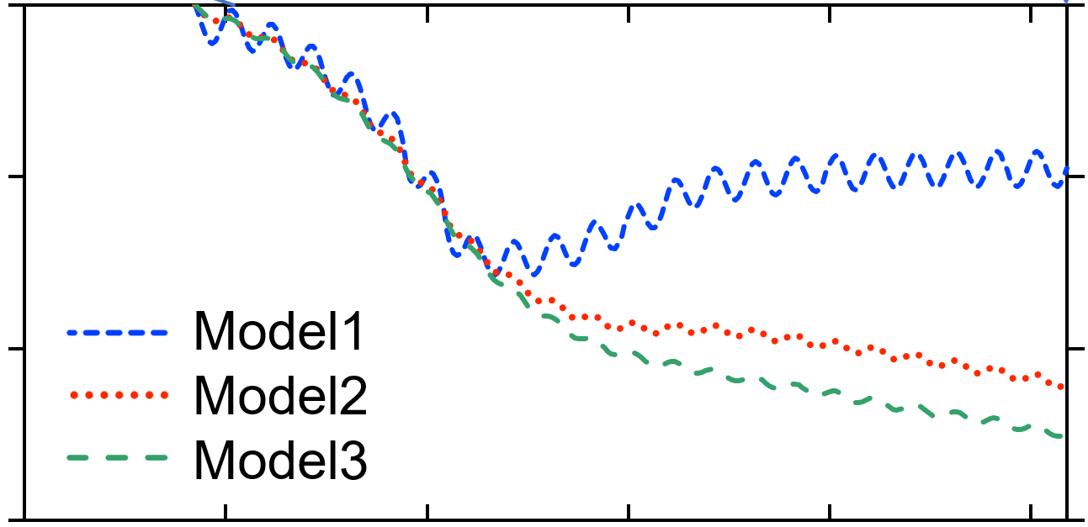
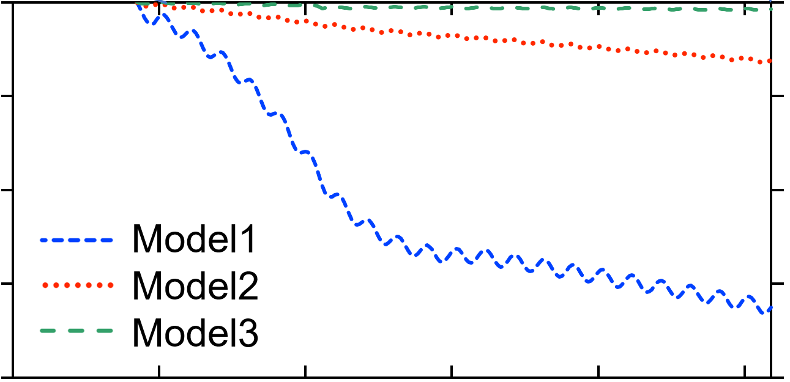
Discussion: Predictive uncertainty with scenario analysis
/14
The difference in the reaction of the past-maximum effective stress against the propagation of pore pressure changes causes predictive uncertainty
Scenario1
Scenario2
0
0
20
20
Pressure head[m]
40
40
Pressure head[m]
60
60
80
80
0
0
-2
-2
Predictive subsidence[cm]
-4
Model1
Model2
Model3
Predictive subsidence[cm]
Model1
Model2
Model3
-4
-6
-6
-8

Slide 14
Conclusion
/14
This study tried to visualize the predictive uncertainty of land subsidence
We calibrated three numerical models to simulate land subsidence with a genetic algorithm by preparing different initial parameter sets
Each model had differences in the response of past-maximum effective stress against changes in pore pressure
Differences in the reaction of the past-maximum effective stress against the propagation of pore pressure changes visualized predictive uncertainty
Further improvements to include
More models
The boundary condition uncertainty

Slide 15
References
Aichi, M. (2020) Land subsidence modelling for decision making on groundwater abstraction under emergency situation, Proc. IAHS, 382, 403-408.
Ferronato, M. Gambolati, G., Teatini, P., Baú, D. (2006) Stochastic poromechanical modeling of anthropogenic land subsidence, International Journal of Solids and Structures, 43, 3324-3336.
Field, G., Tavrisov, G., Brown, C., Harris, A., Kreidl, O. P. (2016) Particle filters to estimate properties of confined aquifers, Water Resour Manage, 30, 3175-3189.

Slide 16
Predictive question:
How many models and how many generations were computed to calibrate one model?
Answer:
100 models were computed in one generation.
To obtain model1, 26000 generations
To obtain model2, 4000 generations
To obtain model3, 6000 generations
Tips: It takes a few seconds to complete one land subsidence simulation

Slide 17
Predictive question:
Isn’t three calibrated models too few for the final statistical analysis of uncertainty?
How many models do you want to calibrate in the end?
Answer:
I think the same; three is not enough.
As a matter of fact, I don’t know how many will be enough.
The more, the merrier, perhaps, but there is a limit of time and computational resources.
Currently, 50 to 100 calibrated models may be the limit.

Slide 18
Predictive question:
Why one-dimensional (1-D) model?
Answer:
The geology of the study site is known to be widespread through borehole surveys, which validates the 1-D model.
Also, one of the objectives of this study is to predict subsidence caused by emergency use of groundwater during droughts and disasters. Therefore, we developed a technique to continue quick model calibration and uncertainty analysis while monitoring groundwater level and subsidence data.

Slide 19
Predictive question:
What is the concept of three initial parameter sets?
Answer:
Model1: Strong elasticity with low specific storage and high permeability, and low compression index
Model2: Middle permeability between model1 and 3; Good balance of elasticity and plasticity with high specific storage and high compression index in clay
Model3: Overall loose. Lowly permeable; Good balance of elasticity and plasticity with relatively high specific storage and general compression index

Slide 20
Predictive question:
Why genetic algorithm(evolutionary programming)?
Answer:
The number of unknown parameters is too large for land subsidence modeling. Therefore, the computational cost of the Monte Carlo method is unrealistic. In addition, the filtering method is not suitable for land subsidence modeling with strong nonlinearity because the filtering method updates the value of past-maximum effective stress sequentially. A genetic algorithm has a stronger bias than these methods but has a good balance between computational cost and uncertainty analysis by preparing multiple models. In addition, considering the robustness of diverse organisms against environmental changes, a genetic algorithm in sequential modeling can calibrate models that are highly adaptive to unknown data.

