Slide 1

Variation of the concentration of particulate matter in the atmosphere and rainwater quality during precipitation
at an urban site of southeast Korea
Hyemin Park¹ · Minjune Yang^{2,*}
¹Division of Earth Environmental System Sciences, Pukyong National University
²Department of Earth and Environmental Sciences, Pukyong National University
Environmental Hydrogeology Lab
Notes:
Hello, everyone.
Thank you for being here.
I'm hyemin and MS student in EHL
What I'm going to talk about today is my research topic that will be published in the journal.
The title of the research is the washing effect of precipitation on particulate matter, as known as PM10 in the atmosphere / and rainwater quality based on rainfall intensity.

Slide 2
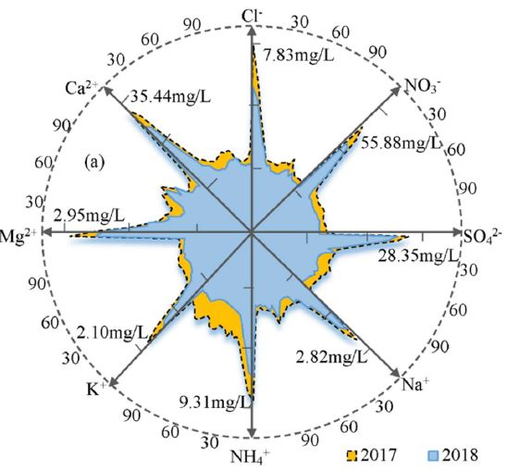
Introduction
0.0
Ouyang et al._2015_Science of the Total Environment (Fig. 1, Fig. 2)
120
Gao et al._2019_Atmospheric Environment (Fig. 3)
PM_{2.5}
0.5
rainfall
80
PM_{2.5}(㎛·m³)
Rainfall(mm)
1.0
40
1.5
0
2.0
0
20
40
60
80
100
120
Time (min)
Fig. 1. Temporal patterns of PM_{2.5} during rainfall at five-minute intervals.
120
y = -34.16x + 124.59
R²=0.959
PM_{2.5}(㎛·m³)
80
40
0
0
1
2
3
4
Fig. 3. Temporal concentration patterns of the ionic species in rainfall in 2017 and 2018.
Cumulative Rainfall (mm)
Fig. 2. Correlations between PM_{2.5} concentrations and accumulated rainfall.
Environmental Hydrogeology Lab
06/22/18
1
Environmental Hydrogeology Lab
Notes:
Precipitation can directly remove atmospheric pollutants through the wet deposition process.
Some studies have suggested that precipitation can effectively remove particulate matter from the air by the manner of wet deposition.
As a result of evaluating/ the effect of precipitation on Particulate Matter in Beijing, It showed a significant negative correlation between cumulative rainfall and PM concentrations, as shown in Figure 1 and Figure 2.
Furthermore, it was suggested that the washing effect on PM is significant depending on the high rainfall intensity in a short period of time.
However, In this process, the washing effect of precipitation on PM concentration in the atmosphere, can also affect the chemical composition of rainwater. Like components of particulate matter reduce the pH and increase the electrical conductivity of rainwater.
Therefore, it is essential to study the chemical characteristics of rainwater based on PM concentration.

Slide 3
Objective
To identify the washing effect of precipitation on particulate matter 10 (PM₁₀) in the atmosphere based on rainfall intensity
To analyze the effect of the PM₁₀ concentration in the atmosphere on rainwater quality
Environmental Hydrogeology Lab
06/22/18
2
Environmental Hydrogeology Lab
Notes:
So, the objective of the study is
One. To analyze(에널라이즈) the washing effect of precipitation on PM10 in the atmosphere based on rainfall intensity,
and the effect of the PM10 concentration in the atmosphere on rainwater quality.

Slide 4
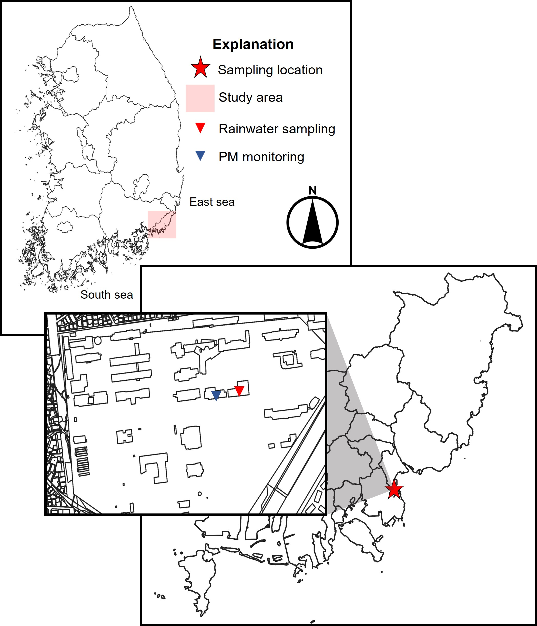
Materials and methods
Study area
200 m
Fig. 4. Regional map showing the location the sampling location, Nam-gu, Busan, South Korea.
Environmental Hydrogeology Lab
06/22/18
3
Environmental Hydrogeology Lab
Notes:
Now, I’d like to move on to materials and method.
The sampling site for this study is located in Busan, a port city with an oceanic(오쉬에닉) climate.
Over the past four years, the average PM concentration in spring and summer has been higher than the annual average concentration of PM.
In Busan, emission of gas and sea salt from industrial and port areas have a significant impact on PM formation.

Slide 5

Materials and methods
Rainwater sampling and chemical analysis
PM₁₀ and meteorological monitoring
polyvinyl chloride, PVC
PM sensor node
PMS5003 (Plantower, China)
Laser scattering technique
30 cm
polypropylene, pp
50 cm
80 cm
Fig. 6. Image of the sensor assembly.
pH, EC
Cations: Na⁺, Mg²⁺, K⁺, Ca²⁺, NH₄⁺
Anions: Cl⁻, SO₄²⁻, NO₃⁻
AWS (automatic weather system)
Cumulative rainfall
Rainfall intensity
Fig. 5. Image of the collecting well.
Environmental Hydrogeology Lab
06/22/18
4
Environmental Hydrogeology Lab
Notes:
Rainwater samples were collected with a self-manufactured collecting well, as in Figure 5.
The collecting well system was designed to improve the efficiency of the water collection and be favorable to transportation by using pp boxes and PVC vinyl.
The pH, Electrical Conductivity, and eight water-soluble ions / of rainwater were analyzed(에널라디즈드).
The PM10 con cen tration was measured at one-minute increments using a custom-built PM sensor, as shown in Figure 6.
We used the cumulative rainfall and rainfall intensity data from AWS.

Slide 6
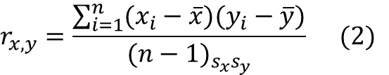
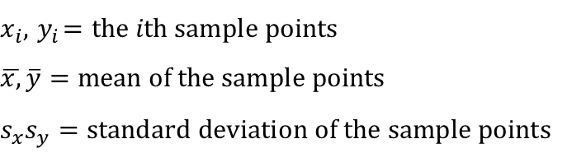
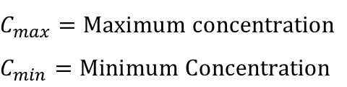

Materials and methods
Data analysis
Reduction efficiency (%)
PM₁₀ concentration reduction efficiency
Ions concentration reduction efficiency
Pearson correlation coefficient
Correlation between pH and EC
$$Reduction efficiency \left(\%\right)= \frac{C_{max}−C_{min}}{C_{max}} × 100 (1)$$
$$r_{x,y}=\frac{\sum_{i=1}^{n}{(x_{i}−\overline{x})(y_{i}−\overline{y})}}{{(n−1)}_{s_{x}s_{y}}} (2)$$
$$C_{max}=Maximum concentration$$
$$C_{min}=Minimum Concentration$$
$$x_{i},{ y}_{i}=the ith sample points$$
$$\overline{x,}\overline{y}=mean of the sample points$$
$$s_{x}s_{y}=standard deviation of the sample points$$
Environmental Hydrogeology Lab
06/22/18
5
Environmental Hydrogeology Lab
Notes:
The following is data analysis.
Equation 1 was used to calculate the reduction / efficiency of PM10 concentration in the atmosphere and ion concentrations in rainwater,
And Pearson correlation coefficient between pH and EC of rainwater was calculated using equation 2

Slide 7
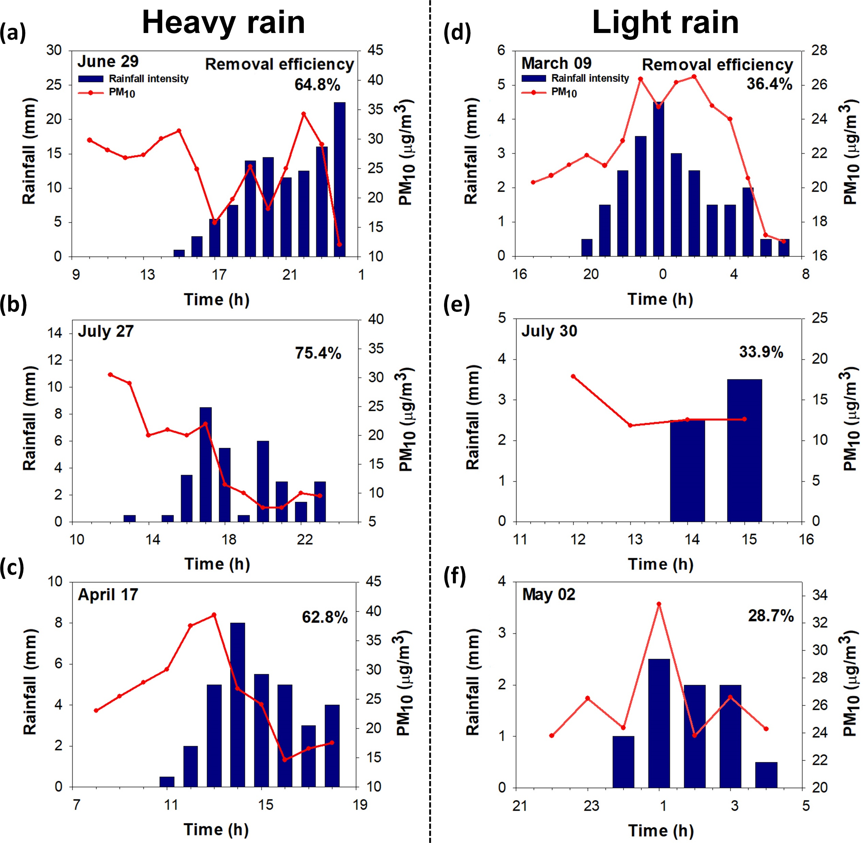
Results and Discussion
Reduction of particulate matter based on rainfall intensity
July 27
PM₁₀ max 30.5 µg/m³
PM₁₀ min 7.5 µg/m³
Reduction efficiency (%) 75.4%
May 02
PM₁₀ max 33.4 µg/m³
PM₁₀ min 23.8 µg/m³
Reduction efficiency (%) 28.7%
Fig. 7. Temporal variations in precipitation and PM₁₀ concentration during heavy rain (a – c) and light rain events (d – f).
Environmental Hydrogeology Lab
06/22/18
6
Environmental Hydrogeology Lab
Notes:
Here's the results and discussion of this study.
Figure 7 is showing the temporal variation in precipitation and PM10 concentration in the atmosphere.
The PM10 concentration in the atmosphere was reduced with precipitation duration, but different reduction efficiency was shown based on rainfall intensity.
I'd like to illustrate this / by showing you figure 7.
(click)
When the rainfall intensities were enhanced to more than seven point five millimeter per hour (7.5 mm/h), the reduction efficiencies reached more than 60%.

Slide 8
Results and Discussion
Reduction of particulate matter based on rainfall intensity
July 27
PM₁₀ max 30.5 µg/m³
PM₁₀ min 7.5 µg/m³
Reduction efficiency (%) 75.4%
May 02
PM₁₀ max 33.4 µg/m³
PM₁₀ min 23.8 µg/m³
Reduction efficiency (%) 28.7%
Fig. 7. Temporal variations in precipitation and PM₁₀ concentration during heavy rain (a – c) and light rain events (d – f).
Environmental Hydrogeology Lab
06/22/18
6
Environmental Hydrogeology Lab
Notes:
For example,
On July 27, when the maximum rainfall intensity, the PM10 reduction efficiency was the high.

Slide 9
Results and Discussion
Reduction of particulate matter based on rainfall intensity
July 27
PM₁₀ max 30.5 µg/m³
PM₁₀ min 7.5 µg/m³
Reduction efficiency (%) 75.4%
May 02
PM₁₀ max 33.4 µg/m³
PM₁₀ min 23.8 µg/m³
Reduction efficiency (%) 28.7%
Fig. 7. Temporal variations in precipitation and PM₁₀ concentration during heavy rain (a – c) and light rain events (d – f).
Environmental Hydrogeology Lab
06/22/18
6
Environmental Hydrogeology Lab
Notes:
On the other hand,
When the rainfall intensities were relatively weak,
PM reduction efficiencies were less than 40%.

Slide 10
Results and Discussion
Reduction of particulate matter based on rainfall intensity
 | Heavy rain | Light rain
Rainfall intensity (mm/h) | > 7.5 | < 5
Reduction efficiency (%) | > 60 | < 40
Fig. 8. Correlation between rainwater intensity and reduction efficiency of 6 rainfall events.
Environmental Hydrogeology Lab
06/22/18
7
Environmental Hydrogeology Lab
Notes:
In this study,
rain events with high rainfall intensity and a PM10 reduction efficiency of 60% or more / were classified as heavy rain,
And rainfall events with low rainfall intensity, and a PM10 reduction efficiency of 40% or less were classified as light rain.

Slide 11
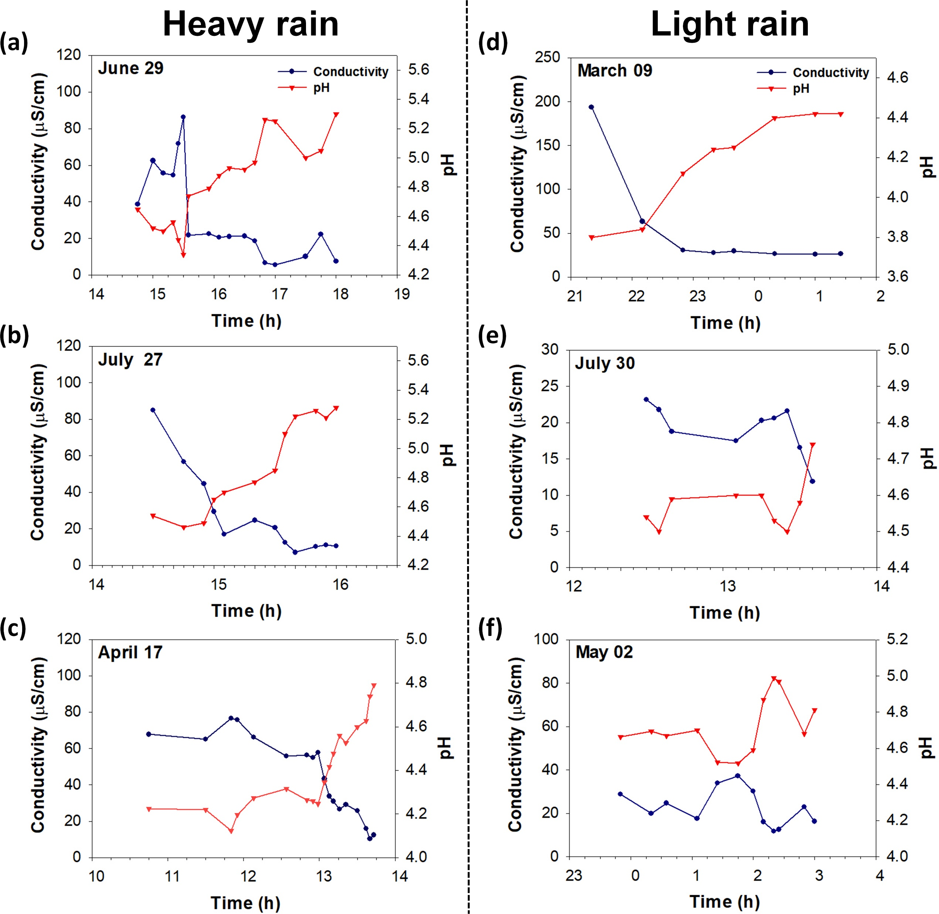
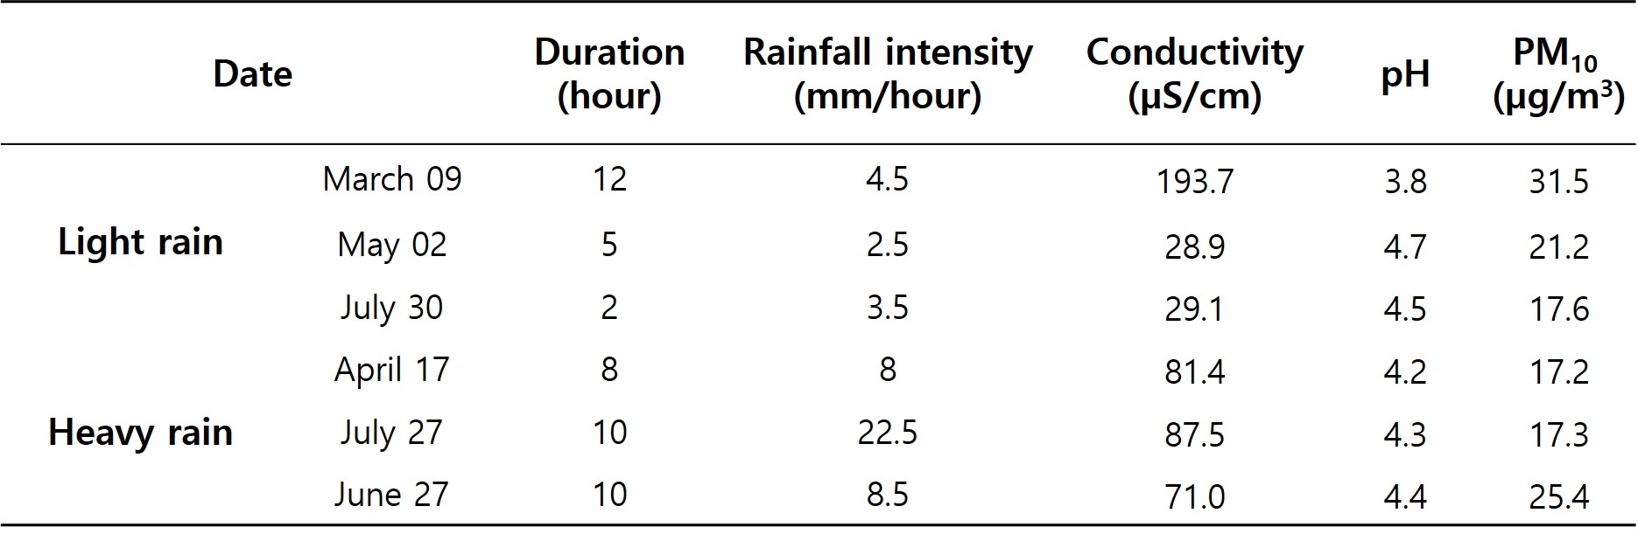
Results and Discussion
Time series analysis of rainwater quality based on rainfall intensity
Table 1. Rainfall characteristics, initial pH and conductivity of rainwater samples for 6 rainfall events, and PM₁₀ concentration in the atmosphere measured 1 hour before each rainfall event
Fig. 9. Temporal variations of the pH and EC during heavy rain (a – c) and light rain events (d – f).
Environmental Hydrogeology Lab
06/22/18
8
Environmental Hydrogeology Lab
Notes:
The following are the results of the rainwater quality analysis.
For initial rainwater samples, the average pH and EC were approximately four point three and eighty one point nine µS/cm
(4.3 and 81.9)
In particular, the디 initial pH of rainwater in the heavy rain was relatively렐러티블리 low, and EC was high.
Figure 9 is showing the temporal variations of the pH and EC with precipitation duration.

Slide 12
Results and Discussion
Time series analysis of rainwater quality based on rainfall intensity
Table 1. Rainfall characteristics, initial pH and conductivity of rainwater samples for 6 rainfall events, and PM₁₀ concentration in the atmosphere measured 1 hour before each rainfall event
Fig. 9. Temporal variations of the pH and EC during heavy rain (a – c) and light rain events (d – f).
Environmental Hydrogeology Lab
06/22/18
8
Environmental Hydrogeology Lab
Notes:
In heavy rain, the pH of rainwater gradually increased with precipitation duration, (whereas EC) relatively decreased.

Slide 13
Results and Discussion
Time series analysis of rainwater quality based on rainfall intensity
Table 1. Rainfall characteristics, initial pH and conductivity of rainwater samples for 6 rainfall events, and PM₁₀ concentration in the atmosphere measured 1 hour before each rainfall event
Fig. 9. Temporal variations of the pH and EC during heavy rain (a – c) and light rain events (d – f).
Environmental Hydrogeology Lab
06/22/18
8
Environmental Hydrogeology Lab
Notes:
However, Light rain showed no pattern of increase or decrease in pH and EC.

Slide 14
Results and Discussion
Time series analysis of rainwater quality based on rainfall intensity
Table 1. Rainfall characteristics, initial pH and conductivity of rainwater samples for 6 rainfall events, and PM₁₀ concentration in the atmosphere measured 1 hour before each rainfall event
Fig. 9. Temporal variations of the pH and EC during heavy rain (a – c) and light rain events (d – f).
Environmental Hydrogeology Lab
06/22/18
8
Environmental Hydrogeology Lab
Notes:
On March 9, despite the weak rainfall intensity, the pH was low and EH was high, and the pH increased with precipitation duration and the EC tended to decrease.
It can be considered by the high concentration of PM10 in the atmosphere and the(디) effect of long-lasting precipitation.

Slide 15
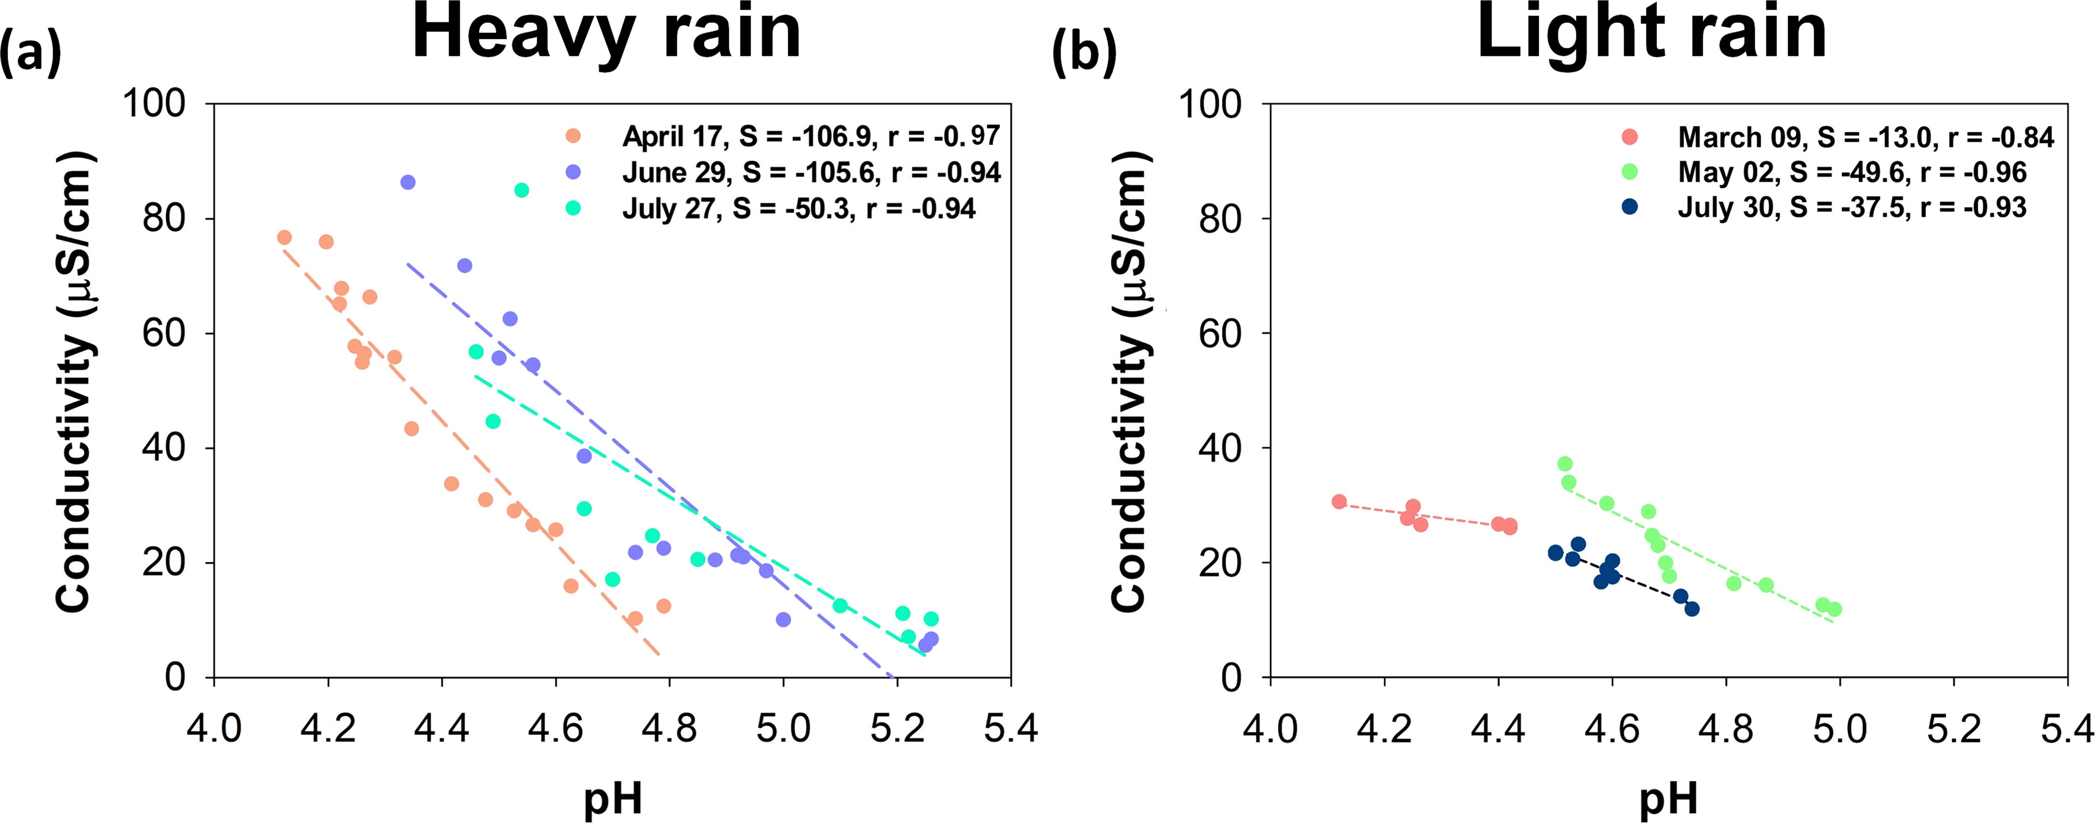
Results and Discussion
Time series analysis of rainwater quality based on rainfall intensity
Fig. 10. Correlations between pH and EC for (a) three heavy rain events with strong rainfall intensities (>7.5 mm/h) and (b) three light events with rainfall intensities of <5 mm/h.
Environmental Hydrogeology Lab
06/22/18
9
Environmental Hydrogeology Lab
Notes:
If you look at this figure 10, you can see that correlation between pH and EC based on rainfall intensity.
The pH of rainwater gradually increased with precipitation duration, whereas EC / relatively decreased, / resulting in a significant negative correlation between pH and EC.
The slope of the linear regression line was large for heavy rain, but / the slope of the linear regression line was relatively small for light rain.
This process is determined by the high rainfall intensity effect / that the pH and EC have reached equilibrium in a short period of time.

Slide 16
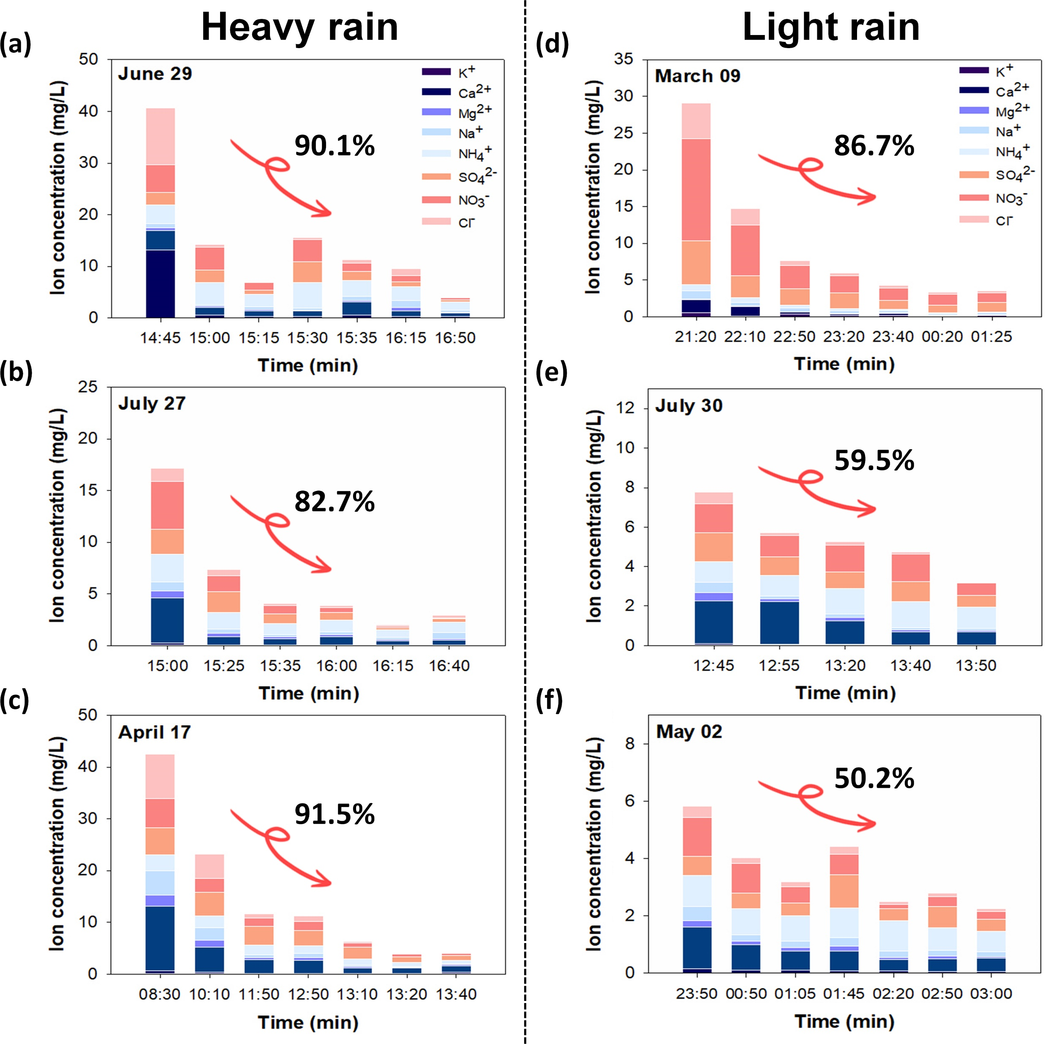
Results and Discussion
Time series analysis of rainwater quality based on rainfall intensity
Fig. 11. Temporal variations of the ion concentrations in the rainwater samples during heavy rain (a – c) and light rain events (d – f).
Environmental Hydrogeology Lab
06/22/18
10
Environmental Hydrogeology Lab
Notes:
The final point is in regard to the temporal variation of ion con centration in rainwater based on rainfall intensity.
(click)
For Heavy rain, the reduction efficiency of ion concentrations were enhanced to more than 80%,

Slide 17
Results and Discussion
Time series analysis of rainwater quality based on rainfall intensity
Fig. 11. Temporal variations of the ion concentrations in the rainwater samples during heavy rain (a – c) and light rain events (d – f).
Environmental Hydrogeology Lab
06/22/18
10
Environmental Hydrogeology Lab
Notes:
Conversely, for light rain, the reduction efficiencies were relatively(렐 러디블리) low.

Slide 18
Results and Discussion
Time series analysis of rainwater quality based on rainfall intensity
Fig. 11. Temporal variations of the ion concentrations in the rainwater samples during heavy rain (a – c) and light rain events (d – f).
Environmental Hydrogeology Lab
06/22/18
10
Environmental Hydrogeology Lab
Notes:
On March 9, despite the weak rainfall intensity, at four point five millimeter per hour (4.5 mm/h), ion concentrations reduction efficiency was high at eighty six point seven percent, (86.7%,)
It can be considered by the relatively high rainfall intensity and the(디) effect of long-lasting precipitation approximately 6 hours (Fig. 6d).)

Slide 19
Conclusion
For initial rainwater samples, the average pH and EC were approximately 4.3 and 81.9 µS/cm.
For heavy rain (>7.5 mm/h), the PM reduction efficiencies were more than 60%, with pH increasing continuously and EC decreasing relatively. The reduction efficiency of ion concentrations was more than 80%, and ion concentrations reached equilibrium in a short period of time.
For light rain (<5 mm/h), the PM reduction efficiencies were less than 40%, and there was no temporal variation of the pH and EC in rainwater. The reduction efficiency of ion concentration is relatively low, and it took a long time for the ion concentration to reach equilibrium.
Environmental Hydrogeology Lab
06/22/18
11
Environmental Hydrogeology Lab
Notes:
This study investigated the washing effect of precipitation on PM10 concentration / in the atmosphere, / and rainwater quality.
The key points of my conclusion are as follows
First, For initial rainwater samples, the average pH and EC were approximately four point three and eighty one point nine µS/cm
Second, For heavy rain, the PM reduction efficiencies were more than 60%, with pH increasing continuously and EC decreasing relatively. The reduction efficiency of ion concentrations was more than 80%, and ion concentrations reached equilibrium in a short period of time.
Final, For light rain, the PM reduction efficiencies were less than 40%, and there was no temporal variation of the pH and EC in rainwater. The reduction efficiency of ion concentration is relatively low, and it took a long time for the ion concentration to reach equilibrium.

Slide 20
Thank you for your attention
Environmental Hydrogeology Lab
Environmental Hydrogeology Lab
Notes:
Today, I have shown you my research.
That's all I have prepared for you today
I'd like to finish by thanking you all for your attention.

Slide 21
Q & A
Environmental Hydrogeology Lab
Environmental Hydrogeology Lab
Notes:
If you have any questions, I'd be pleased to answer them.

