Slide 1


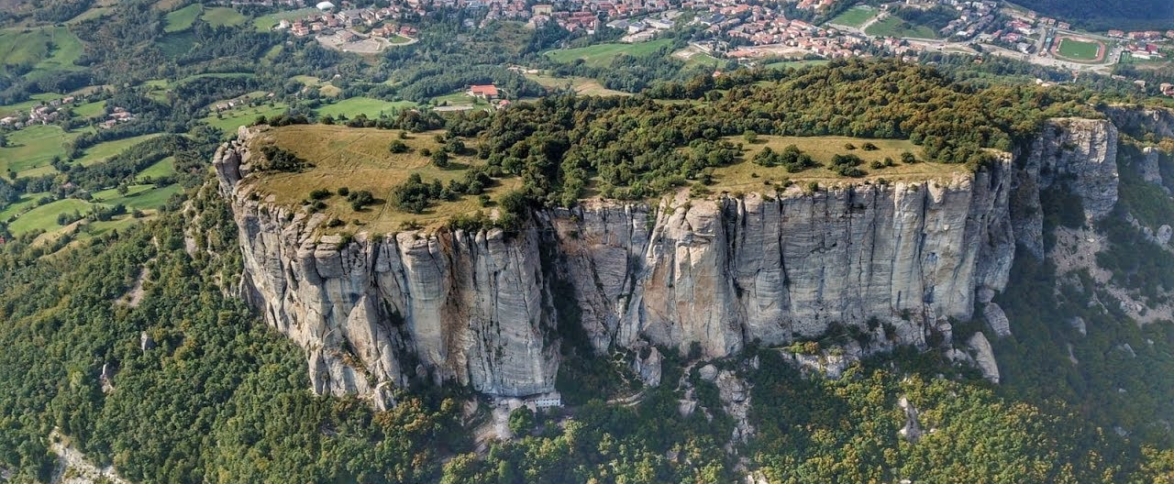
Structural characterization of the wedge - top Epiligurian Units in the framework of the Northern Apennines tectonic evolution
(northern Italy)
Stendardi F.*, Vignaroli G., Viola G.
*francesca.stendardi2@unibo.it

Slide 2

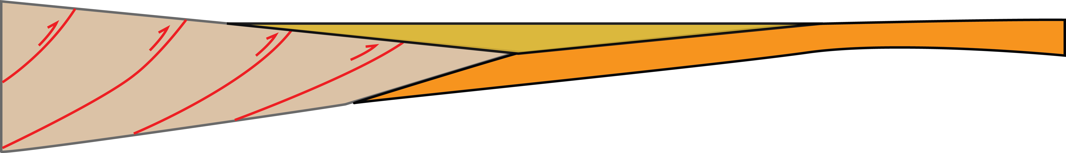
INTRODUCTION AND AIMS
The Northern Apennines are an arc shaped fold-and-thrust belt developed during the Neogene, after the collision between the European margin (Sardinia-Corsica block) and the Adriatic microplate.
In this context, the Epiligurian Units are commonly considered as
«wedge-top basins» developed since the middle Eocene and passively transported by the northeastward propagation of the underlying apenninic thrusts.
The Epiligurian Units have been extensively studied from a sedimentological-stratigraphical point of view, but it has not yet been defined their structural role during the Northern Apennines evolution
W-vergent subduction system
EUROPE
ADRIA
Fold and thrust belt
H
ACCRETIONARY WEDGE
U
L
HINTERLAND
FORELAND
Wedge-top basins
FOREDEEP
t1
t2
t3
Modified & redrawn from Carminati & Doglioni (2012)
Modified & redrawn from Ford (2004)

Slide 3

INTRODUCTION AND AIMS
To characterize the deformation structures affecting the Epiligurian Units;
To define the geometric and kinematic characteristics of the structural elements through a multiscalar and multitechnique approach:
Macro-scale remote sensing analysis
Meso-scale (fieldwork) data analysis
To provide a comprehensive syn-to-post accretion evolutionary scenario for these shallow basins.

Slide 4
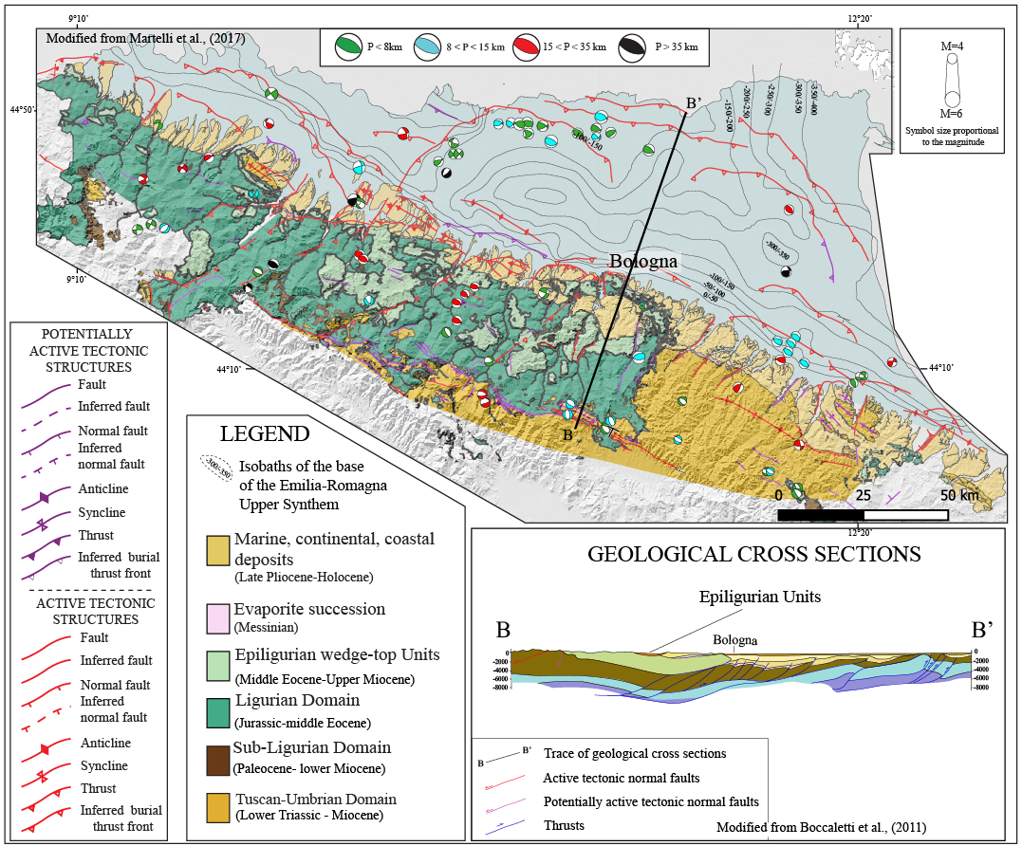
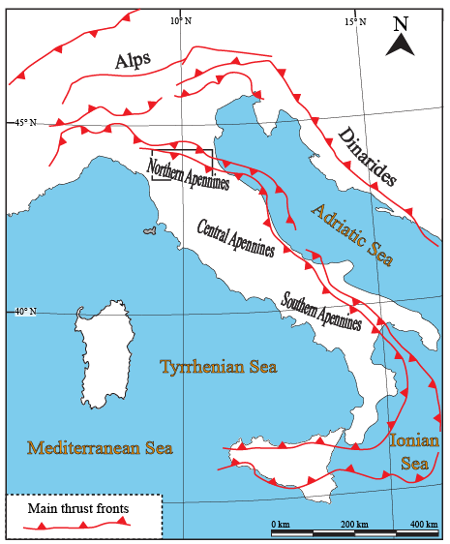
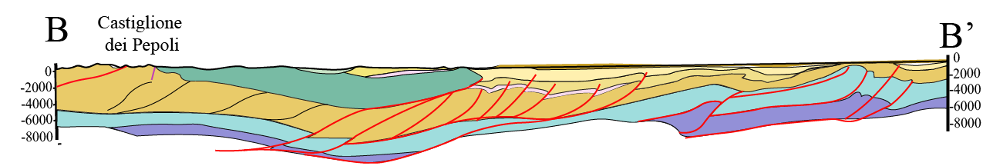
GEOLOGICAL
SETTING
Basement
Meso-Cenozoic
succession
(Miocene)

Slide 5
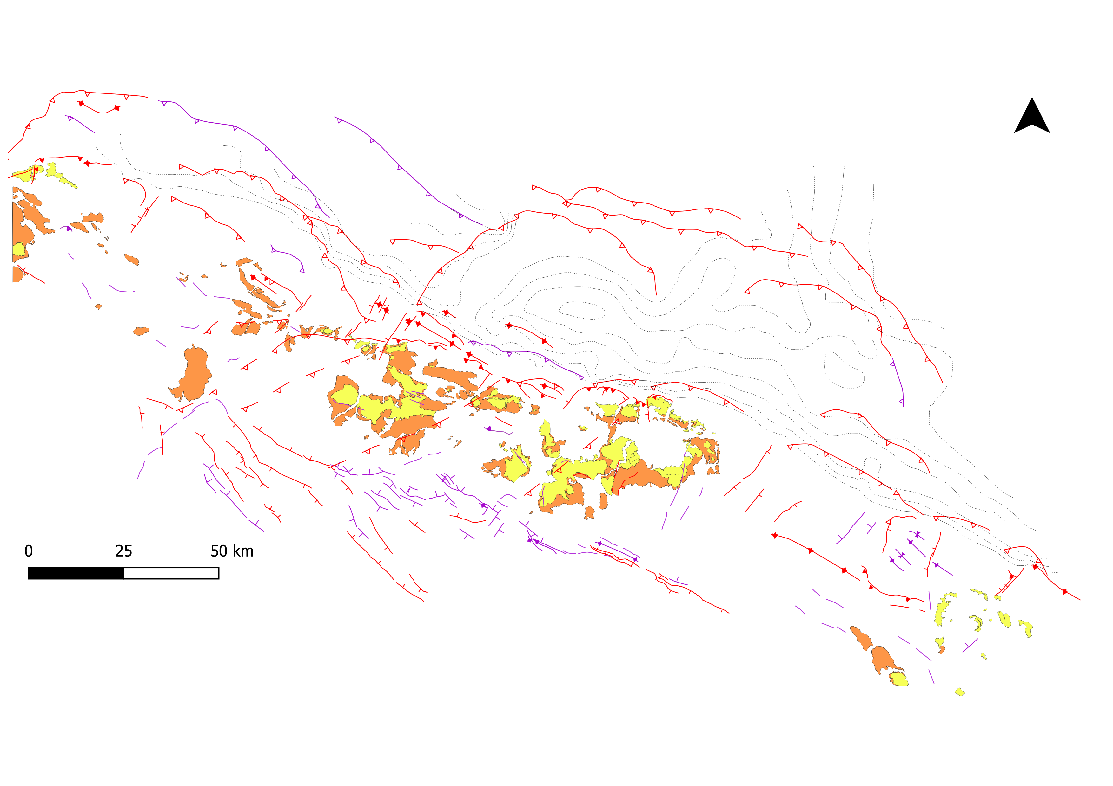

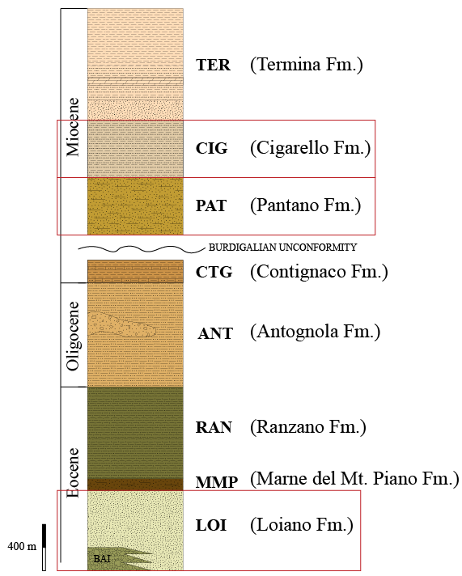
STUDY AREA
N
POST-BURDIGALIAN
Study area
PRE -BURDIGALIAN
Modified from Panini et al., (2002)

Slide 6
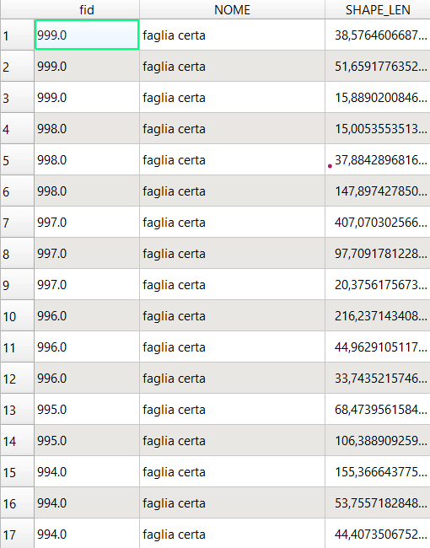
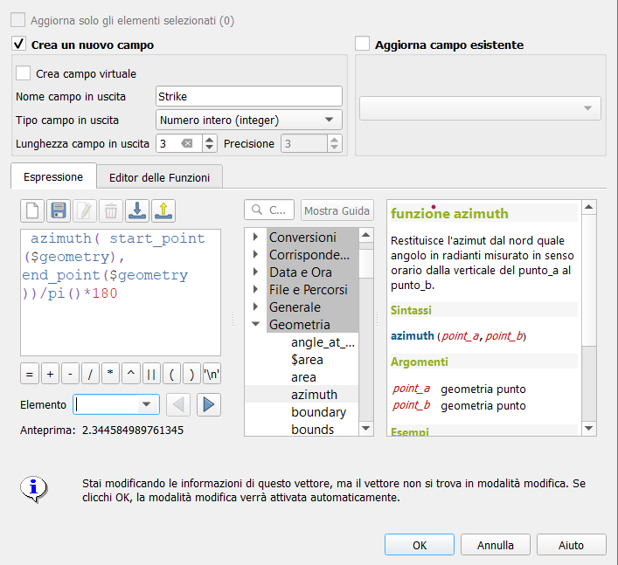
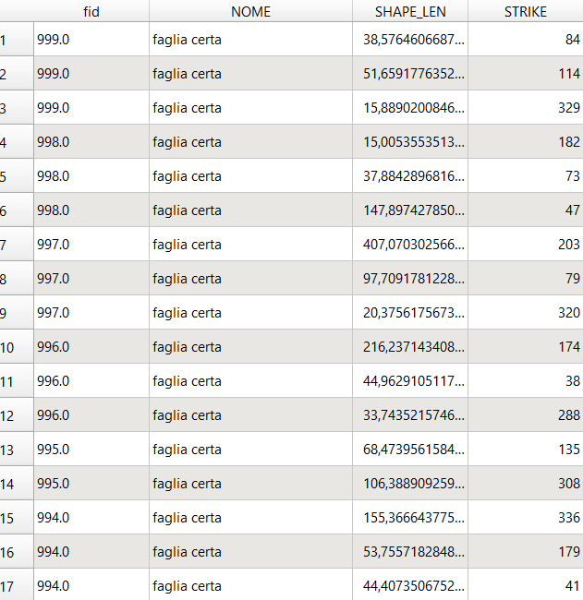

STRUCTURAL ANALYSIS THROUGH REMOTE SENSING
Fault database available from «https://datacatalog.regione.emilia-romagna.it/(Portale minERVA)» (Servizio Geologico Sismico e dei Suoli - Regione Emilia-Romagna)
STRIKE
Statistical analysis
(Salvini et al.,(1999))
1
2
3

Slide 7
FAULT CATEGORIES
ALL THE EPILIGURIAN BASINS
Normal fault
Reverse fault
PRE-BURDIGALIAN
(n: 4401)
Strike-slip fault
Thrust
Minor thrust
Normal fault
Reverse fault
POST-BURDIGALIAN
Strike-slip fault
(n:3014)
Thrust
Minor thrust
STUDY AREA
Undefinedfault
(n:203)

Slide 8
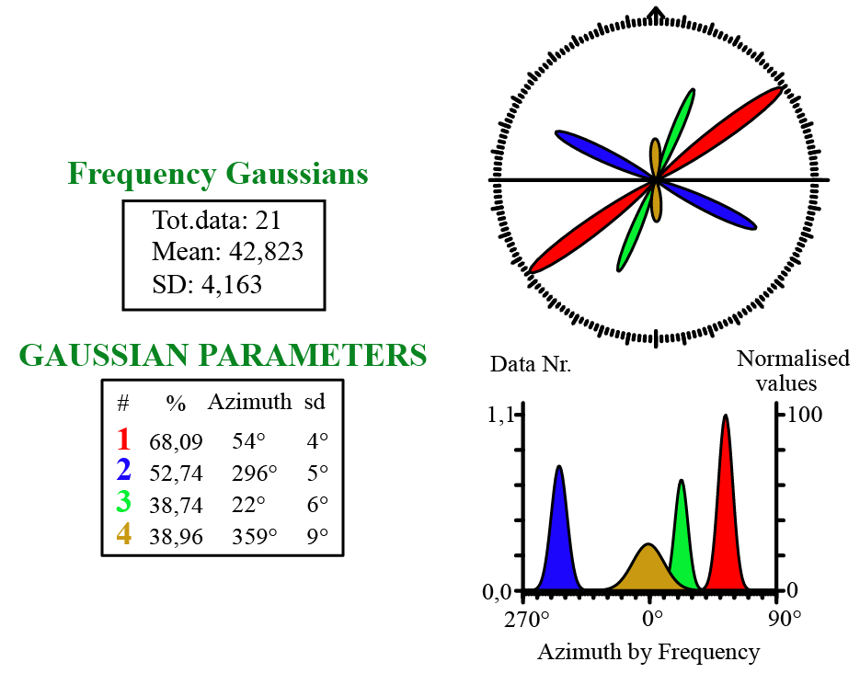
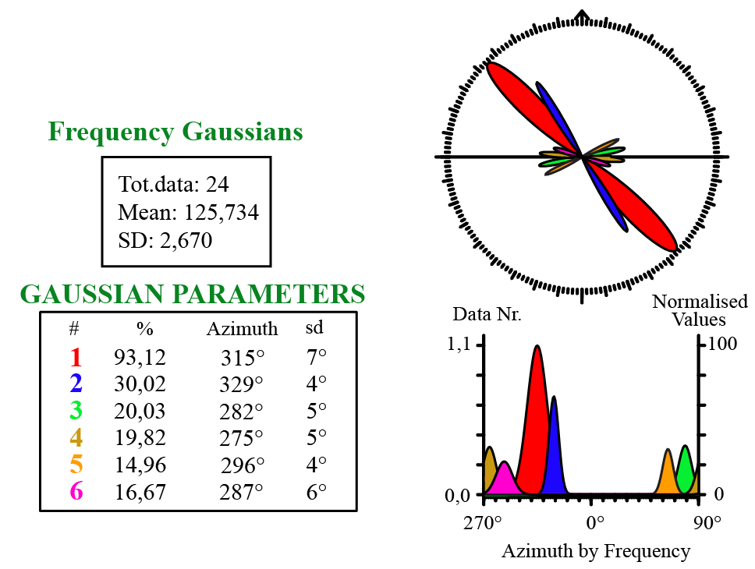
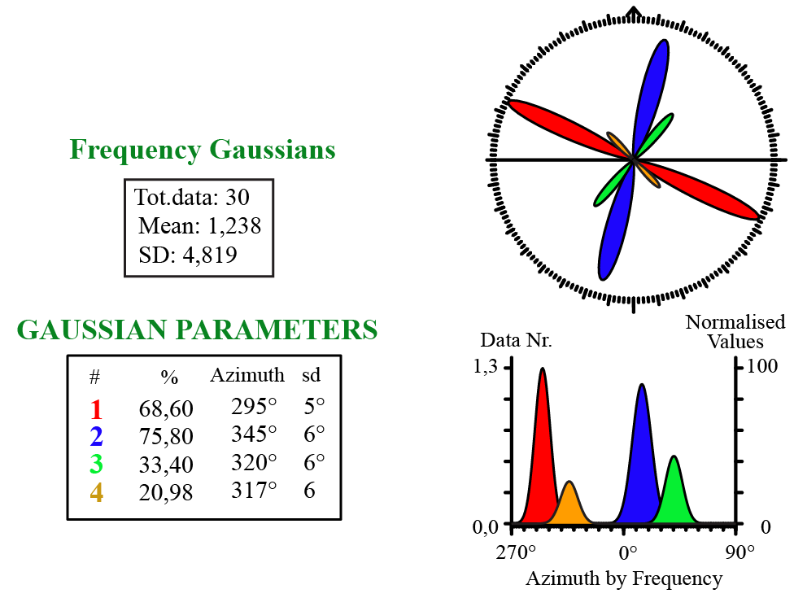
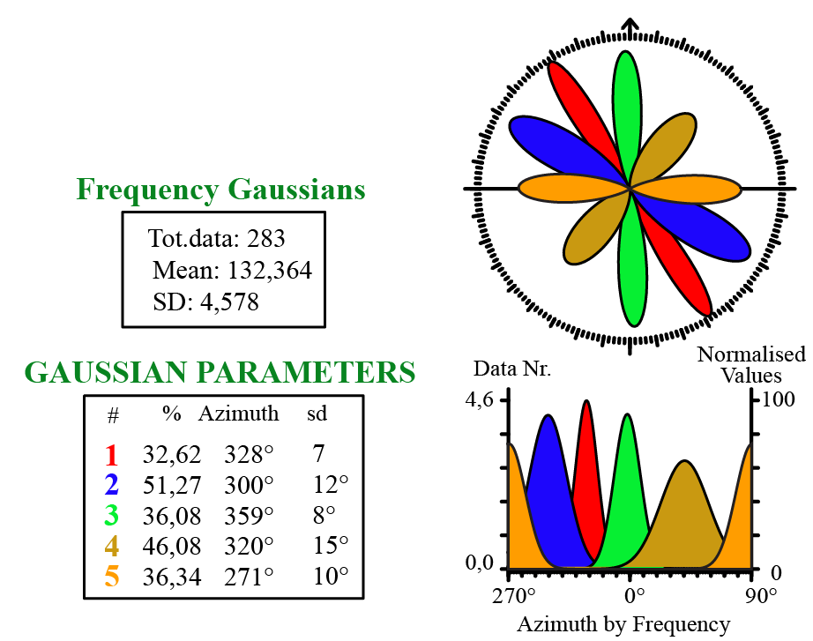
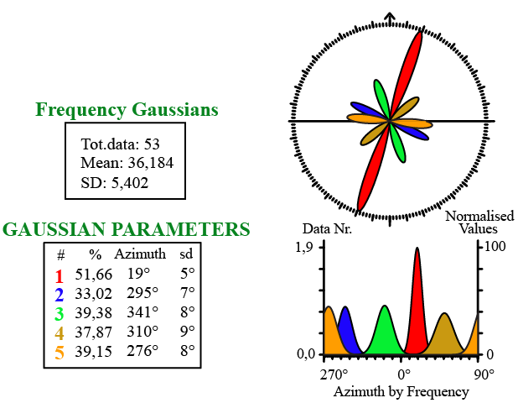
PRE-BURDIGALIAN
NORMAL FAULT
REVERSE FAULT
STRIKE-SLIP FAULT
THRUST
MINOR THRUST

Slide 9
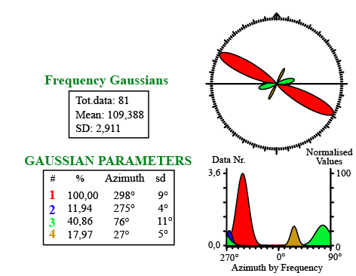
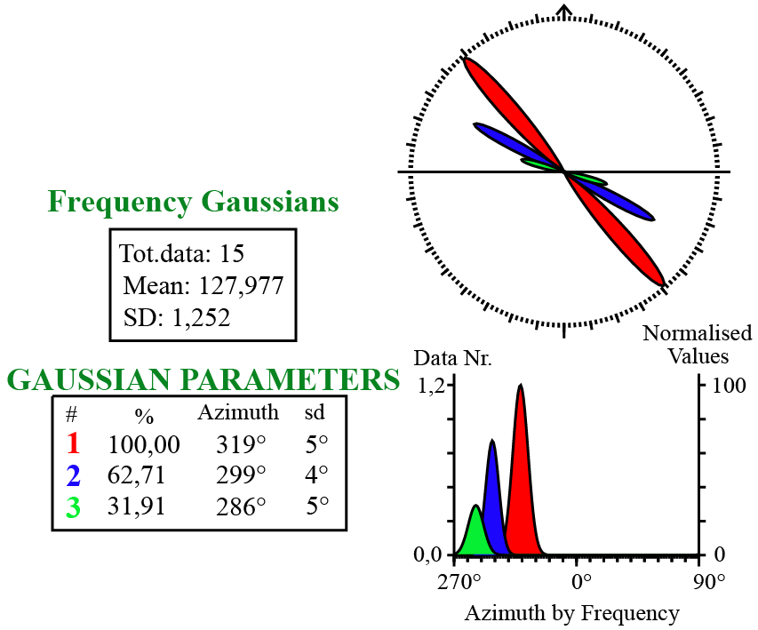
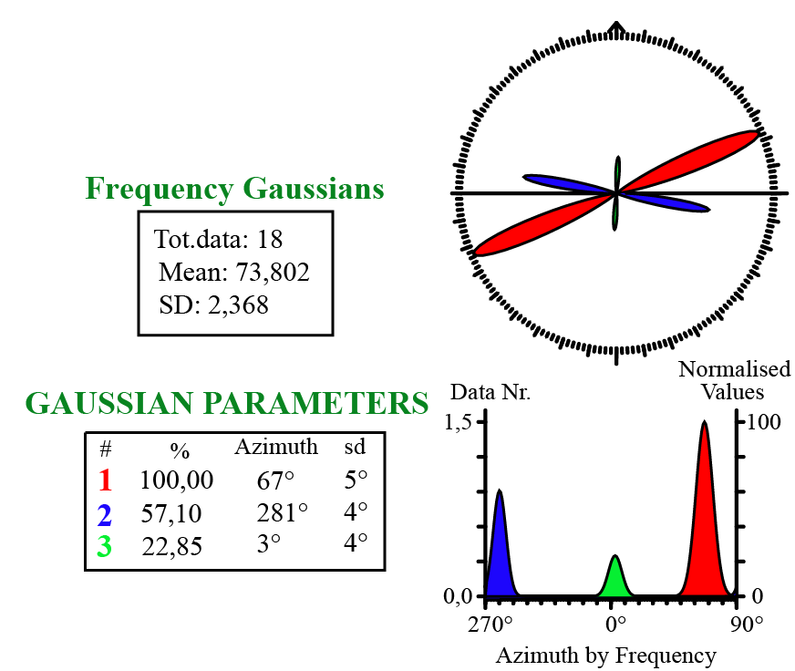
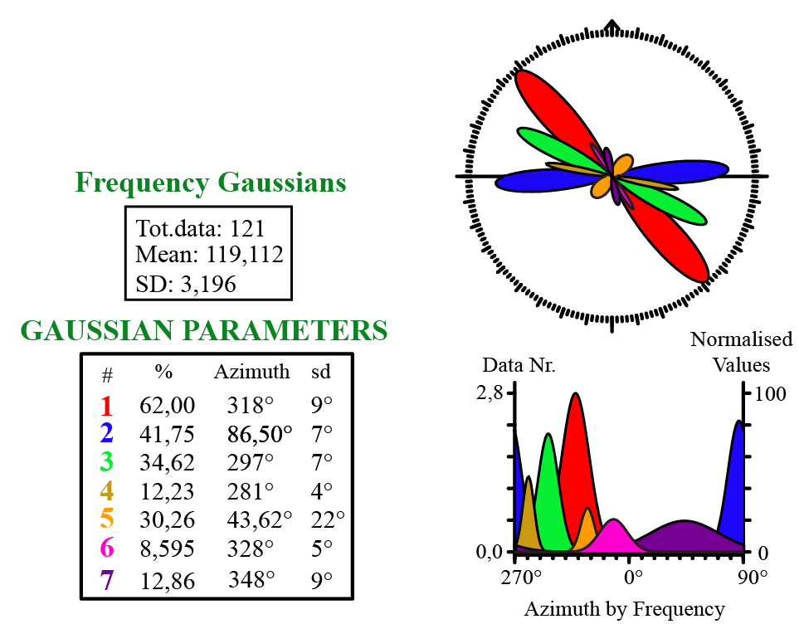
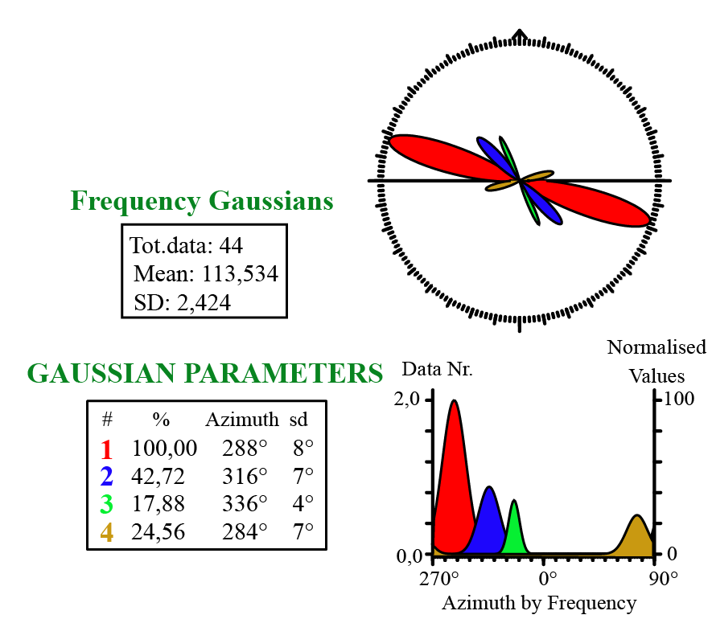
POST-BURDIGALIAN
NORMAL FAULT
REVERSE FAULT
STRIKE-SLIP FAULT
THRUST
MINOR THRUST

Slide 10
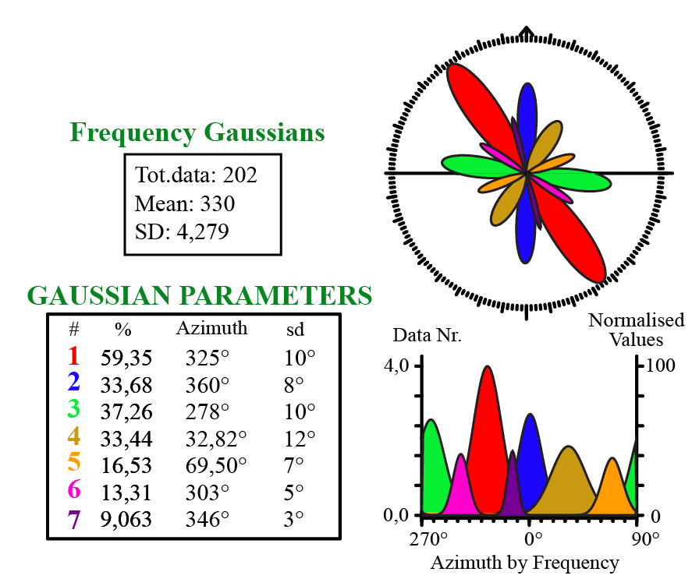
STUDY AREA
UNDEFINED FAULTS
The analysed dataset includes only faults with unknown kinematics

Slide 11
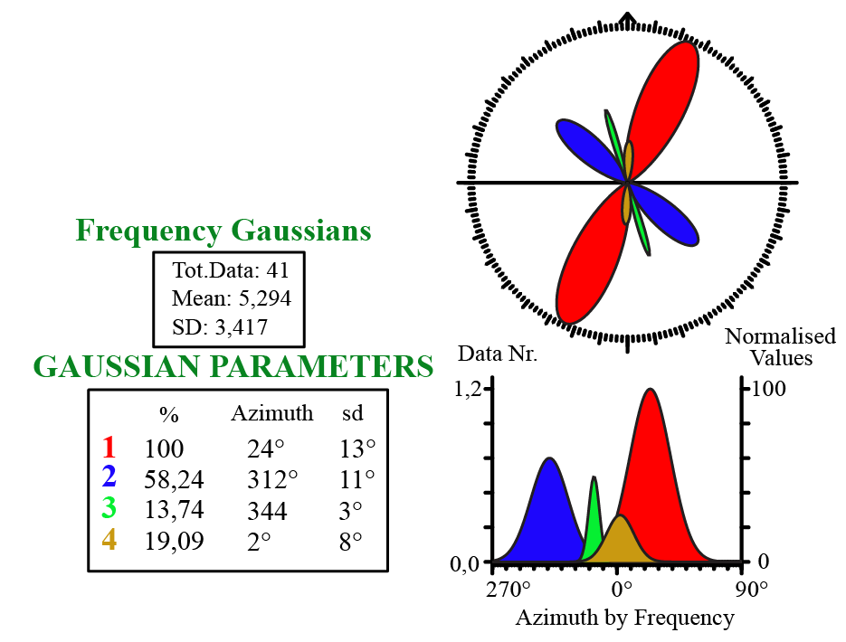
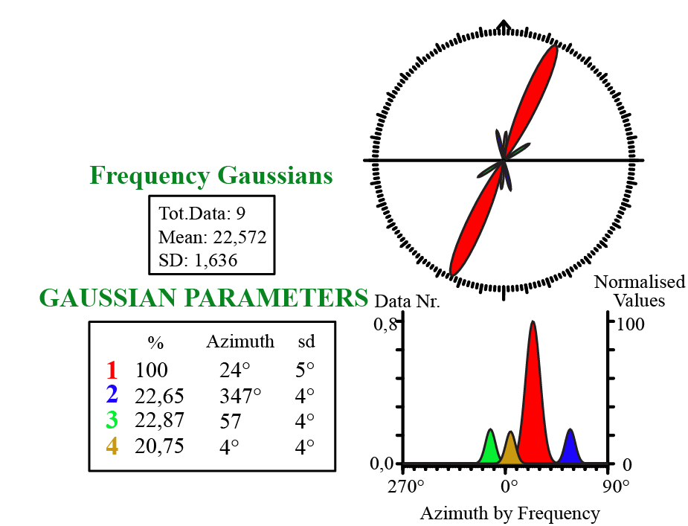
FIELD DATA
PRE-BURDIGALIAN
NORMAL FAULT
REVERSE FAULT

Slide 12
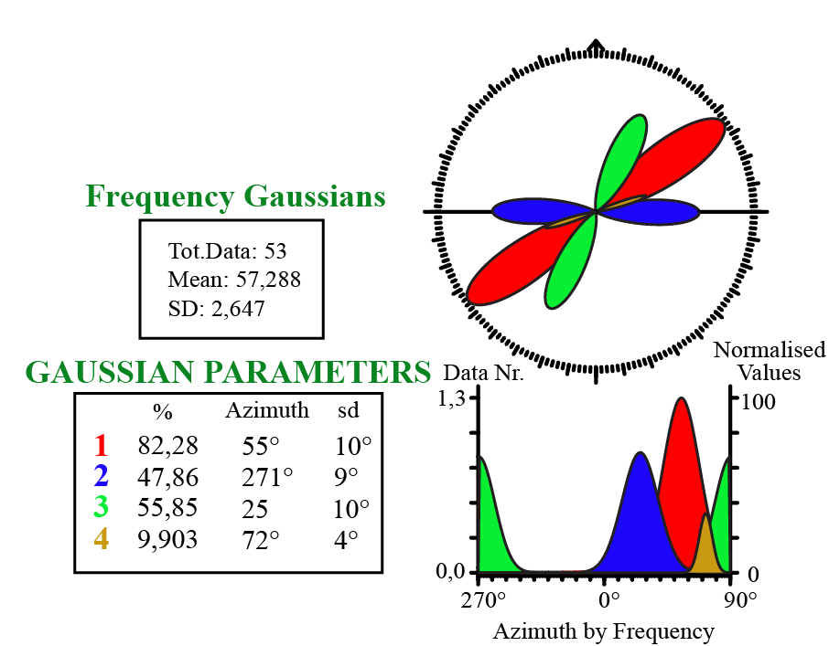
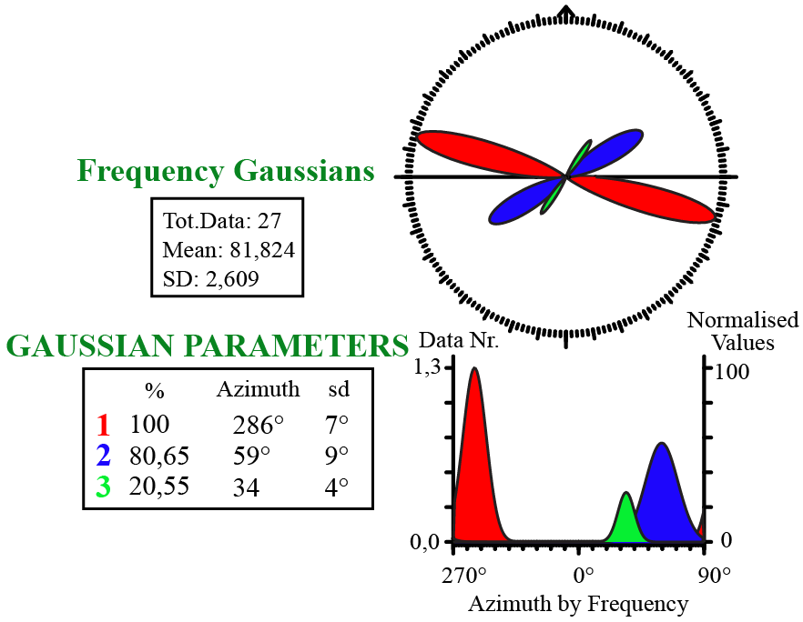
FIELD DATA
POST-BURDIGALIAN
NORMAL FAULT
REVERSE FAULT

Slide 13
STRUCTURAL ANALYSIS THROUGH FIELDWORK

Slide 14
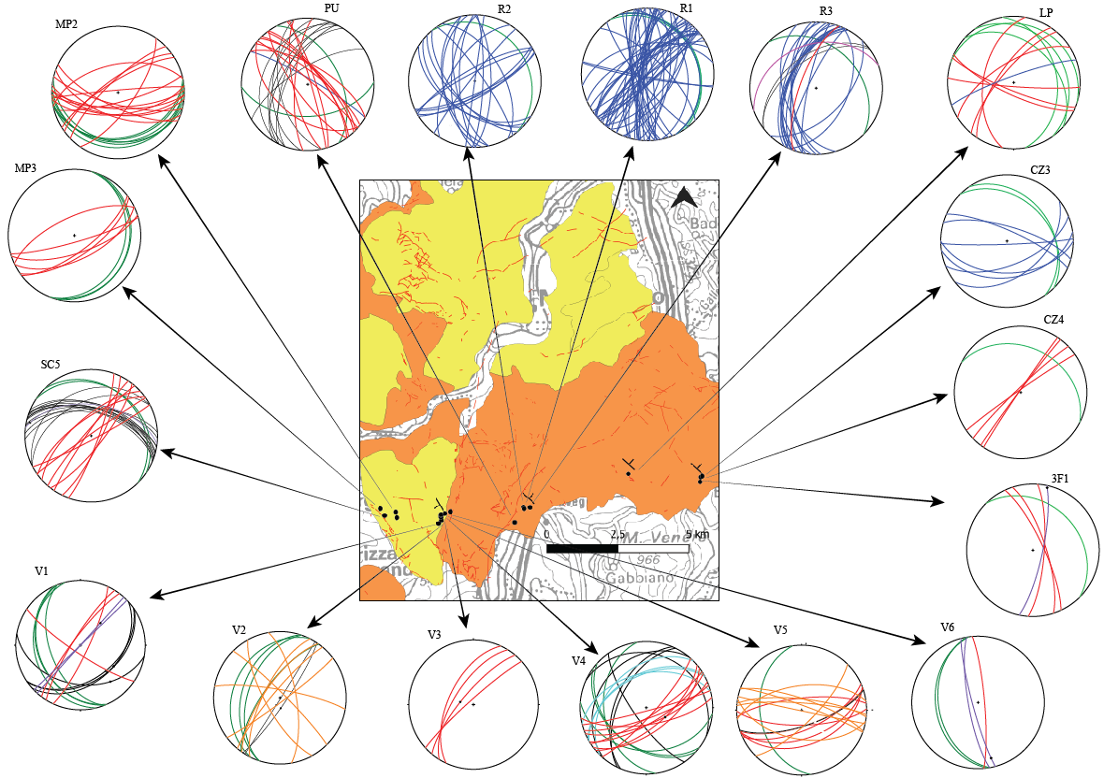
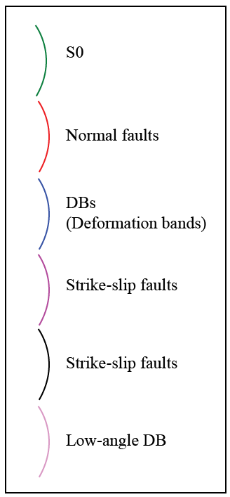

STEREOGRAPHIC
ANALYSIS OF
STRUCTURAL DATA
S0
Normal fault
(Deformation
bands)
DBs
Strike-slip fault
Reverse fault
35
Low-angle DB
30
25
Monzuno
34
Fault
Grizzana
Morandi
Slickenside
35
Bedding

Slide 15
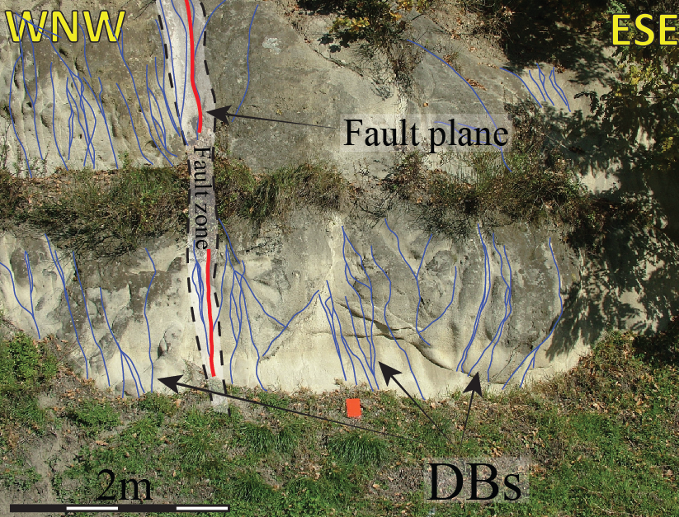
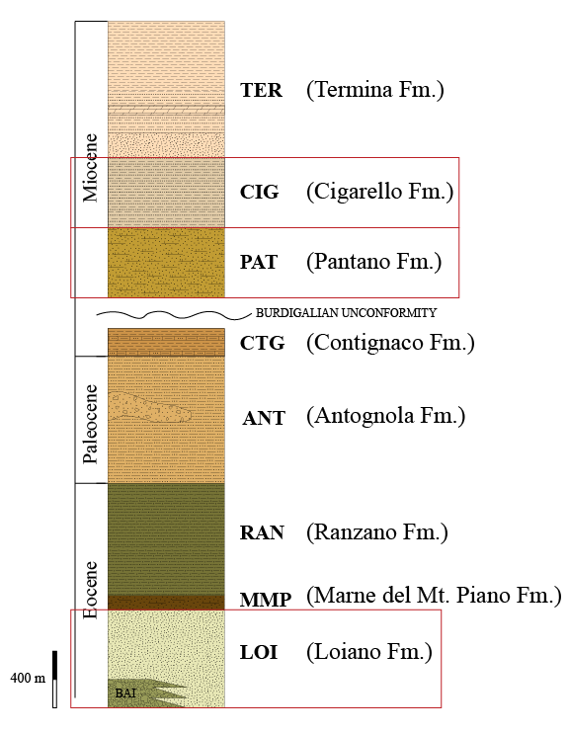
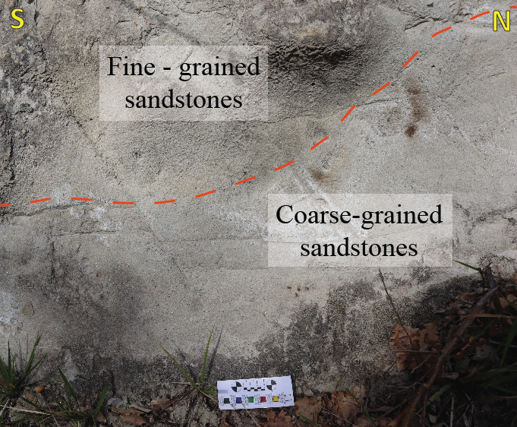
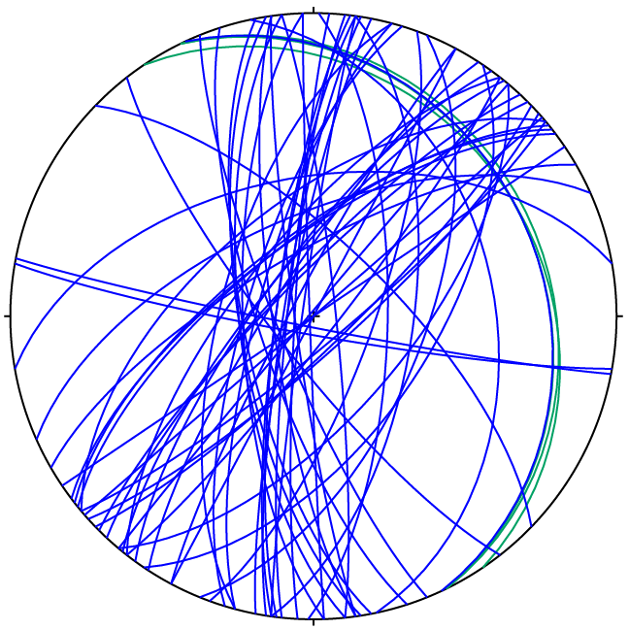
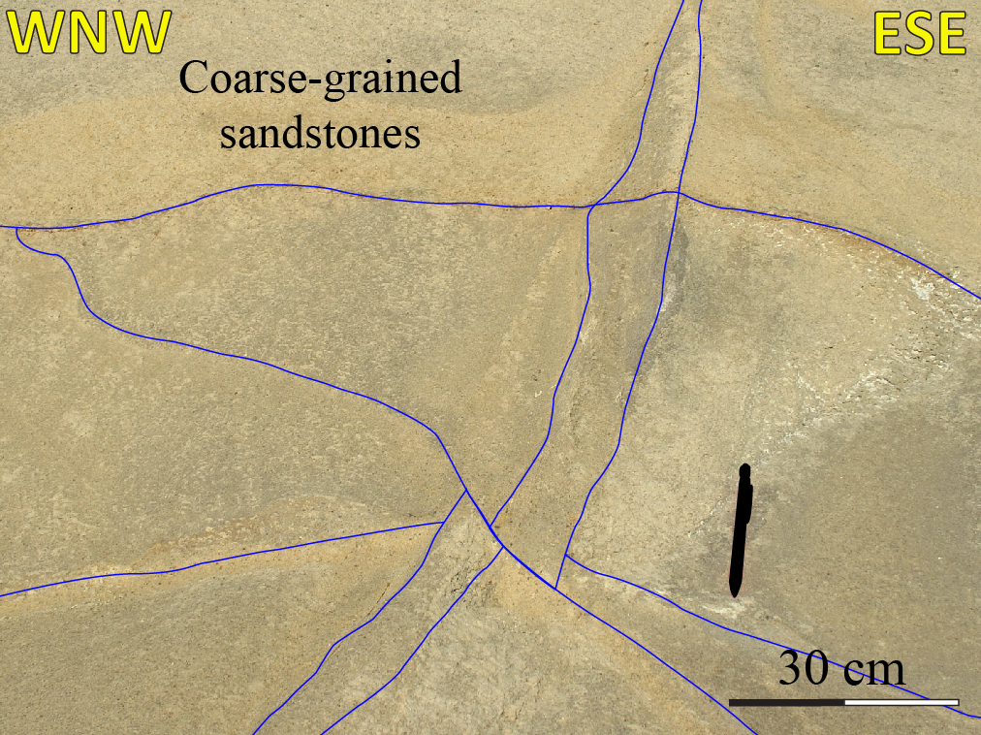
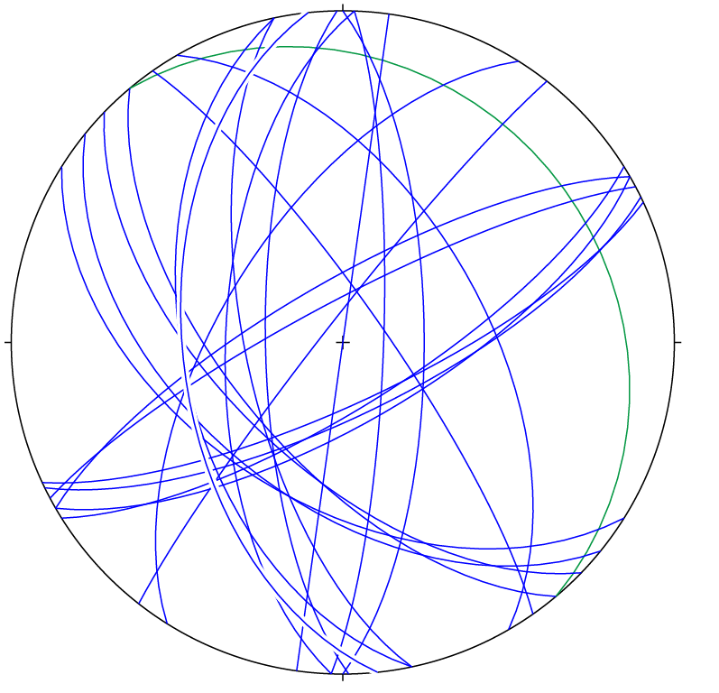
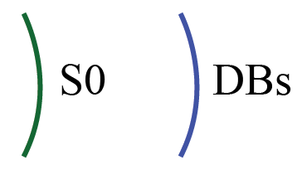
Normal faults & related
deformation bands (DBs)
Grey-yellowish quartz-feldspatic sandstones,
with no or poorly visible bedding,
characterised by a fining upward
granulometric sequence
POST-BURDIGALIAN
PRE -BURDIGALIAN
Spatial architecture of DBs clusters
resulting from the defomation localisation
and development of a main fault zone
Cross-cutting relationship between different
oriented DBs used to
reconstruct the chronology of the deformation events

Slide 16
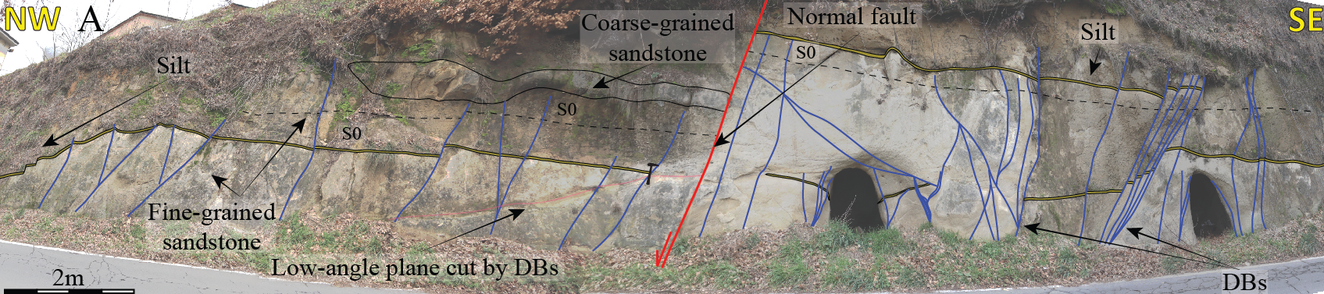
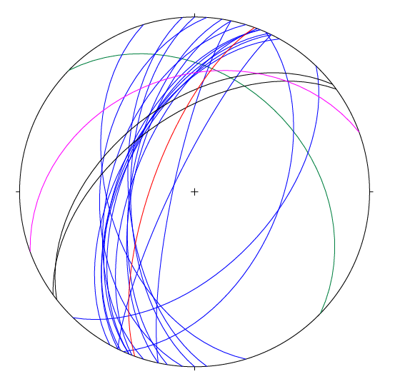
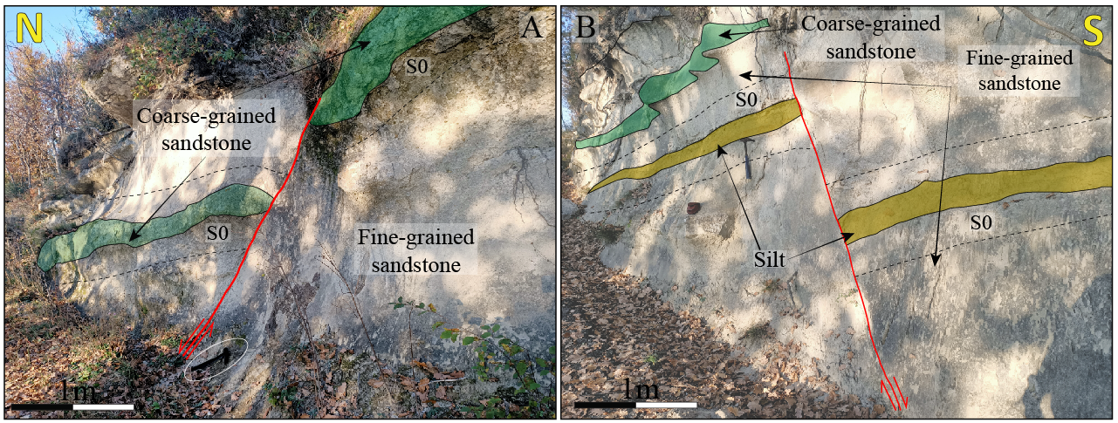
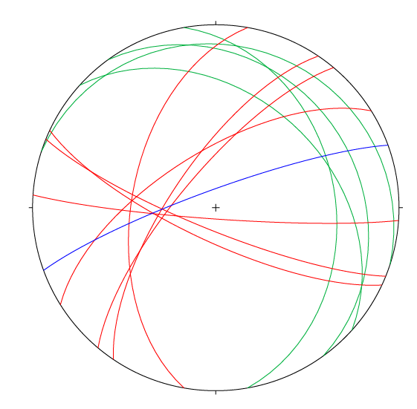
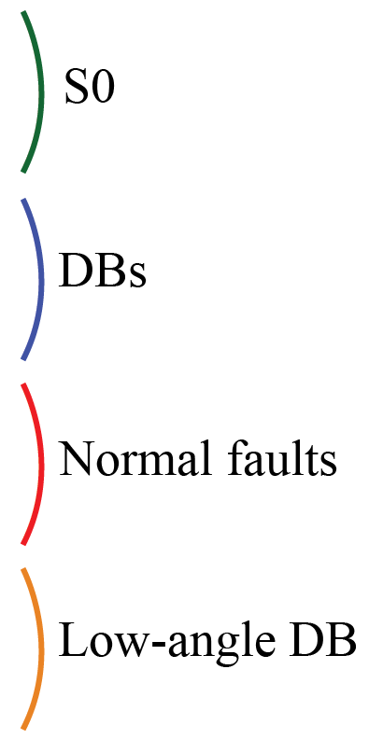
Normal faults & related
deformation bands (DBs)
POST-BURDIGALIAN
NW-dipping DBs arranged parallel to each other
and development of a fault plane concordant in both
orientation and kinematic
PRE -BURDIGALIAN
NE-SW to WNW-ESE-striking normal faults
without occurrence of DBs clusters

Slide 17
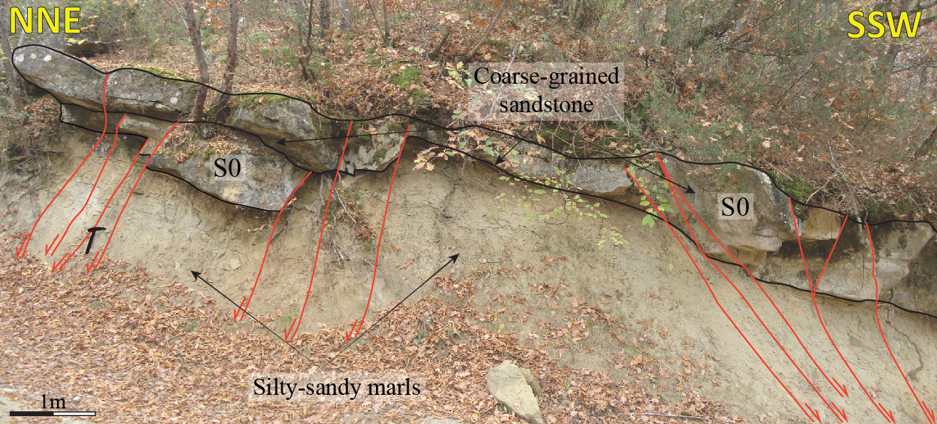
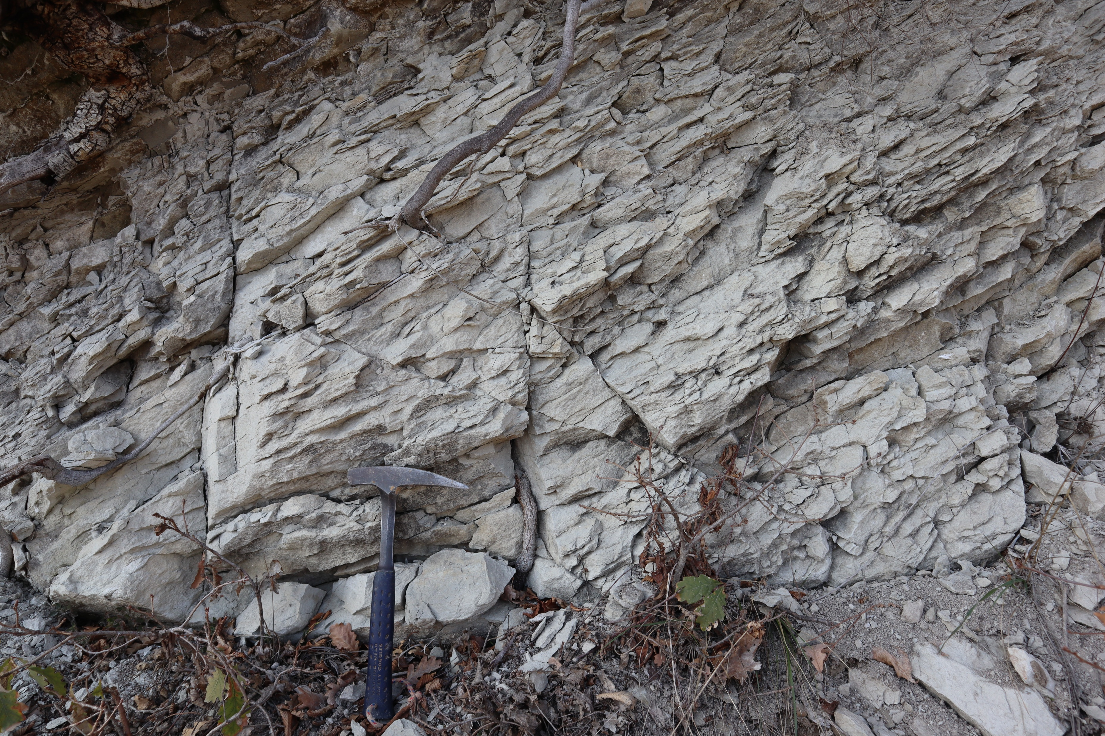
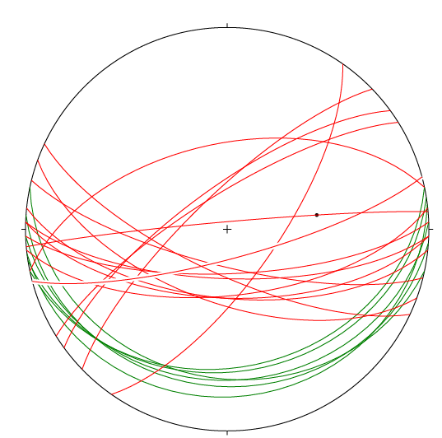
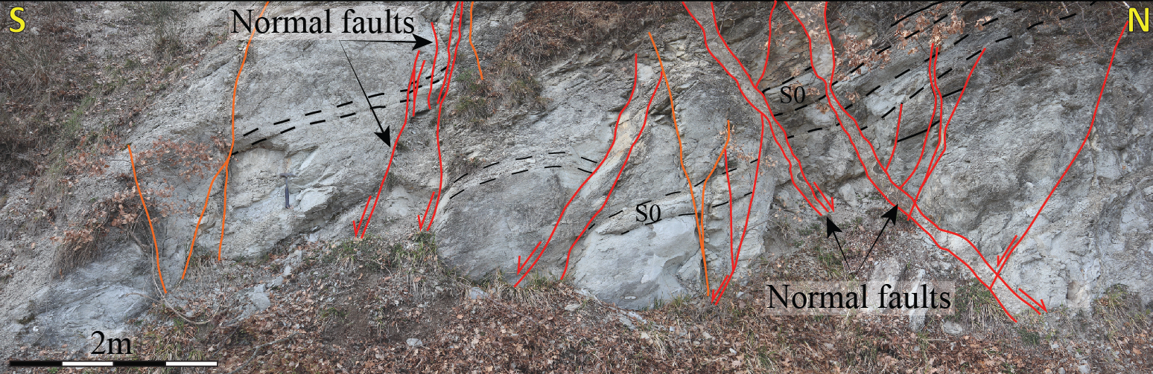
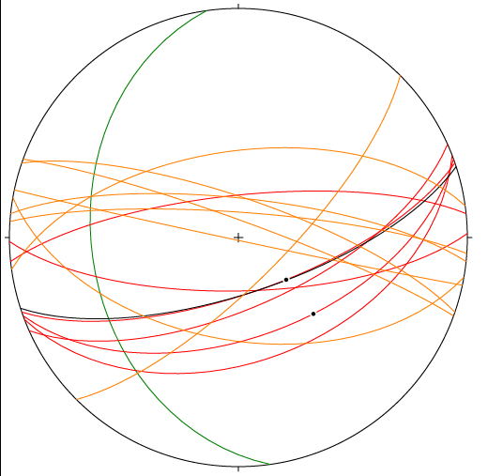
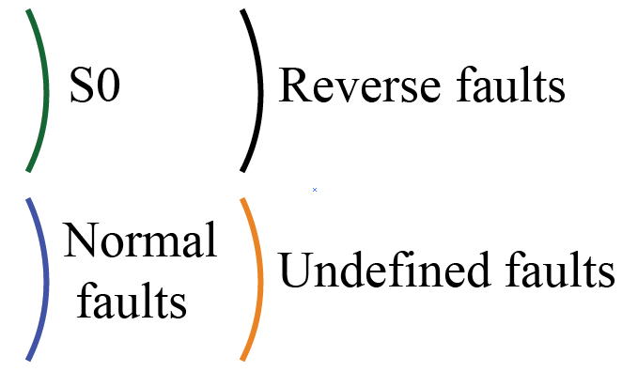
Normal faults & related
deformation bands (DBs)
Poorly stratified grey silty-marly sandstone
intercalated with fine, cemented
calcareous sandstones.
S
N
POST-BURDIGALIAN
PRE -BURDIGALIAN
The tectonic structures in Pantano Fm. show different characteristics to those observed within the Loiano Fm.:
Undefined faults
1. Absence of DBs
2. Deformation localised along main fault surfaces
3. Syn-kinematic mineralization (calcite) along fault surfaces

Slide 18
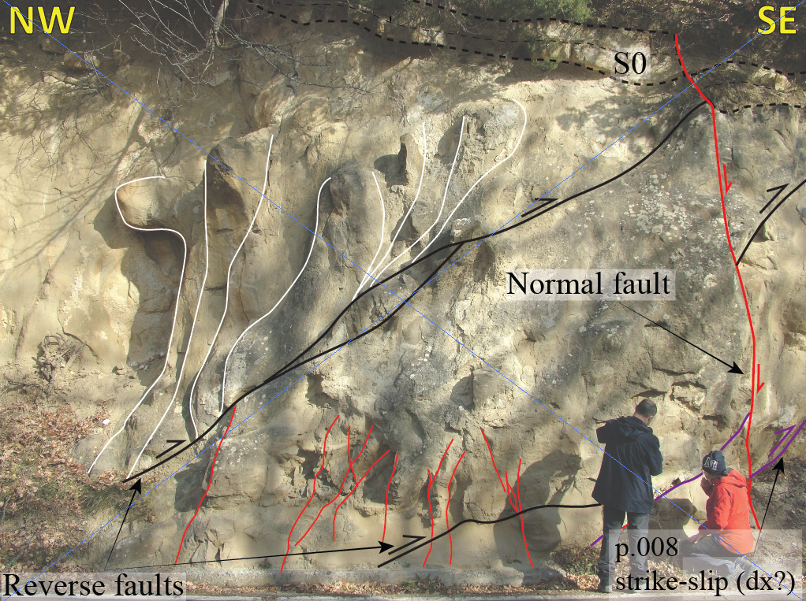
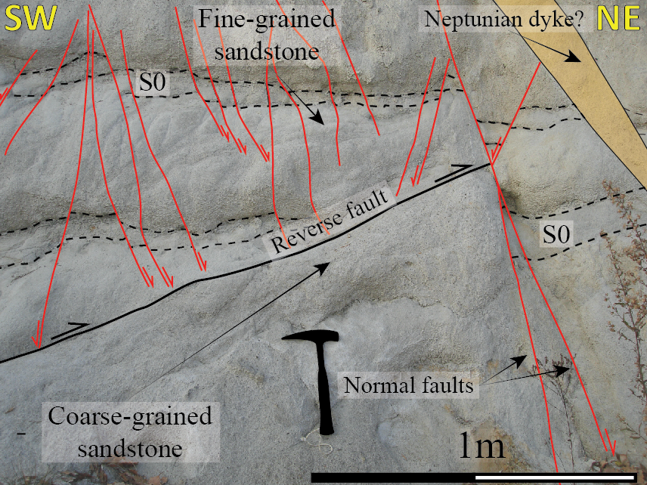
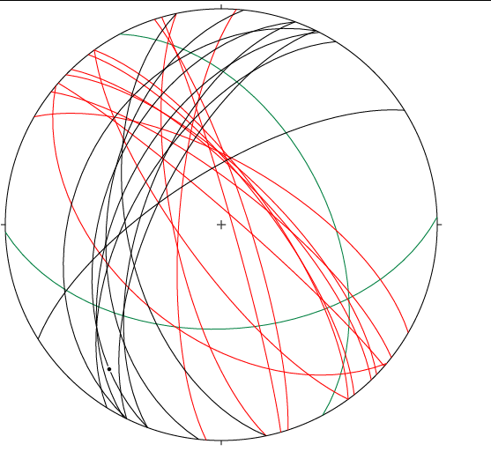
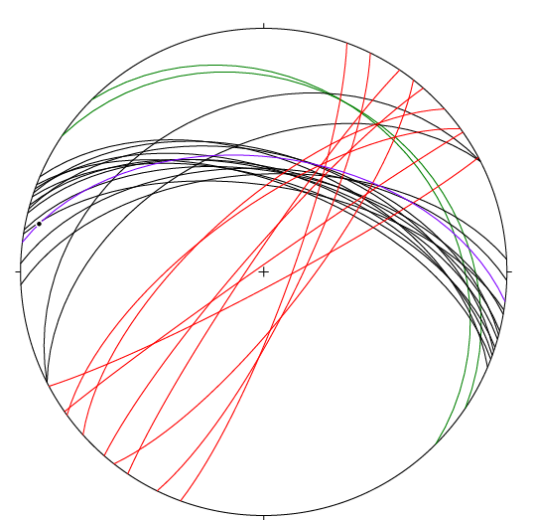
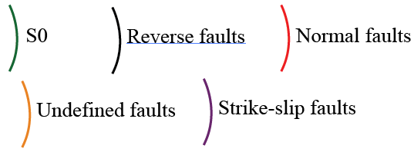
Normal/reverse faults interactions
We observed cross-cutting
relationships between
normal and reverse faults
within the Epiligurian Units
POST-BURDIGALIAN
PRE -BURDIGALIAN
CIGARELLO FM.
Normal faults cut sistematically
reverse ones as observed in different Fms.
LOIANO FM.

Slide 19
CONCLUSIONS (REMOTE SENSING)
Our preliminary results show that the Epiligurian Units are characterised by a complex tectonic evolution as shown by both the regional scale and mesoscale analysis. We constrained:
Study area
REMOTE SENSING DATA
FIELDWORK DATA
PRE-BURDIGALIAN
It isn’t currently possible to compare these two dataset because their elements are inconsistent from a cinematic point of view
NORMAL FAULT
REVERSE FAULT
POST-BURDIGALIAN
UNDEFINED FAULTS
NORMAL FAULT
REVERSE FAULT

Slide 20
Other Epiligurian basins VS. Study area
REMOTE SENSING DATA
FIELDWORK DATA
PRE-BURDIGALIAN
PRE-BURDIGALIAN
The data belonging
to the study area and those from the other Epiligurian basins, show completely different trend from each other
NORMAL FAULT
REVERSE FAULT
NORMAL FAULT
REVERSE FAULT
POST-BURDIGALIAN
POST-BURDIGALIAN
NORMAL FAULT
REVERSE FAULT
NORMAL FAULT
REVERSE FAULT
THIS MEANS THAT THESE WEDGE-TOP BASINS PROBABLY EVOLVE INDIPENDENTLY, INFLUENCED BY LATERAL VARIATIONS, EROSION, SUBSIDENCE RATES AND TECTONICS, IN RESPONSE TO LOCAL VARIATIONS IN THE UNDERLYING OROGENIC PRISM

Slide 21
CONCLUSIONS (FIELDWORK)
Main trends indentified:
Top-to-the NE, WNW-ESE-striking thrusts/reverse faults;
NNE-SSW shortening followed by NE-SW extension are associable to a wedge build up and tearing down during the progressive evolution of the continental collision
Top-to-the SE, ENE-WSW-striking thrusts/reverse faults;
NW-SE and NE-SW-striking normal faults locally characterised by deformation bands.
The orientation, kinematic and the relationship between reverse and normal faults
reflect the tectonic history of the appenninic orogen on which the Epiligurian Units set.
IT IS THEREFORE APPROPRIATE TO DEFINE THE EPILIGURIAN UNITS AS «WEDGE-TOP/PIGGY BACK BASINS»?

